Slide 1




Developing School Grounds Webinar
Exploring how school grounds can be transformed to create outdoor learning opportunities for students.
Notes:
Risk assessments are important because they help you to:
Spot hazards.
Think about the potential harm.
Identify people who may be at risk.
Protect the people at risk.
Plan the work safely.
Review existing controls.
Make improvements.
Comply with the law.

Slide 2
Each School is on a unique journey to create a school grounds that invites and inspires students to learn and play.

Slide 3

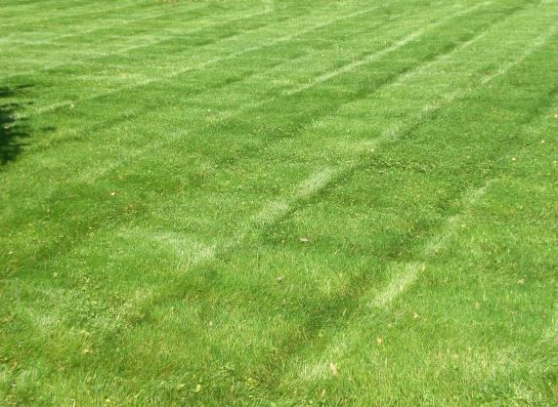
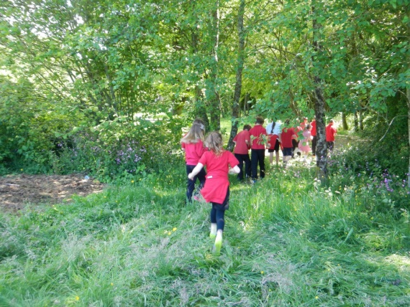
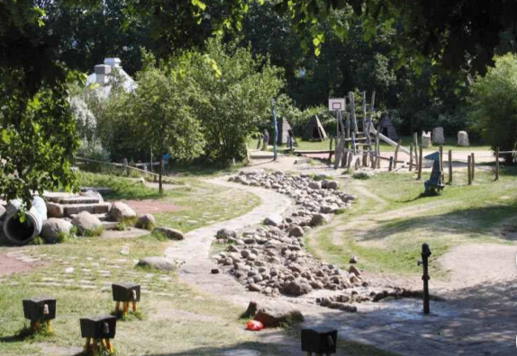
Diversifying Opportunities for High Quality Outdoor Learning

Slide 4
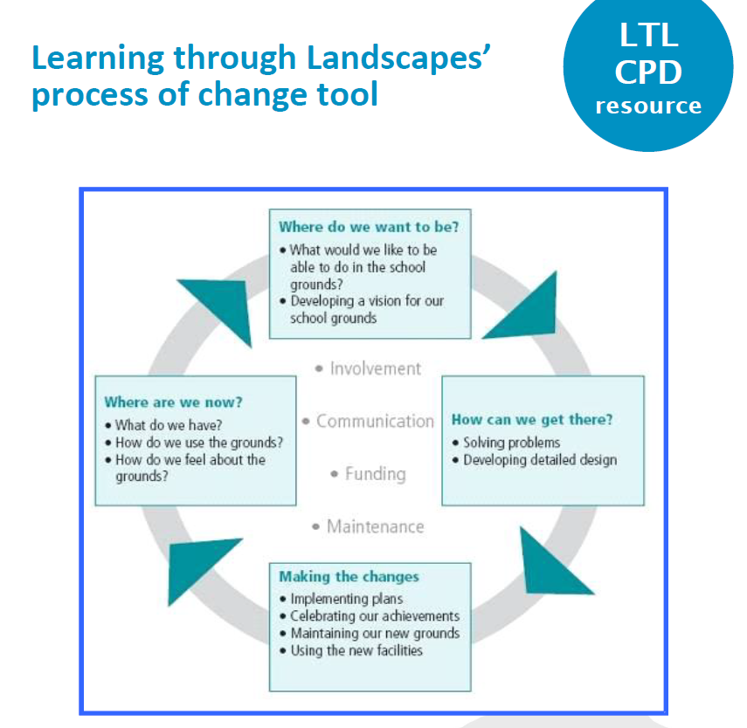

Slide 5
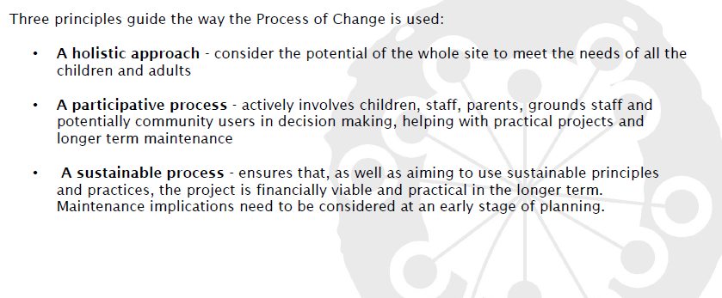

Slide 6
Where are you now?
Which area of your school grounds
is most used by the students a) for play and b) for learning?

Slide 7
Your school grounds already has learning opportunities.
How can these be maximised?

Slide 8
Where are you now?
Knowing how to get started is sometimes the toughest part of the school grounds development process.
Bear in mind that these processes take time. It is basically kick starting the improvement process.
Try to avoid focusing on what people want in their grounds. Thinking about what you do is more useful.
It’s also important to get everyone thinking about the differing needs within the outdoor space:
Learning activities relating to ongoing classwork
Playtimes
Out of hours visitors
Wildlife – the more biodiverse an outdoor space is, the better it becomes for people as well as wildlife

Slide 9
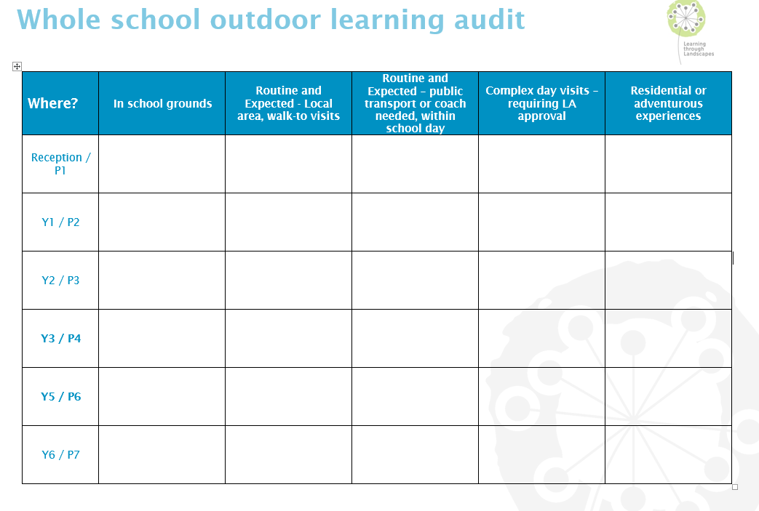
Auditing for teachers

Slide 10
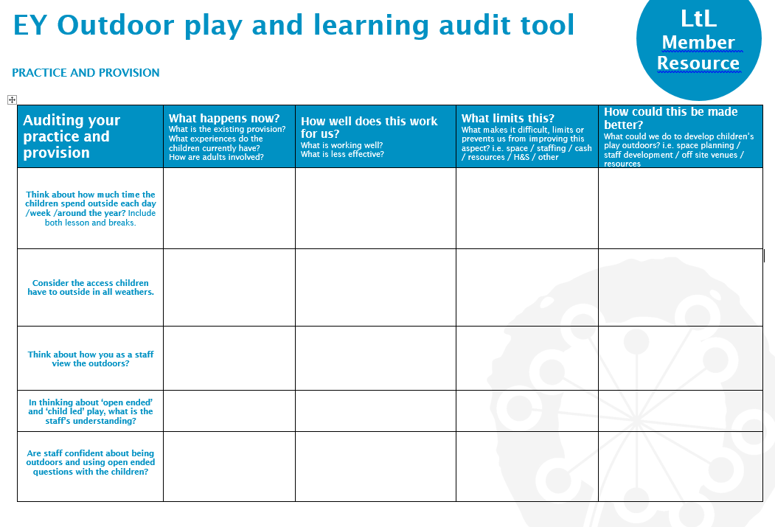
Auditing

Slide 11
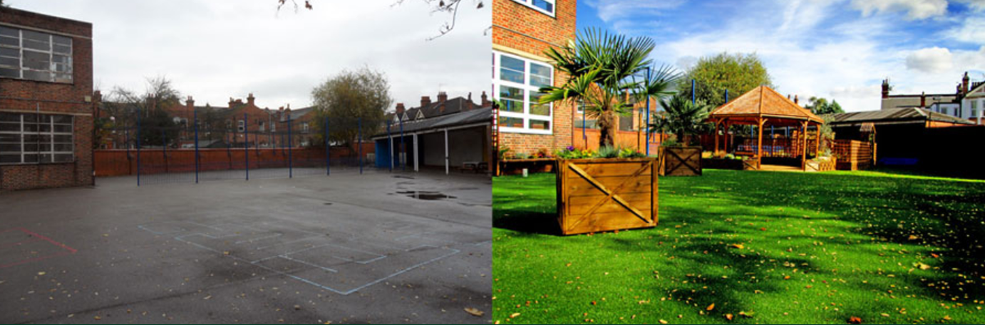
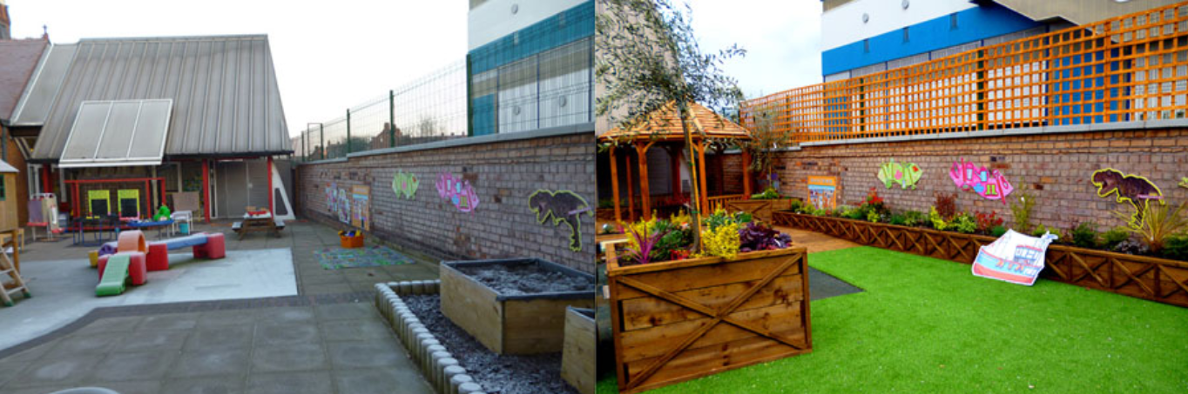
Where do you want to be?

Slide 12
How can you get there?
Design and creation
Actively involve pupils in designing and creating playground improvements.
Involve parents and other community members in the process and reach out to them for support.
Staff members, both teaching and non-teaching, actively involved.
What were the most recent playground improvements that pupils have been involved in?

Slide 13
Students are key!
An amazing space can be created but doesn’t mean students will interact with that space!
Develop a space together that you all want to learn and play in.

Slide 14
Auditing Activities for Students
Activities that involve every child in a primary or secondary school, with an aim to create on-going dialogue about the school grounds.
Problems and Solutions! This tends to work more effectively than asking children and adults what they want in the school grounds. This puts the focus what needs sorted and improved. It’s also very powerful in that the children are really part of the solution and can be actively involved in making the changes.
Have a slideshow! Show students images of a well developed outside space can look like.
Student Surveyors! All children contribute to mapping their thoughts and feelings about their school grounds.
Take lots of photos! Ask student to take lots of images from every angle so that you can get plenty of good before and after comparative photos.
Plus, minus, interesting! This is a good task to display and record children and others people’s thoughts.
Rate the Grounds! This activity is works well for Information Handling. Every child rates different areas 1-10 then work out the mean, median and mode of the results and compare students results to teachers/adults.

Slide 15
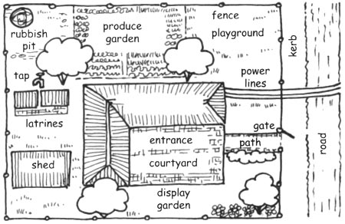
Auditing for Students
Every person must mark on the map:
Where you play most often NAVY BlUE
Where you go to be alone BLACK
The place with the best view LIGHT BLUE
The place to find lots of wildlife and nature GREEN
Best place for being physically active PURPLE
The quietest space BROWN
A good place to relax ORANGE
A dangerous place RED
A safe place PINK

Slide 16
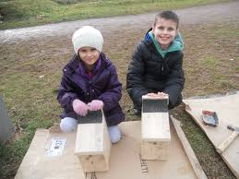
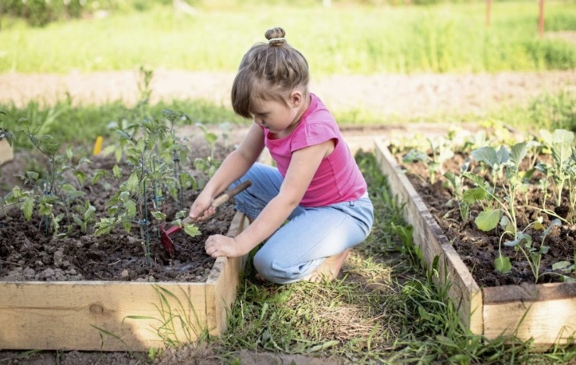
Making the Changes
Pupils can actively be involved in many of the aspects of developing the grounds:
General maintenance
Growing and tending
Building new features

Slide 17
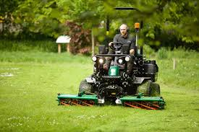
Management
A Management Plan is key to sustain your school grounds.
Some things that need to be considered:
Who is responsible?
What role does the caretaker play?
Do you use PCC maintenance team
or an independent contractor?

Slide 18
School Grounds Supporting Learning
School grounds features can support different areas of the New Curriculum for Wales:
Science and Technology- water feature, wild areas, bird feeders and boxes, livestock or poultry pens, polytunnel or greenhouse, food growing area, boulders illustrating different rock types.
Mathematics and Numeracy - number squares or grids, giant board games, maths trails, themed murals.
Languages, Literacy and Communication - reading area, themed murals, story telling chair, story trail.
Expressive Arts – stage, amphitheatre, outdoor music, outdoor art etc.
Health and Wellbeing - sensory garden, reflection area, themed murals, labyrinth.
Humanities - features that reflect local heritage, themed murals, weather station, food garden, wind turbine, solar panels, use of different materials, surfaces and finishes, bird box, habitat web cam, weather station.

Slide 19
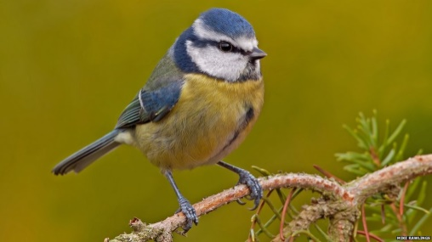
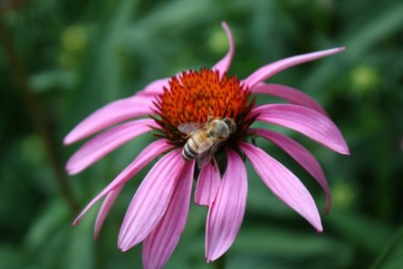
Areas of Development
Organic Gardening
Wildlife Gardens
Forest Gardens
Safe to wildlife and humans.
Cost effective.
Perennial
Low maintenance.
Promotion of biodiversity.
Multi-sensory.

Slide 20
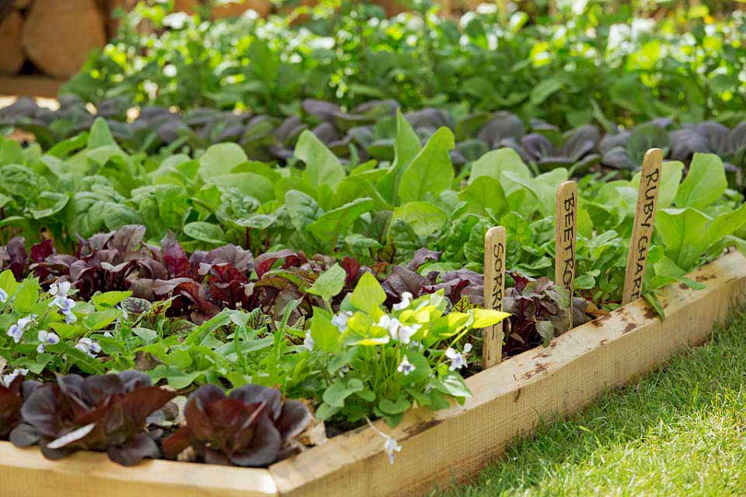
Growing in School Grounds
Do your pupils know where their food originally comes from? A vegetable garden is an excellent teaching resource and will provide great enjoyment and satisfaction to all involved.
School term: All year round
Level of experience: No experience needed
Subject(s): Maths, Science, Health and Wellbeing
Why grow vegetables?
Food growing can teach children about soil, nutrition, science and life cycles of the vegetables and the creatures attracted to the garden.
A vegetable plot can raise children’s awareness of the seasonal nature and the variety of food.
A food growing project should be part of a school’s development plan with staff, pupils, parents and even local residents being involved.

Slide 21
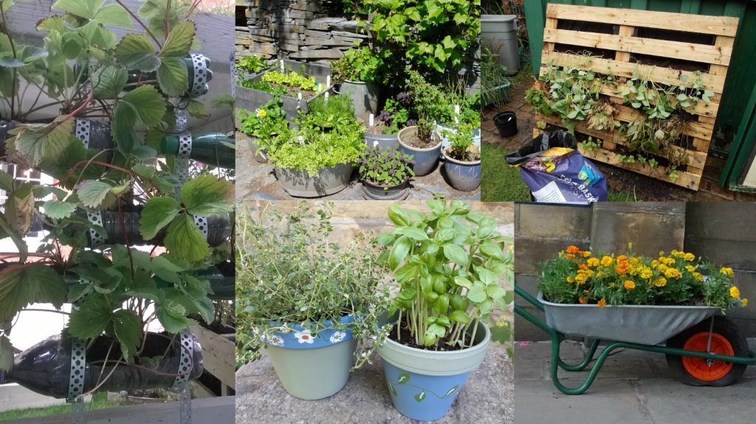
Growing on Concrete
If your school is short of soil space or if the soil might be contaminated, use containers. Ask parents or local businesses to collect materials for you. Clean them thoroughly before use and make sure they have drainage holes in the bottom.
Here are a few ideas:
Chimney pots
Bricks for making raised beds
Wooden pallets
Old sinks and baths
Fruit and vegetable crates
Large cooking oil tins
Dustbins

Slide 22
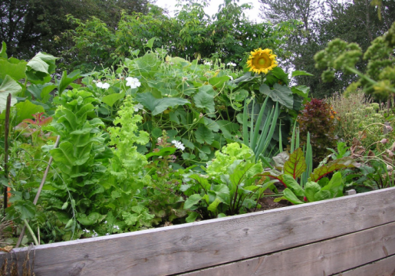
Growing Organic Food
Some examples:
Outdoors | Suitable varieties
Potatoes | Sarpo varieties are more blight resistant
Blackcurrants | Naturally sweet- Ben Sarek, Ben Conan.
Raspberries | Chose Autumn fruiting varieties for harvesting after the Summer holidays.
Chose plants that will ripen before the Summer holidays/will require no additional maintenance over the holidays.

Slide 23
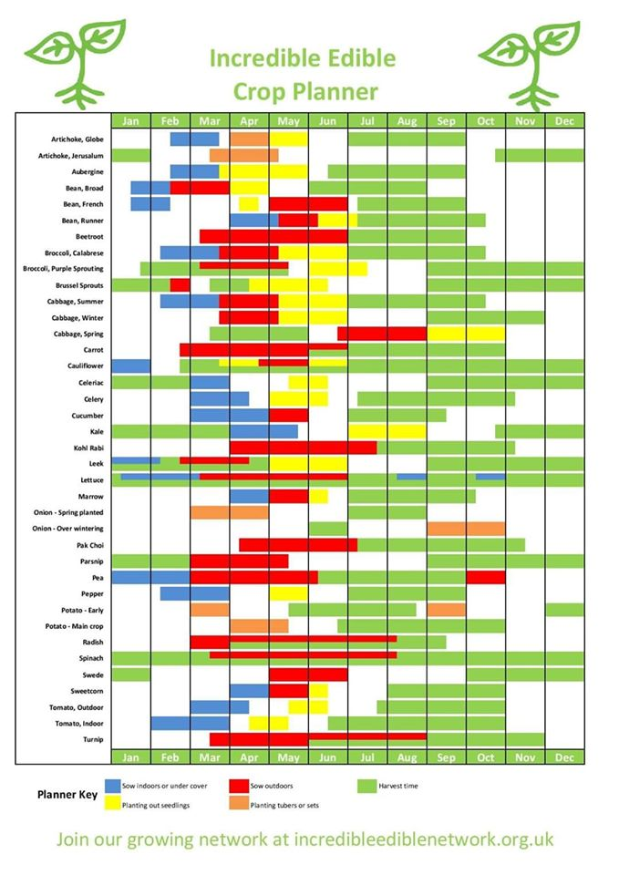

Slide 24
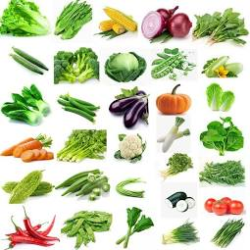
Speedy Crops
These vegetables can be ready for harvest in one term. From 3 to 13 weeks (up to three months) after sowing or planting:
Beetroot
Carrots
Cucumber
French beans,
Lettuce
Marrows & courgettes
Peas (spring term)
Potatoes (first early)
Radish
Spinach
Turnip

Slide 25


Medium Term Crops
Medium-term crops are sown or planted in one term to harvest in the next term, 14 to 25 weeks (three to six months) later.
Broad beans
Cabbage (early) from seed and plugs,
Onion sets (spring)
Peas (autumn sown)
Sweetcorn
Tomatoes

Slide 26
Long Season Crops
Slow-growing or long-season crops are sown or planted in one term to harvest in the next term or even the following term, 26 to 52 weeks (six months or more) later.
Broccoli
Onion sets (autumn planting)
Brussels spouts
Parsnips
Leeks
Potatoes (main crop)

Slide 27
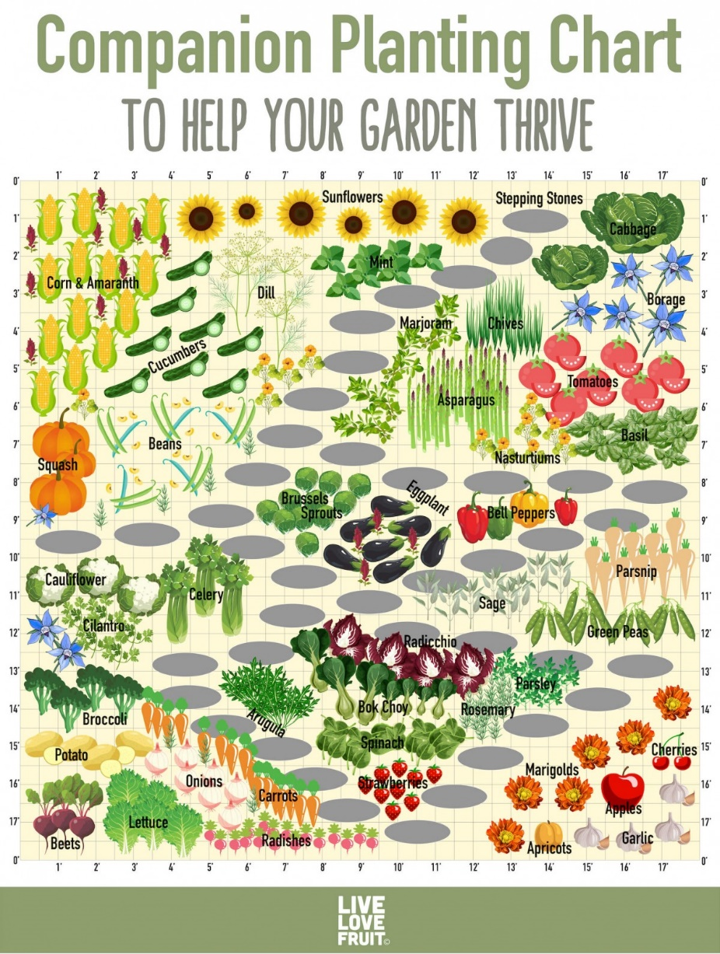
Companion Planting
What is companion planting?
Growing two species of plant that can benefit each other. For example, alliums (onion family) and carrots to deter root fly attacking the carrots.

Slide 28
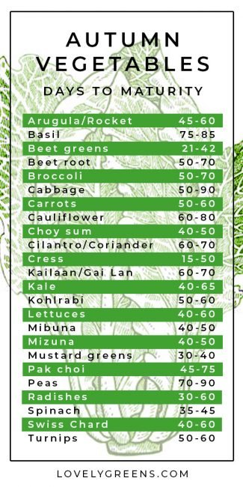
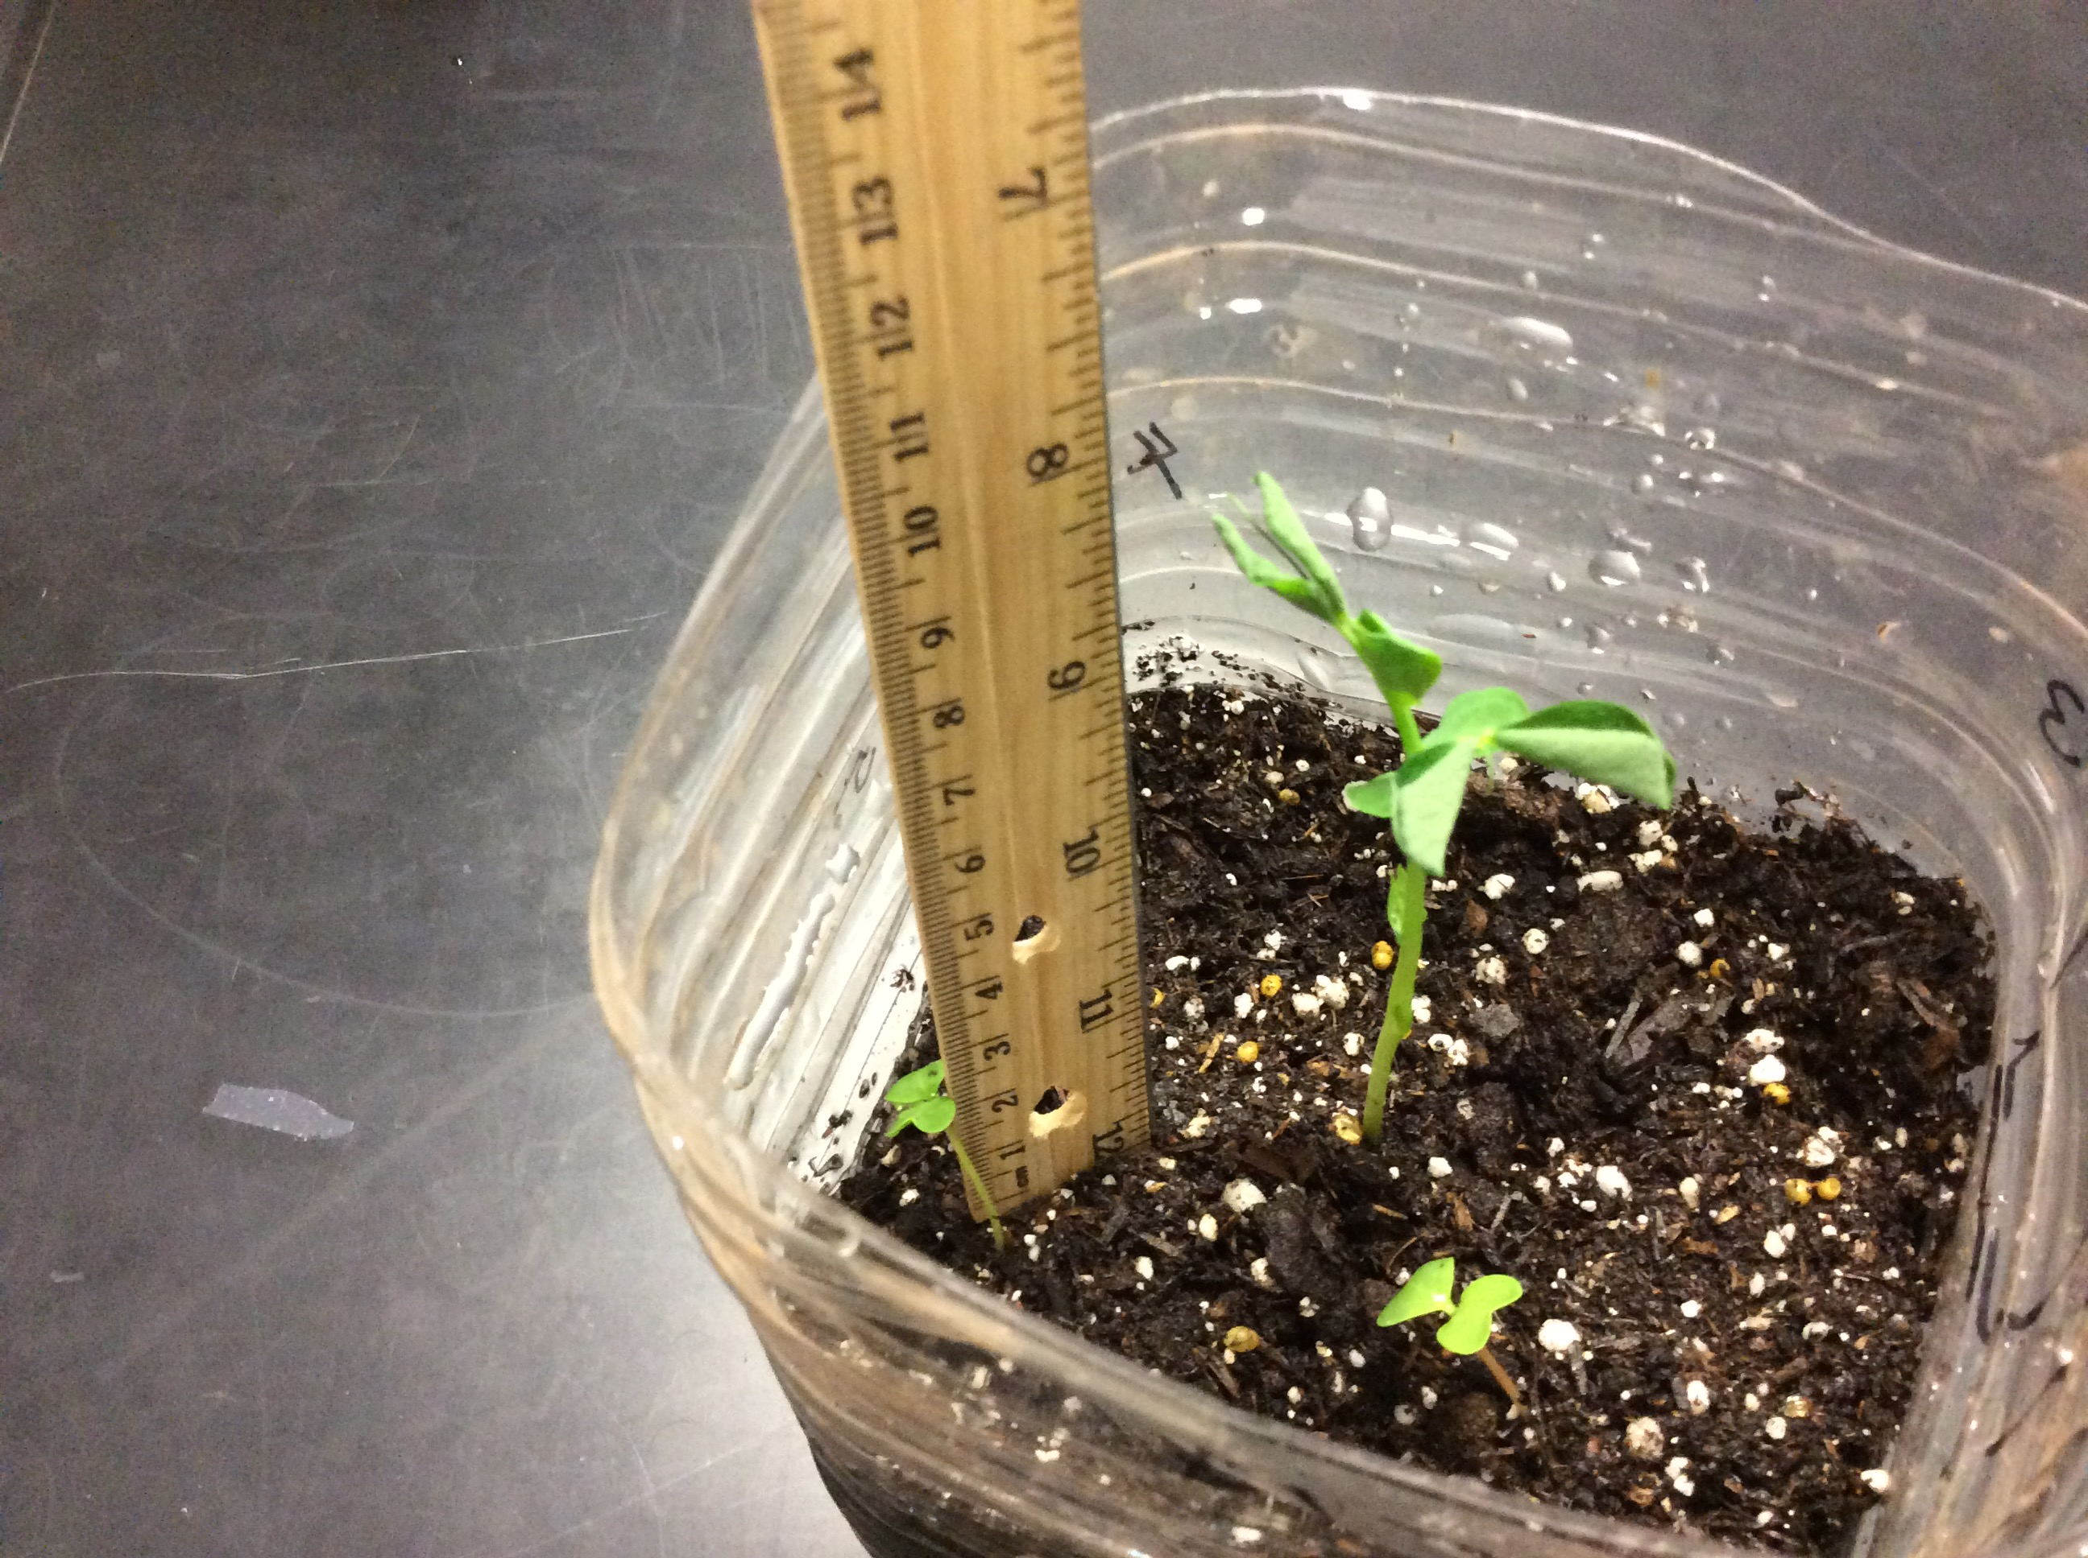
Growing and the Curriculum

Slide 29
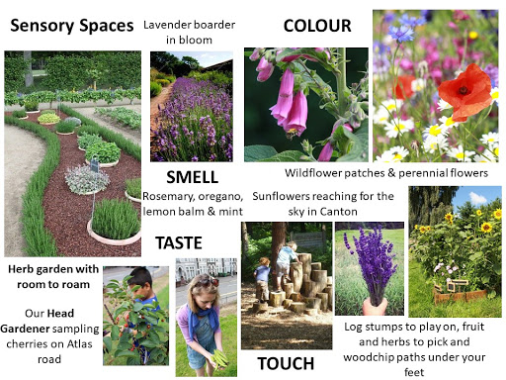
Sensory Spaces

Slide 30
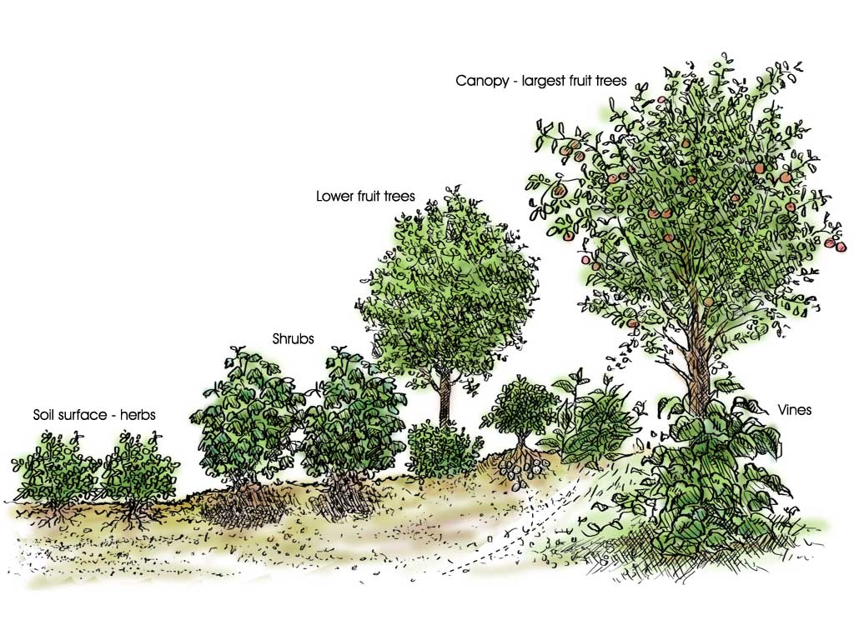
Forest Gardens
A forest garden mimics a natural ecosystem using perennial/self-seeding plants that bear edible fruit, nuts, leaves or otherwise useful materials.
In a school setting this might involve:
  Canopy: fruit trees - apple, pear, cherry
  Lower canopy: nut trees – hazel
  ‘Woodland edge’ fruiting bushes - blackcurrants, raspberries
  Herbaceous layer: Shade tolerant Spring bulbs,
  perennial flowers for pollinators - Geranium phaeum.
Notes:
* See Crawford, M (2010) ‘Creating a Forest Garden: Working with Nature to Grow Edible Crops.’ Green Books, Cambridge.

Slide 31
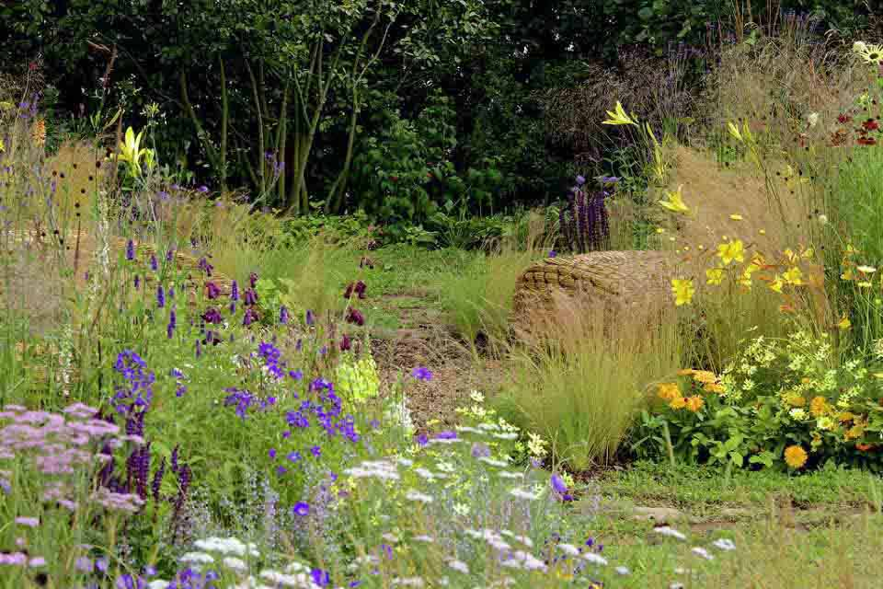
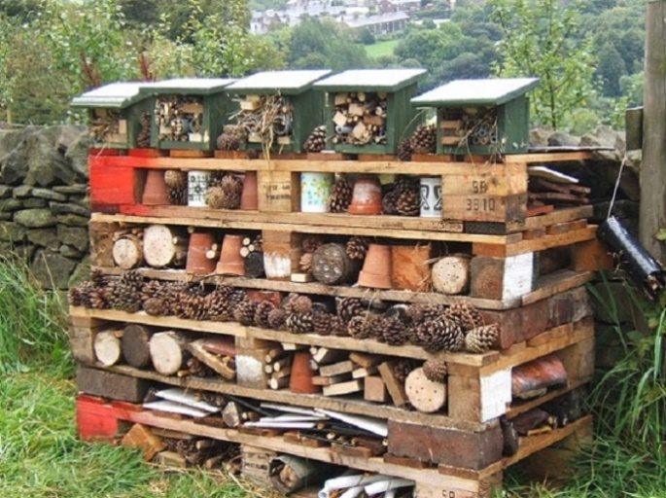
Gardening for Wildlife
Habitat Creation
(supporting the food web/promoting biodiversity)
  Bees, butterflies and moths: pollinator service stations including wildflower swathes, meadow creation, blossom.
  Insects: log piles/bug hotels/wildflowers/ponds.
  Amphibians: ponds.
  Birds: boxes, feeding stations.
  Mammals: discourage! No cooked food in compost containers. Except hedgehogs.
  No chemicals!
Notes:
See https://schoolgardening.rhs.org.uk/Resources/Info-Sheet/Plants-for-a-wildlife-garden
See Baines, C (2000) ‘How to Make a Wildlife Garden’ . Francis Lincoln Ltd. London.
See ‘RHS Plants for Places’ (Wildlife Gardens) p 494. 3rd Edition (2011).

Slide 32
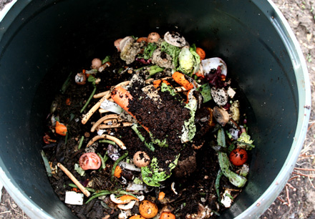
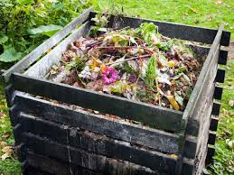
Making Good Compost
Mix ‘brown’ to ‘green’ material to a 70:30 ratio.
Brown material includes leaf litter, cardboard, paper, twigs.
Green material includes food waste, grass clippings, other fresh material.

Slide 33

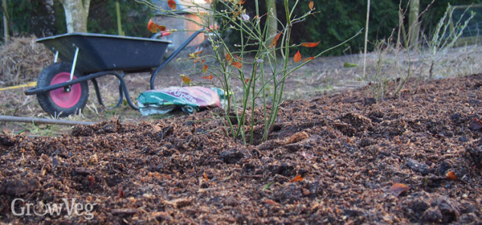

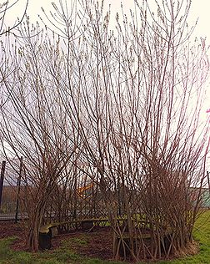
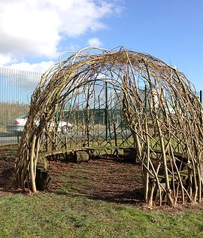
Autumn Term
Site Preparation and Planting
Apply mulch (a thick layer of well rotted compost onto beds) to beds to supress weeds and feed the soil.
Plant bare root trees/shrubs (Nov- March).
Plant Spring flowering bulbs (Sept-Nov).
Pruning and Cutting Back
Prune some fruit trees and shrubs to promote next year’s growth.
Cut back dead stems and foliage to add to the compost heap.
Cut back current year’s growth on willow to maintain willow structures.
Before After
Pond Maintenance
Cover with a net to prevent acidification by leaf fall/regularly remove leaves.
Put in a small ball to prevent it from freezing over.

Slide 34
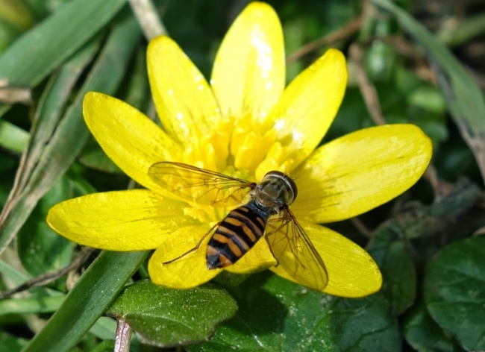
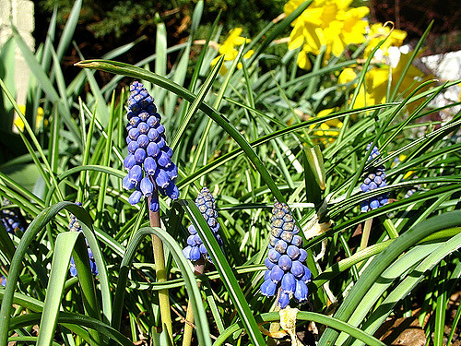
Spring Term
What can be done:
Sow seeds
Plant perennials/annuals flowers.
Start selectively removing so called ‘weeds’ to eliminate competition around your new plantings (trees to shrubs 3-5 years until they establish). But consider the pollinators!

Slide 35
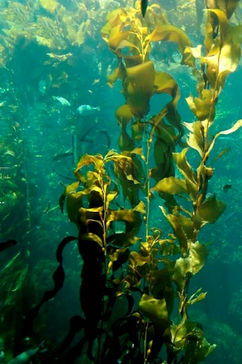
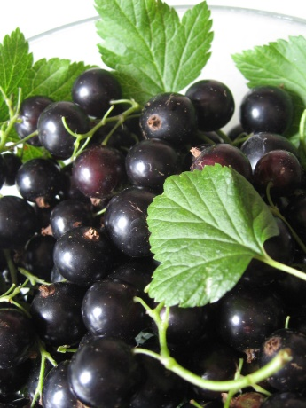
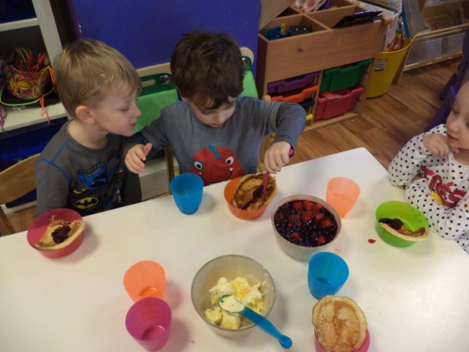
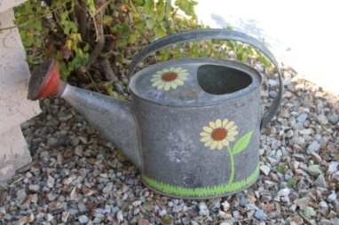
Summer Term
Watering
Feeding
Harvesting
Enjoying!

Slide 36
Making Good use of Small Space
Marsden Infant School Case Study
Grounds:
Small tarmac playground and raised beds situated around the edge of the playground.
Issue:
The school wanted to incorporate growing and tending vegetables and fruit into the routine of the school week. The challenge was how to do this in the raised borders in a small playground. With lots of curious and prying hands at play time, together with the slugs, would the vegetables stand much of a chance?
Solution:
The answer was to fill the majority of the beds with permanent hardy plants – raspberry & blackcurrant bushes, a dwarf apple tree, strawberry bed and perennial herbs and flowers such as rosemary, sage, fennel, thyme, geraniums and daisies. In the small area left we grow easy food crops, close together – potatoes, climbing beans, leeks, garlic, beetroot, pumpkins - grown upwards on plant supports to keep the plants away from prying hands. Experimenting with safe methods of slug control is a lesson in itself. What will work? eggshells, bran, bottle cloches, sheep’s wool?
Impact:
We have put up clearly marked signs telling the children and teachers what everything is: a compost bin, a digging area, an apple tree, beans growing here! Even in a small busy space you can pack a lot in.

Slide 37
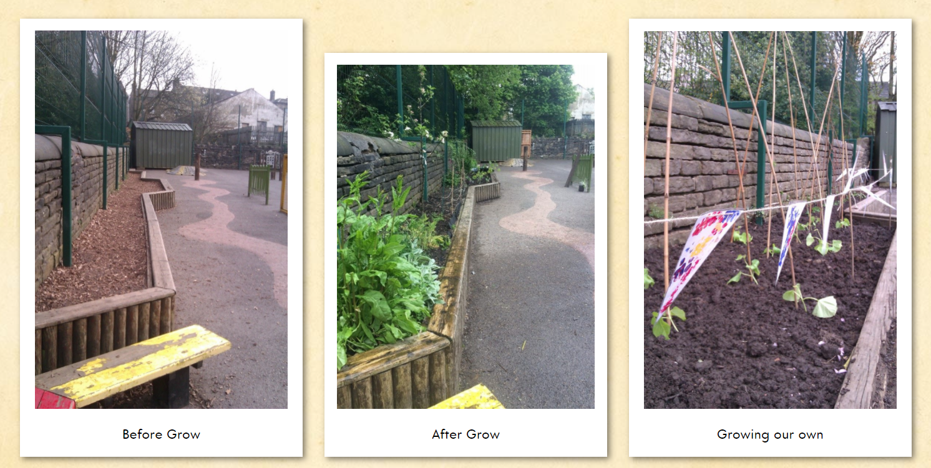
After many years of trying without success we have been delighted to have some crops to harvest and colorful flowers around our playground. The blackcurrant crumble was a definite tasty treat for our school lunch. It now feels we have made a breakthrough in keeping the slugs at bay and can work with the children to nurture things that ‘grow’. Thank you
Frances Swallow, Headteacher, Marsden Infant and Nursery School, Marsden

Slide 38
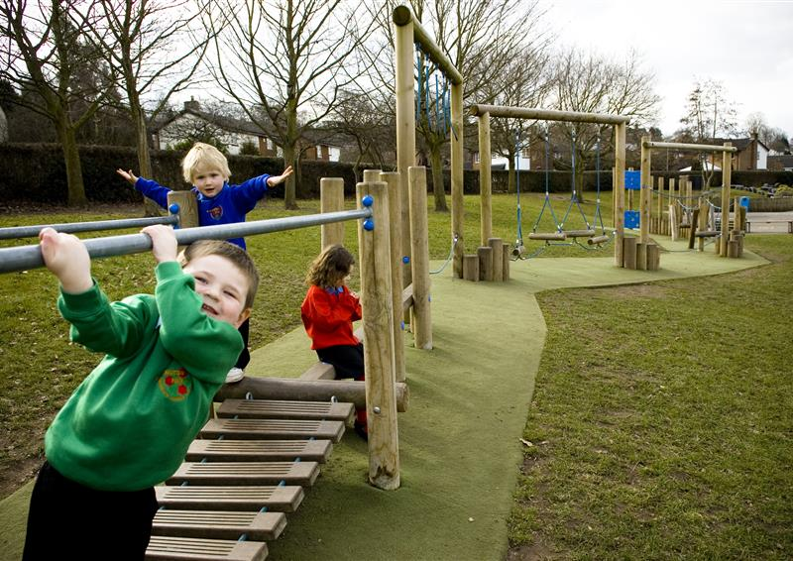
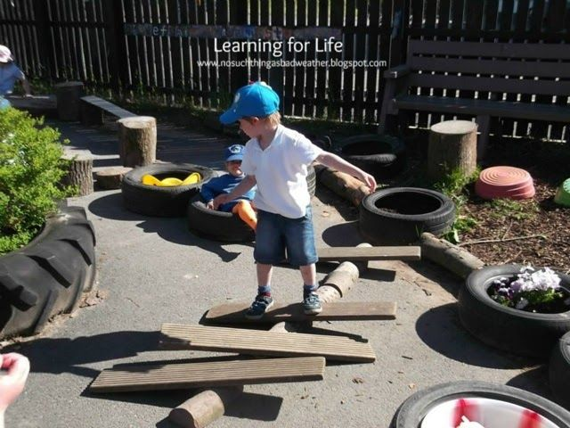
Play
There are many different features that give pupils plentiful opportunities for:
climbing and scrambling
balancing
swinging
jumping off or between

Slide 39
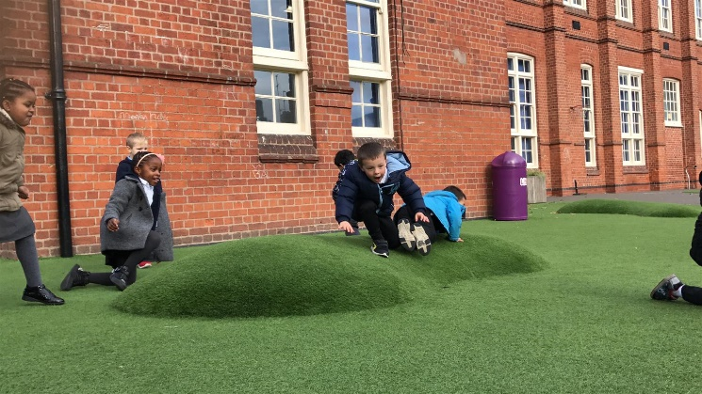
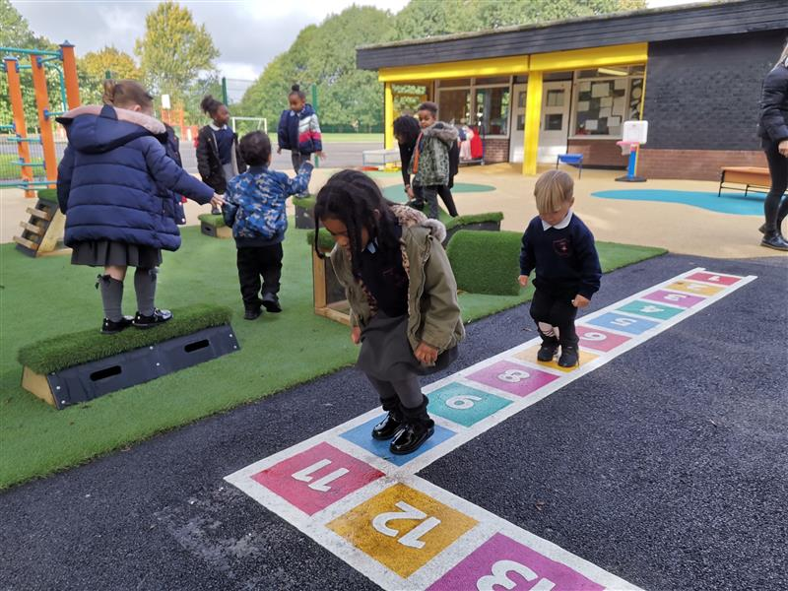
Play
These include…
Good trails or paths to encourage walking or running
Slopes and dips to encourage running and rolling
Opportunities for physical challenge and for pupils to assess and manage risk in play
Good range of game markings painted on the playground
Range of goals, targets and hoops to encourage play and sport

Slide 40
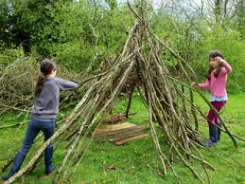
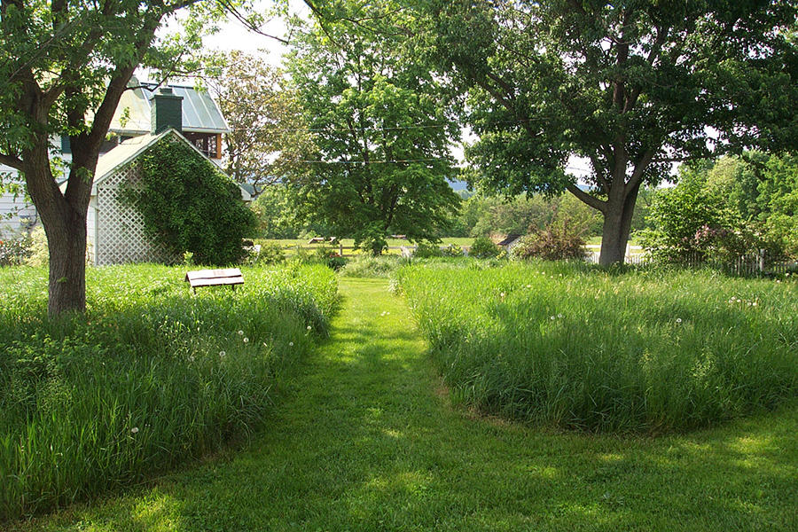
Imaginative Play
There are an array of features that give pupils plentiful opportunities for imaginative play such as:
Uncut grass
Areas of woodland or shrubs in
Bushes, willow tunnels or dens create fun hiding spaces
Soil and muddy areas/mud kitchen
Sand pit/area
Larger tree trunks / logs provide creative play possibilities
Larger rocks and boulders provide creative play possibilities

Slide 41
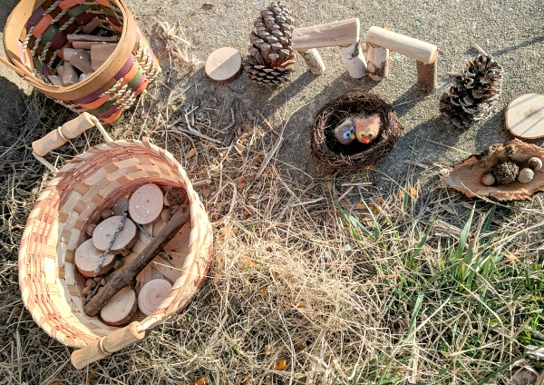
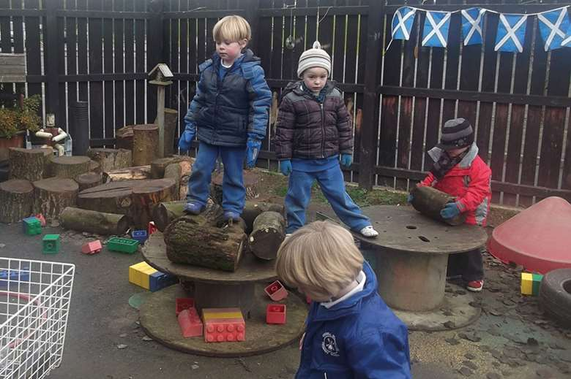
Resources
There are also many natural resources that give pupils opportunities for imaginative play:
Natural materials for play; berries, cones, bark, twigs, leaves etc.
Providing additional natural materials for play; wooden discs, stones, poles, straw etc.
Materials and spaces for den-building
Children have access to non-natural loose materials for play; tyres, guttering, blankets, milk crates etc.
Wood storage for outdoor play materials

Slide 42
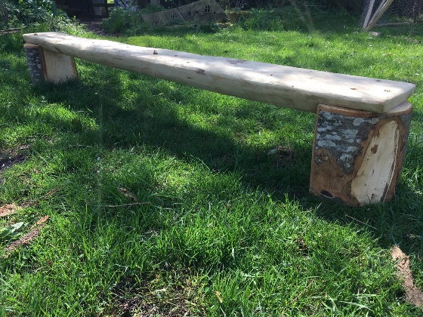
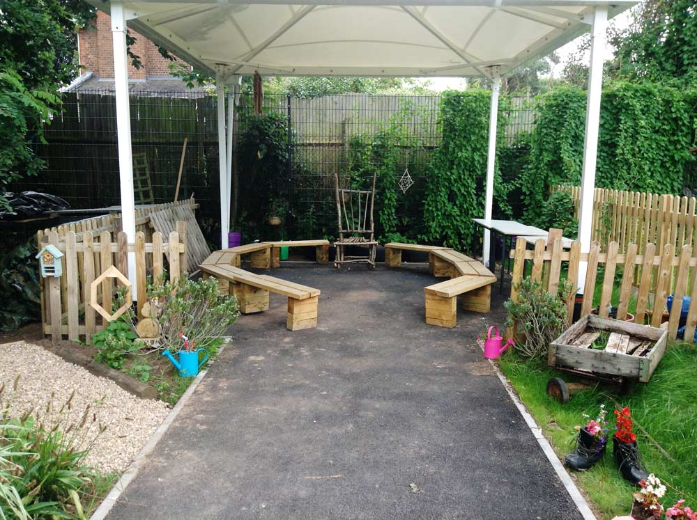
Wellbeing Spaces
Wellbeing spaces are important for when students would like quiet time or time to reflect.
Social spaces
Seating widely available in grounds
Seating areas cater for different sizes and types of group
Shelter from wind and rain
Shade from the sun
Spaces for pupils or staff can eat their lunch outside in good weather

Slide 43
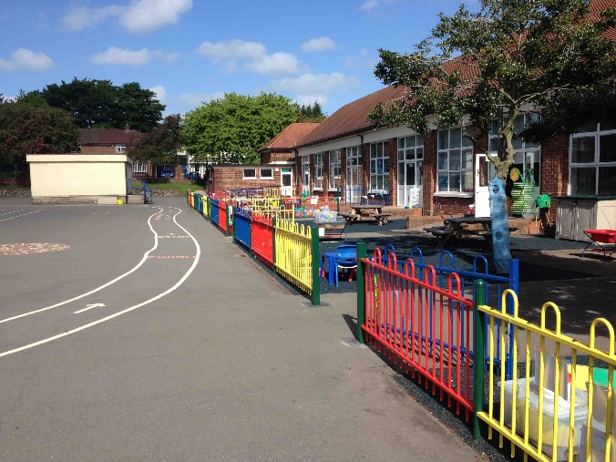

Wellbeing
Emotional health
School grounds give a first impression of the school
Entrances and signs that are colourful, bright, happy and welcoming
Access to attractive outdoor spaces designed for quiet and calm.
Trees, shrubs and flowers are used to create an attractive external environment
The grounds display a range of attractive outdoor art such as murals, sculpture and mosaics

Slide 44


Sustainability
Nature
Trees of different species and ages
Wide range of flowers to encourage wildlife
Shrubs or hedges to encourage wildlife
Areas of meadow or longer grass
Water features such as ponds, streams or wetland
Log piles or areas of deadwood to encourage insects
Birdlife is encouraged through use of bird boxes, tables or baths
Other facilities to encourage wildlife, such as bug hotels, hedgehog and bat boxes etc.

Slide 45


Sustainability
Sustainable Practices
Provision for secure storage
Good composting facilities
Outdoor litter bins located in the right places
Renewable energy features

Slide 46

Sustainability
Food
Facilities for growing food in the grounds.
Vegetables grown in pots.
Fruit trees or bushes.

