Slide 1




Pembrokeshire Outdoor
Schools (PODS)
Outdoor Learning and the
New Curriculum for Wales
Notes:
Risk assessments are important because they help you to:
Spot hazards.
Think about the potential harm.
Identify people who may be at risk.
Protect the people at risk.
Plan the work safely.
Review existing controls.
Make improvements.
Comply with the law.

Slide 2
‘An adult’s attitude to the environment and time spent in green space is strongly influenced by their experience as a child. The critical age of influence appears to be before 12years old.’
(Bird. Dr W. (2007) Natural Thinking)

Slide 3
History
PODS developed from a Professional Learning Community (PLC) in 2010.
Initially set up by two head teachers – Mr Simon Thomas and Mr Kevin Phelps.
It has grown into a dynamic partnership with a wide range of expertise.
Brings together a wide range of specialist organisations, head teachers and Local Authority advisors.

Slide 4
Aims of PODS
Providing high quality, safe learning experiences linked to the curriculum.
Enriched, stimulating off-site environmental learning.
Expand the horizons and knowledge of the natural environment.
Learning tasks involving enquiry, teamwork, problem solving and co-operation between peers and adults.
"Awe and wonder" experiences that increase self-esteem, confidence and lead to improved engagement.

Slide 5
What PODS can offer
Access to free CPD and INSET events for teaching staff across the county and from further afield.
Opportunities for subject coordinators and teachers to participate in Professional Learning Communities (PLCs) focussed on outdoor learning.
Downloadable bilingual resources and lesson ideas generated from PLCs.
An optional structured, staged programme of support schools towards whole school cultural change in relation to outdoor learning.
Opportunities for practical support, advice and input from our partners.
Recognition and awards for innovative and excellent practice.
Tracking changes in wellbeing, attendance and end of phase outcomes.

Slide 6













PODS Partners

Slide 7
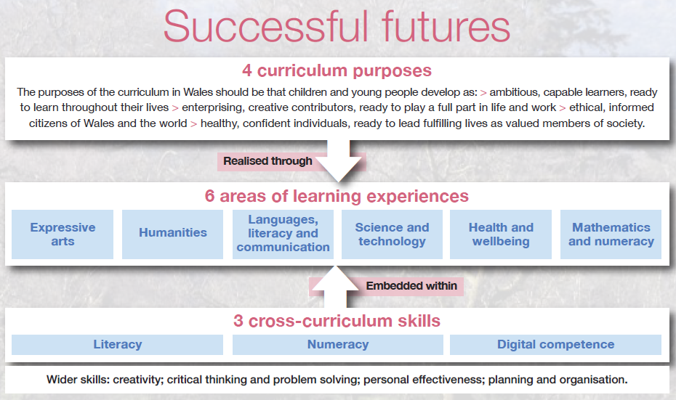
New Curriculum for Wales

Slide 8
Curriculum Purposes
Outdoor Learning can be used effectively to support the purpose of the new curriculum.
The 4 purposes are to support our children and young people to be:
ambitious, capable learners, ready to learn throughout their lives.
enterprising, creative contributors, ready to play a full
part in life and work.
ethical, informed citizens of Wales and the world.
healthy, confident individuals, ready to lead fulfilling lives as valued members of society.

Slide 9
The Benefits of Outdoor Learning
Maximise the value of learning by linking off-site excursions and on site activities with the curriculum.
An opportunity for students to see somewhere outside of their current sphere of influence.
Opportunities to see, touch, feel and outdoor activities first hand and build links with their local environment.
Builds confidence and self-esteem, particularly of those who find the classroom environment challenging.
Gain knowledge and skills that can be disseminated throughout the school.
Giving students an insight in to a different way of life to broaden their horizons for the future.
First hand outdoor experiences and memories that will stay with individuals for a life time.

Slide 10
New Curriculum and Outdoor Learning
Flexibility to build in Outdoor Learning
Student led themes
  Where would the students prefer to learn?
  What would they like to learn about?
Cynefin - an integral part of the new curriculum

Slide 11
Cynefin
“Cynefin – the place where we feel we belong, where people and landscape around us are familiar, and sights and sounds are reassuringly recognisable. Though often translated as ‘habitat’, cynefin is not just a place in a physical or geographical sense: it is the historic, cultural and social place which has shapes and continues to share the community which inhabits it.”

Slide 12
Estyn on Outdoor Learning
‘The outdoor environment, both on and off-site, provides high-quality learning experiences for all pupils.’ (Estyn Inspection Tavernspite School)
Estyn reported that ‘the Outdoor Schools programme at Tavernspite CP School, Pembrokeshire has significantly impacted on pupils’ physical development and fitness, scientific awareness and wellbeing’

Slide 13
Differentiation by environment

Slide 14
When?
When it’s best for learners
When it compliments or enhances the Curriculum
As a hook activity or exit activity
When activities are: messy, loud, need space

Slide 15
When? In Practice….
Once a day
Once a week
What works for you and your students!
Build Outdoor Learning into your planning!

Slide 16
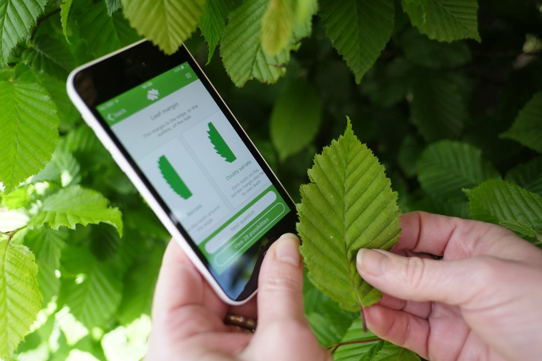
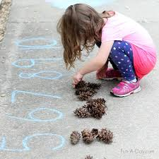
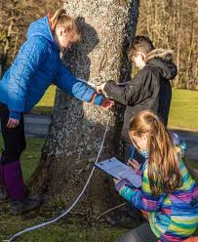
Cross-Curricular Skills
Digital Competence
Literacy
Numeracy
Notes:
https://theplantguide.net/2017/08/23/best-plant-identification-apps/

Slide 17

Wider Skills
Learners will gain important transferable skills in:
Critical thinking and problem‑solving
Planning and organising
Creativity and innovation
Personal effectiveness

Slide 18
Health and Wellbeing
Evidence from across the world show that being in nature can make us feel better and be healthier.
80% of the happiest people have a strong connection to nature!
Children and young people who experience stressful events in their lives are less stressed if they have opportunities to spend time in nature.
Exposure to nature supports the regulation of mood and helps to improve emotional resilience.
83% more individuals engage in social activity in green spaces as opposed to sparsely vegetated or concreted ones!
Sources: Natural Resource Wales, Welsh Government, NHS, National Trust, BBC, NCBI, Forestry Commission Scotdland, Sullivan, Kuo and DePooter.)

Slide 19
The Benefits of Outdoor Learning
Enjoyment
Health and Wellbeing
Engagement
Attainment
Confidence and character
Social and emotional awareness
Activity skills
Personal Qualities
Skills for life
Broadening Horizons

Slide 20
“Access to such important experiences
should be an expectation for all young people.”
Welsh Council for Outdoor Learning

Slide 21
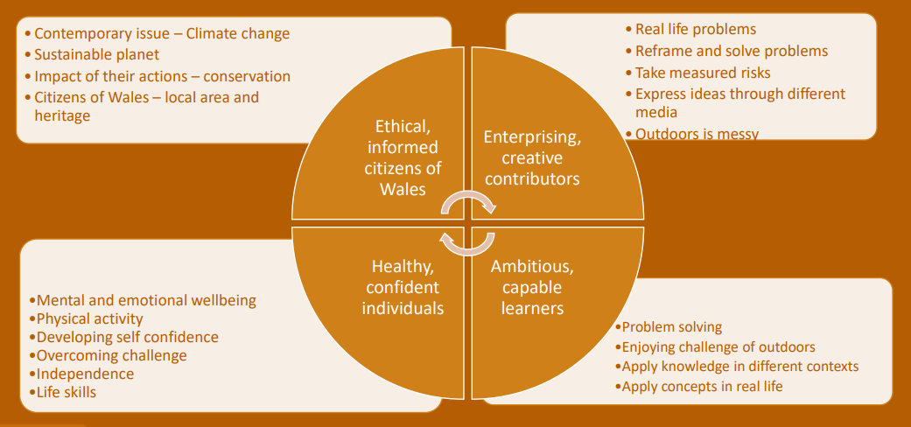
New Curriculum For Wales
(Nature Days)

Slide 22
Humanities
Examine the connections between different places, humans and the environment.
Understand that, in a diverse, dynamic and changing world, they can make a positive difference.
Mathematics and Numeracy
Develop a sense of size and amount by observing and exploring the world.
Explore patterns in wider environment.
Languages, Literacy and Communication
Communicate; take part in conversation.
Within real and imaginary situations, share experiences and feelings, ideas and information.
Understand features of different texts to find, select, sort and use information for specific purpose.
Create stories in interesting settings.
Expressive Arts
Explore patterns in wider environment.
Be creative through collecting, sticking, drawing the shapes of the different species of plants and leaves.
Health and Wellbeing
Manage risks.
Express ideas and emotions.
Develop and maintain healthy relationships.
Take on different roles and responsibilities.
Sciences and Technology,
Examine the life cycle of plants and animals.
Understand what happens to the plants and trees each season.
Explore the process that occurs in the seasons.

Slide 23
to develop ethical citizens of Pembrokeshire,
Wales and the World.
Inspiring
Outdoor Learning

