Slide 1





Ysgolion Awyr Agored
Sir Benfro
Pembrokeshire Outdoor Schools (PODS)
Tavernspite School Grounds Tour
Ymweliad â safle
Ysgol Tavernspite

Slide 2

Tavernspite School
Ysgol Tavernspite
Background Info:
Tavernspite Community Primary School is situated in the small village of Tavernspite in Pembrokeshire, close to the border with Carmarthenshire near Whitland.
It serves a large rural catchment area, which includes the communities of Red Roses, Ludchurch, Lampeter Velfrey, Llanddewi Velfrey and Llanteg.
There are 220 pupils aged three to eleven years in the school. Pupils are organised into seven single-aged classes for children from four to eleven years. In addition a part and full-time Nursery class forms part of the Early Years Unit.
The school strive to provide exciting and varied learning experiences which ensures that all children ‘Be all they can be’.
Outdoor learning is very important to the schools ethos. Estyn reported that, ‘the school’s commitment to using the outdoors to improve pupils’ learning and wellbeing is outstanding.’ Tavernspite was the first Pembrokeshire Outdoor School and are an accredited Forest School.

Slide 3
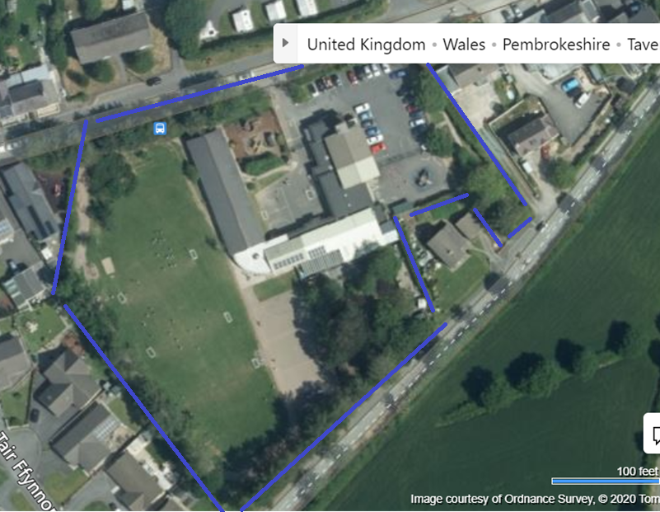
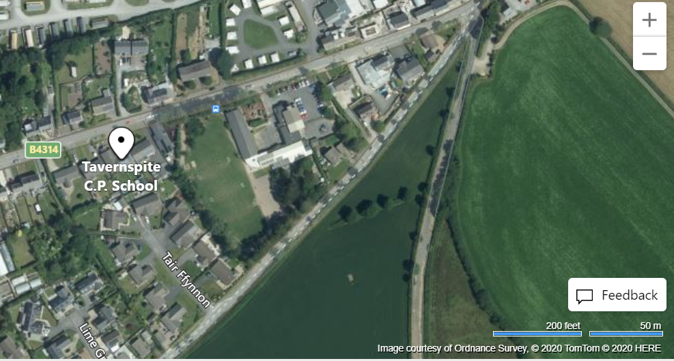
The Early Years Outdoor Learning Area

Slide 4
Outdoor Learning Areas
Meysydd Dysgu Awyr Agored
Pirate Ship Area (FP)
Discovery Area (EY)
3a. Log Circle Area (All ages)
3b. Year 1 and 2 Canopy
4a. Top Playground
4b. ‘Bushtukka’
4c. Trim Trail
4d. School Field
4e. Wild Area
5a. Adventure Playground
5b. Playground (FP)
5a.
1.
5b.
4e.
3b.
2.
4d.
3a.
4a.
4b.
4c.

Slide 5
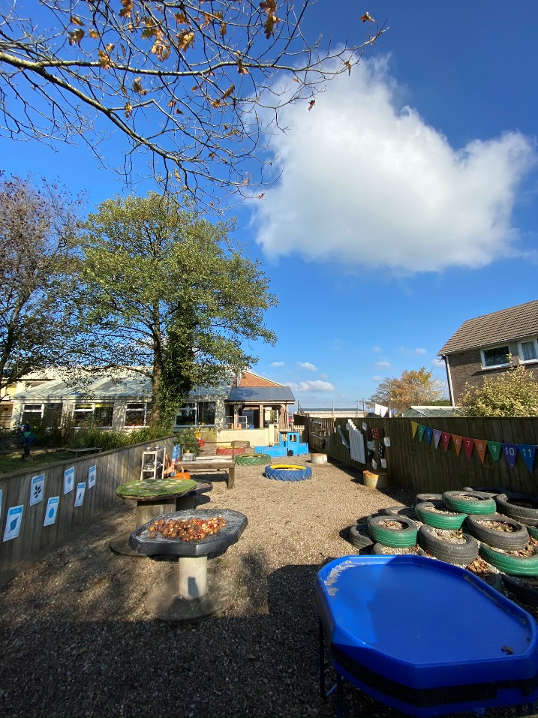
Video
The Early Years
Discovery Area

Slide 6
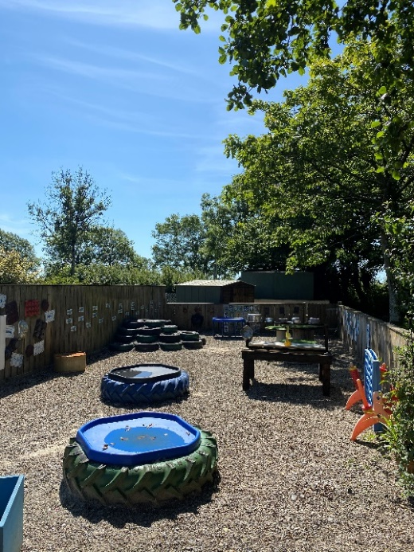
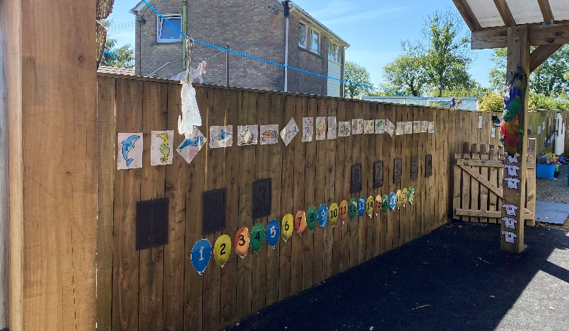
The Early Years Outdoor
Learning Discovery Area
Recycled Materials:
Tractor/Car tyres
Pipes
Steel Drums
Old rope reels
Mixing Trays

Slide 7
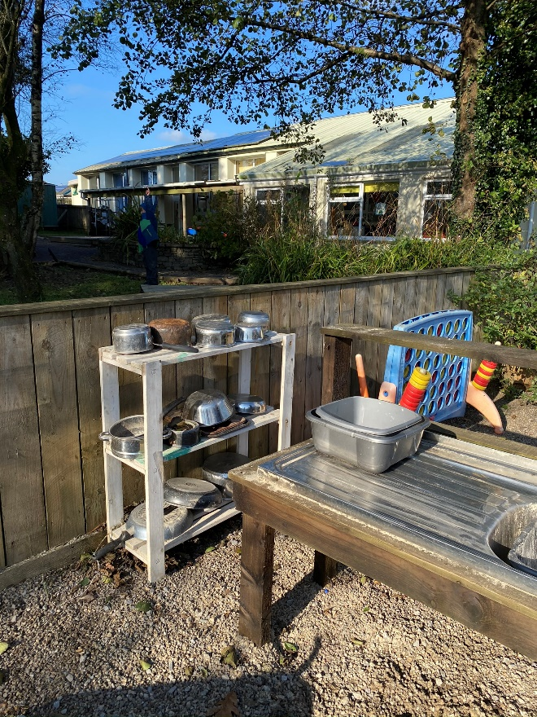
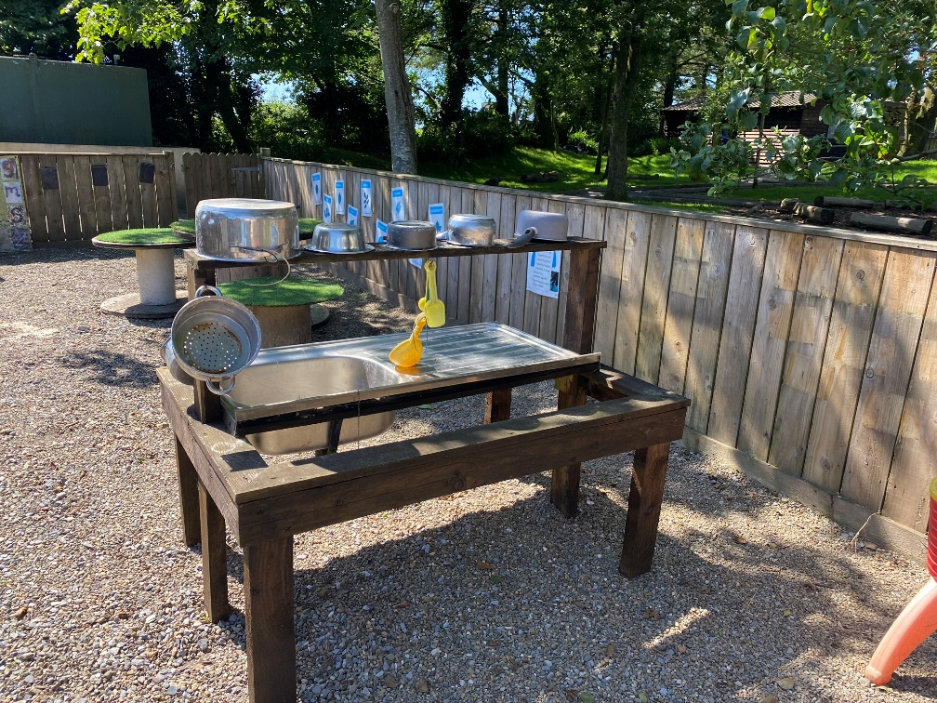
The Early Years Outdoor
Learning Discovery Area
Recycled kitchen Equipment:
Backing Trays
Pots and Pans
Utensils
Mud kitchen

Slide 8
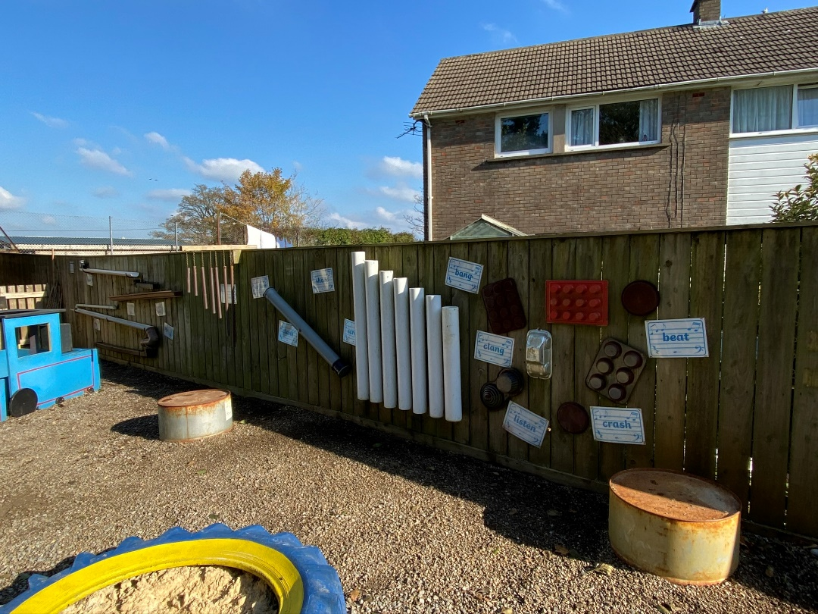
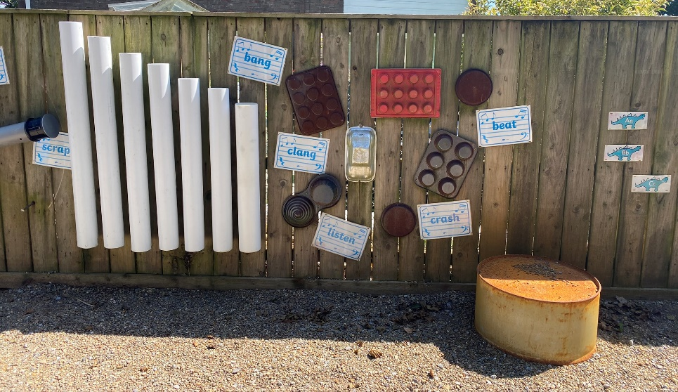
The Early Years Outdoor
Learning Discovery Area
Soundboard

Slide 9
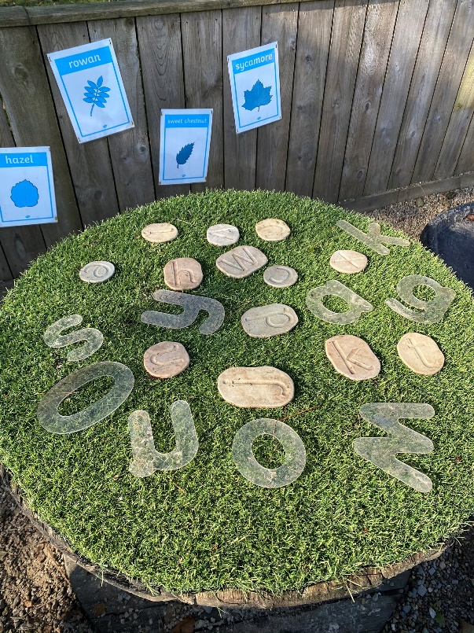
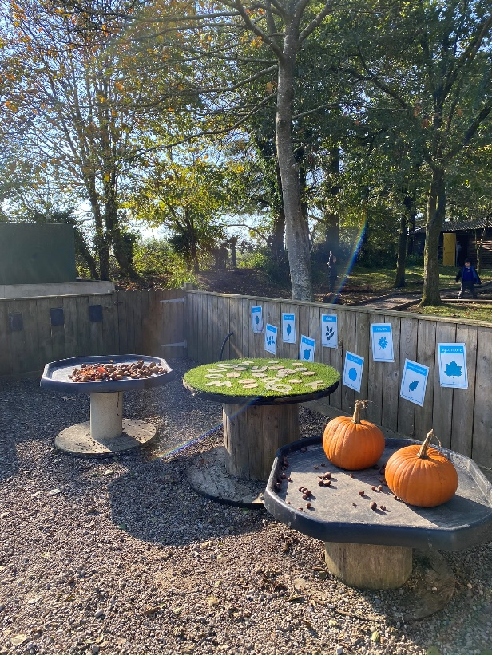
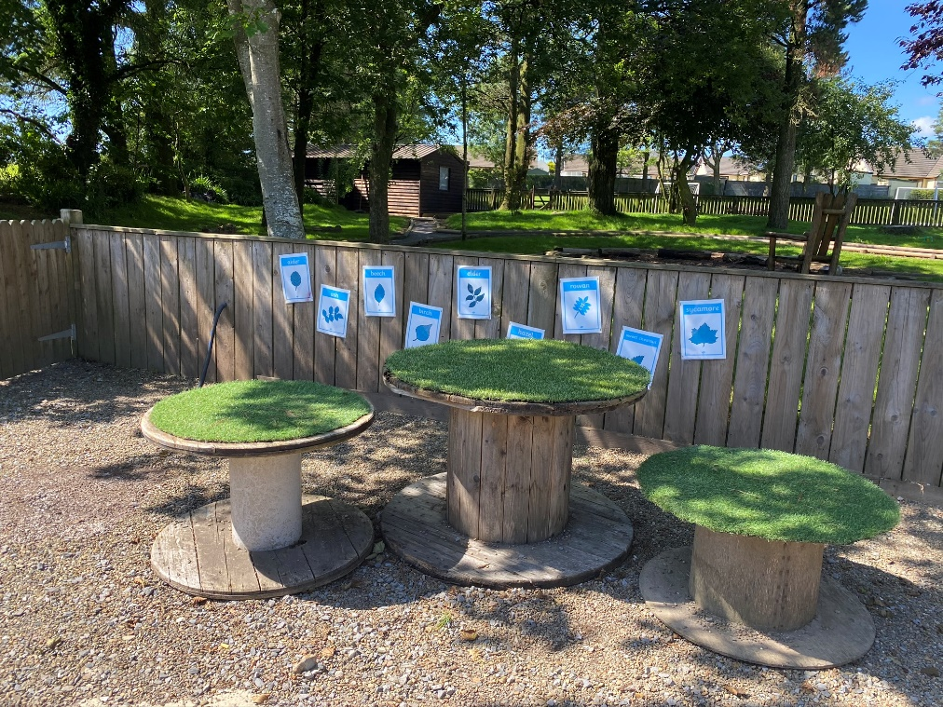
The Early Years Outdoor
Learning Discovery Area

Slide 10
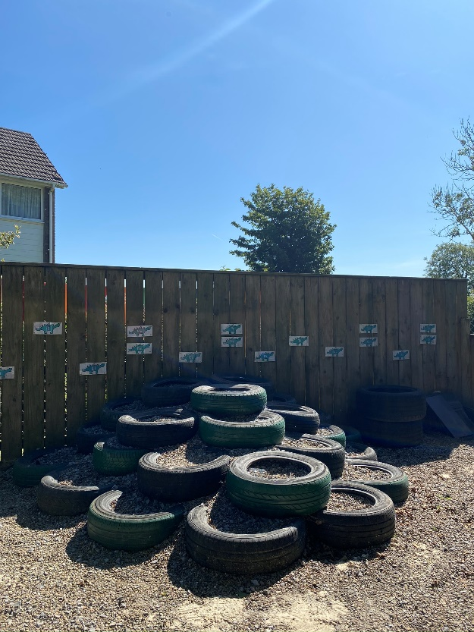
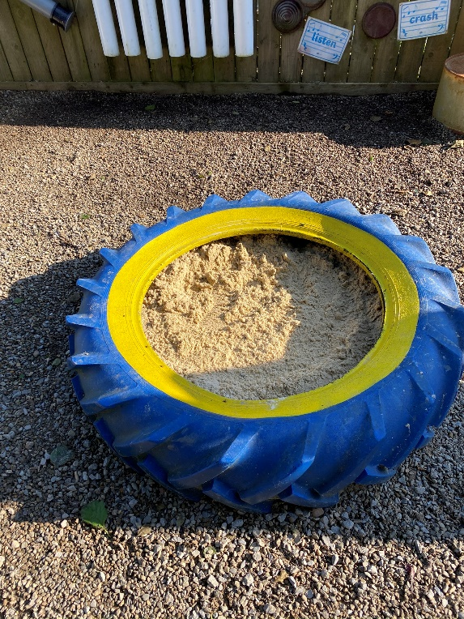
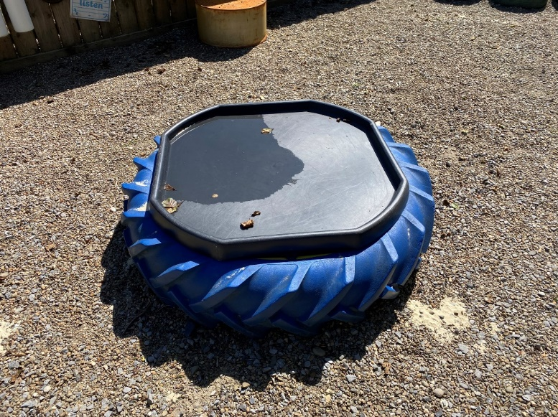
The Early Years Outdoor
Learning Discovery Area

Slide 11
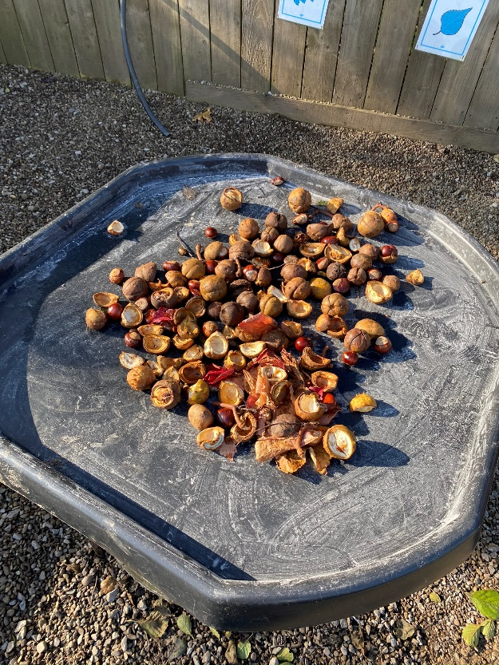
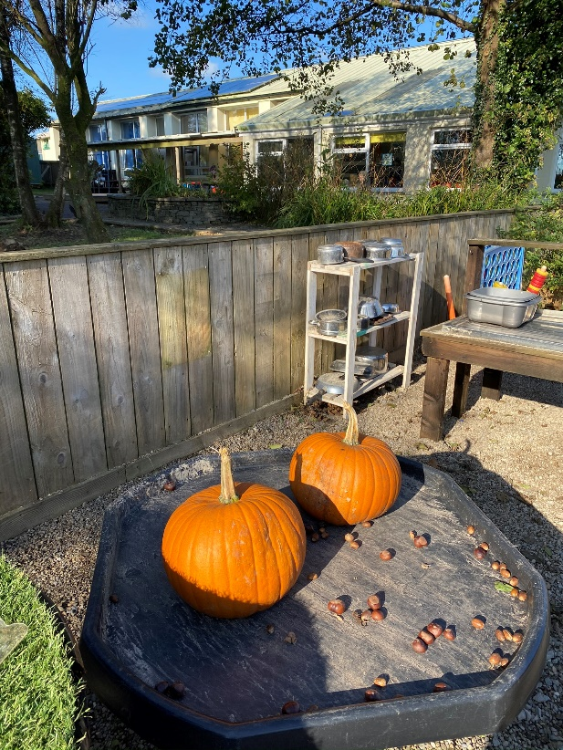
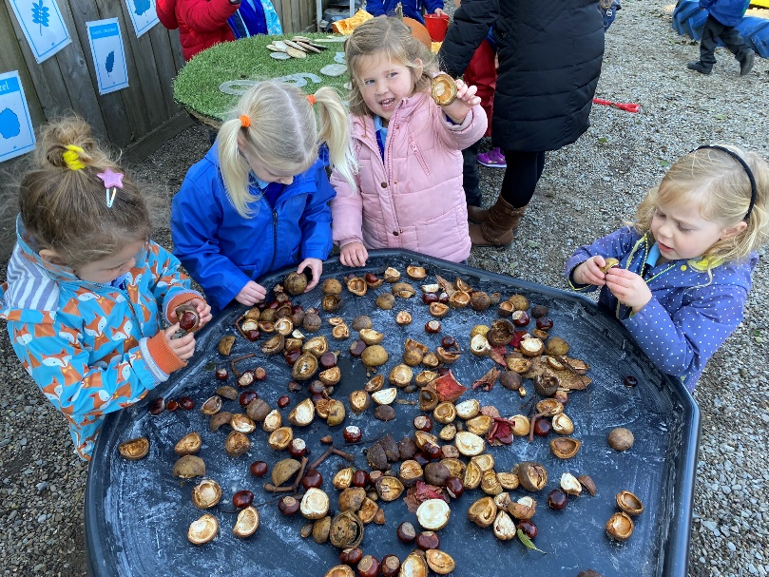
The Early Years Outdoor
Learning Discovery Area

Slide 12
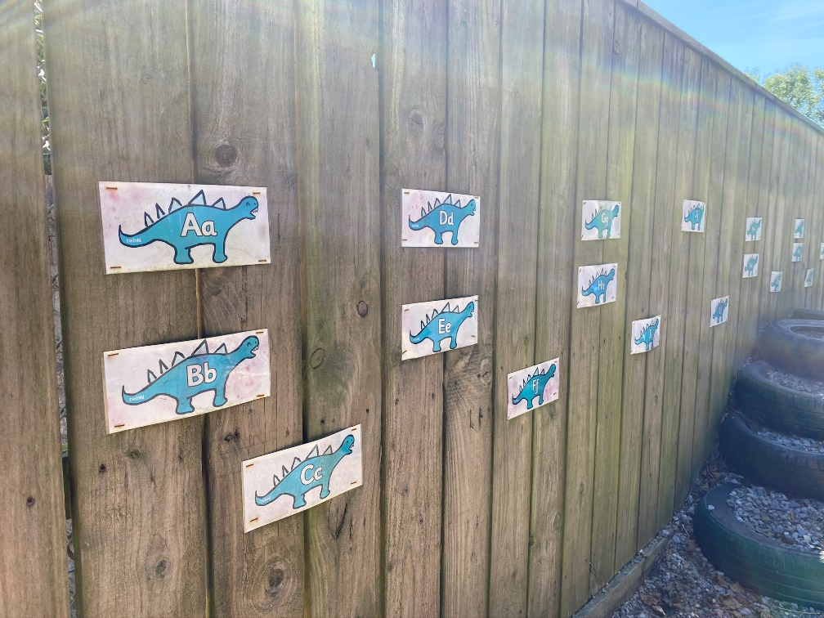
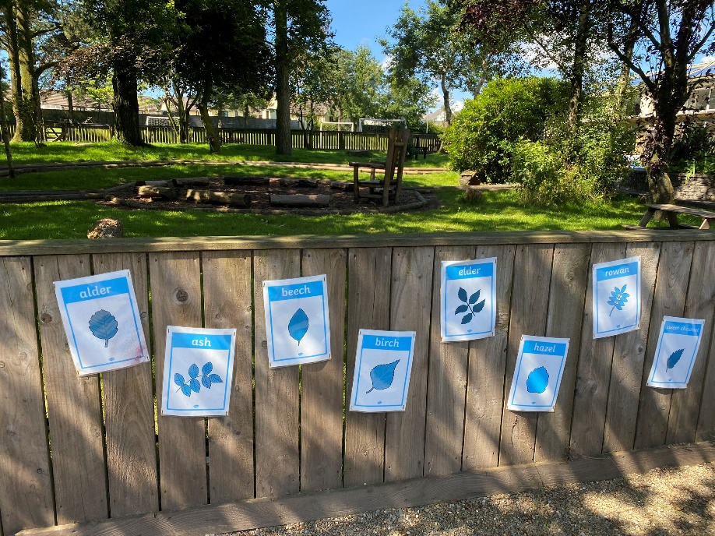
The Early Years Outdoor
Learning Discovery Area
Laminated Resources:
Alphabet
Numbers
Sounds
Alphabet animals
Type of leaves/trees
Mud Kitchen Recipe

Slide 13

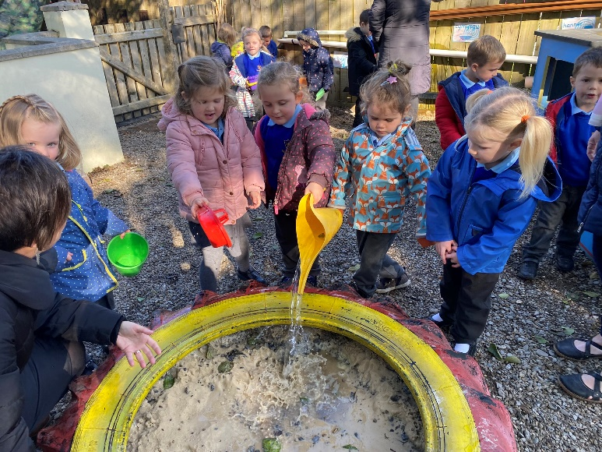
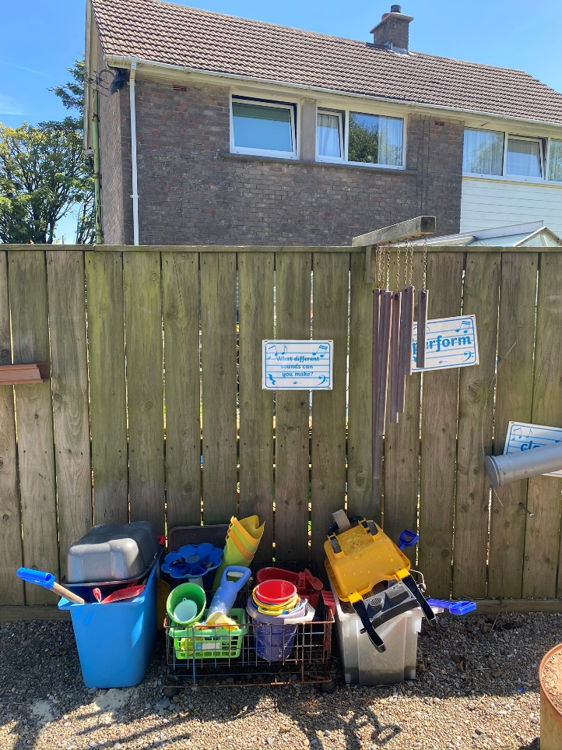
The Early Years Outdoor Play Area

Slide 14
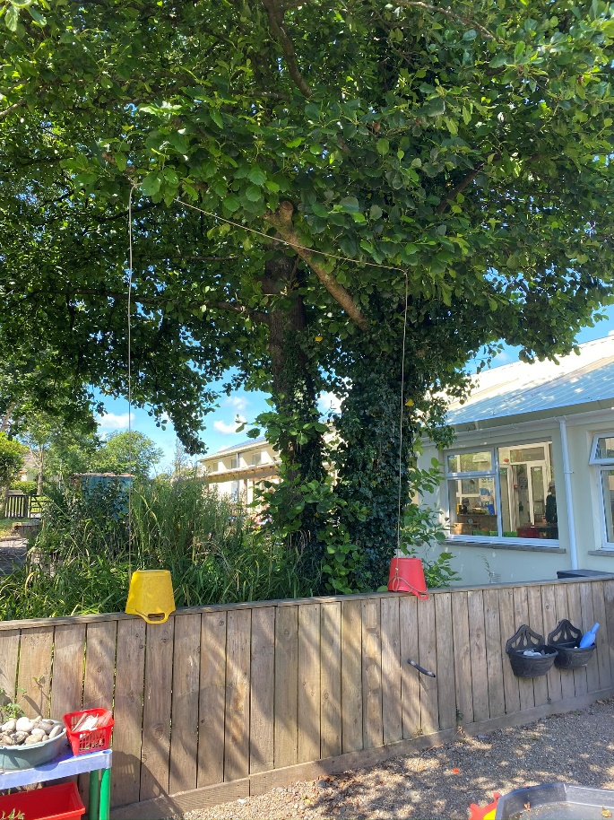
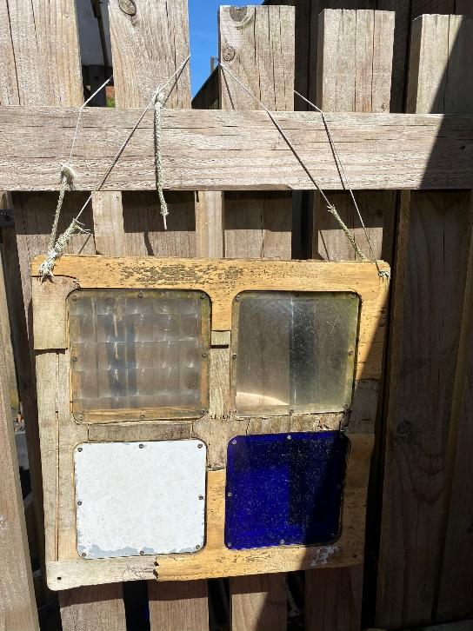
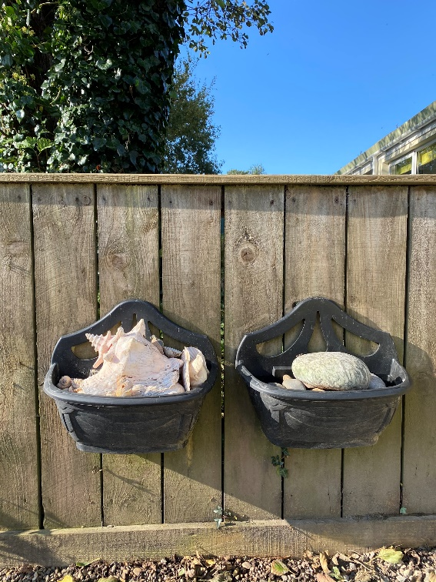
The Early Years Outdoor
Learning Discovery Area

Slide 15
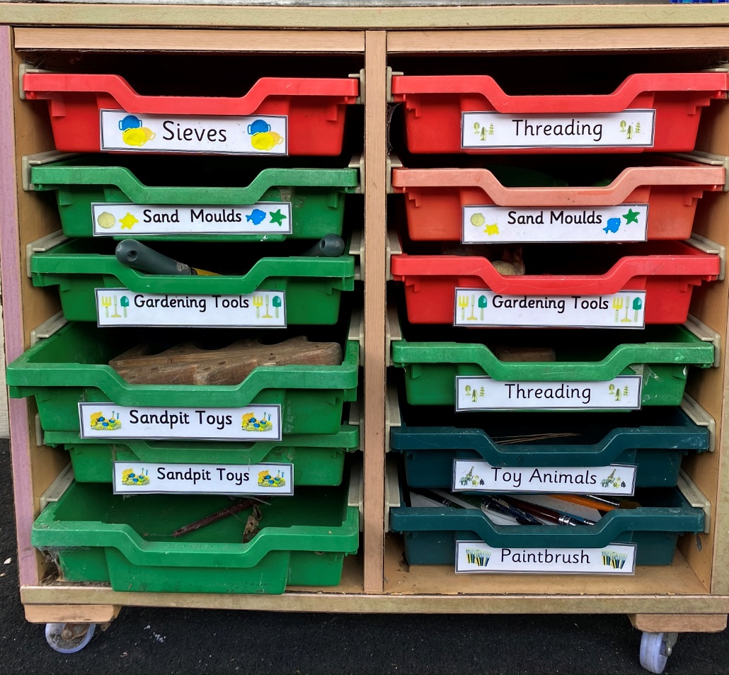
The Early Years Outdoor
Learning Discovery Area

Slide 16
Outdoor Learning Areas
Meysydd Dysgu Awyr Agored
Pirate Ship Area (FP)
Discovery Area (EY)
3a. Log Circle Area (All ages)
3b. Year 1 and 2 Canopy
4a. Top Playground
4b. ‘Bushtukka’
4c. Trim Trail
4d. School Field
4e. Wild Area
5a. Adventure Playground
5b. Playground (FP)
5a.
1.
5b.
4e.
3b.
2.
4d.
3a.
4a.
4b.
4c.

Slide 17
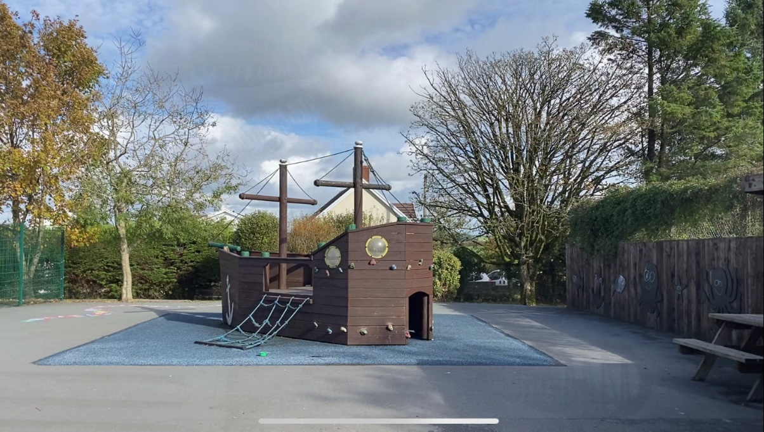
The Foundation Phase
Pirate Ship Area
Video
The Foundation Phase Pirate Ship Area

Slide 18
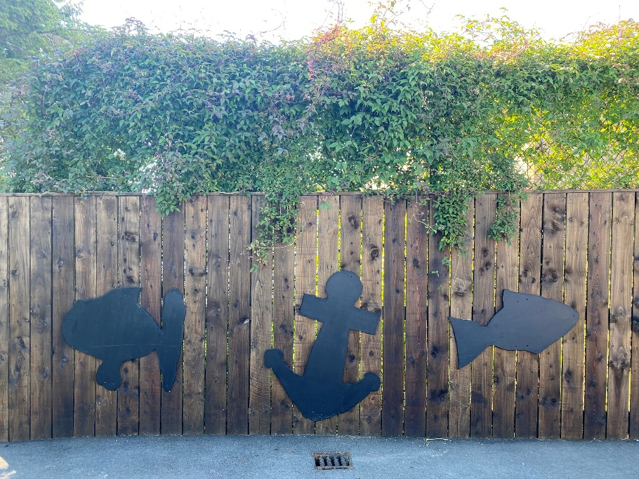
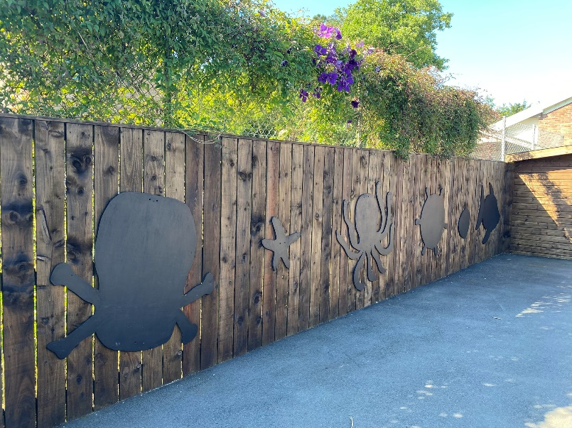
The Foundation Phase
Pirate Ship Area

Slide 19
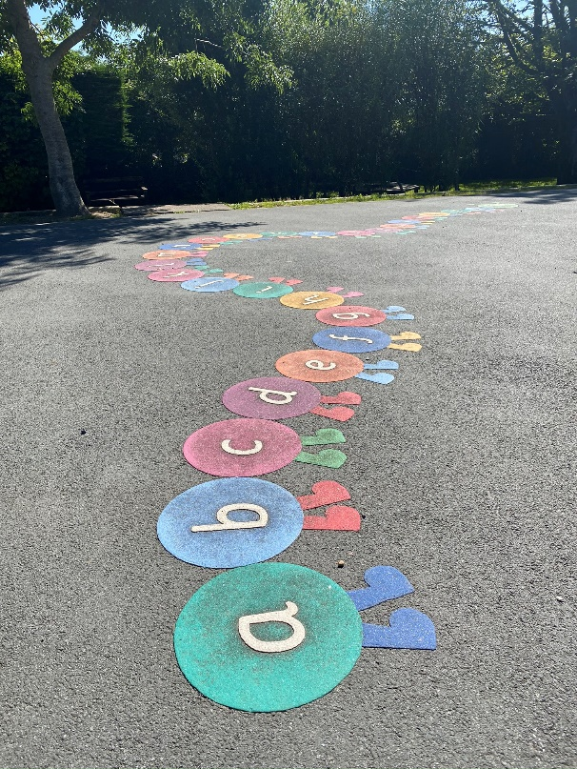
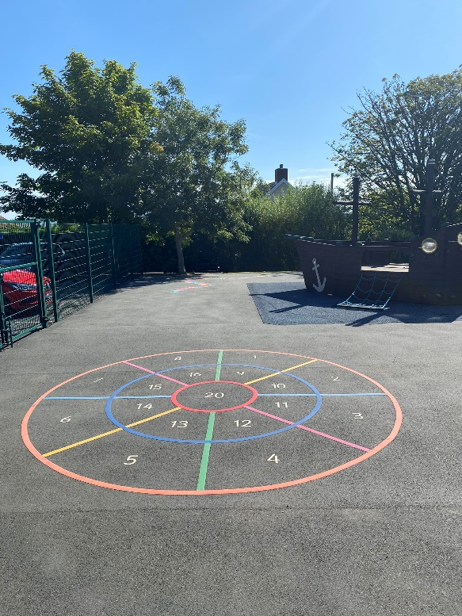
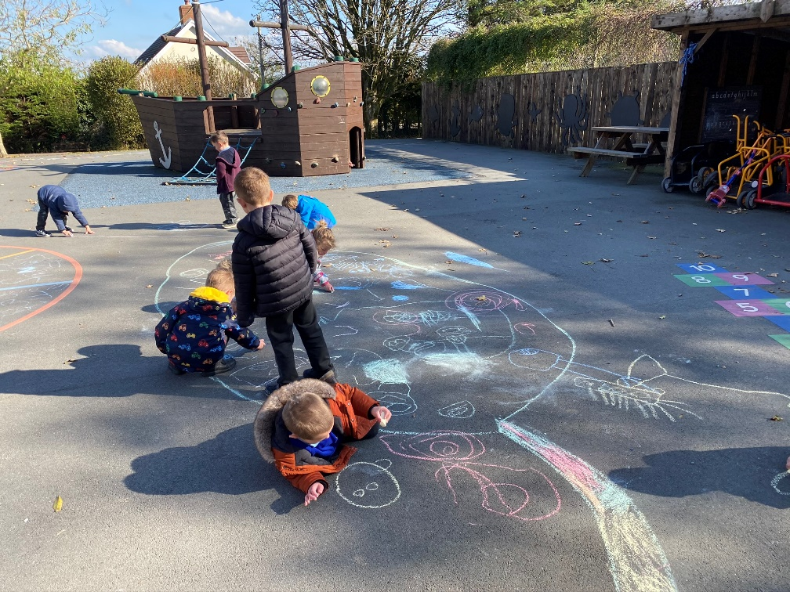
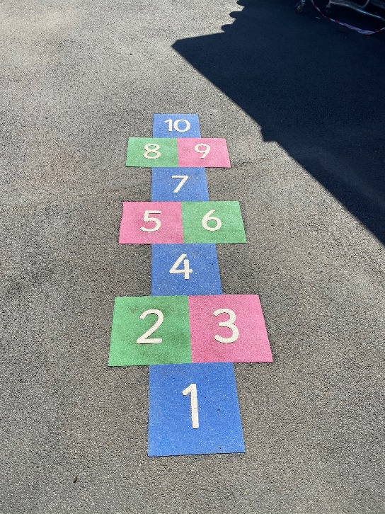
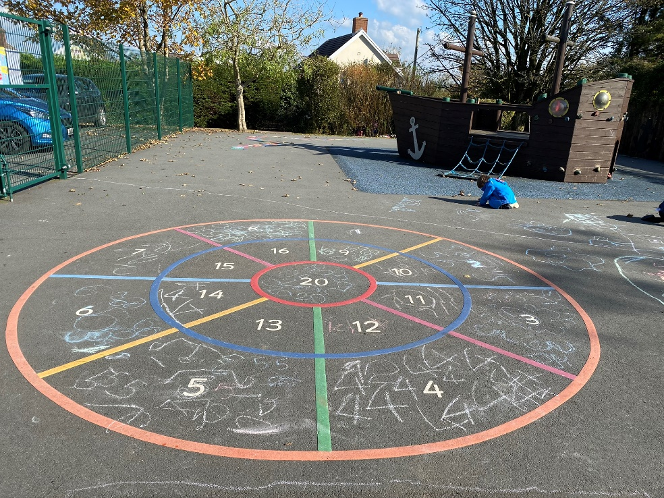
The Foundation Phase
Pirate Ship Area

Slide 20
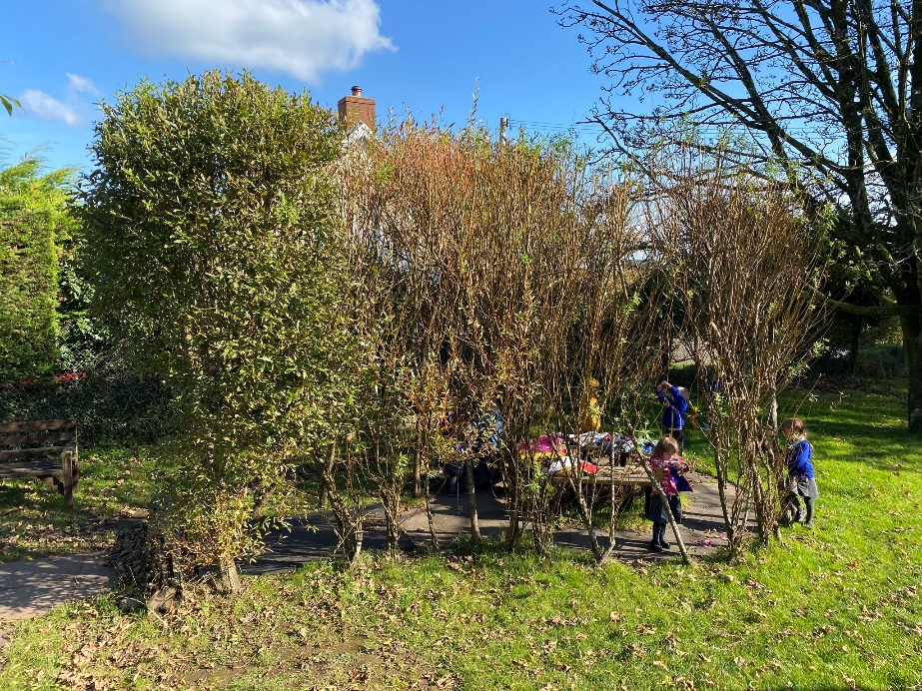
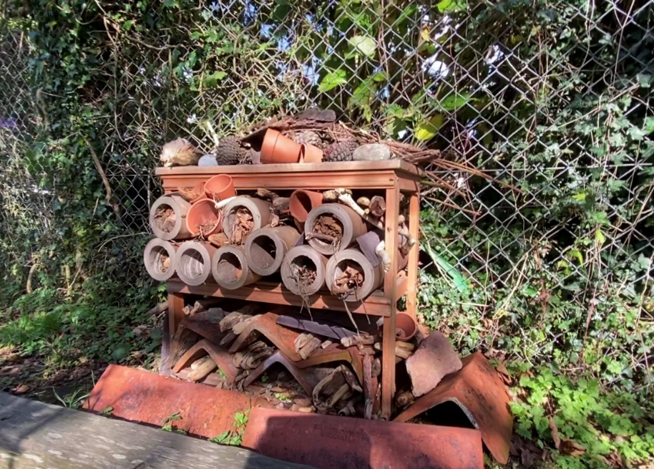
The Foundation Phase
Pirate Ship Area
Willow Dome
Seating Area
Bug Hotel

Slide 21
Outdoor Learning Areas
Meysydd Dysgu Awyr Agored
Pirate Ship Area (FP)
Discovery Area (EY)
3a. Log Circle Area (All ages)
3b. Year 1 and 2 Canopy
4a. Top Playground
4b. ‘Bushtukka’
4c. Trim Trail
4d. School Field
4e. Wild Area
5a. Adventure Playground
5b. Playground (FP)
5a.
1.
5b.
4e.
3b.
2.
4d.
3a.
4a.
4b.
4c.

Slide 22
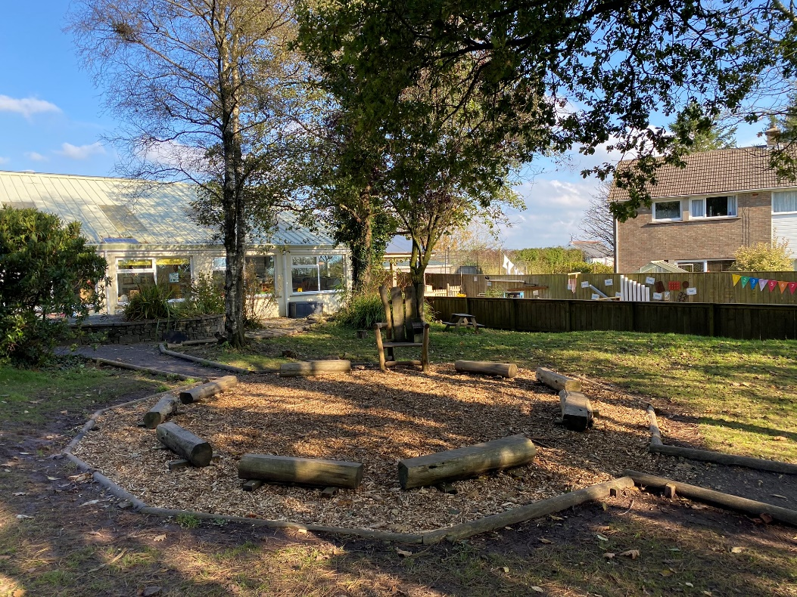
Log Circle Area
Video
Log Circle Area

Slide 23
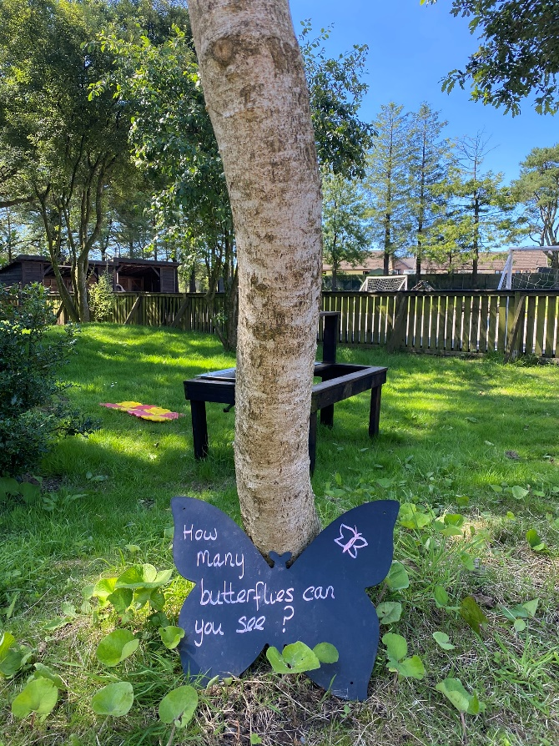
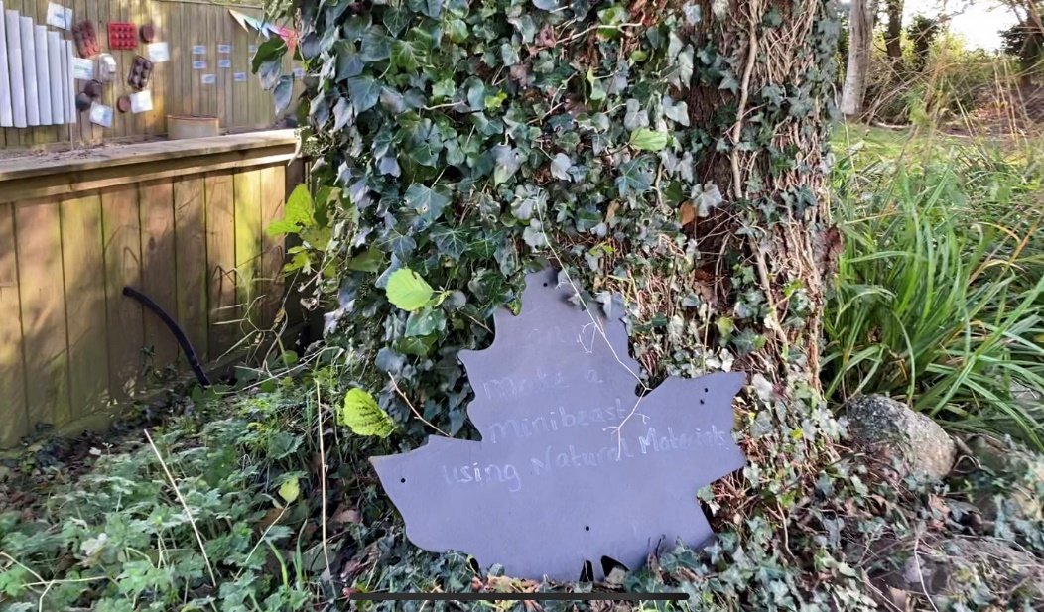
Log Circle Area

Slide 24
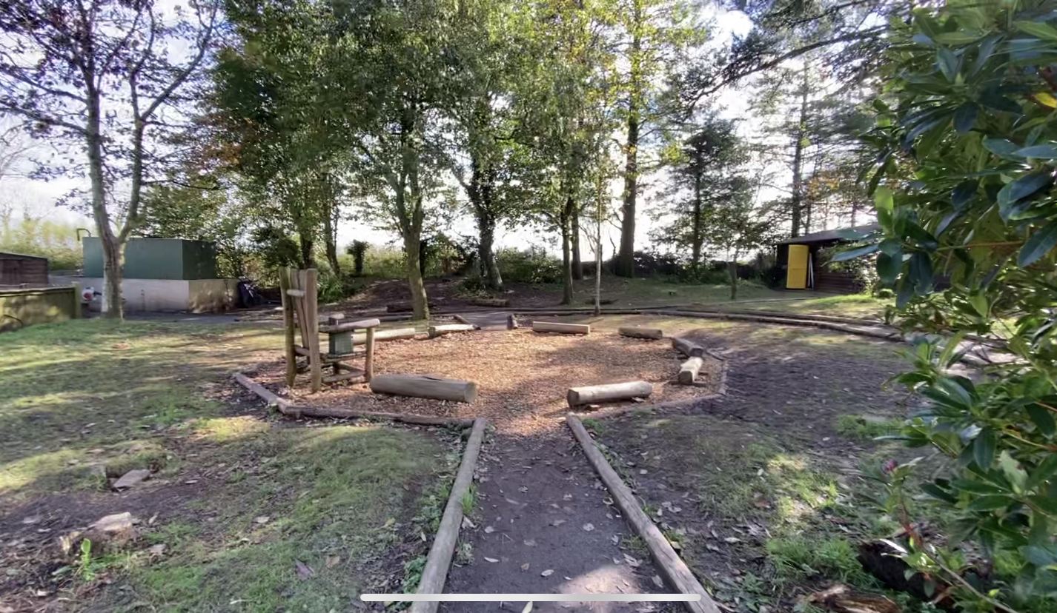
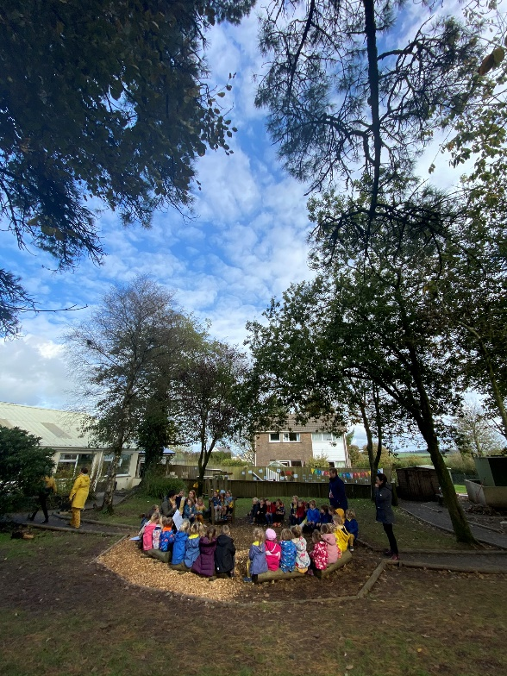
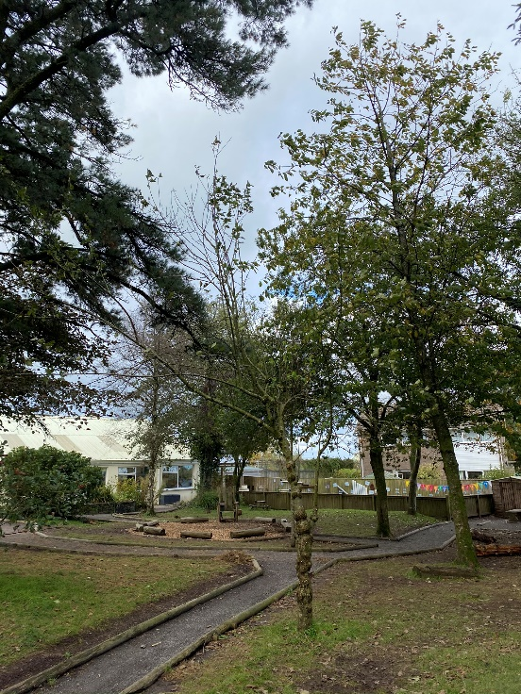
Log Circle Area

Slide 25
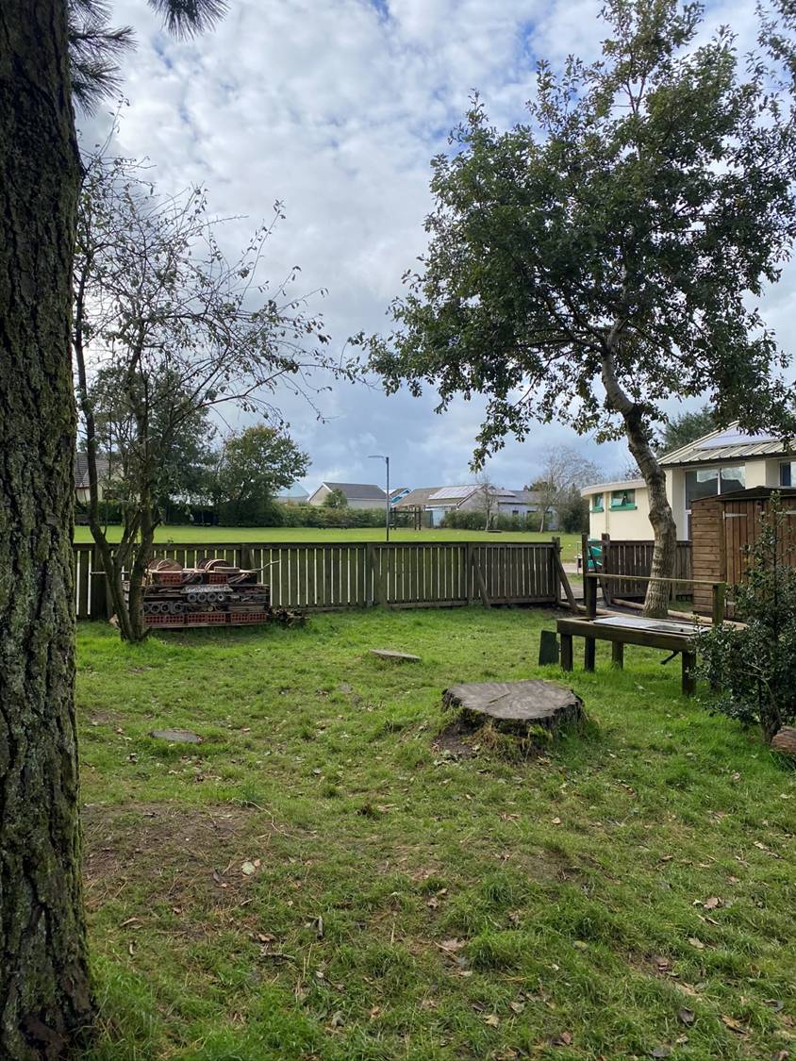
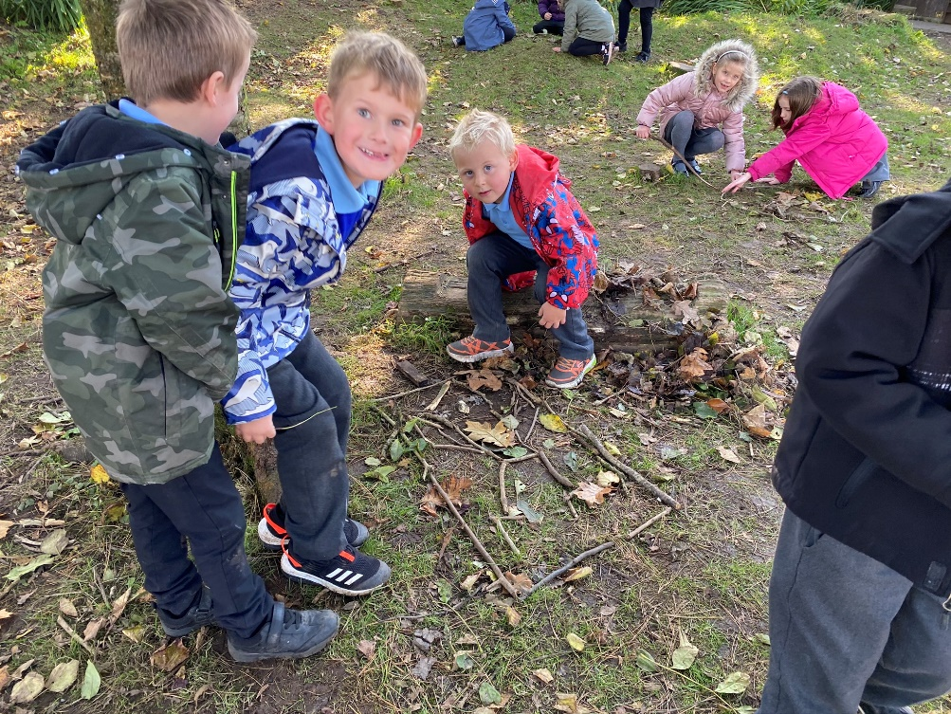
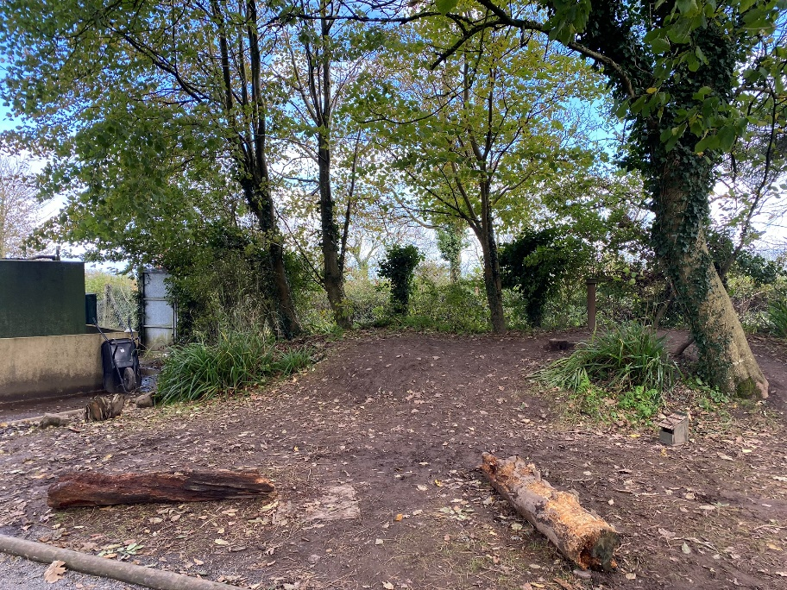
Log Circle Area
Use of Natural Features:
Trees
Tree Stumps
Uneven Ground
Natural Materials:
Loose parts
Wooden chopping boards
Logs
Sticks, leaves

Slide 26
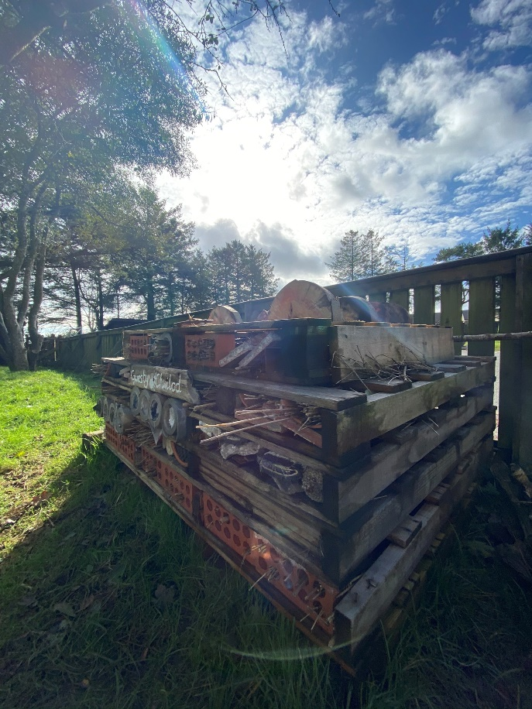
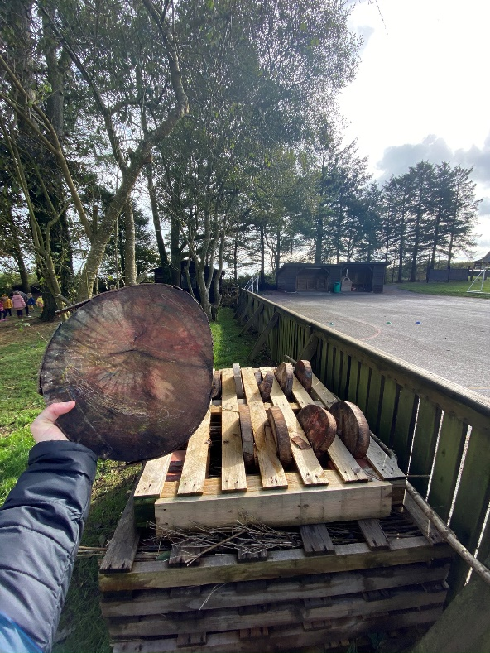
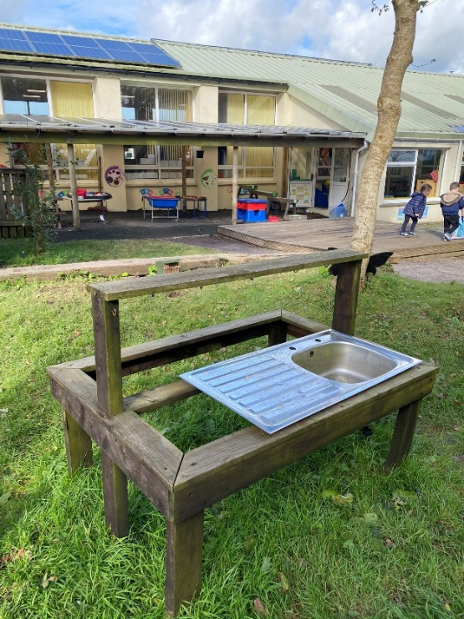
Log Circle Area

Slide 27
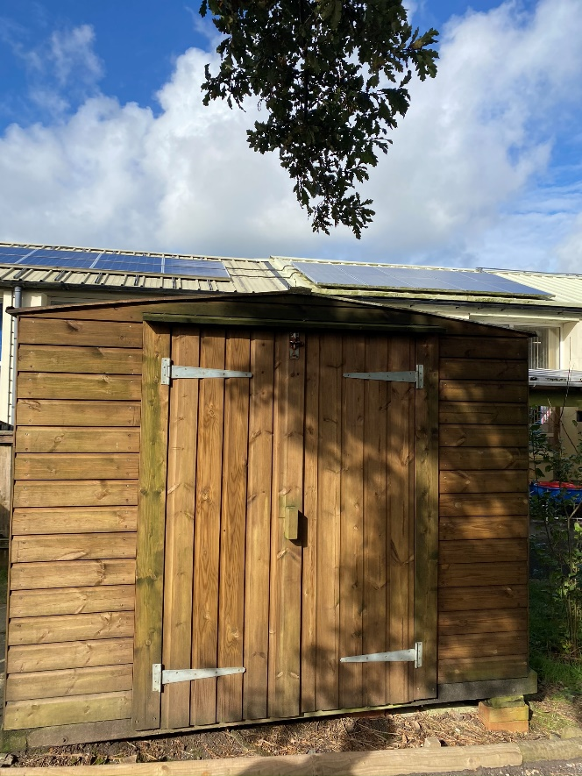
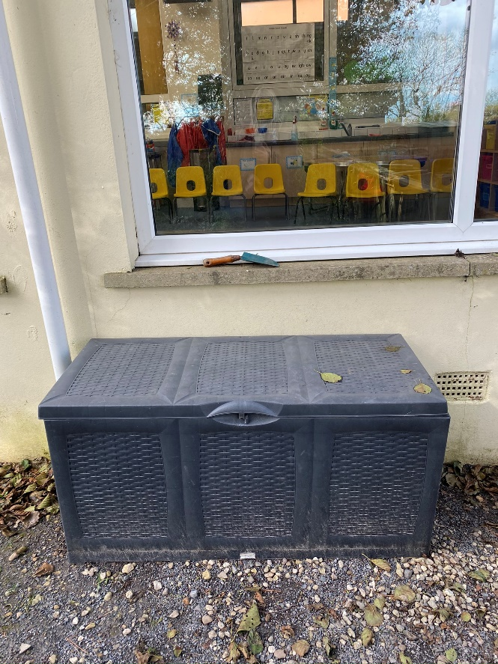
Storage

Slide 28


Log Circle Area

Slide 29


Maintenance
Caretaker Emma Lewis

Slide 30



Pond

Slide 31



Platform

Slide 32
Outdoor Learning Areas
Meysydd Dysgu Awyr Agored
Pirate Ship Area (FP)
Discovery Area (EY)
3a. Log Circle Area (All ages)
3b. Year 1 and 2 Canopy
4a. Top Playground
4b. ‘Bushtukka’
4c. Trim Trail
4d. School Field
4e. Wild Area
5a. Adventure Playground
5b. Playground (FP)
5a.
1.
5b.
4e.
3b.
2.
4d.
3a.
4a.
4b.
4c.

Slide 33

Video
Year 1 and 2 Canopy

Slide 34



Year 1 and 2 Canopy

Slide 35


Year 1 and 2 Canopy

Slide 36




Year 1 and 2 Canopy

Slide 37

Year 1 and 2 Canopy

Slide 38
Outdoor Learning Areas
Meysydd Dysgu Awyr Agored
Pirate Ship Area (FP)
Discovery Area (EY)
3a. Log Circle Area (All ages)
3b. Year 1 and 2 Canopy
4a. Top Playground
4b. ‘Bushtukka’
4c. Trim Trail
4d. School Field
4e. Wild Area
5a. Adventure Playground
5b. Playground (FP)
5a.
1.
5b.
4e.
3b.
2.
4d.
3a.
4a.
4b.
4c.

Slide 39

Playground
Video
Top playground
‘Bushtukka’
Trim Trail
School Field
Wild Area

Slide 40



School Field

Slide 41

School Field

Slide 42


Trim Trail

Slide 43



Trim Trail

Slide 44




Wild Area

Slide 45



Years Outdoor Area

Slide 46
Outdoor Learning Areas
Meysydd Dysgu Awyr Agored
Pirate Ship Area (FP)
Discovery Area (EY)
3a. Log Circle Area (All ages)
3b. Year 1 and 2 Canopy
4a. Top Playground
4b. ‘Bushtukka’
4c. Trim Trail
4d. School Field
4e. Wild Area
5a. Adventure Playground
5b. Playground (FP)
5a.
1.
5b.
4e.
3b.
2.
4d.
3a.
4a.
4b.
4c.

Slide 47

Adventure Playground
Foundation Phase Area
Video
Adventure Playground

Slide 48


Adventure Playground
Foundation Phase Area

Slide 49


Adventure Playground
Foundation Phase Area

Slide 50


Adventure Playground
Foundation Phase Area

Slide 51


Adventure Playground
Foundation Phase Area

Slide 52


Adventure Playground
Foundation Phase Area

Slide 53


Years Outdoor Area

Slide 54



Playground
Foundation Phase Area

Slide 55

‘Bushtukka’

Slide 56



‘Bushtukka’
Pizza Oven

Slide 57


‘Bushtukka’

Slide 58
Diolch yn fawr iawn i
Mr Phelps a'r staff a myfyrwyr
Ysgol Tavernspite!
Thank you very much to
Mr Phelps and the staff
and students of
Tavernspite School!

