Slide 1




Event 2 – Teaching safely in the Outdoors Webinar
Practical solutions to overcoming barriers in an Outdoor Learning Area. A simple guide to managing risks and completing risk assessments.
Guest: Dave Sommerville, Pembrokeshire County Council
Notes:
Risk assessments are important because they help you to:
Spot hazards.
Think about the potential harm.
Identify people who may be at risk.
Protect the people at risk.
Plan the work safely.
Review existing controls.
Make improvements.
Comply with the law.

Slide 2
The benefits of outdoor learning and play are far too important to forfeit, and by far outweigh the risks of an accident occurring.
(Learning Through Landscapes)

Slide 3
PODS approach to
Outdoor Learning Risk Management
As an organisation, PODS believes it is important for students to be able to experience outdoor learning opportunities and challenging play and learning activities in the day-to-day environment of their school or nursery grounds.
Our belief is that the benefits of any activity can be balanced against the risks associated with that activity. We want to enable schools and nurseries to make careful and considered judgements that will allow children to develop as ethically informed citizen and give them the skills that they need in adult life.
Balancing immediate risk with long-term benefits is a skill that can we constantly develop through experiences. (Teachers you are great at this!)

Slide 4
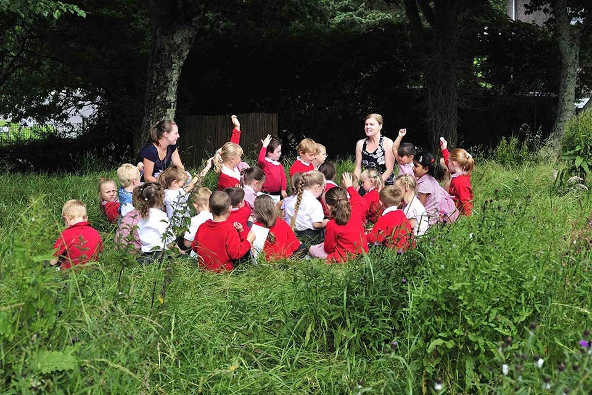
Your School Requirements
Your school needs to ensure all activities and practices operate in line with the health and safety requirements, policies and procedures of your individual schools.
Such policies may include Educational Trips and Visits, Administering First Aid and Health and Safety etc.

Slide 5
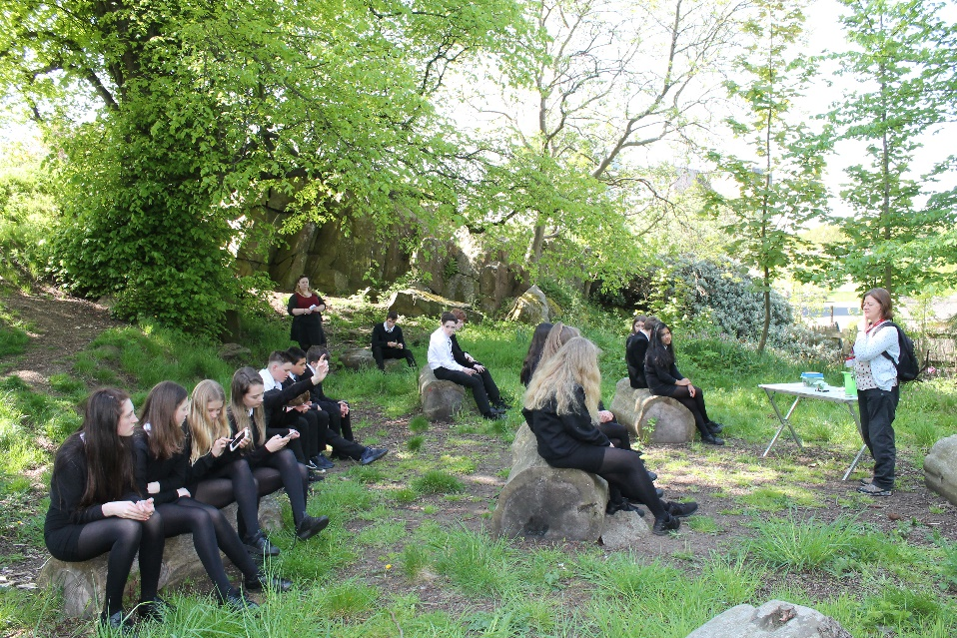
Your Outdoor Learning Risk Assessments
When creating your risk assessments, you should ensure that it meets the requirements of Pembrokeshire County Council.
Contacting the health and safety advisers in your Local Authority for advice if required.
    Simon Nicholls
    Sean Allen
    Dave Sommerville

Slide 6
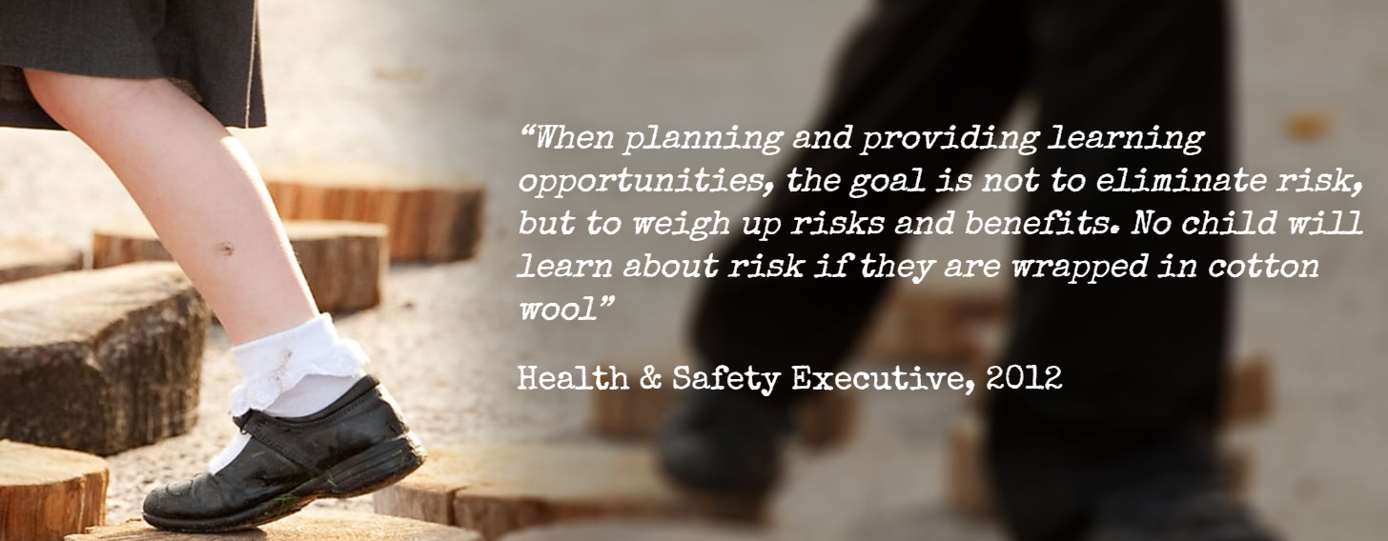

Slide 7


Slide 8
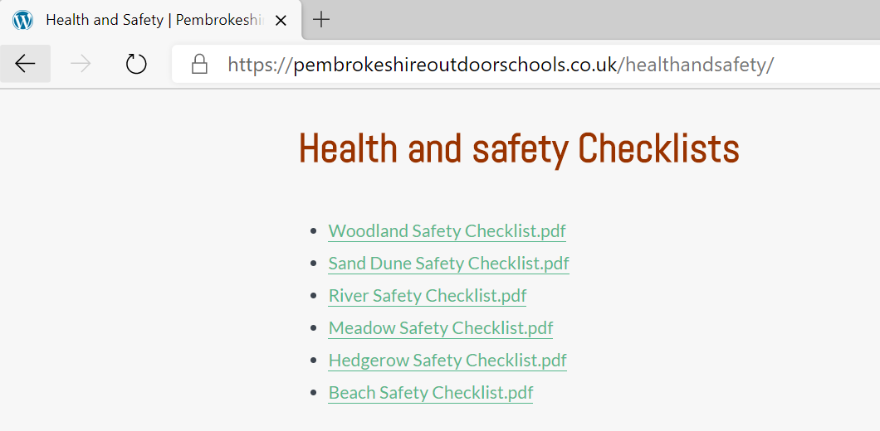
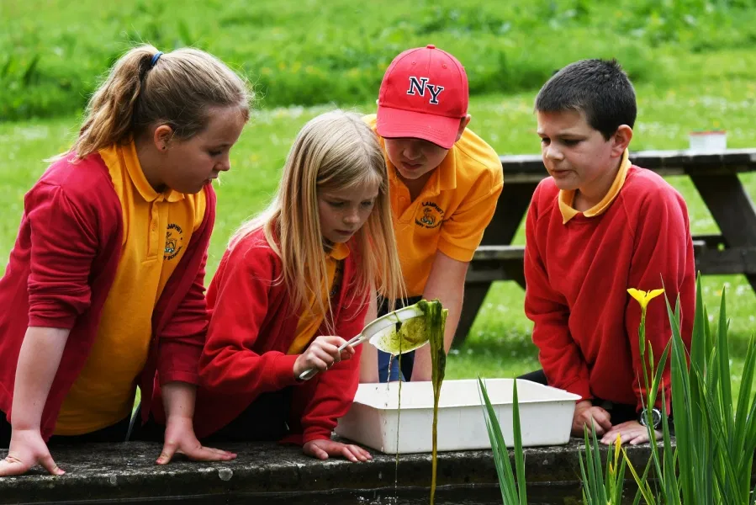
Pembrokeshire Outdoor Schools Support
The information provided from Pembrokeshire Outdoor Schools about health and safety and risk assessing in different environments is for guidance only.

Slide 9
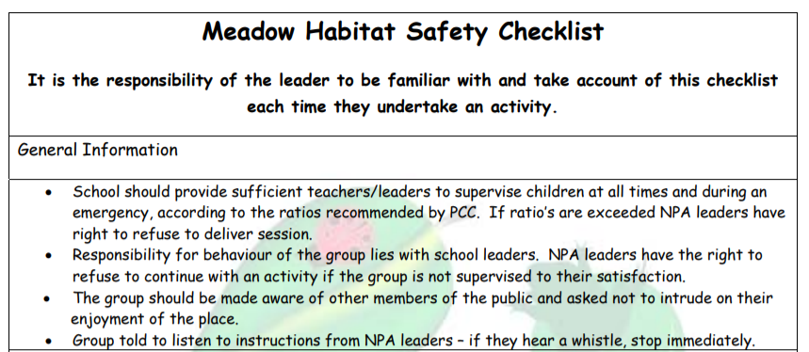

Slide 10
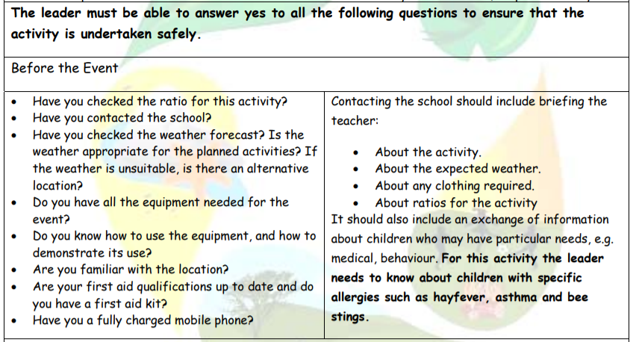
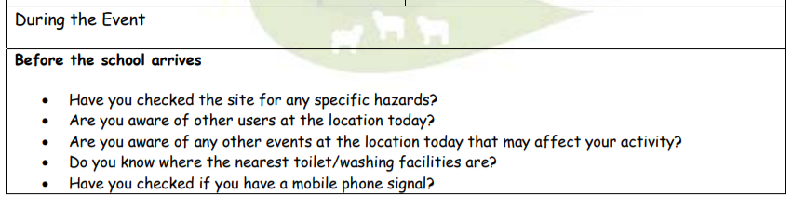

Slide 11
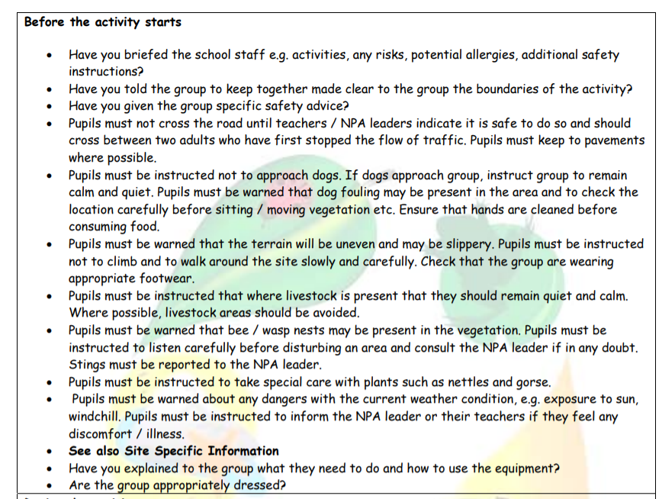

Slide 12
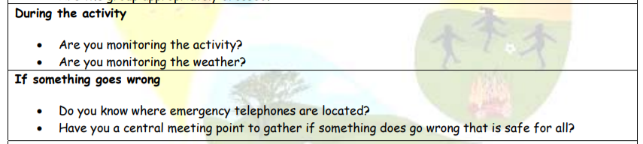
Dynamic risk assessment is the practice of mentally observing, assessing and analysing an environment while we work, to identify and remove risk. The process allows individuals to identify a hazard on the spot and make quick decisions in regards to their own safety.

Slide 13
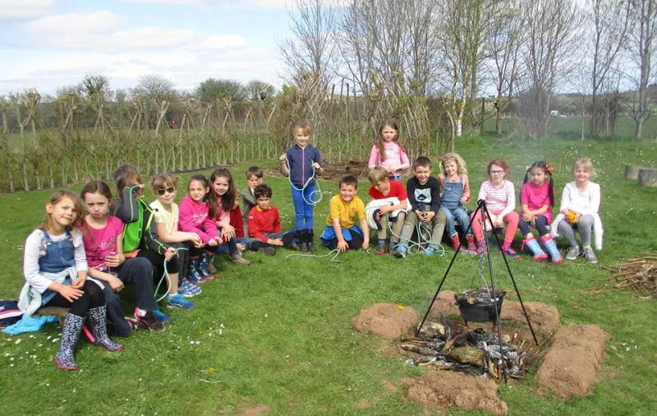

Slide 14
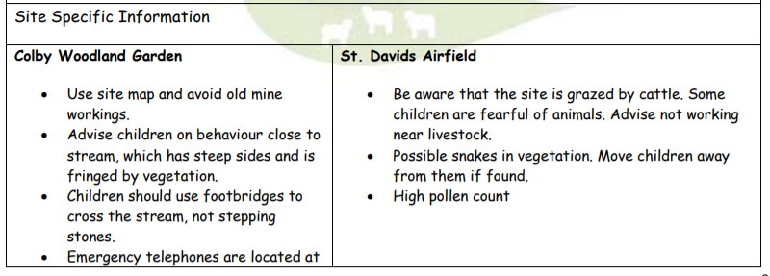
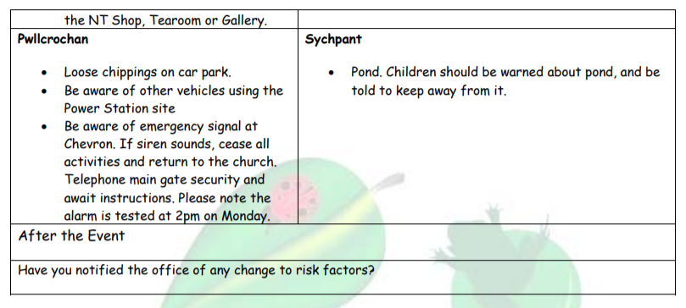

Slide 15
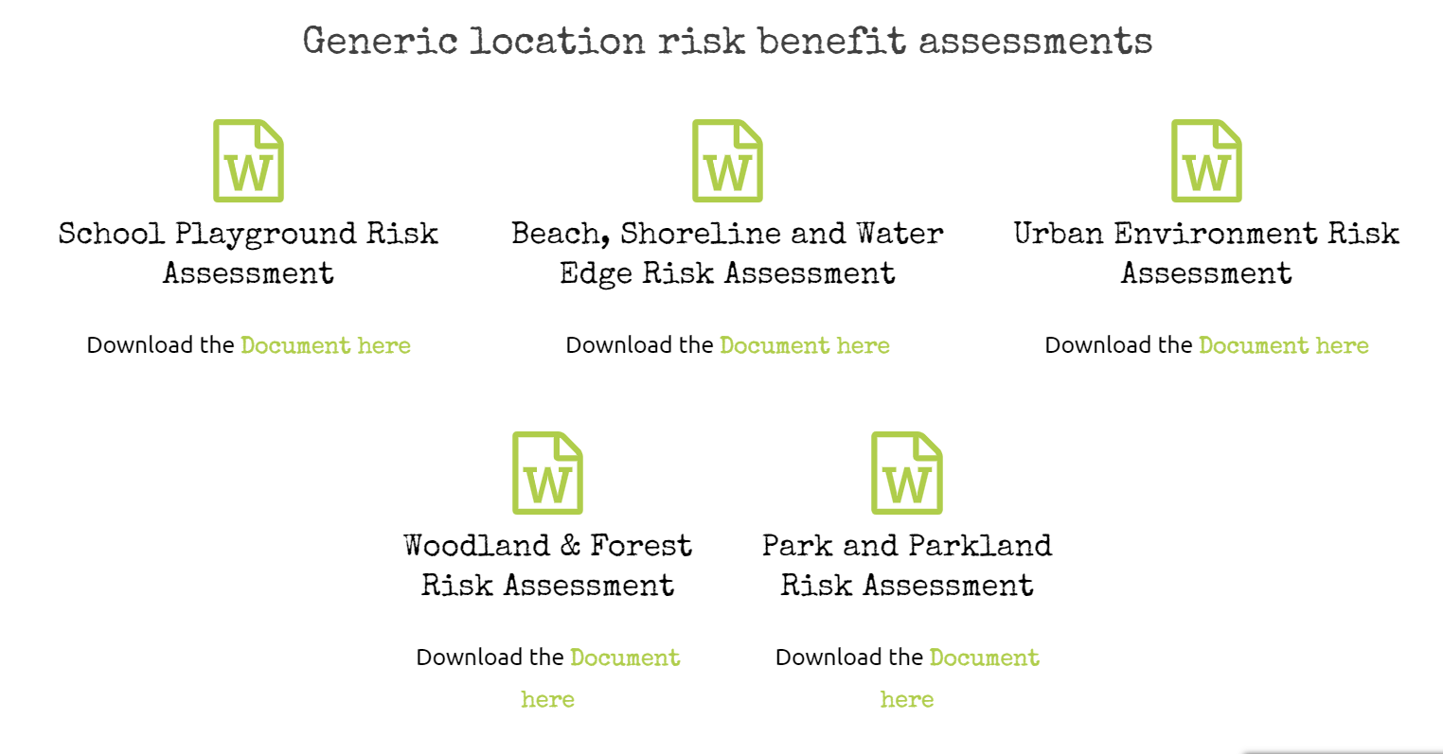
Learning Through Landscapes

Slide 16
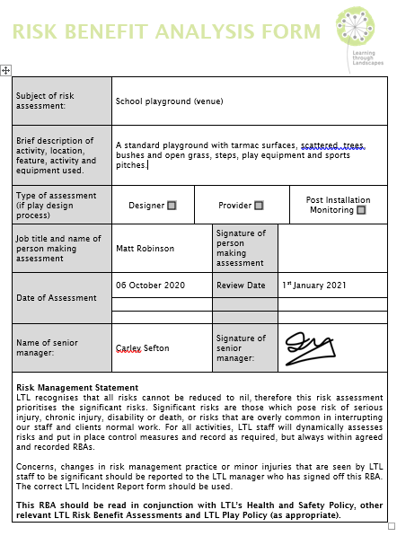

Slide 17
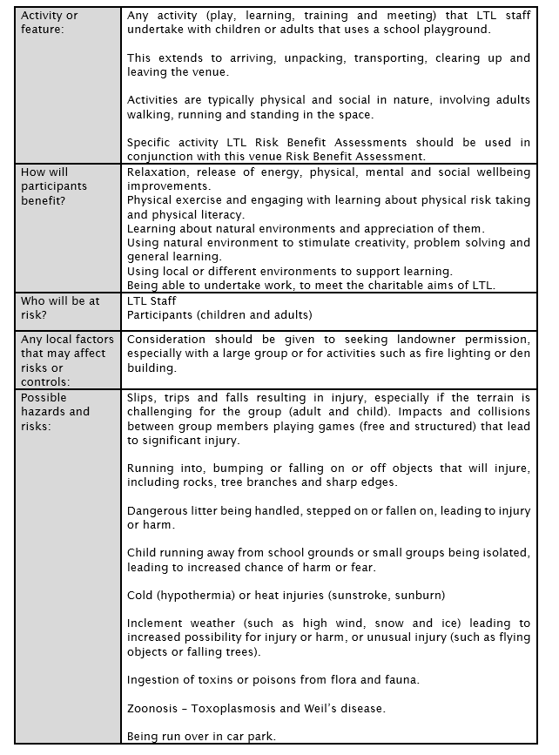

Slide 18
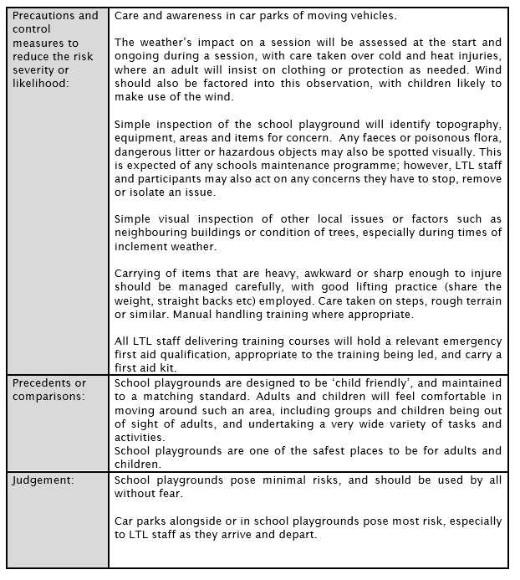

Slide 19
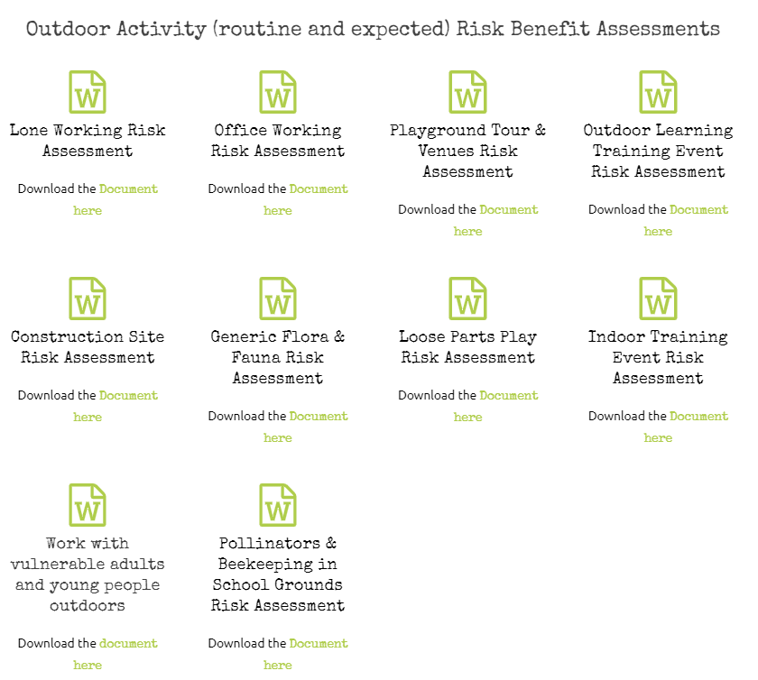
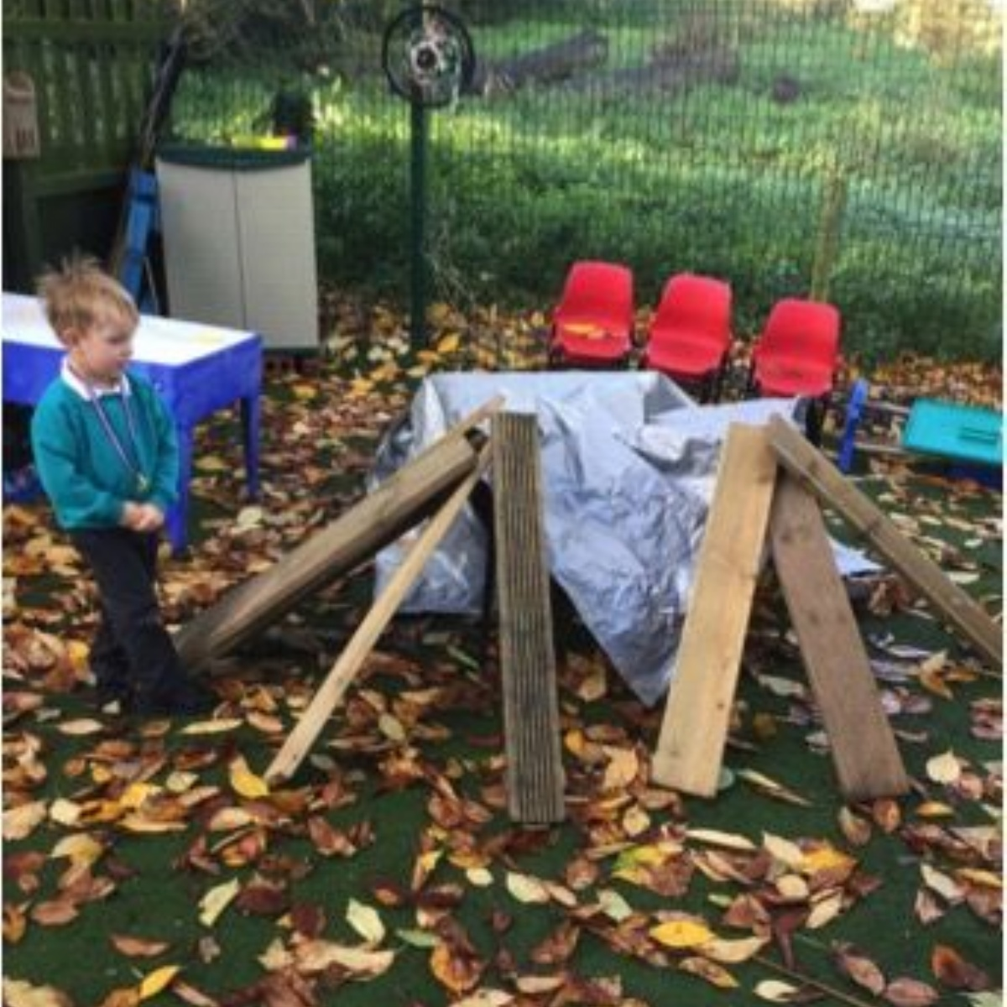
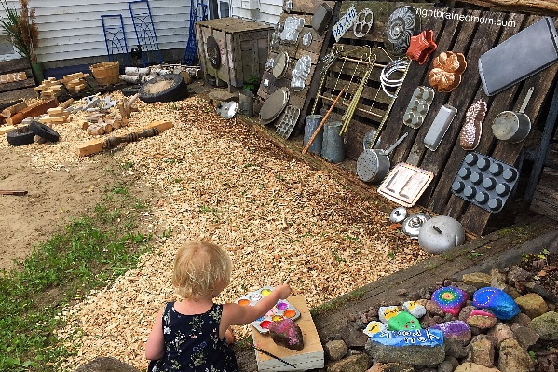

Slide 20
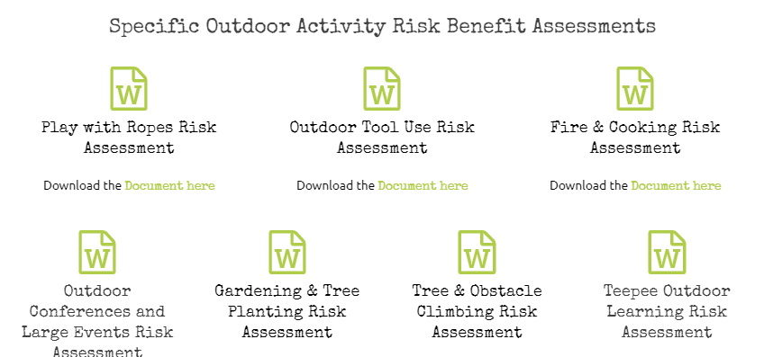
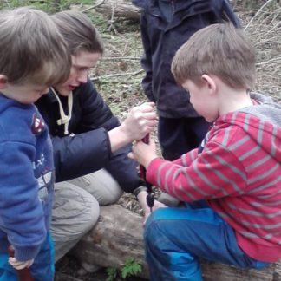
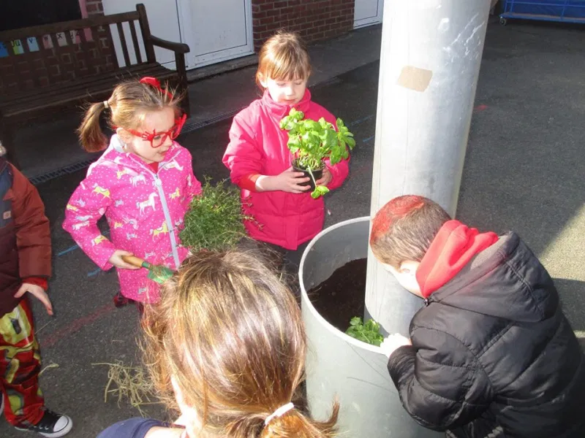
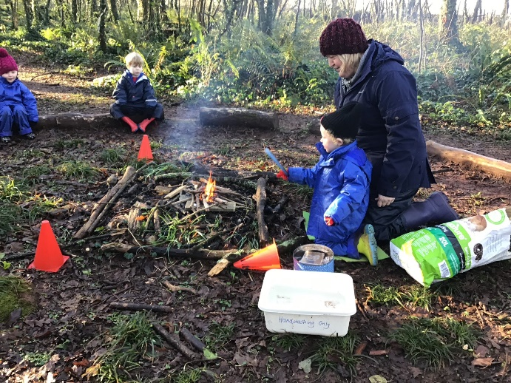

Slide 21
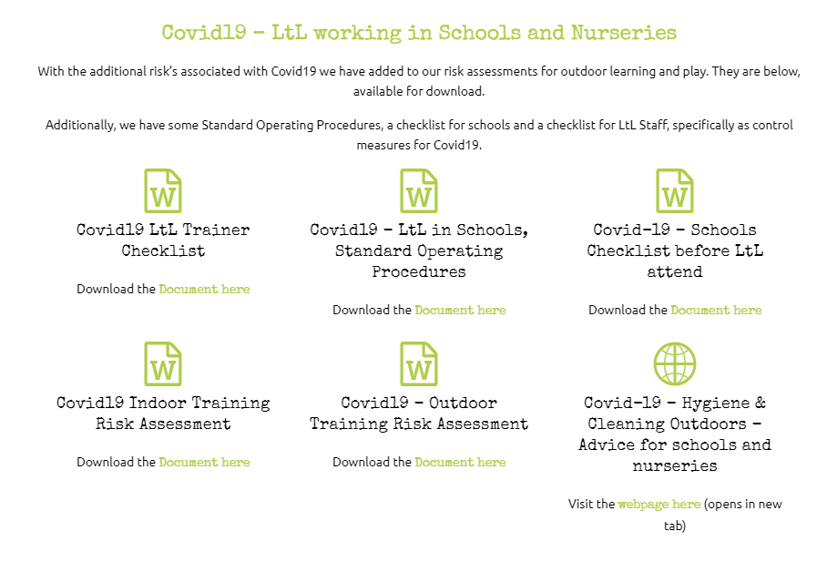

Slide 22
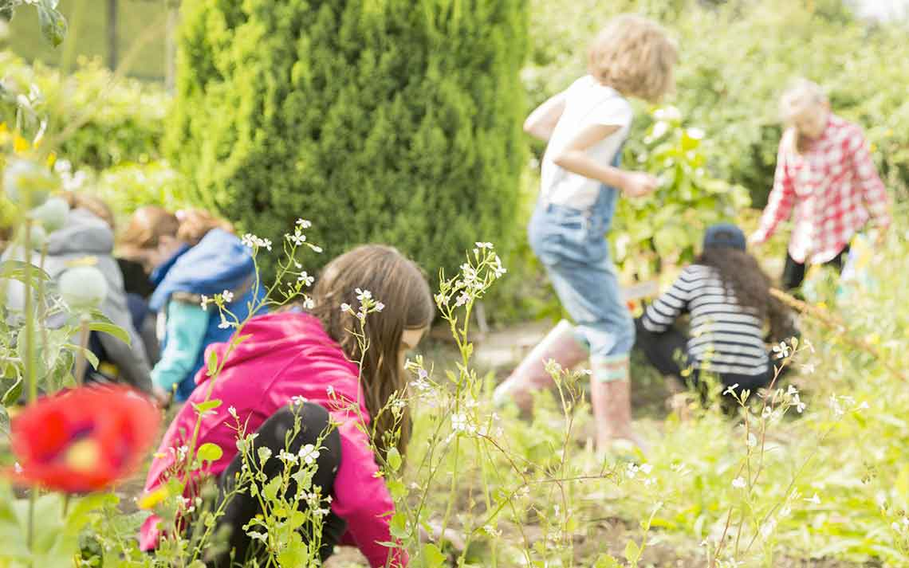
Advice on Hygiene and Cleaning for School Grounds and Equipment
Formal guidance from the World Health Organisation and the UK Government. The source of the documents are available online.
Learning Through Landscapes recommends that all decisions are made through a risk-benefit approach – understanding that no risk can be reduced to zero, and outdoors already offers a safer place than indoors for our staff and learner at present. Any risk-benefit assessment therefore must start with a more beneficial view of outdoor spaces than indoor spaces as we consider Covid-19.

Slide 23
World Health Organisation (WHO)
A summary of the key questions:
What is the guidance for the disinfection of outdoor spaces?
In outdoor spaces, large-scale spraying or fumigation in areas such as streets or open market places for the COVID-19 virus or other pathogens is not recommended.
Are public systems for disinfecting individuals such as spraying via tunnel or chambers safe to use?
No. Spraying of individuals with disinfectants (such as in a tunnel, cabinet, or chamber) is not recommended under any circumstances.
What are the recommended practices once back home after outdoor activities?
Thorough hand hygiene: washing hands with soap and water or using alcohol-based hand gel, should be performed before touching surfaces, items, pets, and people within the household environment.
Are gloves recommended for the community in public spaces to protect against COVID-19?
No. The use of gloves by the public in public spaces is not a recommended or proven prevention measure.

Slide 24
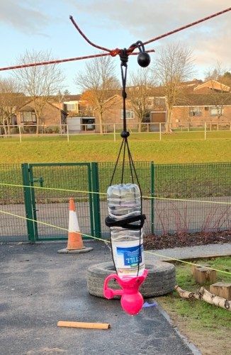
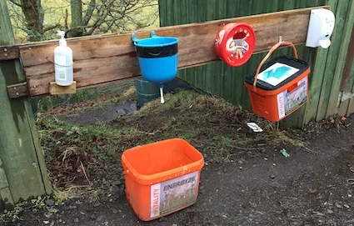
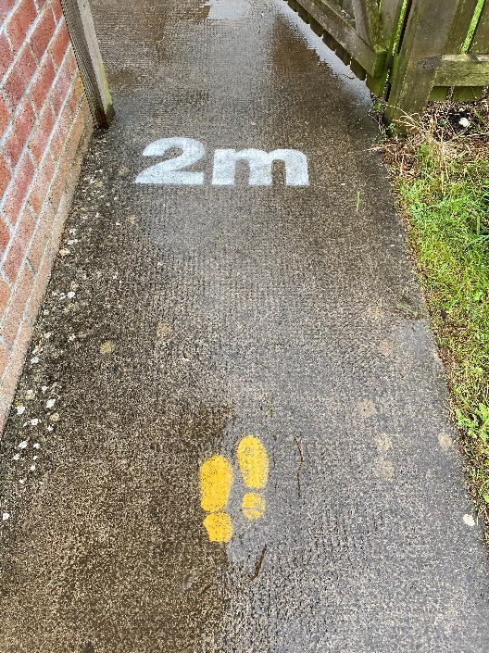
Practical Ideas For School Grounds
Hygiene and Cleaning, Handwashing and Equipment Cleaning

Slide 25
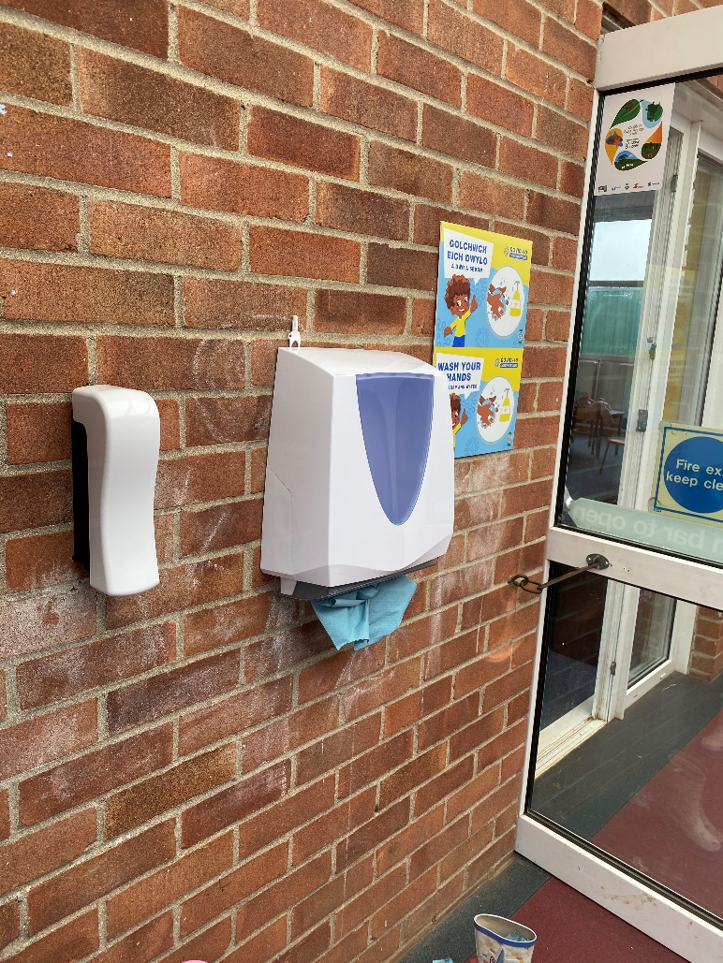
Handwashing in School Grounds
Handwashing outdoors will become an ongoing issue through the autumn.
The main challenge here is the number of handwashing stations needed, access by multiple class bubbles and protection from weather.
It is recommend a full sink and soap solutions, attached to buildings in multiple locations and likely with a cover.

Slide 26
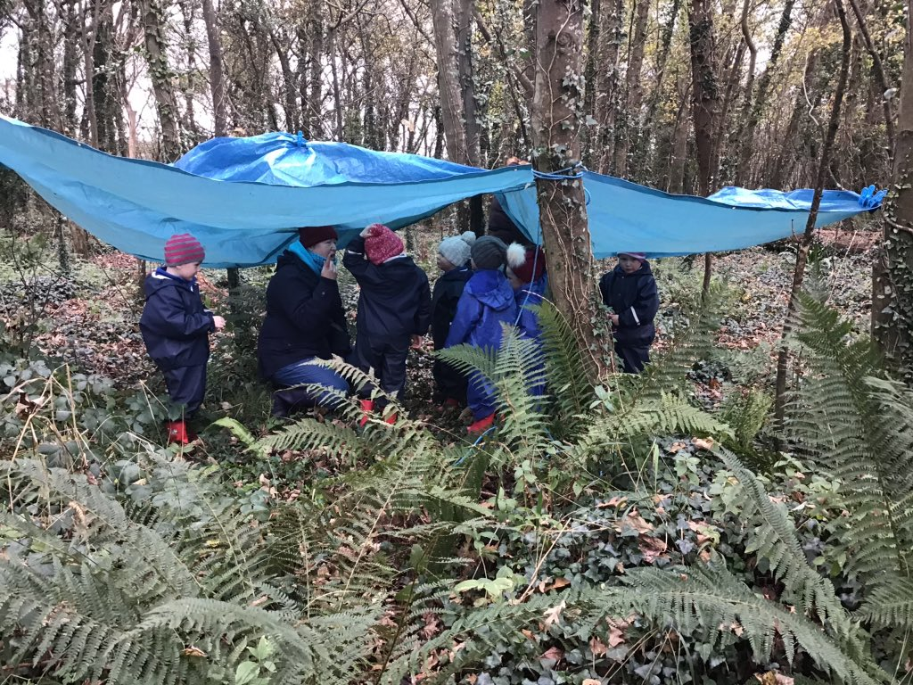
Washing loose parts play and sports equipment
Wiping, immersion, steam cleaning or 72-hour exclusion are the recommended processes for cleaning of play equipment, sports equipment, clipboards or loose parts.
Cleaning with a cloth is the same protocol as indoors, where desks, handles, seats etc will be wiped down with a suitable dilution of a cleaning fluid.
If possible fabrics such as tarpaulins or den building can be steam cleaned, as the carpets will be indoors at present.

Slide 27
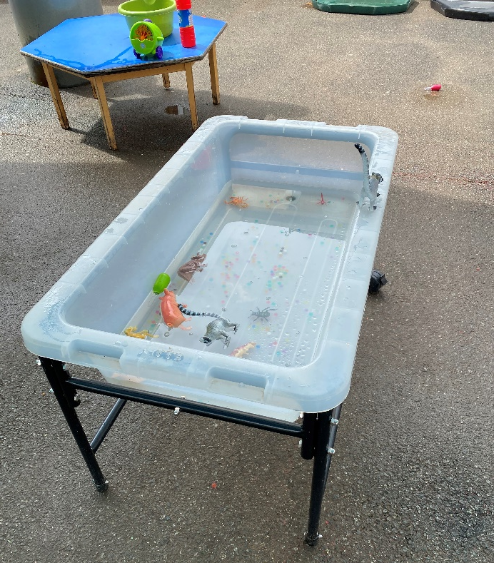
Washing loose parts play and sports equipment
‘Hard to clean’ items can be fully immersed and hung to dry.
Outdoor centres typically use a large blue barrel or sink, filled with a suitable dilution of a cleaning fluid. These are items such as ropes, hoops, plastic toys, tennis balls, fabric etc.
Disinfecting Fluid can be used to clean mouldy sand, applied by watering can and left to the air and sunlight for example.

Slide 28
That said, in line with WHO and UK Government there is a recognition that full cleaning is not possible, or needed, when outdoors in public spaces. We do recommend that you undertake a risk-benefit process and once again point out that the consensus is that outdoors is a safer place than indoors when starting your assessment.

Slide 29
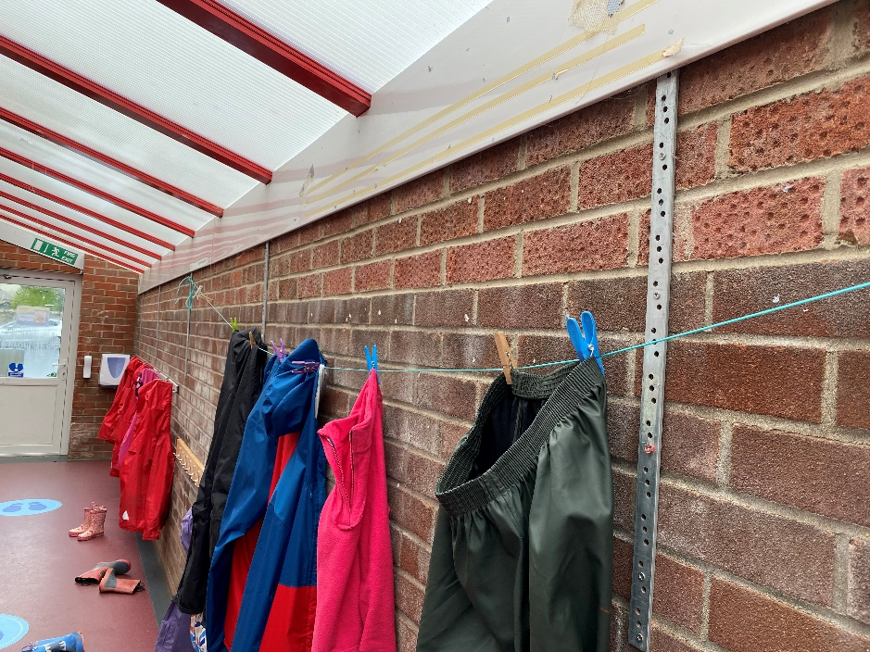
Waterproofs, wellies and personal equipment
Children should not share personal equipment such as clothes. Clothes should also be washed reasonably often.
An important point is that disinfectant will break down waterproofing, and therefore pure soapflakes should be used only.
Children’s equipment, from coats to pencils, are best stored in their own bags or boxes, ready for pupils to access themselves. This storage is separate to outdoor play and sports equipment storage.

Slide 30
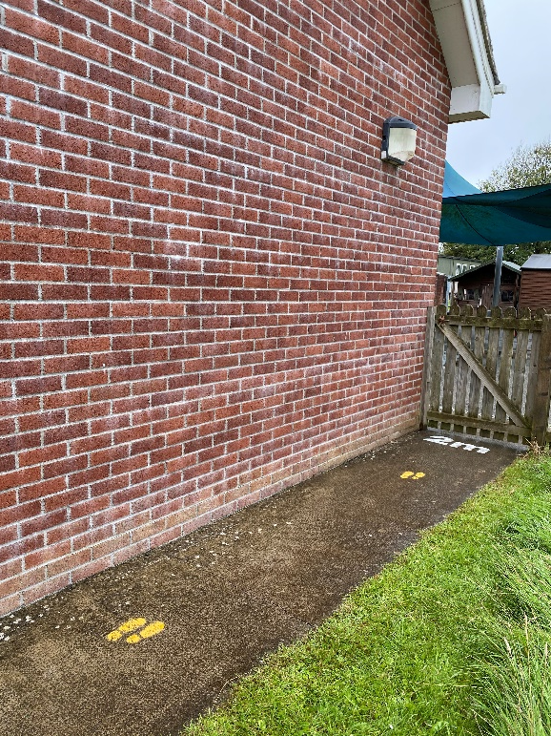
Pinch-points, Building Entrances and Bubble Management
Utilise as many of the areas of the school grounds for play and learning as possible. Implementing a rotation if necessary to ensure that as many areas as possible are being used at any given time.
Maximise as many entrances to the building as possible for pupils, taking account of their route around building and grounds.
Queuing areas or entrances should have the handwashing available before pupils enter the building.

Slide 31
