Slide 1





Case Study: Croesgoch Community School
Pembrokeshire Outdoor Schools (PODS)

Slide 2
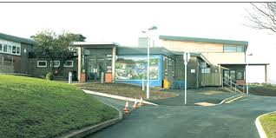
Ysgol Gyumunedol Croesgoch
Croesgoch Community School
Background Info:
Ysgol Croesgoch is a rural primary school located between St. Davids and Fishguard.
Ysgol Croesgoch is situated in the small village of Croesgoch which has views towards Porthgain and the coast.
The school was built in 1966 and fully refurbished and extended in 2010.
The catchment area is comparatively wide. As well as Croesgoch itself, pupils come from local villages, hamlets and farms over a wide radius.
There are just over 100 pupils on roll, including part-time nursery pupils. The school has four mixed-age classes.

Slide 3
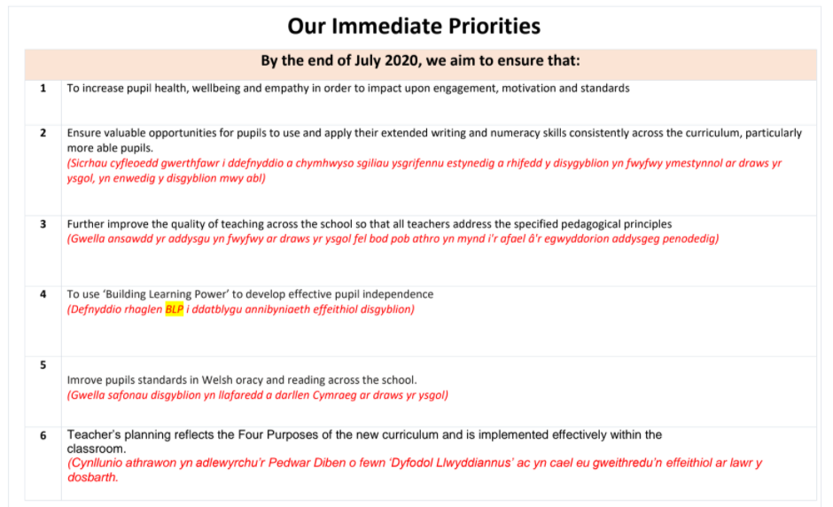
School Development Plan

Slide 4
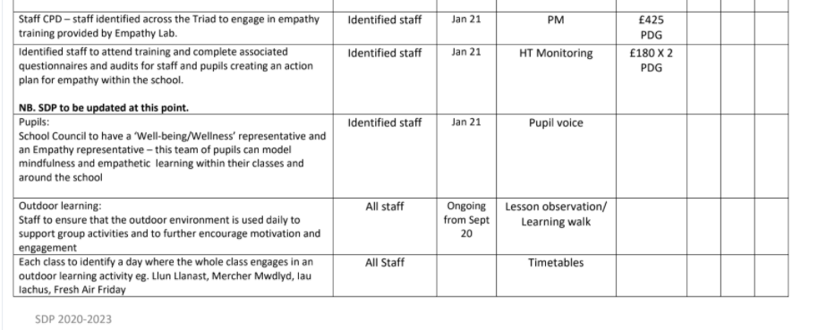
School Development Plan

Slide 5
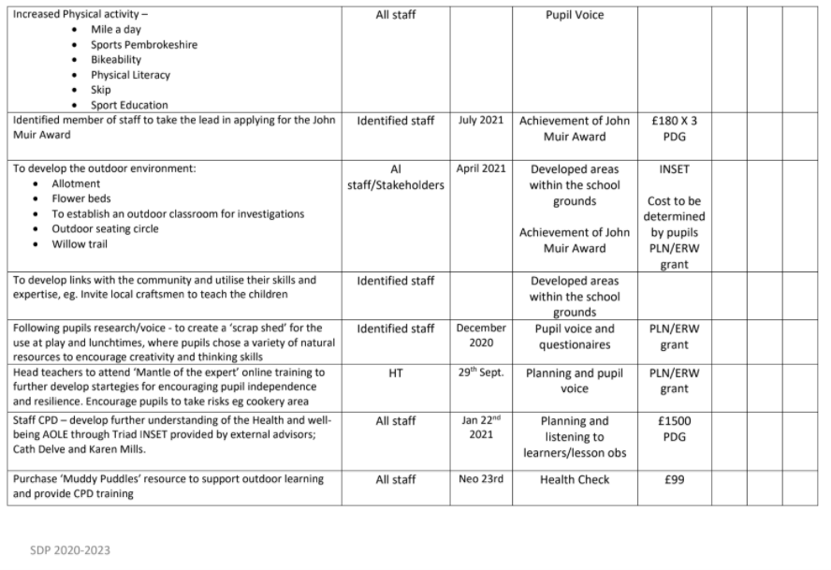
School Development Plan

Slide 6
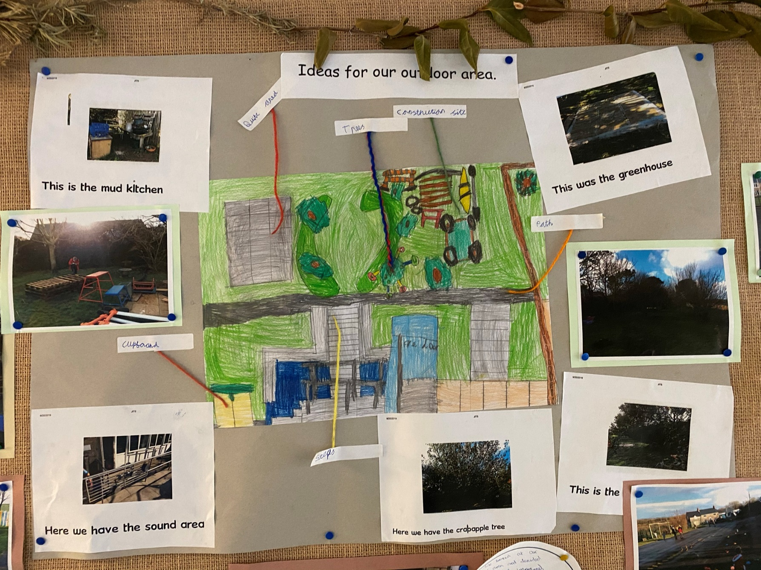
Student Input

Slide 7
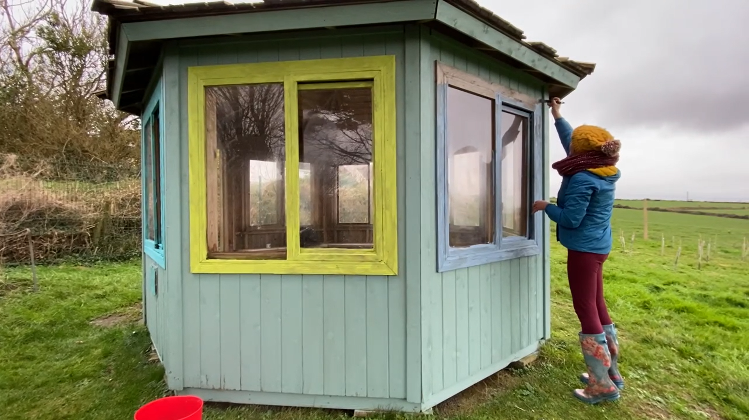
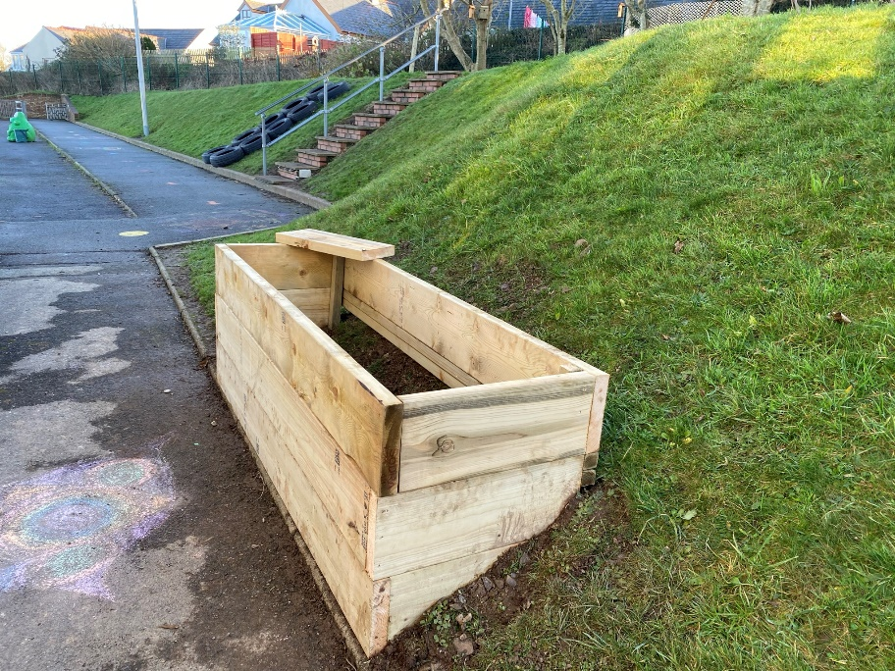
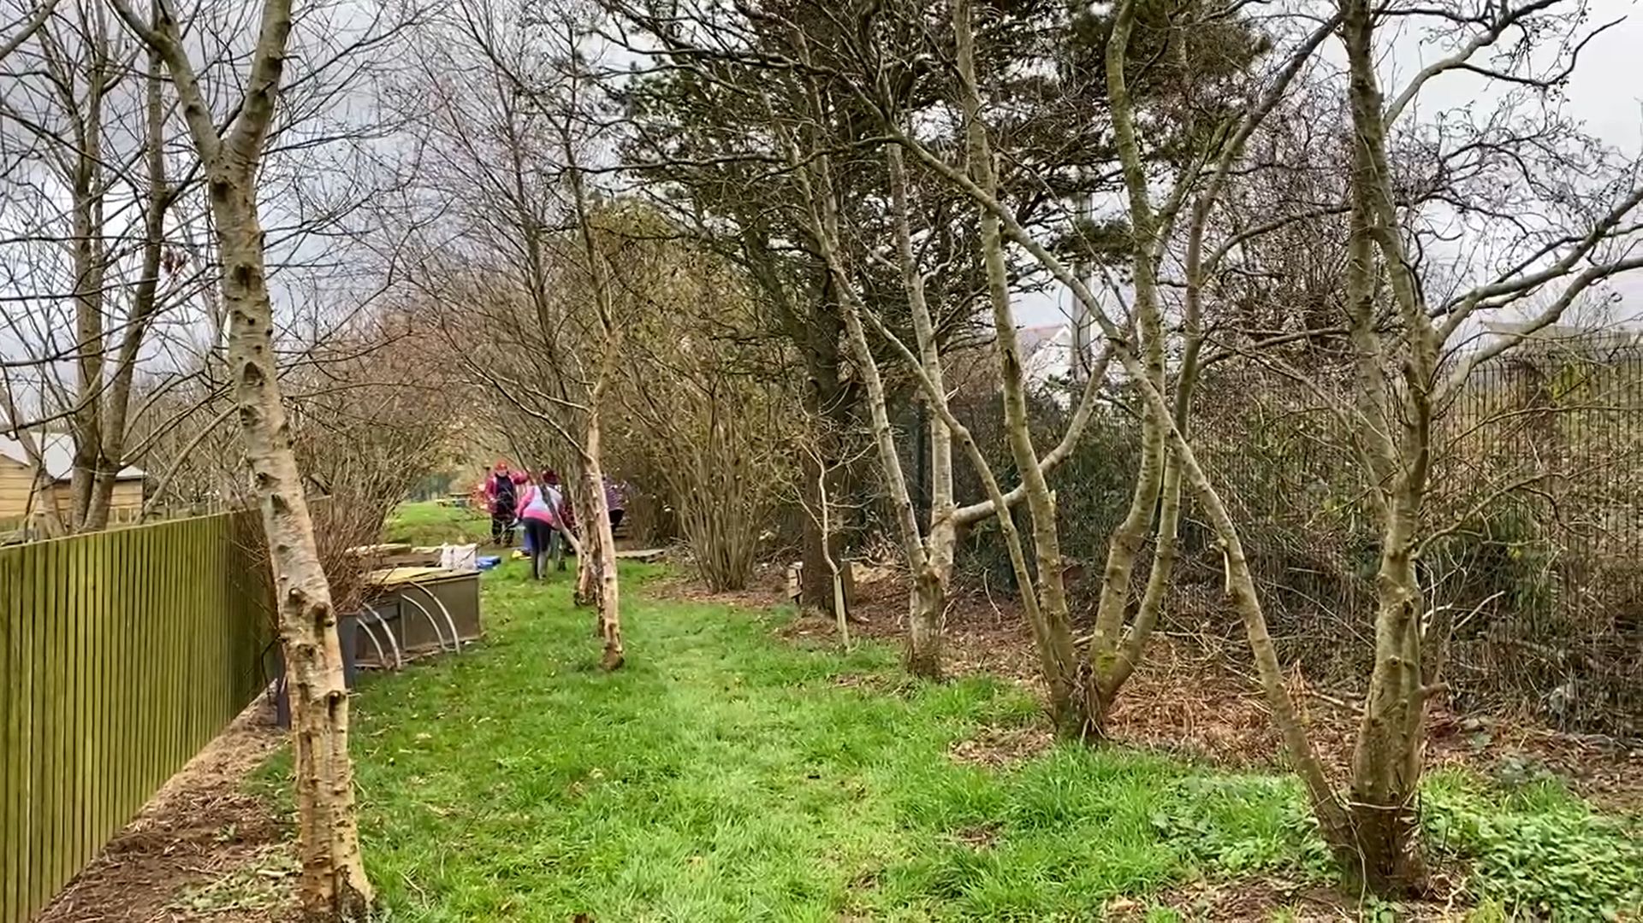
School Grounds Developments

Slide 8
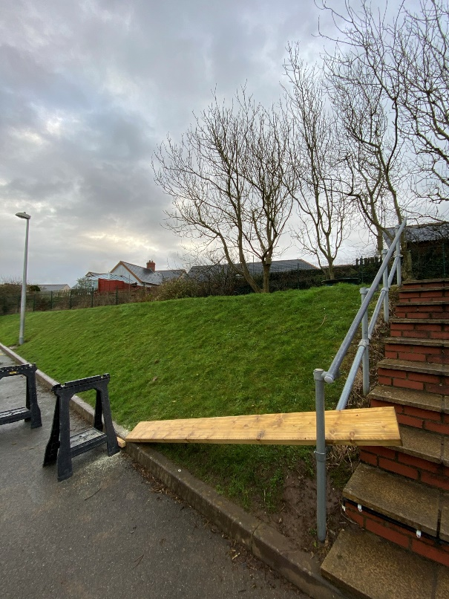
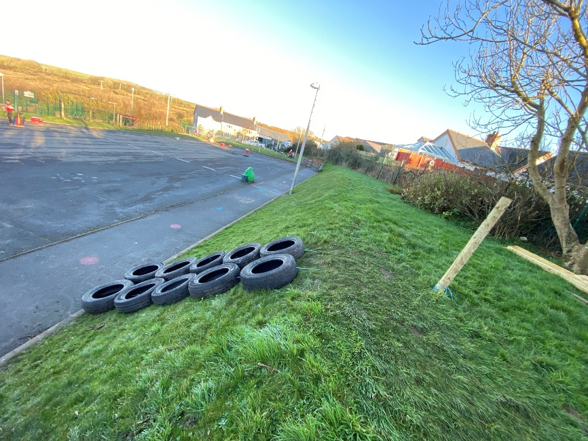
School Grounds Developments

Slide 9
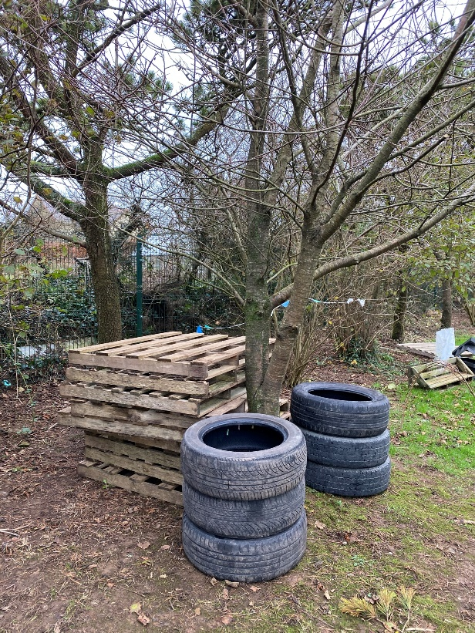
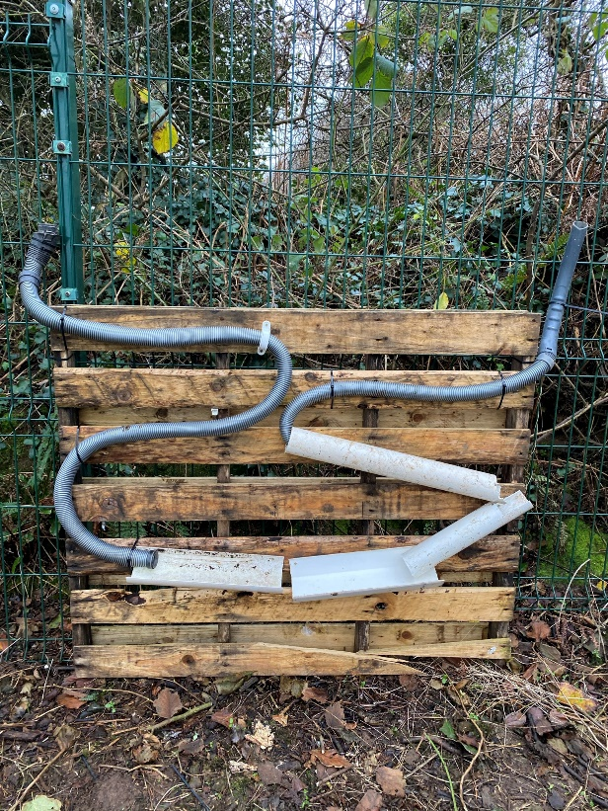
Recycled Materials

Slide 10
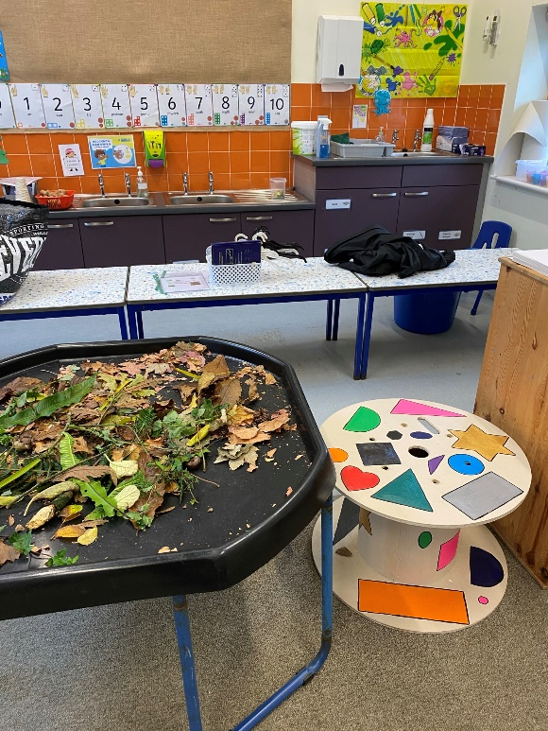
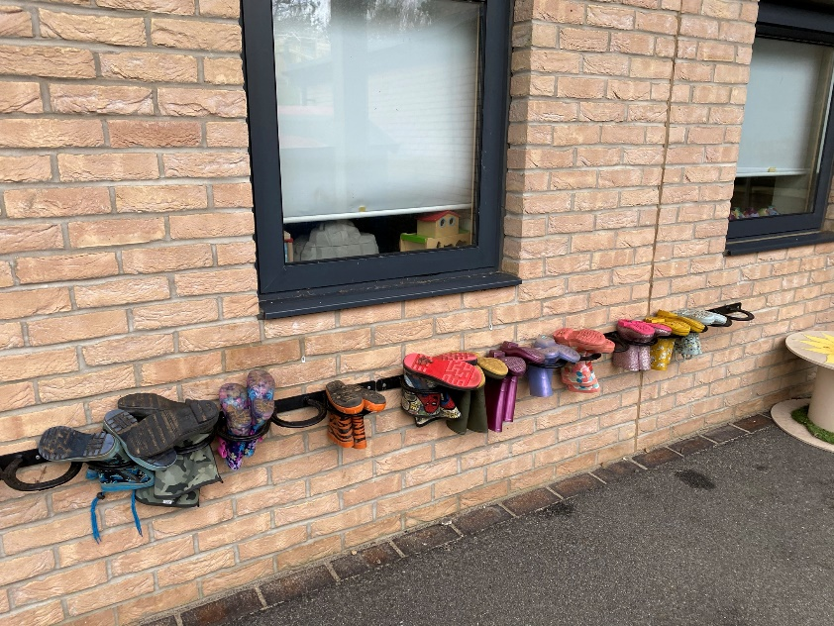
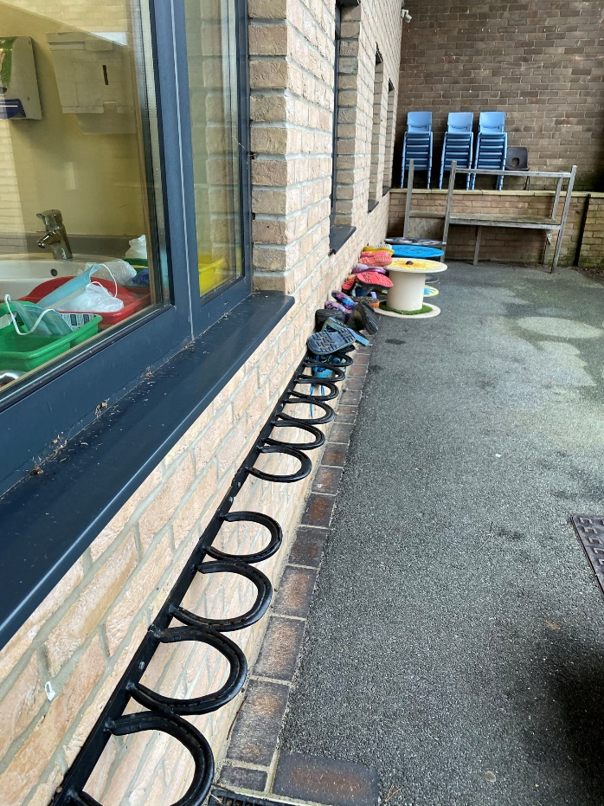
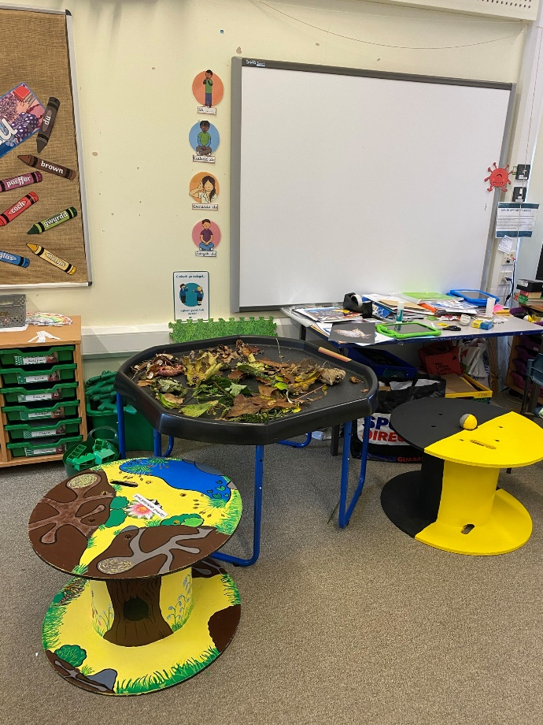
Recycled Materials

Slide 11
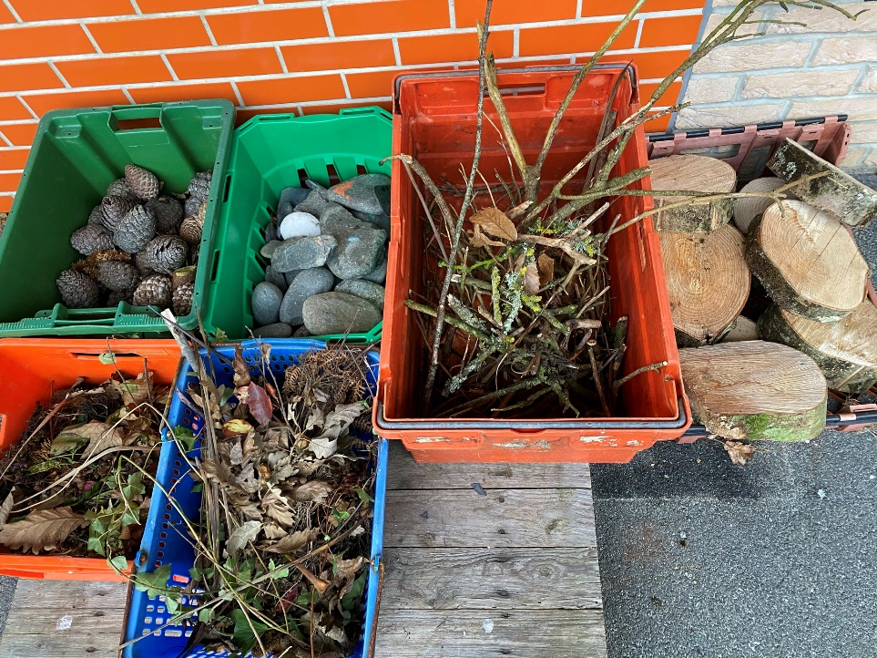
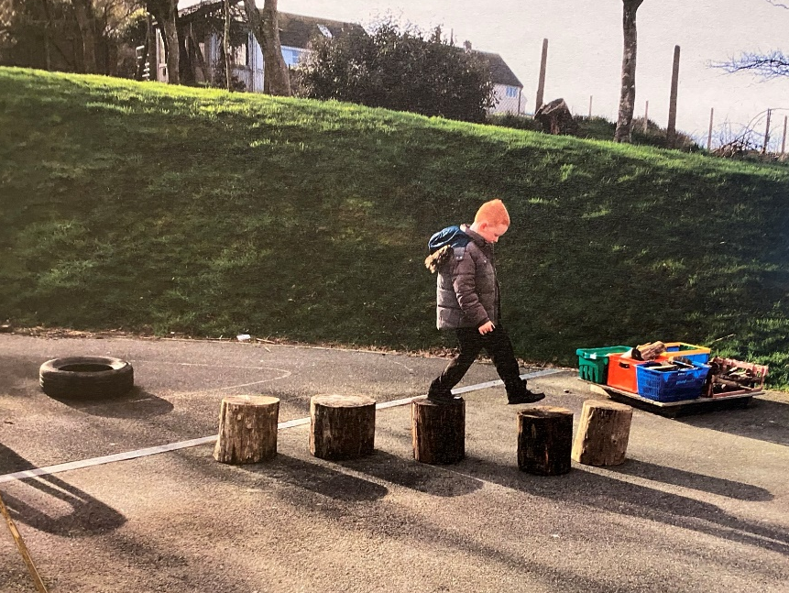
Loose Parts

Slide 12
Outdoor Learning at Croesgoch
Whole School approach to Outdoor Learning.
Aims: Engage students, build resilience and independence
Students cover Mathematics and Languages in the morning and in the afternoon they have ‘mission’ time.
The ‘missions’ include activities for the different Areas of Learning.
Students choose the order they complete their missions.
Students choose where they complete their ‘missions’ inside or outside the classroom.

Slide 13
  ‘Missions’

Slide 14
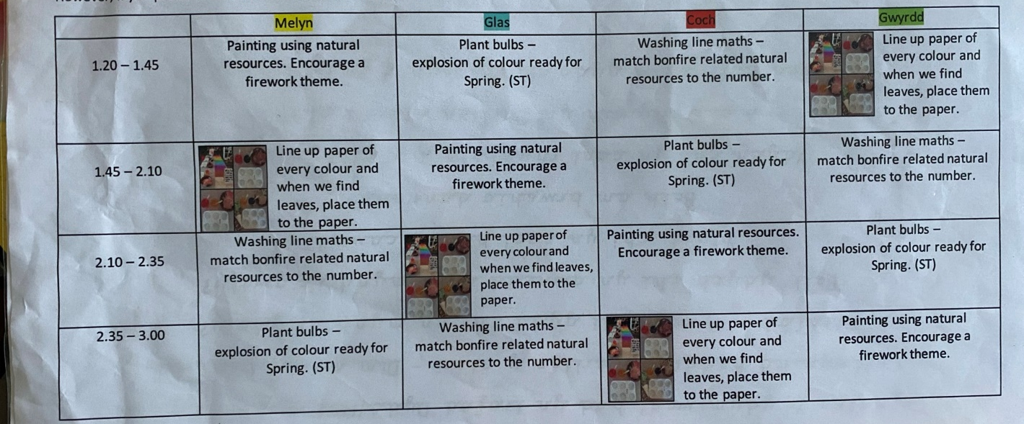
Example Missions – Foundation Phase

Slide 15
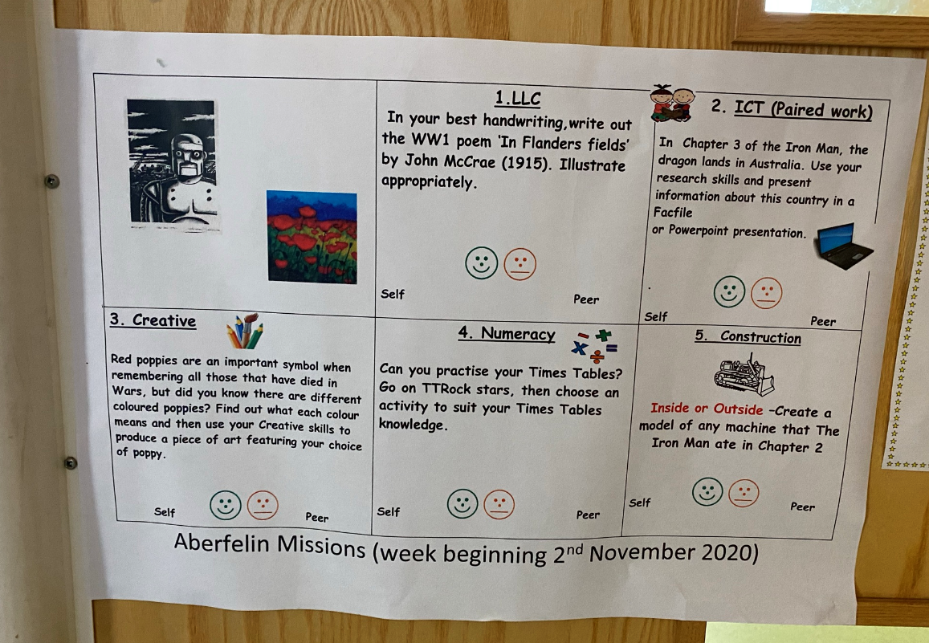
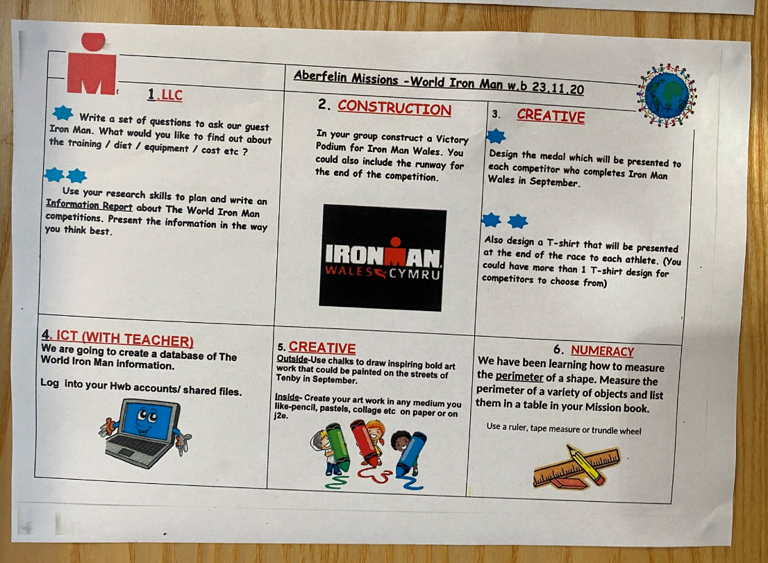
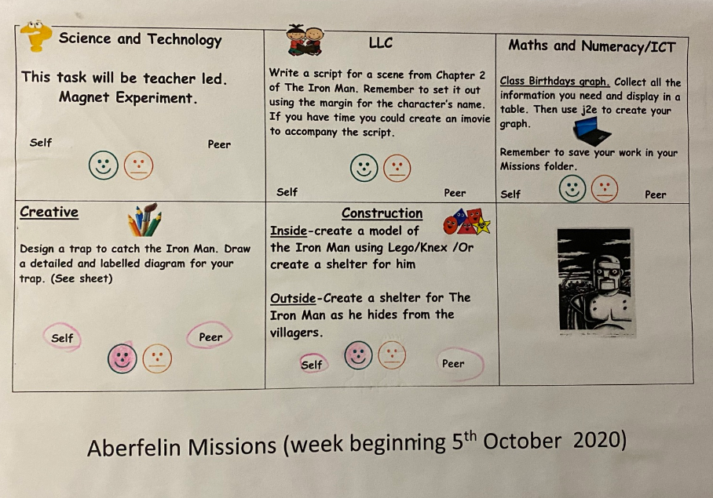
Example Missions – Year 3 and 4

Slide 16
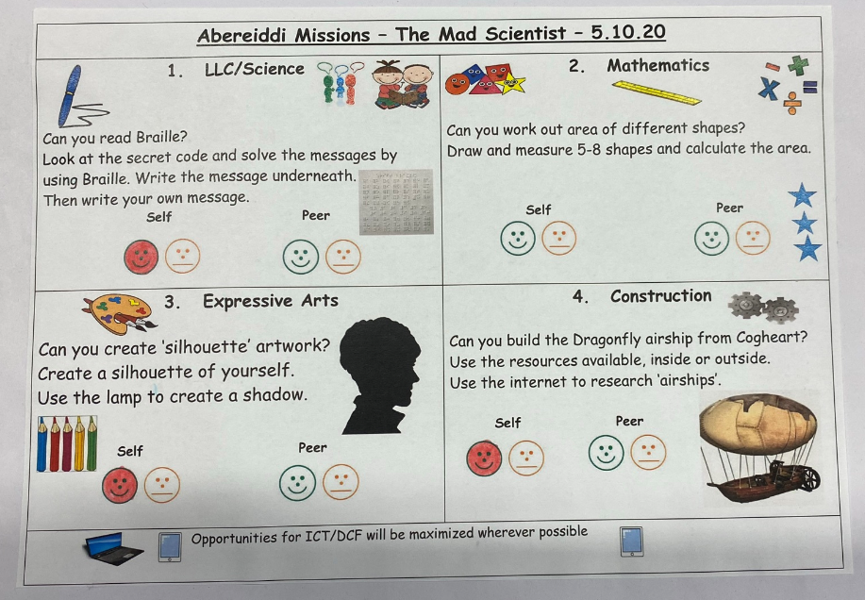
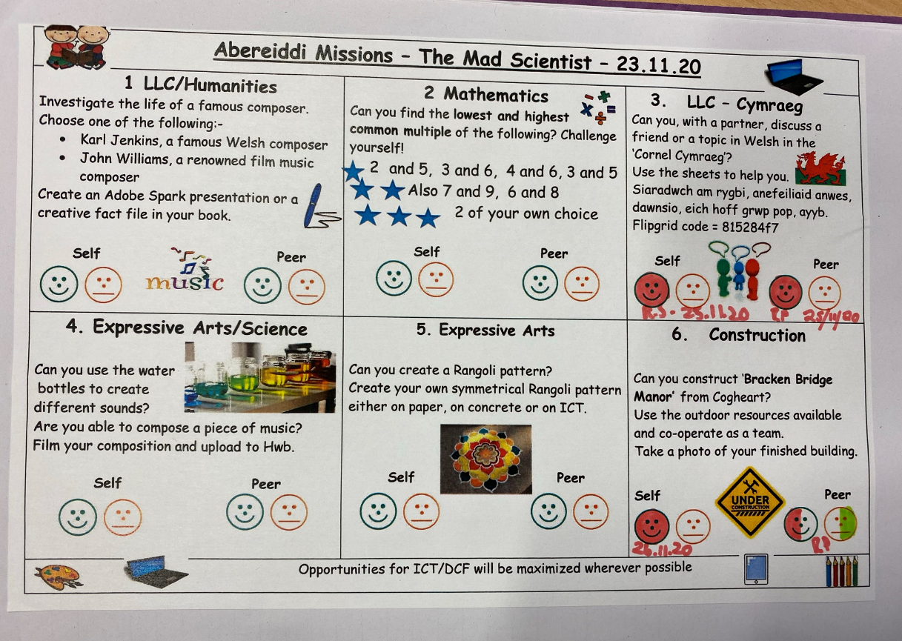
Example Missions – Year 5 and 6

Slide 17
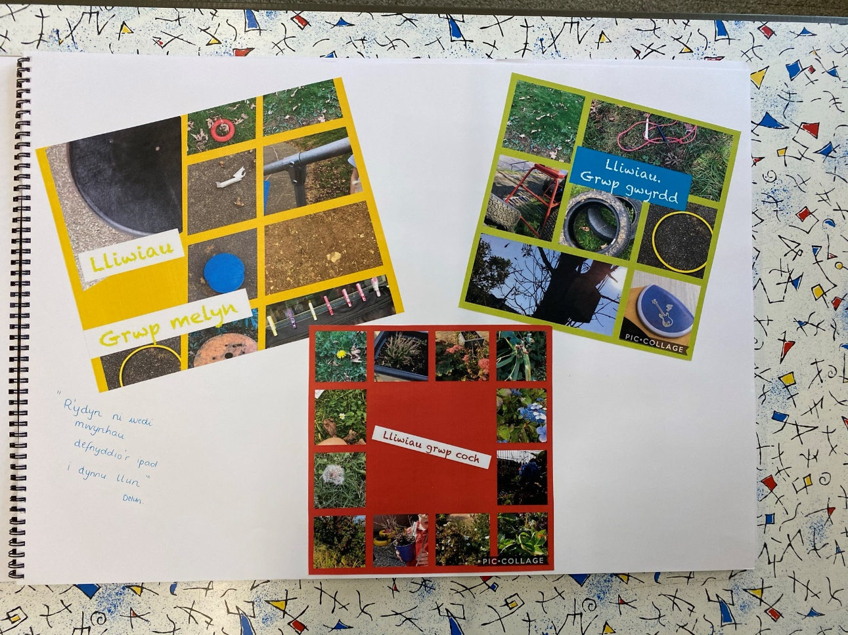
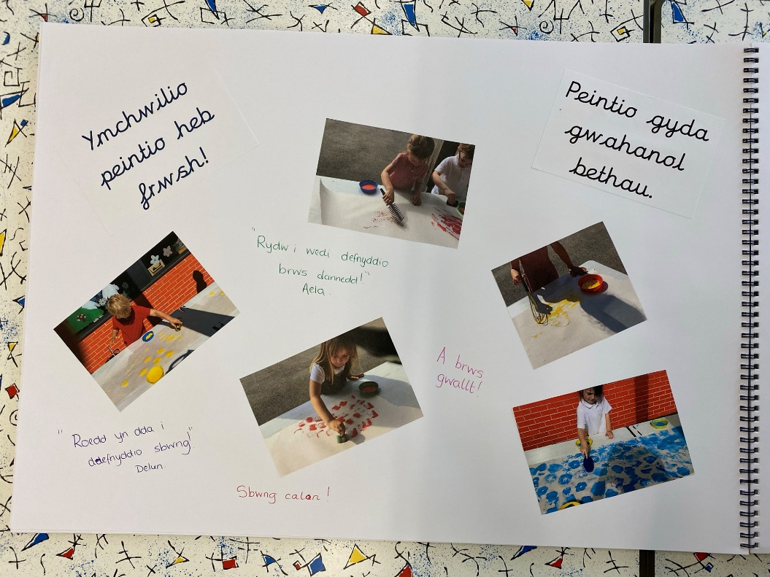
Evidencing Outdoor Learning

Slide 18
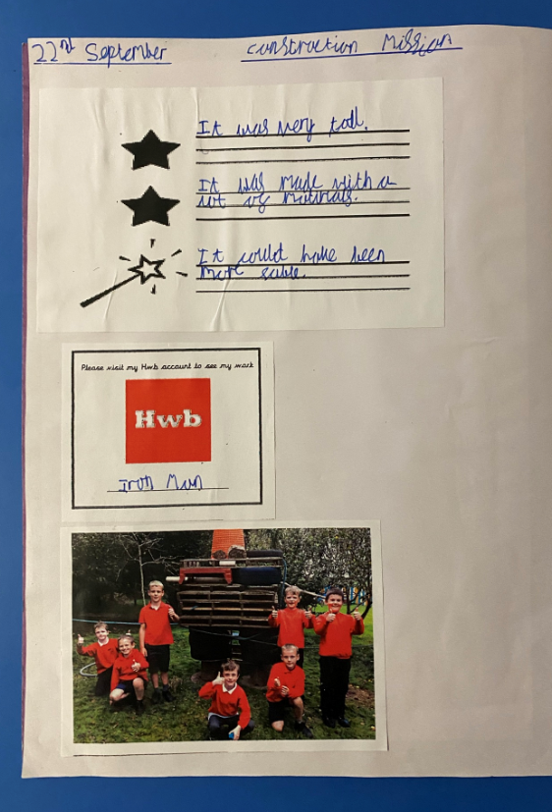
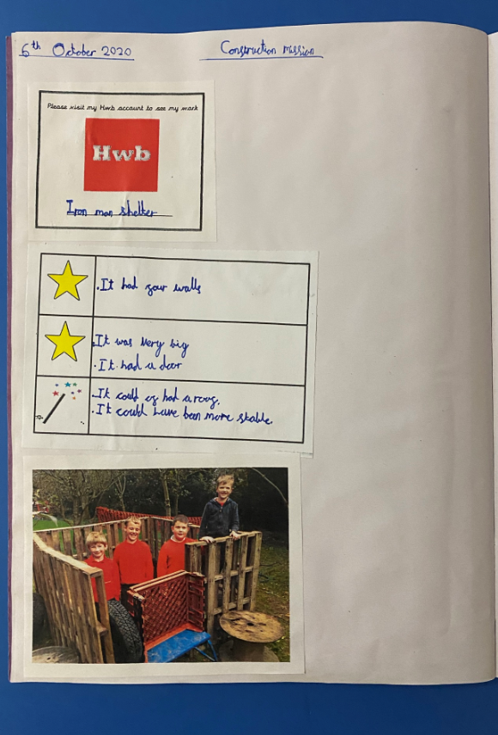
Evidencing Outdoor Learning

Slide 19
Diolch yn fawr iawn i’r holl staff a myfyrwyr or ysgolion a gymerodd ran!
Thank you very much to all the staff and students of the schools involved!

