Slide 1
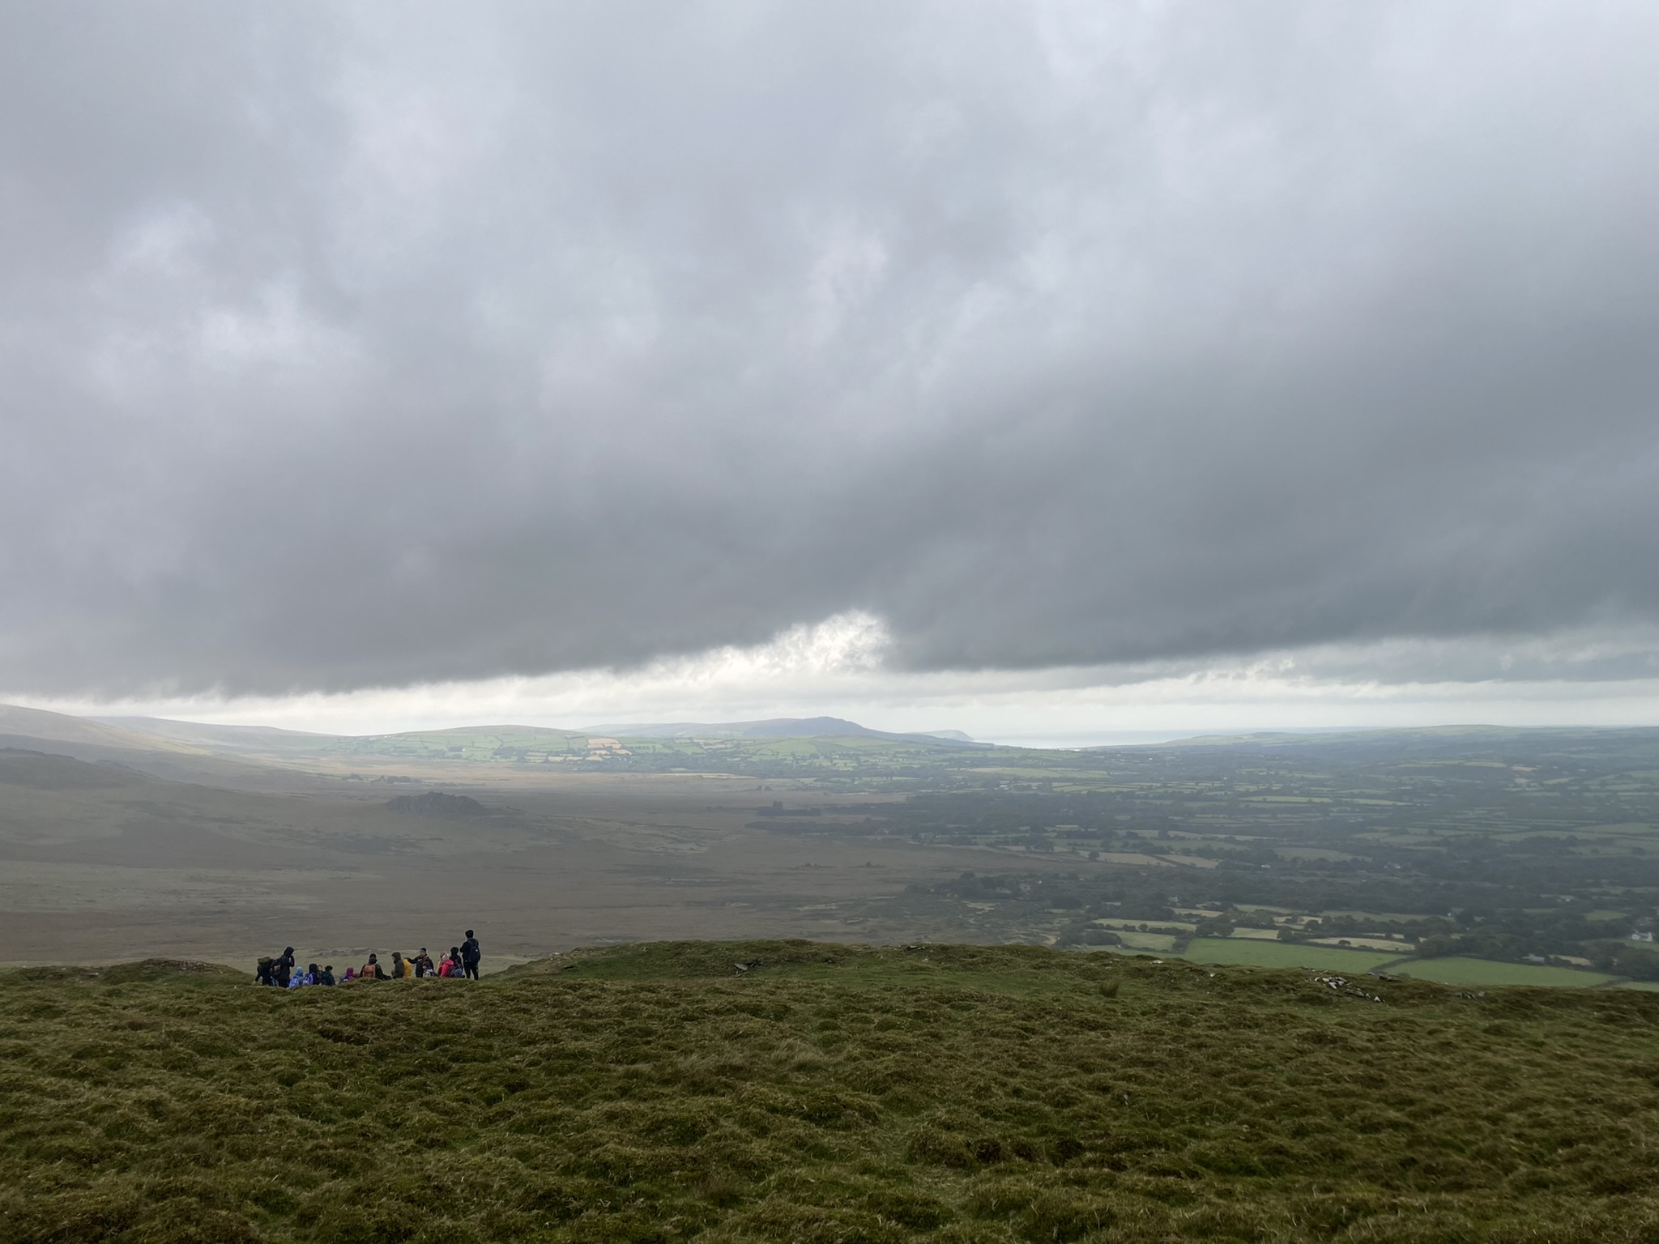
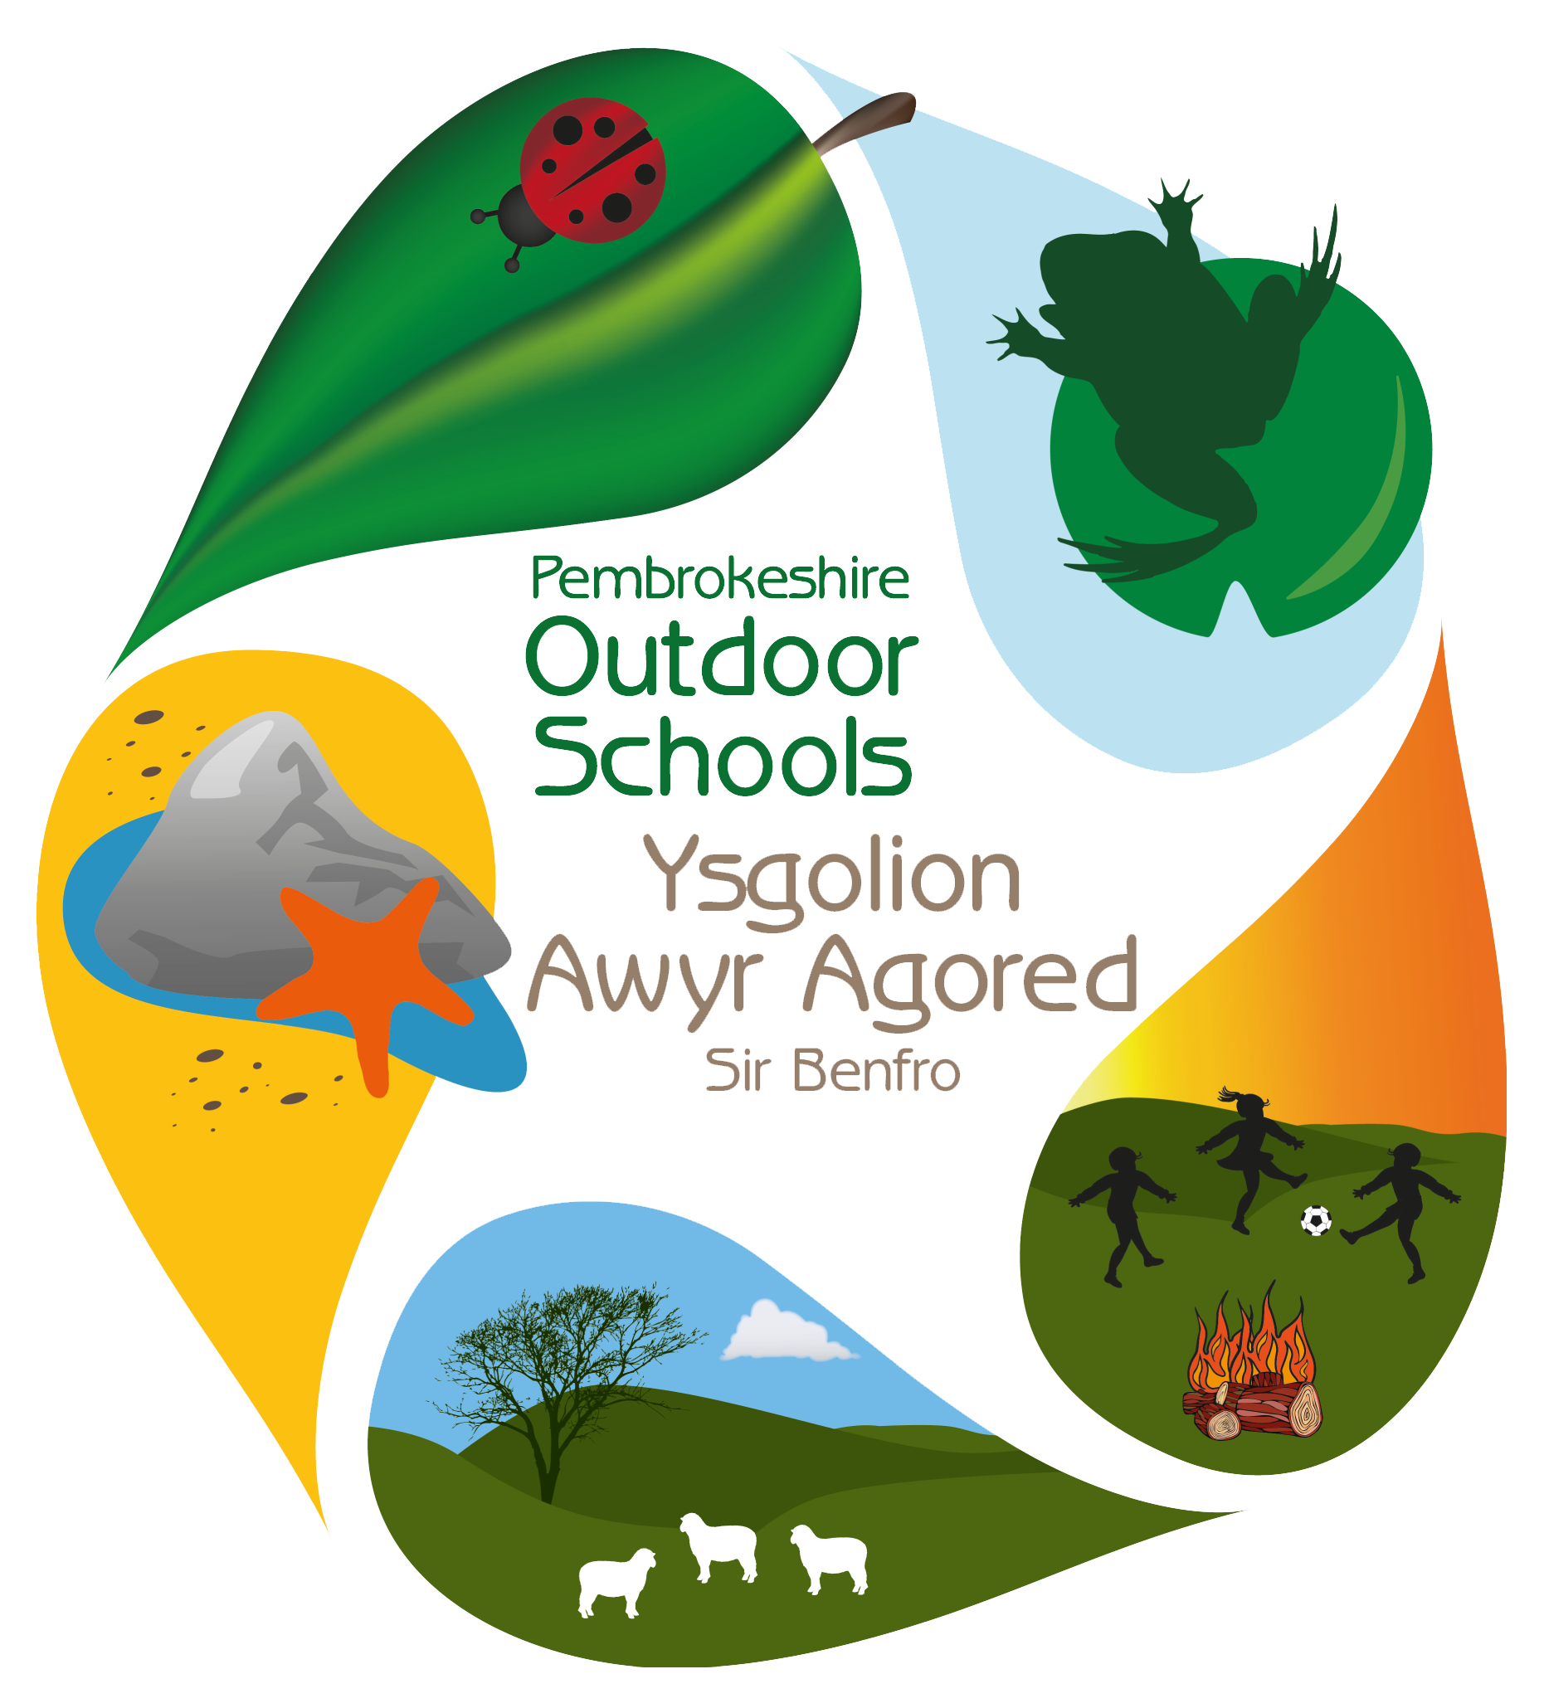

Neyland Community School
Ysgol Gymunedol Neyland

Slide 2


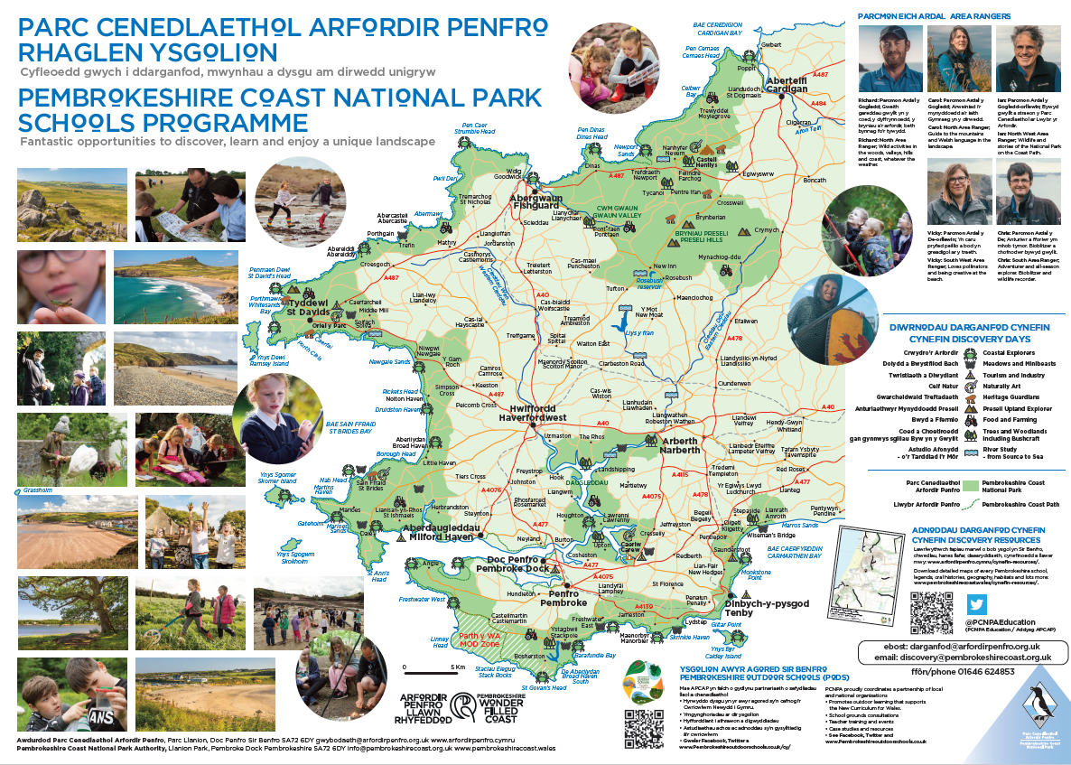
Pembrokeshire Coast National Park (PCNPA)
Education Programme

Slide 3
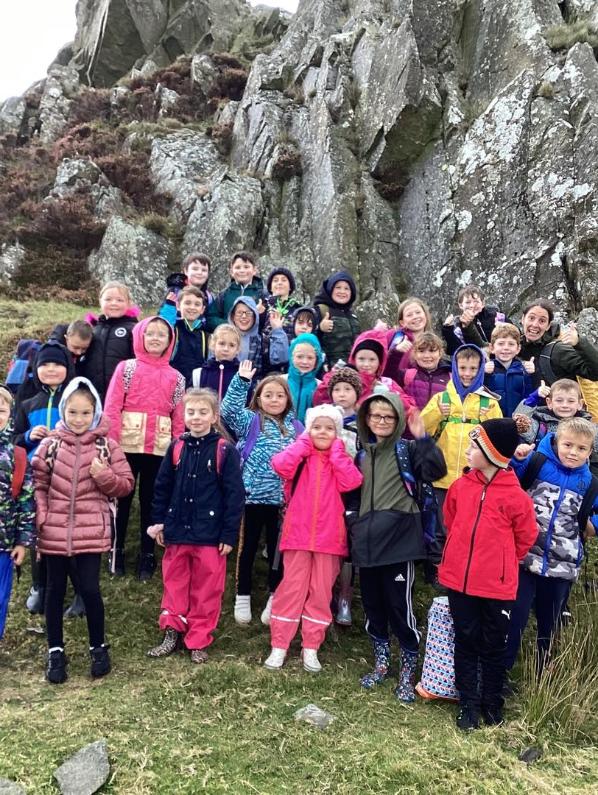
Neyland School
Year 3/4 Class
2 classes
66 children
Curriculum Theme 'Life on Land’

Slide 4
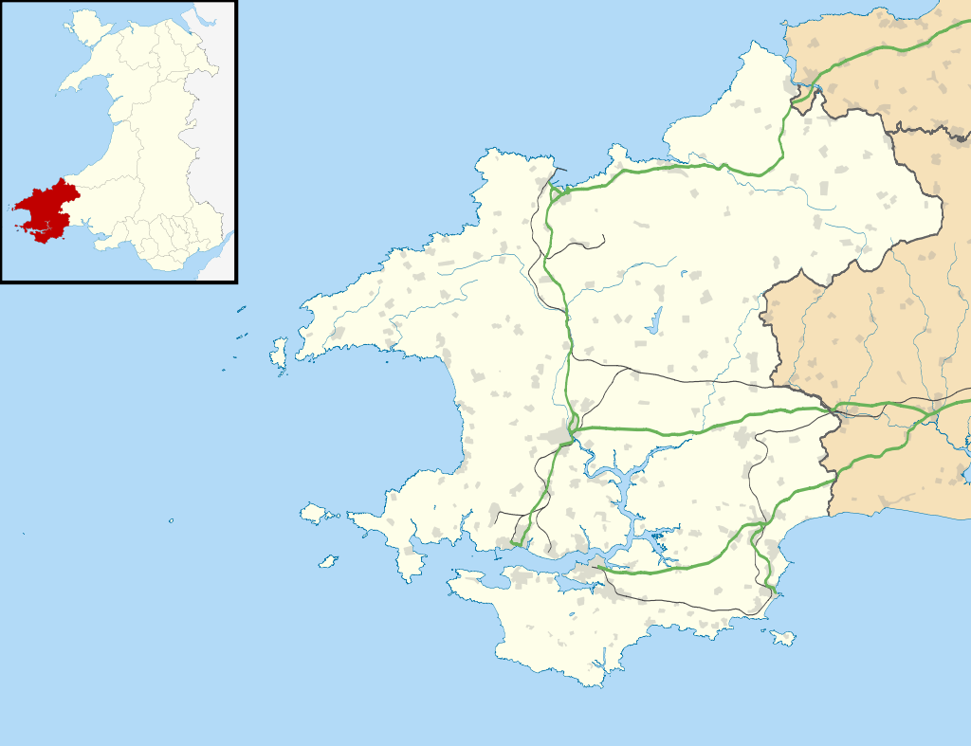

Foel Drygarn
Location: 2km West of Crymych, Wales
Coordinates: 51°58′14″N 4°41′1″W
Height: 363m
OS grid reference: SN 158 336
Type: Hillfort
Area: 1.2 hectares (3.0 acres)
History
Periods : Bronze Age
Iron Age

Slide 5
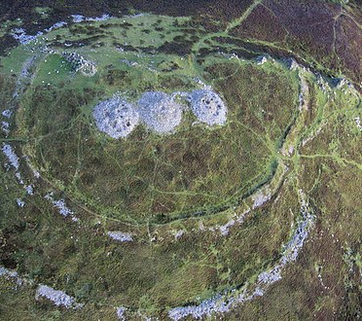
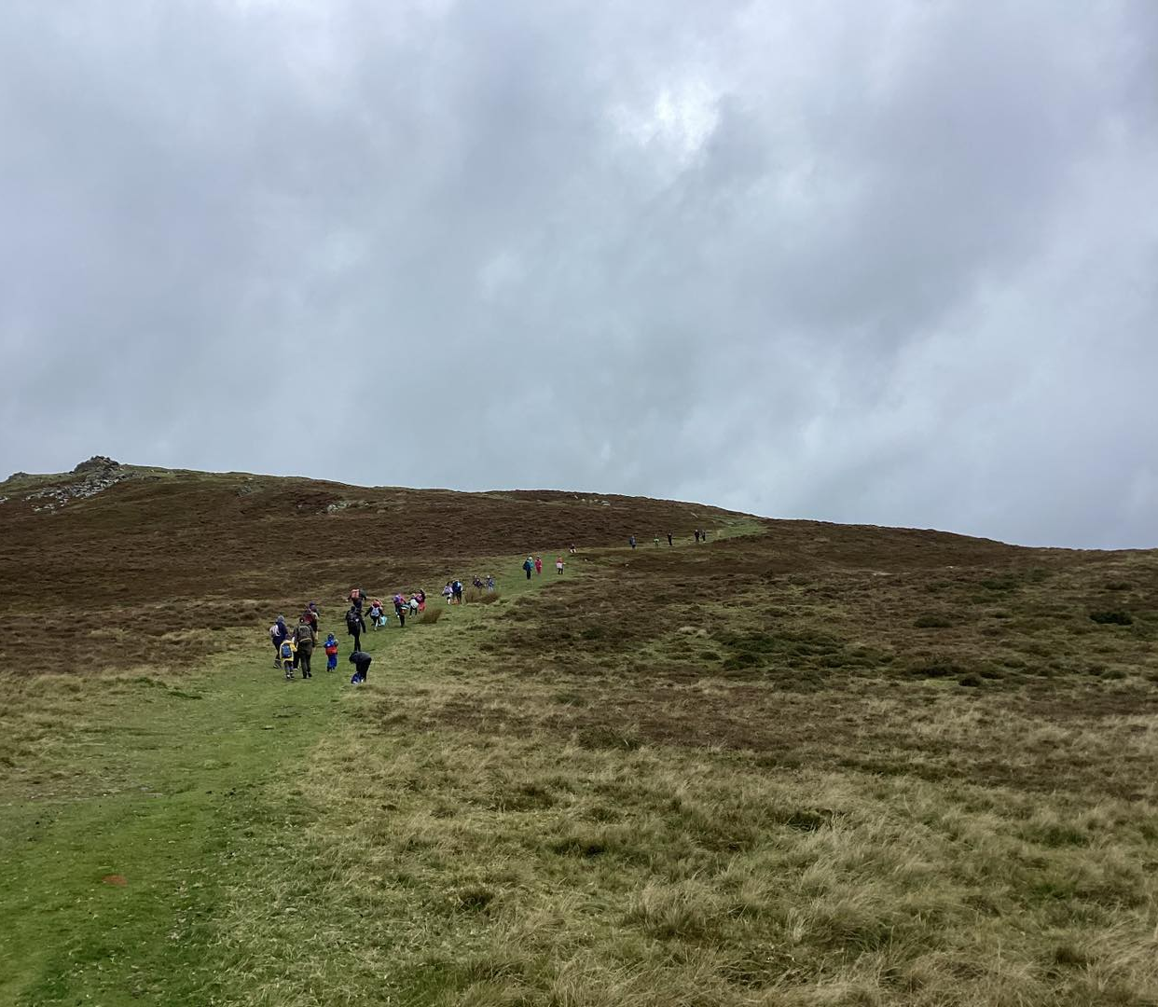
Foel Drygarn Hill Fort

Slide 6
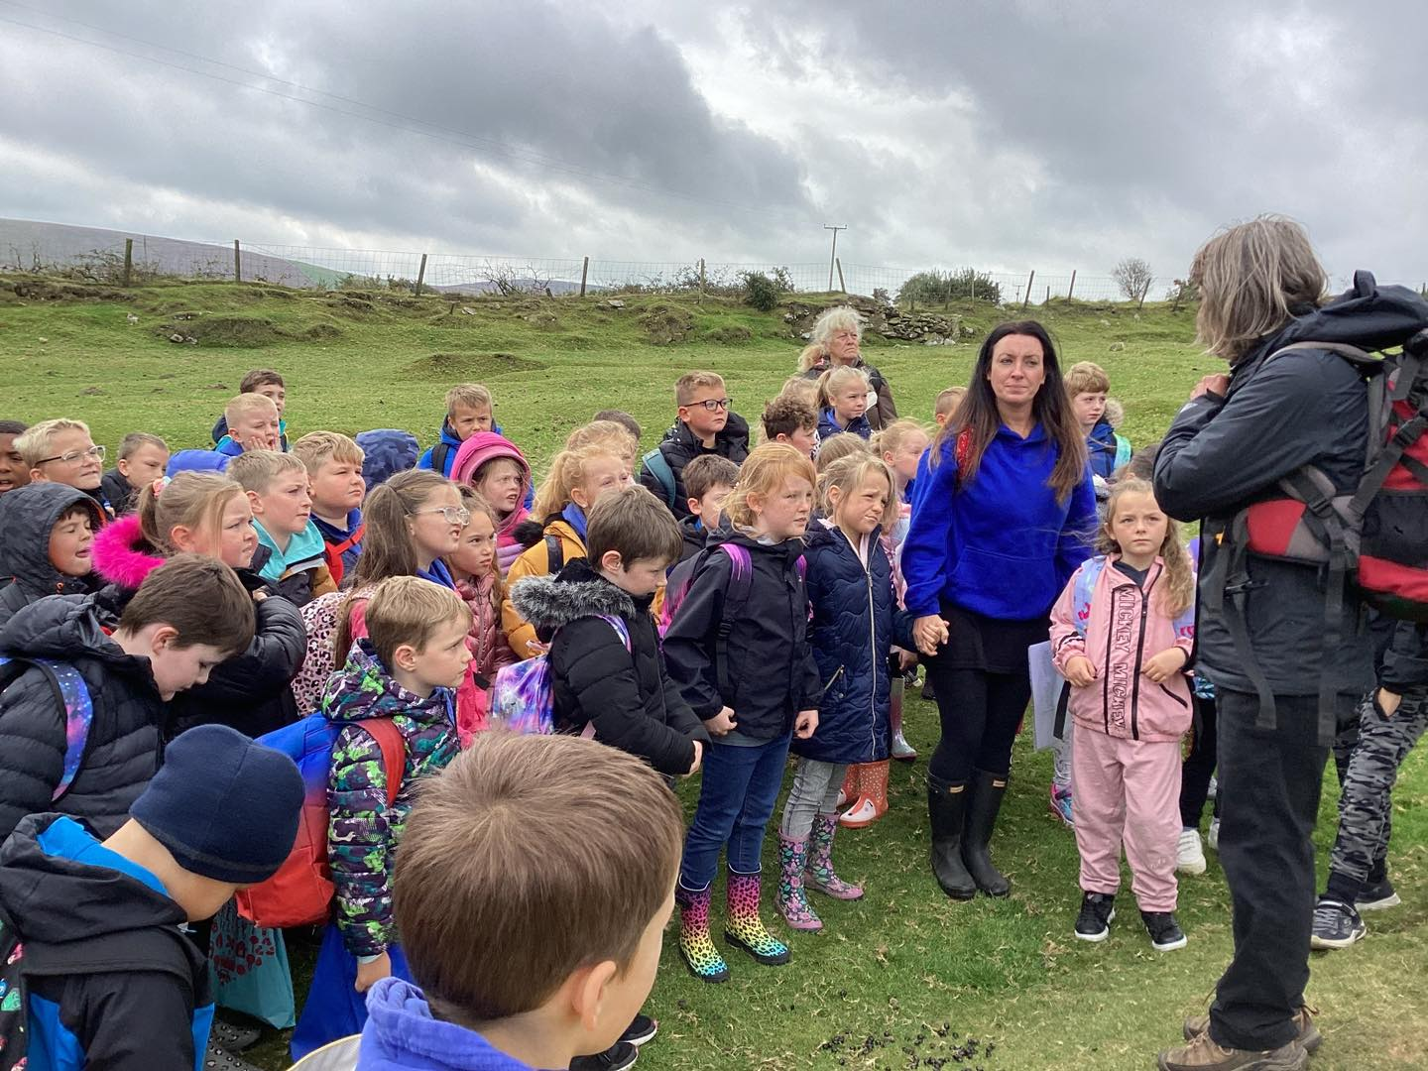
Links to the Curriculum
Iron Age
Prehistoric life
Landscape
Farming/Agriculture
Development in Pembrokeshire

Slide 7
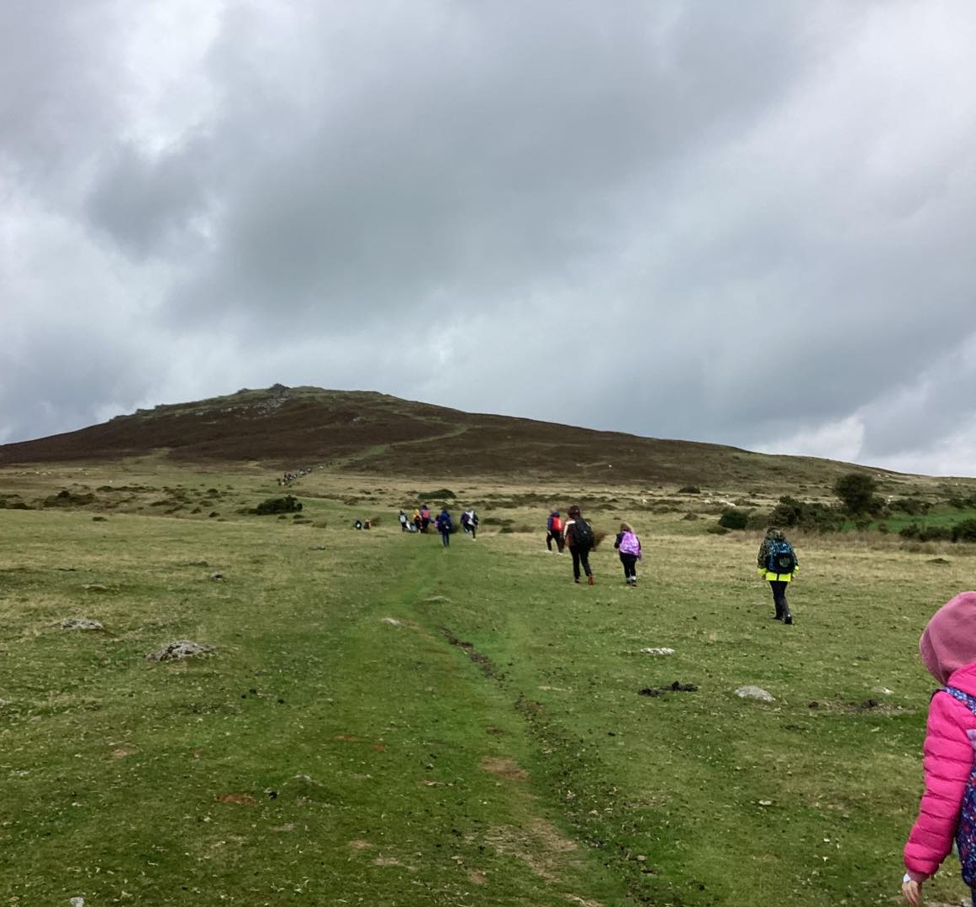
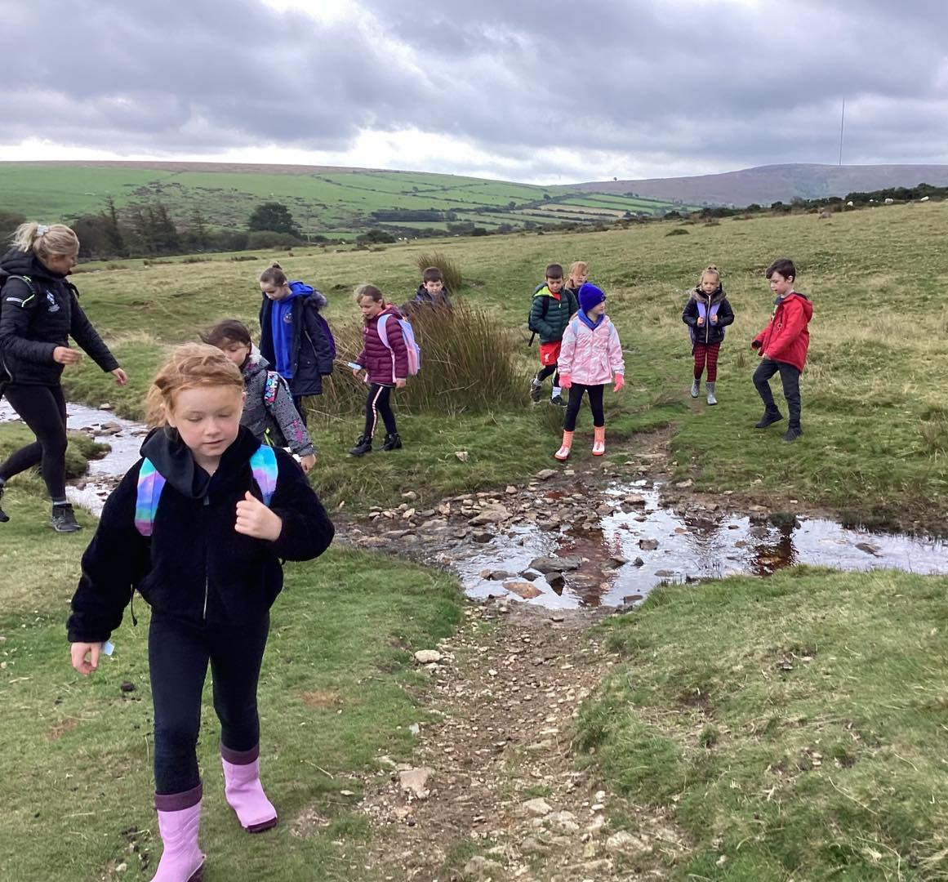
The Climb!

Slide 8
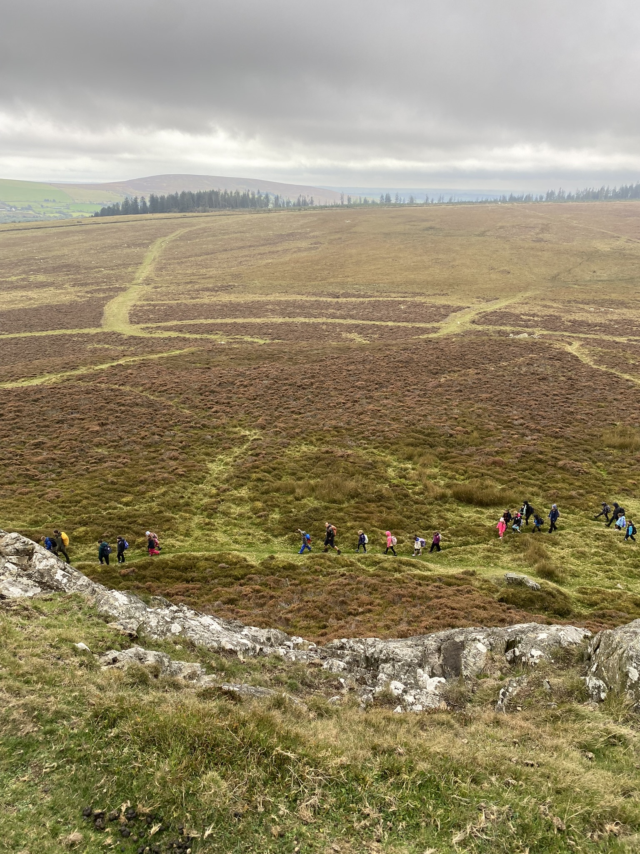
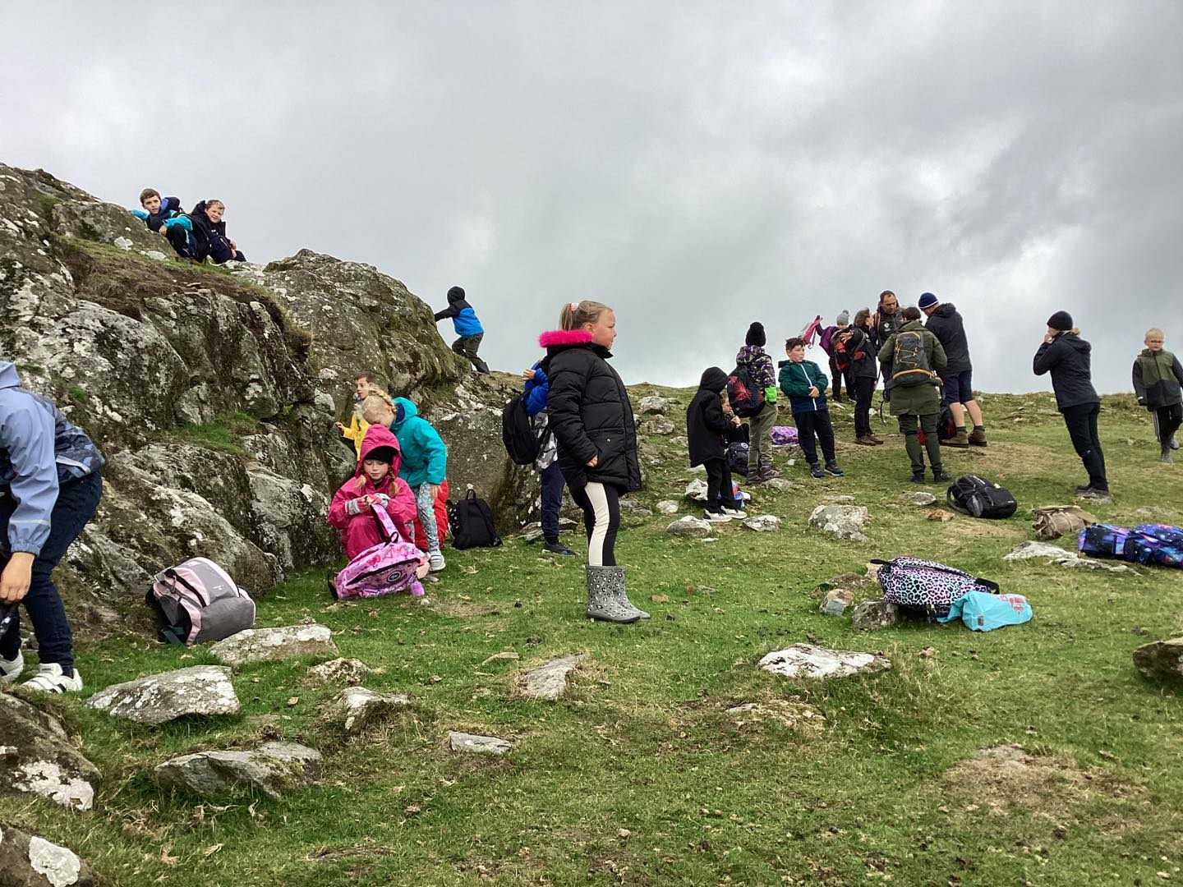
The views of the landscape

Slide 9
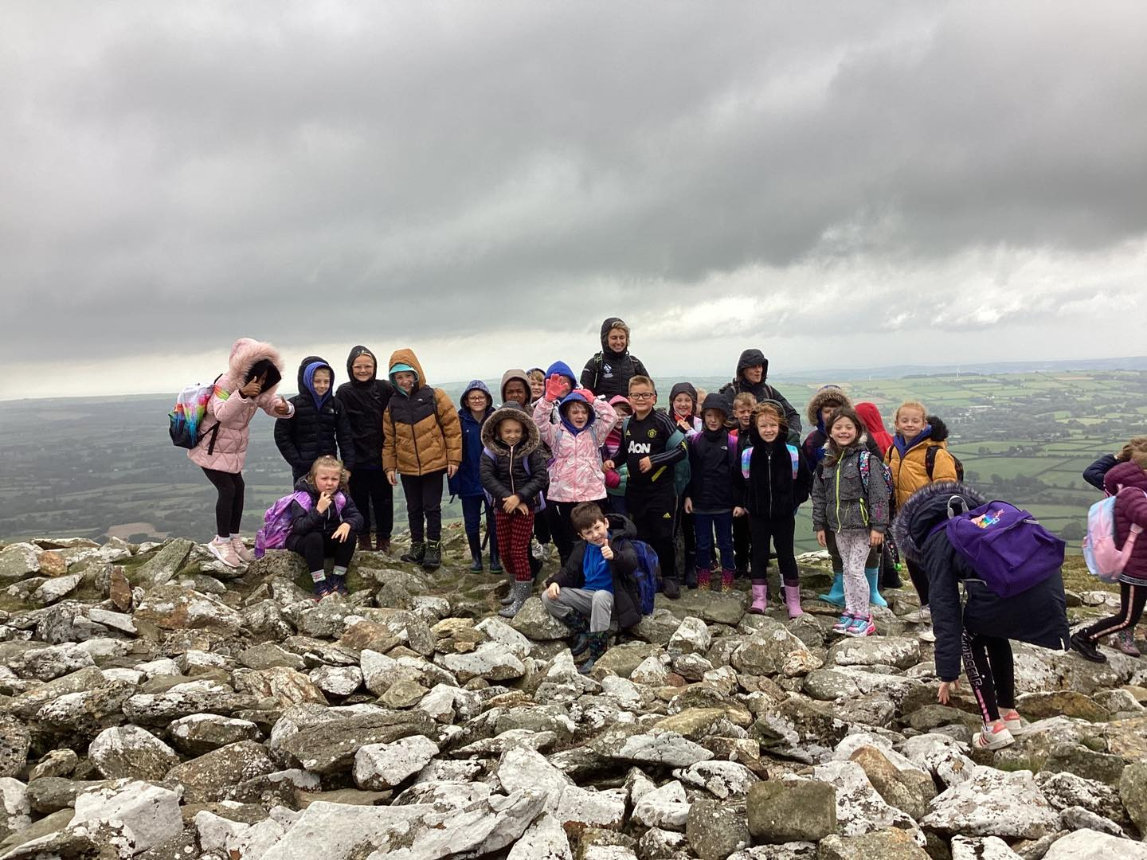
The top! Foel Drygarn, 363m
Well Done Year 3 and 4! Fantastic Achievement!

Slide 10
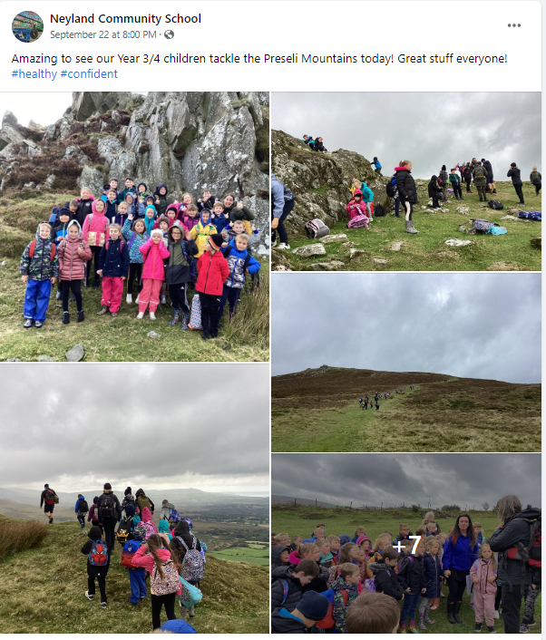

Facebook Post

