Slide 1
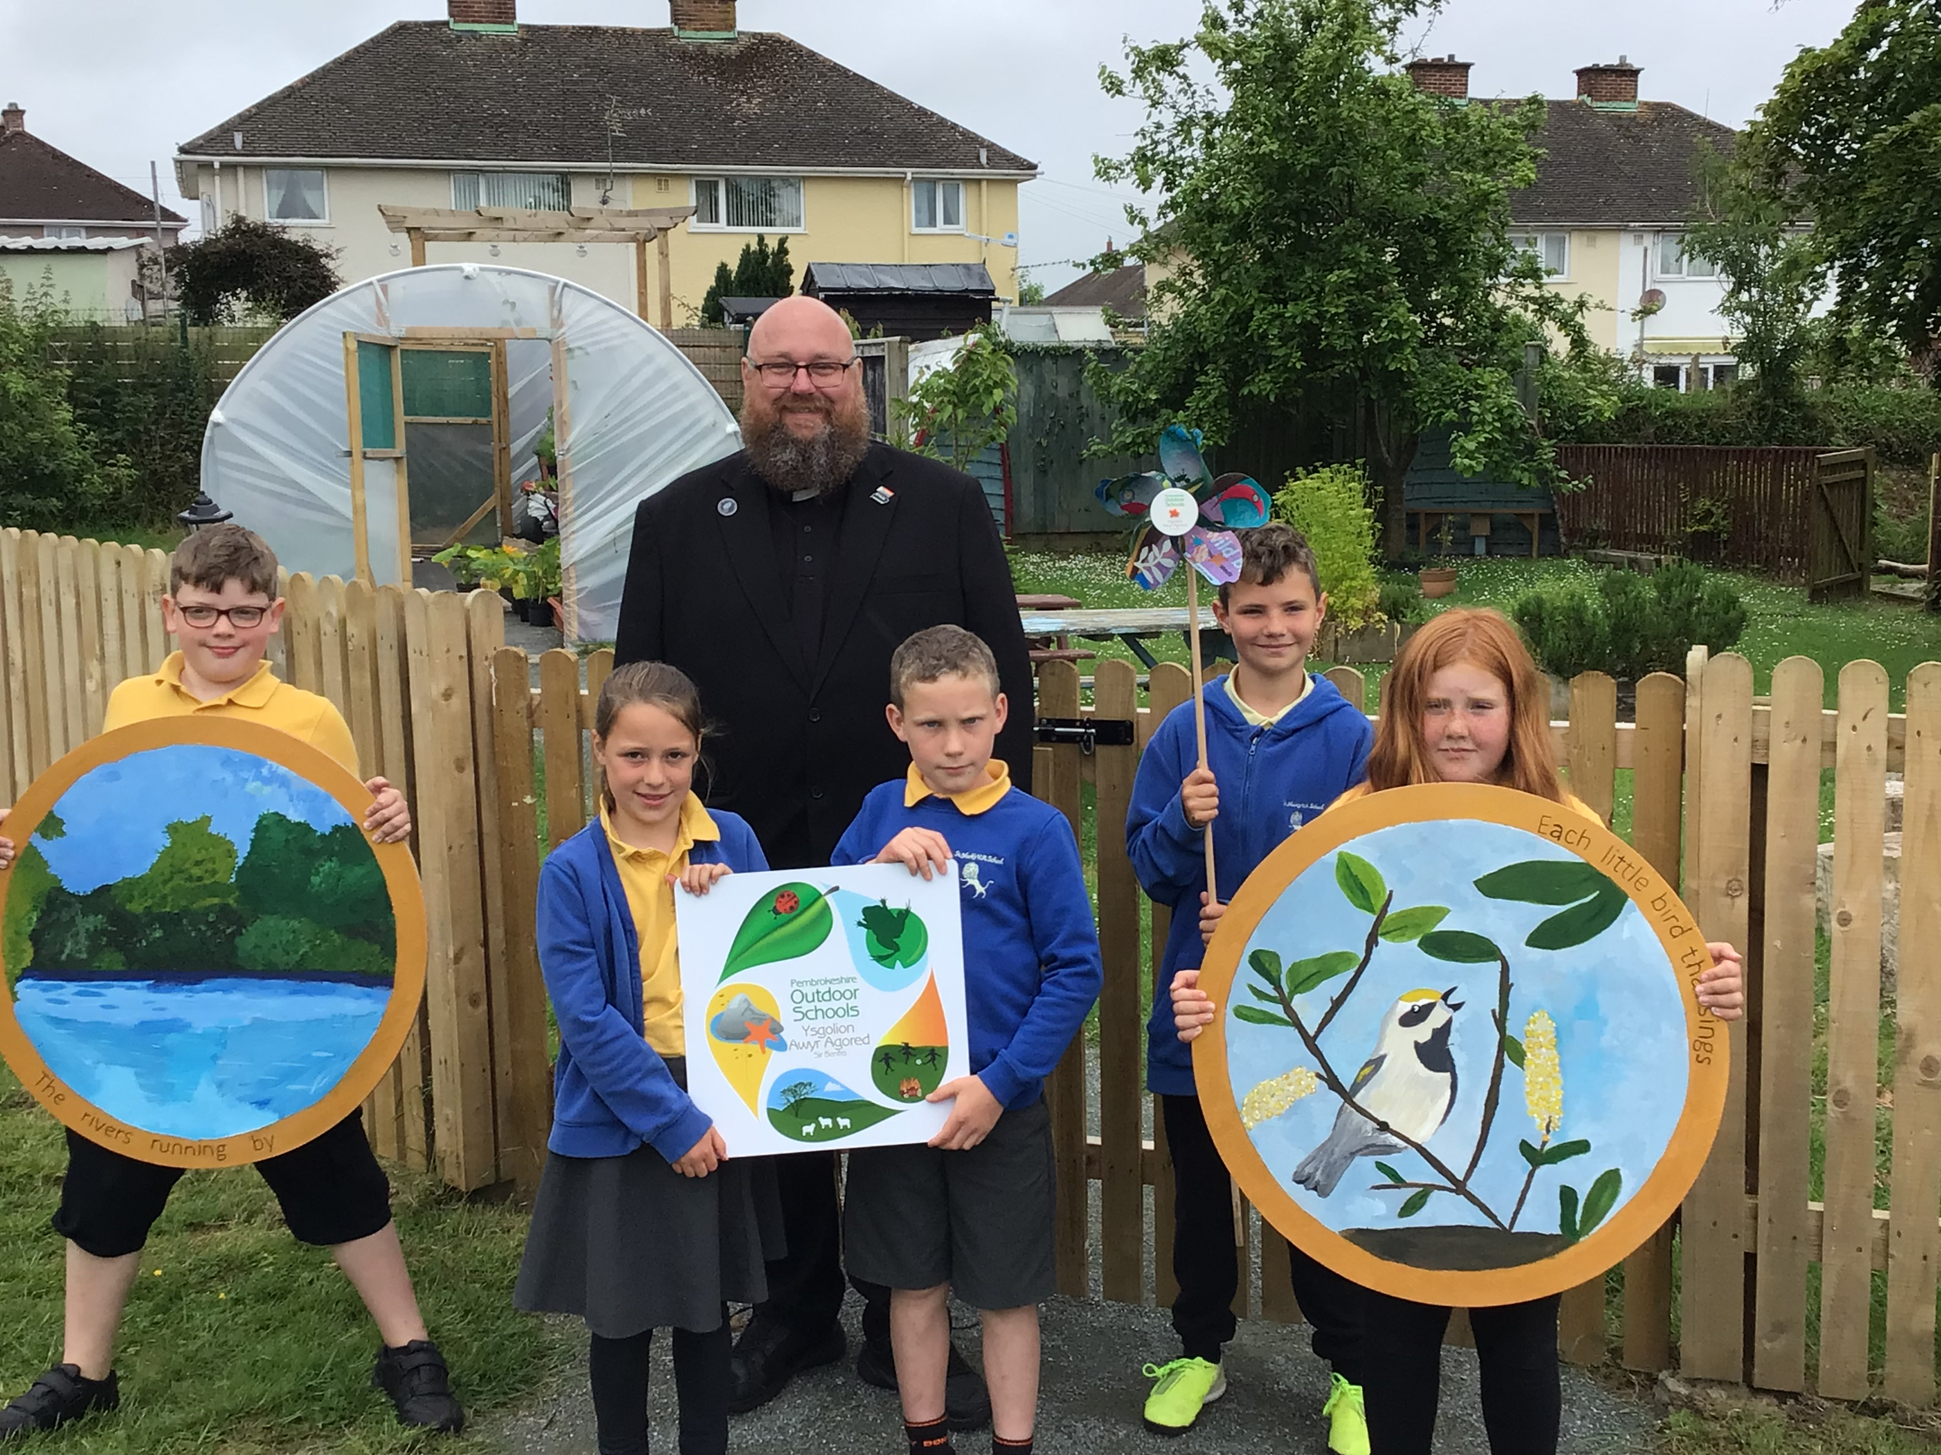
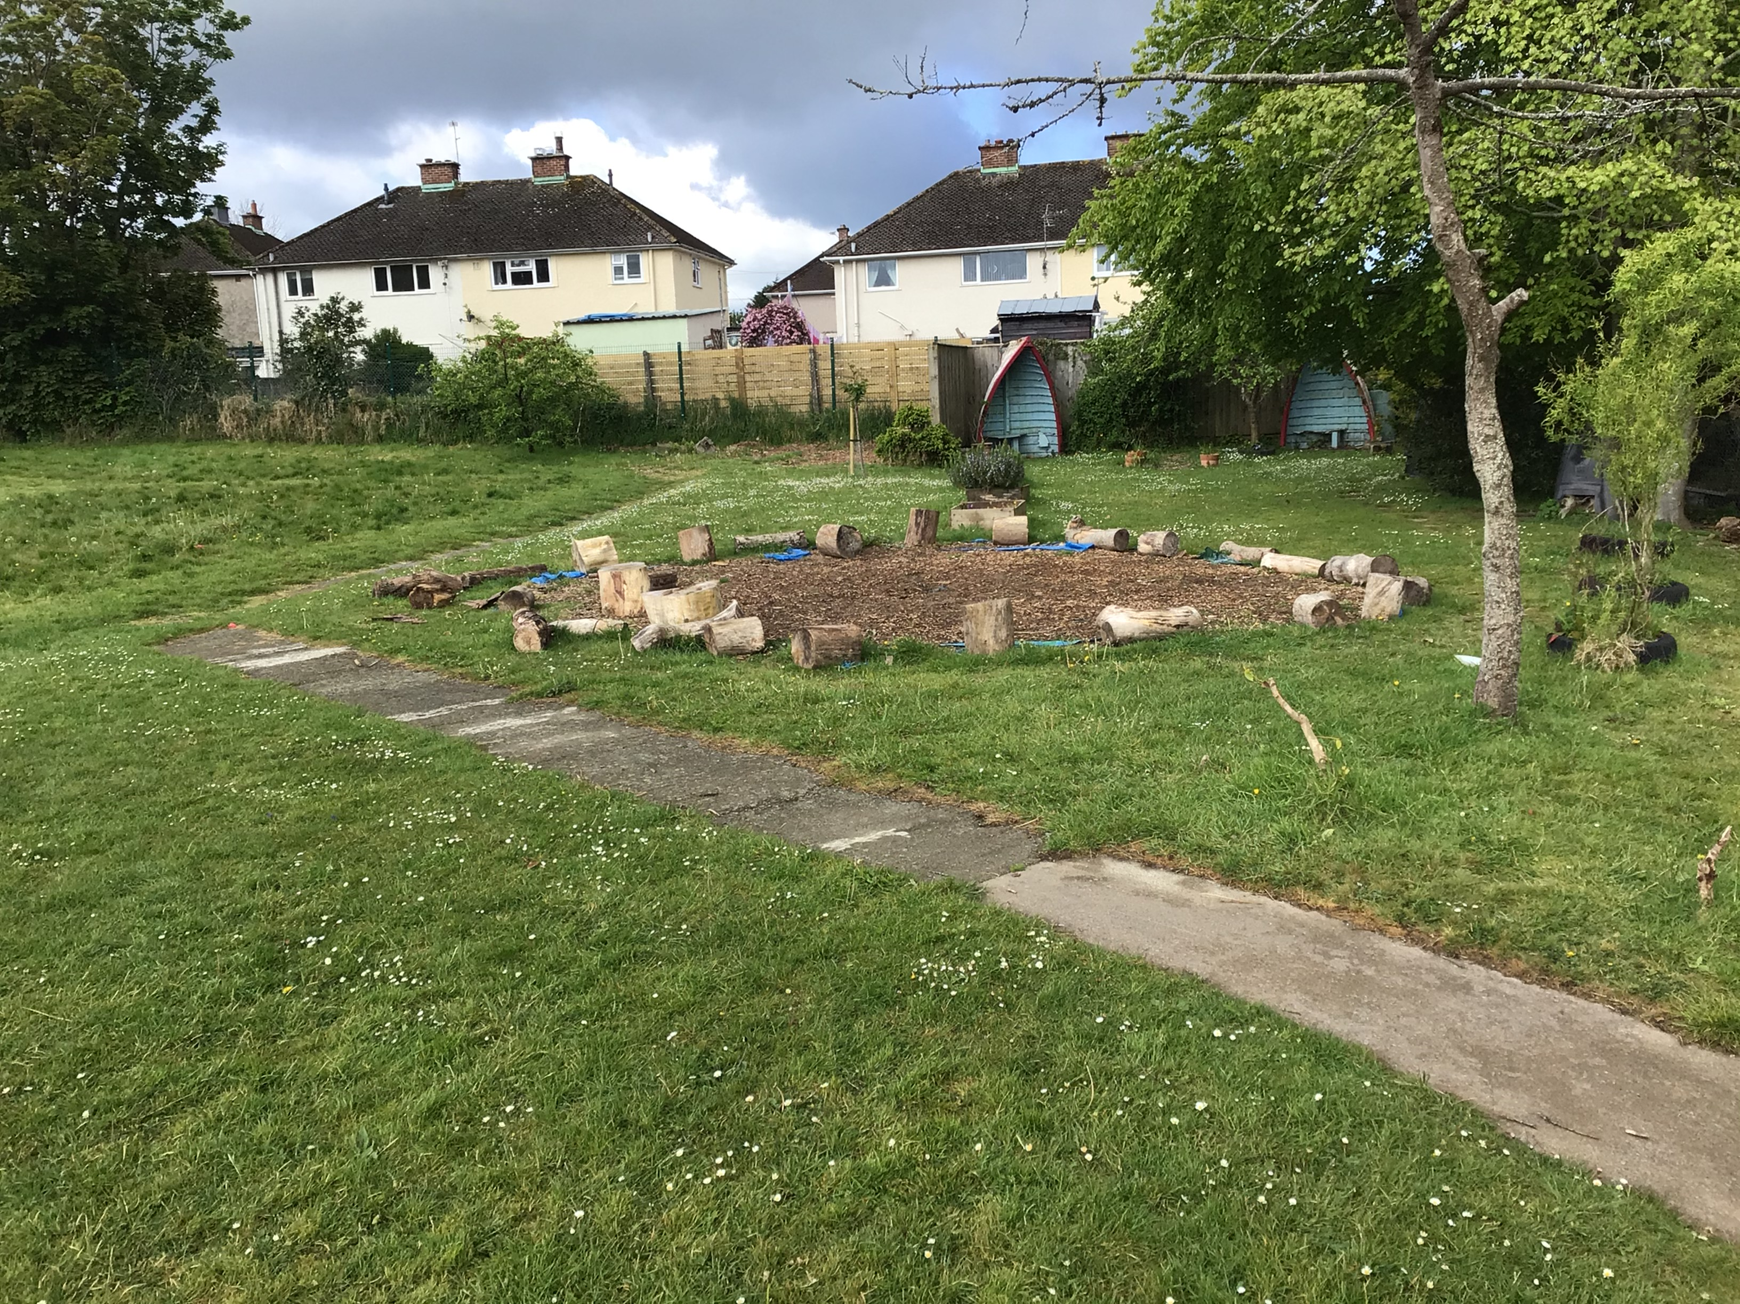
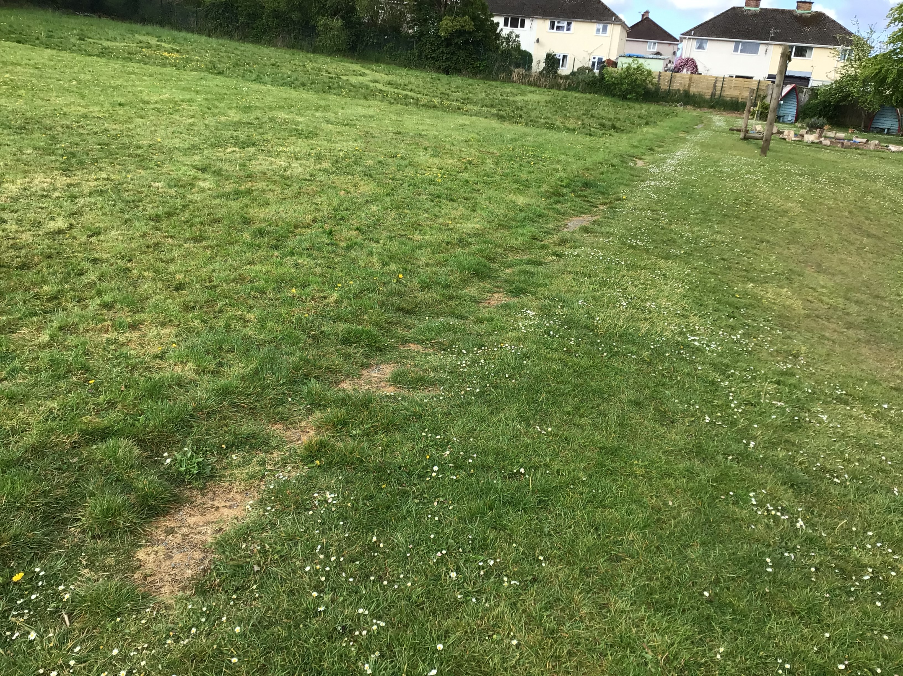
Outdoor learning at St. Mark’s V.A Primary
Sustainable change takes TIME, EFFORT, a WILLINGNESS to be patient to see results and a Great Team of HELPERS !

Slide 2
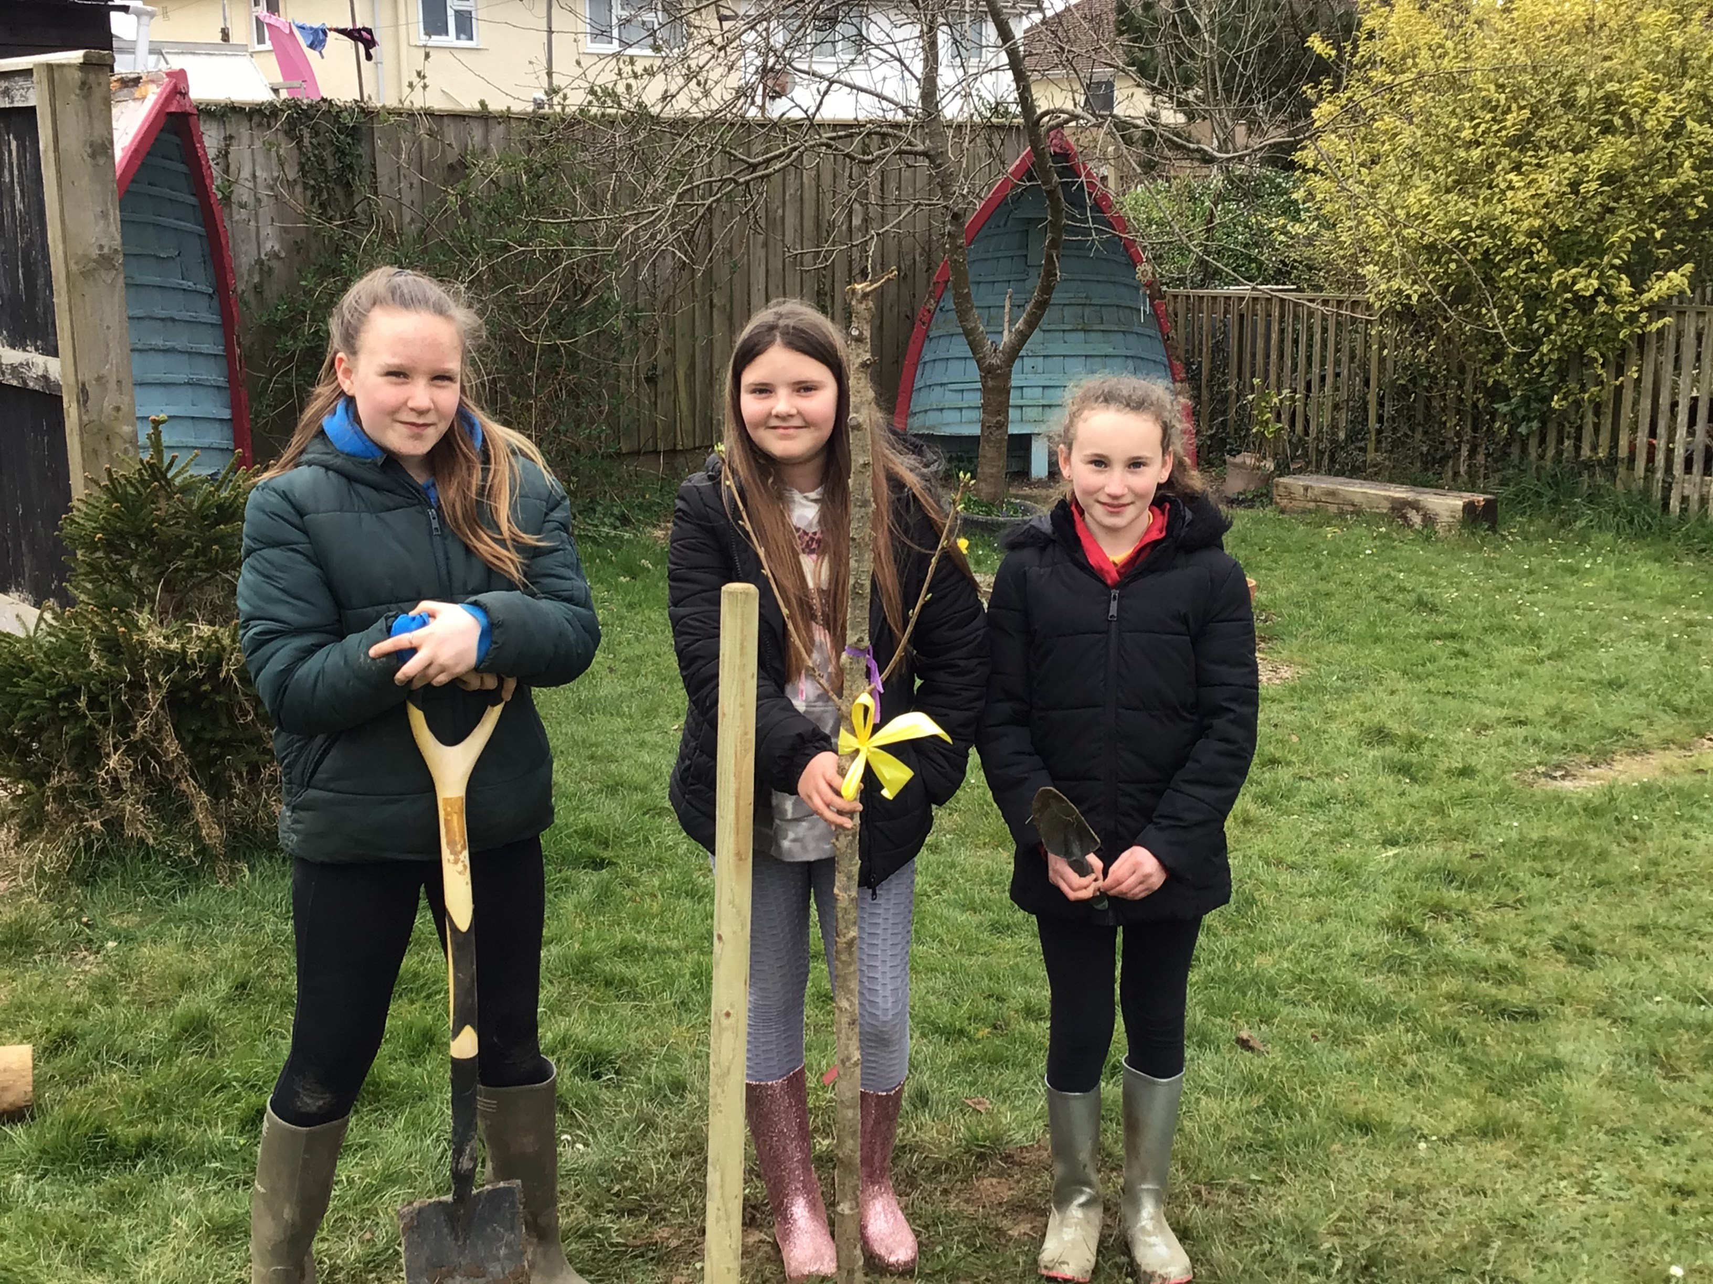
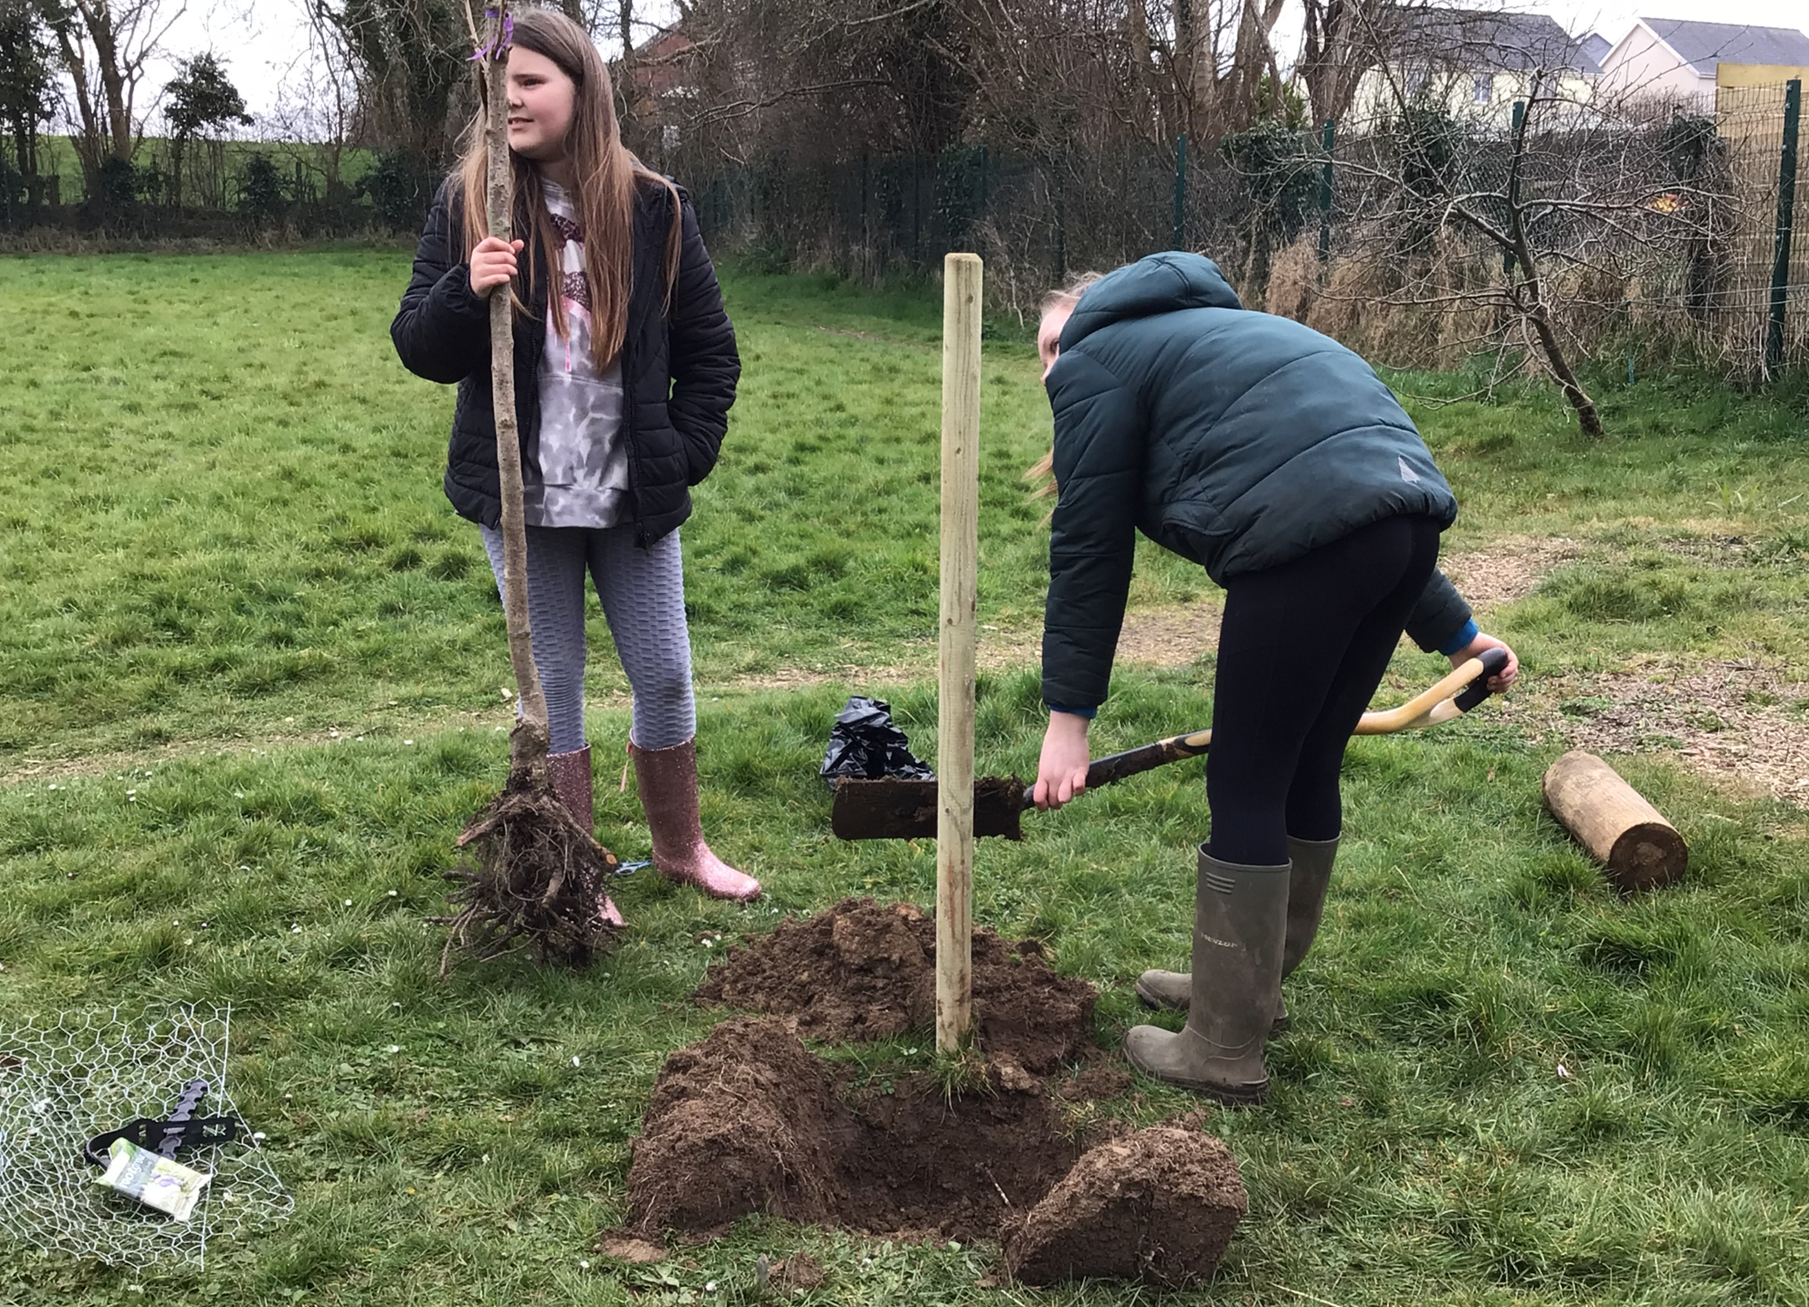
A Vision for Change:
Identify easy fixes?
A clear Action Plan with Short Term and Long Term targets
Be prepared to beg and search for freebies
A Team of parent helpers and key multi agency professionals
Who do we know locally (businesses and organisations)
Children at the heart of the change
Be willing to give the extra hours

Slide 3
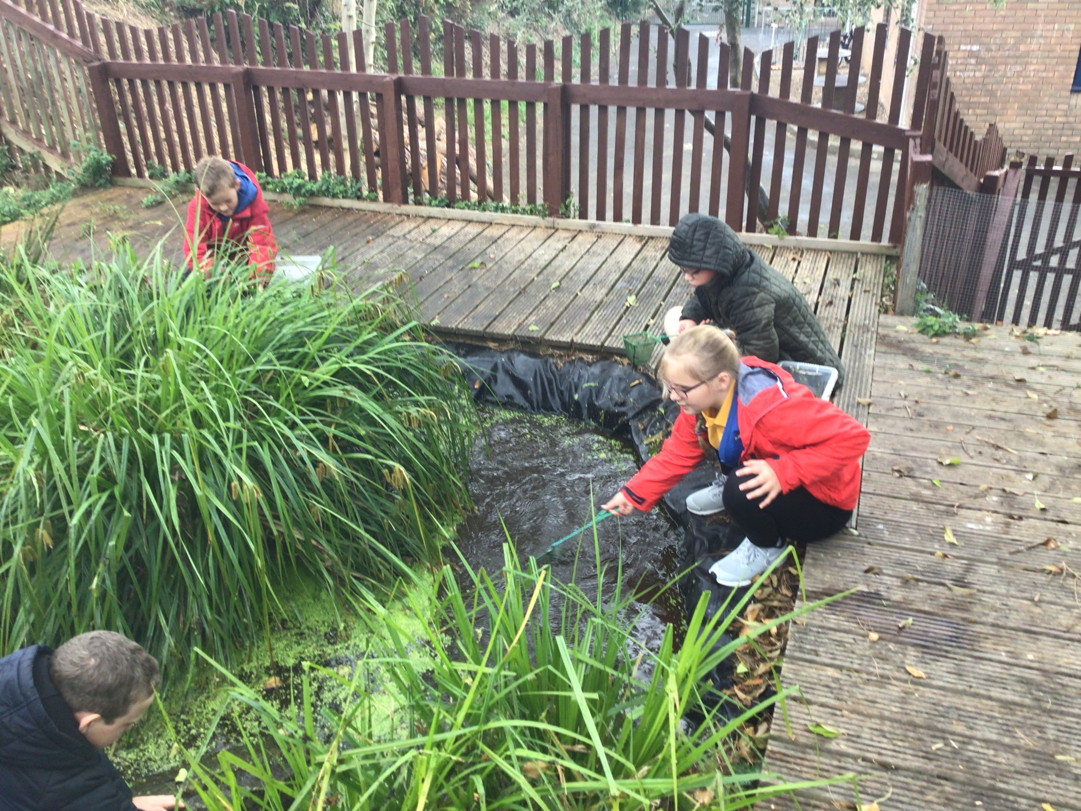
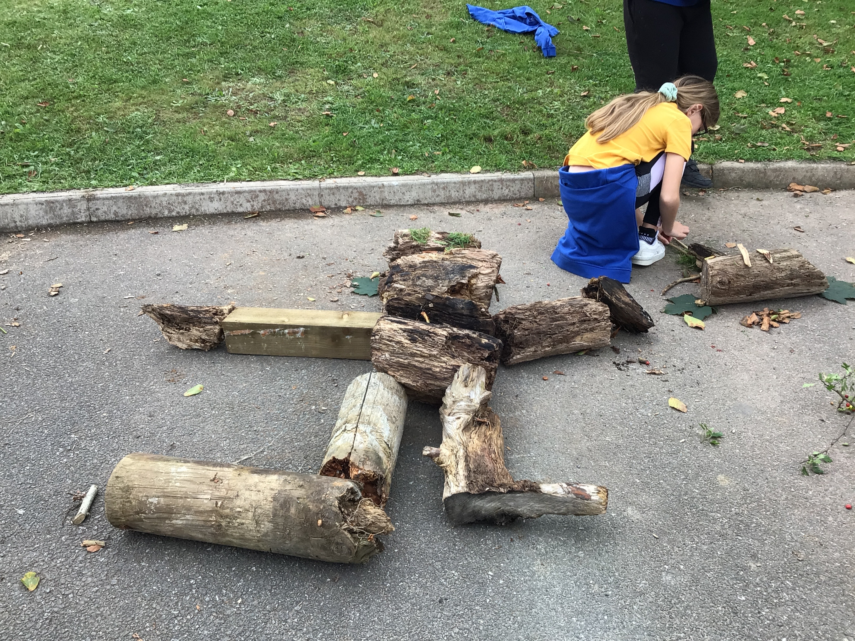
Action Plan
Prioritise and include quick fix change to the outdoors
Apply for Grants – They are out there if you are clear on what you want the
money to be used for:
Our Target Areas:
Clearly Defined Nature Garden site, cut off from the normal thoroughfare of playtimes
Zones for different types of learning (meadow, creative, pond, growing)
Development of a Meadow area suitable for the school and that can be maintained
Be able to produce our own fruits and vegetables with a community focus for growing
Create an environment that pupils WANT to visit, explore and learn together with the adults
A poly tunnel would be nice ☺

Slide 4
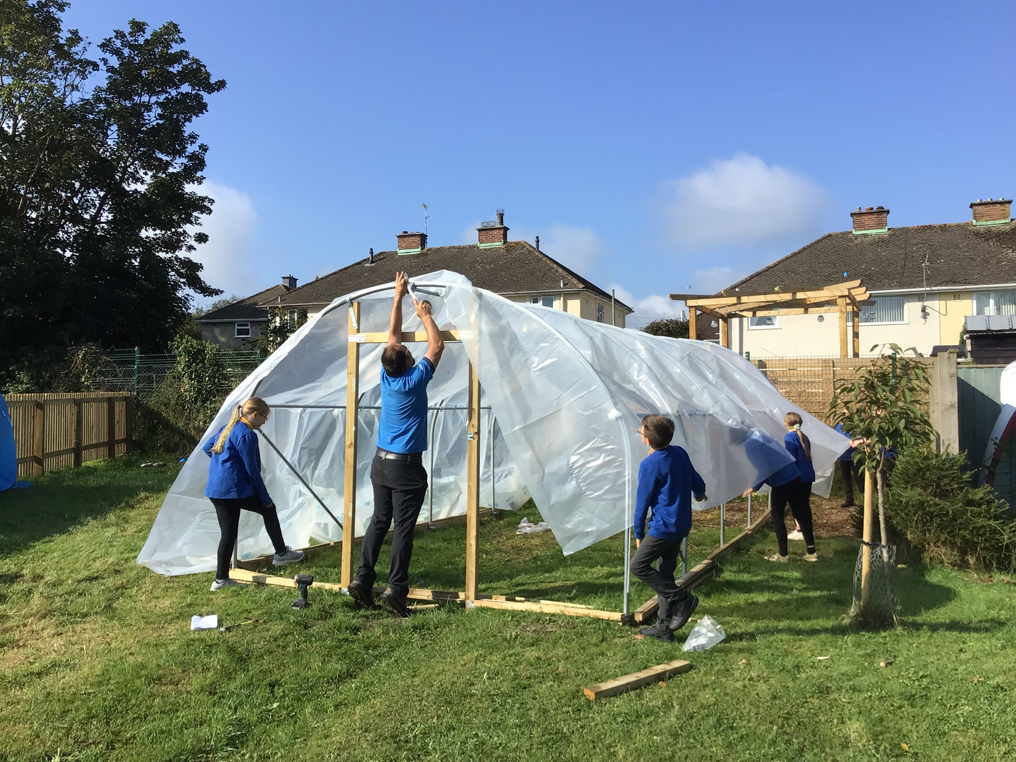
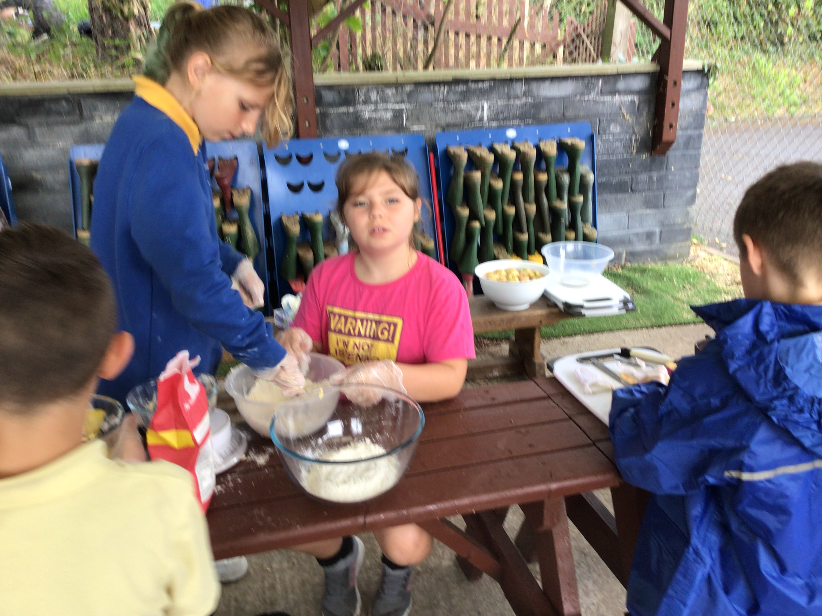
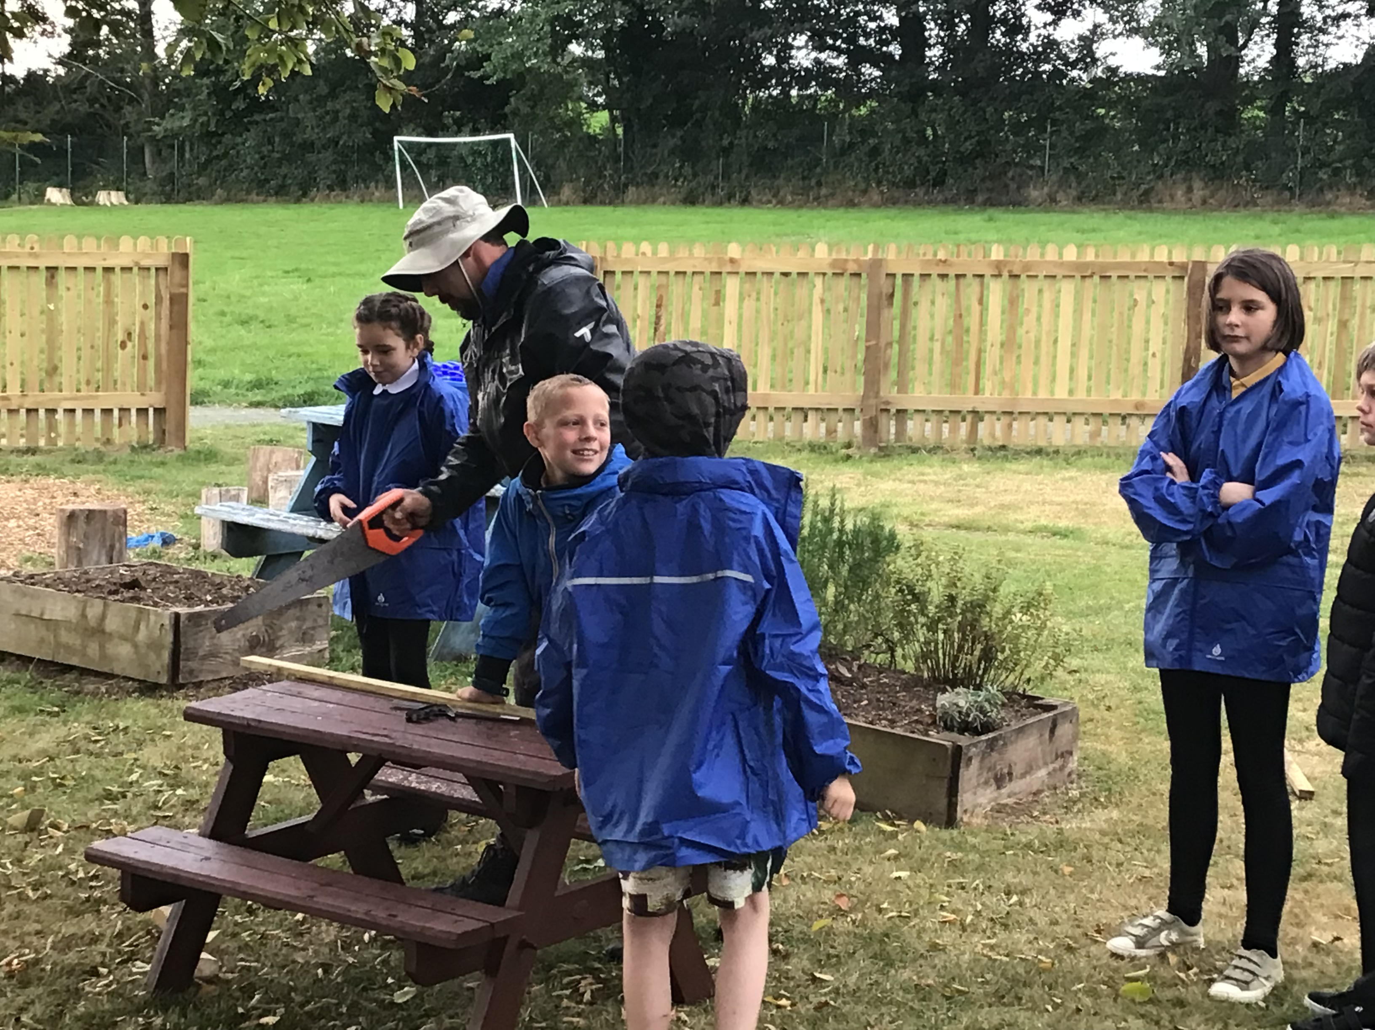
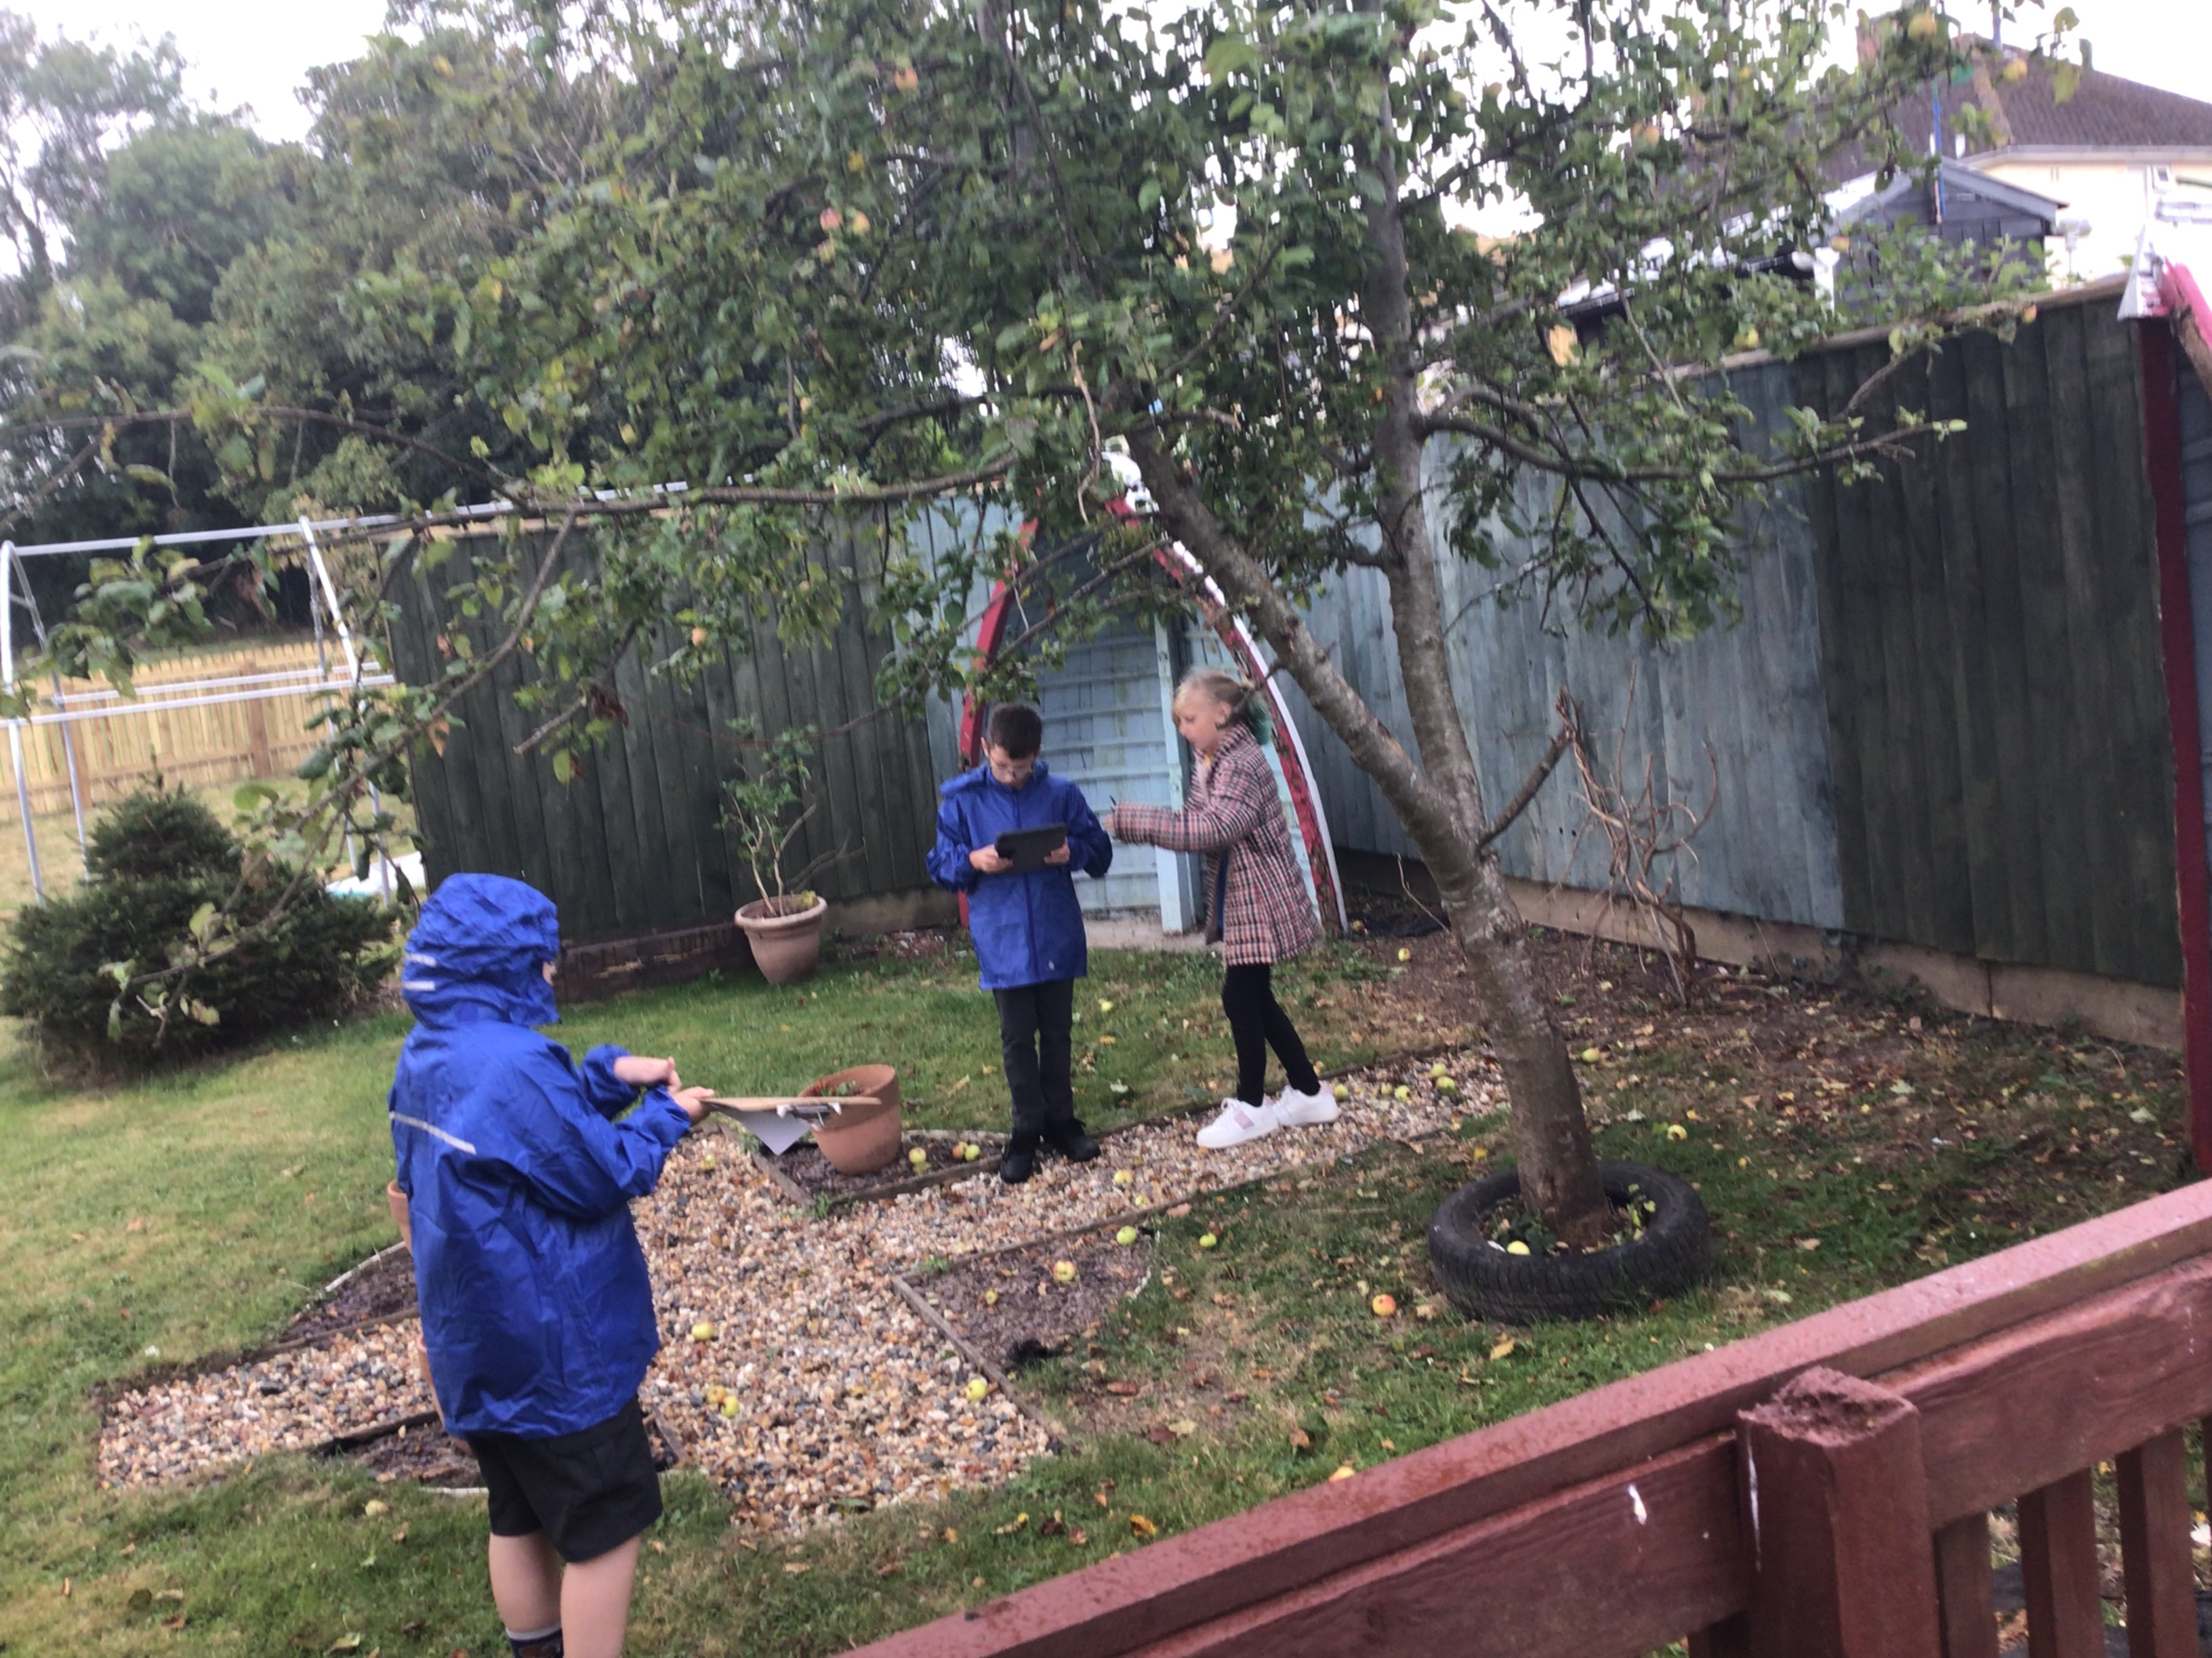
Time Scale
2 Year plan with regular review of
progress (each month)
Plenty of extra hours for willing
volunteers

Slide 5
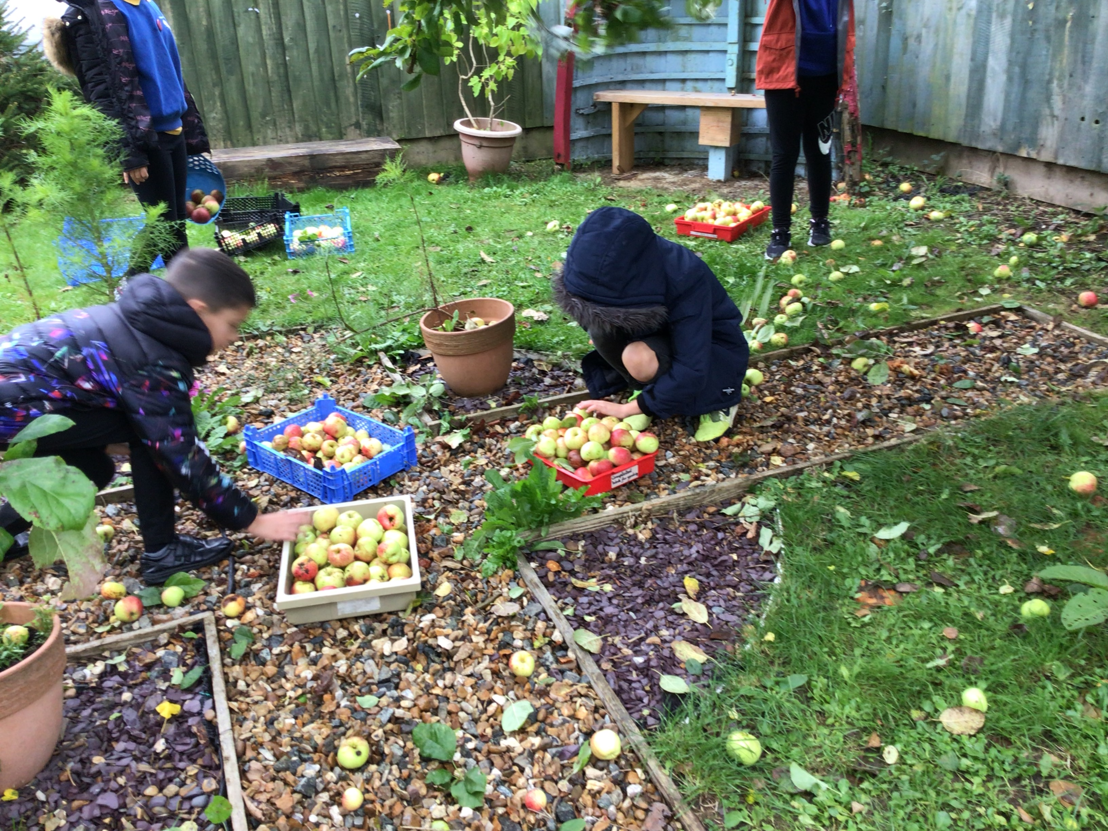
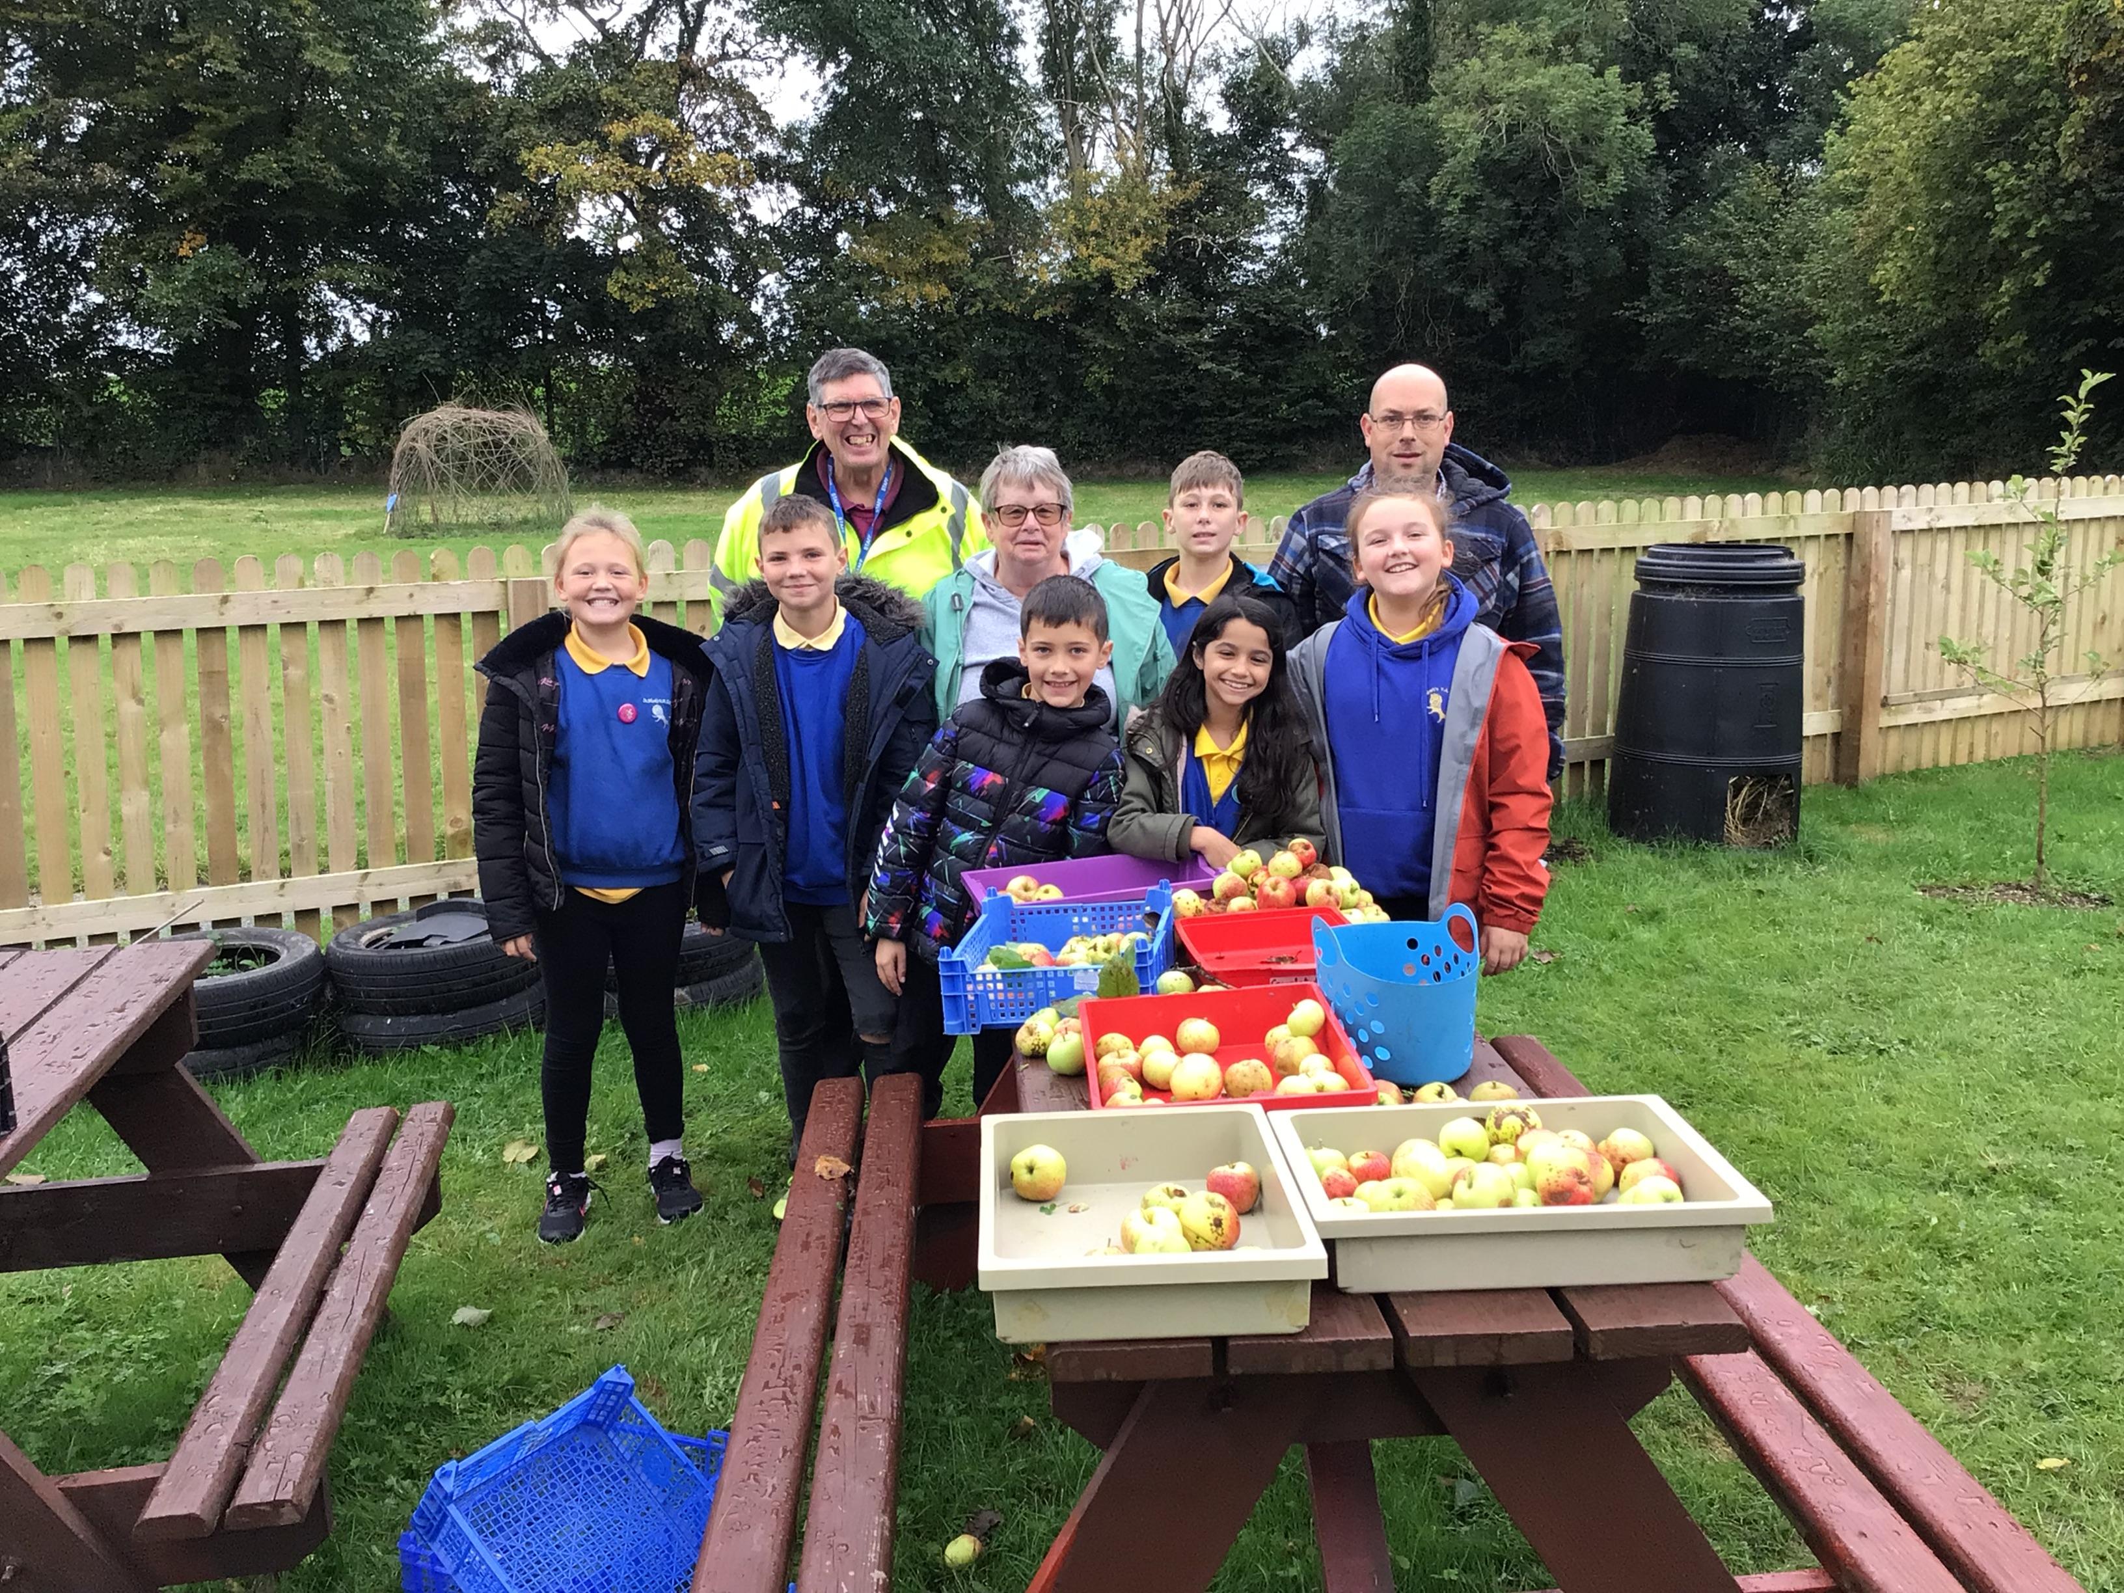
Reap your Rewards
Grant Funding paid a huge part in our success as we prioritised the construction of:
Wellbeing purpose walking track for all weathers
Fenced off Nature Garden to include space for a fruit orchard
Polytunnel
FRAME have helped maintain our Nature Garden over the Summer, harvesting our crops and making Green Chutney from our tomatoes. Our children also harvested our apples to be able to be used in the Community fridge for Merlin’s Bridge
New Partnerships and Friends
National Parks
Pembrokeshire Outdoor Schools (PODS)
Blas Y Tir
Church Army
Haverfordwest Town council
Tesco Tokens
First Milk
Morrisons
National Woodland Trust
Learning through Landscapes
FRAME local Charity

Slide 6
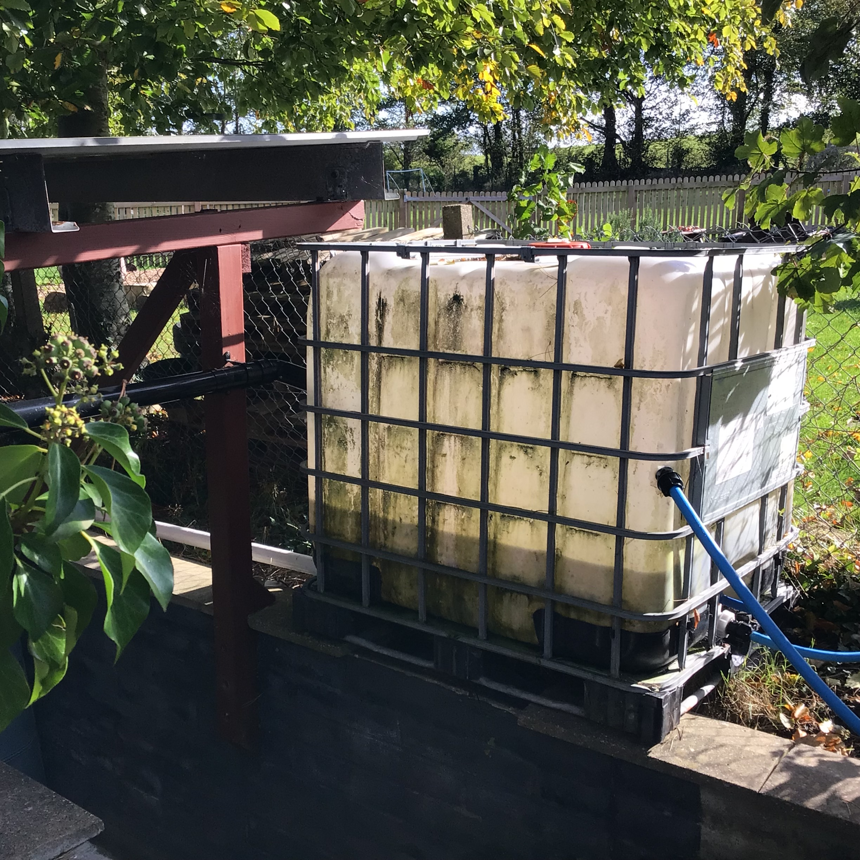
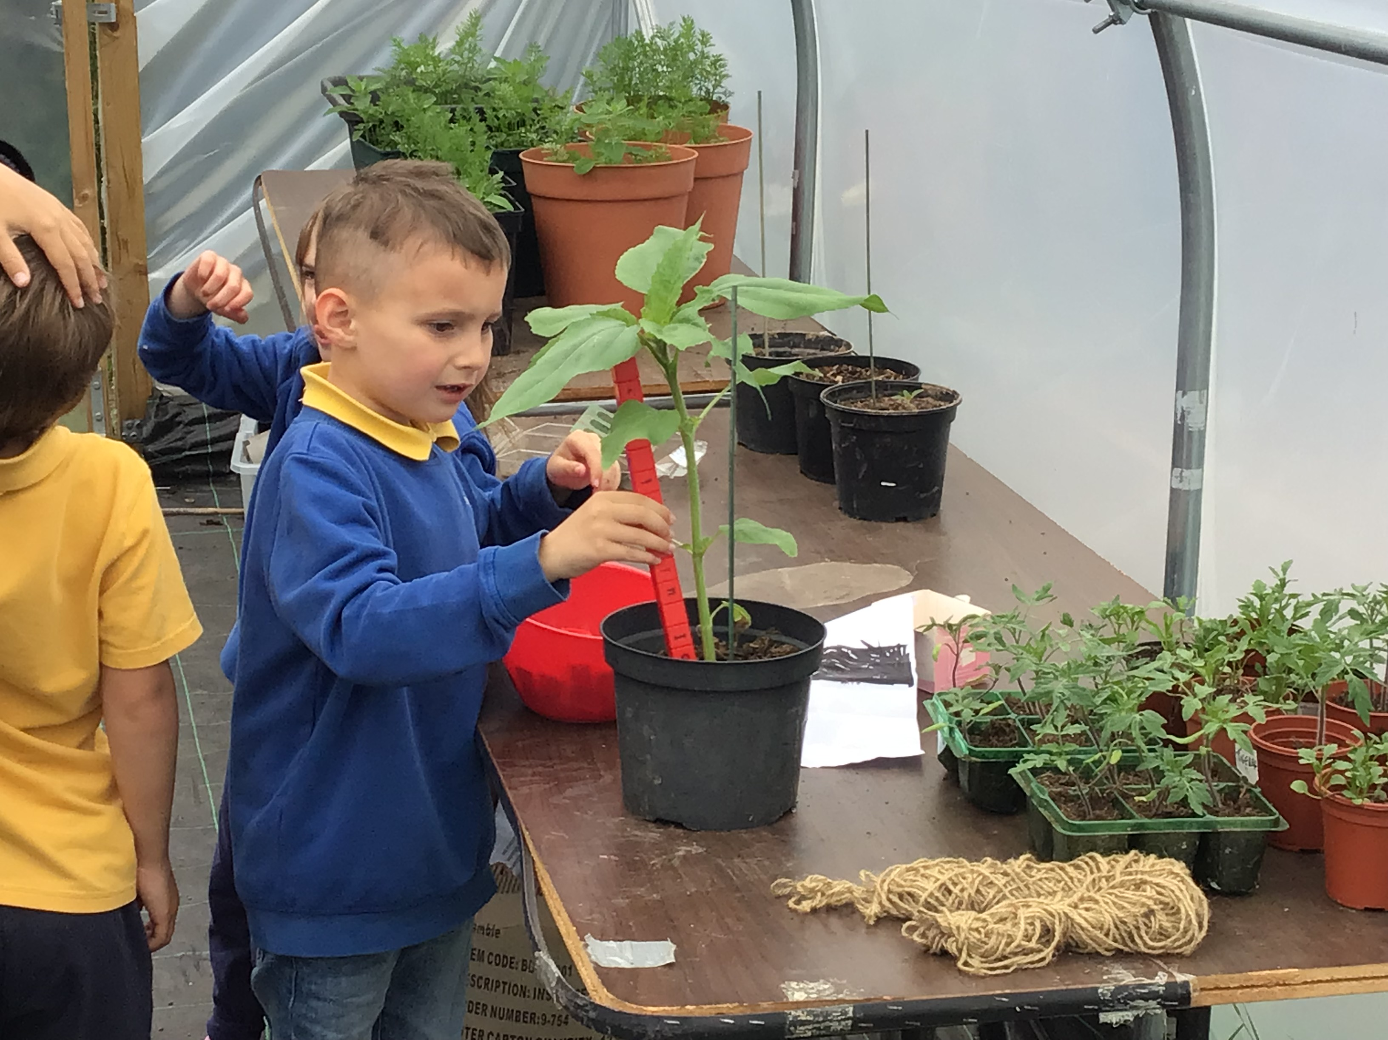
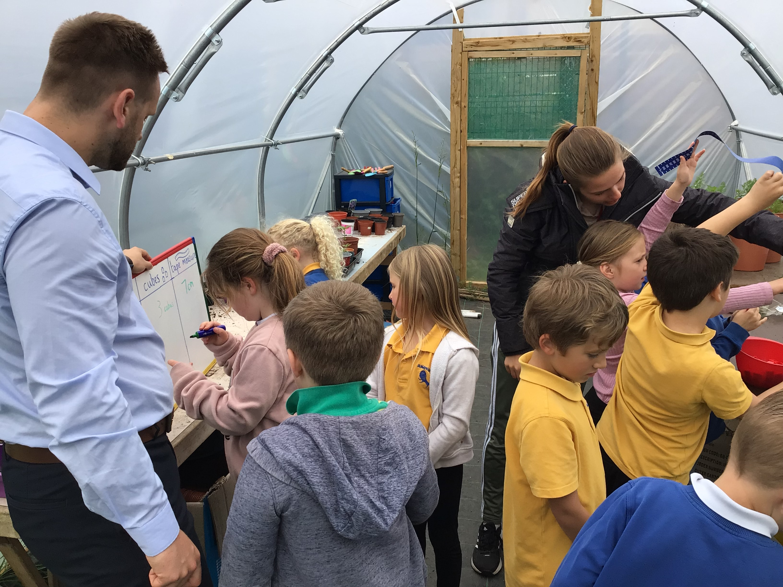
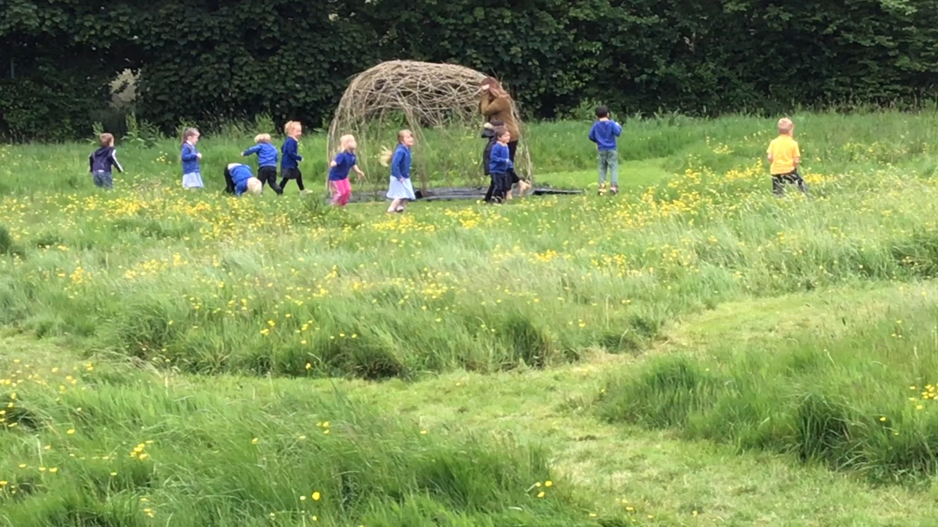
Looking Ahead
Developing our meadow area (conservation)
Increasing our food production and distribution
Community linked projects (Saturday Family Run, Girl Guides using our grounds, Springboard activities, Family After School Clubs)
Energy and our own footprint - Will our newly installed water collection system work?
Develop a wealth of outdoor opportunities to support our learners

