Slide 1




Outdoor Learning in
Your Local Area
Pembrokeshire Outdoor Schools (PODS)

Slide 2
Introduction
Natural places provide important spaces for teaching and learning. Schools in Pembrokeshire are often able to access greenspace, beaches or woodlands.
Many local places also provided opportunities for progression, enhancing curriculum learning opportunities further with links to local heritage and a greater variety of natural habitats.

Slide 3
What local environments do you have in close proximity to your school?

Slide 4
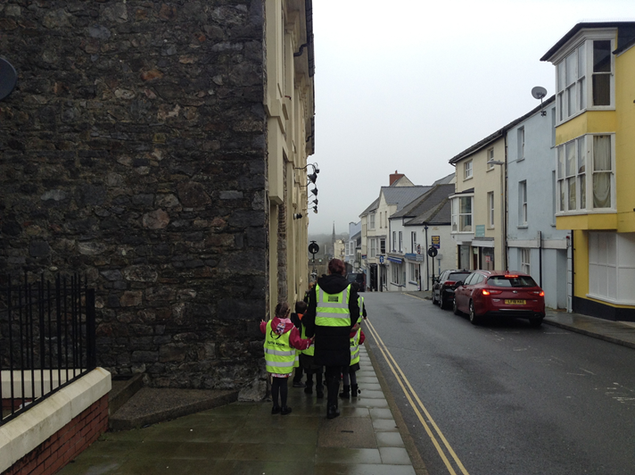
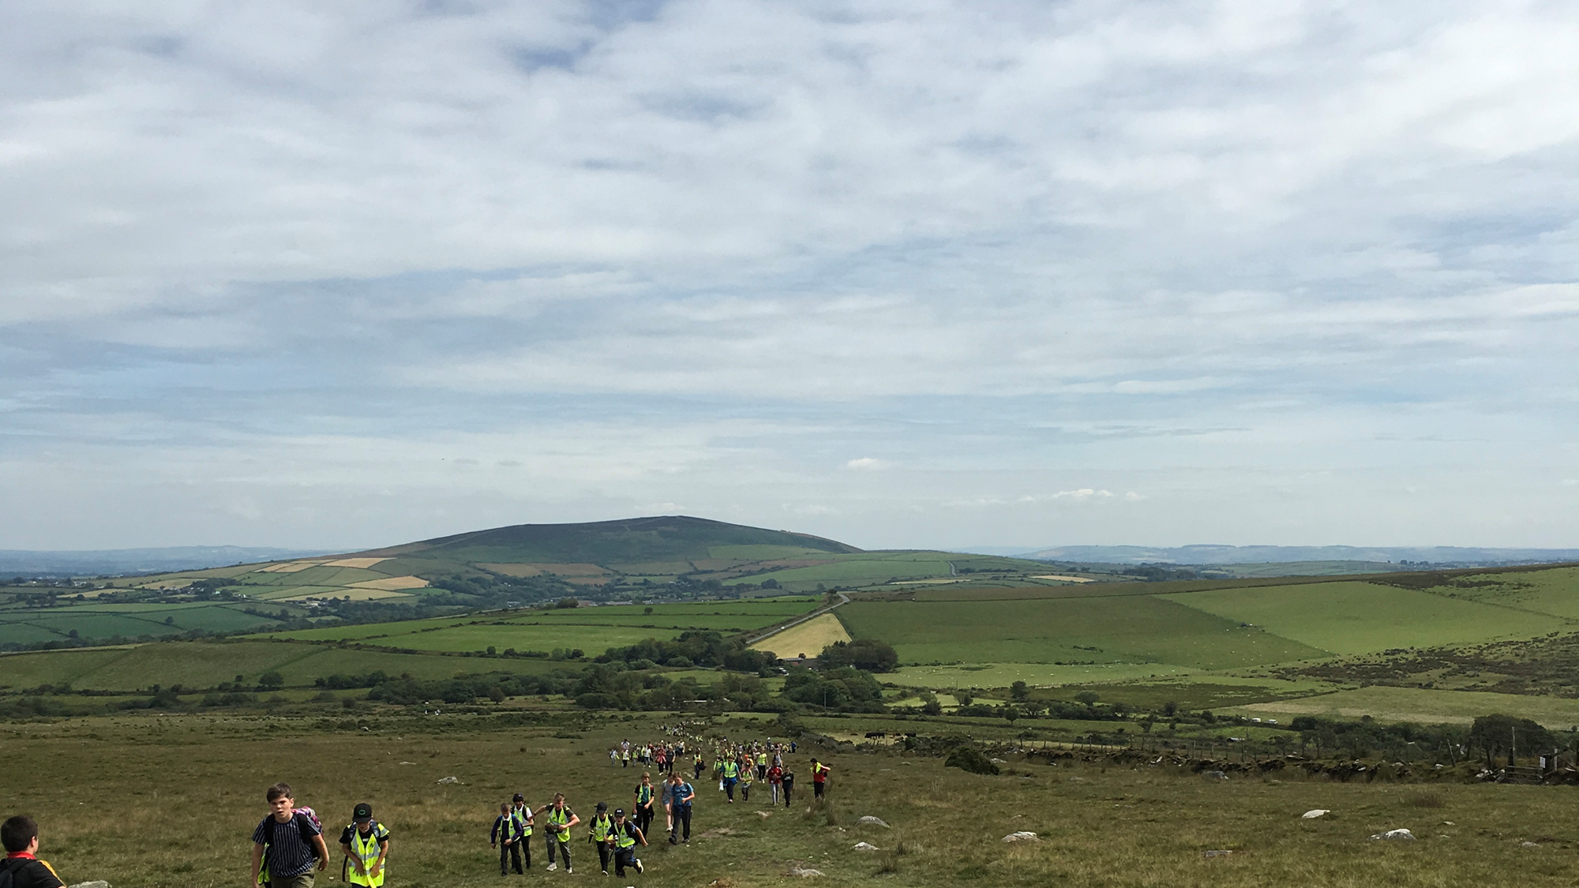
Case Study – Using Local Area
Ysgol Waldo Williams
The ‘Waldo Way Walk’ and The New Curriculum:
Hook - Heritage Tour in Haverfordwest
Year 6 Heritage Project
Year 1 and 2 – Historical Buildings
Exit Point - The Waldo Way Walk – Preseli Mountains

Slide 5

Planning
Recce – walk as students would walk
(average 1km = 15 minutes, double at minimum for students)
Identify hazards
Familiarise yourself with the Highway Code
Check the forecast when planning your trip
Decide on your route – circular walk or a to b
Ratio 1:8
Contingency plan
Risk Assessment

Slide 6

What you will need
First Aid Kit
High Visibility jacket
Clip Board
Go to bag of Resources
Resources for activity

Slide 7
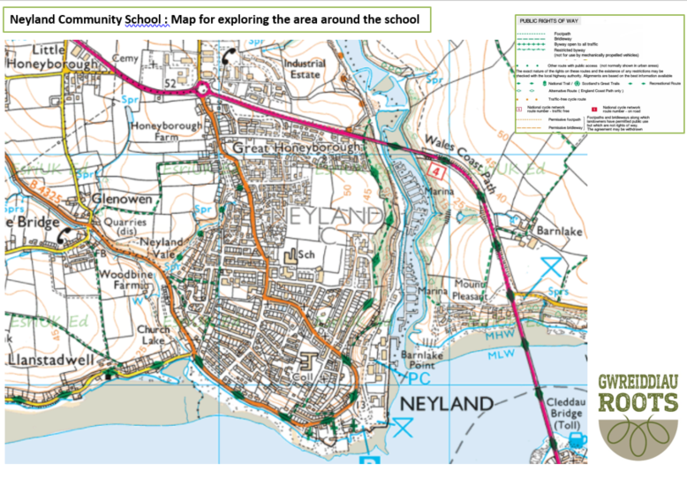

Google Maps
Street View
Bing Maps
Free GIS Platform for schools:
https://schools.esriuk.com/

Slide 8
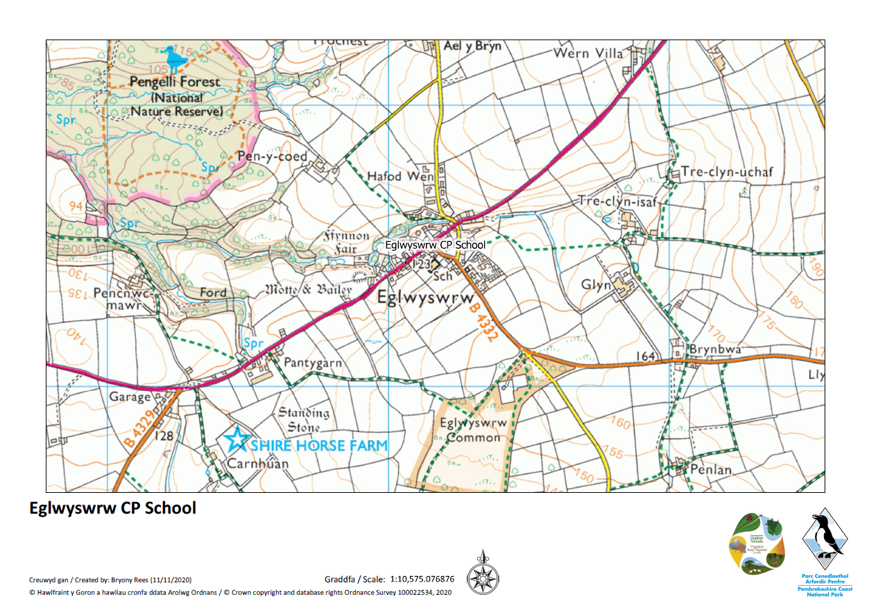
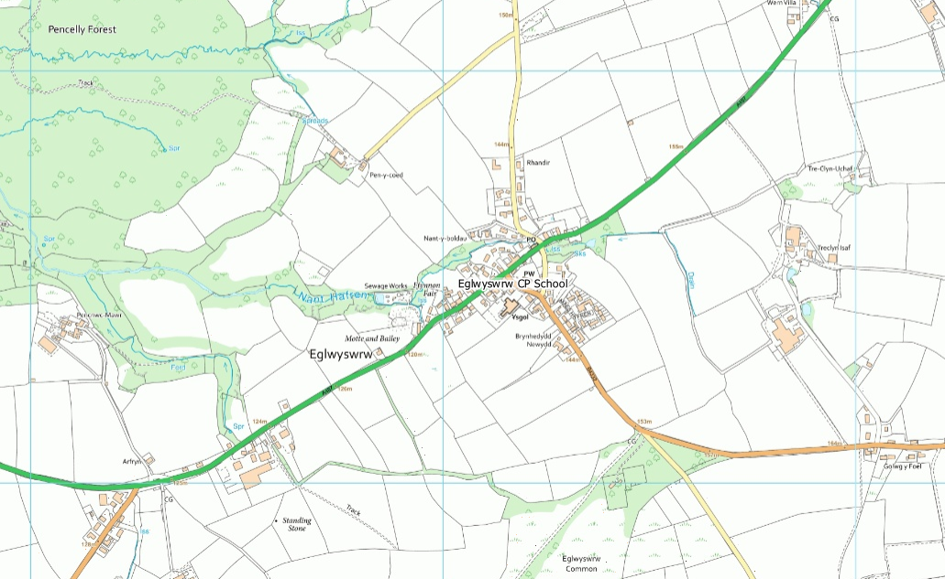
Maps by PODS and PCNPA

Slide 9
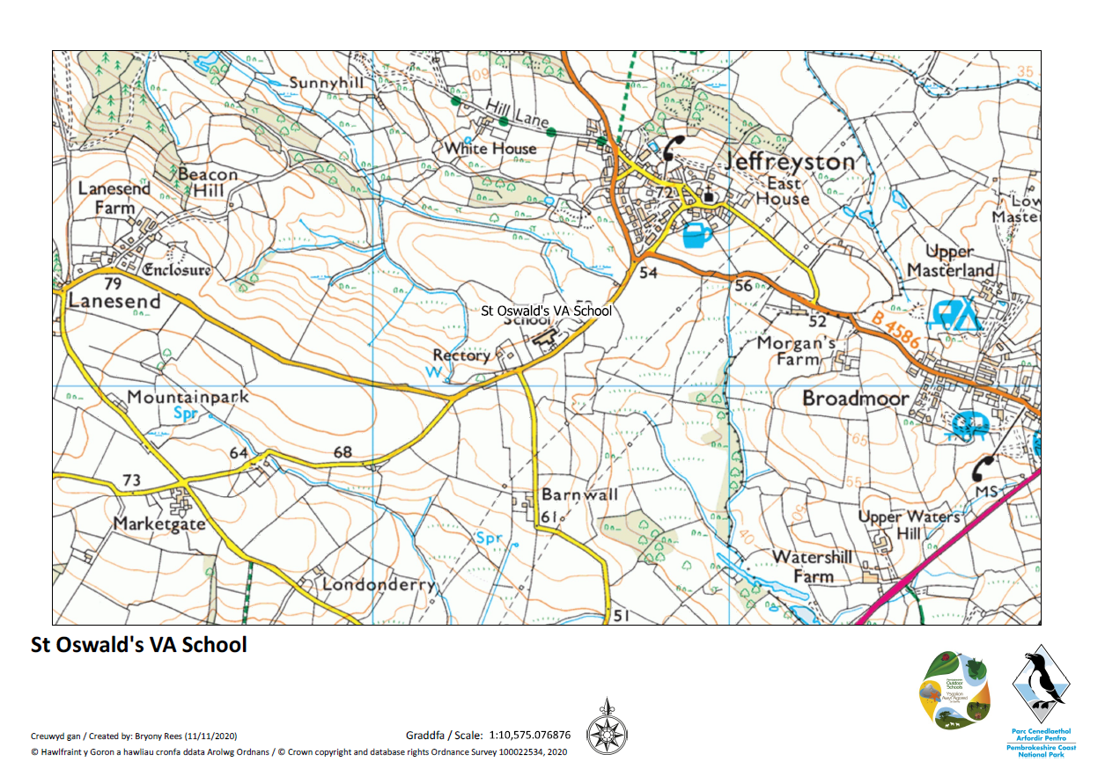
Maps by PODS and PCNPA

Slide 10
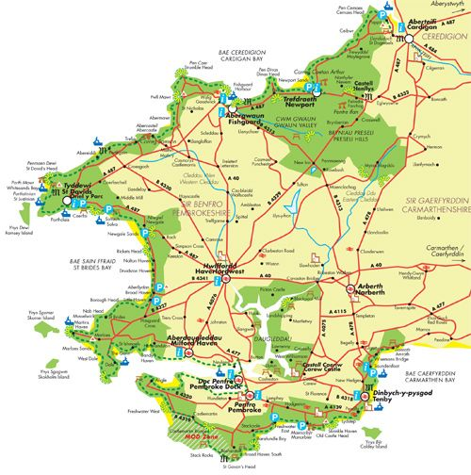
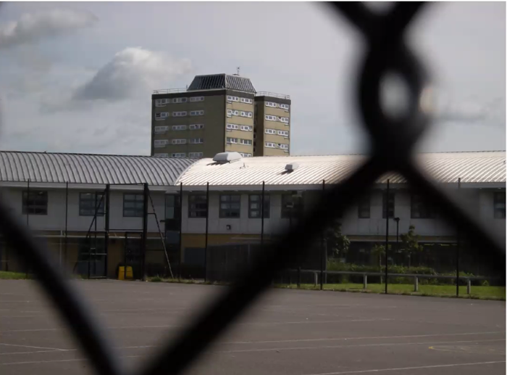

A Sense of Place
What do the students know about the local area?
Activities
Make observational drawings of what they can see of the local area from inside the school grounds.
Go outside the school grounds and sketch the opposite view.

Slide 11

Exploring Your Local Area
Walks in the local area with your can have many different focuses:
Sensory walk – journey sticks, natures pallet, local textures, smelly perfume
Observational walks - human and physical features, scavenger hunt
Historical walk - observe the styles, ages, materials and uses of buildings.
Literacy Focus – names of places, describing your surroundings, describe how you feel
Adventures
Detectives
Explorers

Slide 12

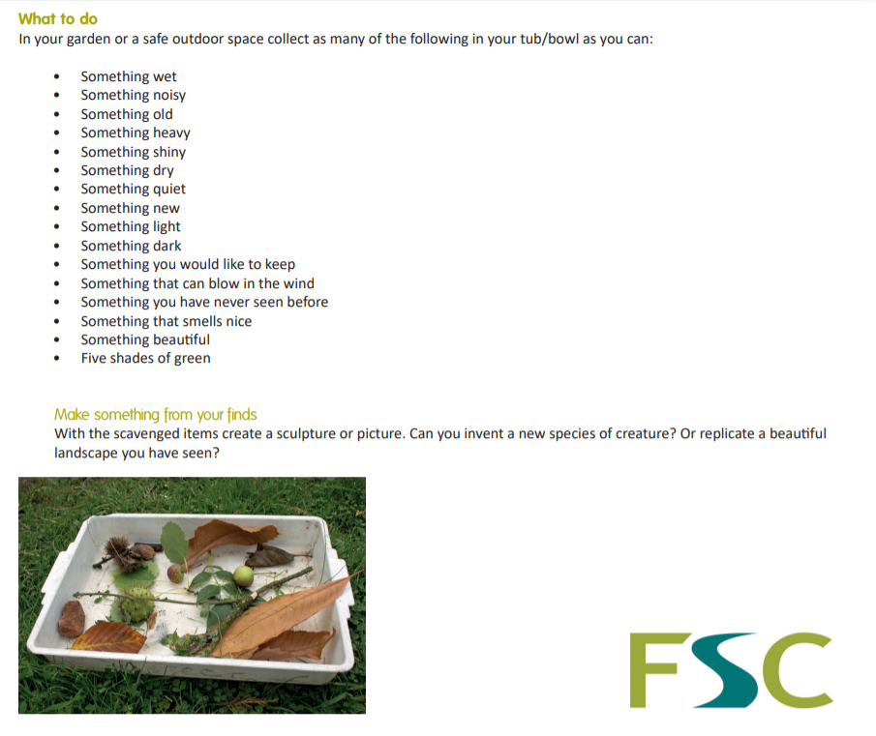
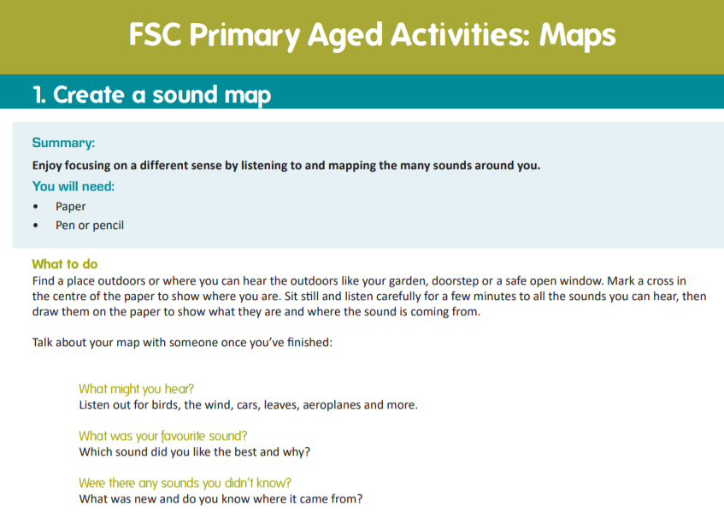
Field Studies
Council (FSC)
Resources can be found here:

Slide 13
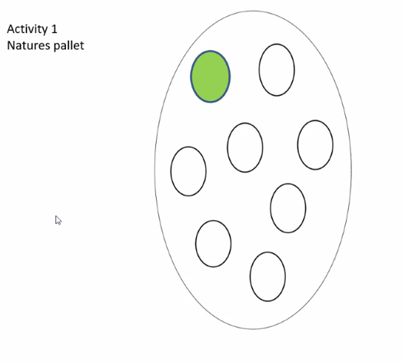
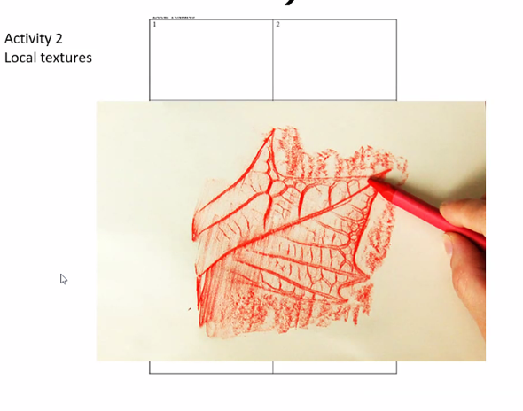
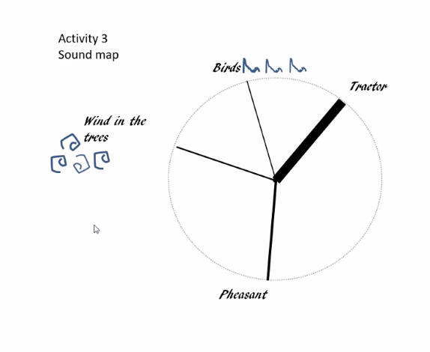
Sensory Activities

Slide 14
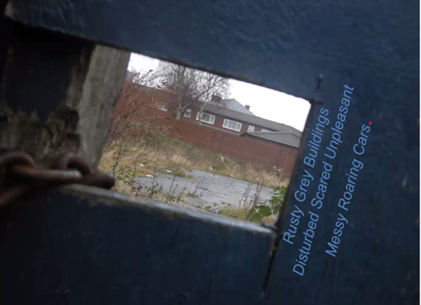
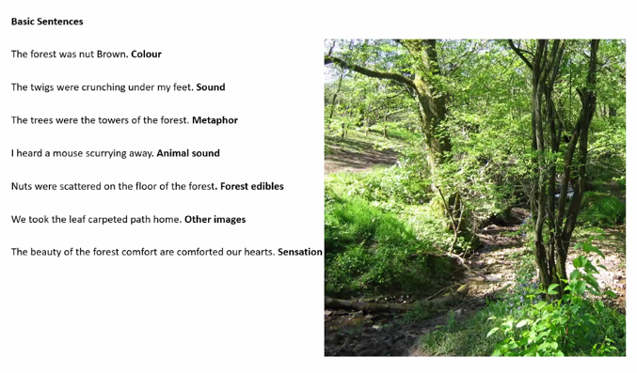
Literacy Activities

Slide 15
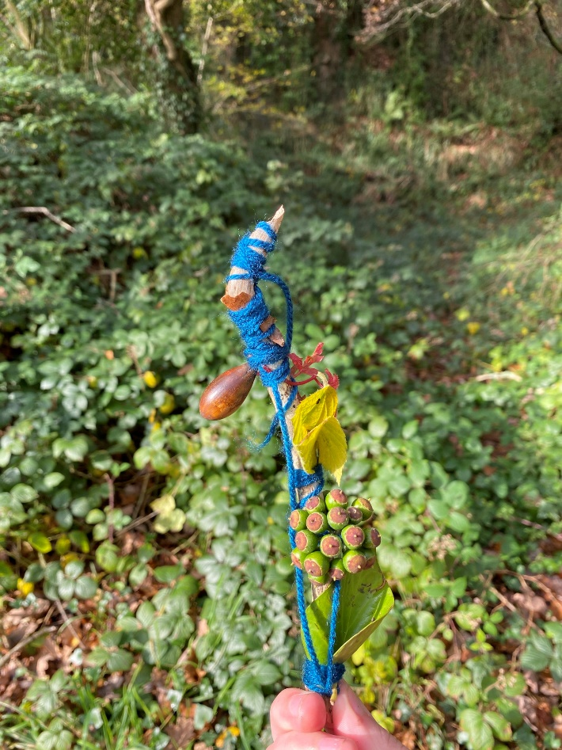
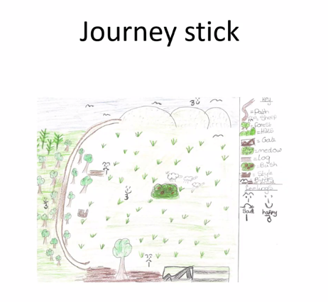
Inspiration from your surroundings

Slide 16
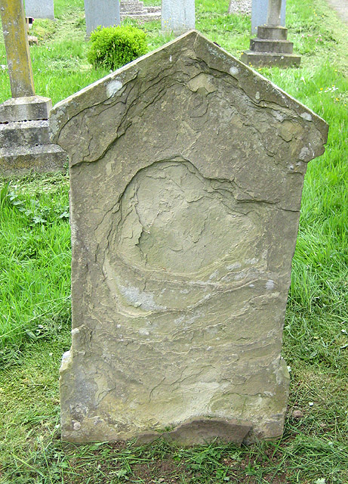
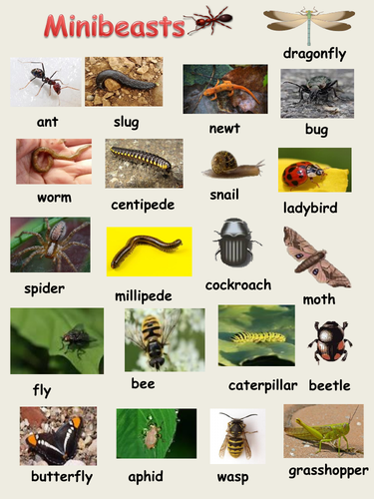

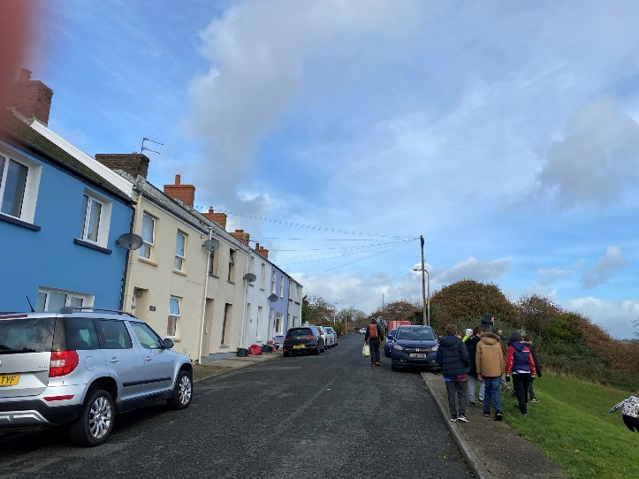
On Your Journey…
Things to look out for:
Stone walls – investigative work.
Plants – lichens and mosses.
Minibeasts – insects or spiders that live there
Wildlife spotting!
Place names
Weather – observe the effects of the wind and rain on features such as walls and gravestones.

Slide 17
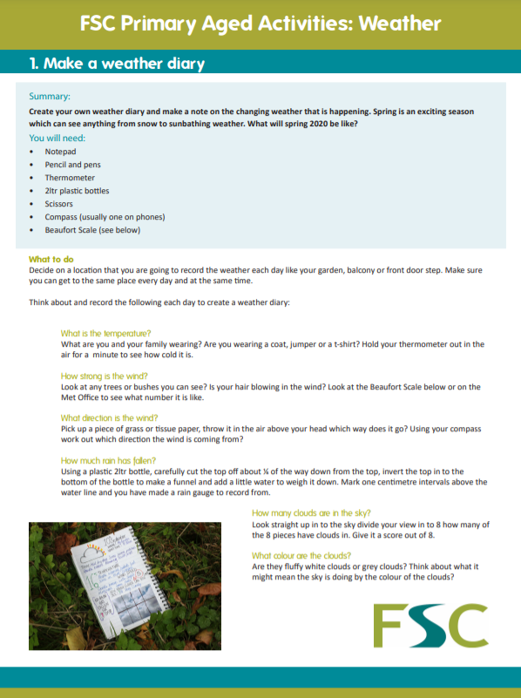

Field Studies
Council Resources

Slide 18
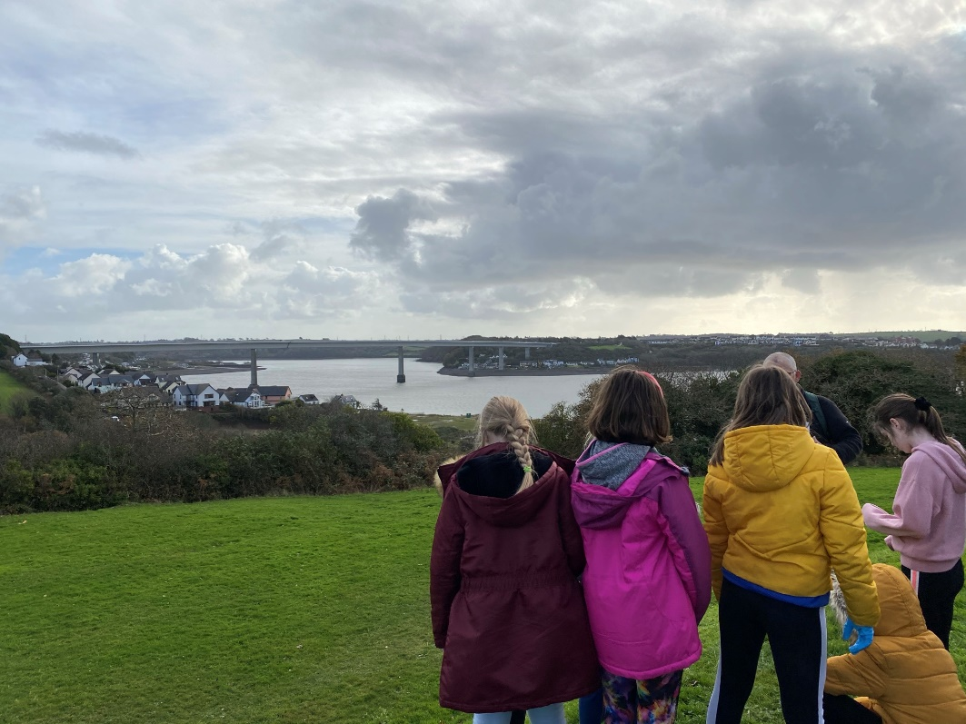
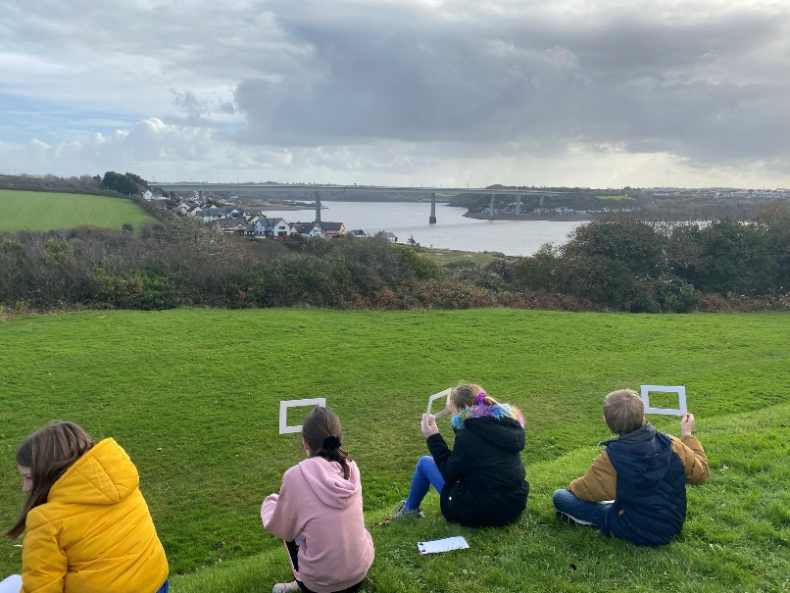
Surrounding Landscape
Activities
Go to a vantage point draw the view.
Look at different views of the local area.
Give students half a photograph or line drawing and students draw the other half.
Think about how that view looked 100 years ago and how it will look in the future.

Slide 19
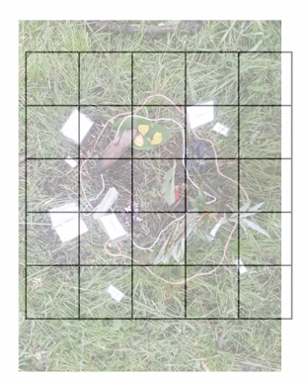
Map Activities
Get each child’s to think about route to school and how they get there.
Using their memory, ask them to draw a map of their route.
Drawing birds eye images of object in school grounds.
Draw a map of school grounds.
Start looking at maps – explore different types – street map, OS map, theme park, digital street map (google maps.)
Introduce map of the local area to the school. Identify different features – road, rivers, paths,
Draw a map of local area, marking on places and features – shops, river, school, church or park as well as other places students might know well.

Slide 20
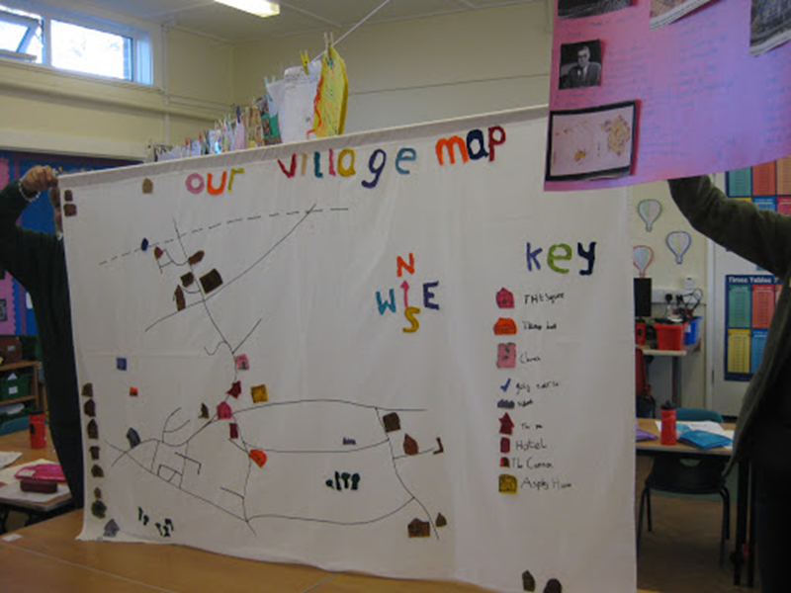
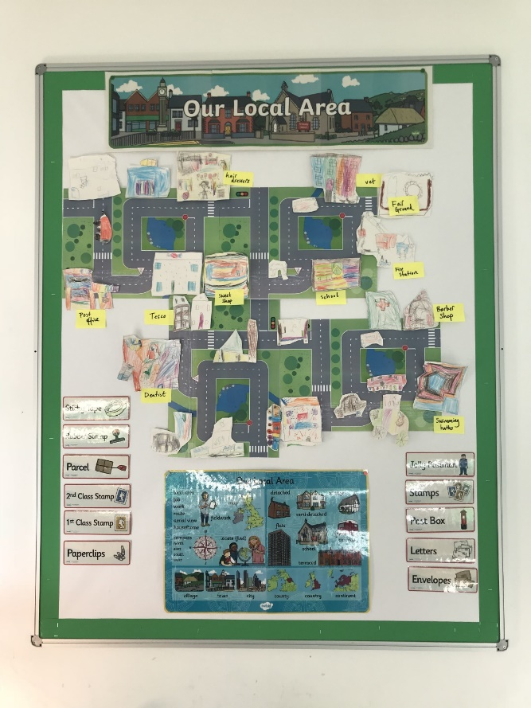
Mapping Your Local Area

Slide 21
Drawing Maps
Use standard and non-standard units.
Create scale drawings and maps of the local area.
Create routes measuring distance and predict time.
Add directions.
Explore map symbols.
Compare old and new maps.

Slide 22
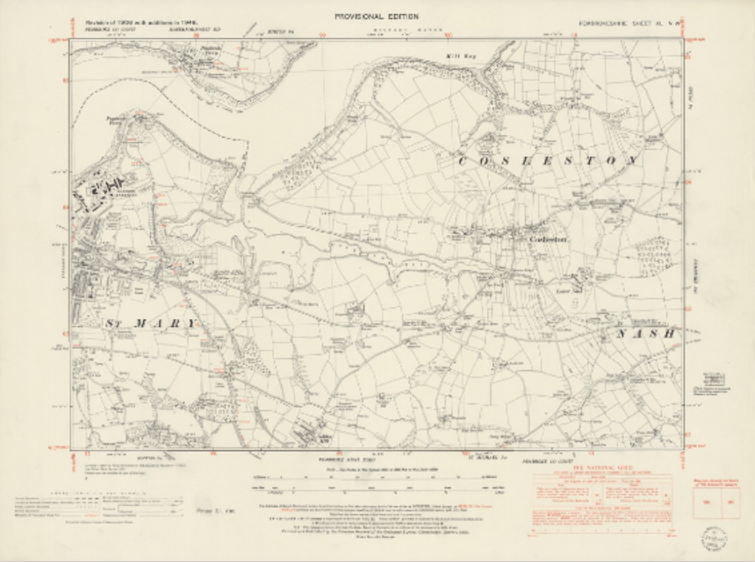



webpage

Slide 23
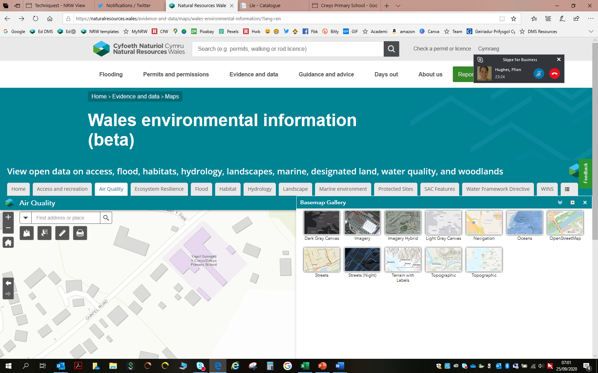
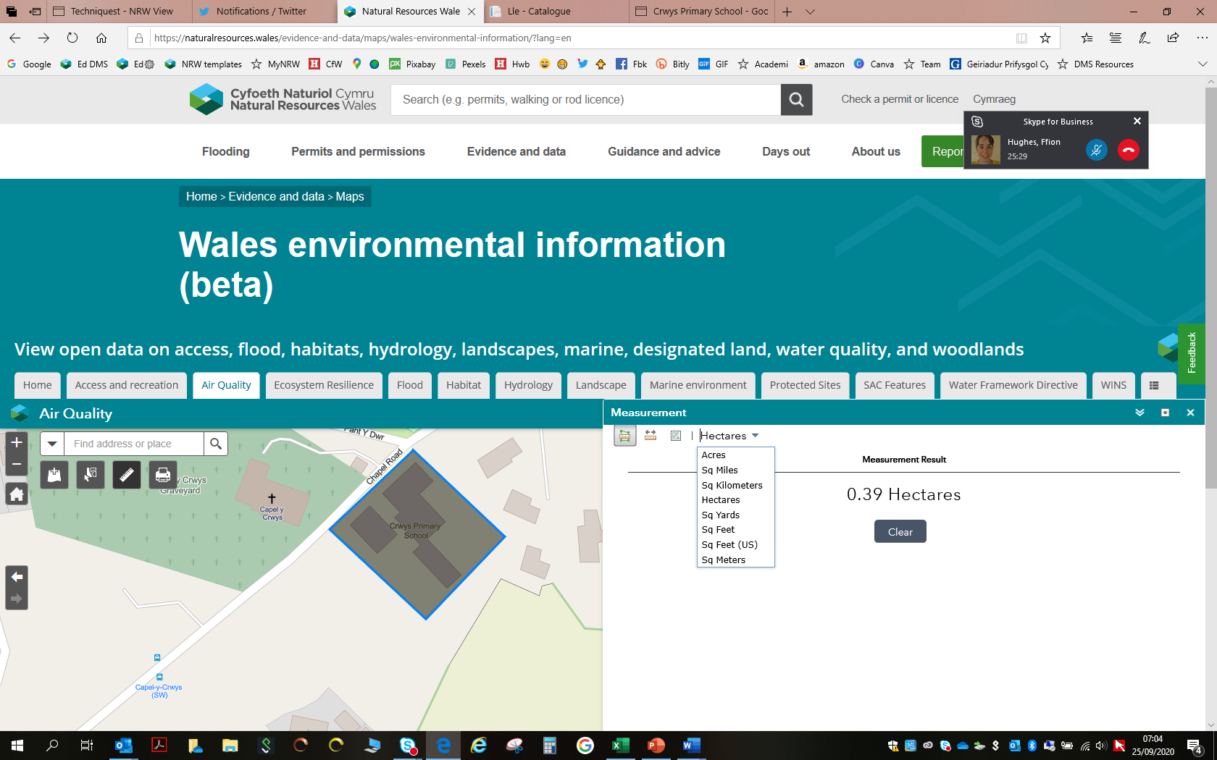
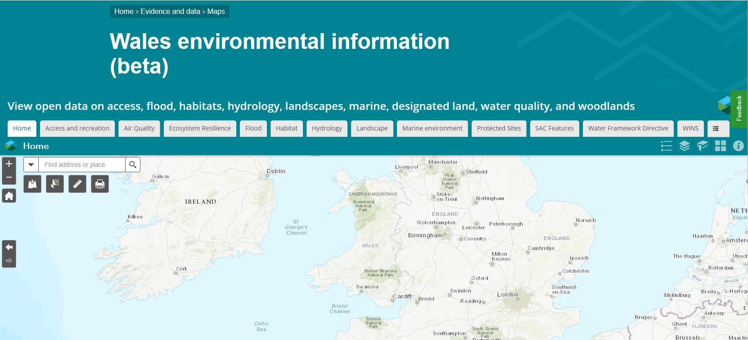
Area, distance, location, maps
Wales environmental information webpage

Slide 24
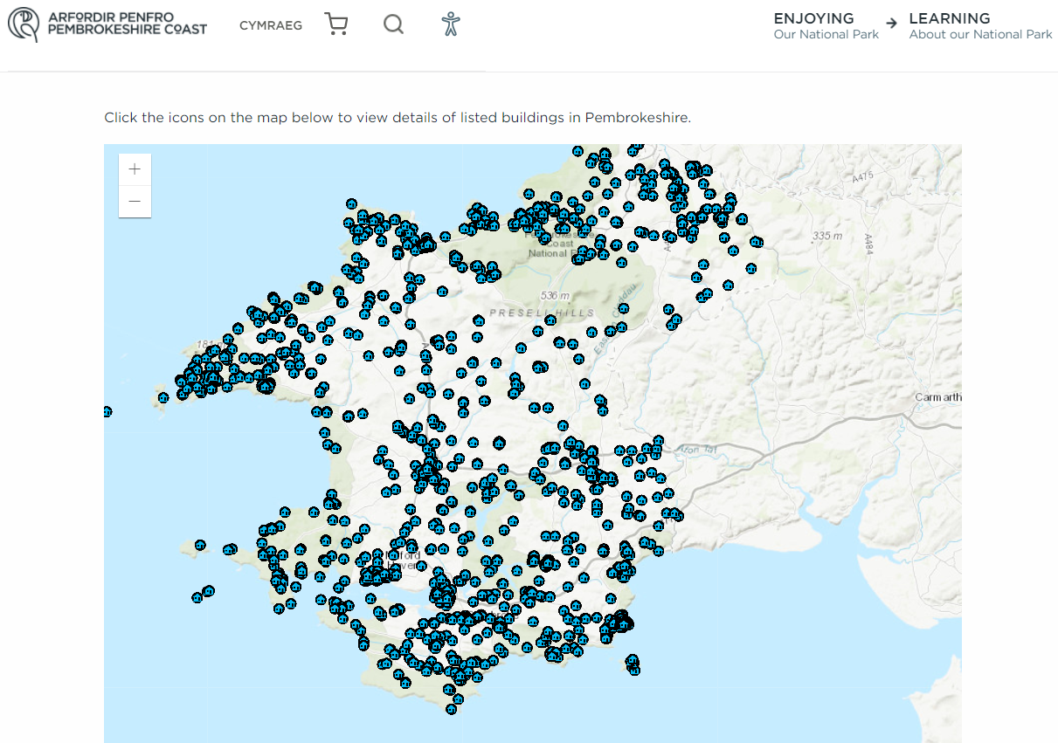
Listed Buildings in Pembrokeshire

Slide 25
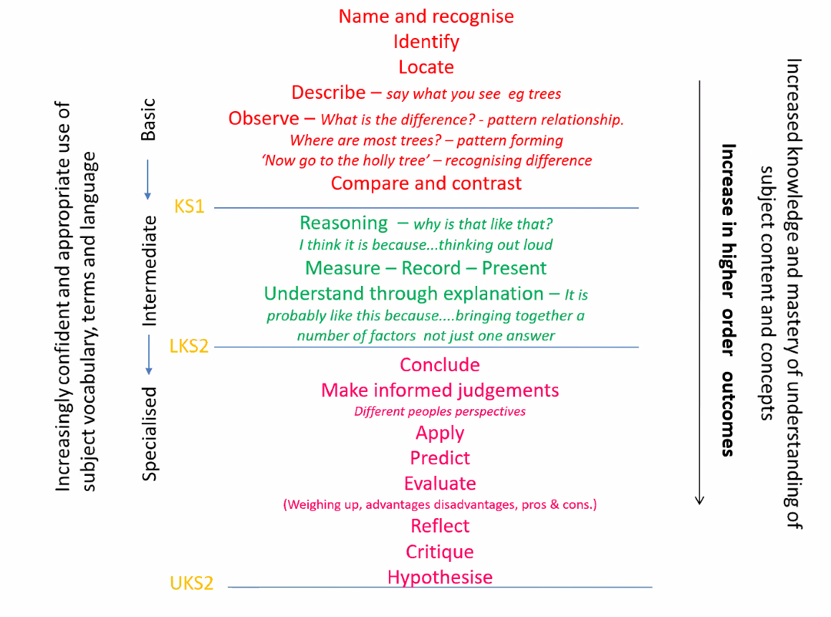

Slide 26
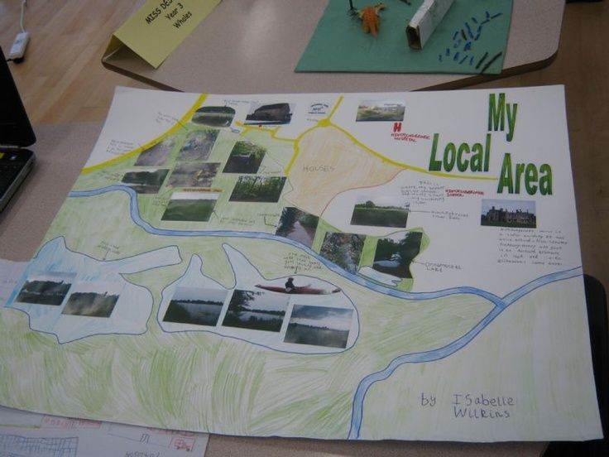
Recording Observations
Drawing pictures/sketches
Annotating maps
Digital Photographs
Voice Recorders
Sound Map
Collecting natural and man made objects.

Slide 27
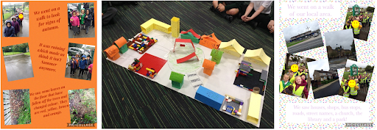
Village Model

Slide 28
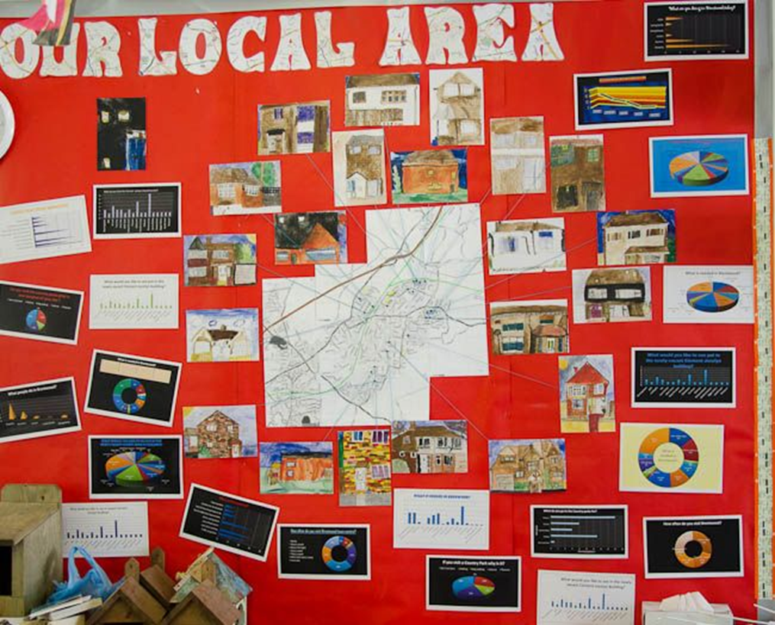

Slide 29










PODS Partners that can support

