Slide 1





Pembrokeshire Outdoor Schools (PODS)
Developing Your
School Grounds
Notes:
Risk assessments are important because they help you to:
Spot hazards.
Think about the potential harm.
Identify people who may be at risk.
Protect the people at risk.
Plan the work safely.
Review existing controls.
Make improvements.
Comply with the law.

Slide 2
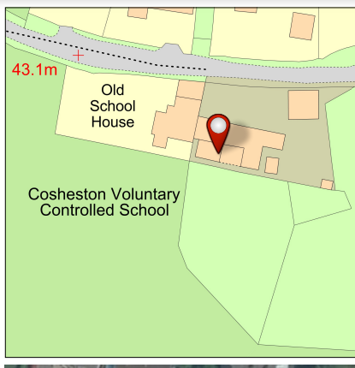
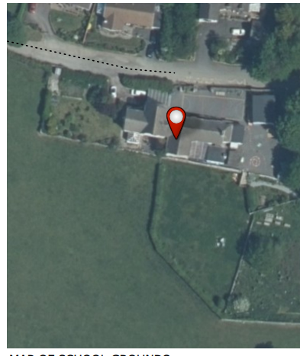
Cosheston School

Slide 3
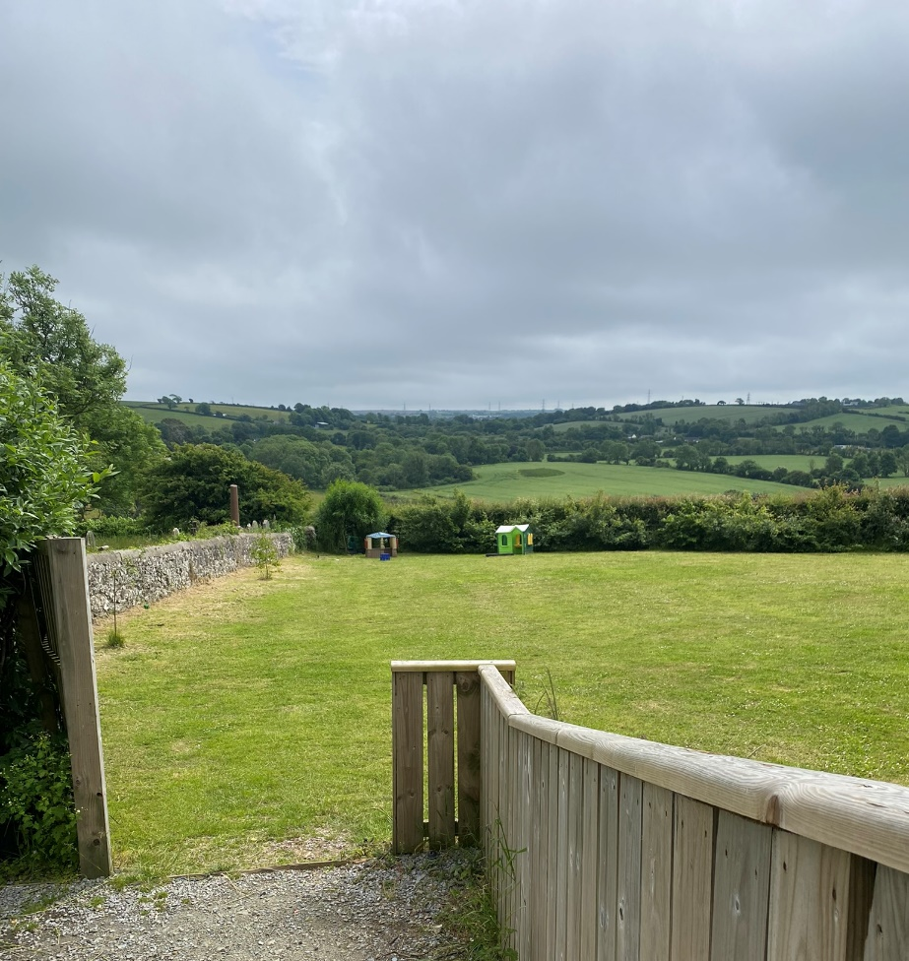
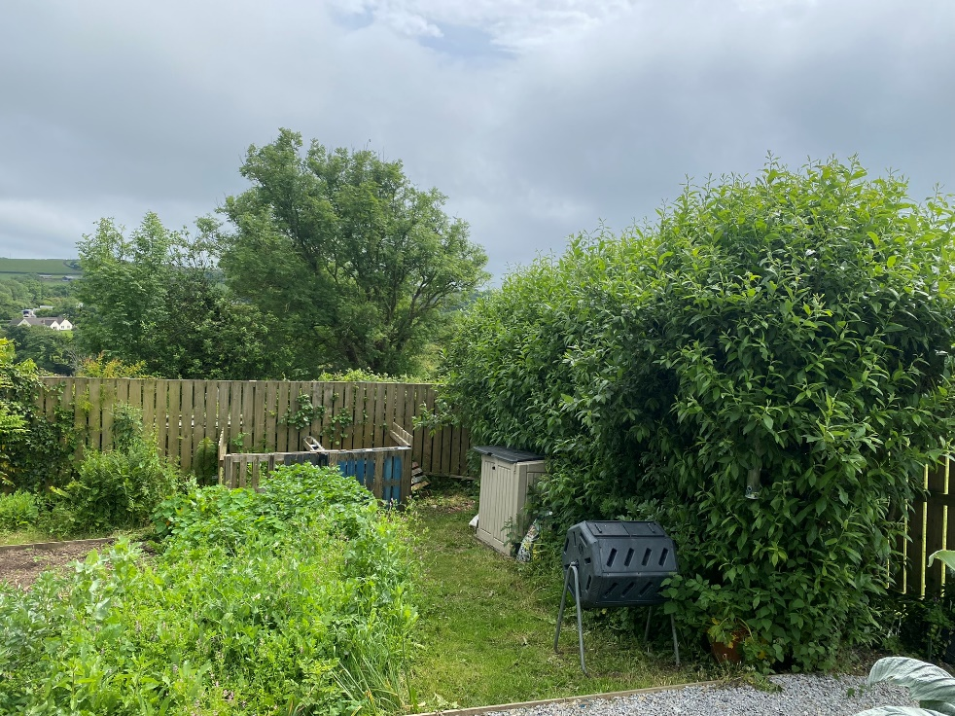
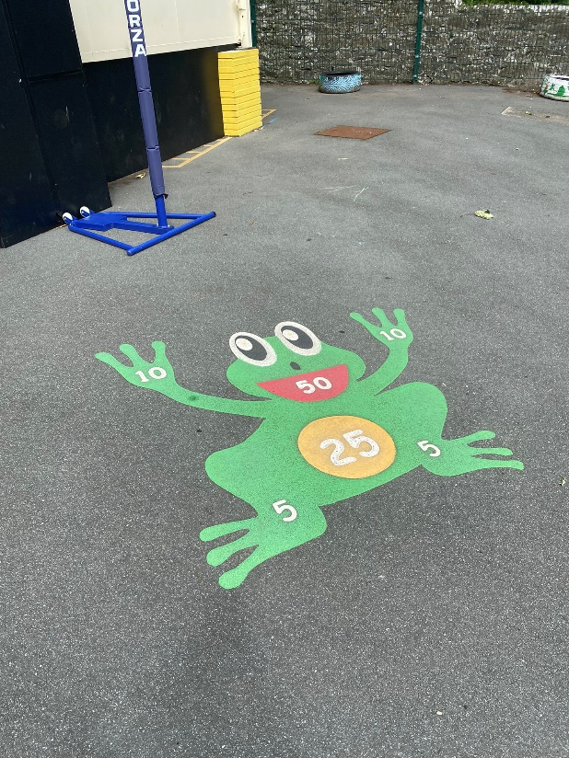
Cosheston School Grouds

Slide 4
What is good about your school grounds at the moment?

Slide 5
What would you like in your school grounds for learning and play?

Slide 6
What have your learnt about that is connected to nature and the outdoors?

Slide 7
How could your schools grounds be improved?

Slide 8
Problems and Solutions!
What are the current problems with the grounds and where?
How could these things be improved or changed?

Slide 9
Slideshow!
Look at images of well developed outside spaces.

Slide 10
Student Surveyors!
Map your feelings on different areas of the school grounds.

Slide 11
Take lots of photos!
Take lots of images from every angle to capture the grounds as it is and annotate the pictures.

Slide 12
Plus, minus, interesting!
Name an area of the grounds that you could add something, an area you would take away something and somewhere you find interesting.

Slide 13
Rate the Grounds!
Rate different areas 1-10.
Now work out the mean, median and mode of the results and compare results.

Slide 14
Rate the Grounds!
Mean = A mean in maths is the average of a data set, found by adding all numbers together and then dividing the sum of the numbers by the number of numbers.
Median = The median of a set of numbers put in ascending order and finding the middle number in that list.
Mode = The mode of a set of numbers is the one that appears most often.

Slide 15
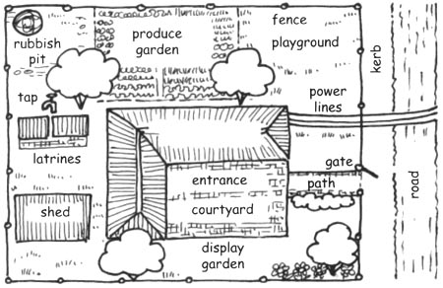
Your School Grounds
Every person must mark on the map:
Where you play most often DARK BLUE
Where you go to be alone BLACK
The place with the best view LIGHT BLUE
The place to find lots of wildlife and nature GREEN
Best place for being physically active PURPLE
The quietest space BROWN
A good place to relax ORANGE
A dangerous place RED
A safe place PINK

Slide 16
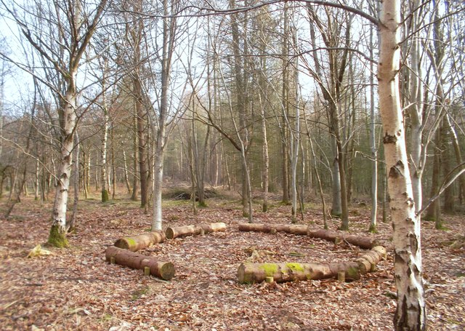
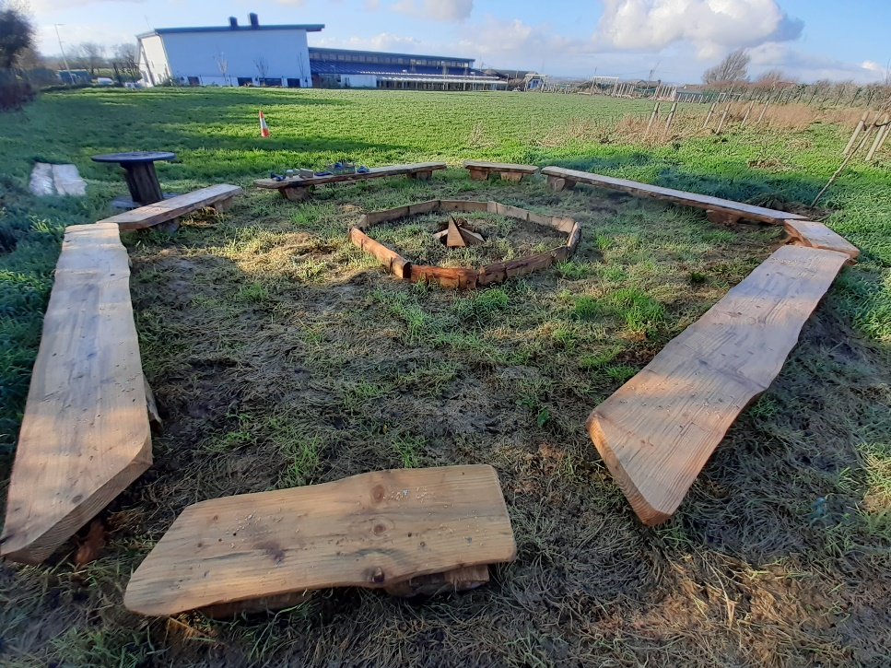
Ideas

Slide 17
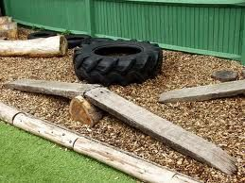
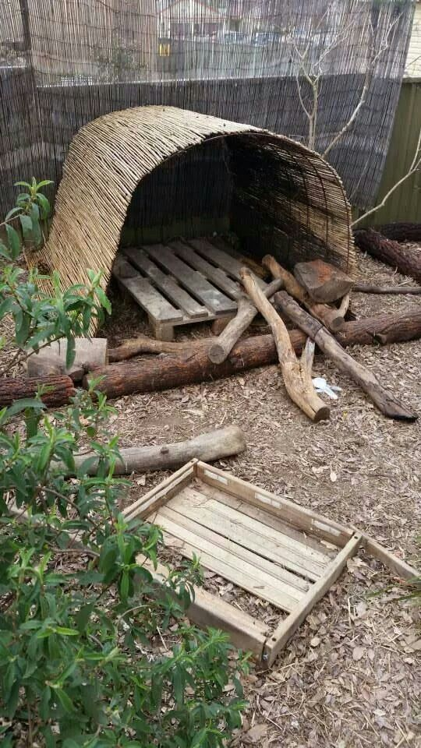
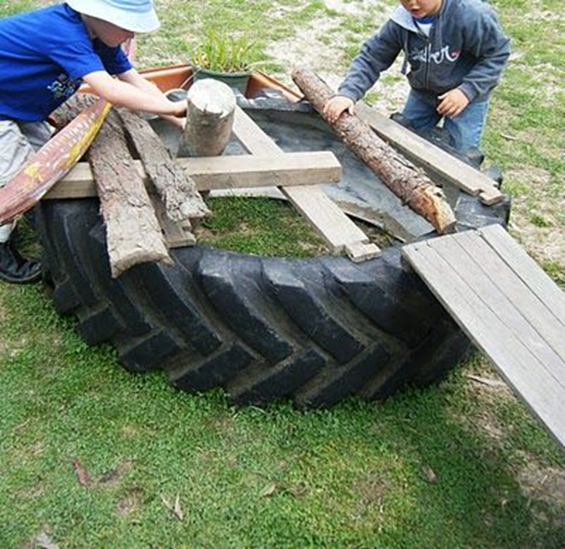

Slide 18
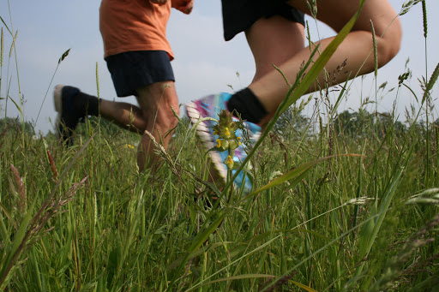
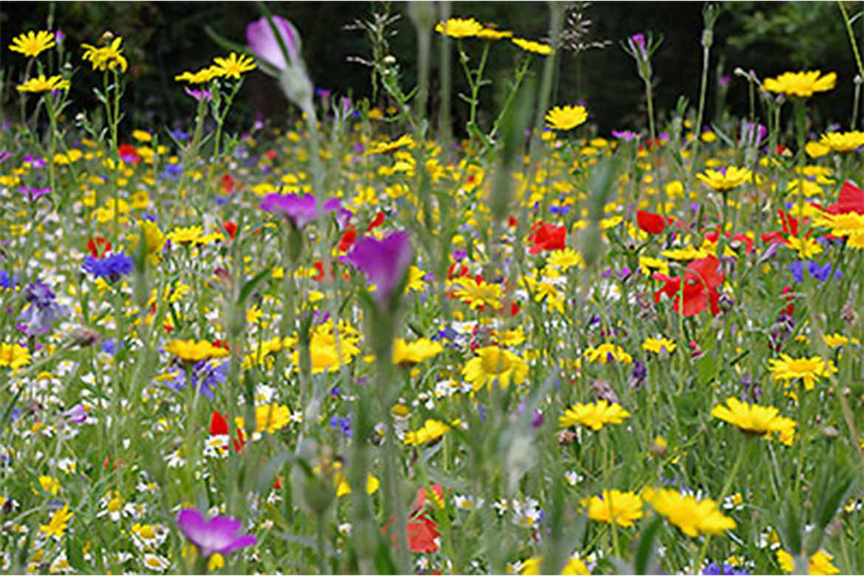

Slide 19
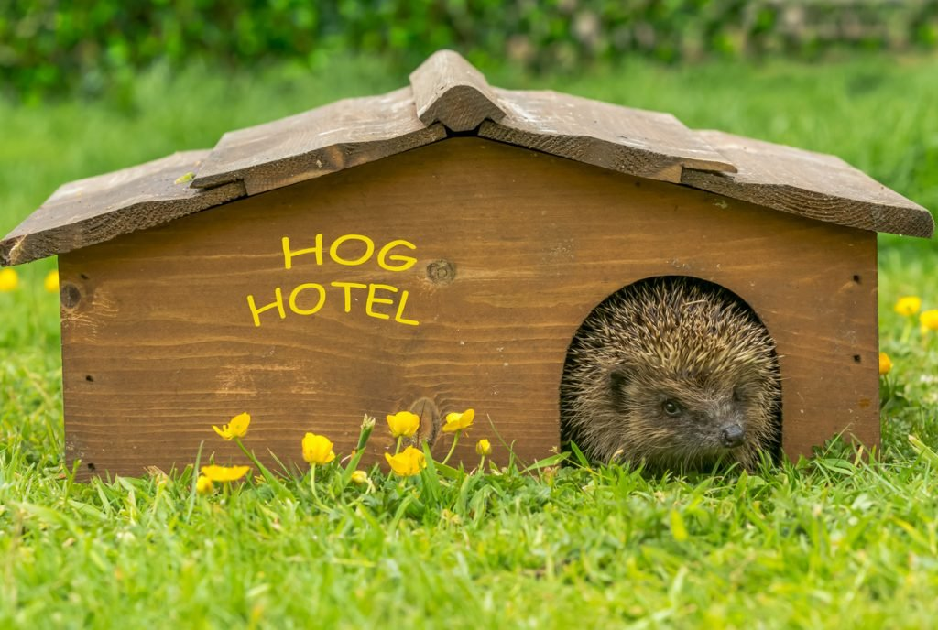
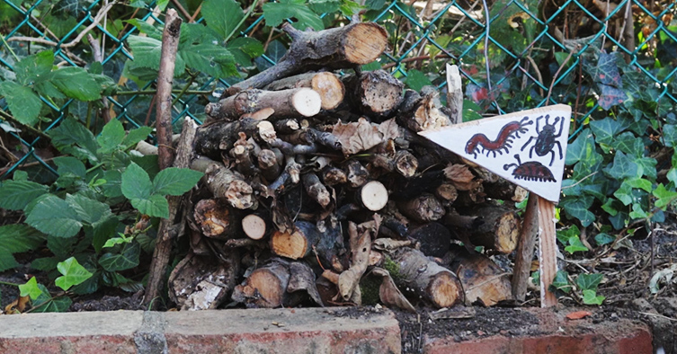
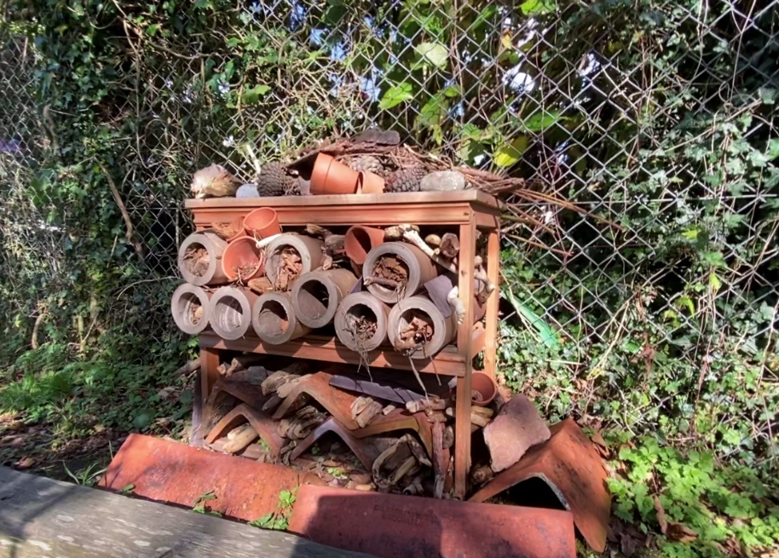
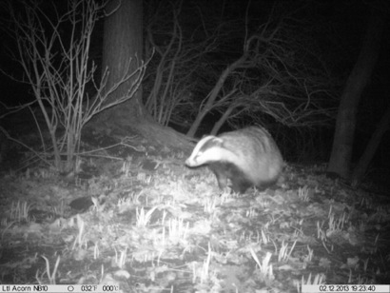

Slide 20
