Slide 1
Developing our Outside area

Slide 2
Prynhawn da
We are the members of Criw Cosh (our school council) and we would like to tell you about how we are planning to develop our outdoor area to make it even better.

Slide 3
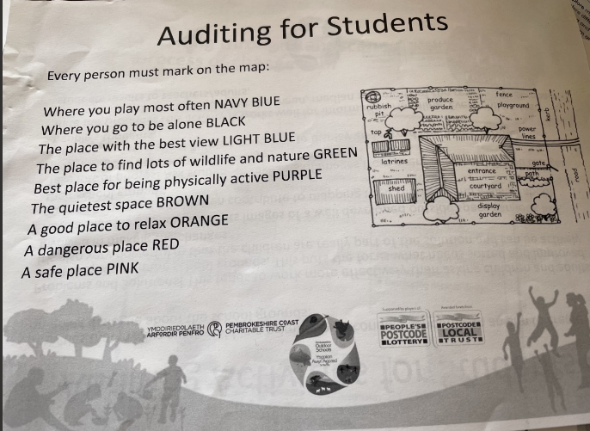
We started with Bryony from PODS coming in to help Dosbarth Seren (summer 22) think about our current school grounds and how we use them.
We plotted any new features on the maps that she had provided then colour coded different areas according to how we all felt they were used.
In our groups we talked about what things worked well and what didn’t work so well – and how to improve this eg moving log circle from where the football ‘goal’ was (which we did straight away as this was an easy thing to sort)

Slide 4
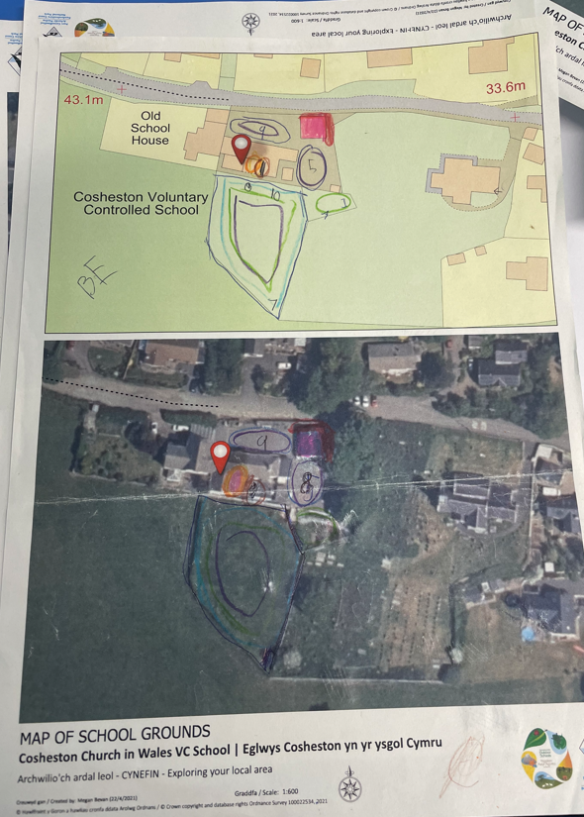
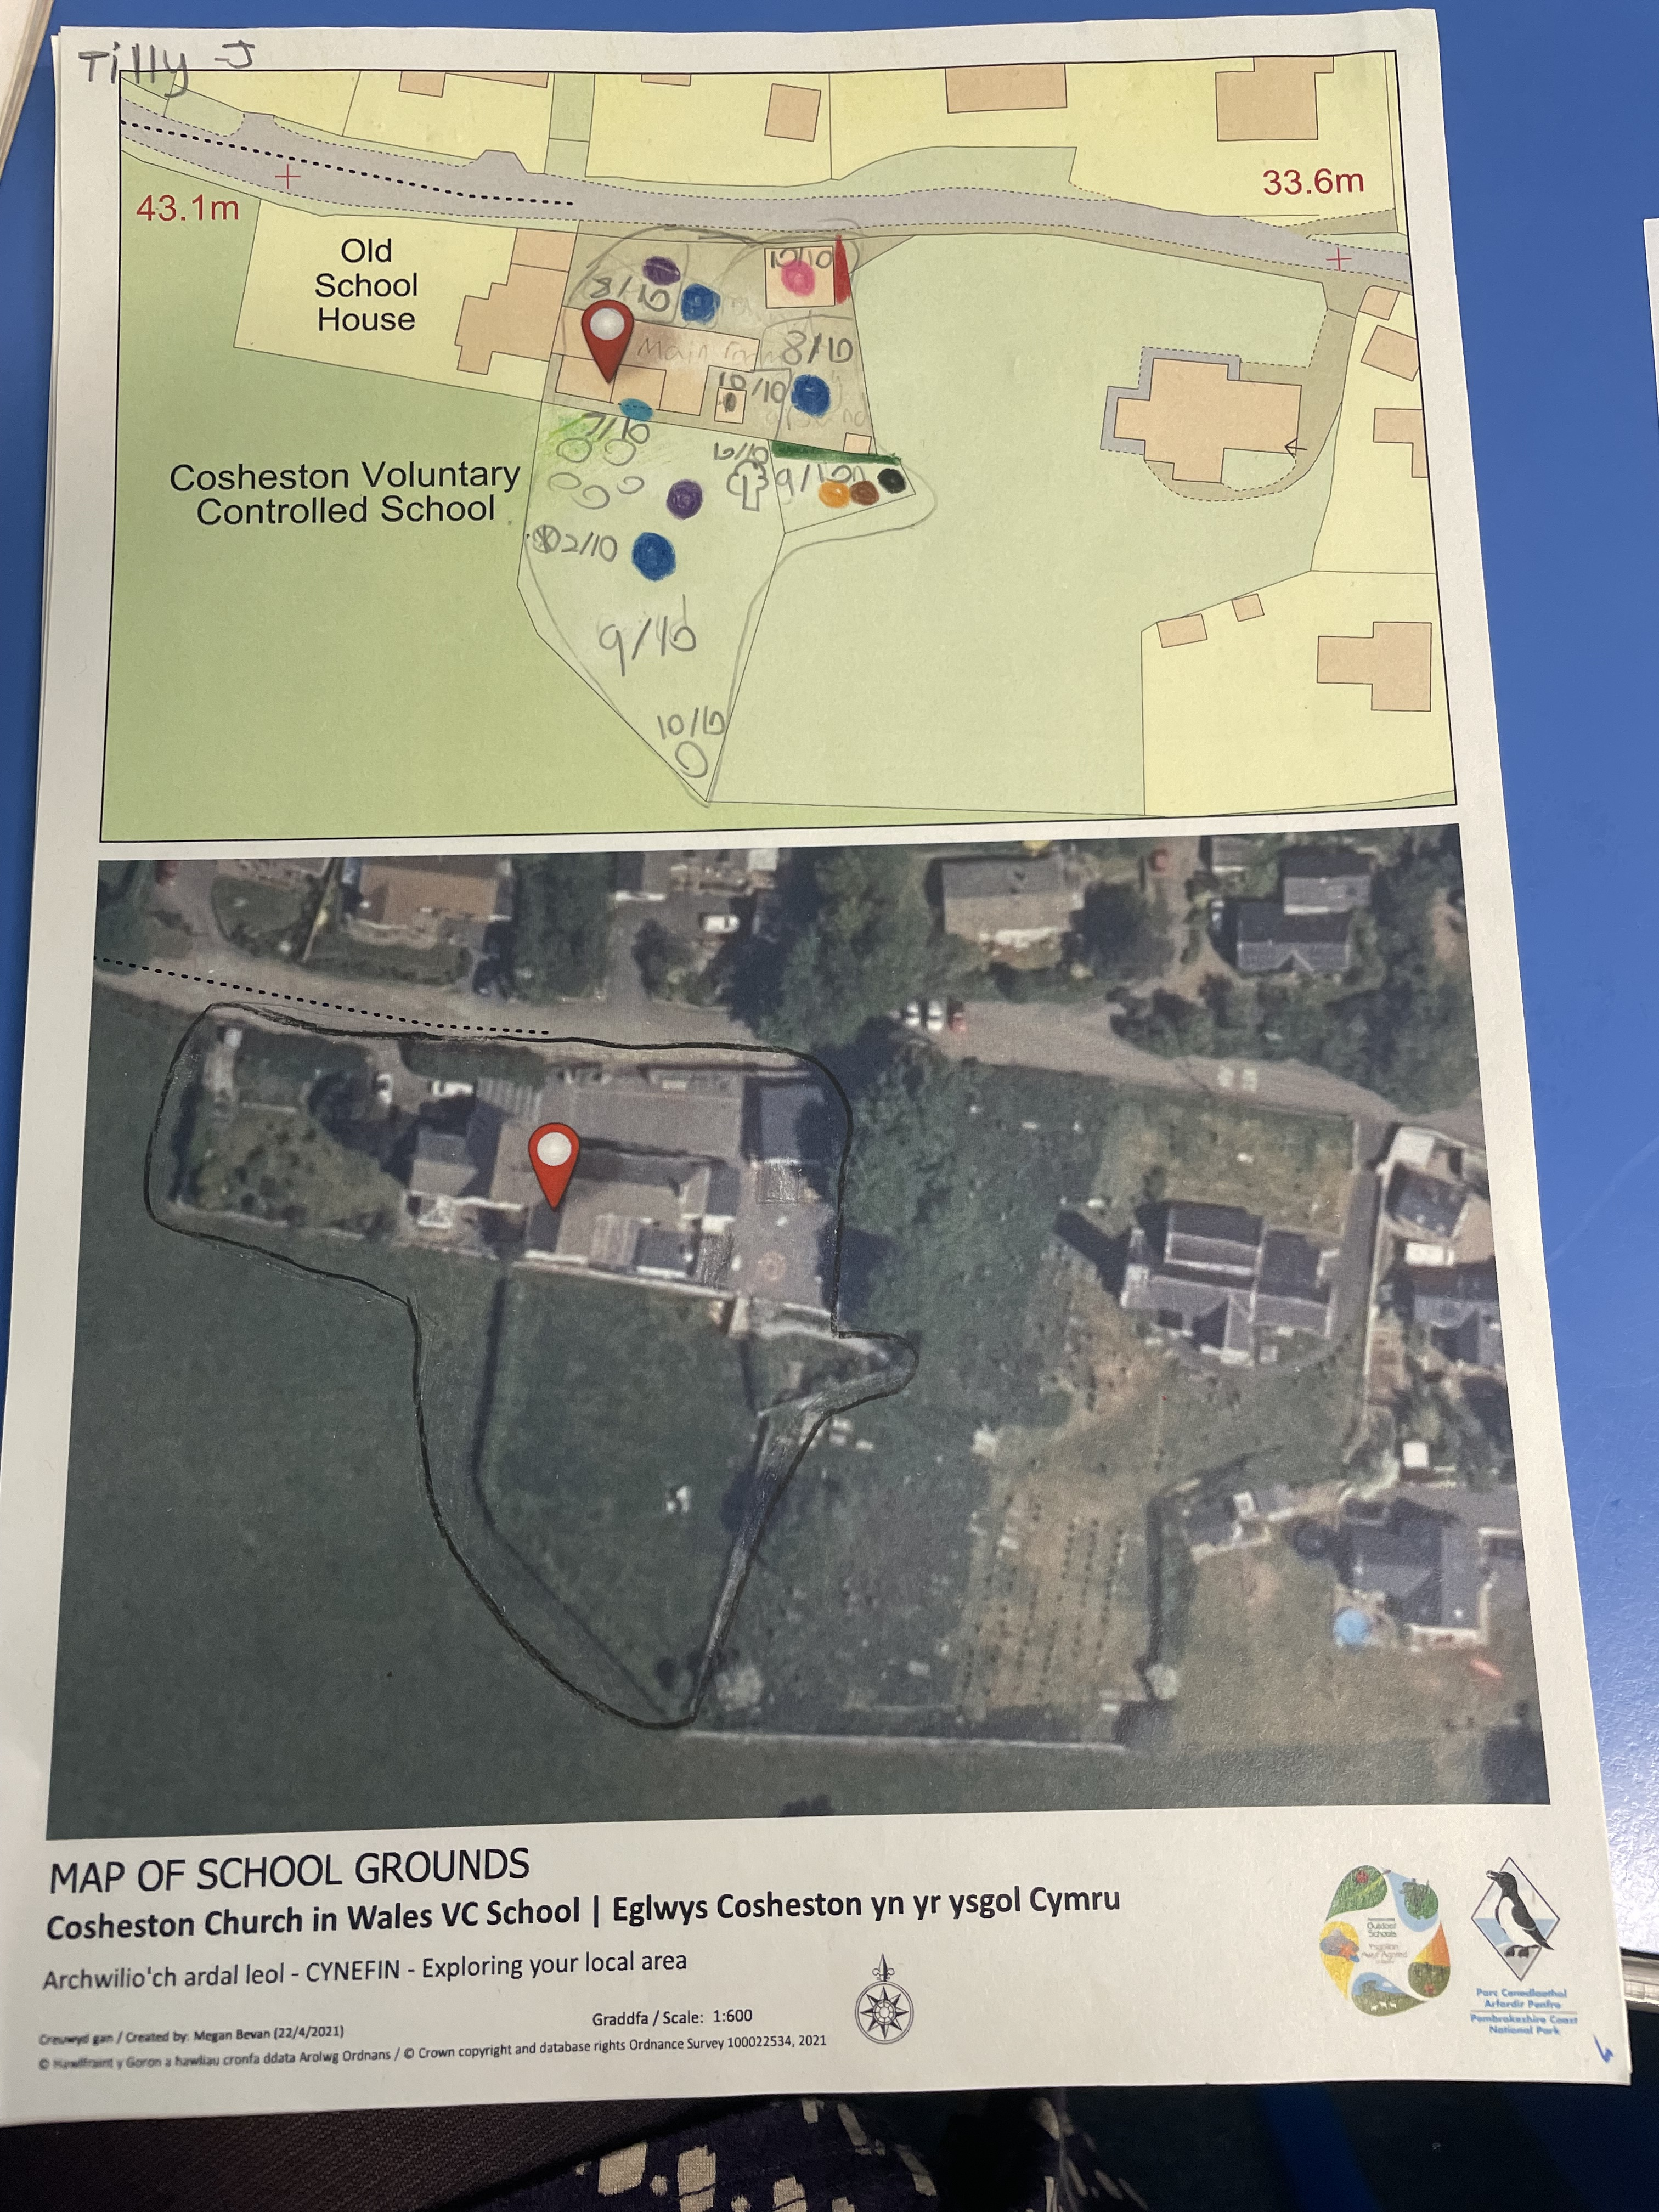
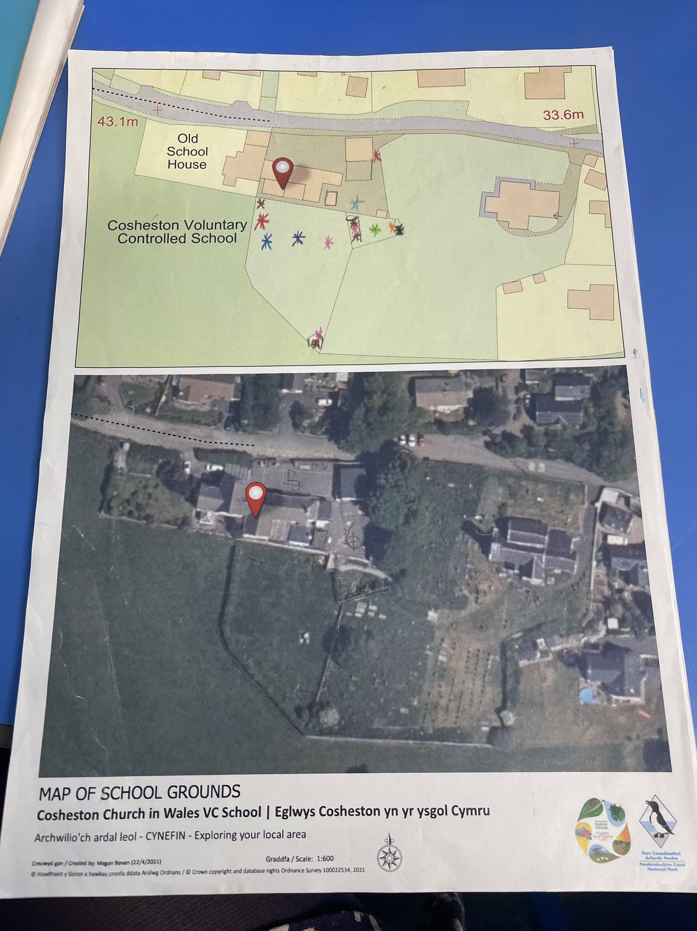
These are the aerial maps we used

Slide 5
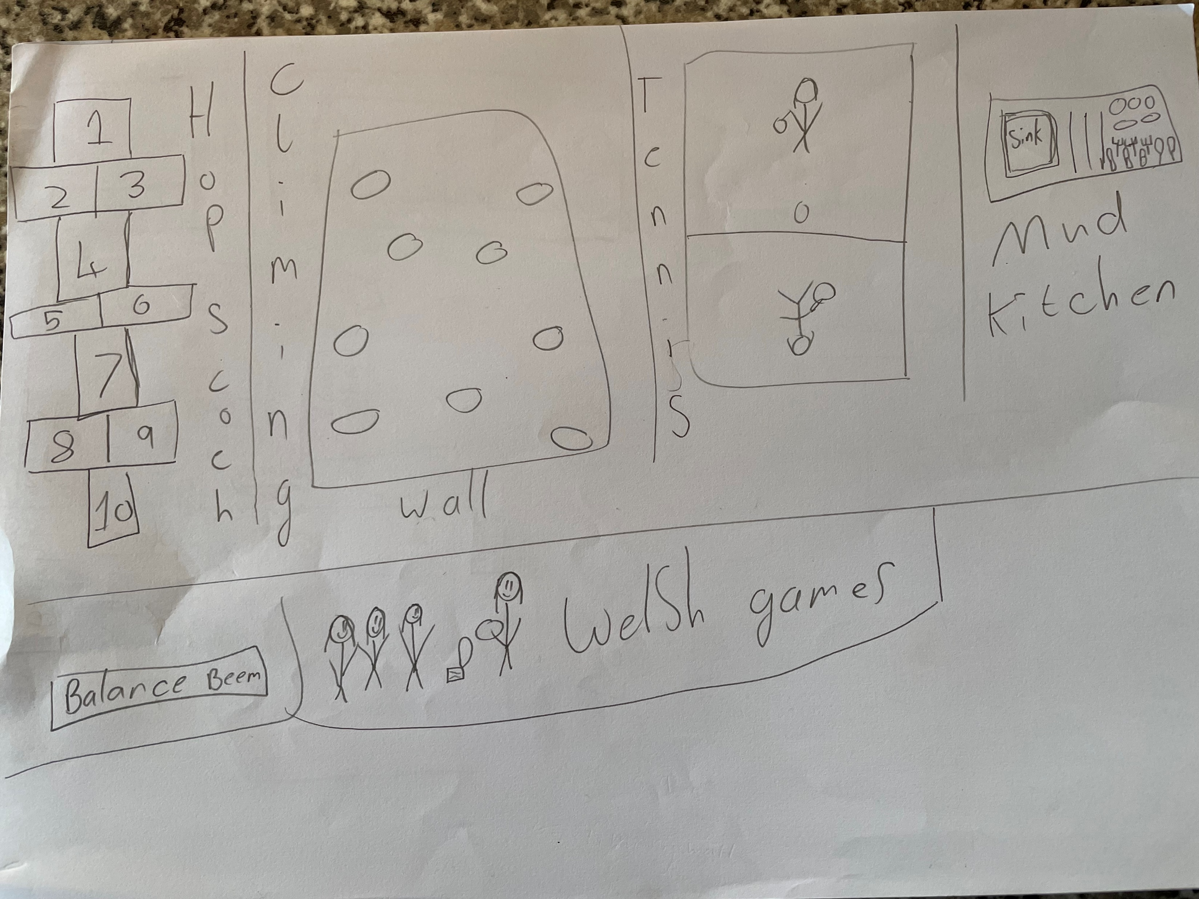
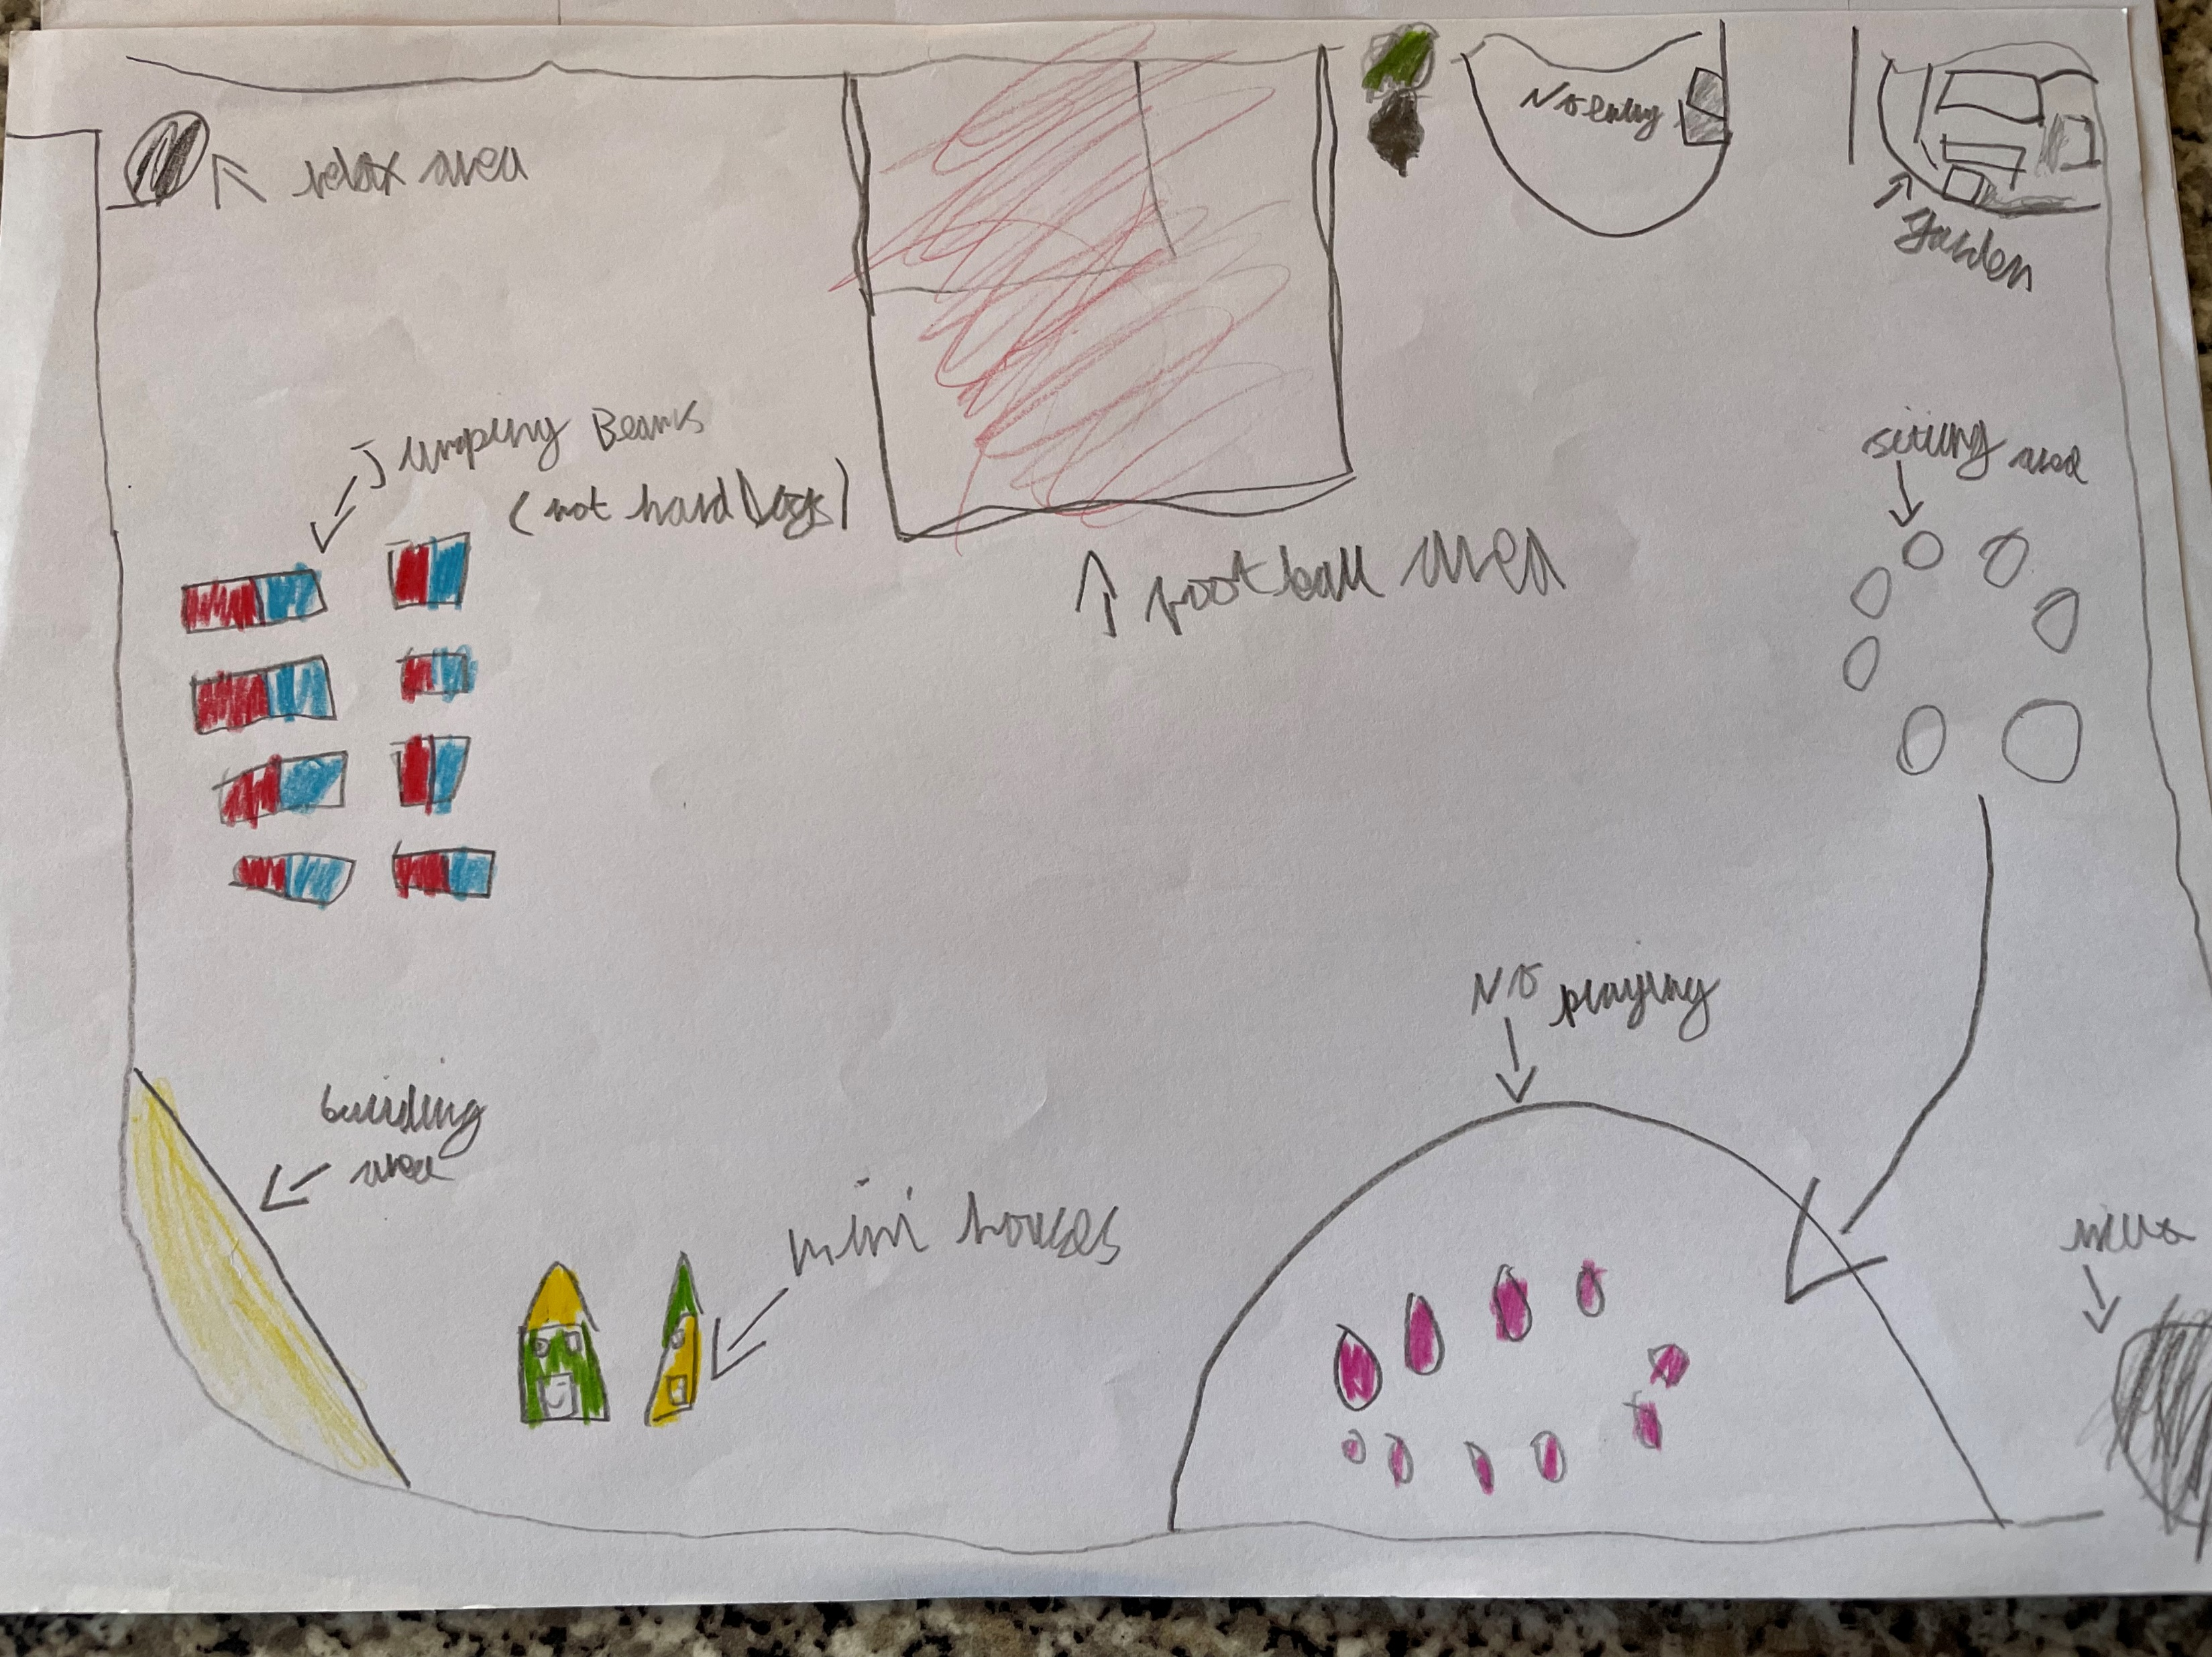
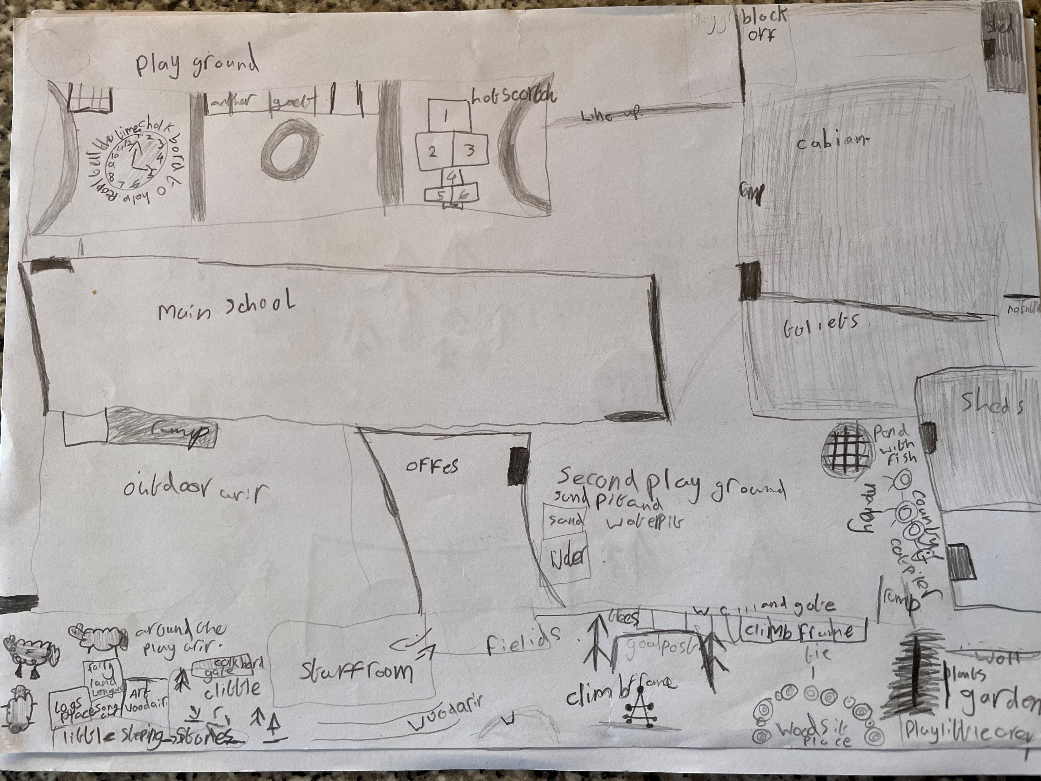
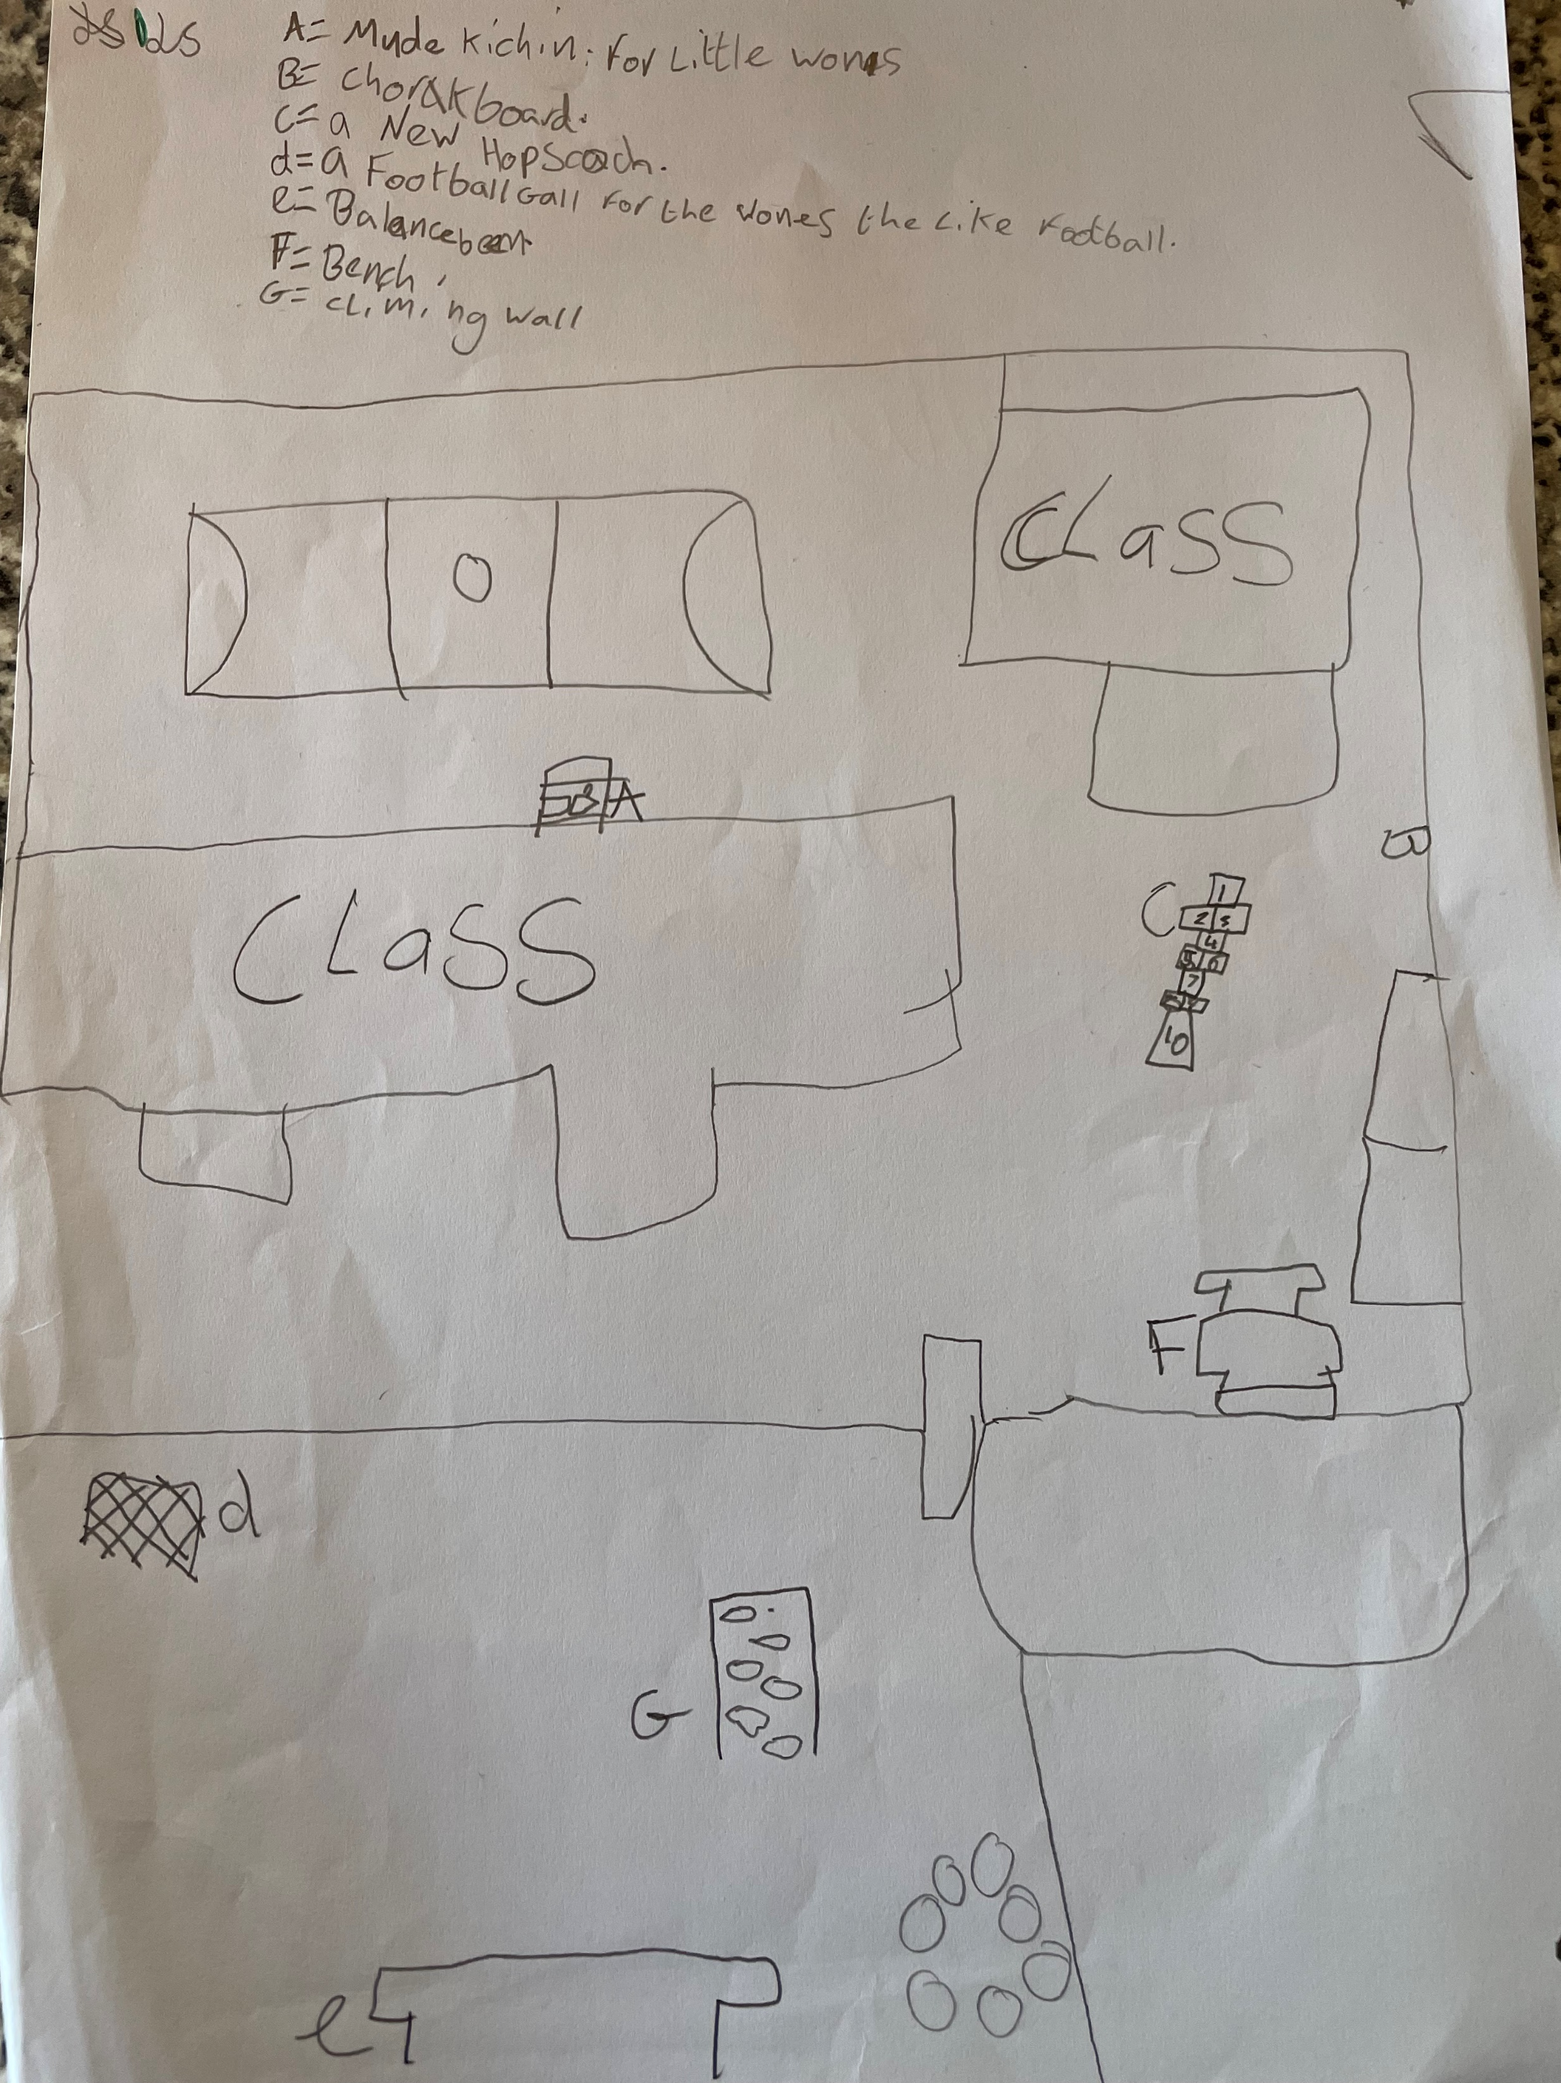
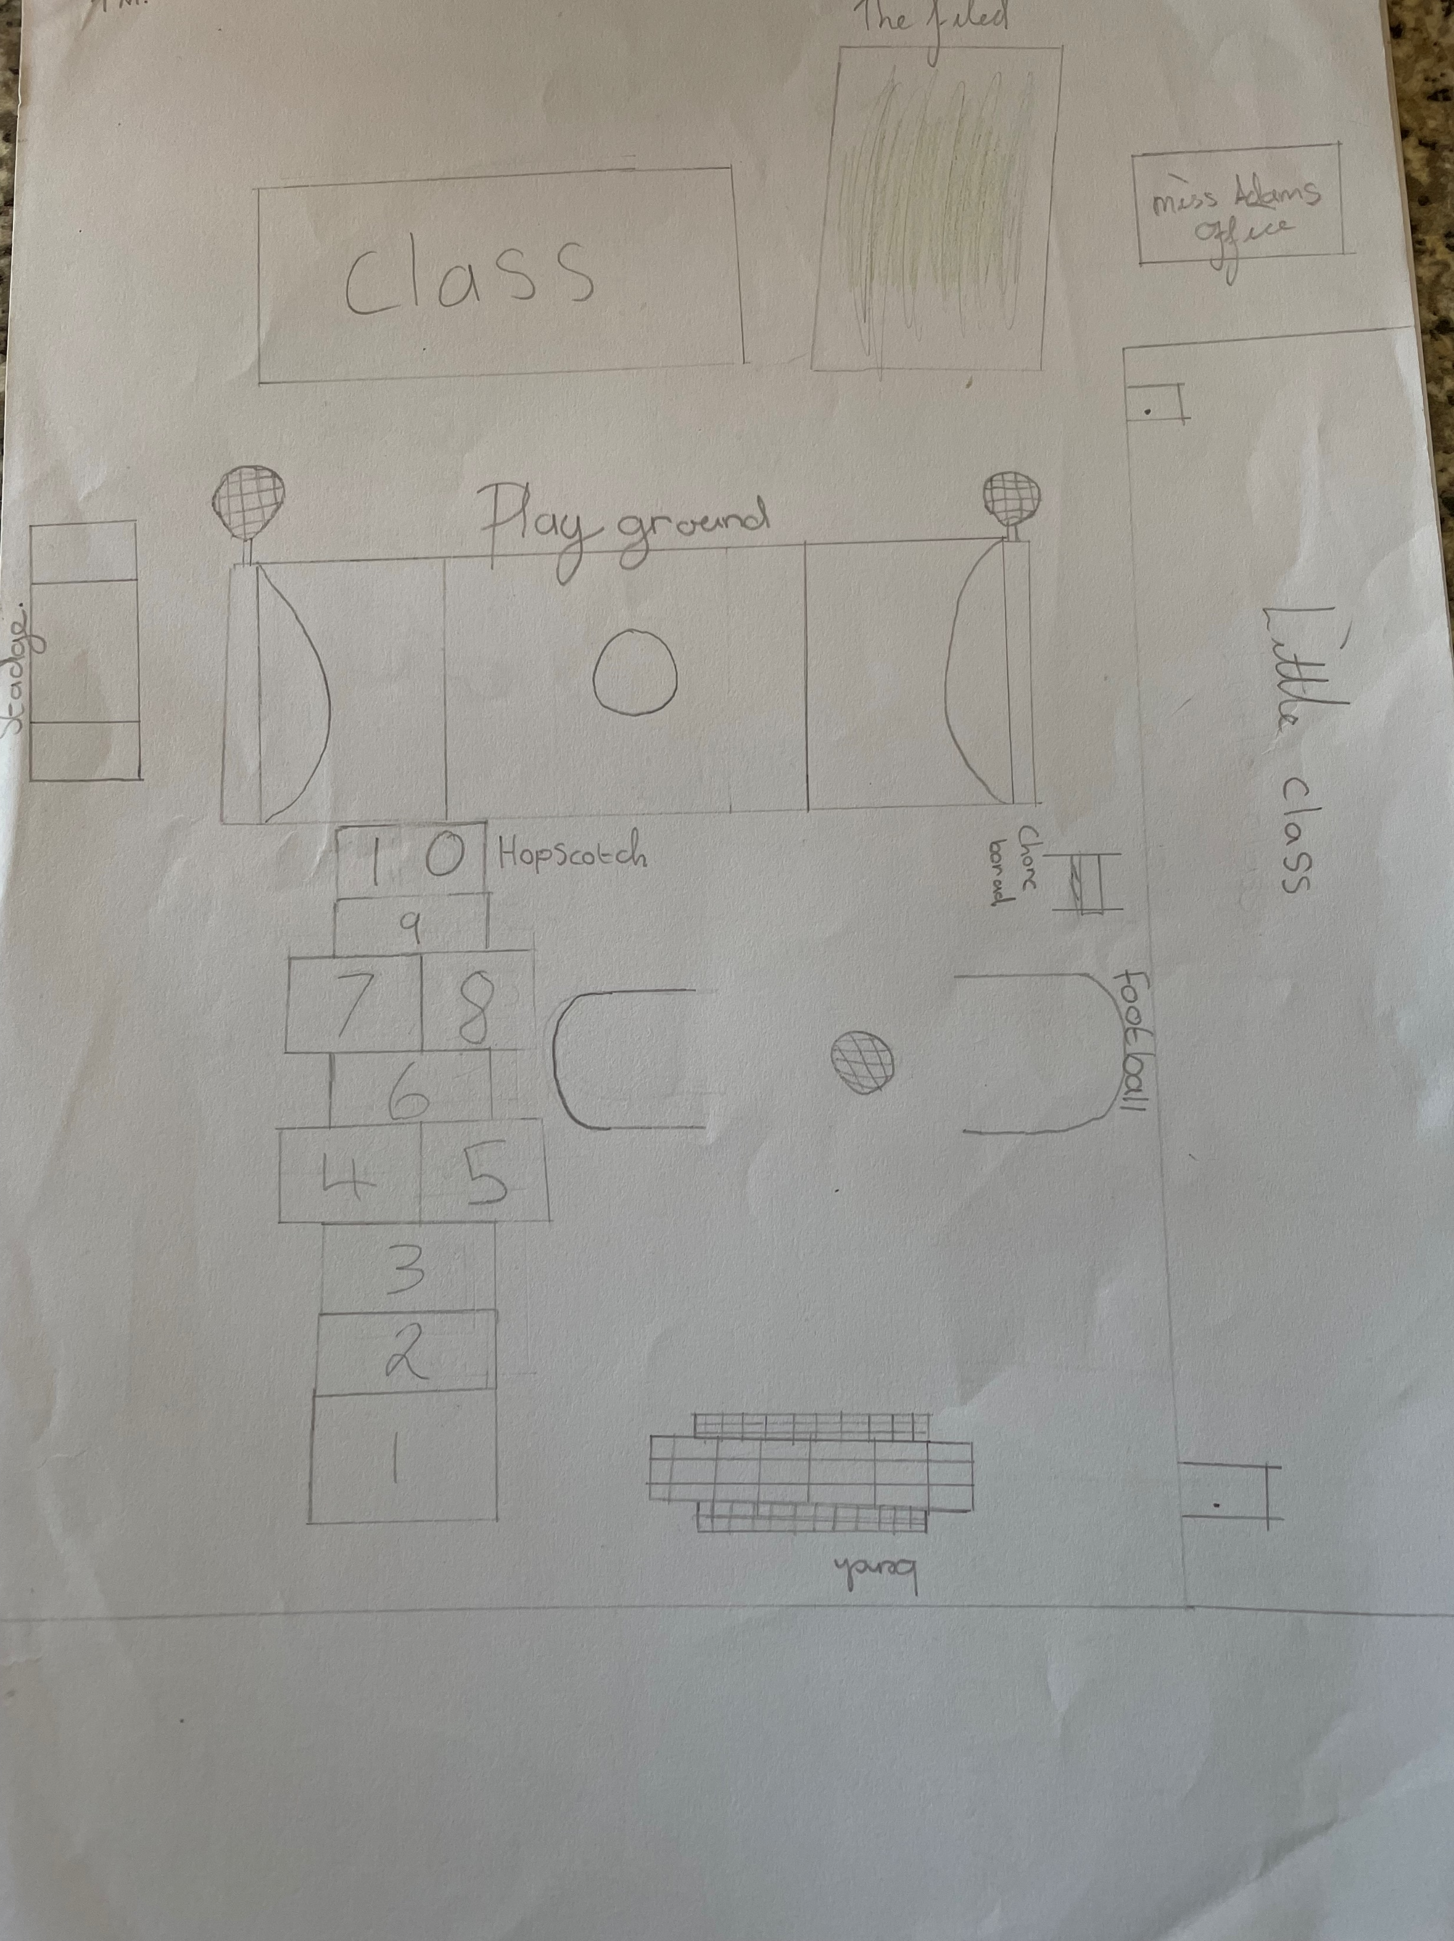
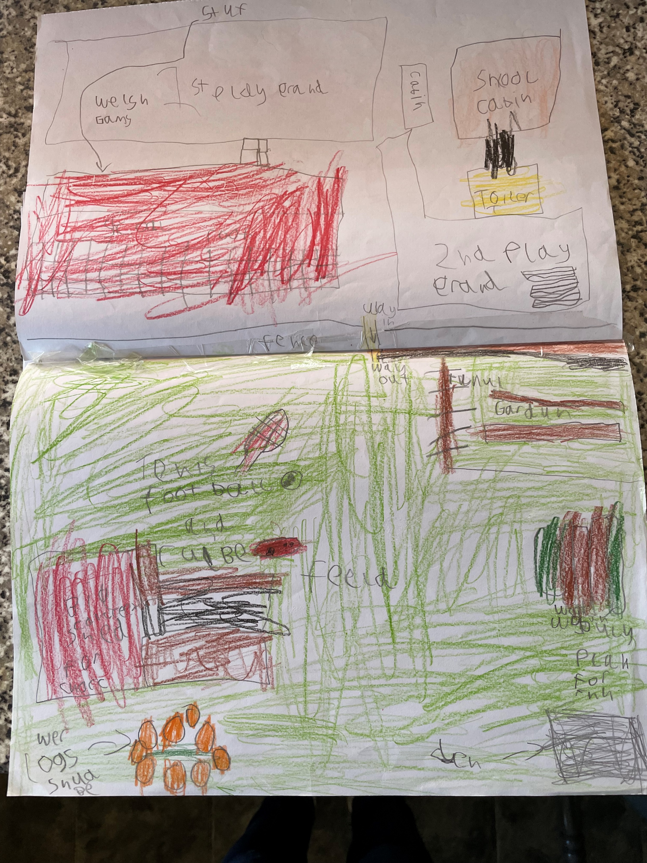
Following Bryony’s visit we looked at pictures of outside areas at other schools to give ideas of what a good outdoor area could look like and then we designed our own outside areas. Using all the plans, we have come up with a list of things we would like to include in our outside area.

Slide 6
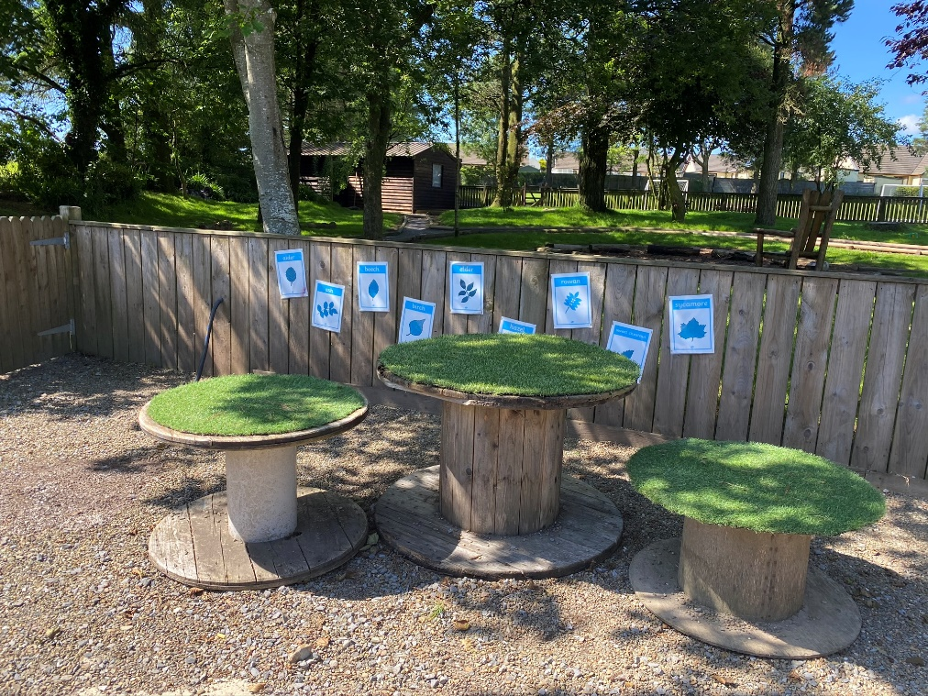
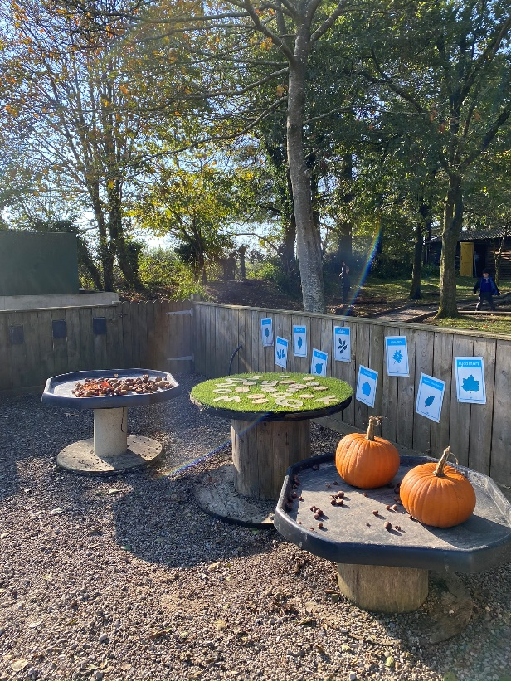
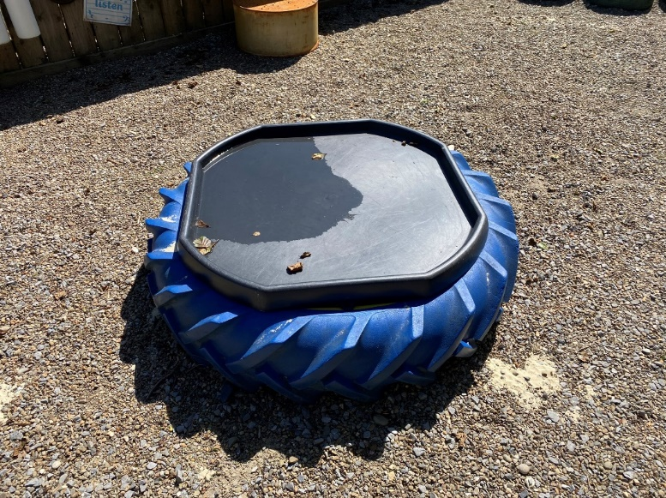
These are some of the things we would like at our school

Slide 7
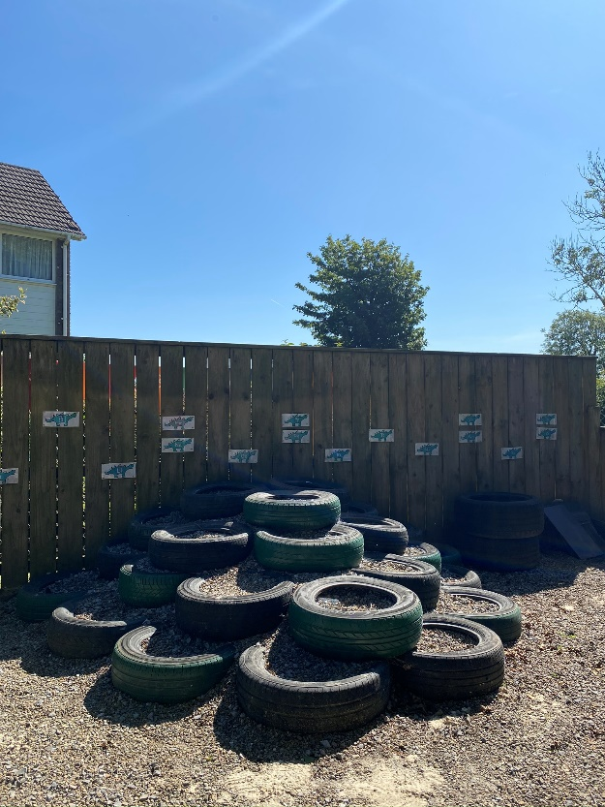
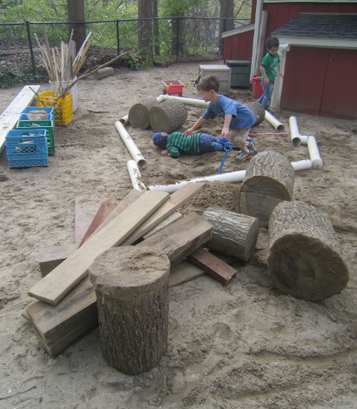
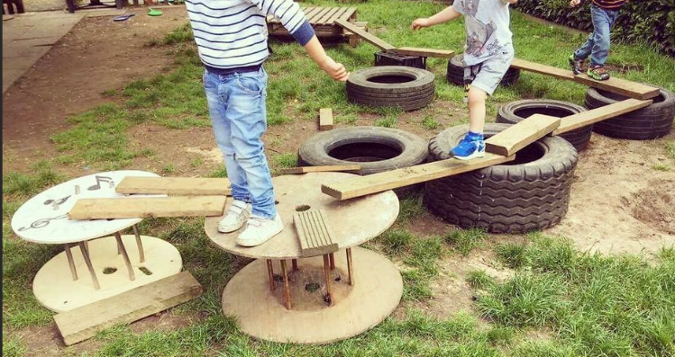

Slide 8
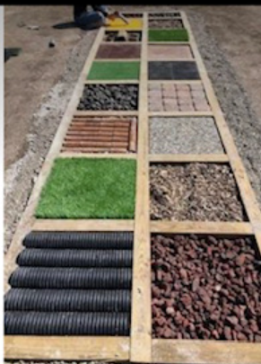
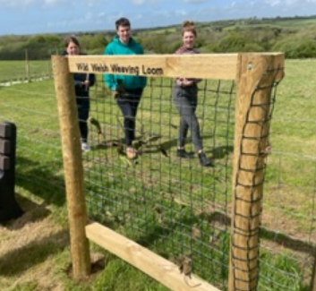

Slide 9
This term, we were chosen as the members of Criw Cosh and one of our first jobs was to come up with a list of items that could go into boxes for playtime.
Mrs Adams wanted the boxes to be based on the 6 areas of learning.
It was quite tricky to think of things for some boxes but we have made a start.

Slide 10
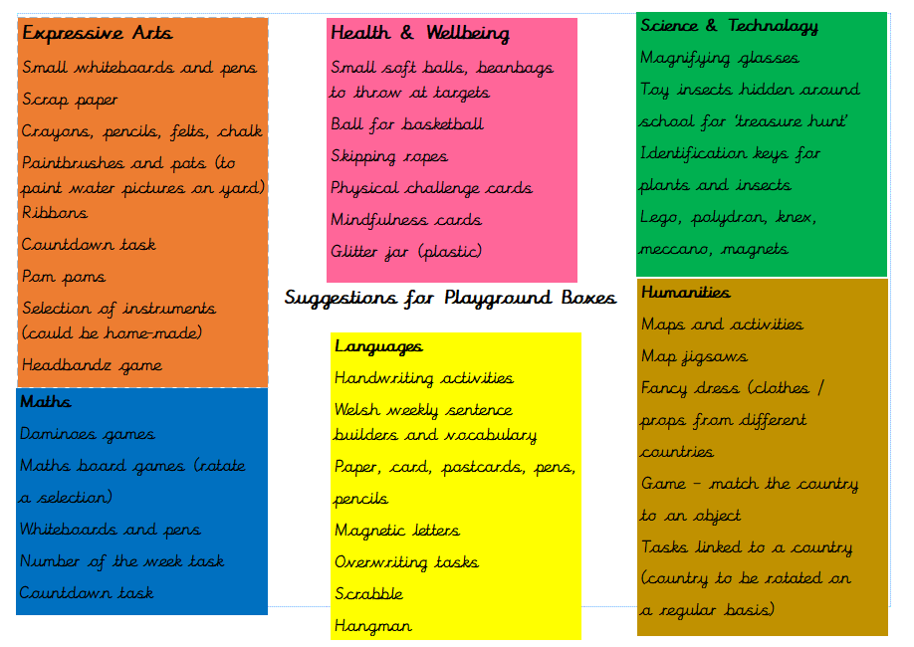
This is what we have come up with so far

Slide 11
We are now waiting for someone to come back to school with some quotes for wooden boxes to store everything before we order and make the activities.
We also plan to have an enterprise day where we make some of the activities and games ourselves.
The next step will be to work with Bryony on putting our plan into action – getting hold of materials and applying for any grants that are available to help with cost.

Slide 12
Diolch am wrando
Thank you for listening
Does anyone have any questions?

