Slide 1
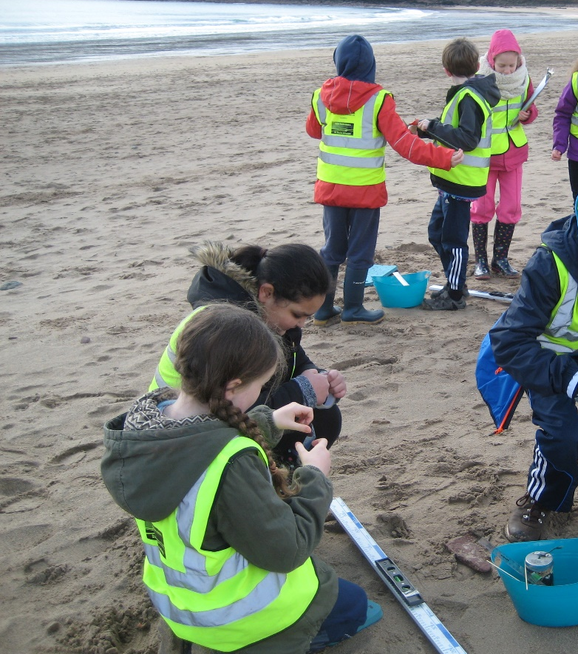
Rich Tasks in the Outdoors
Lamphey Primary School
Mrs Thomas Class teacher
Mr S Thomas Headteacher

Slide 2
Outdoor provision in Lamphey Primary School
Each class is allocated an area/ environment which they are able to integrate in to cross - curricular planning.
Expectation that each class will regularly utilise this area/environment to develop skills in high challenge activities.

Slide 3
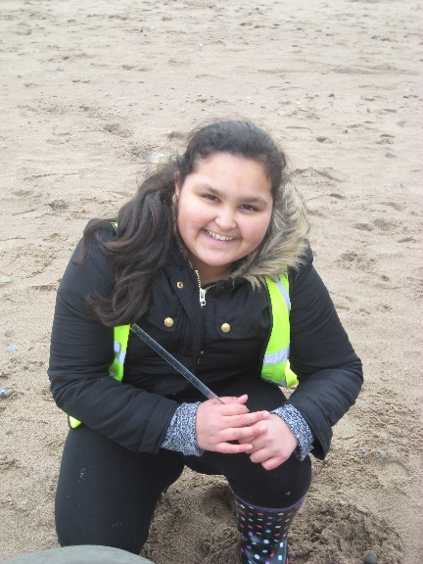
Ensuring good practice
Using the Outdoor environment to gather data or complete activity
Extending the activity by developing skills back in the classroom
Reflection and evaluation to feed in to next activity
Overt teaching of a skill within the classroom
Placing that skill within a real life context

Slide 4
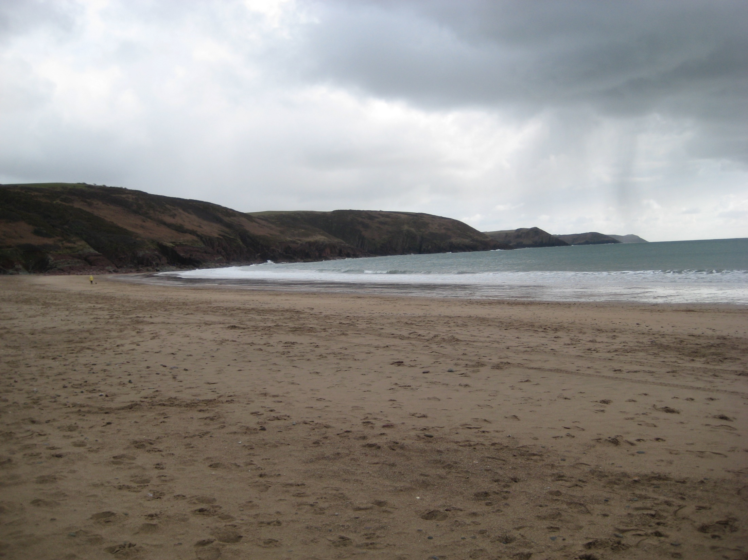
Year 6 - Lamphey Primary School
Designated environment – Freshwater East
Geographical Range – Fieldwork to observe and investigate real places and processes

Slide 5
Freshwater East – Rich Task 1
Prior learning before Visit – Geographical and Numerical
Location – identify and locate places and environments using globes, atlases and maps, e.g they use co-ordinates and four figure references
Follow directions, estimate and calculate distances, e.g follow map and ground routes

Slide 6
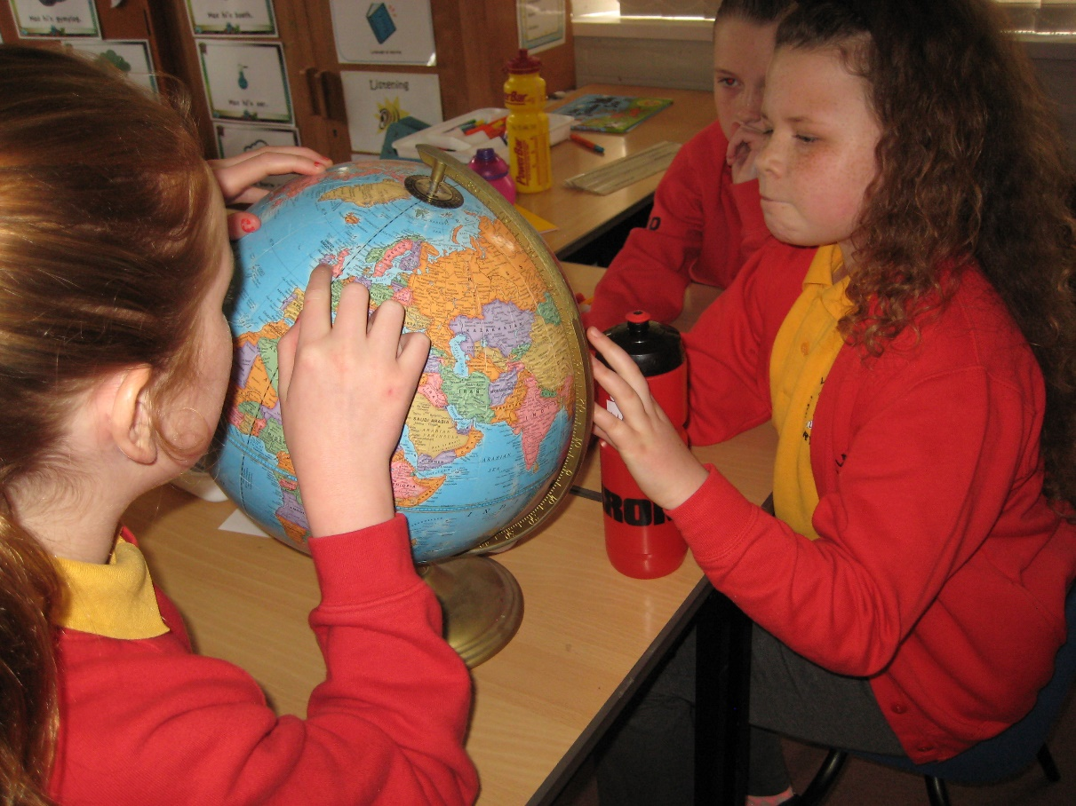
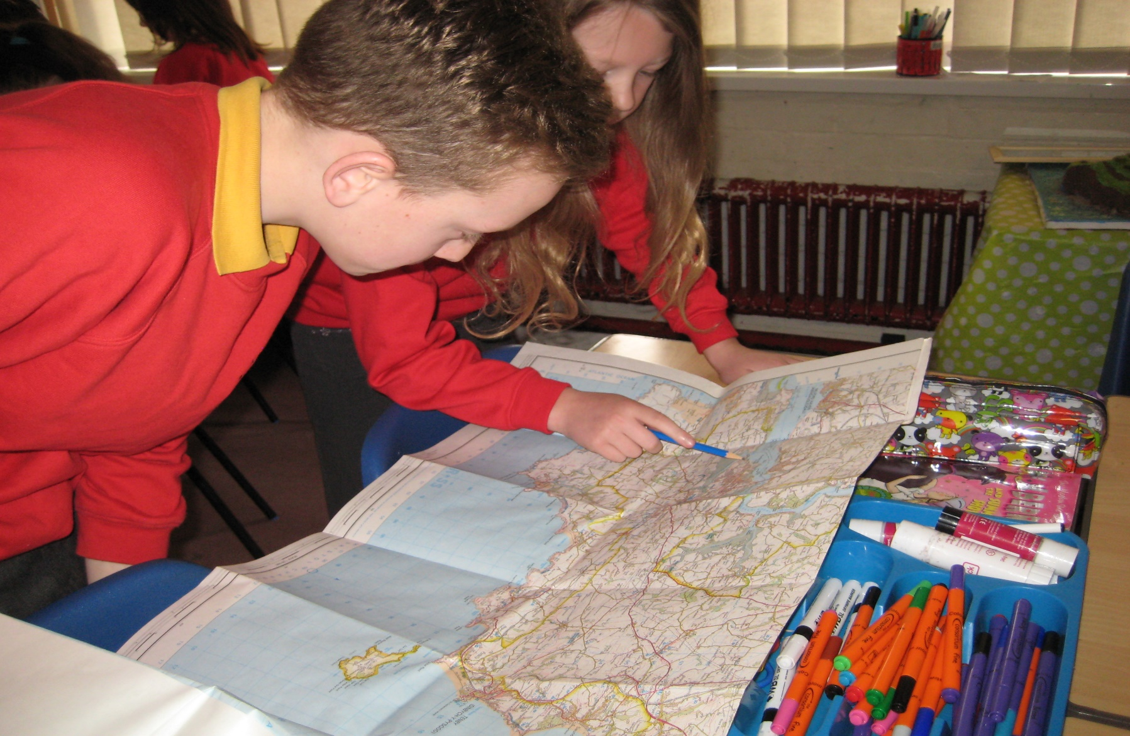
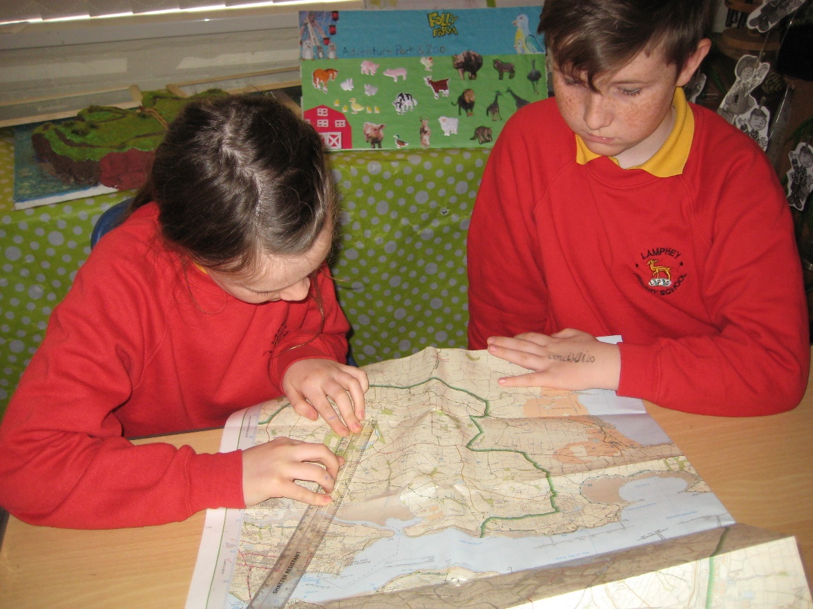

Slide 7
Freshwater East – Rich Task 2
Prior learning before Visit – Science and Numerical
Tides – the daily and annual movements of the Earth and their effect on day and year length
The relative positions and key features of the sun and planets in the solar system

Slide 8
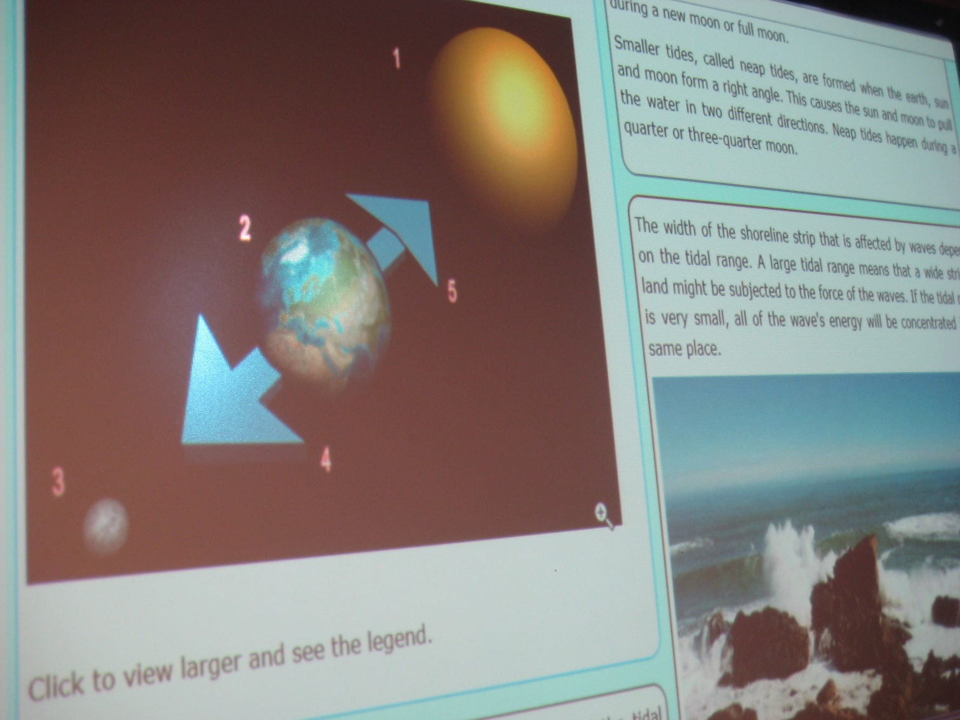

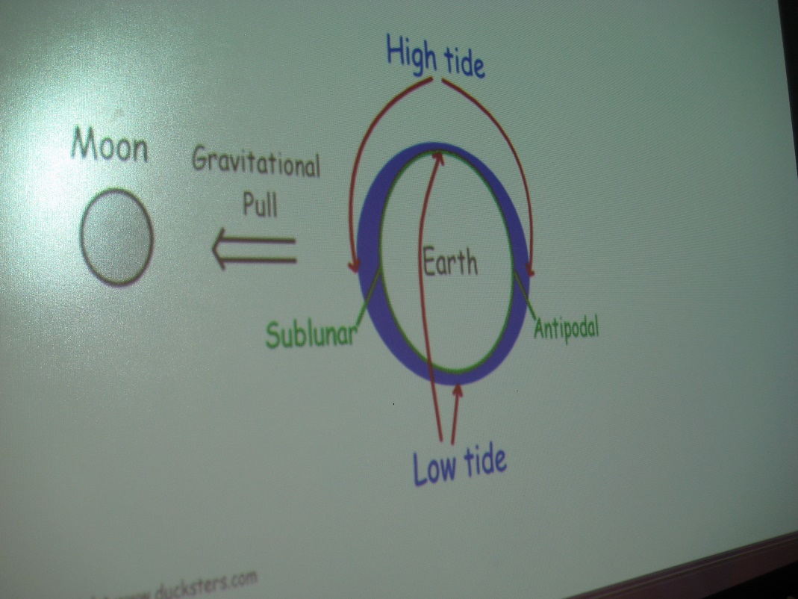

Slide 9
Prior Learning – Beach Formation
Geography: Understanding places, environments and processes Describe the causes and consequences of how places and environments change.
Literacy Focus - Explanation Text
adapt structures in writing for
different contexts
adapt writing styles to suit the
reader and purpose
explore different ways to present work
and use them appropriately

Slide 10
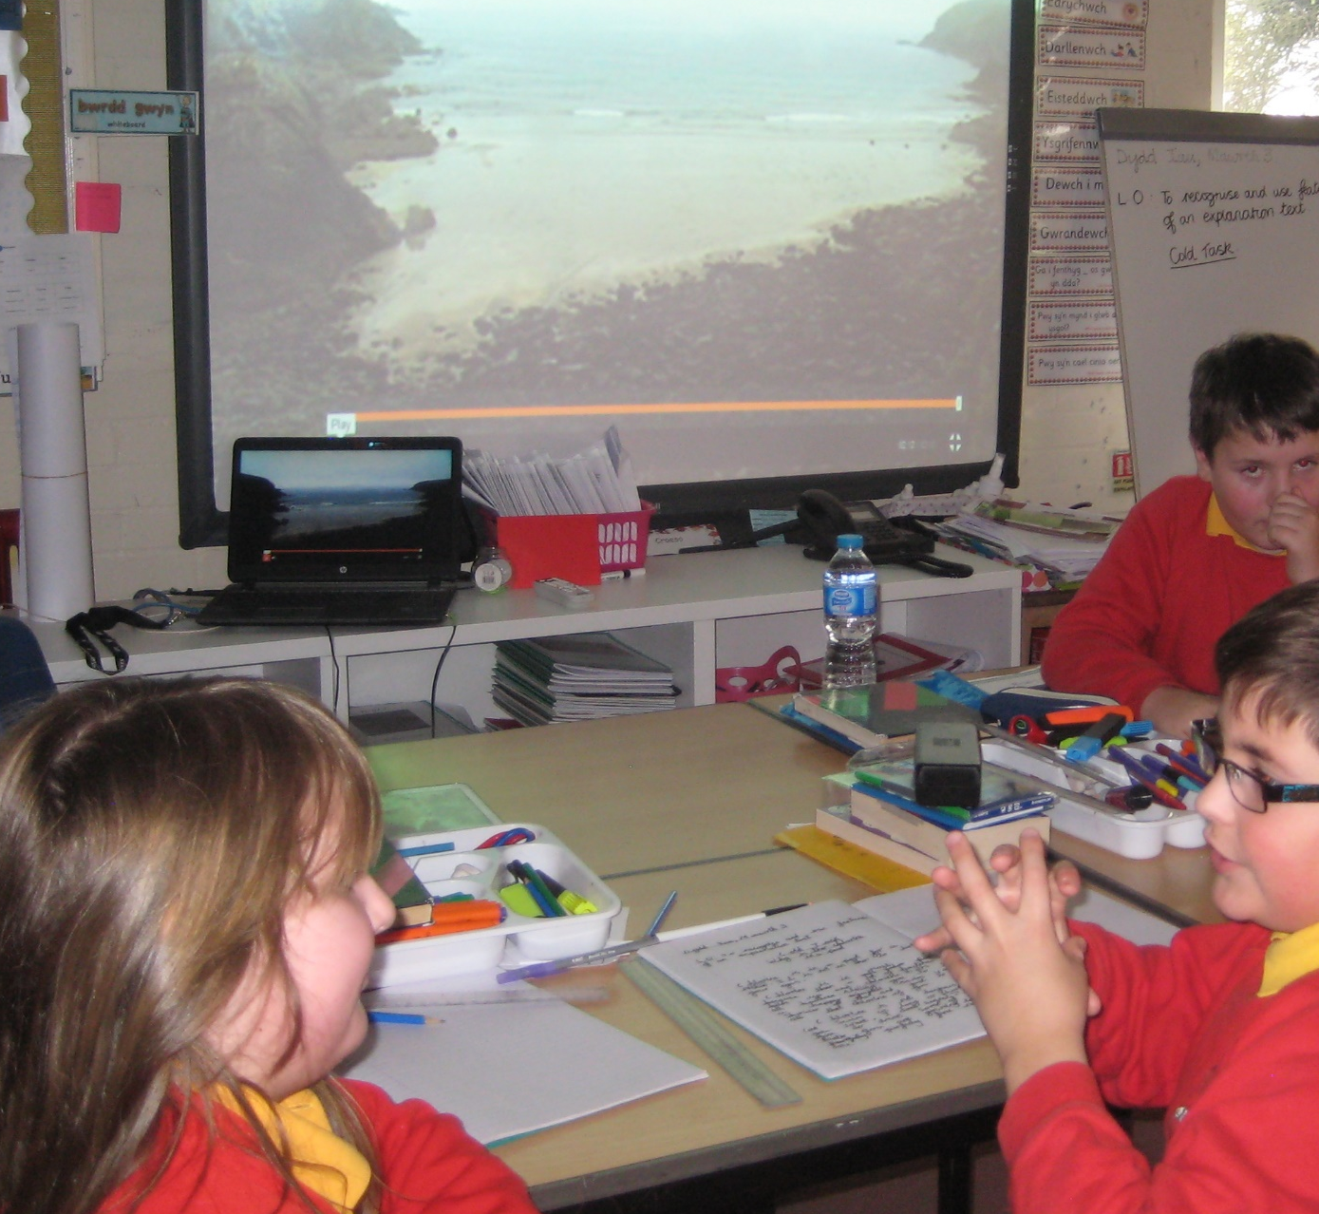
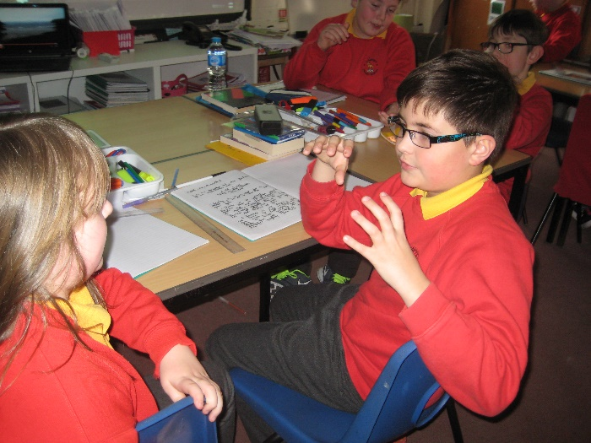
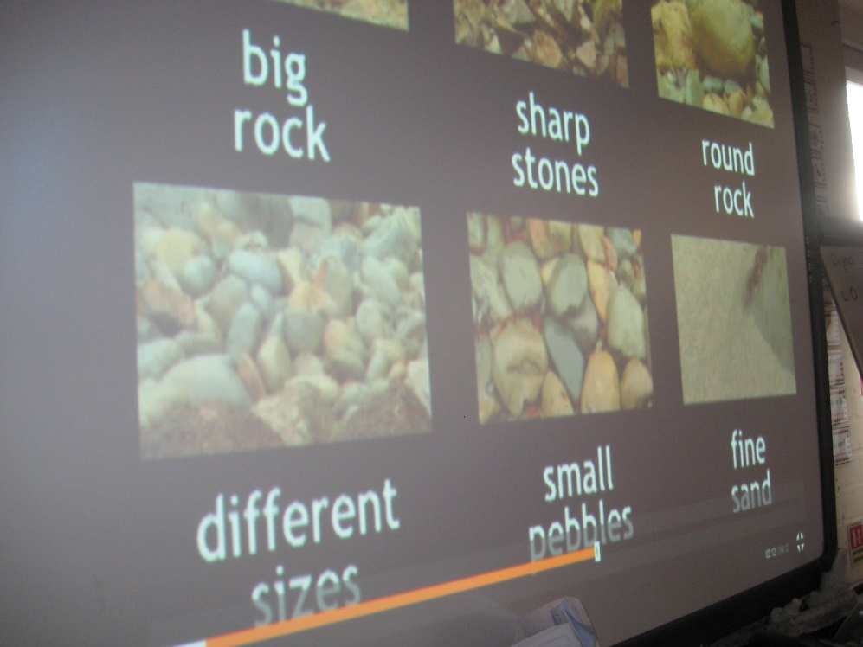
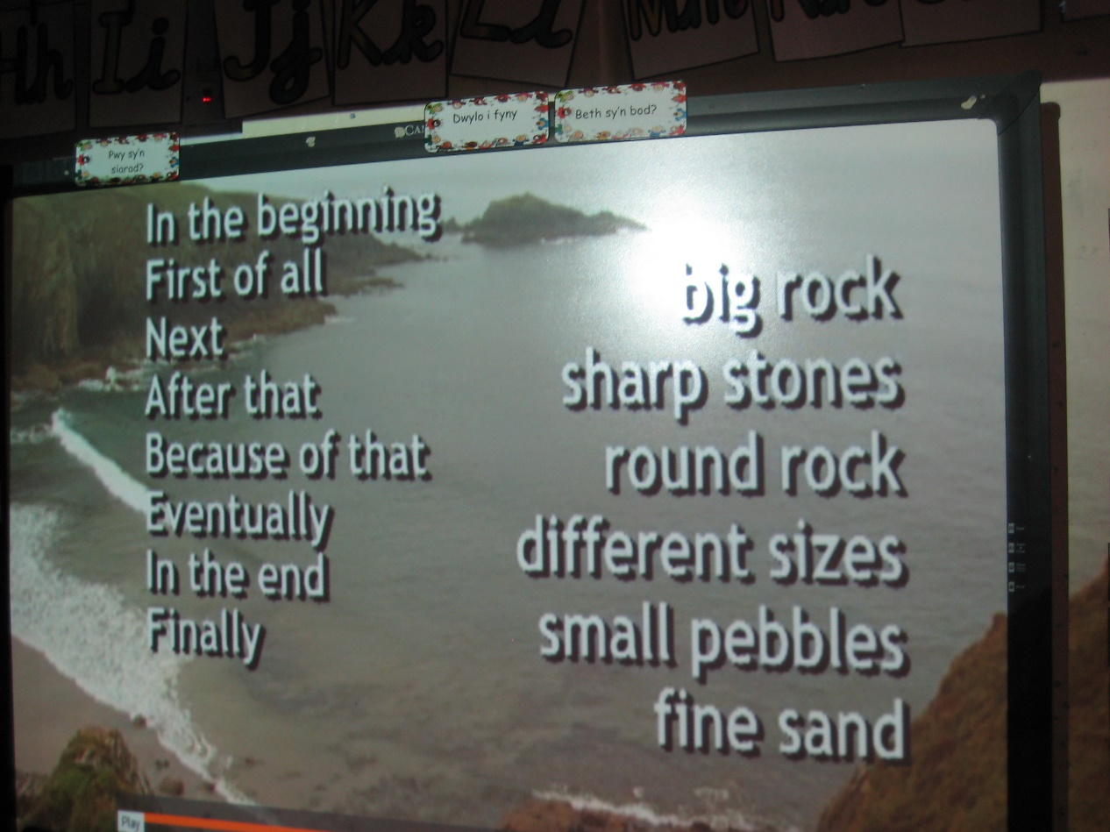
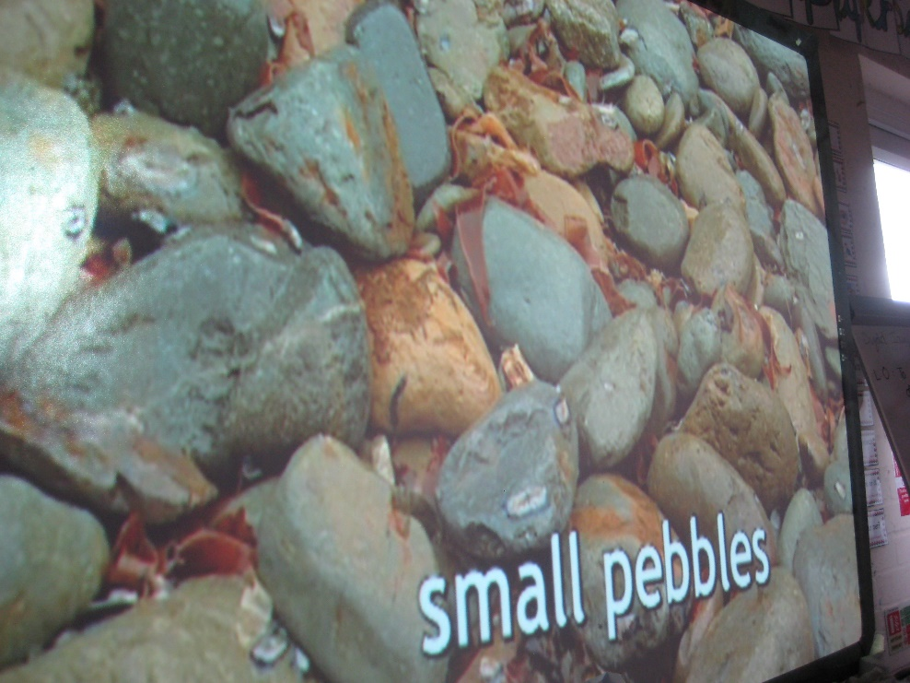
Explaining a process in sequence
Explanation Text
Using appropriate formal tone
Using a variety of sentence starters
Using geographical
vocabulary

Slide 11
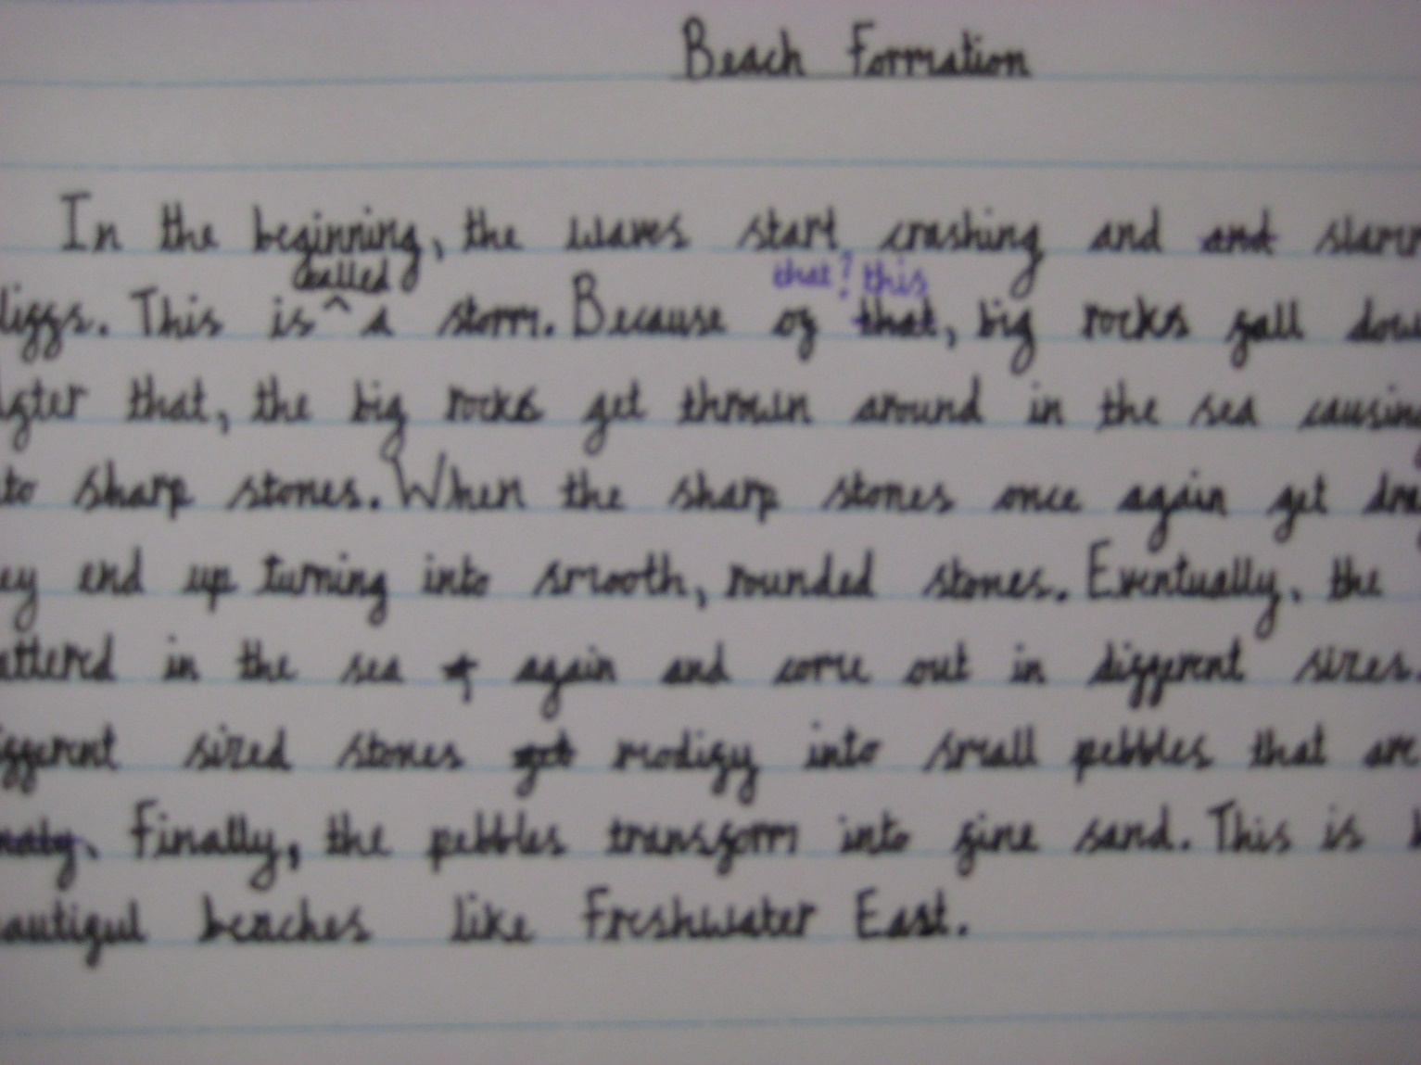
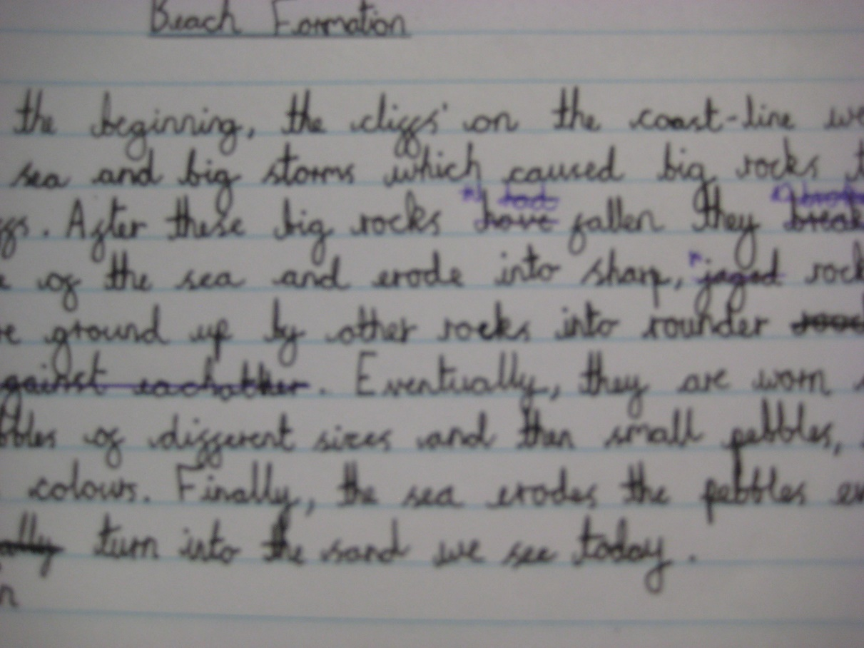

Slide 12
Basics
Ensure children have been briefed thoroughly on the environment that they will be visiting and full safety procedures have been explained.
Ensure all equipment required is gathered and all participants know how to use them.
All staff have been briefed on the requirements of the task and know how much input is required for each group.
Children in groups are given their role and understand the requirements of their responsibility.

Slide 13
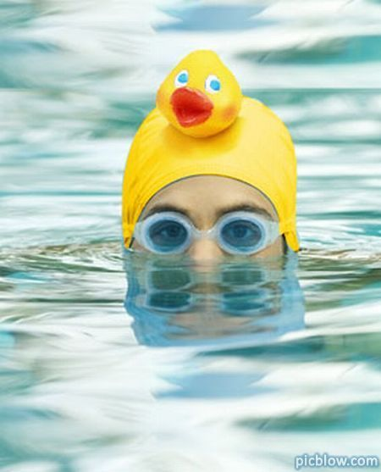
Problem :
Mrs Thomas loves swimming in the sea. However, she does not like going out of her depth. How many metres could she walk out during a high tide before she would be over her head?

Slide 14
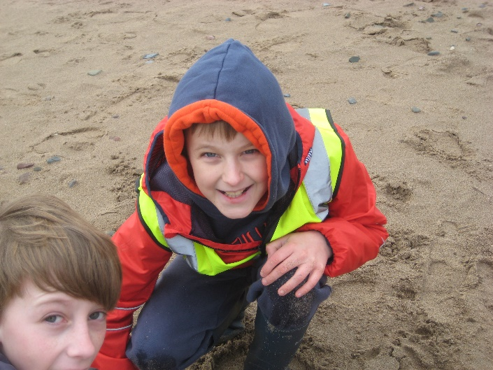
Skills: Numeracy
Developing Numerical Reasoning
Identify processes and connections
Transfer mathematical skills to a variety of contexts and everyday situations
Identify the steps and information needed to complete the task or reach a solution
Select appropriate mathematics and techniques to use
Estimate and visualise size when measuring and use the correct units

Slide 15
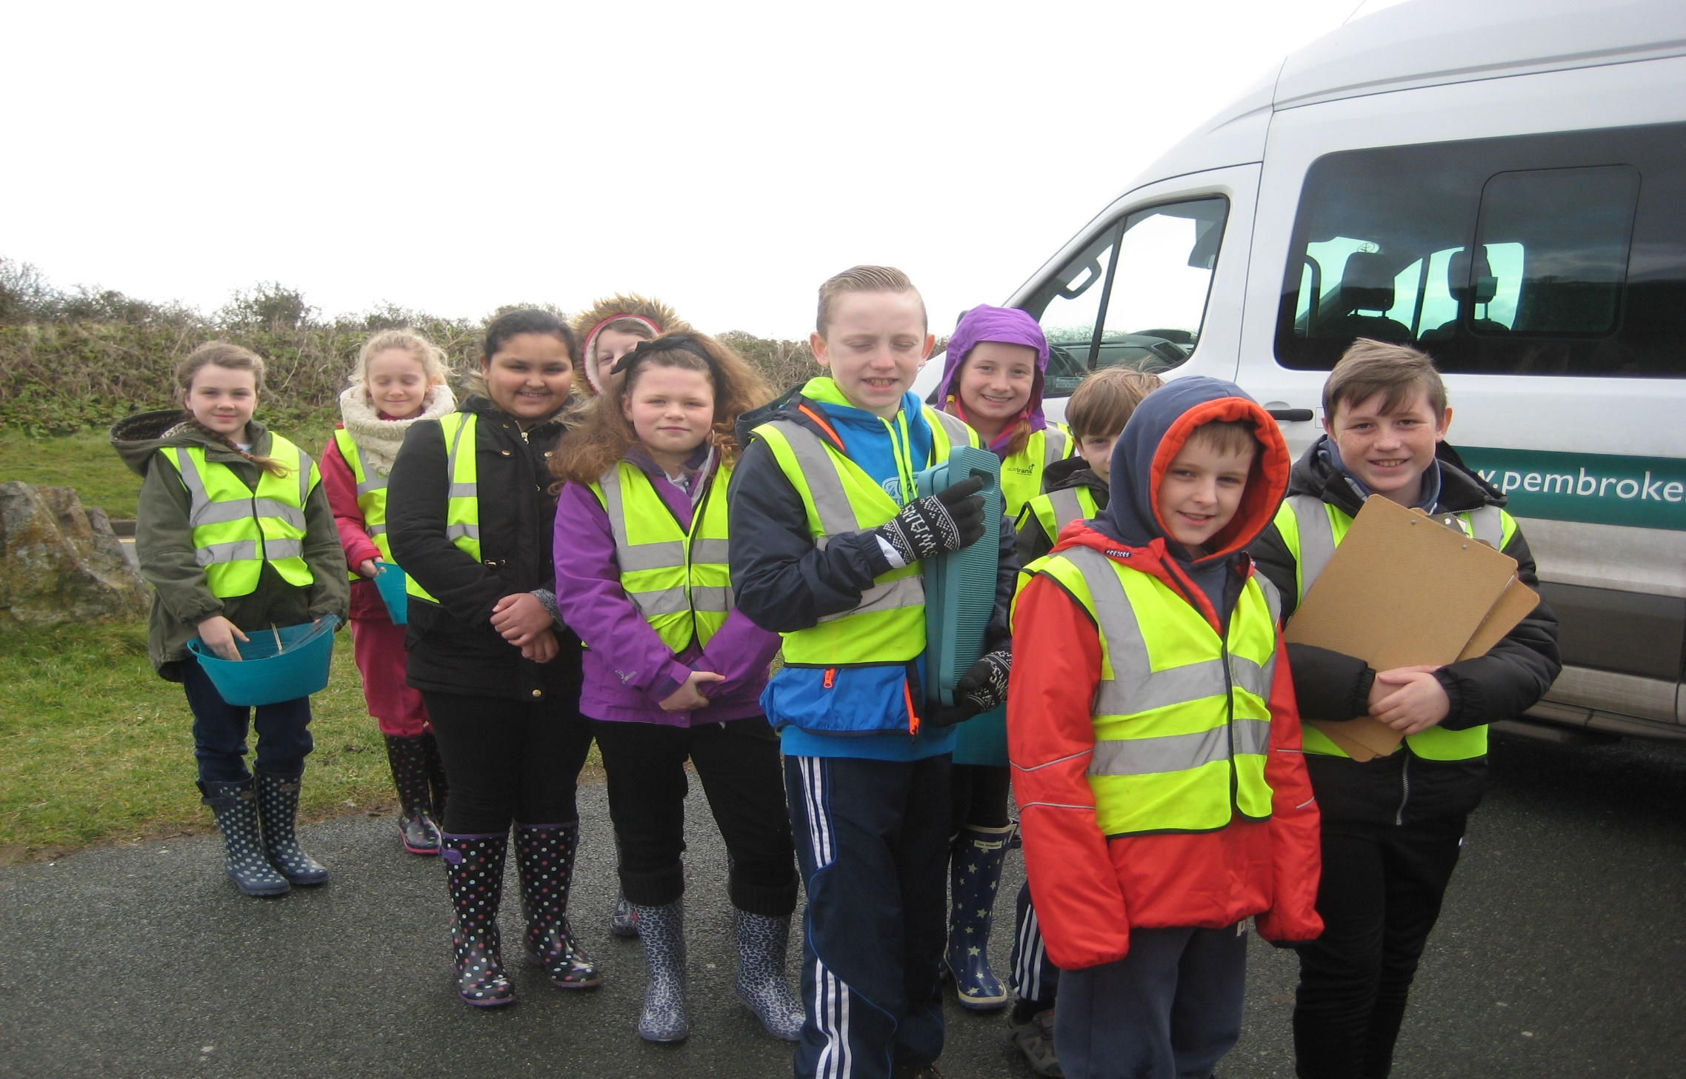
Getting to grips with the problem…..

Slide 16
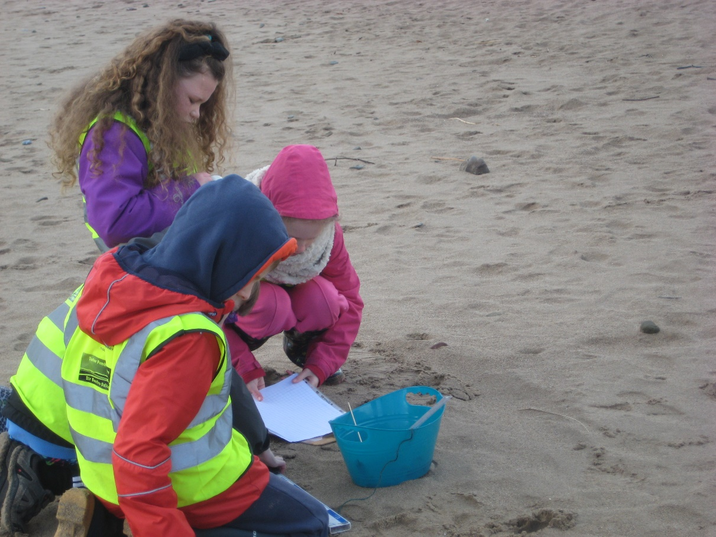
Preparing the equipment
Choosing the area to be measured.
Reviewing their roles

Slide 17
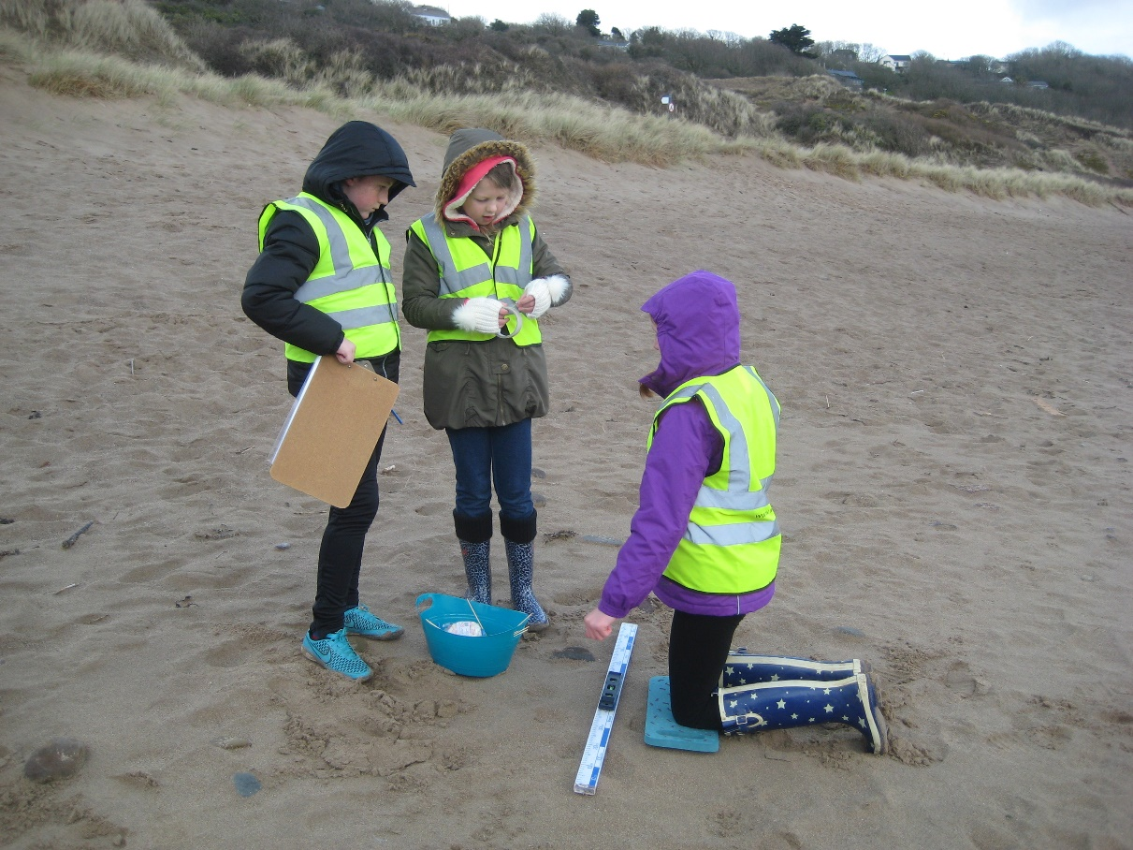
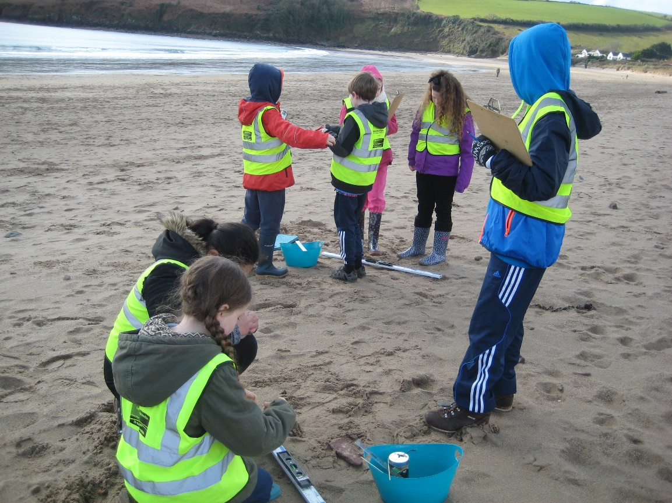
Team work is a crucial ingredient
Communicating ideas effectively

Slide 18
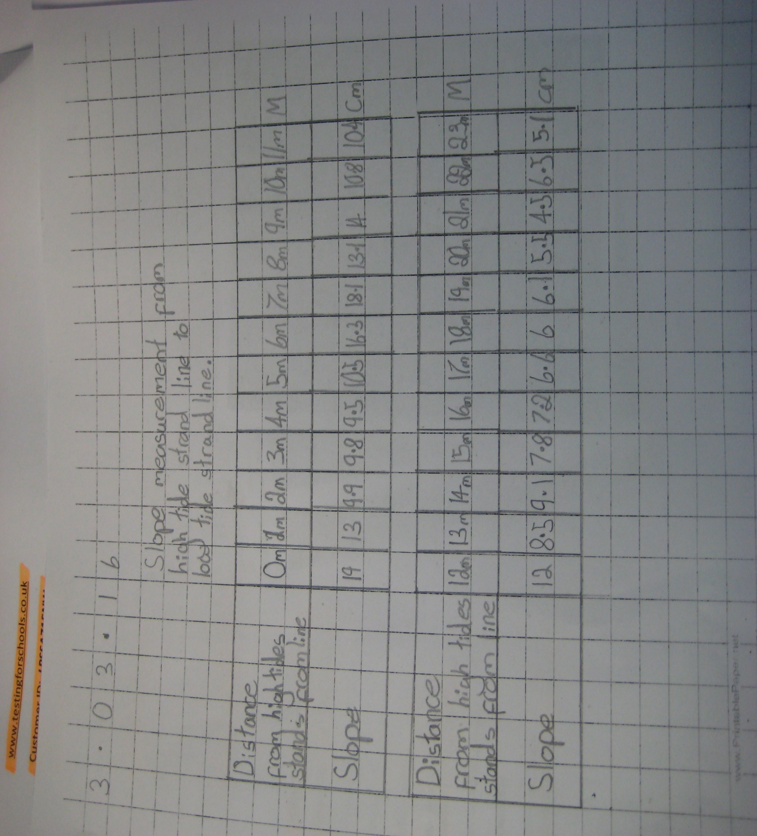

Slide 19
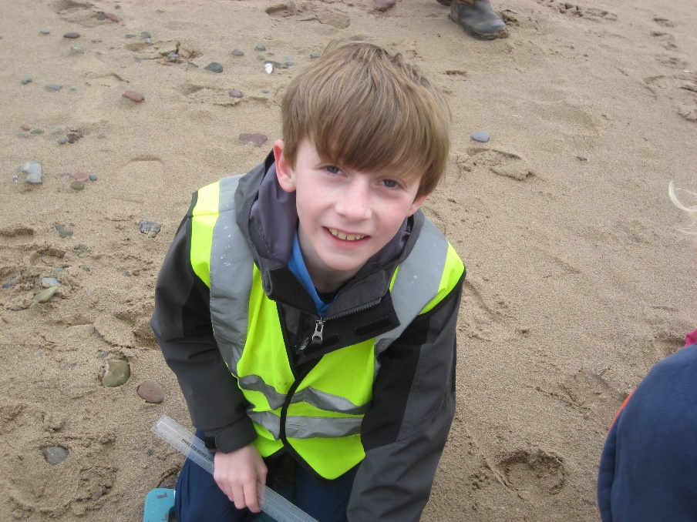
Skills: Numeracy
Represent and Communicate
Explain results and procedures clearly using mathematical language
Use appropriate units of measurement

Slide 20
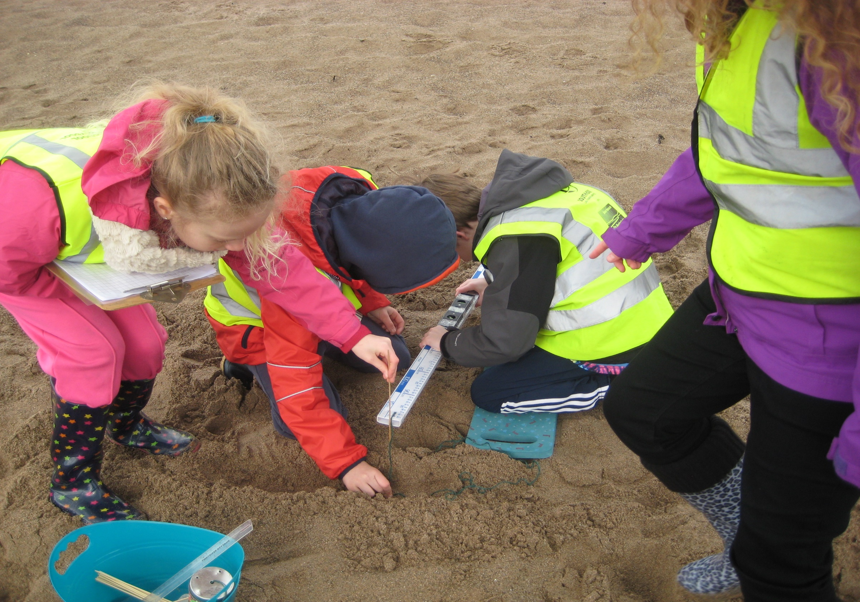

Slide 21
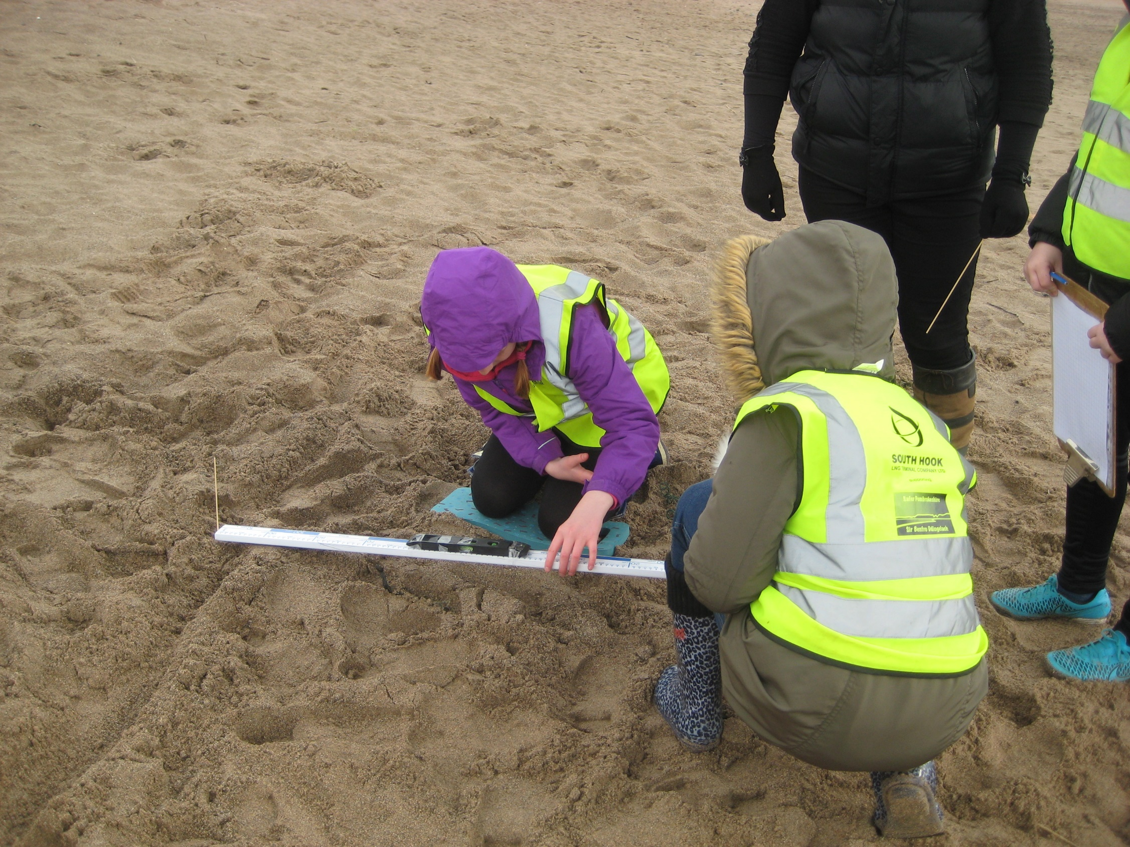

Slide 22
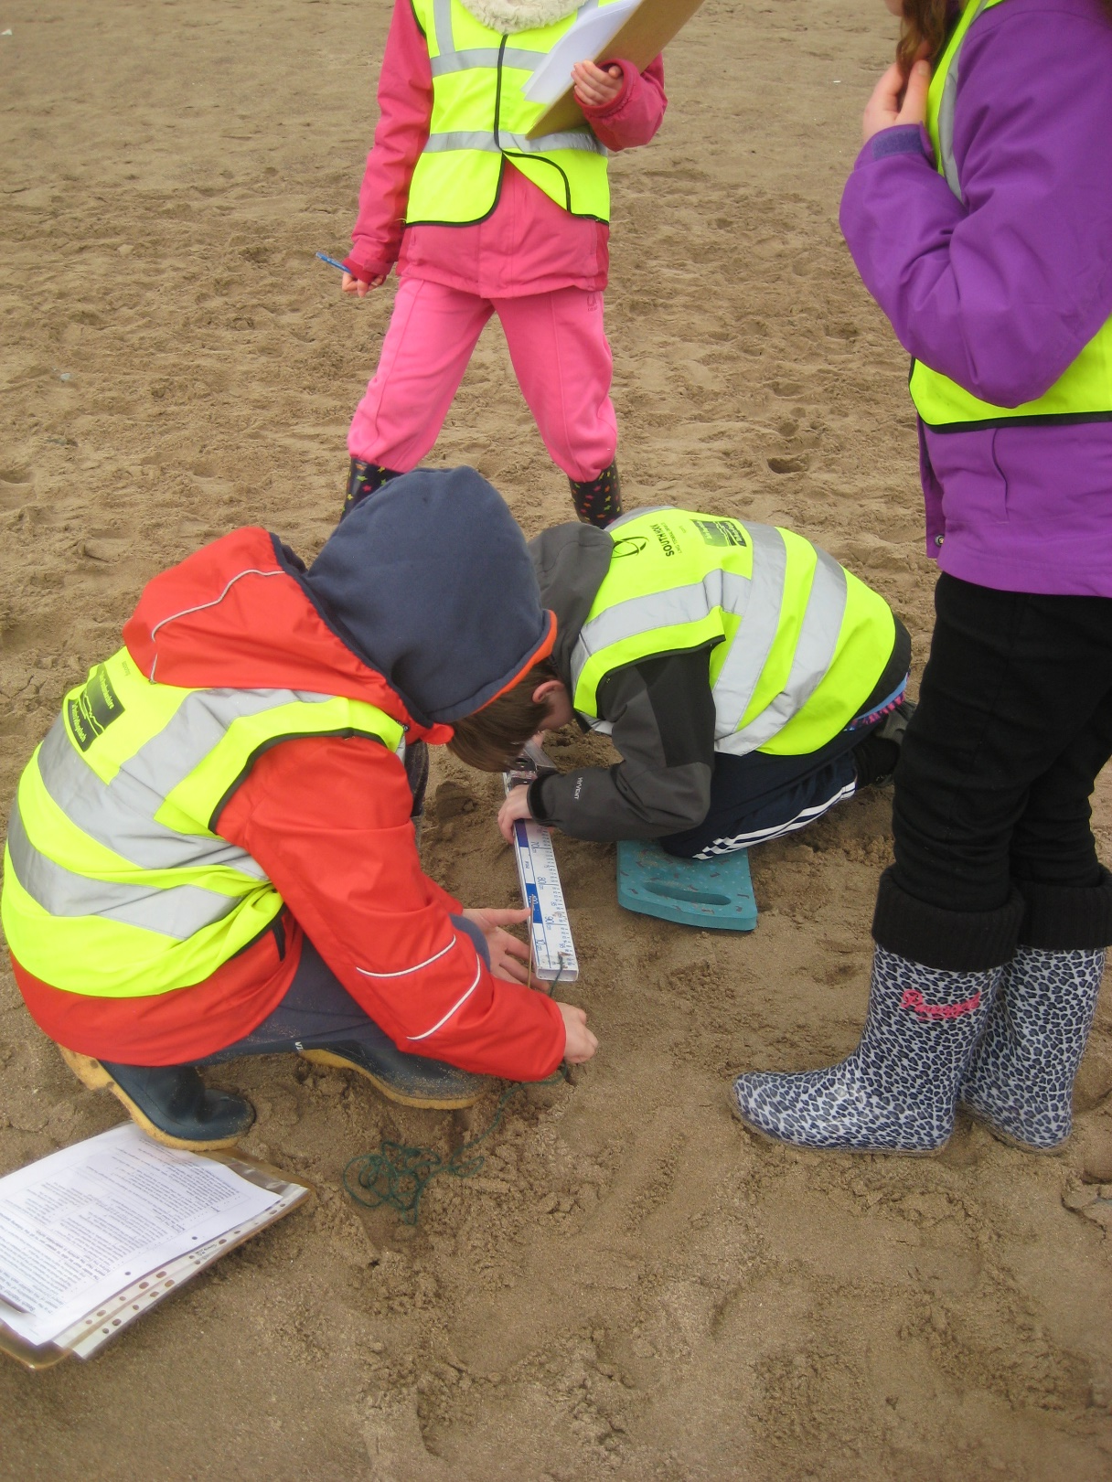

Slide 23
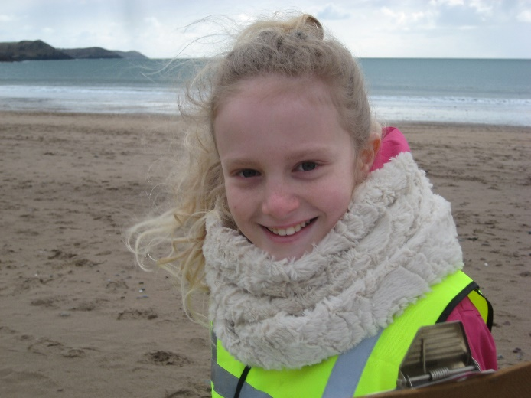
Skills: Numeracy
Review
Interpret answers within the context of the problem and consider whether the answers are sensible
Draw conclusions from data and recognise that some conclusions may be misleading or uncertain

Slide 24
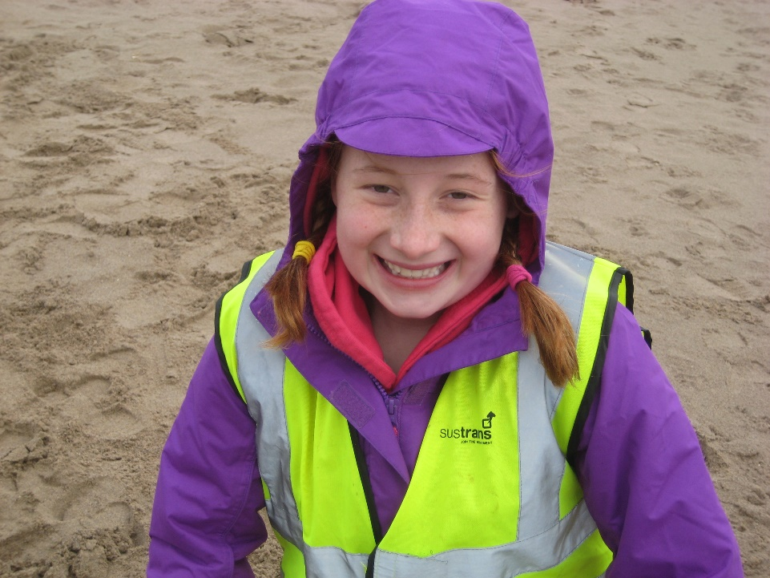
Skills: Numeracy
Using Number skills
Calculate using mental and written methods
Add and subtract numbers using whole numbers and decimals

Slide 25
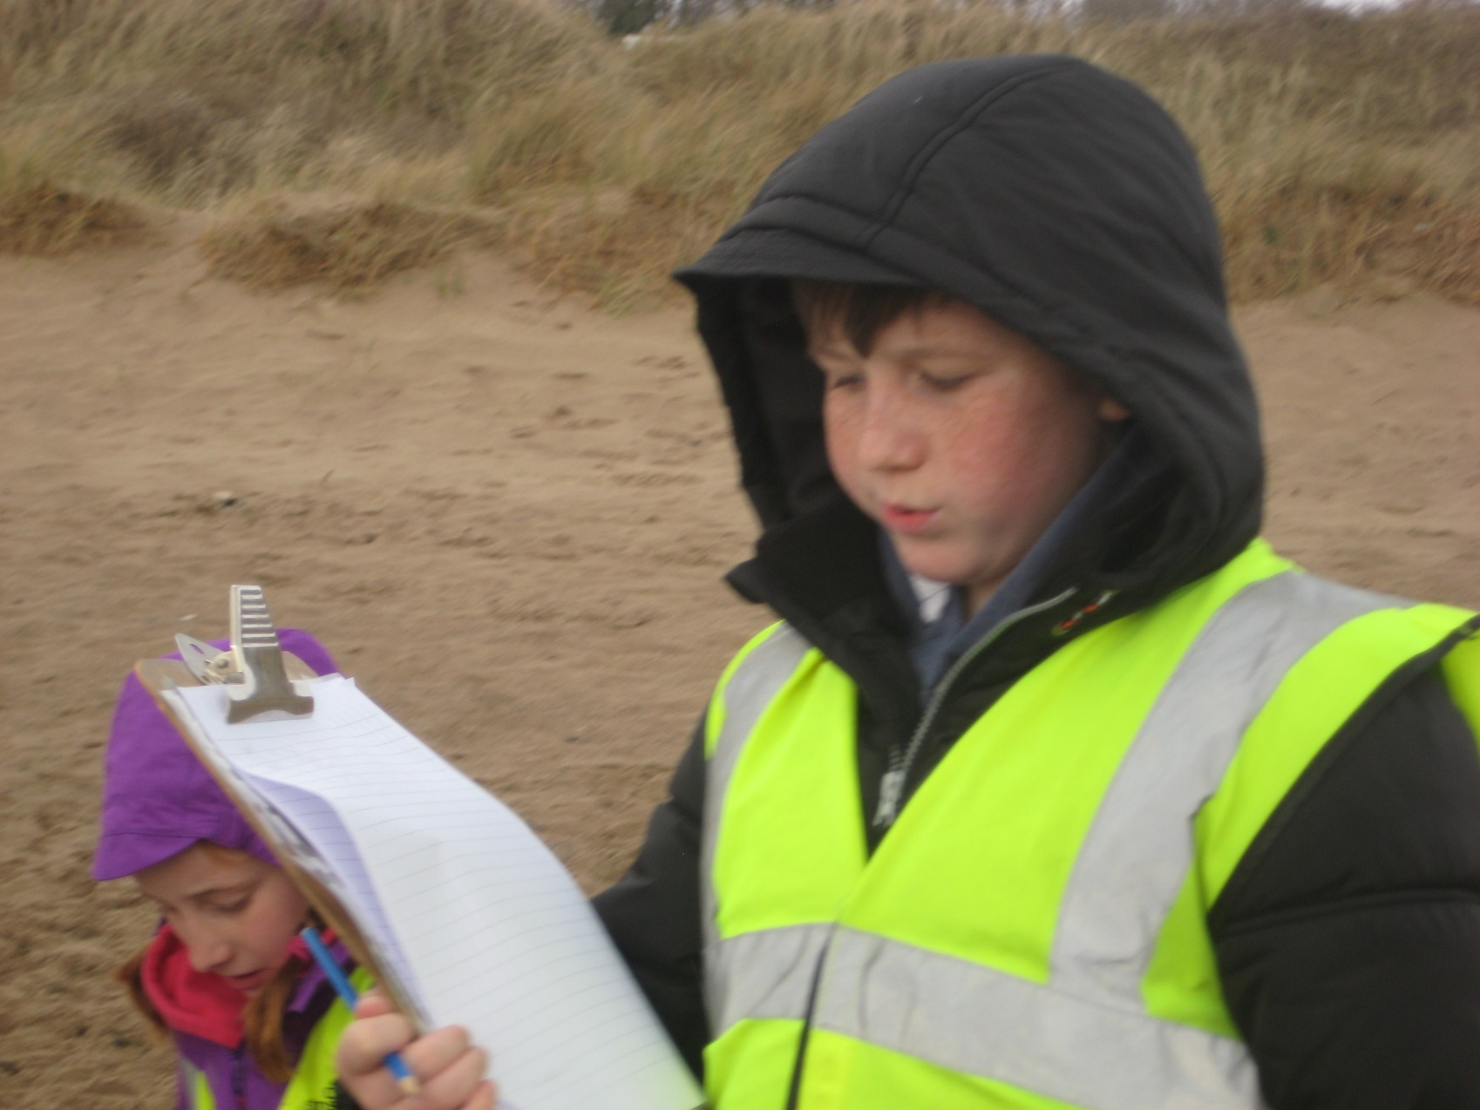
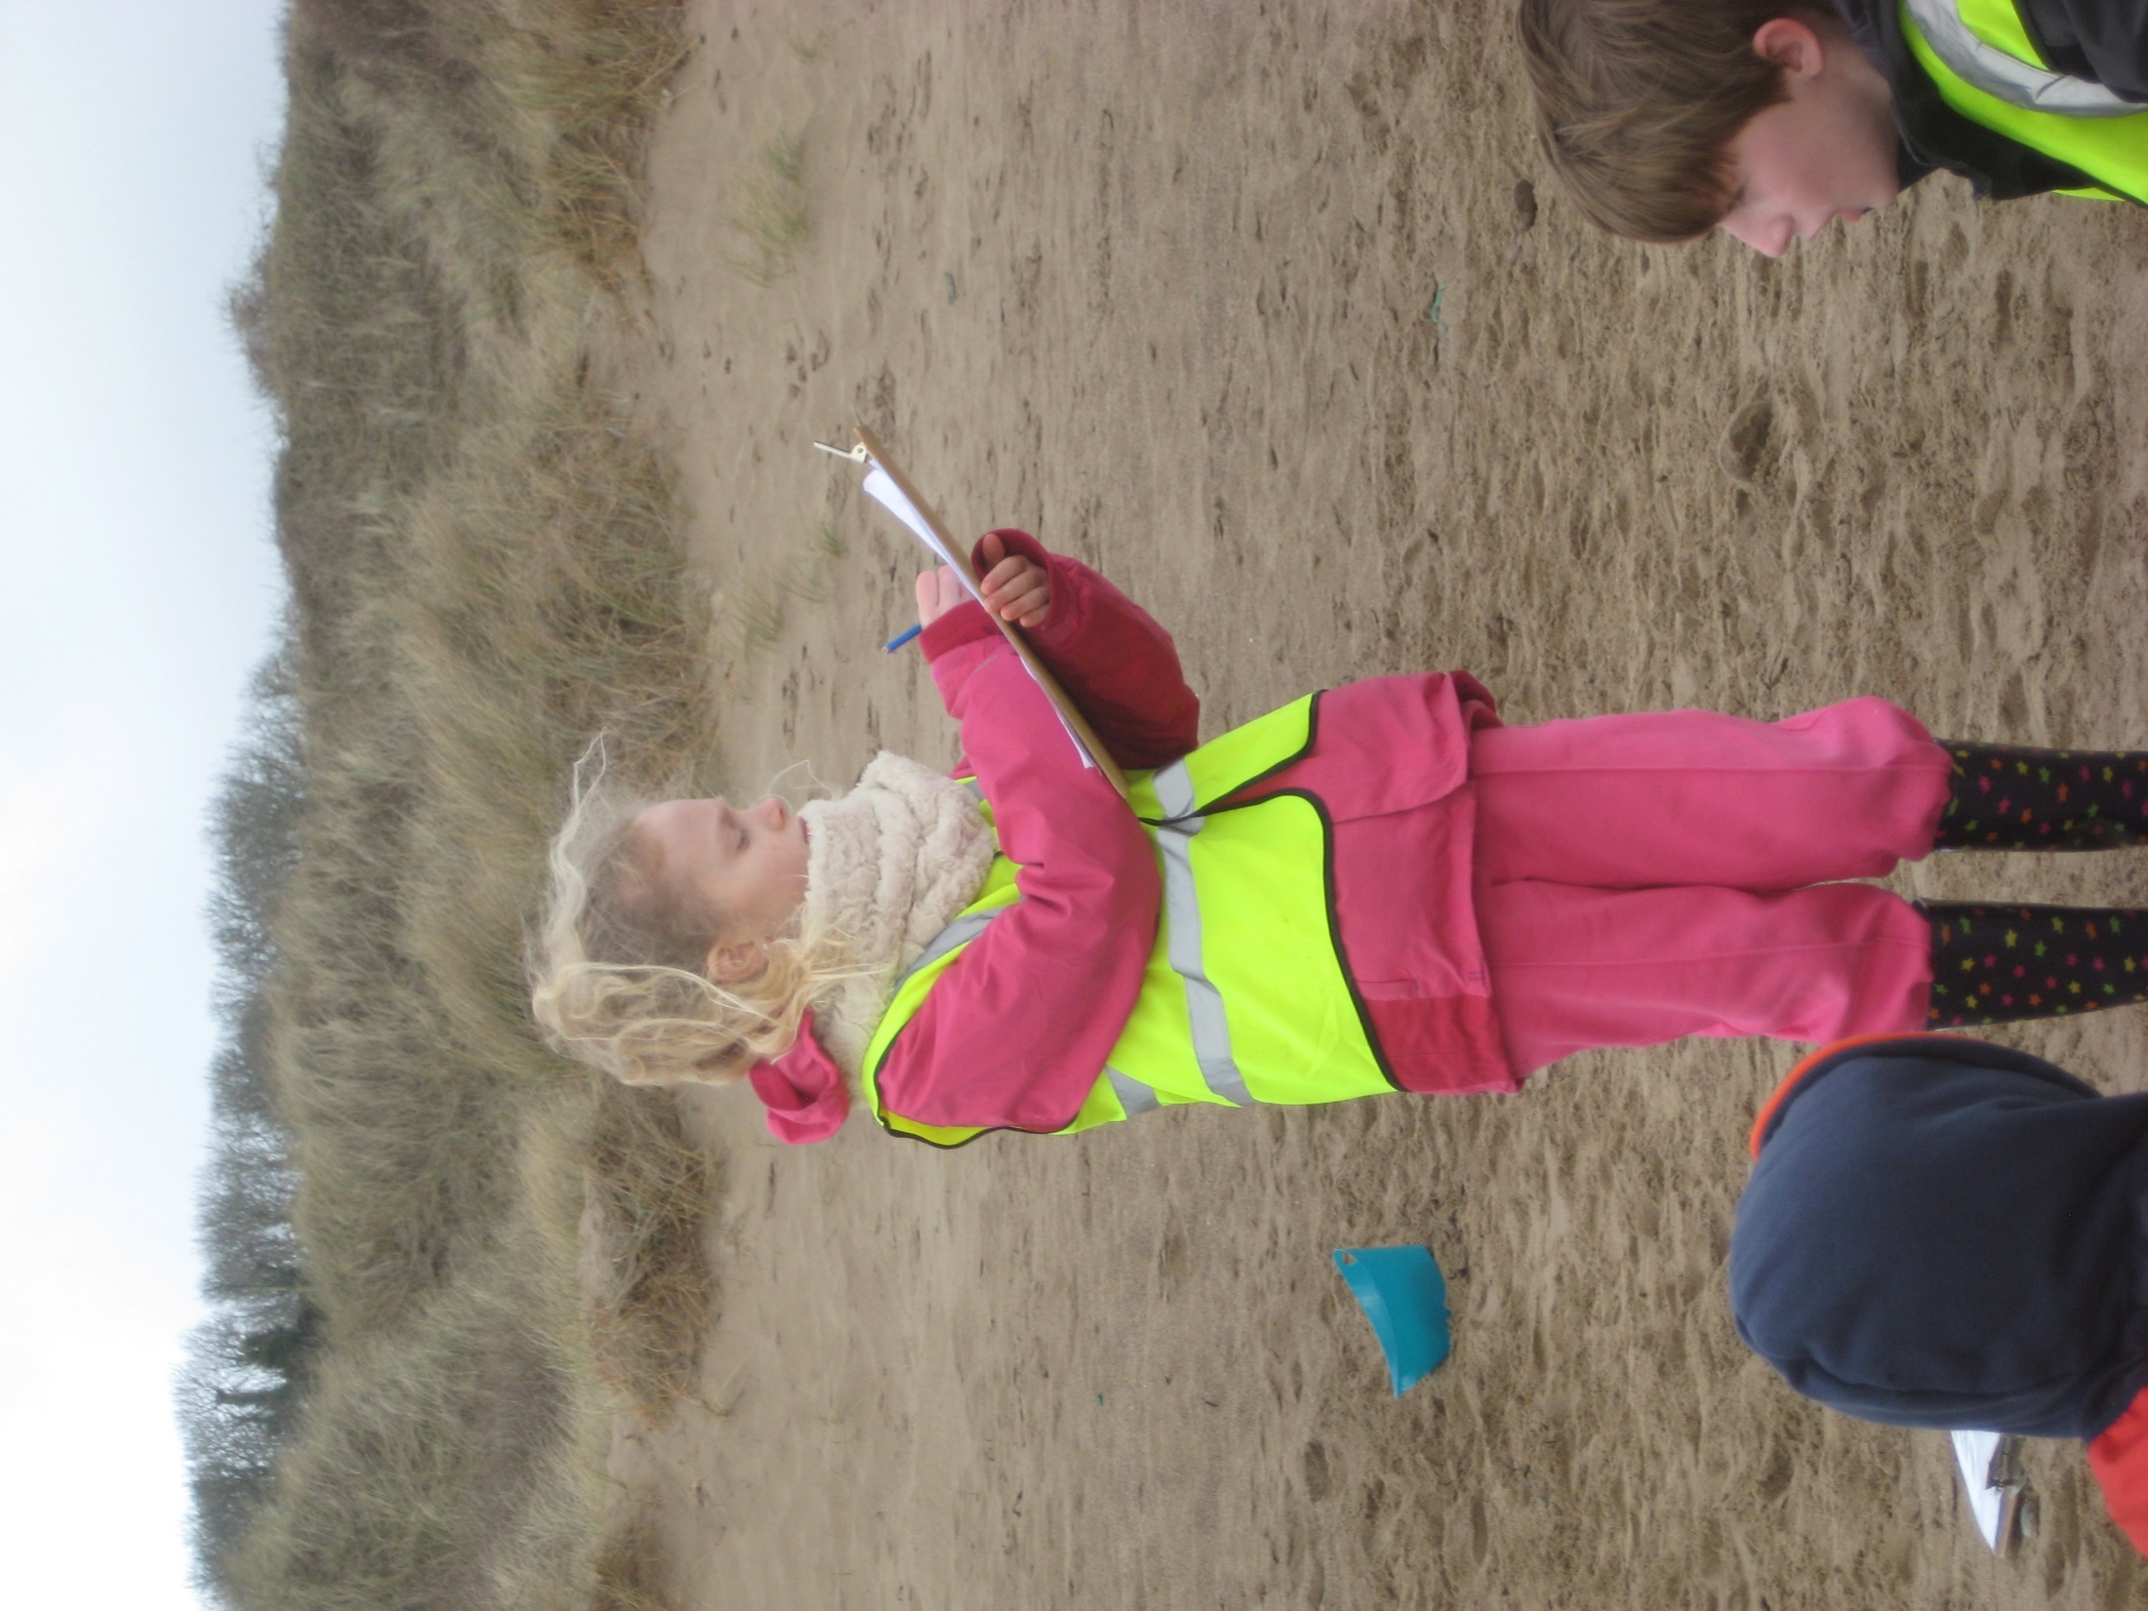
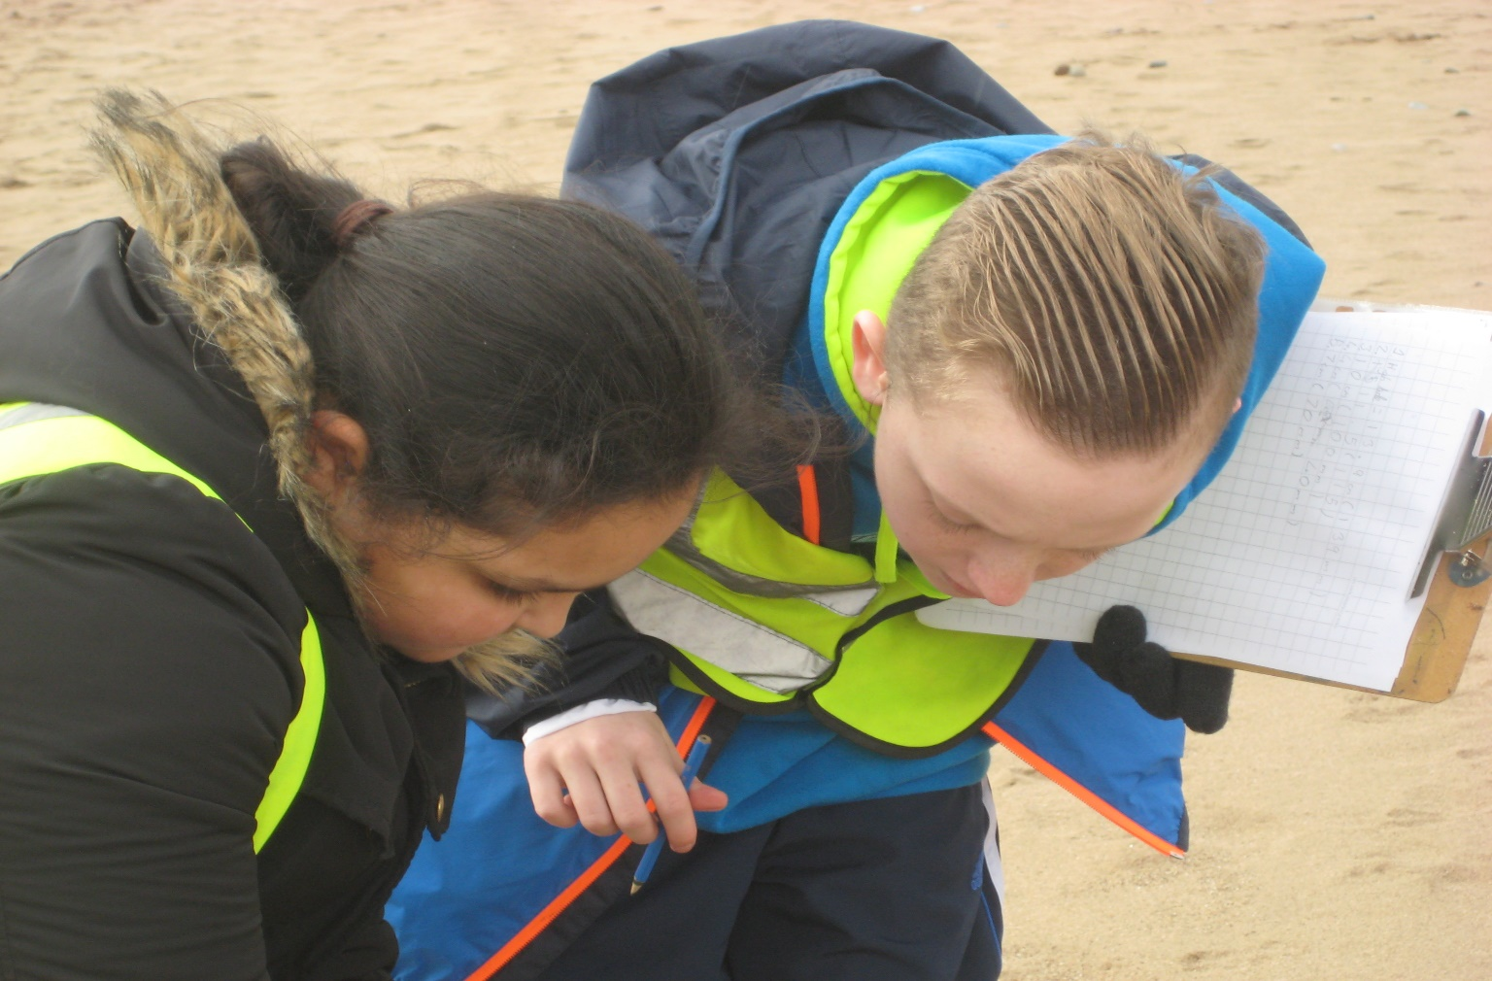

Slide 26
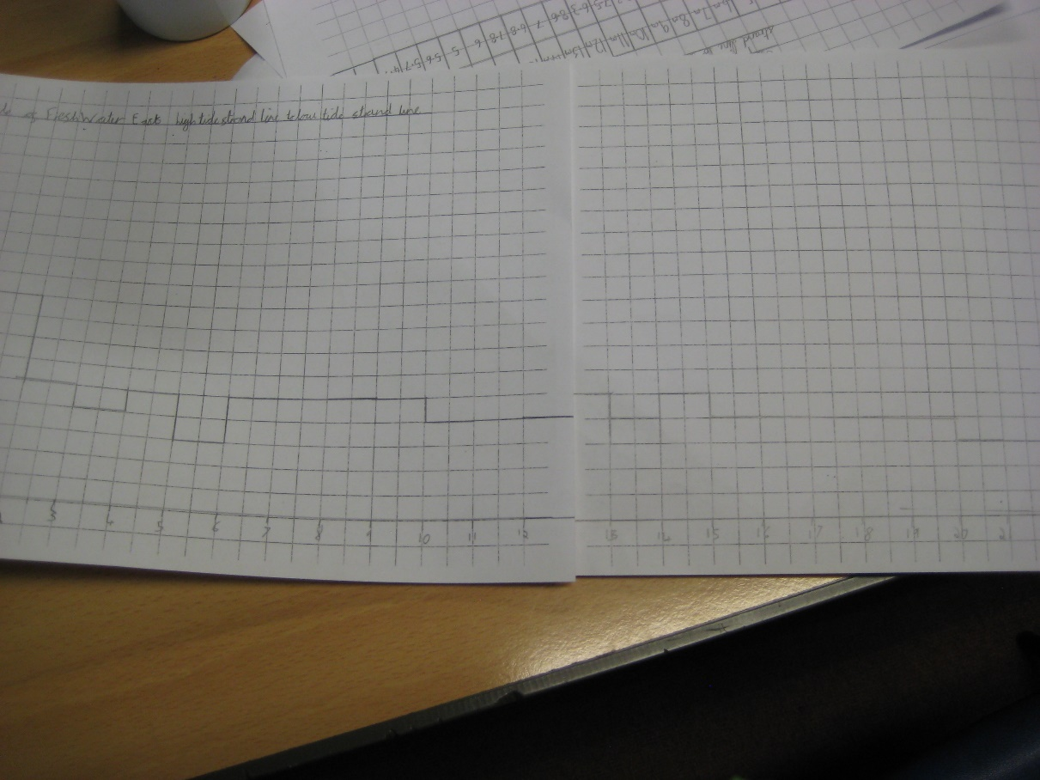
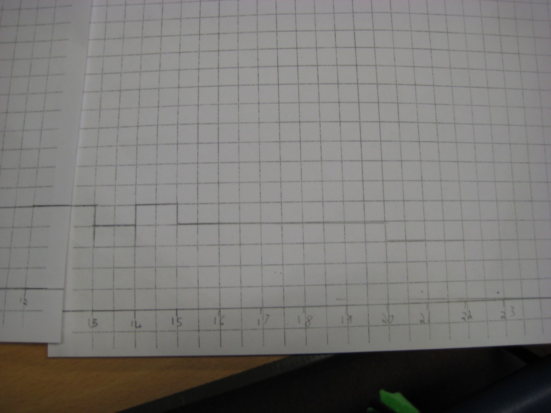
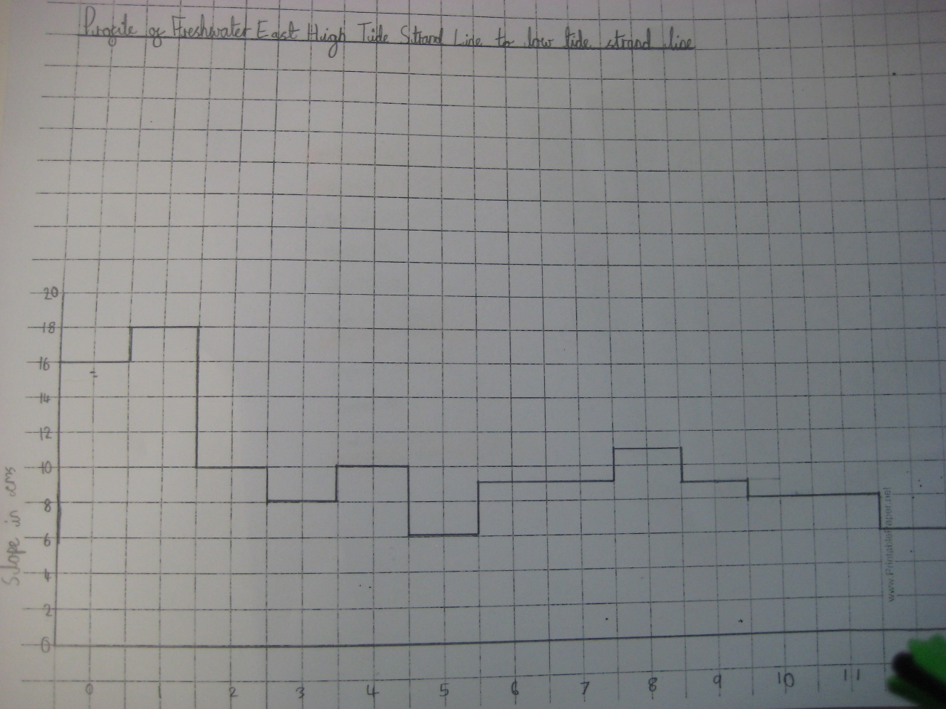

Slide 27
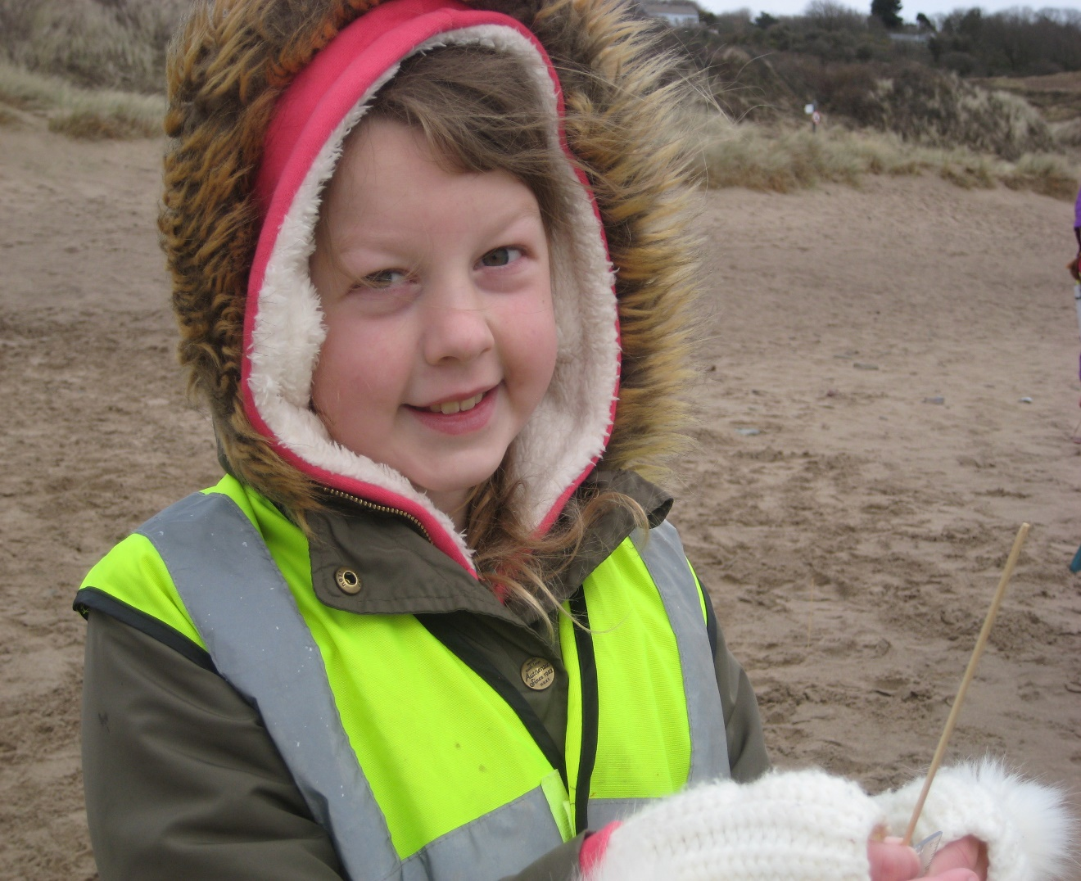
Skills: Numeracy
Collect and record data. Present and analyse data. Interpret results,
Use mean, median, mode and range
to describe a data set

Slide 28
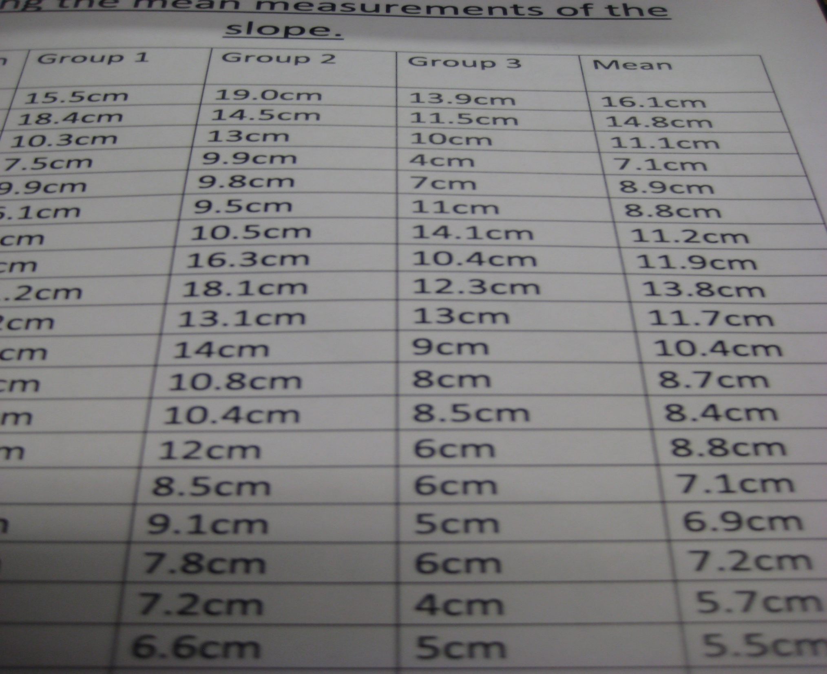

Slide 29
