Slide 1

Pembrokeshire
Outdoor Schools
Ysgolion Awyr Agored
Sir Benfro

Slide 2
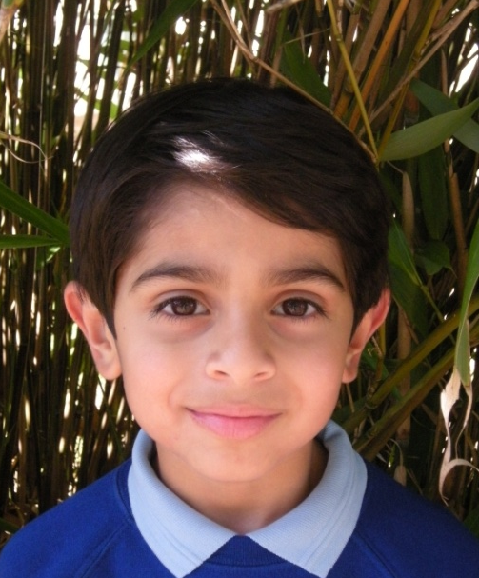
How to become an Outdoor School?
Culture/whole School Ethos
Timetabling all classes
Deciding where to go...
Making a commitment
‘We are an Outdoor School’

Slide 3
Why become an Outdoor School?
It is something to be proud of.
It’s simple – being Outdoors is good for you!
Positive impact on pupil outcomes
– well being and standards.

Slide 4
Impact of Outdoor Schools
PASS results
Personal and social skills
Significant reduction in behaviour incidents
Science results
Improved pupil performance in creative language, report writing etc.

Slide 5

The Way Forward......?
Growth of the Outdoor Schools Project.
Outdoor Schools’ Baby Brother.
Spreading to other Local
Authorities, Clusters and /or
Families of schools.

Slide 6
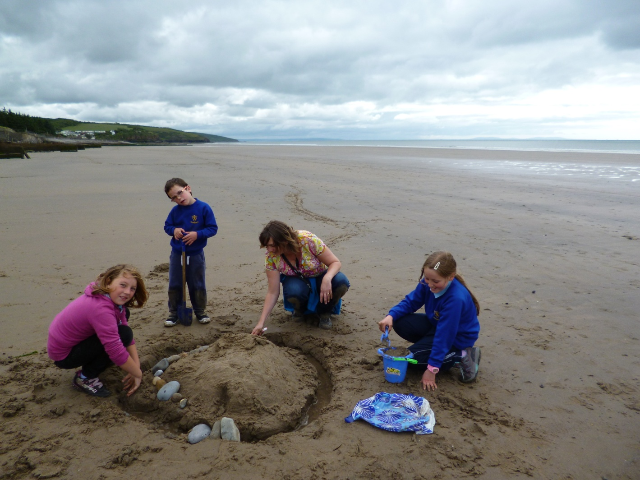
Practical Ideas and Suggestions

Slide 7
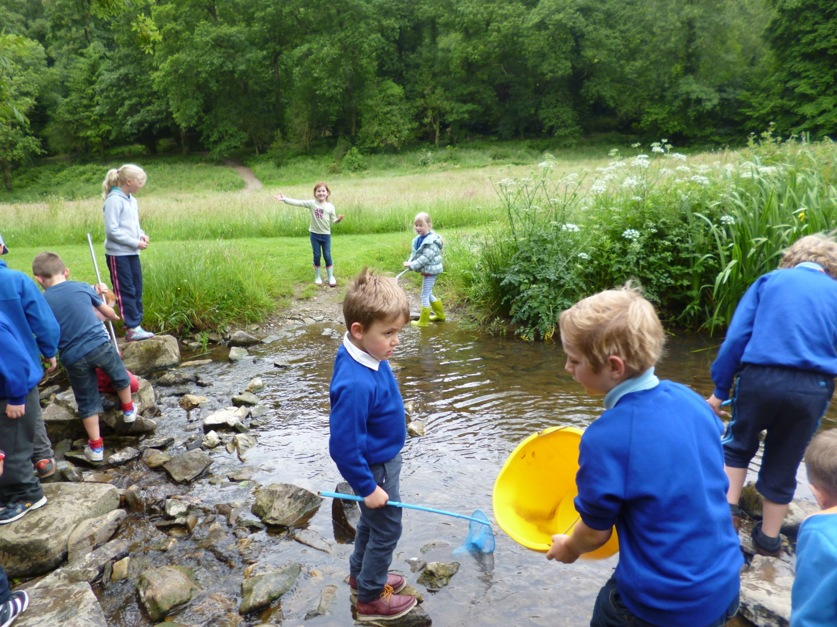

Slide 8
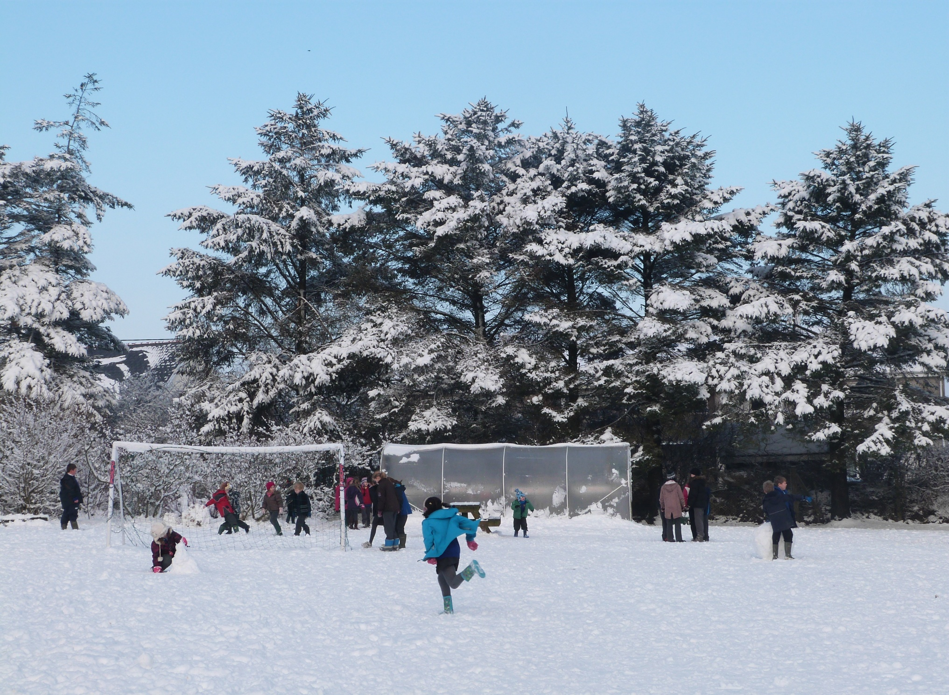

Slide 9
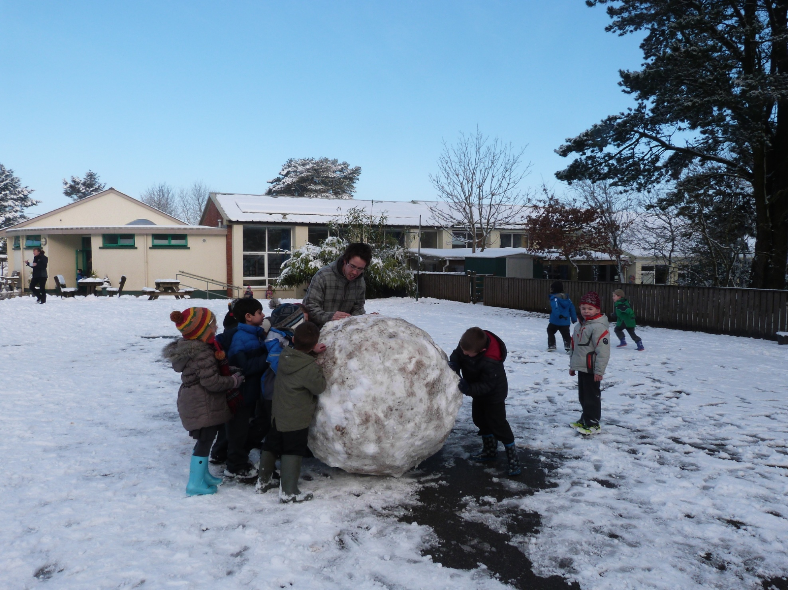

Slide 10
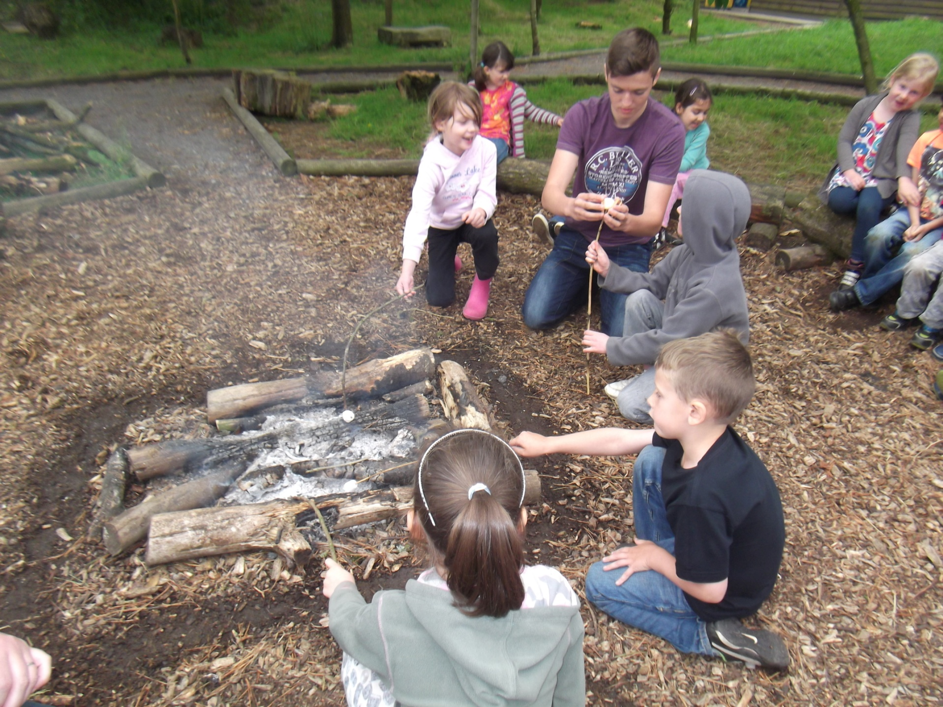

Slide 11
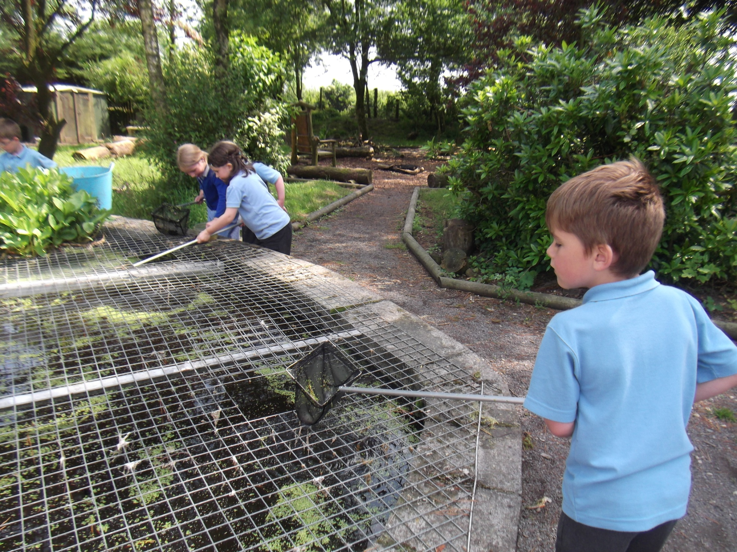

Slide 12
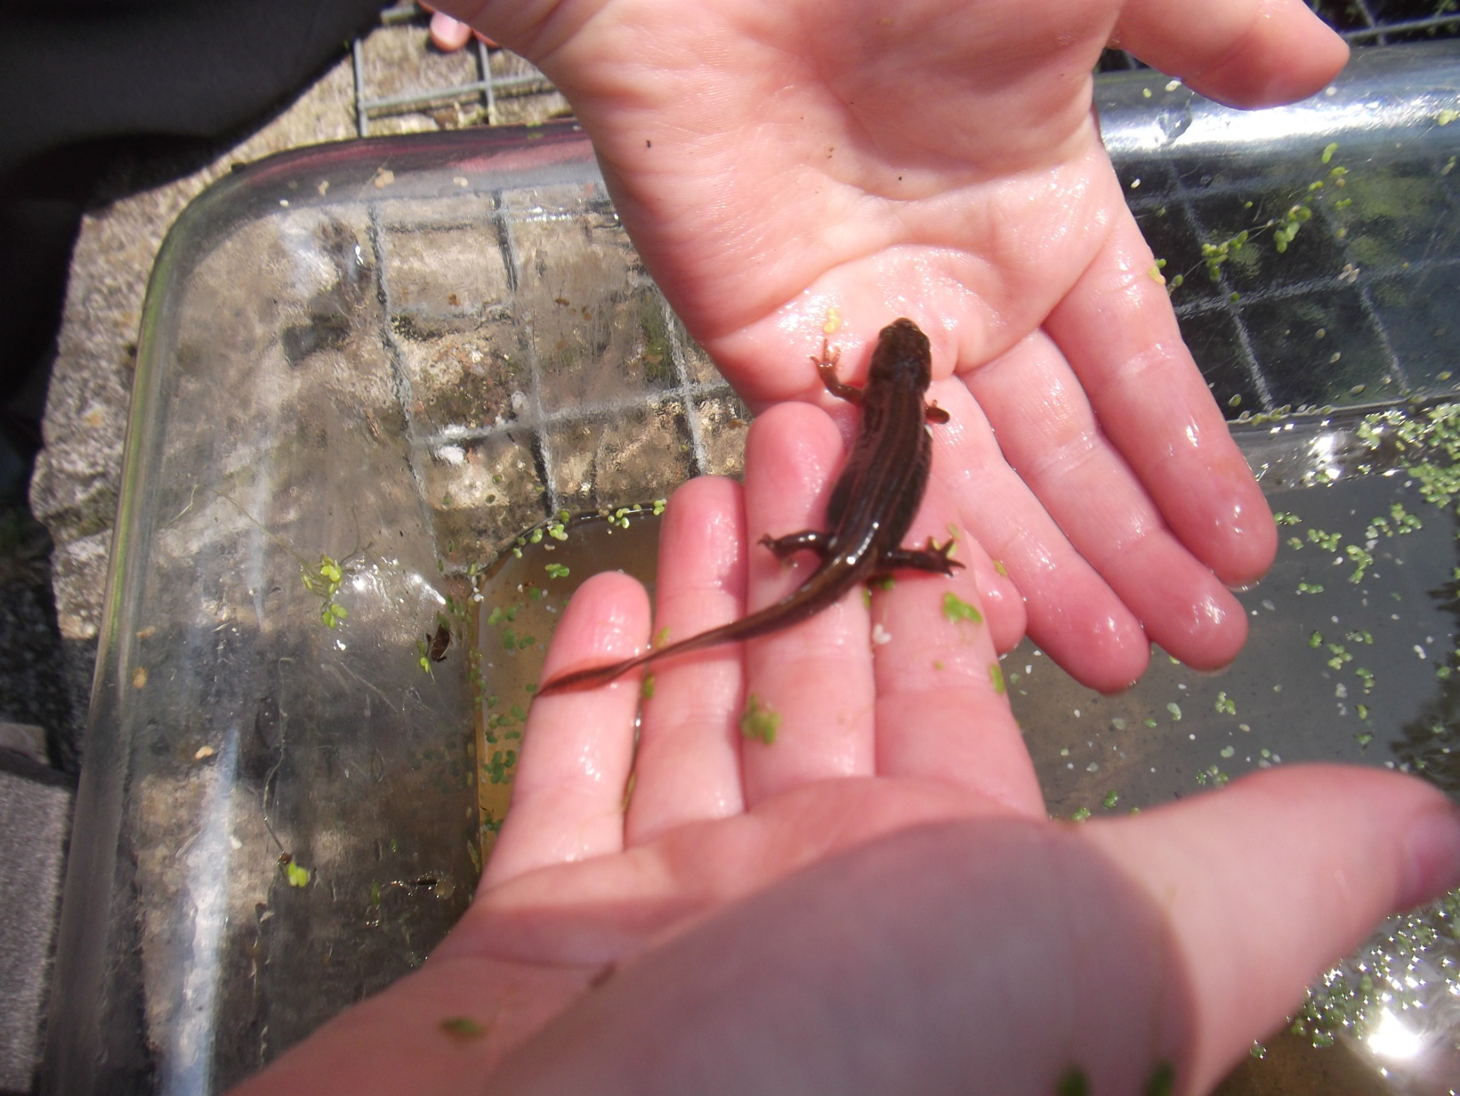

Slide 13
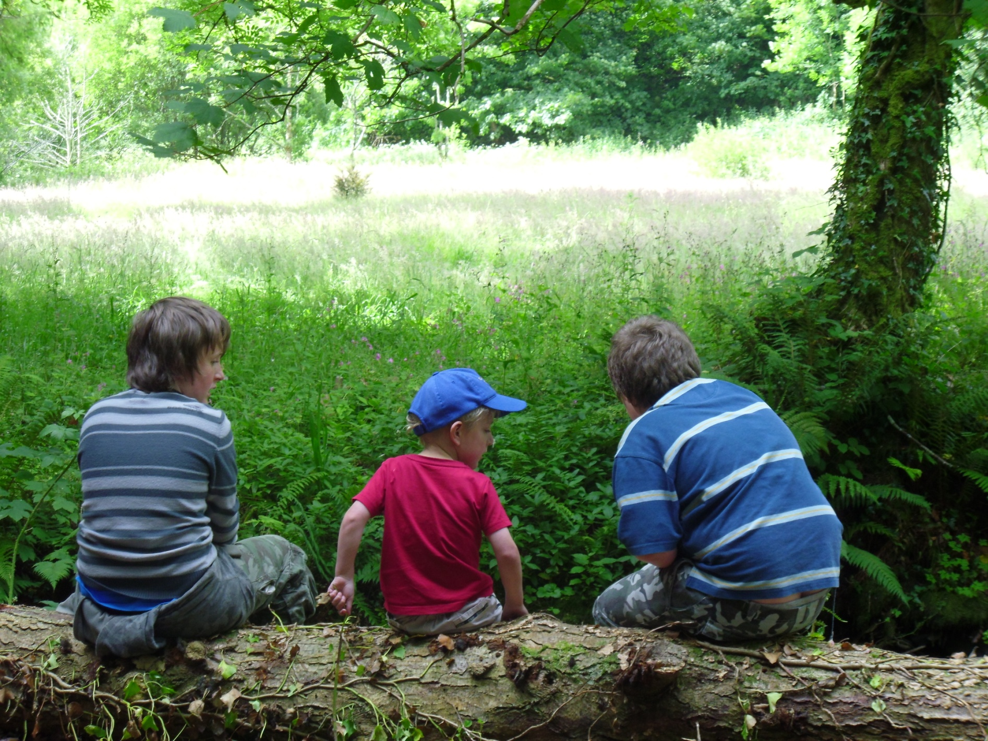

Slide 14
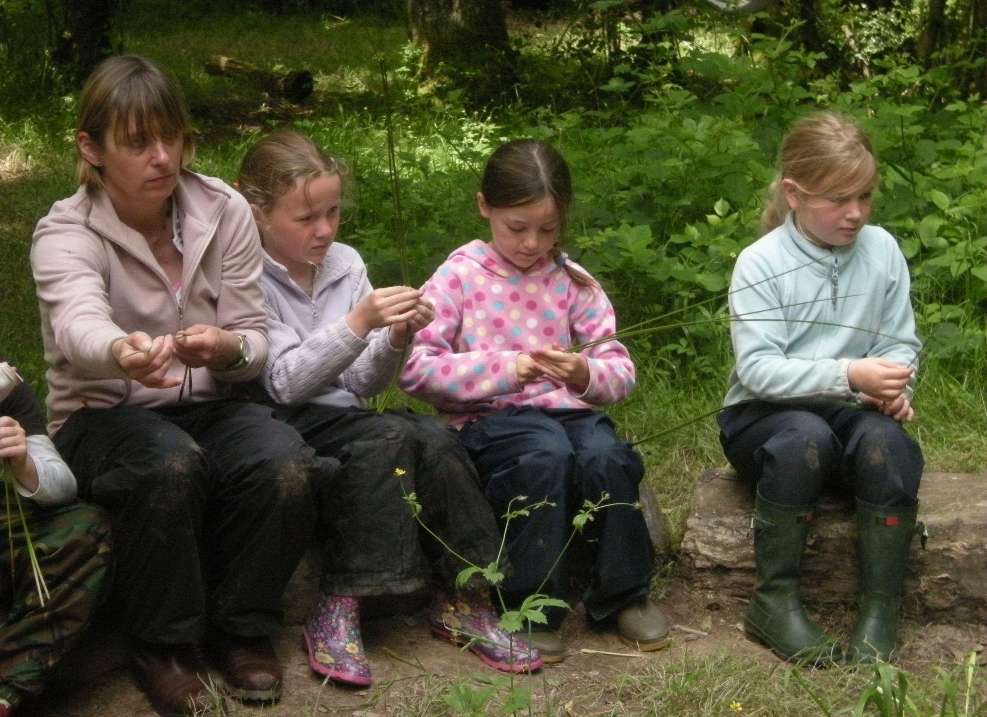

Slide 15
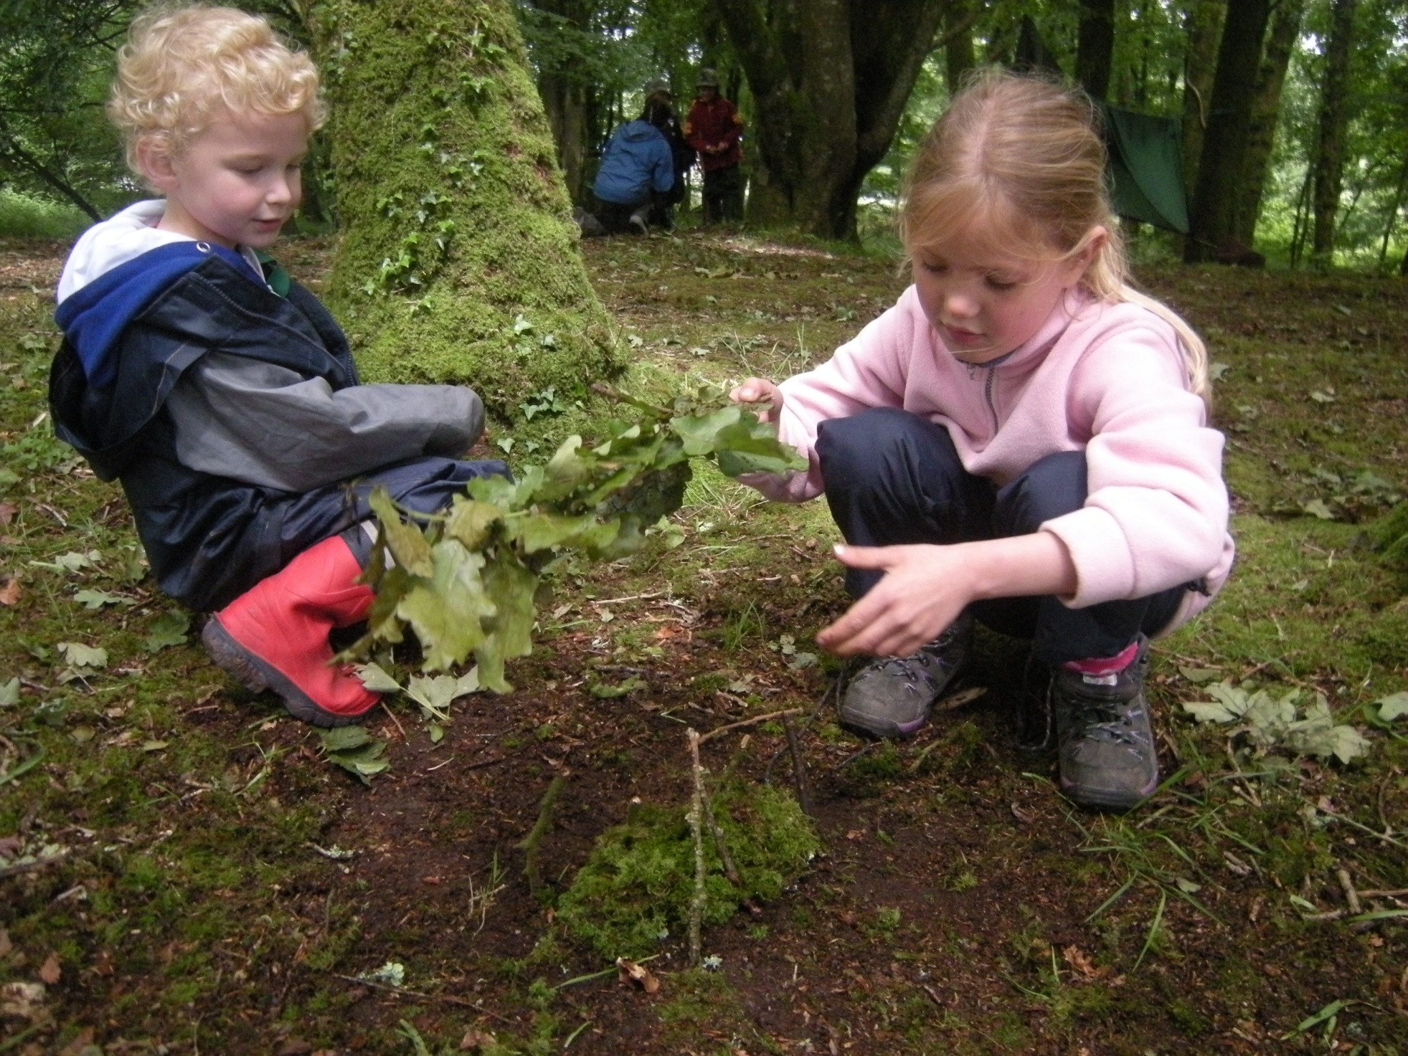

Slide 16
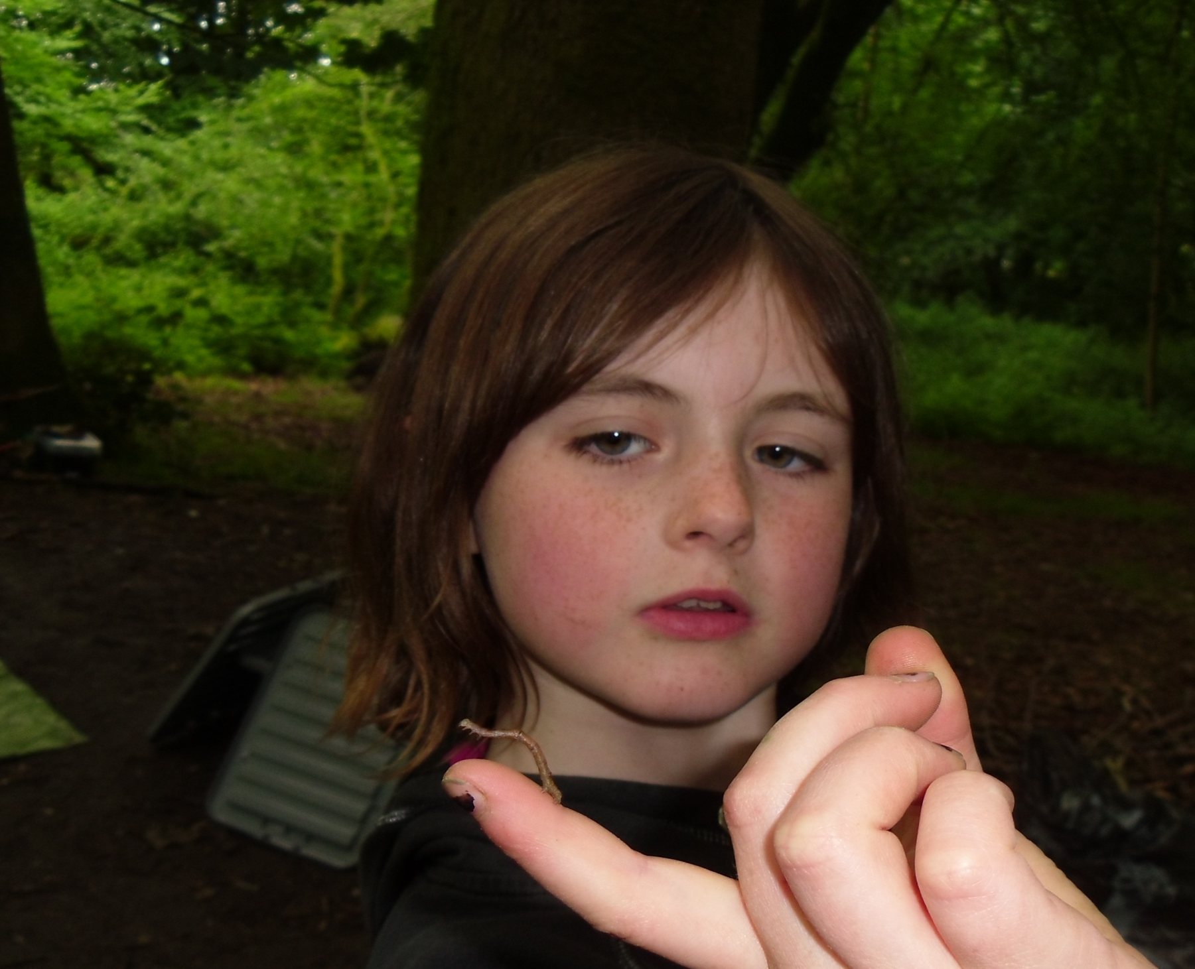

Slide 17
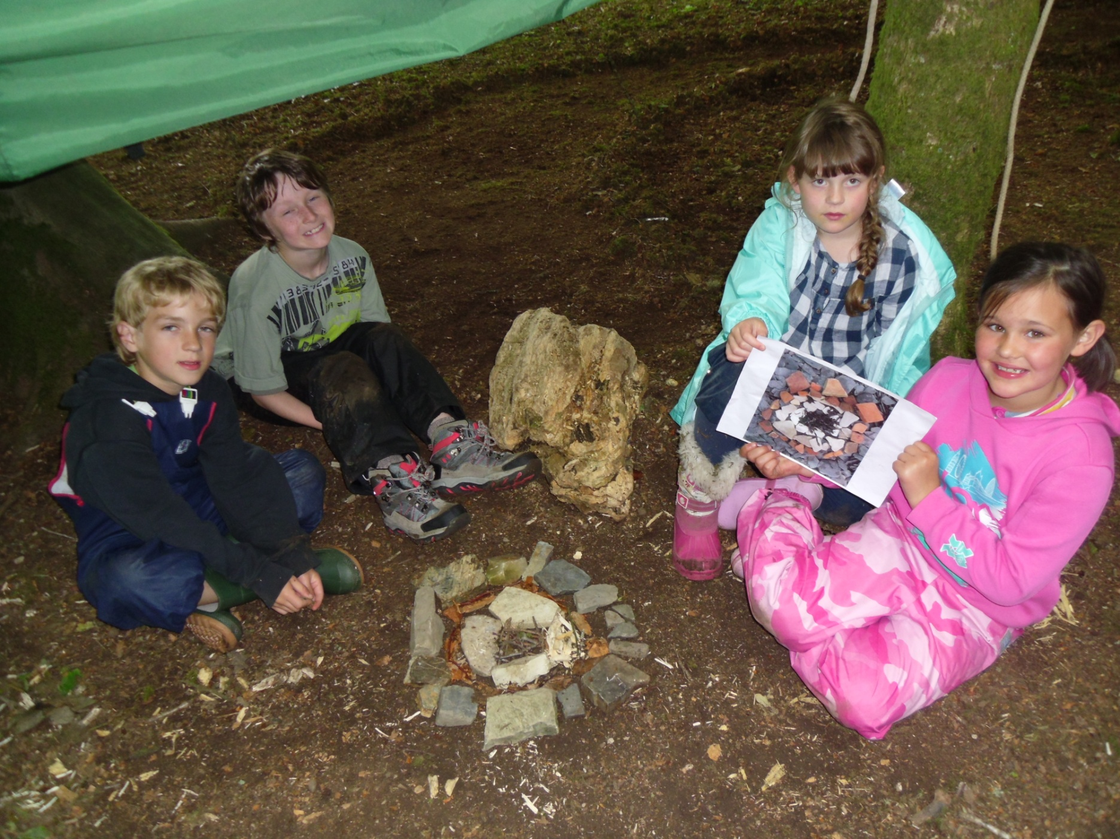

Slide 18
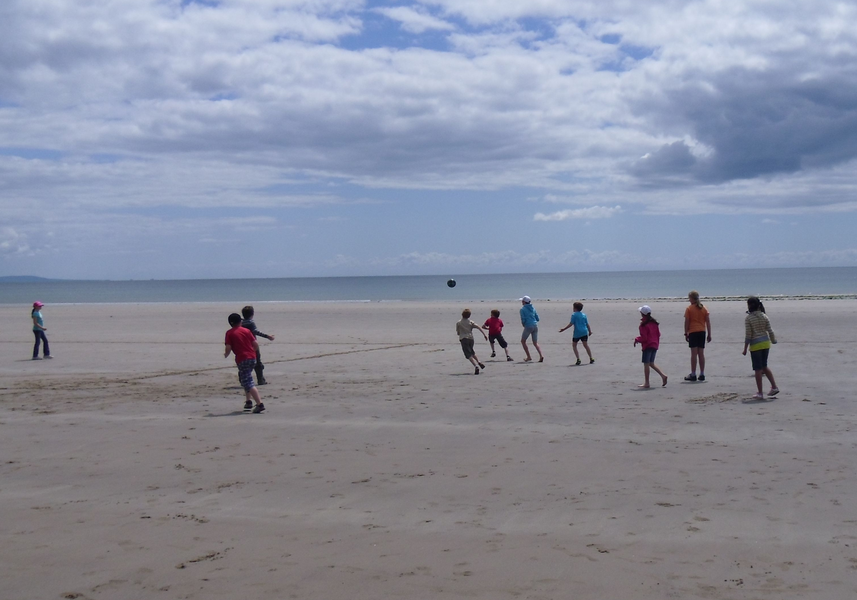

Slide 19
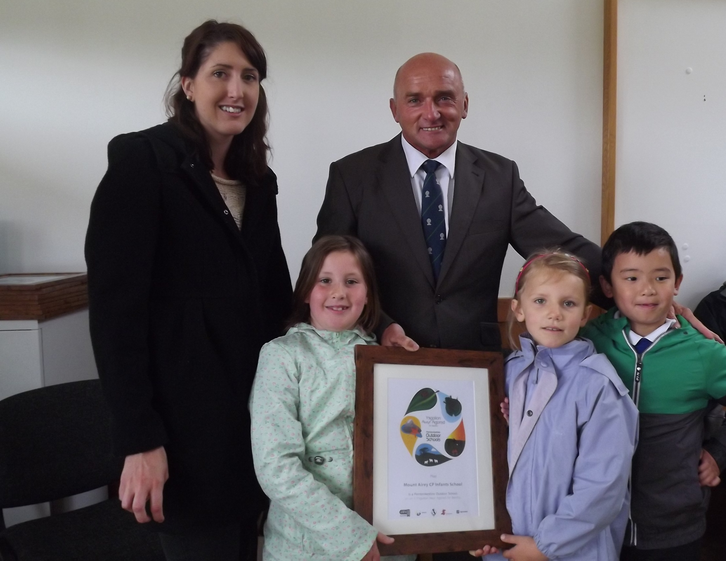

Slide 20
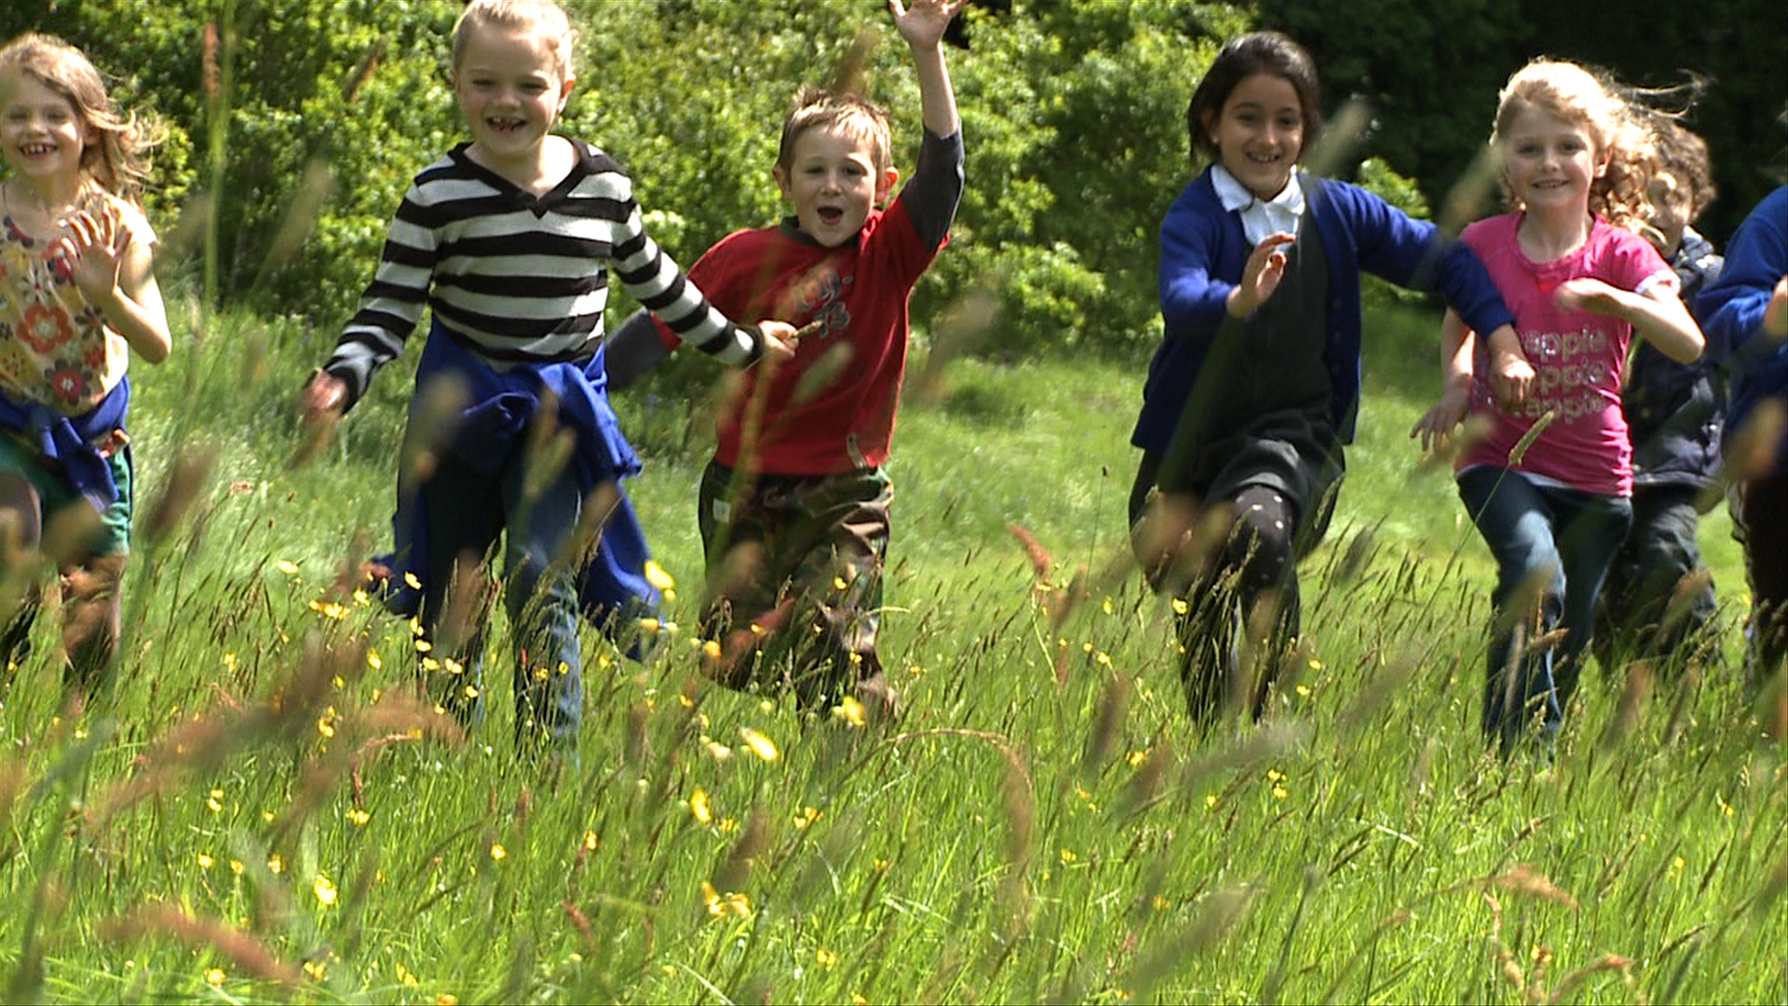

Slide 21
‘Tomorrow’s protectors of the outdoors are the children who play in it today’

