Slide 1


COP1
Conference of Pennar 1
Climate Change Summit
11th November 2021

Slide 2

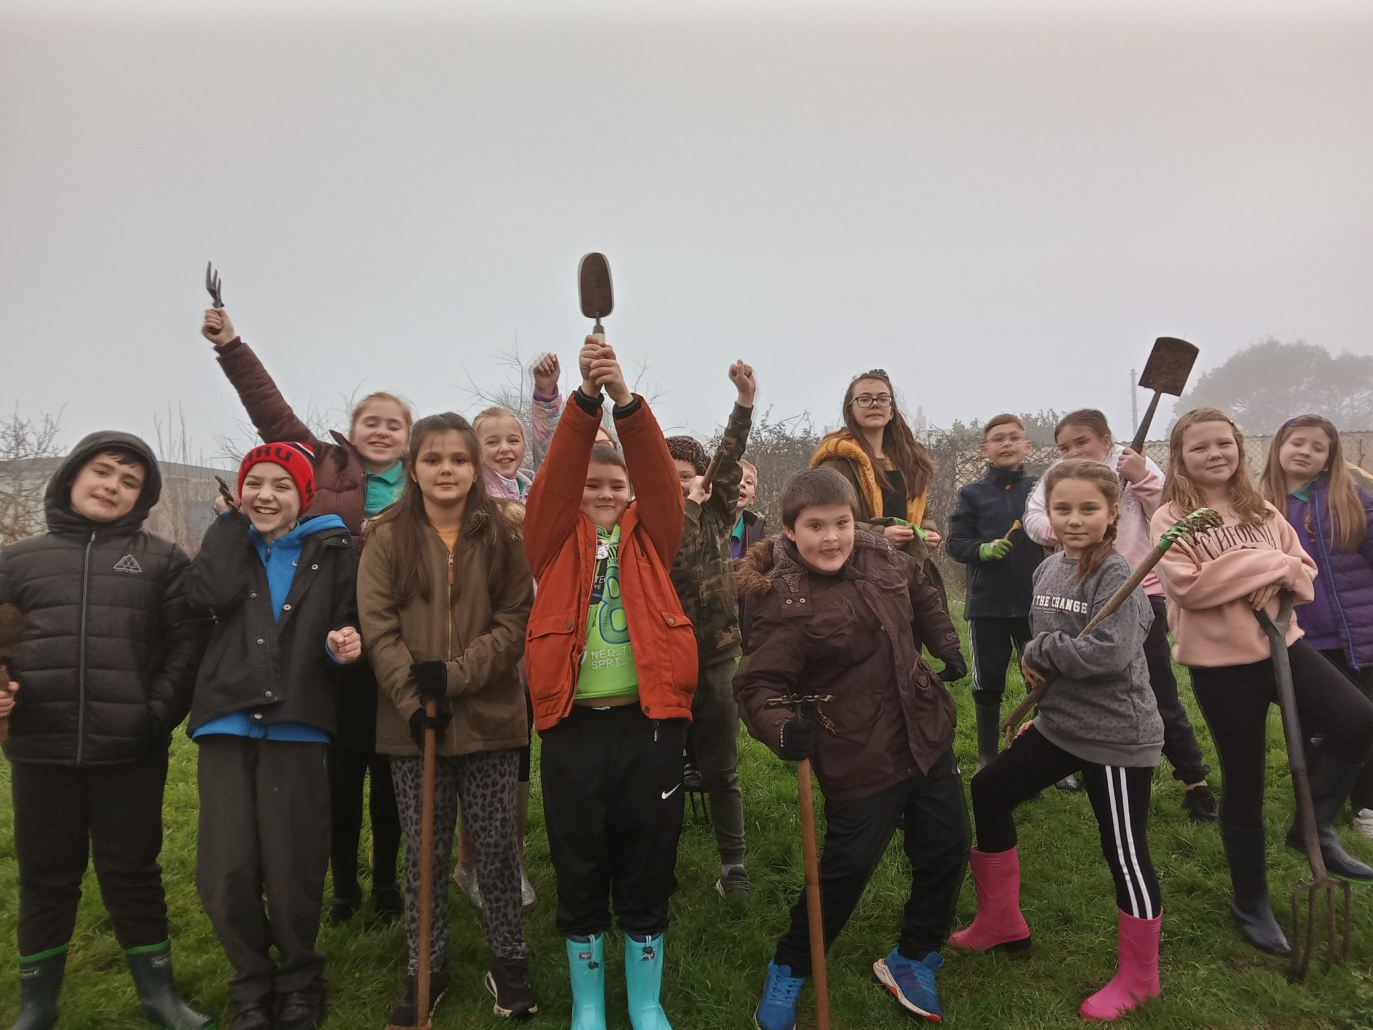

Notes:
We have a very active and enthusiastic Green Team who have made lots of positive changes in and around the school but it was becoming increasingly apparent that it was becoming increasingly apparent that we needed everyone onboard in order to make bigger and more far reaching change happen.

Slide 3
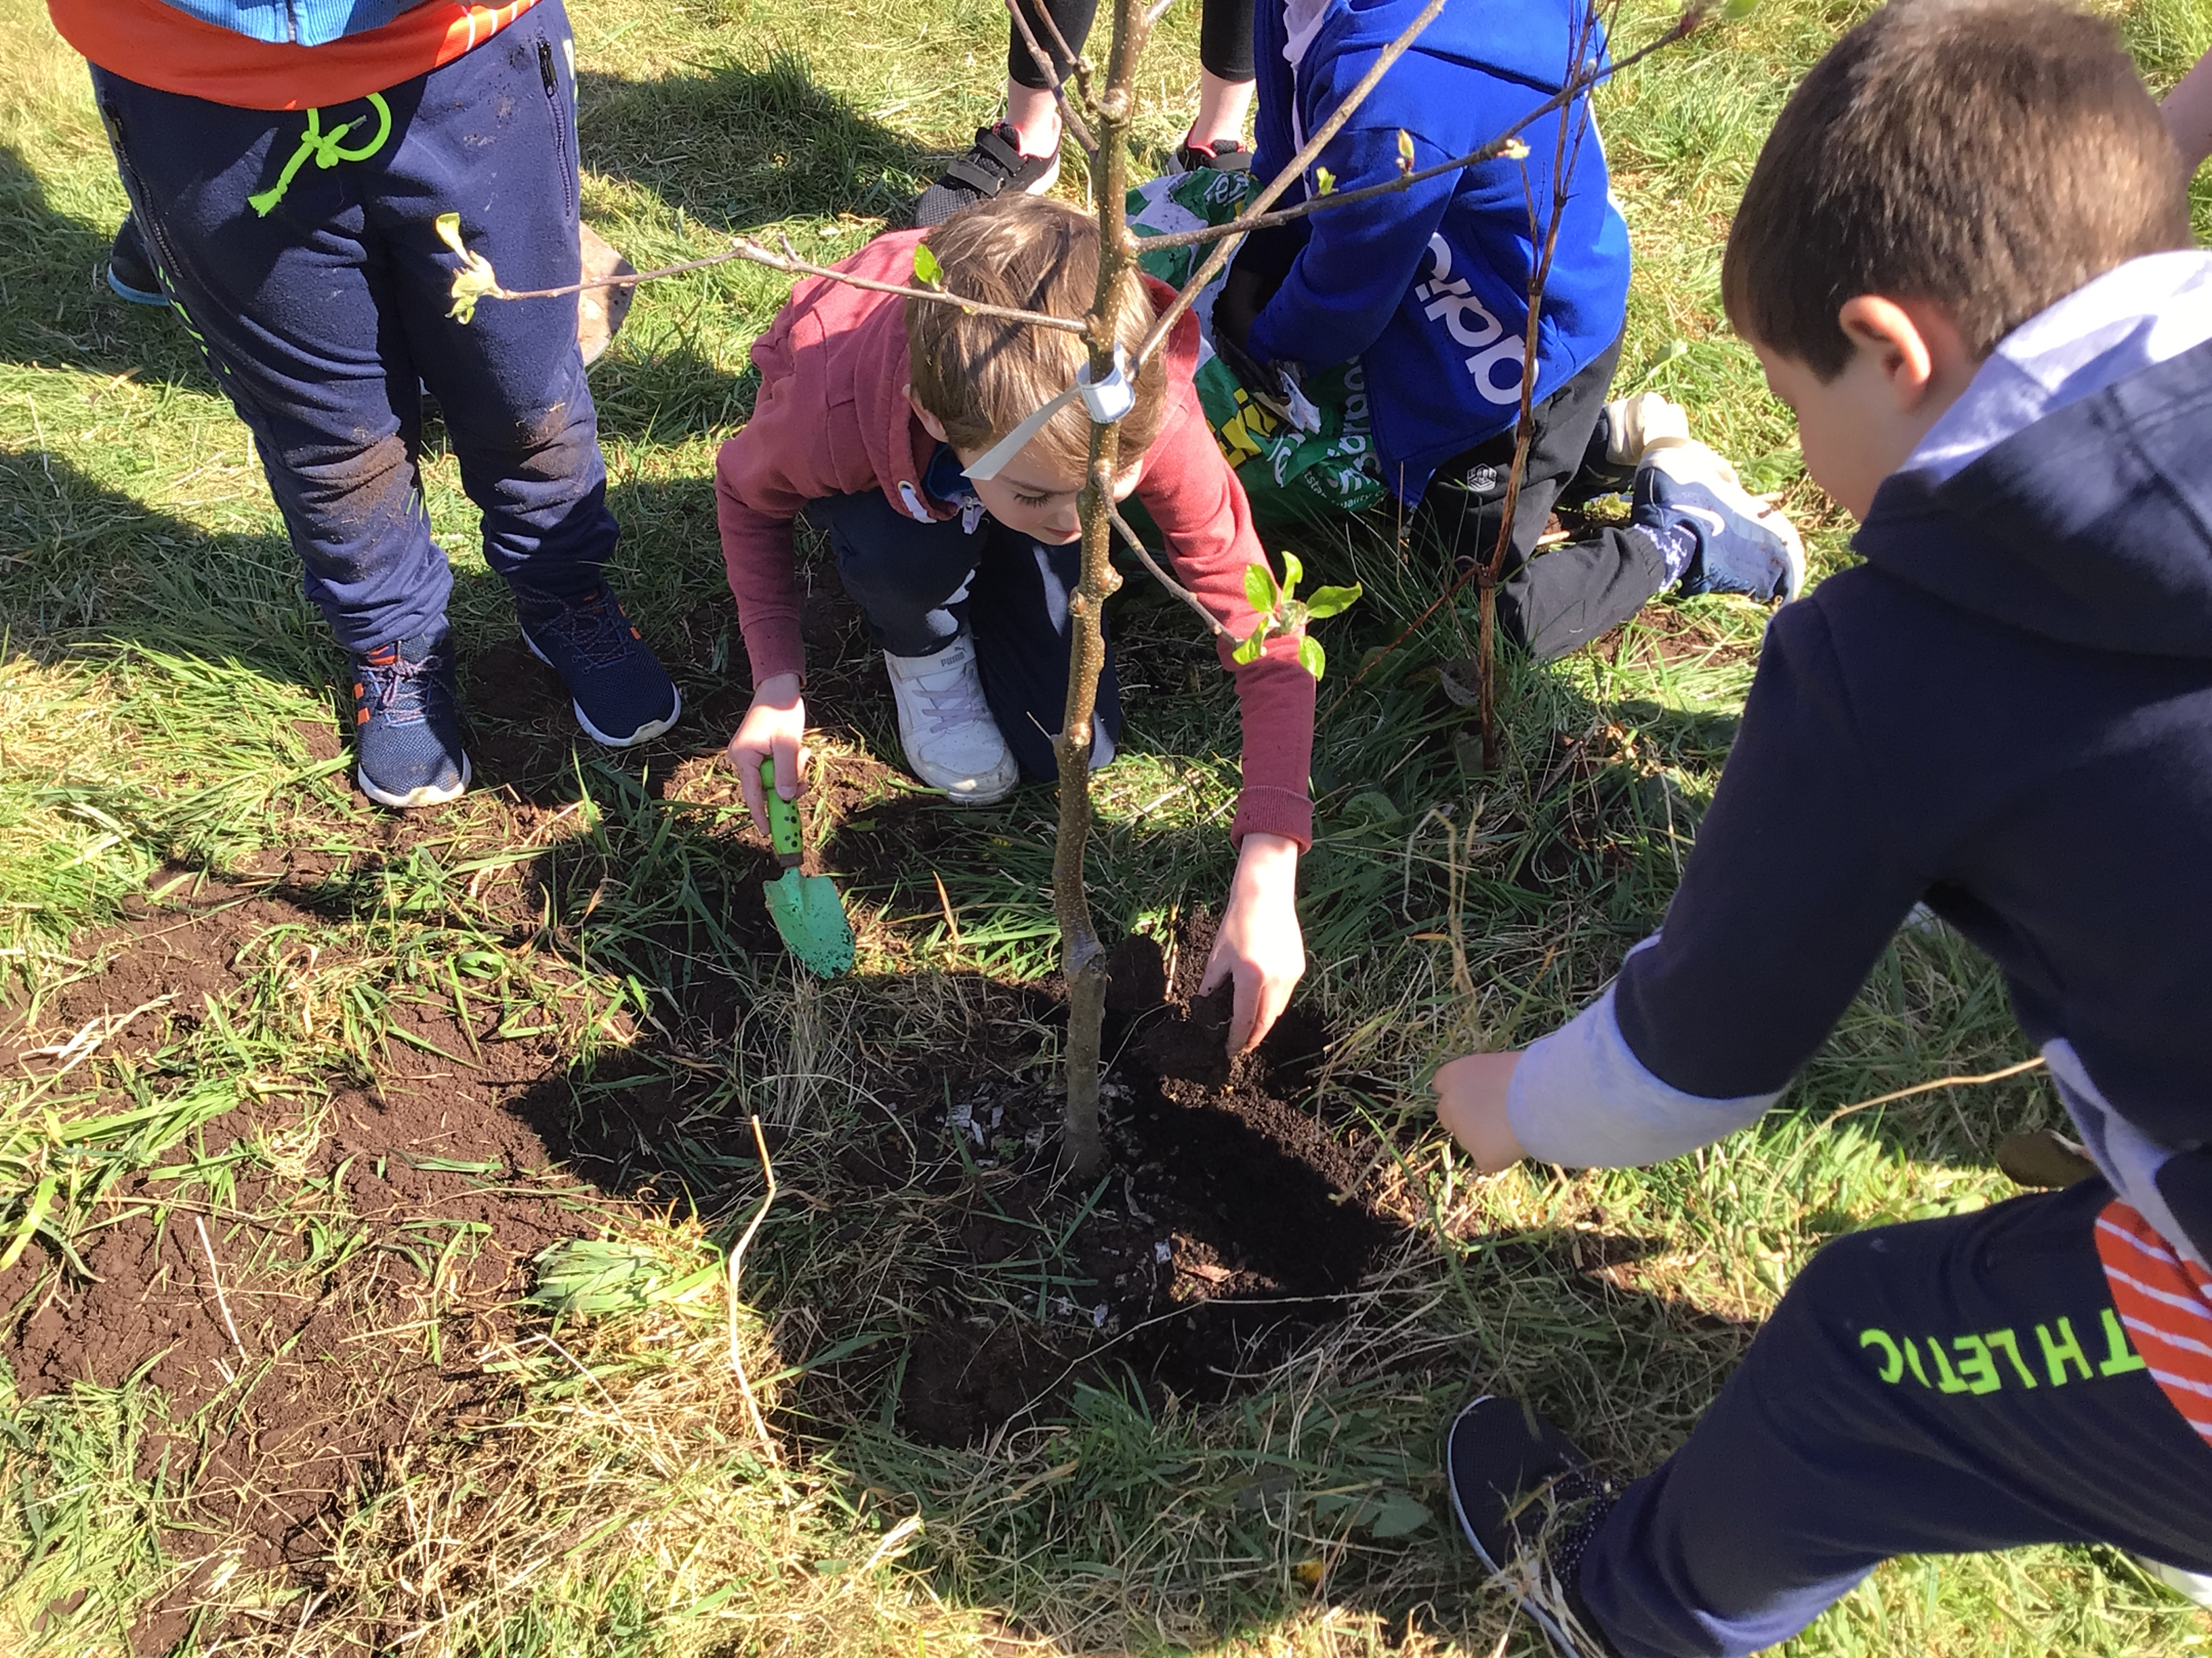
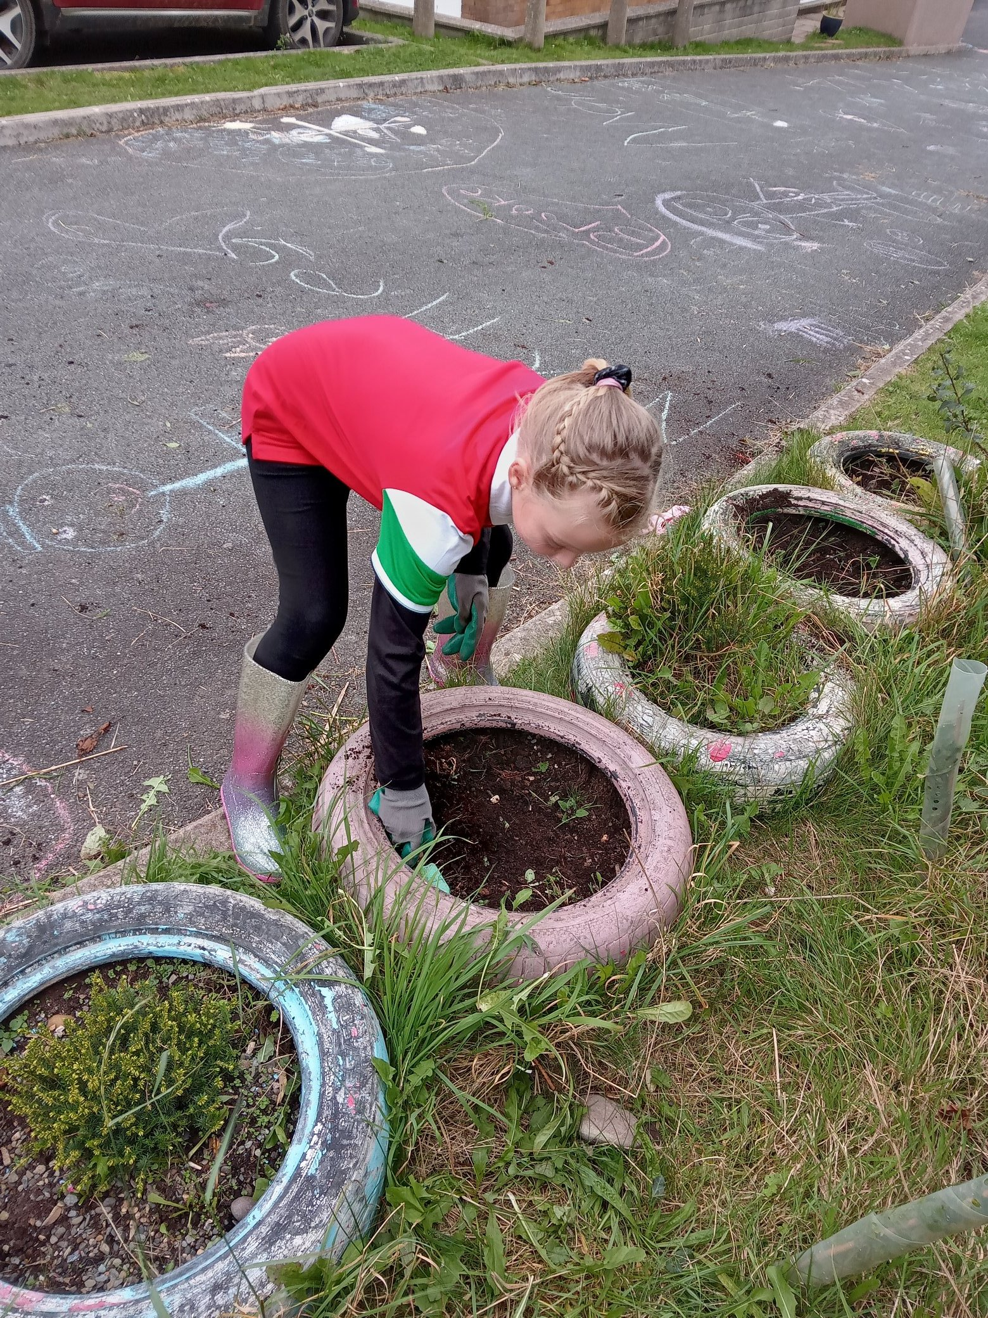

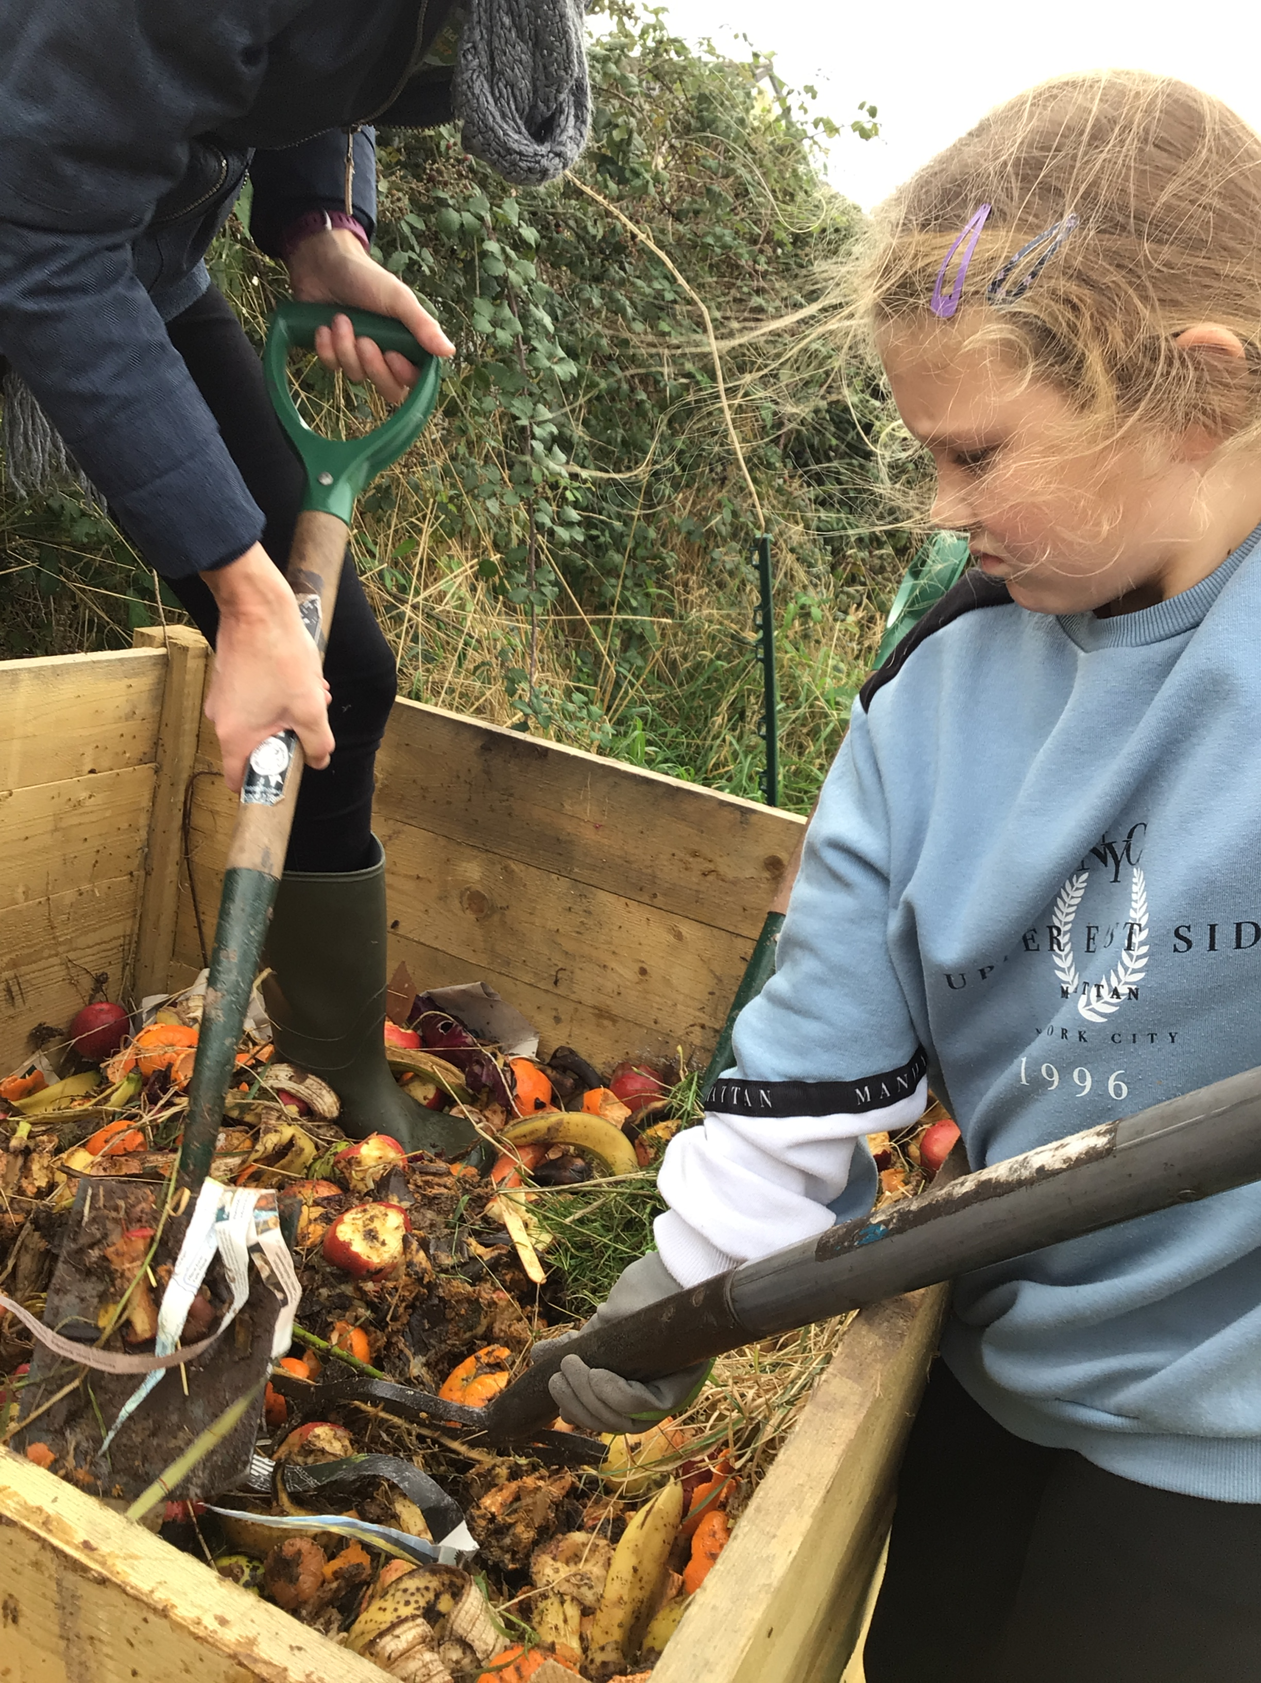
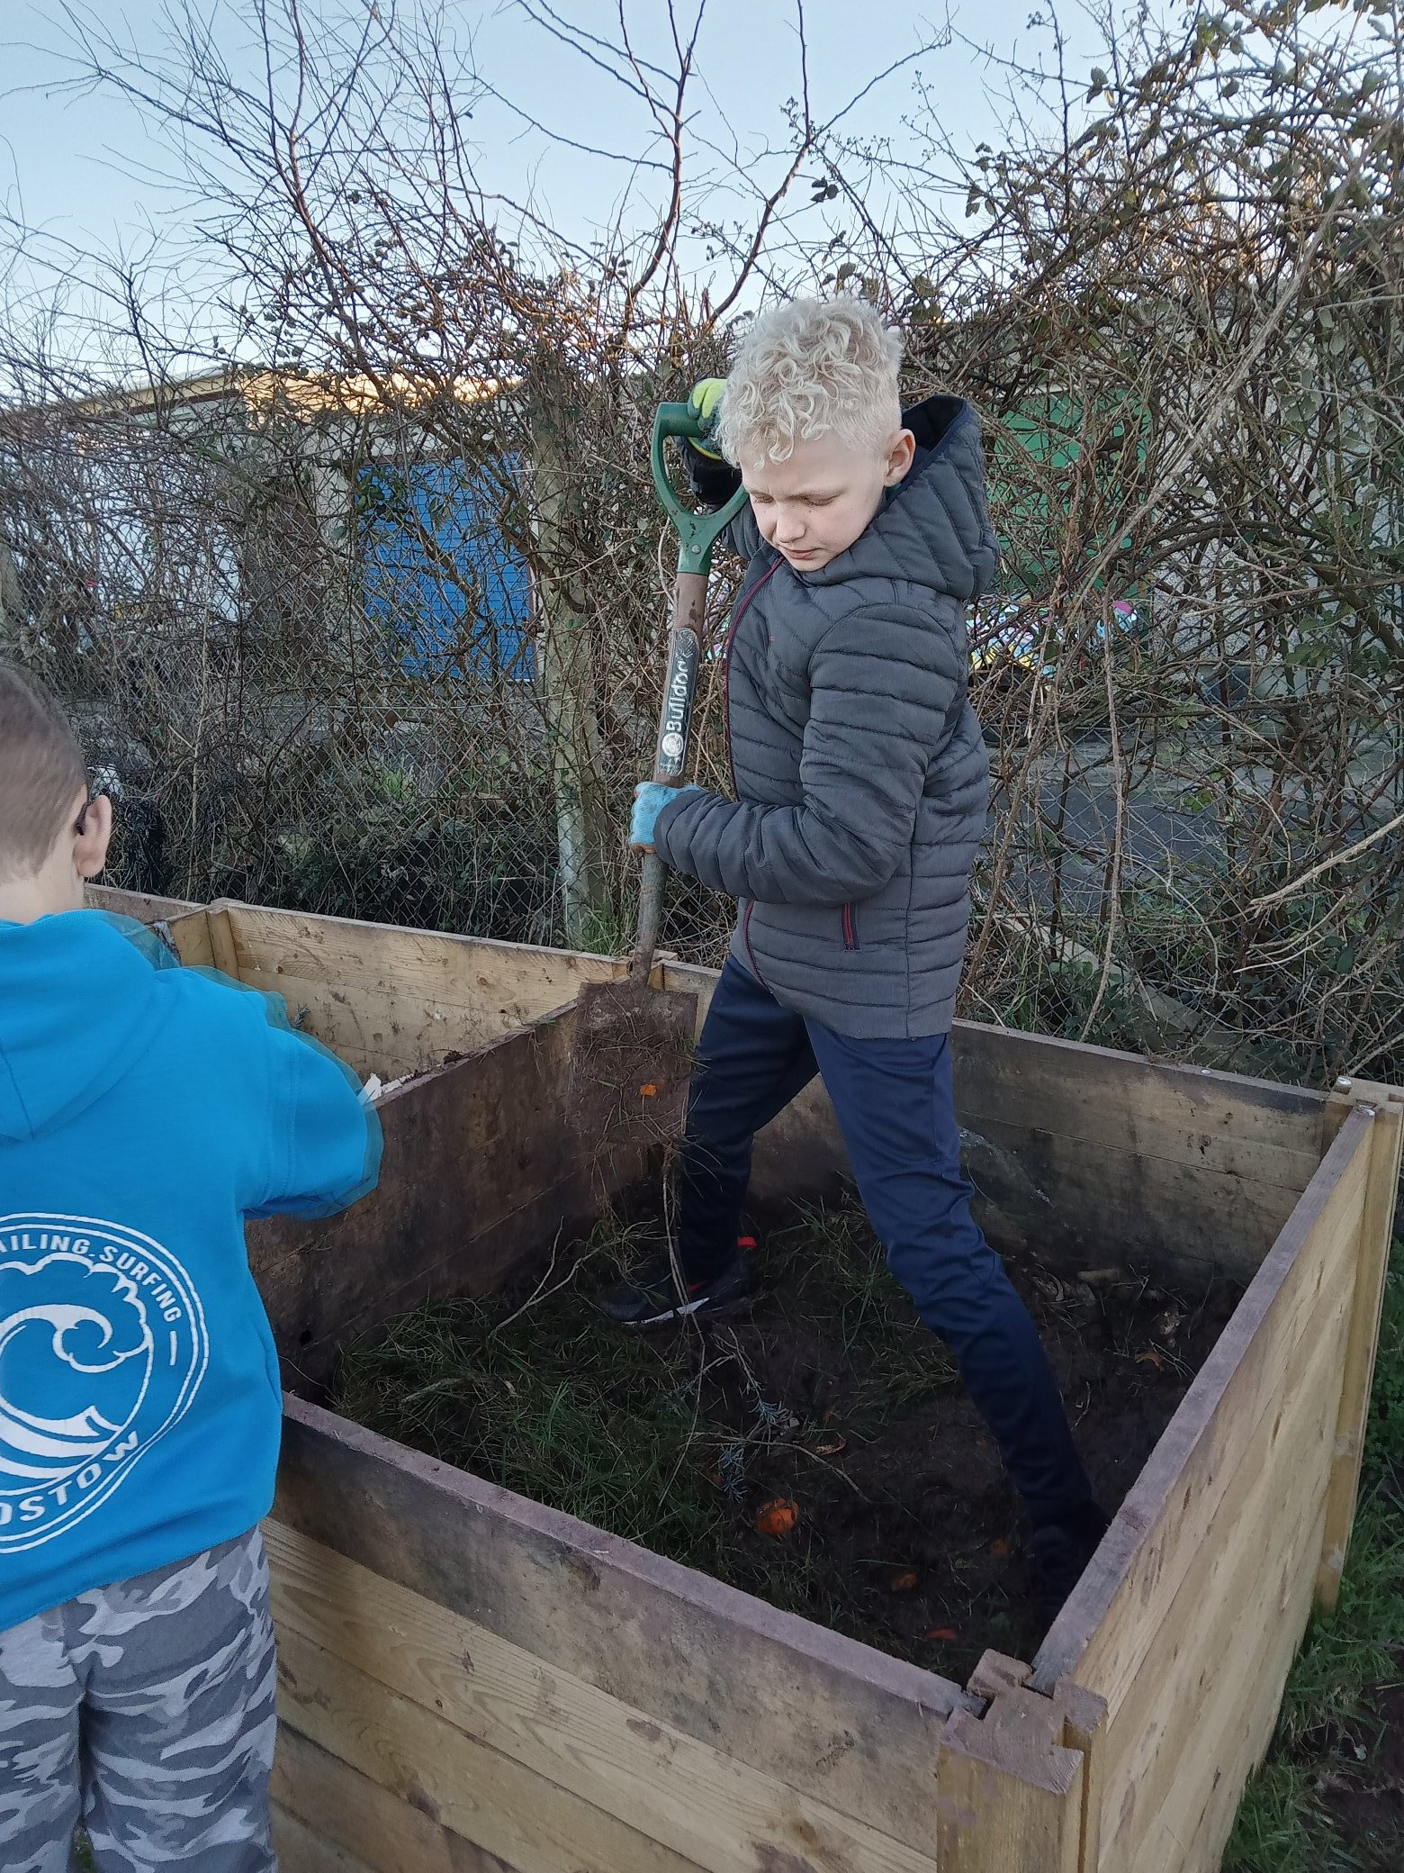
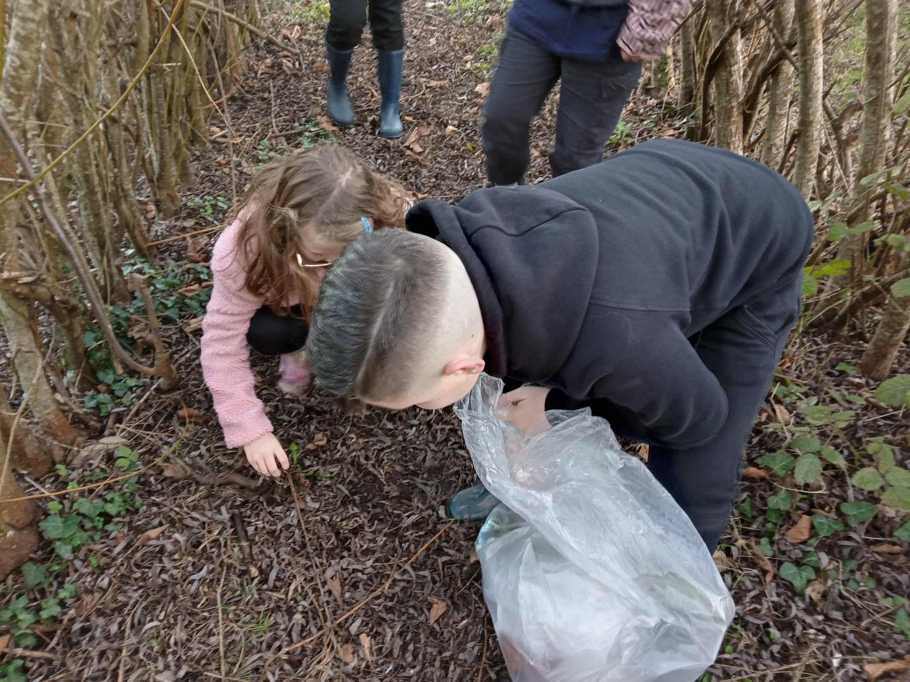

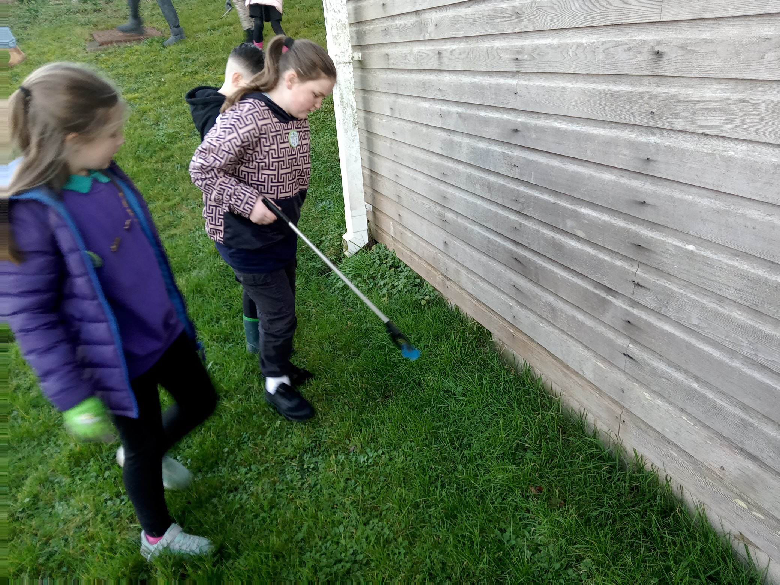
Maintaining the School
Nature Garden
Hosting a ‘Go Green Day’
Managing the Fruit Waste and Compost
Holding Regular Litter Picks – in school and in the local area

Slide 4

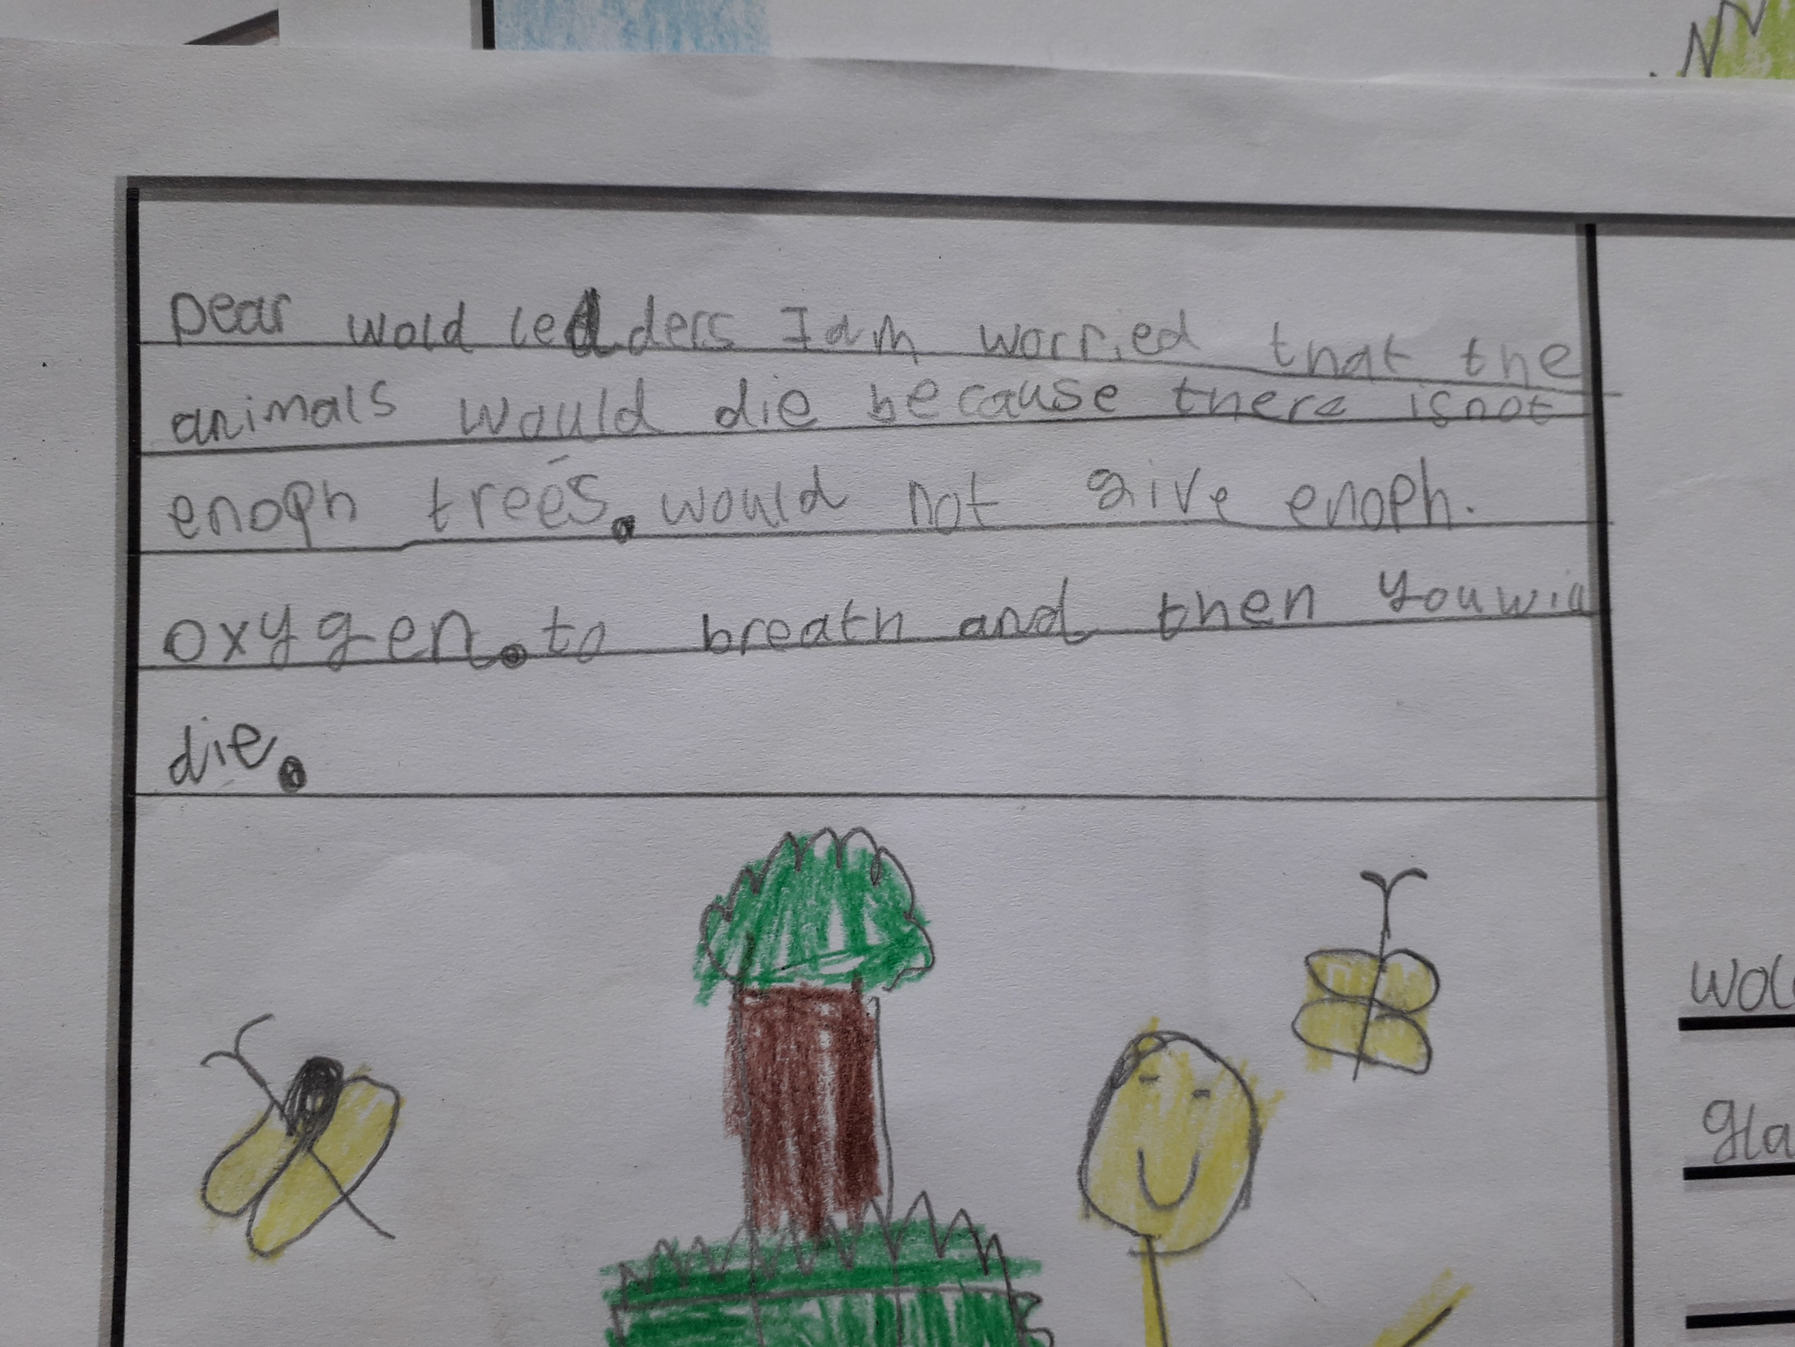
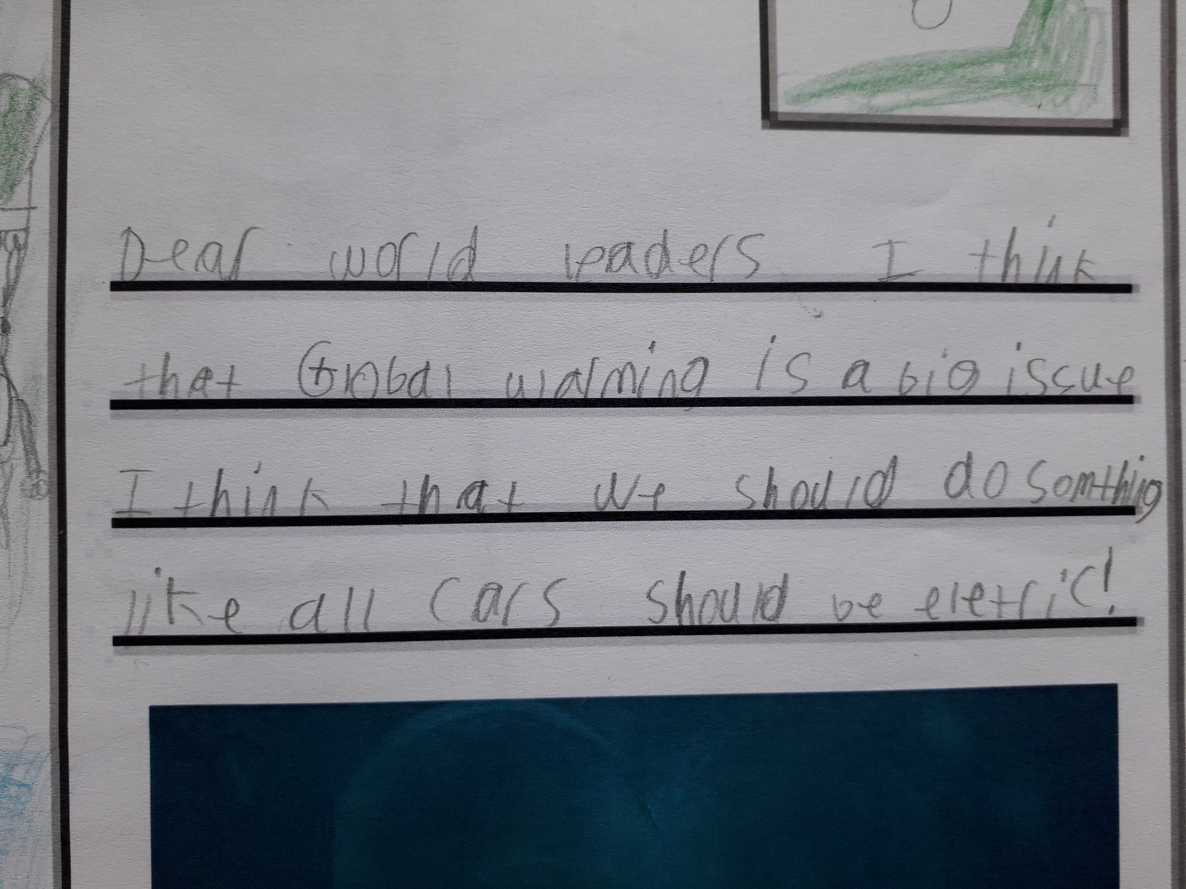
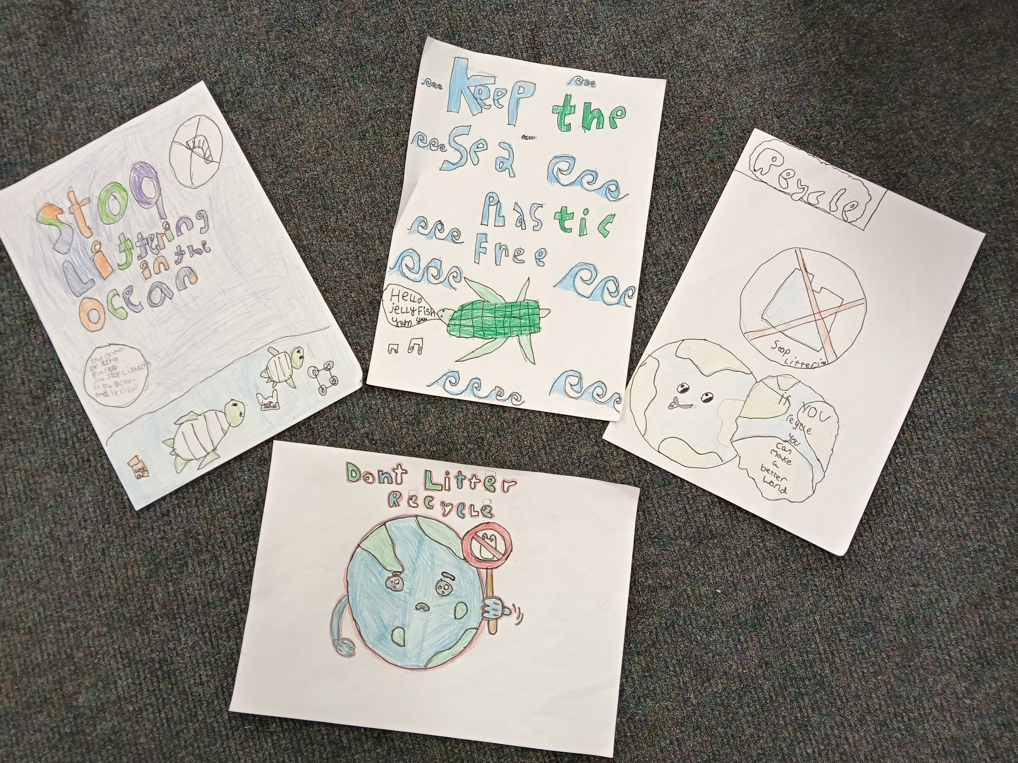
Notes:
Whilst completing class work around COP26 with my class, it became apparent that this was something the pupils felt very passionate about and that some felt high levels of anxiety around the climate crisis.

Slide 5
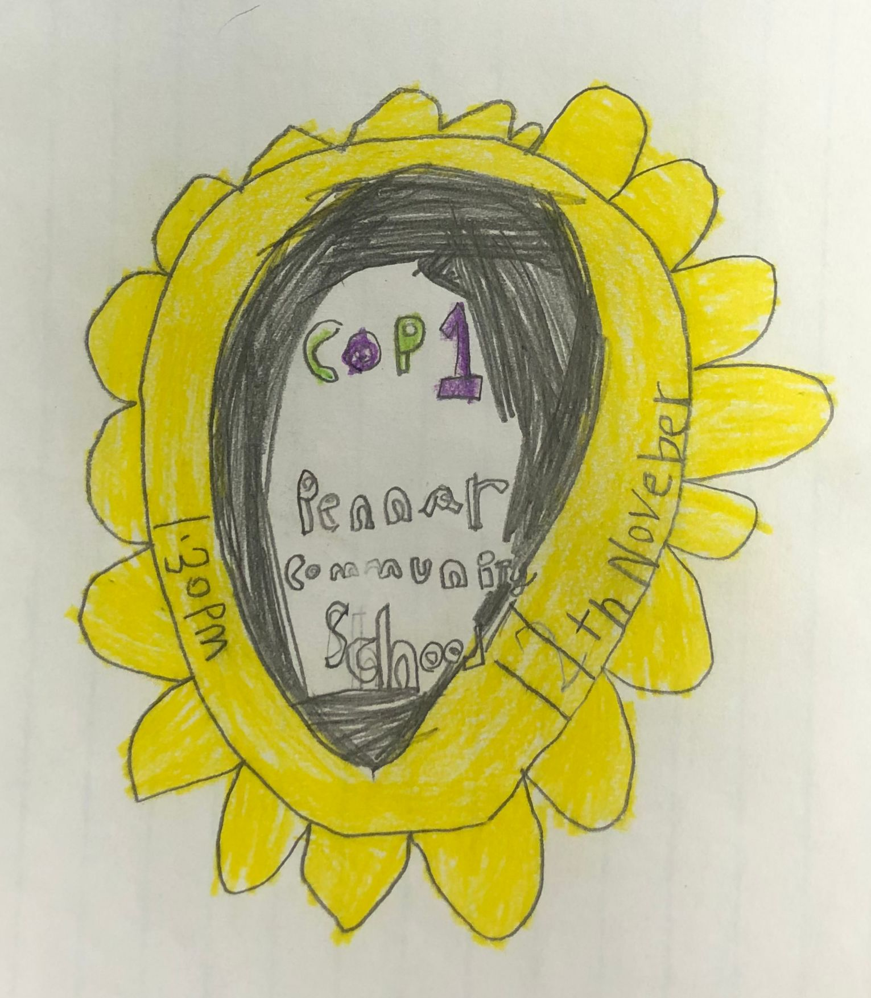
Notes:
So I mentioned to our HT the possibility of holding our own COP Summit (Conference of Pennar 1) and he was very keen and so it sort of spiralled from there.

Slide 6
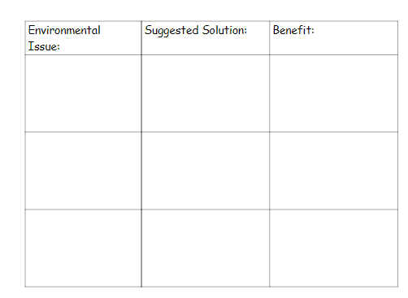
Notes:
I wanted all pupils have their voices heard so I asked all classes to hold an initial Class Council meeting during which they elected a delegate to represent them at the COP1 Summit and they discussed problems and possible solutions. They completed the grid shown here for three of their

Slide 7
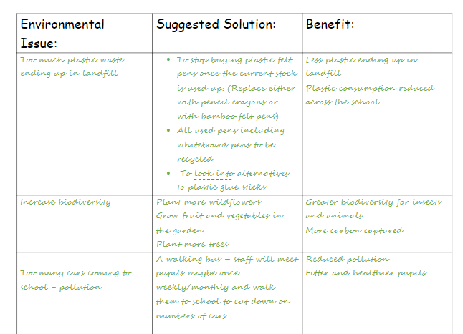
Notes:
Here is an example of the grid completed by my class. items and then passed it on to the GT. The GT then chose one item for each class to ensure there was no overlap or doubling up across the classes. Governors, Teachers and Support staff also put forward agenda items. The GT then shared the agenda with all classes.

Slide 8
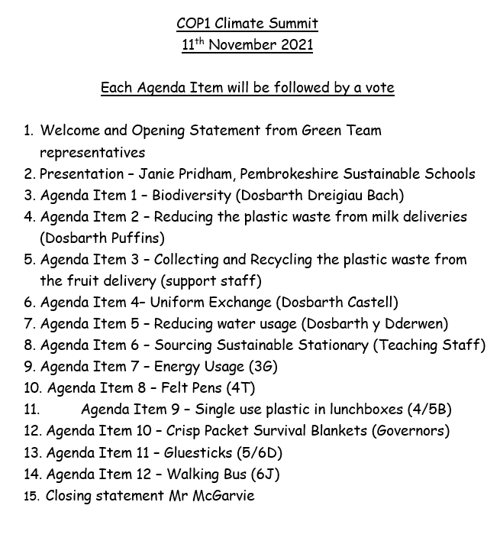
Notes:
Governors, Support Staff and Teaching Staff all put forward an agenda item to be presented at the conference and chose a delegate to represent them.

Slide 9
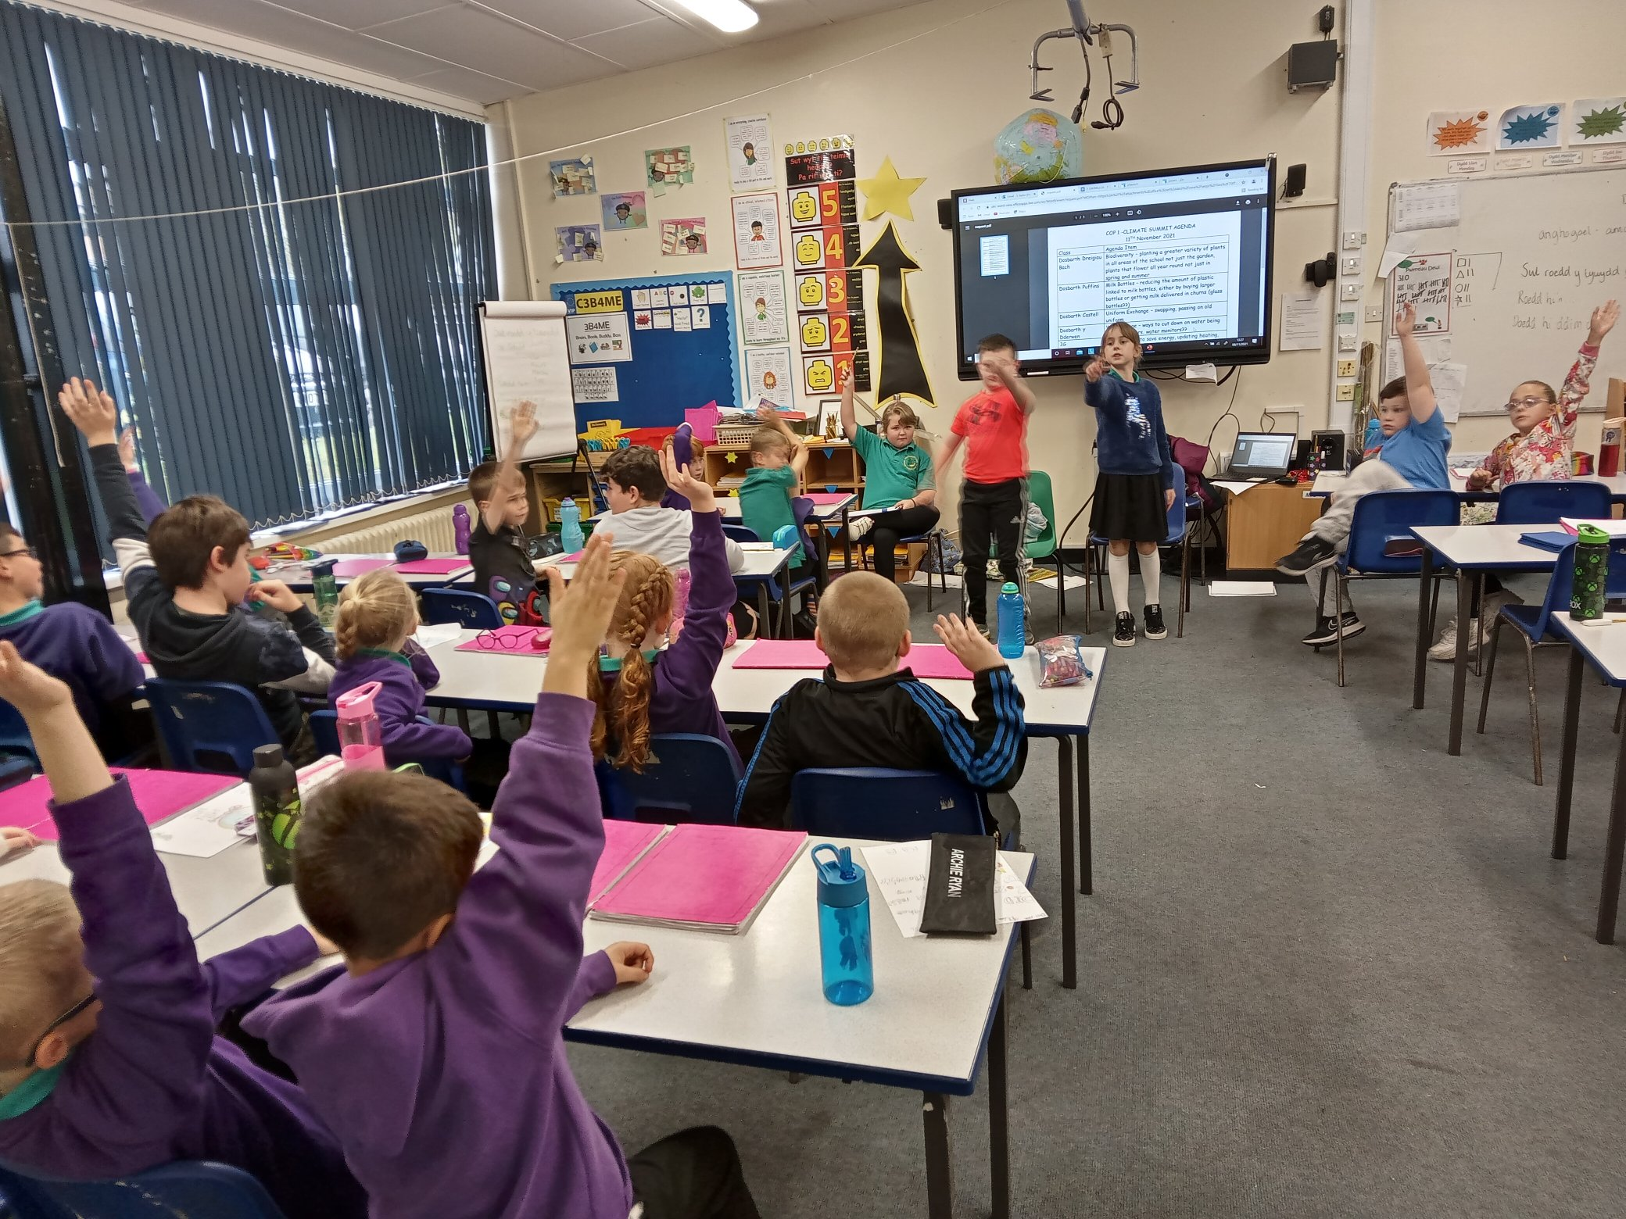
Notes:
I then asked all classes to hold a second class council meeting where the agenda items were discussed and the delegate was able to canvass the opinion of their class mates of each item on the agenda in order to be sure they were able to represent the opinion of the majority of their peers when voting in COP1. (The younger classes, were delegated a member of the GT to support them)

Slide 10

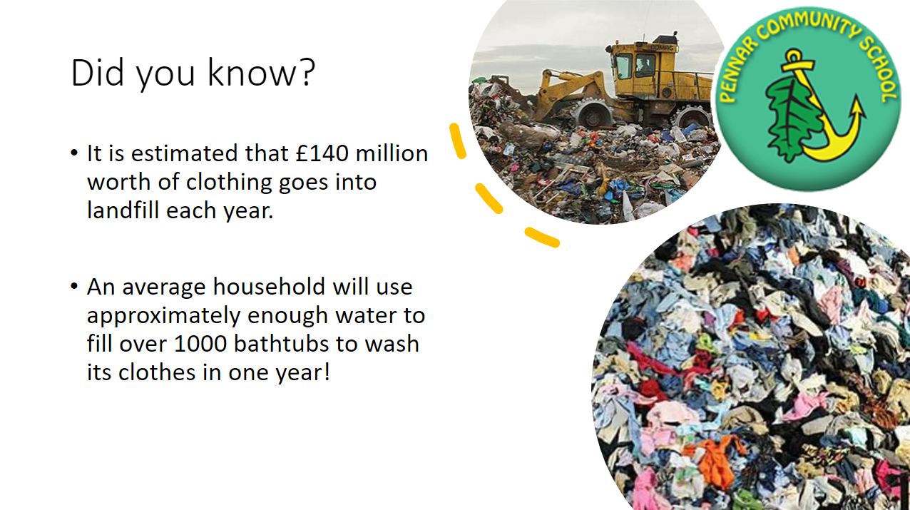
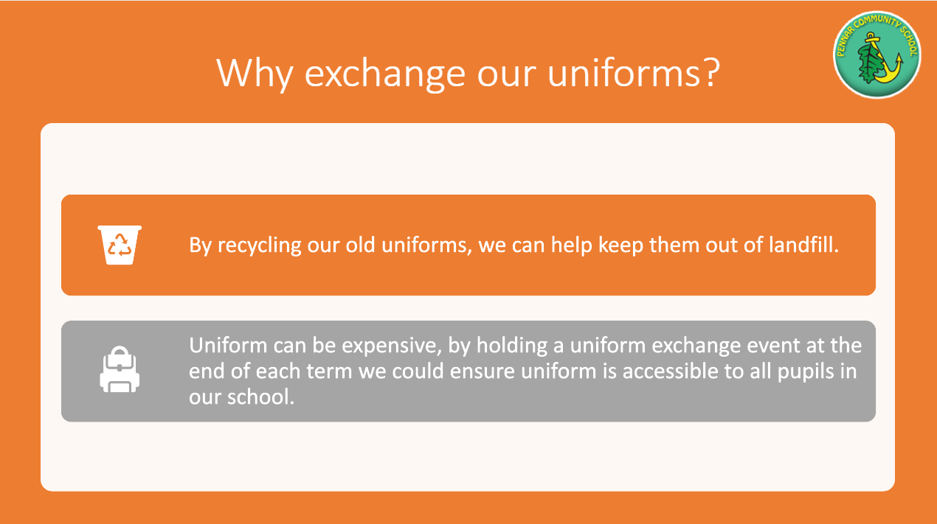
Notes:
Each delegate then created a short three side presentation to support their agenda item – clearly explaining the environmental issue, the suggested solution and what the benefits would be.

Slide 11
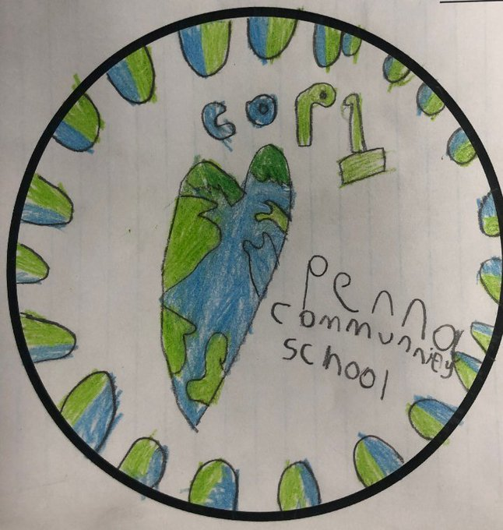
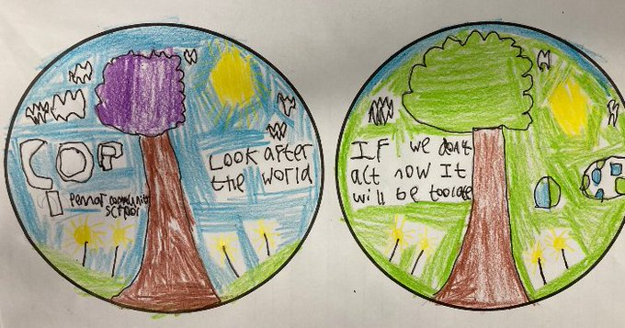
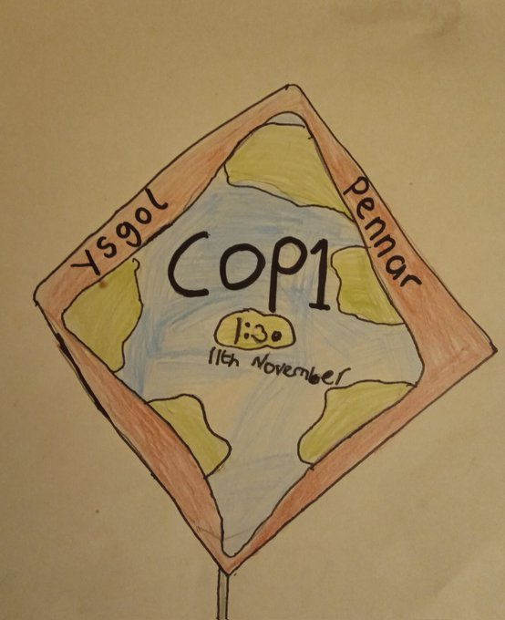
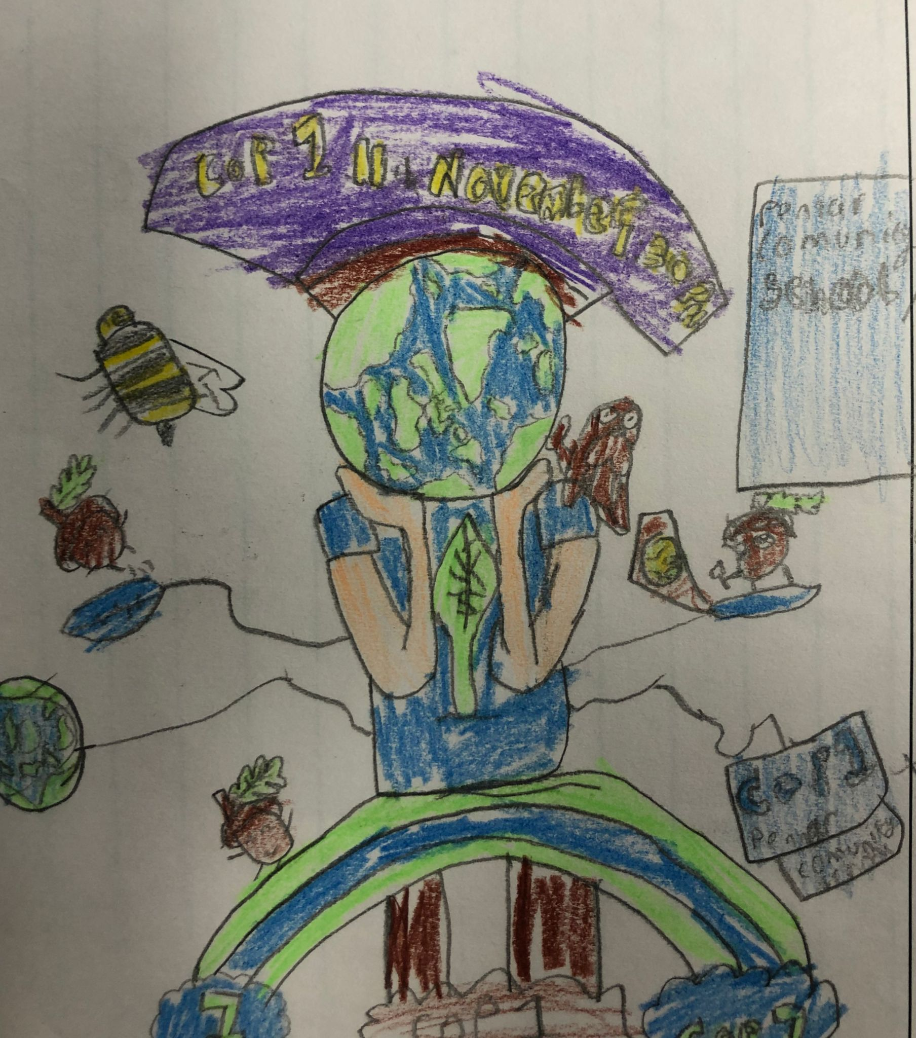
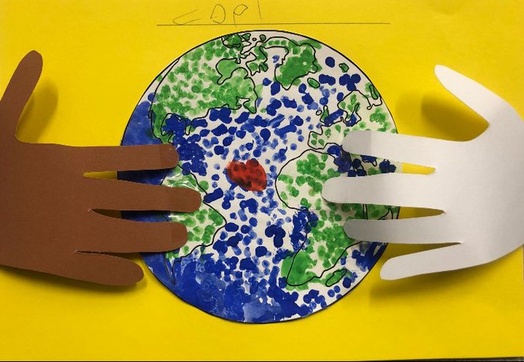
Notes:
We held a logo competition and counted down to the COP1 Summit on out @PennarGoesWild Twitter feed.
We invited Governors, Keep Wales Tidy, Size of Wales, Janie and Bryony from the National Park

Slide 12
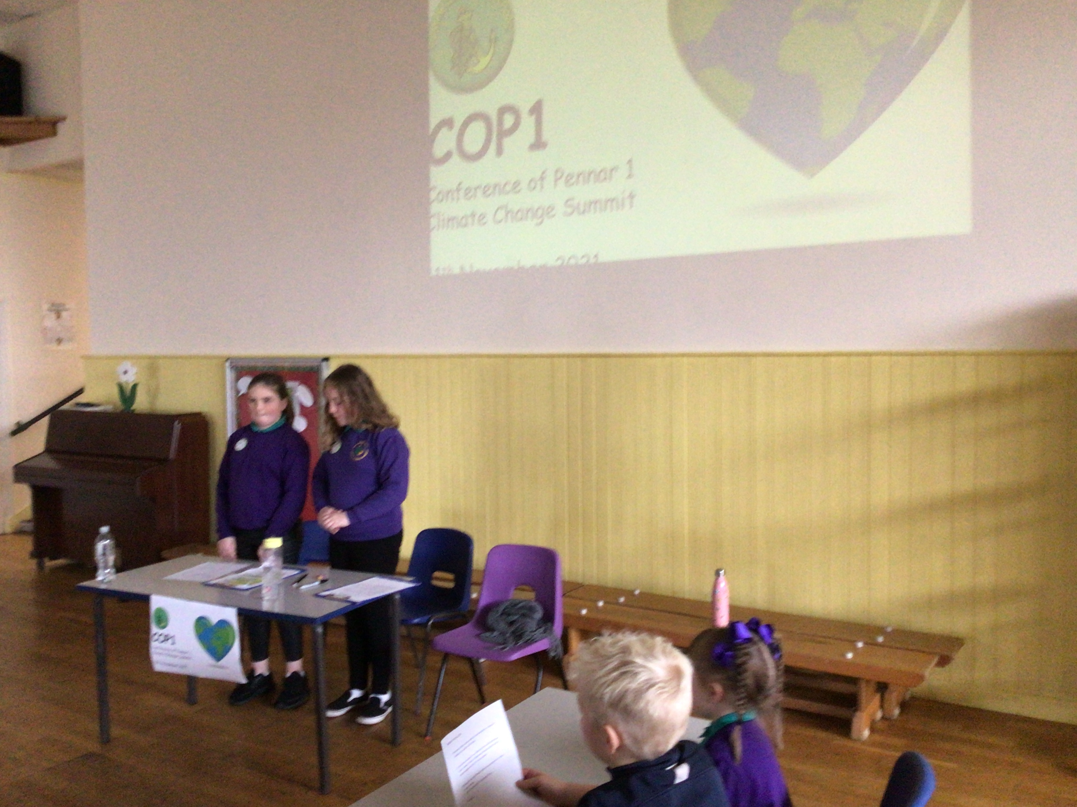
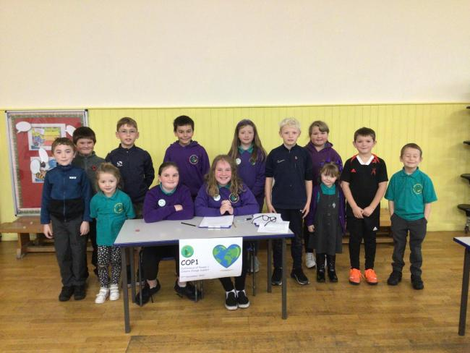
Notes:
COP1 was held on 11th November and was chaired by the GT Chair and Secretary. Each delegate presented their idea before a vote was proposed. The delegates spoke intelligently and passionately about their suggestions backing themselves up with evidence and data. They clearly had researched well. This is what the new curriculum is all about, authentic contexts for learning, ethical informed citizens, ambitious capable learners we ticked a lot of boxes throughout this process. Every item was passed more or less unanimously to the delight of the GT and delegates.

Slide 13
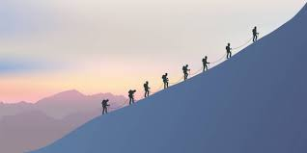
Notes:
So that’s when the real work started!!!! We had a mountain to climb and we even now are not anywhere near the summit however progress has been made.

Slide 14
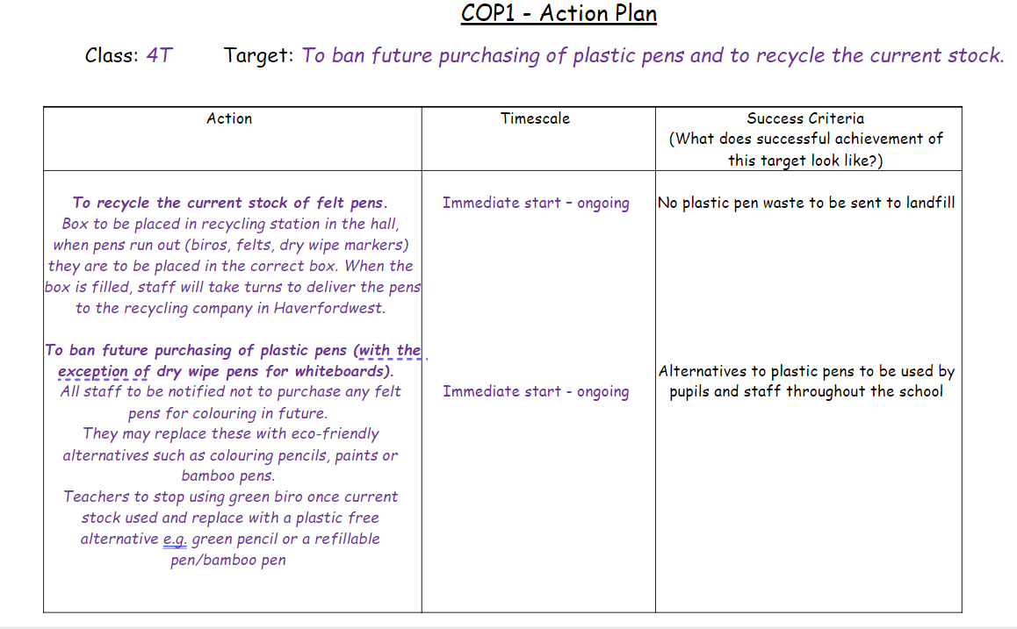
Notes:
As all agenda items were passed, I asked the classes to complete an action plan for their action and return to me. This was completed during a third class council meeting.

Slide 15
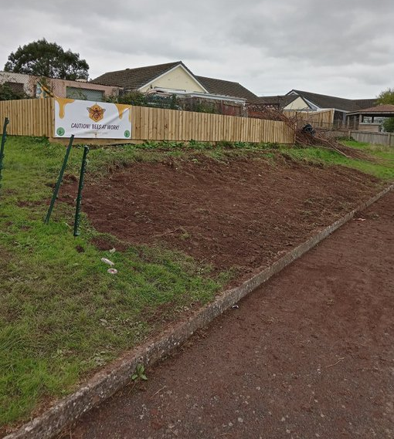
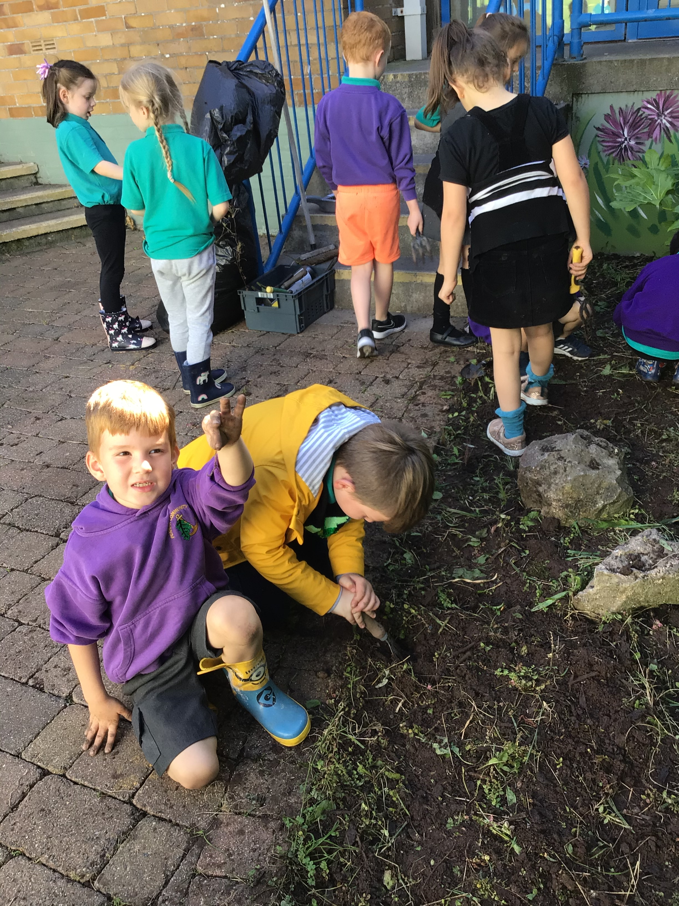
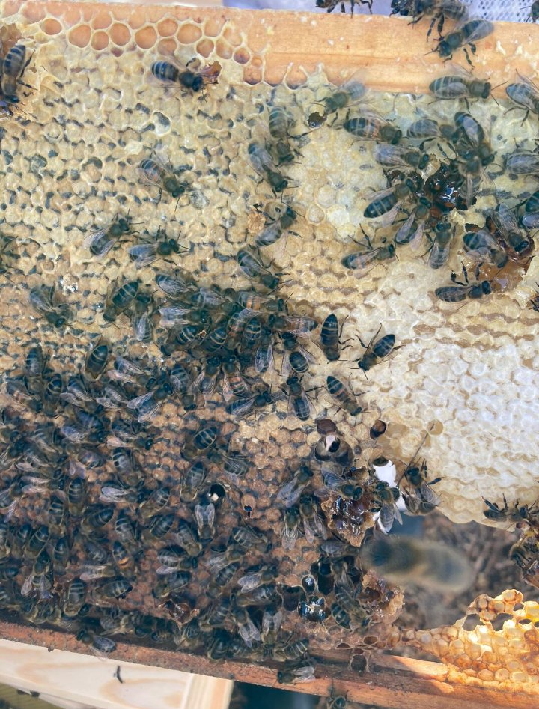
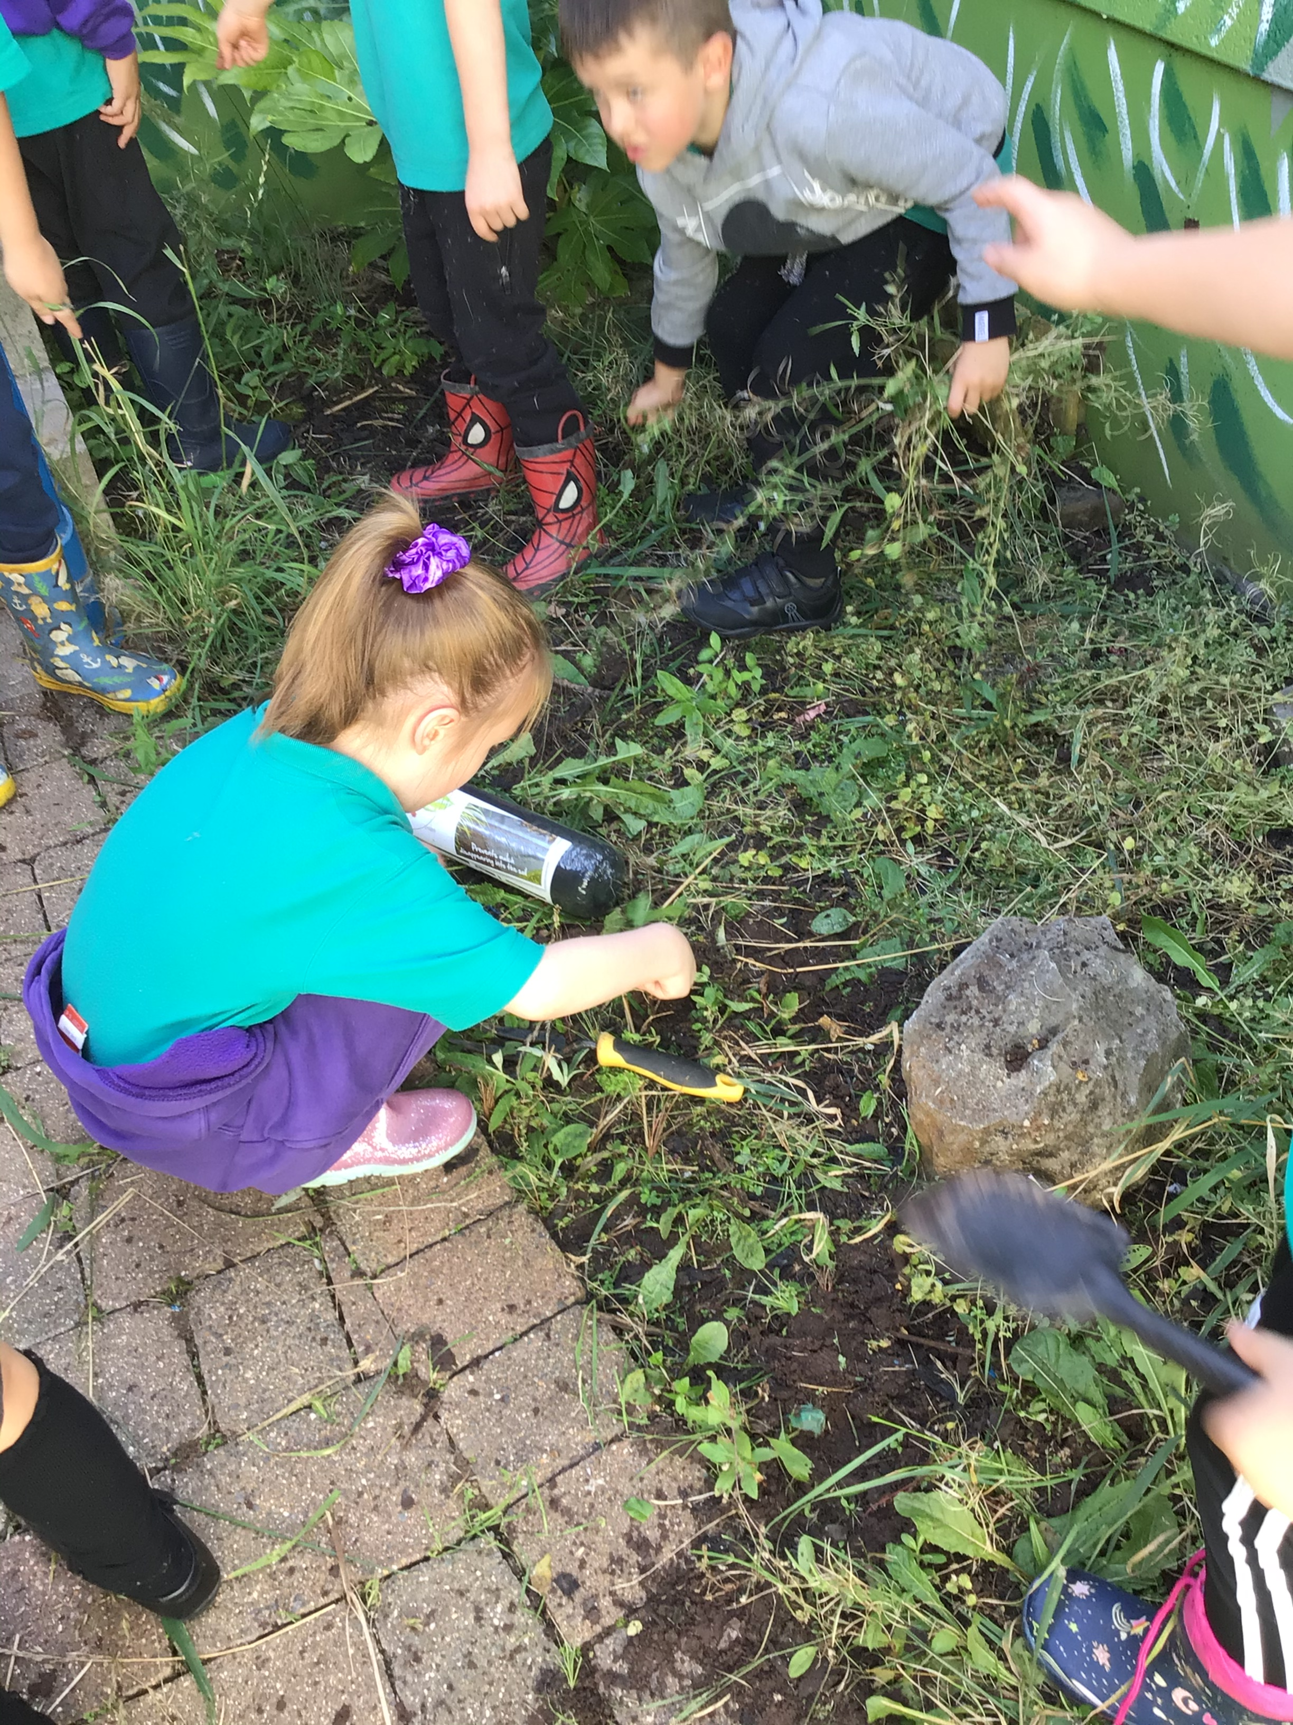
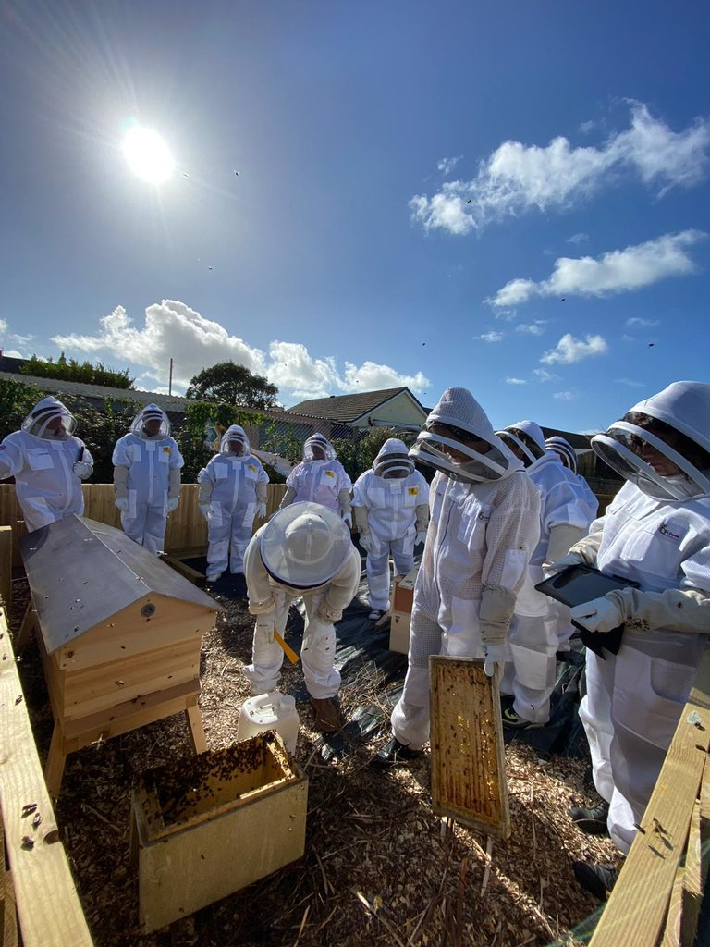
Improving Biodiversity
Notes:
A lot have work has been taking place to improve the biodiversity of the school grounds, we completed an EQA back in the summer term where they decided there was a lot of biodiversity in the school garden but it needed improving in other areas of the school grounds. Lots of classes have taken on weeding and replanting the beds nearest to their classes and every class has been given a planter to plant with pollinator friendly plants to be placed in our bee area to support our resident honey bees.

Slide 16
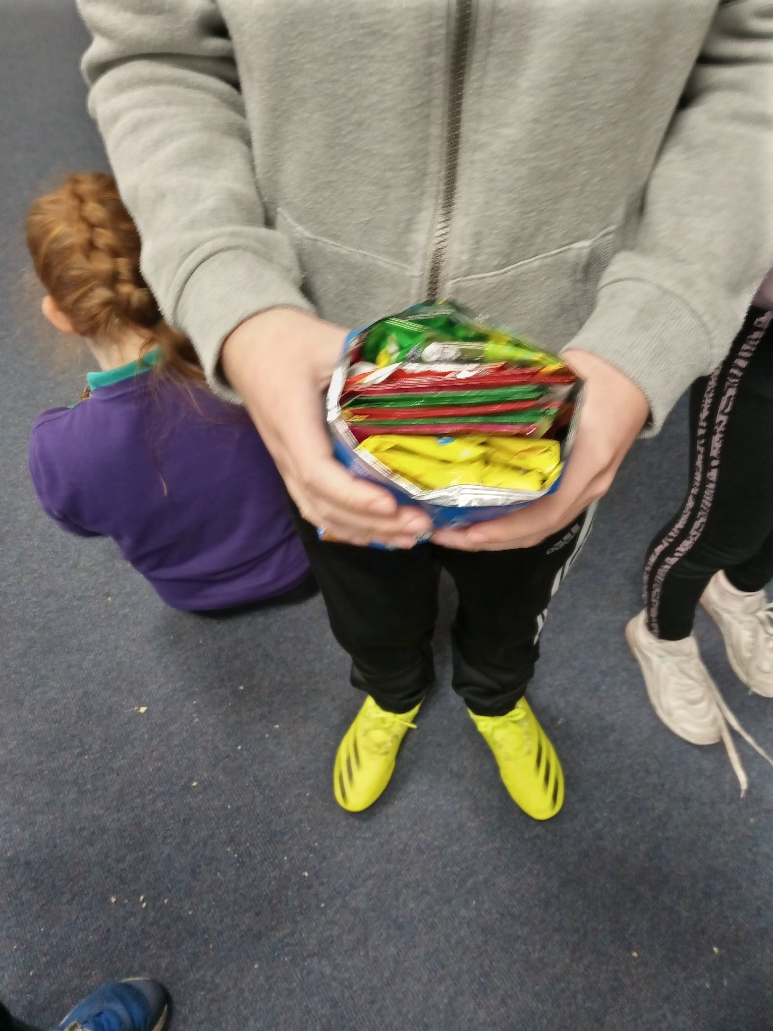
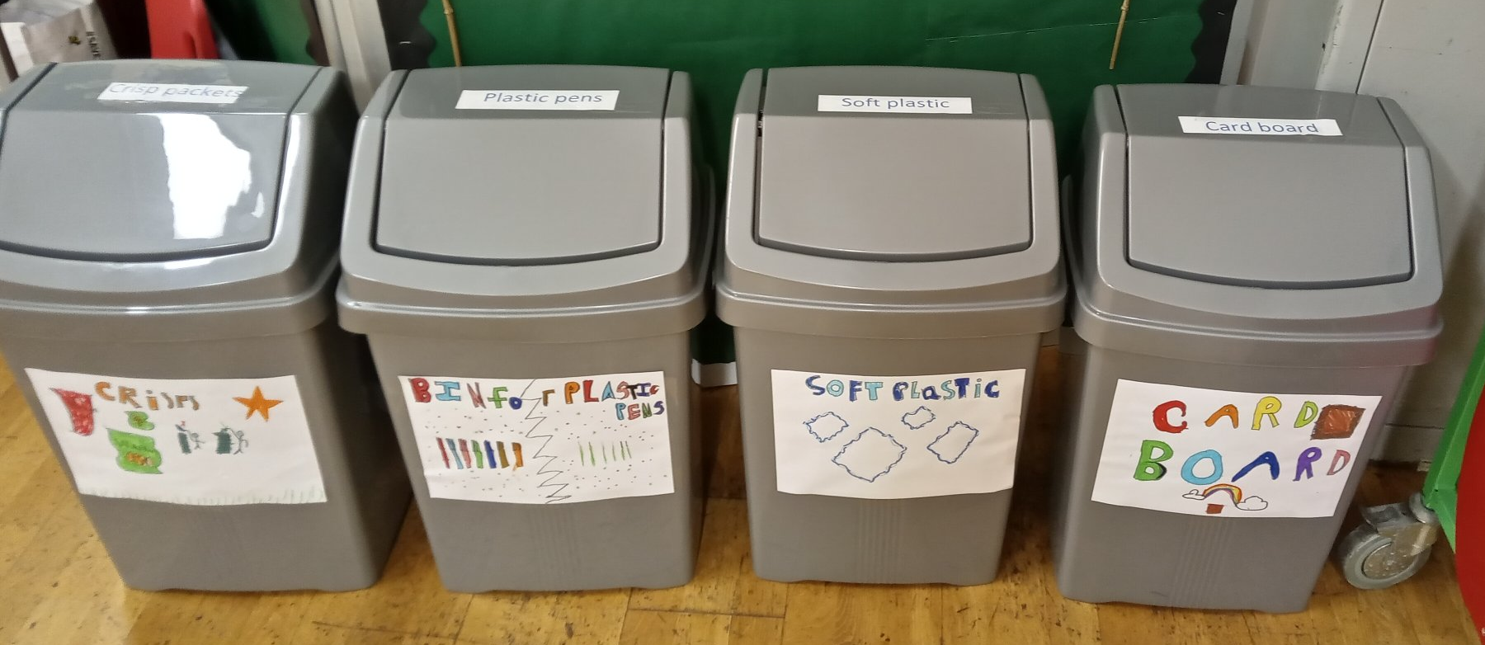
Reducing Plastic Waste
Milk Bottles – Larger Plastic Bottles
Soft plastic waste is collected and recycled.
Crisp packets collected, turned into bricks and recycled
Ban on all future purchase of plastic felt pens (with exception of drywipe pens) All current pens collected and recycled when dried out.
Eco code updated, a section for parents has been added and shared via parent mail and social media.
Pennar Recycling Station
Notes:
We have increased the amount of items we recycle the GT have created a mini recycling centre in the hall

Slide 17
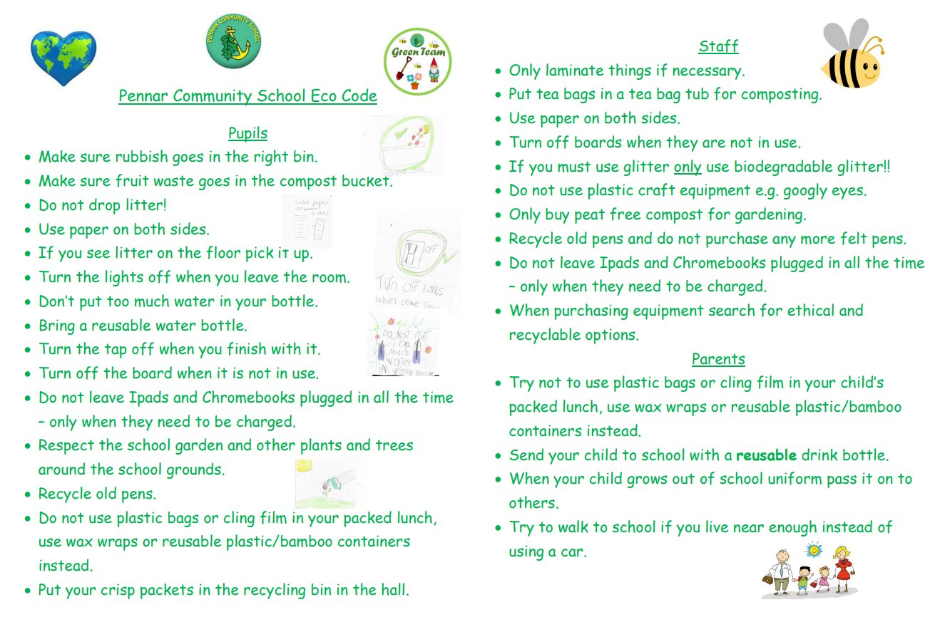
Notes:
UPDATED by GT and displayed in all class/office areas, shared with staff parents and on social media.

Slide 18

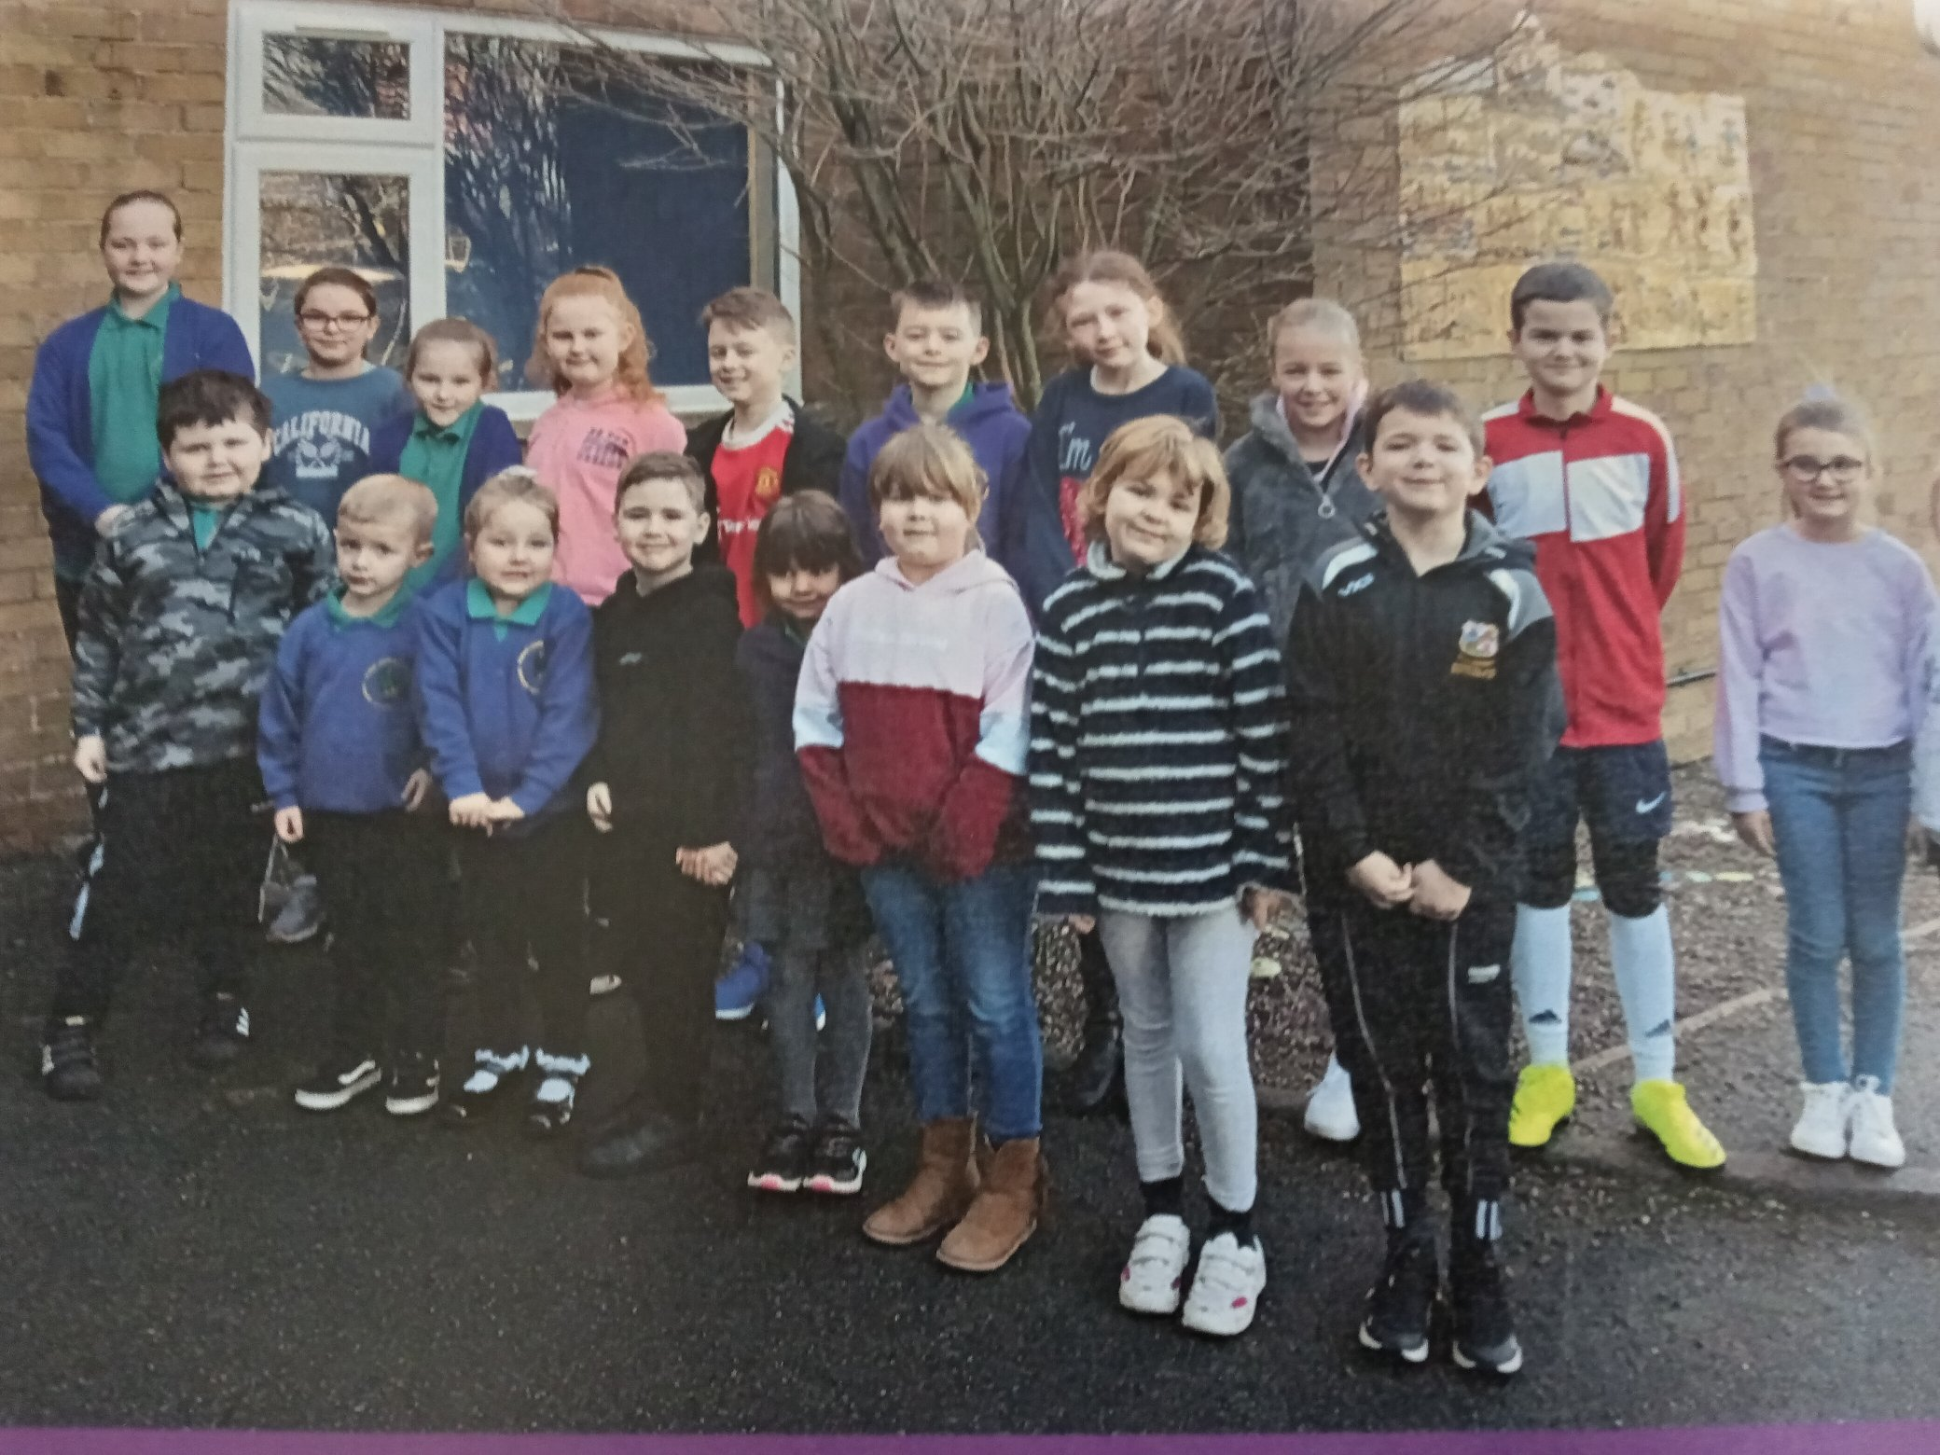

Energy Use/Water Use
Notes:
Climate cops elected. Registered with Energy Sparks

Slide 19
Whole school topic of
‘Bee the Change the World needs you to be’
Work linked to:
Sustainable energy
Biodiversty
Water usage
Charity – uniform exchange
Celebrating Diversity
Bees
Minibeasts

Slide 20
Next Steps –
Walking bus
Uniform exchange
Water waste awareness day raising money for water charities.

Slide 21
COP1
Conference of Pennar 1
Climate Change Summit
11th November 2021
Notes:
The plan is to hold the event annually or biannually depending on how well we get on with the current actions.
We have a lot other work going on in and around the school but I have stuck to the COP1 actions for today. Thank you for listening, I am happy to answer any questions.

