Slide 1
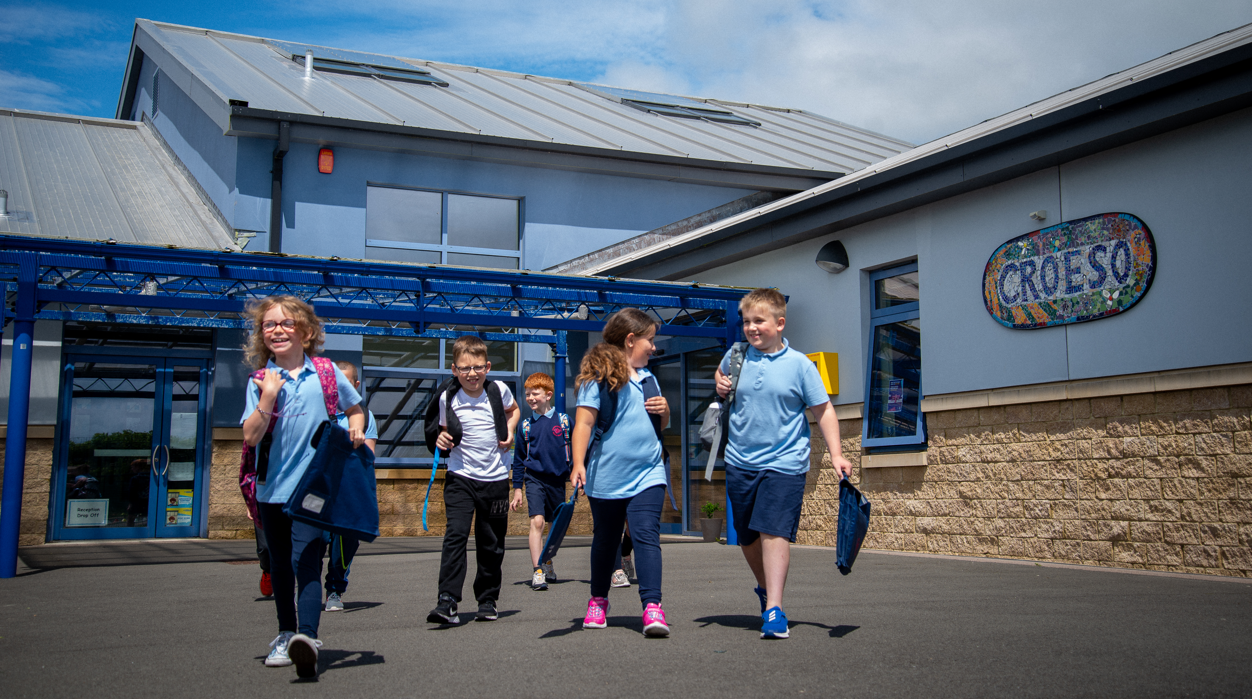
Pupil Voice
Johnston C.P. School - 2022
Notes:
Shwmae a croseo cynnes I ysgol Johnston dwirnod agored. Mae ‘n pleasure I cyfarch I chi a, dwin wyth fy mordd I siarad I chi heddiw am sut ‘ni wedi datpluggi dysgu agored yar draws yr ysgol Johnston. Cali yw fy enw I a dyma Morgan ac ni gweithio fel arweinwyr o cyngor yr ysgol. Tus yn ni’n ti, ymlacia a mwnhau yr gwaboadaeth heddiw. Gyda llaw, yn yr diwedd, chi’n croeso I gofyn qwestionau am inryhbeth ddiddorol.
Cali - Black. Morgan - in italics.
Hi, my name is Cali and this is Morgan. We are head girl and head boy. To achieve these roles as head of the school council, we had to write letters to Mr. Thomas. During the school year, we have been working with Mr. Williams to develop the school council and make sure that the school is improving.

Slide 2
Contents
What has changed in our learning during the last year?
-What has the new curriculum meant? How have we been developing the four purposes?
-Welsh history and our learning experiences!
Extending the School Day
Planning a Celebration to Celebrate the Queen’s Jubilee
Outdoor Learning

Slide 3
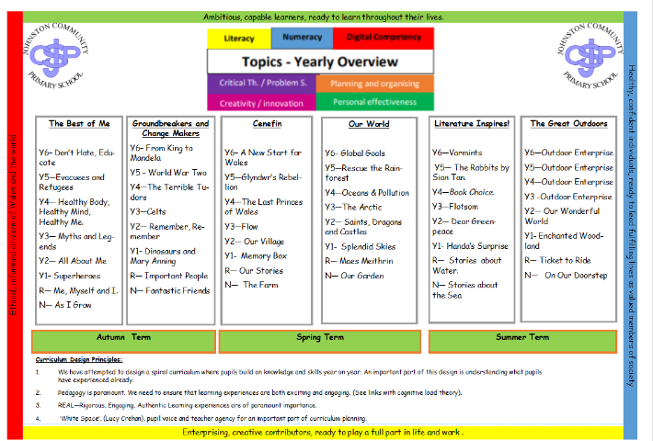
How do we know that we are developing the four purposes…
What have we learnt about?
Everything that we learn links to the four purposes. We have worked with our teachers to link our topics to different curriculum experiences. In all of our learning we use the outdoors.

Slide 4
What did we learn about? - Unit sample
The Tudors!
-We used our pupil voice board to let our teacher know what we would like to learn.
We discovered more about how Richard the III was defeated...
We used the outdoors for:
Building trebuchets
Cooking Tudor Bread
Learning about Tudor traditions
Acting out battles and marches

Slide 5
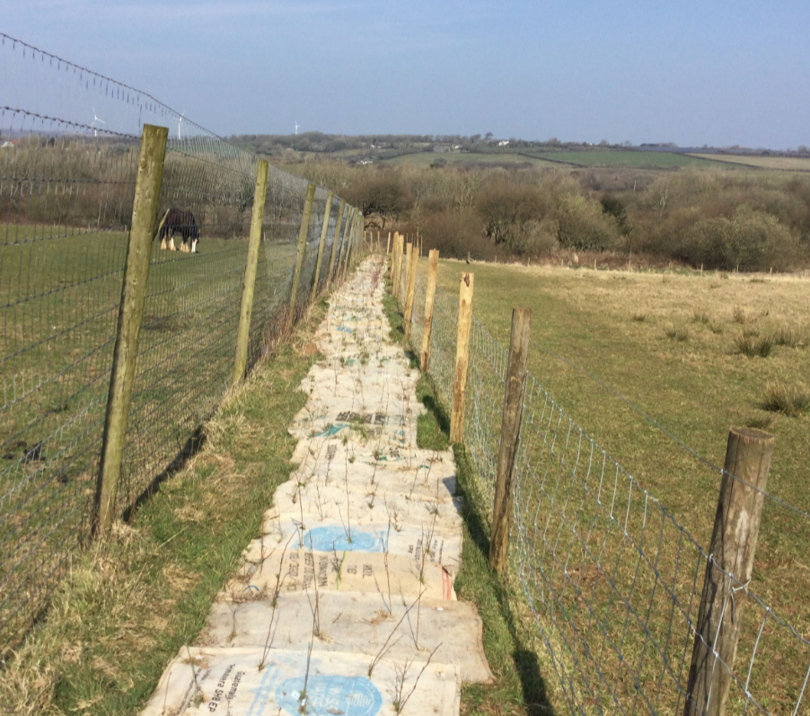
Hedge Row Project
We have been:
Helping create a wildlife corridor.
Planting 600 trees!
Working as a team!

Slide 6
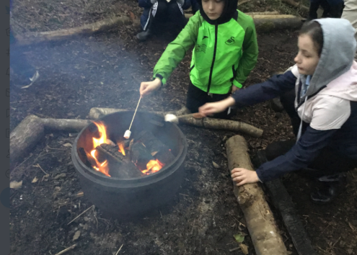
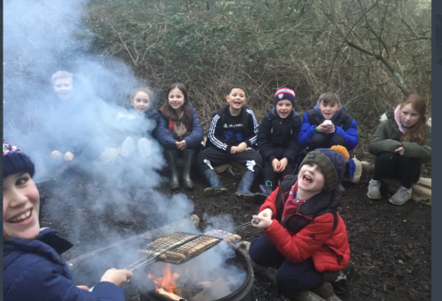
How has our learning of Welsh history changed?
During the Spring Term, all classes had themes linked to Cynefin.
We had meeting with the Senedd.
Some pupils learnt about the Welsh Princes
Some pupils discovered more about Owain Glyndwr.
We landed our topic returning to school at night to cook hot dogs and listen to Welsh Myths and Legends.

Slide 7
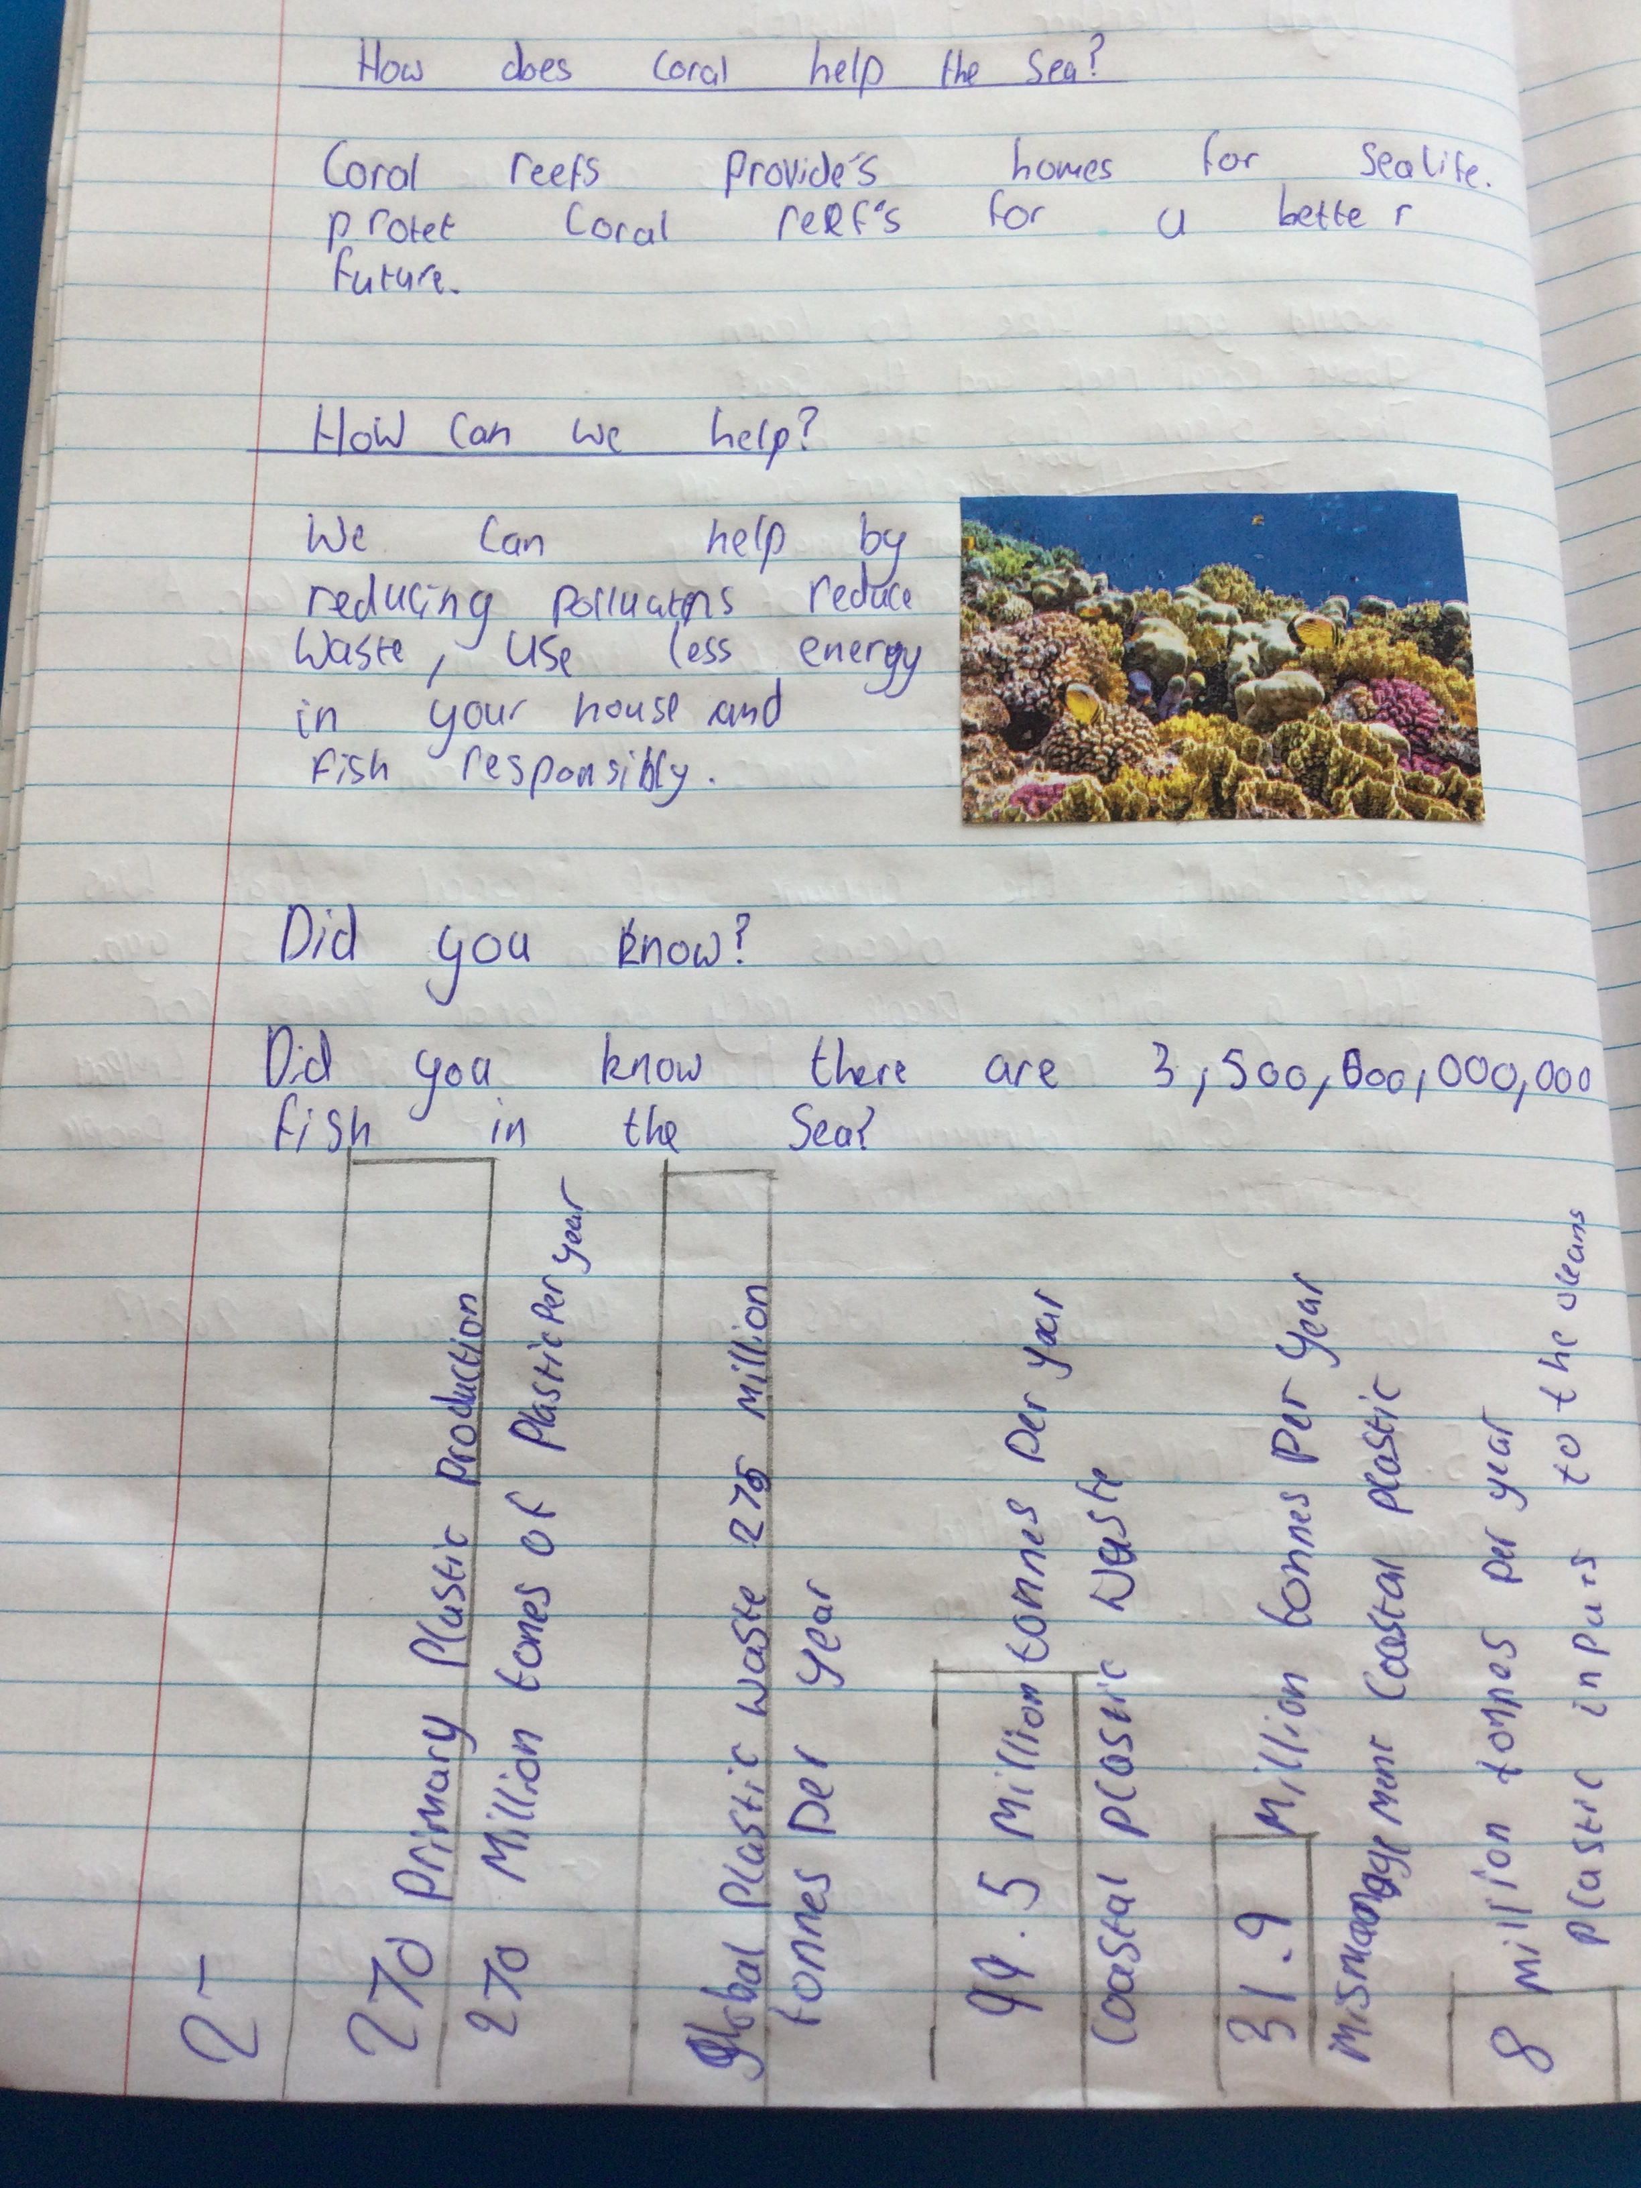
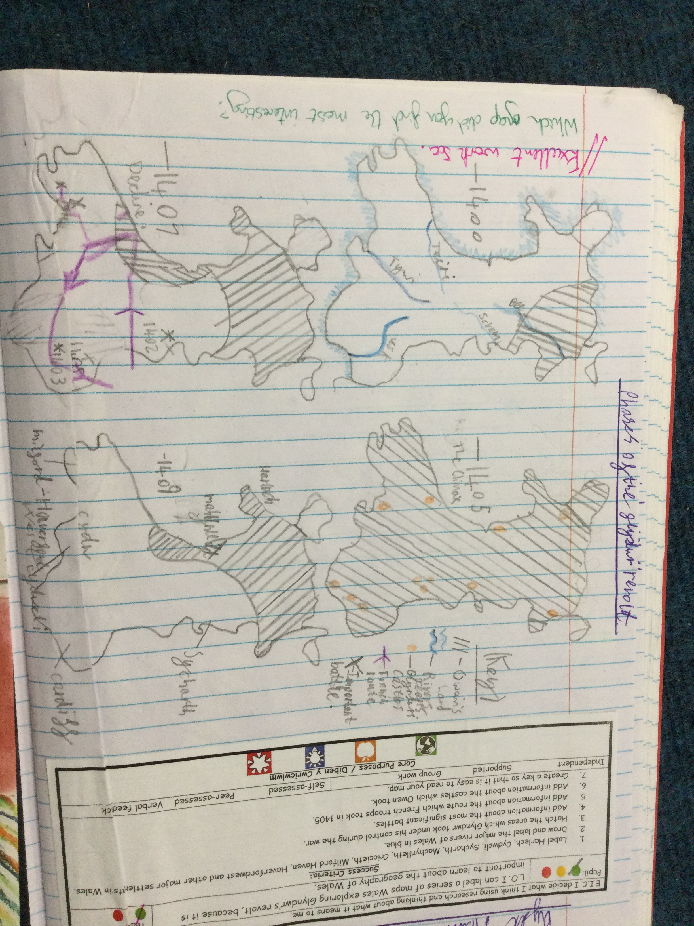
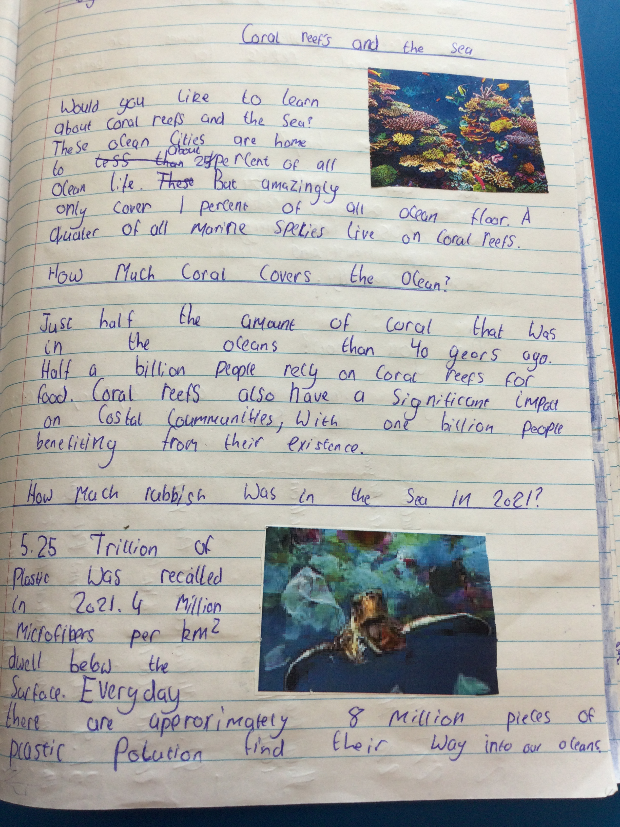
Here is some of our learning…

Slide 8
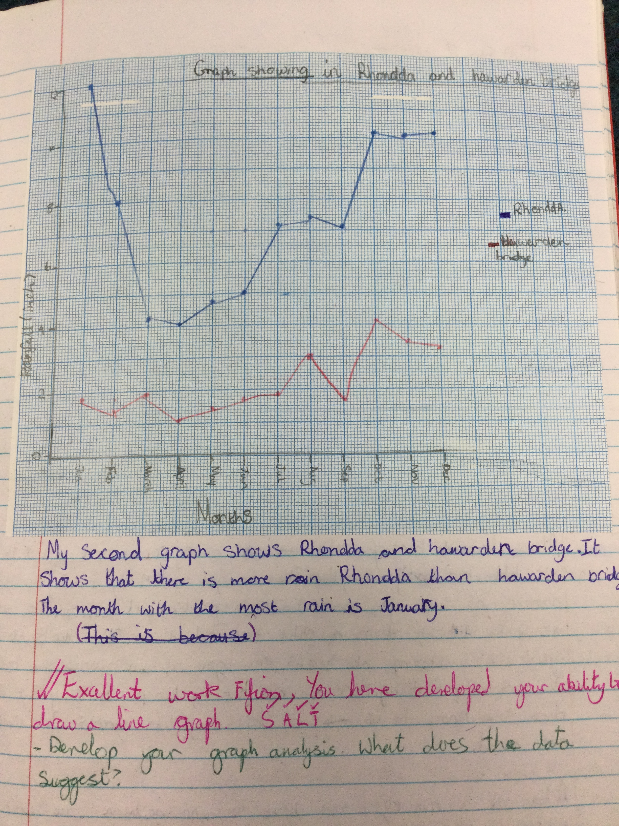
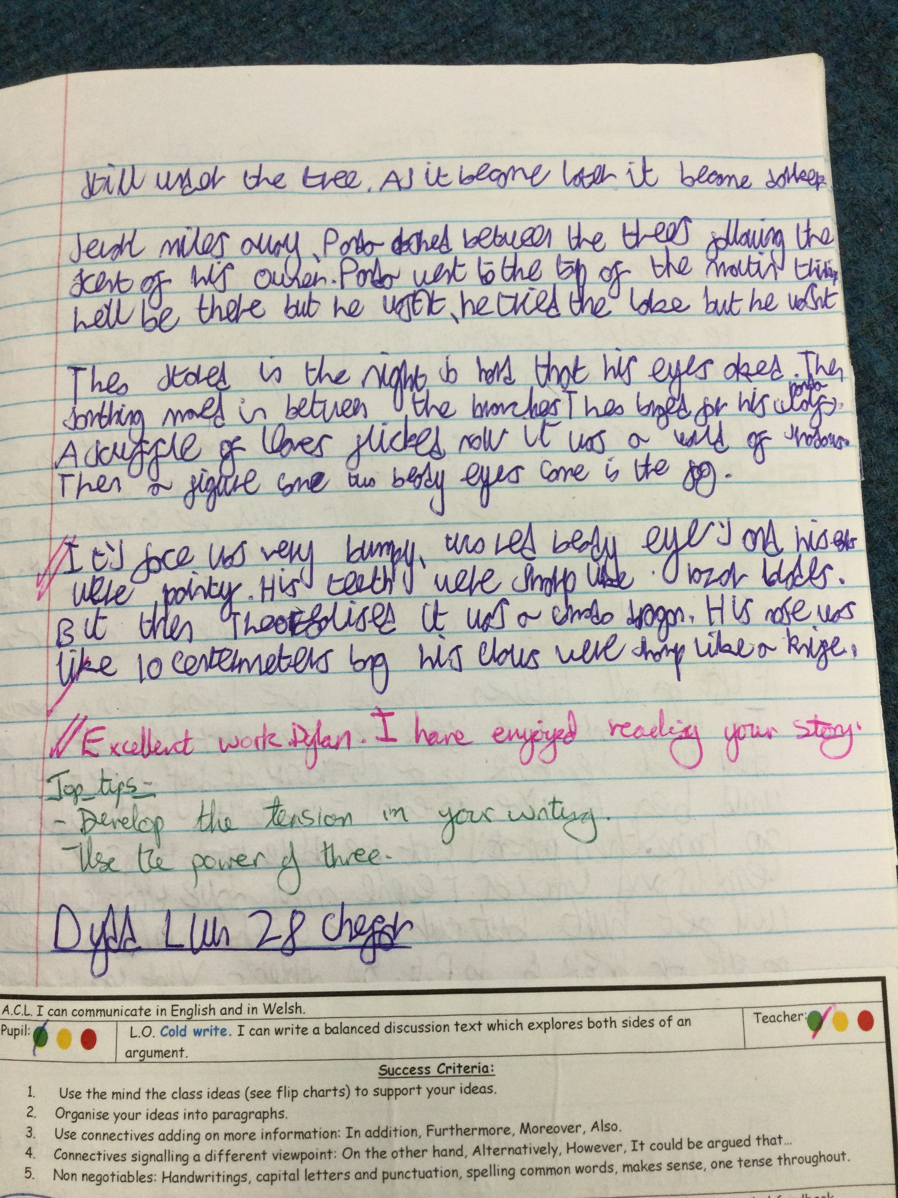
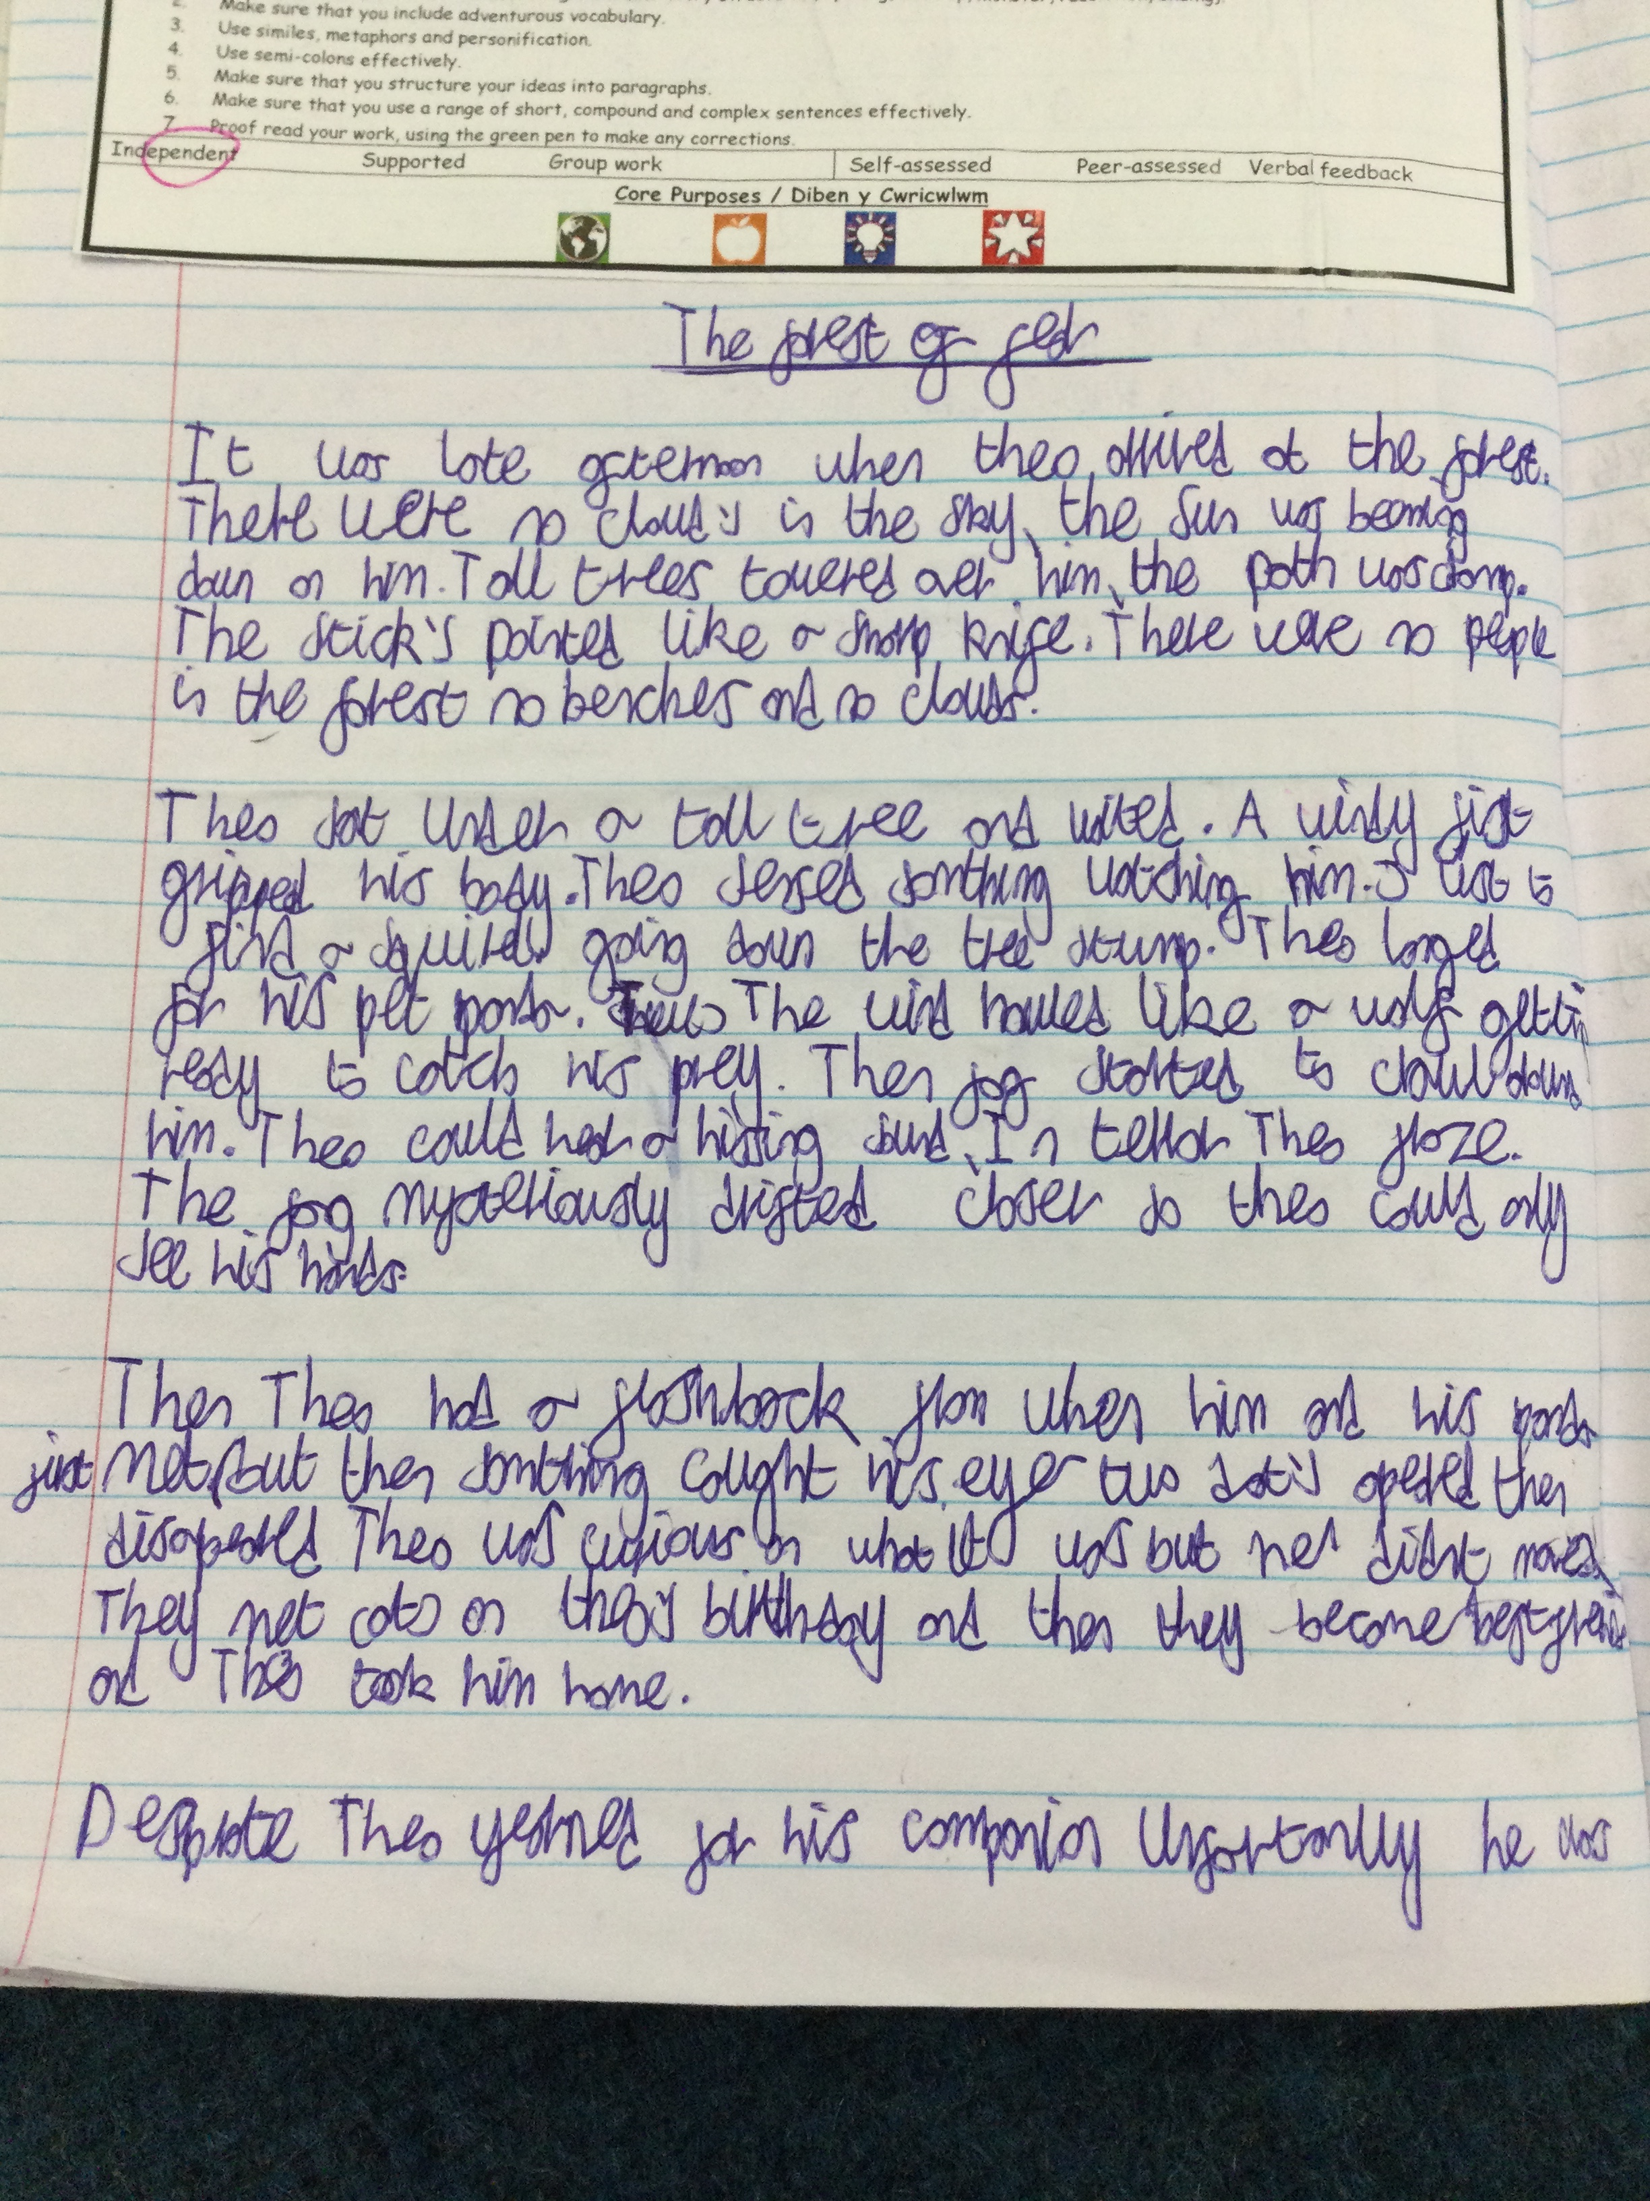
Here is some of our learning…

Slide 9
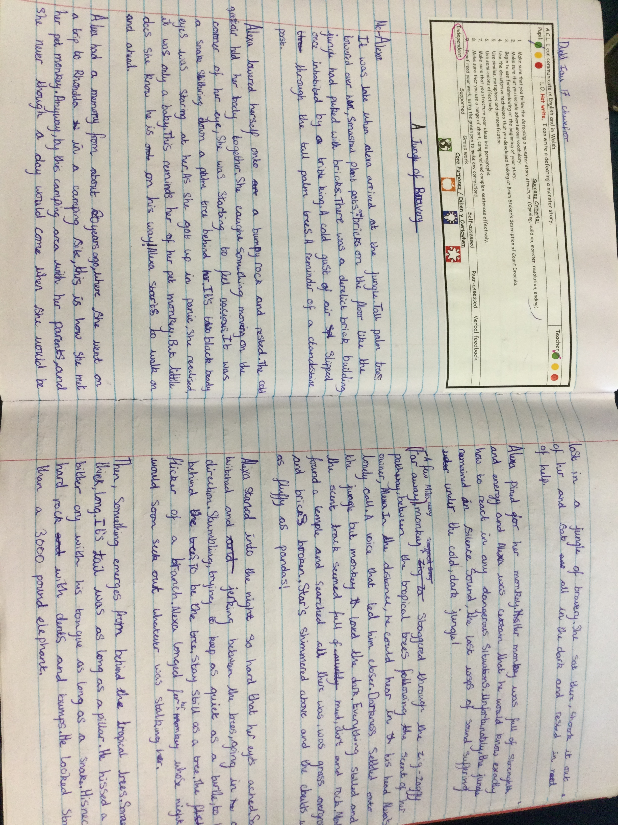
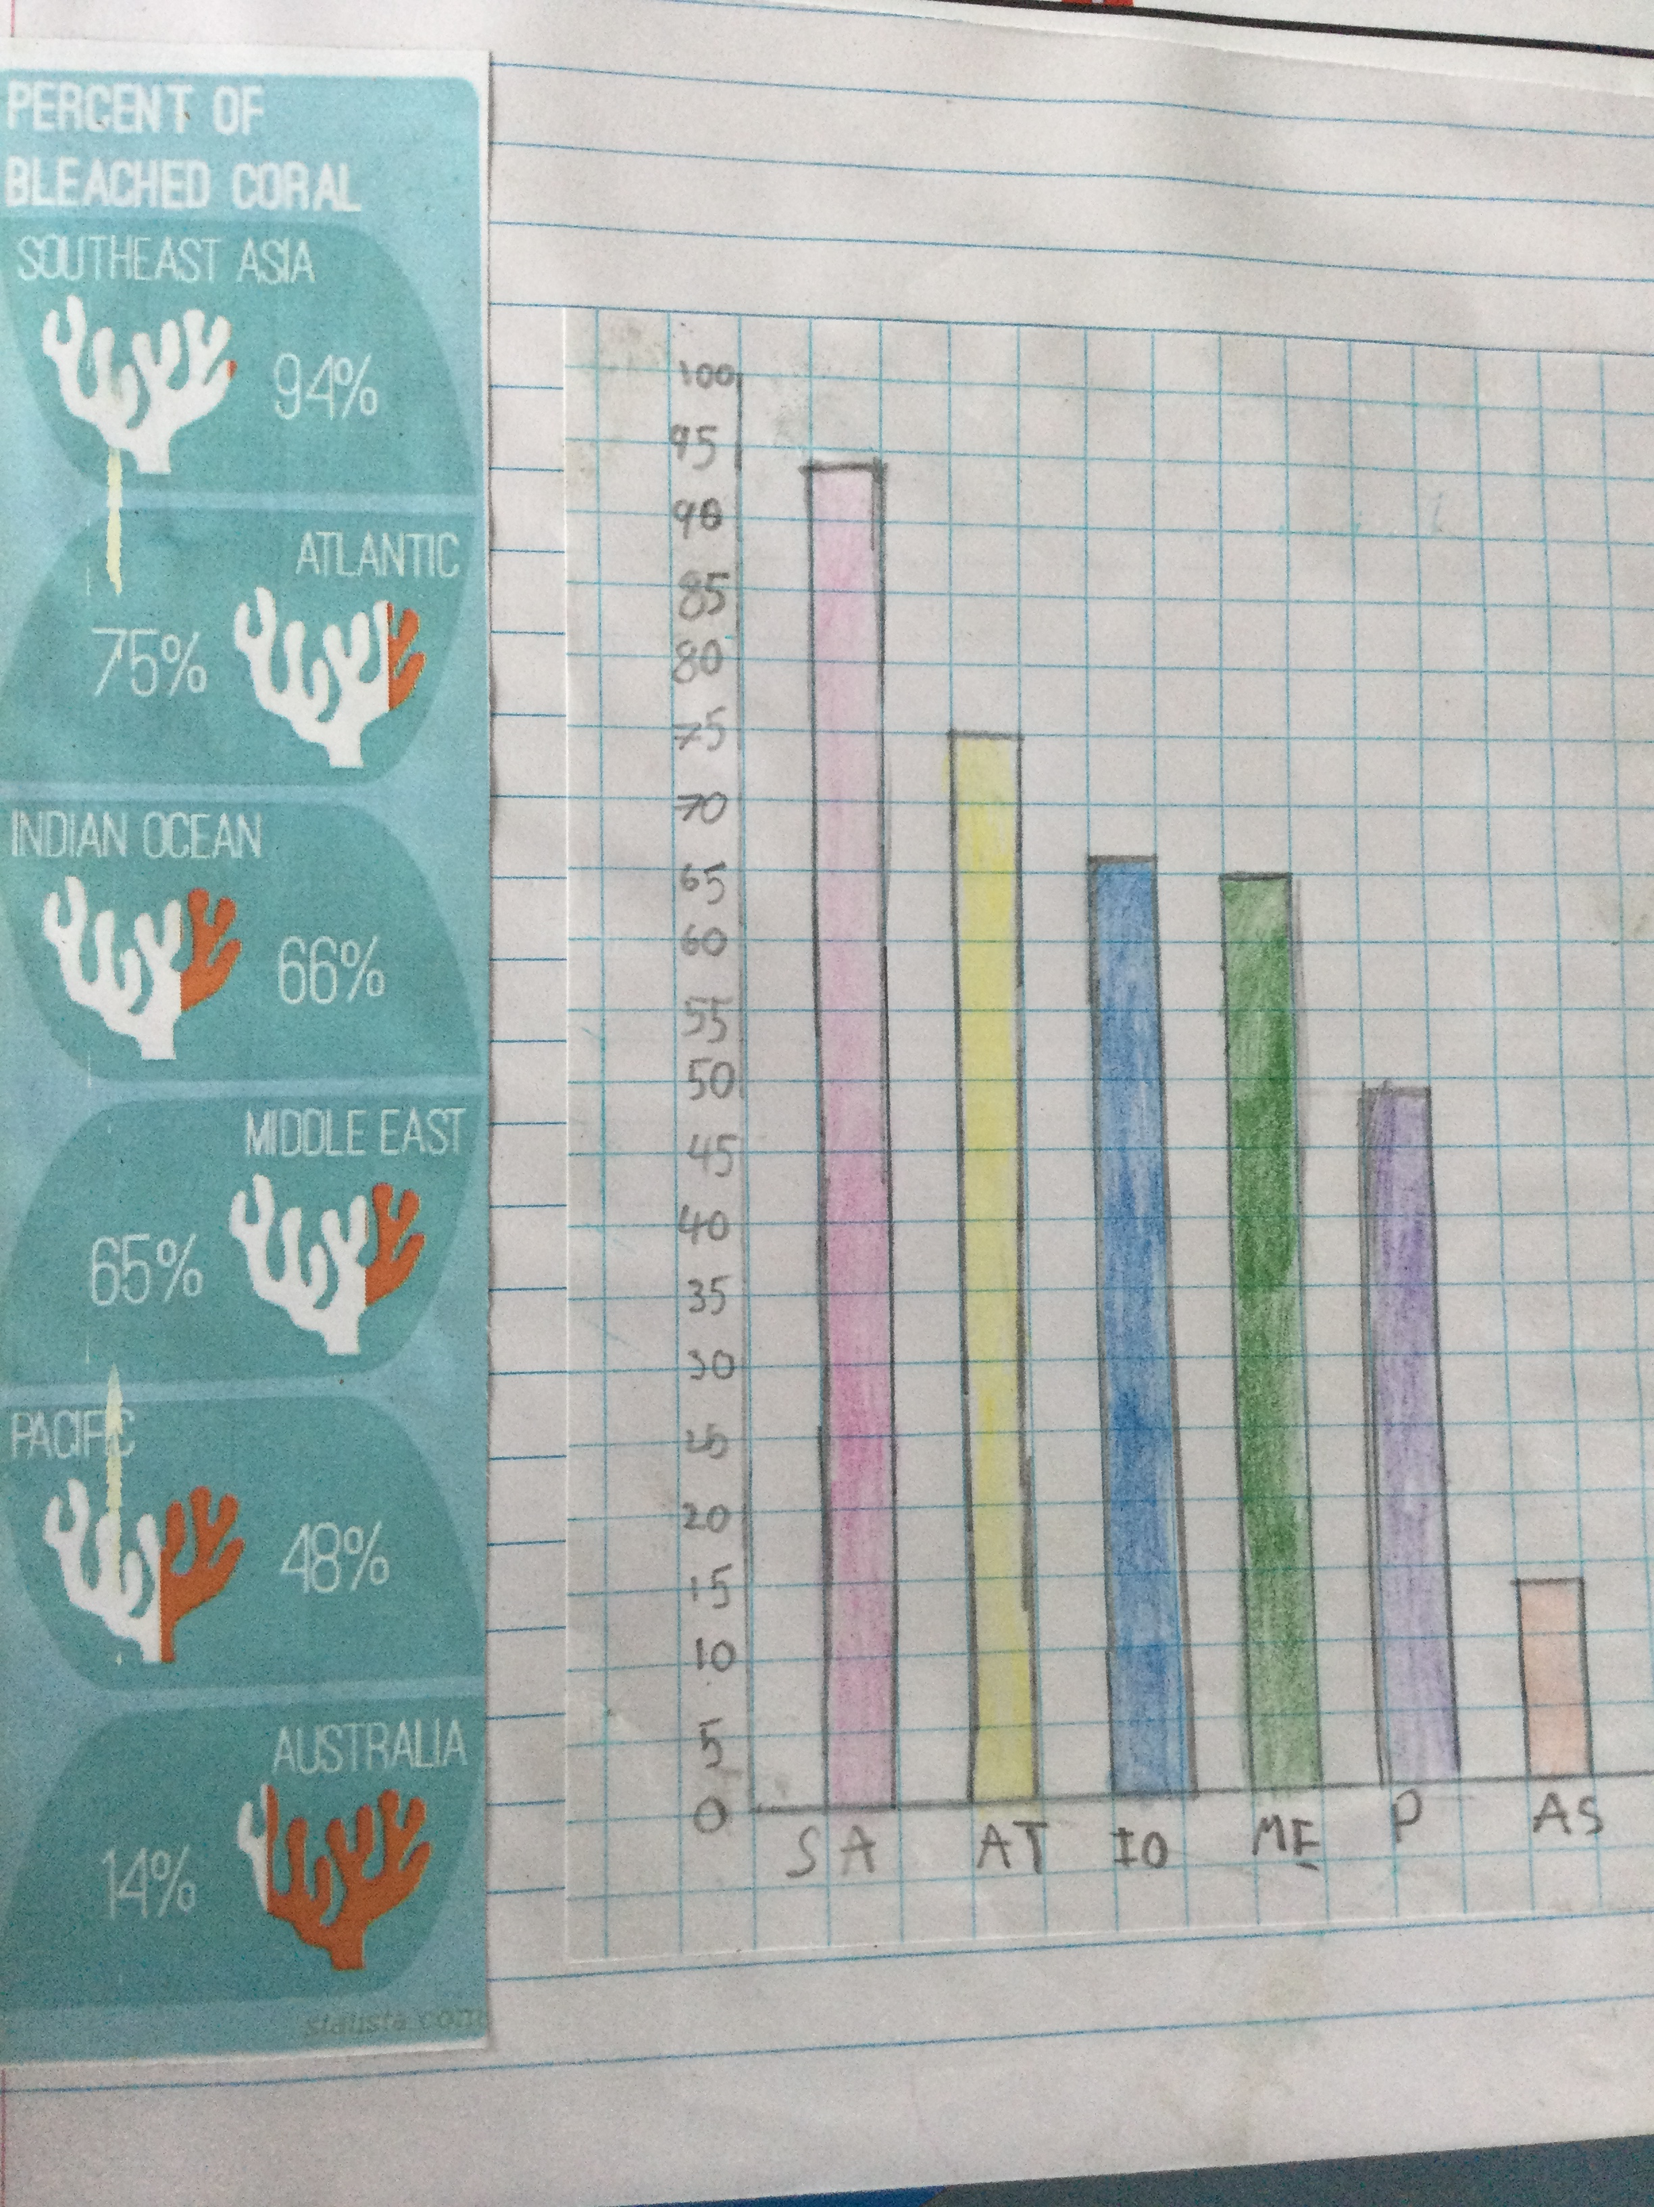
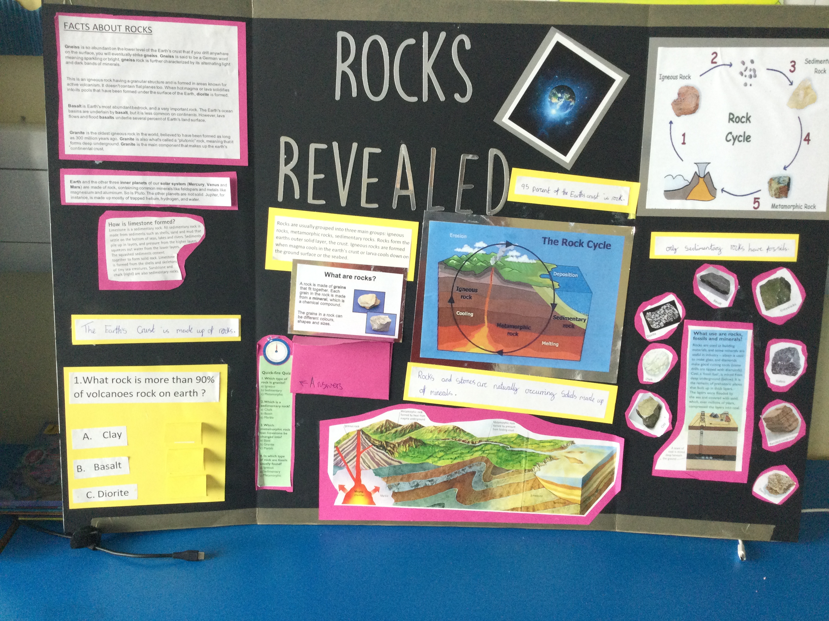
Here is some of our learning…

Slide 10
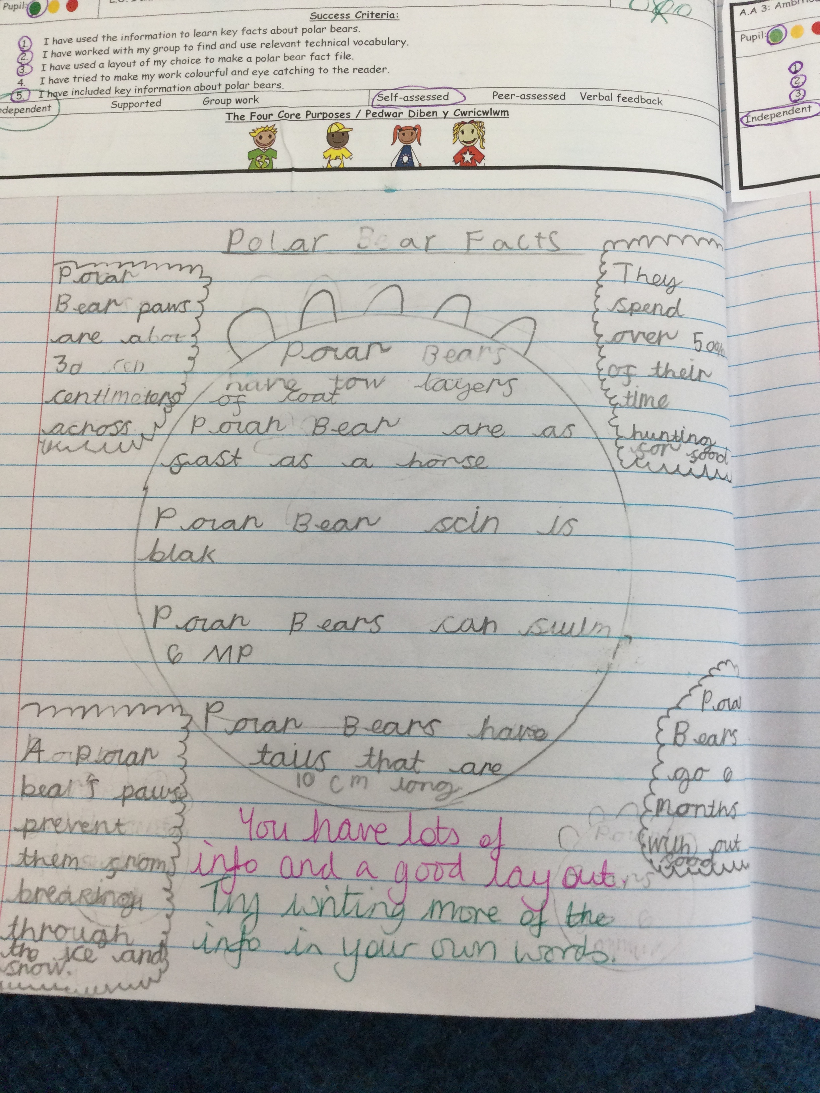
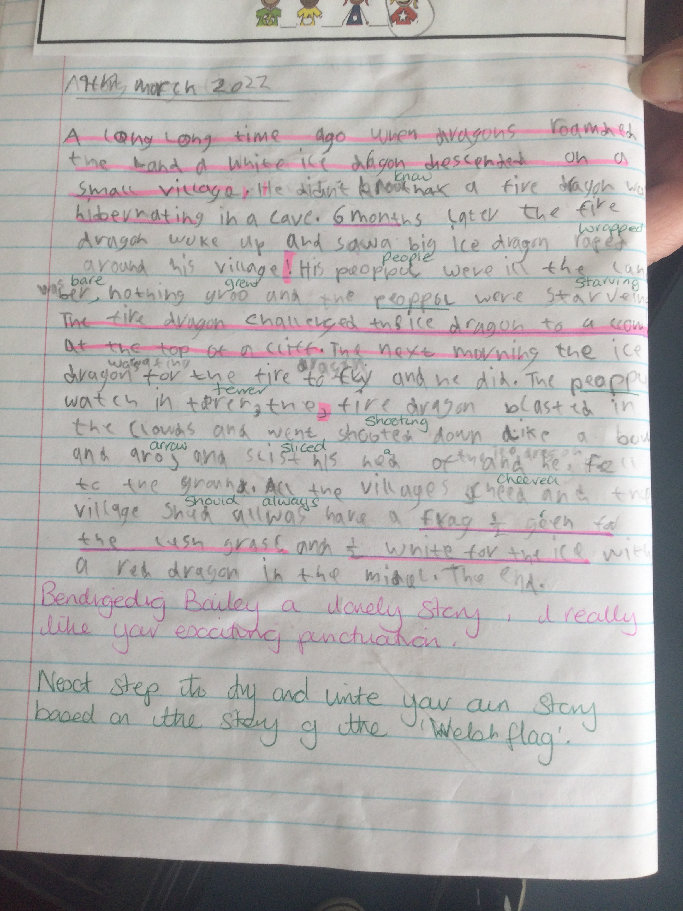
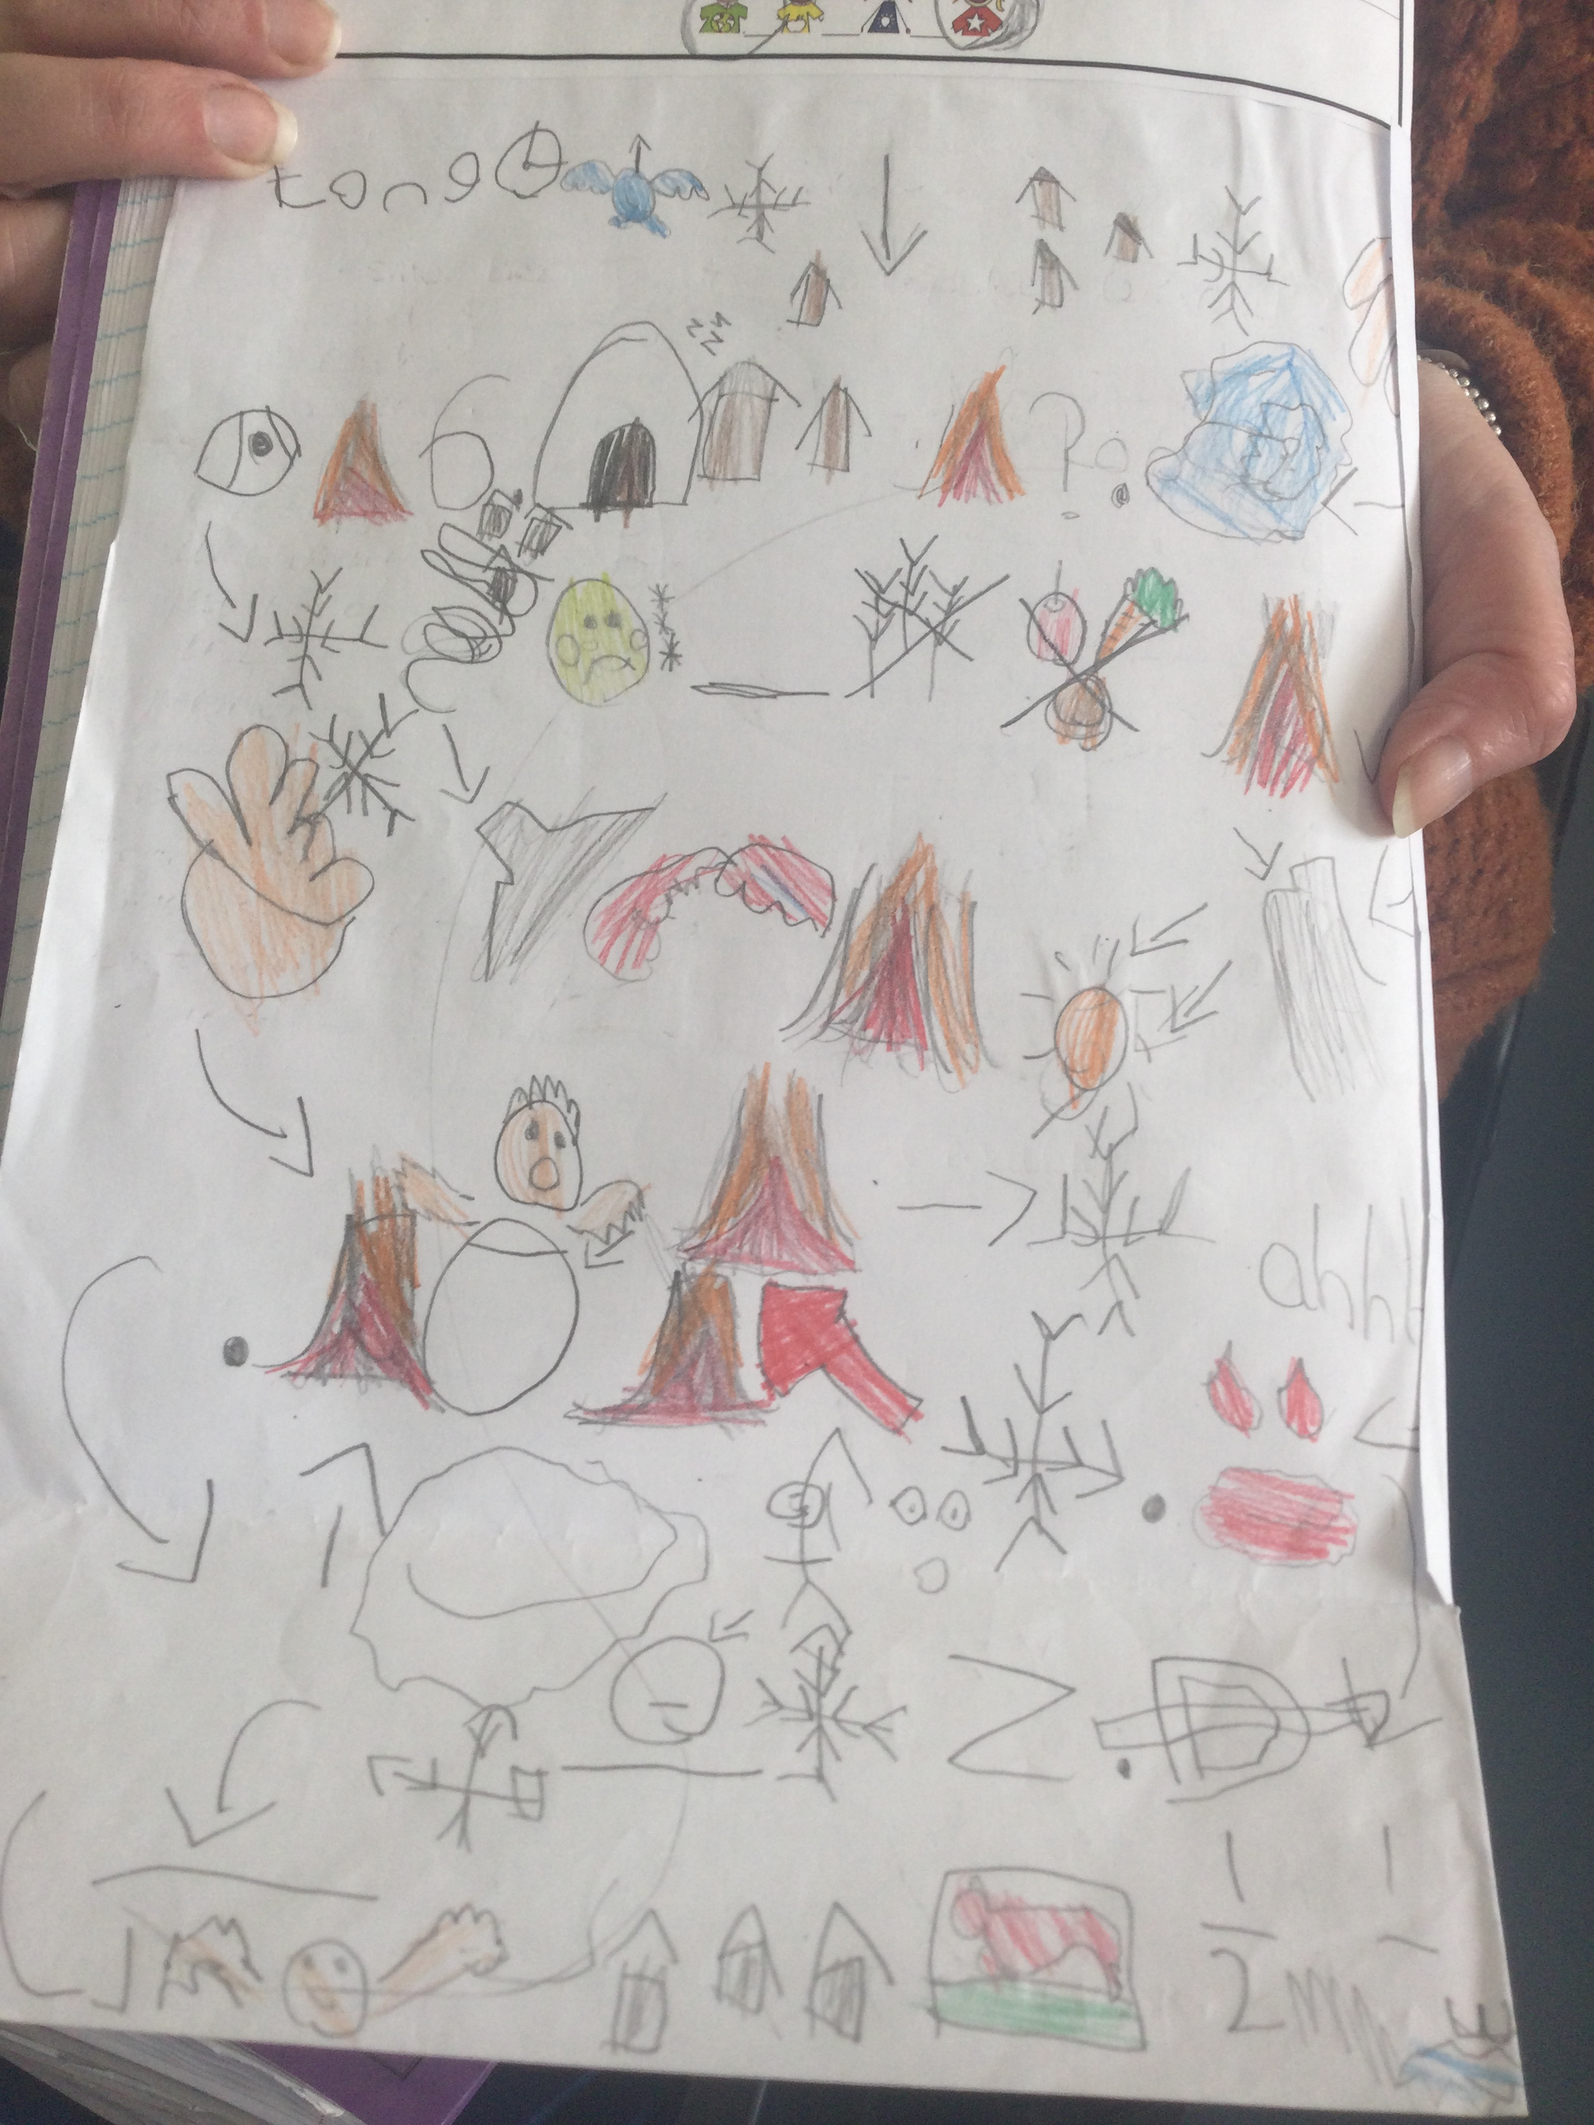
Here is some of our learning…

Slide 11
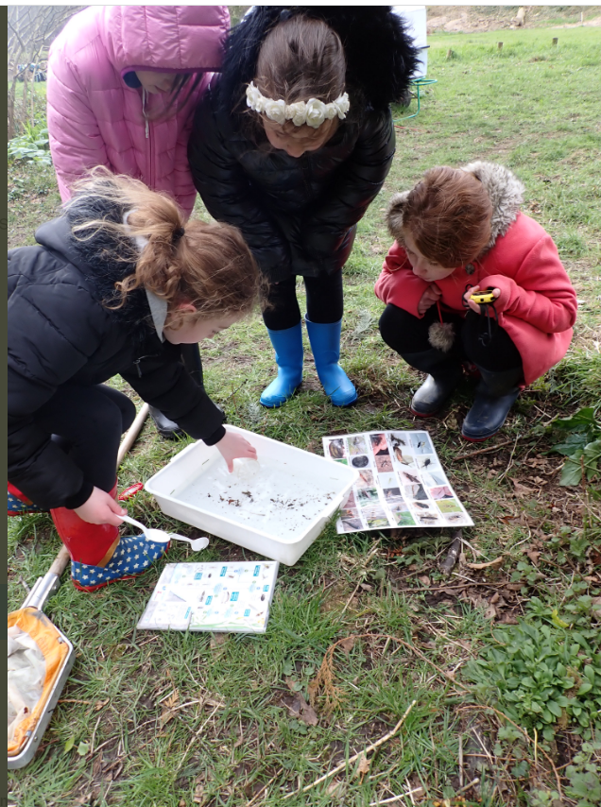
How Else has the outdoors been used?
River Study…

Slide 12
Extending the School Day - Active Education

Slide 13
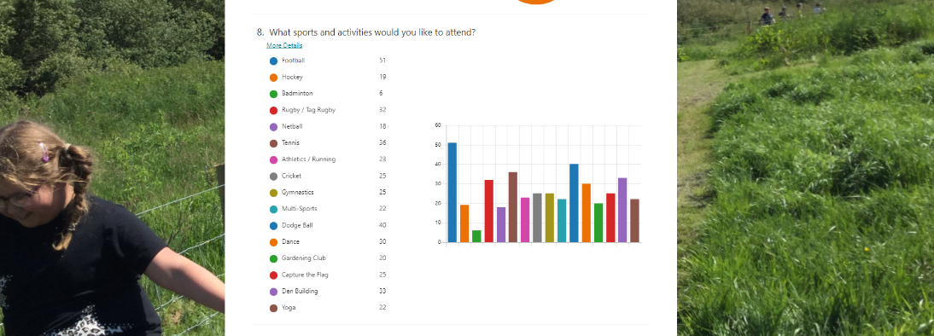
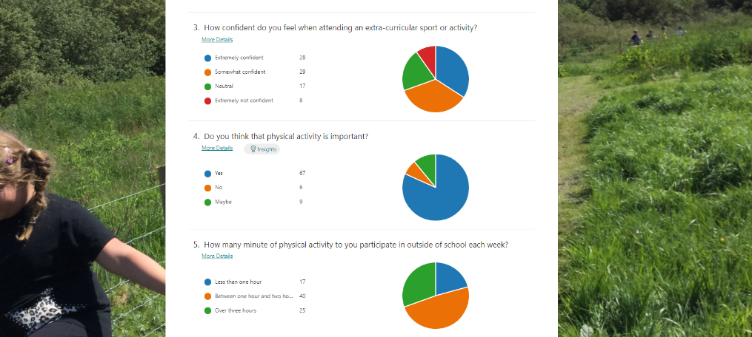
We asked children what they wanted to do…

Slide 14
Then we looked at the data and launch our clubs..
We have:
Basketball
Dodgeball
Lots of football
Rugby
Gardening
Netball
Athletics
Running
Tots football
Some of our year six pupils are helping at other clubs.
More clubs are launching in the next few weeks.

Slide 15
How have after school clubs helped you?
“It has helped me learn more about how to look after different areas in our field.” (Y3)
“I have gained in confidence to try new things.” (Y2)
“I have loved being with the older children because I have learned from them how to engage with other activities.” (Y1)
“I love being active and going outside to run around.” (Y1)

Slide 16
Jubilee Celebrations

Slide 17
Tea Party Celebrations
We are organising a community tea party on 27th May.
The party will take place during the afternoon.
All classes are going to be running a business.
Lots of fun things will be going on, such as cooking competitions and other things!
During the week running up to the party, we are all going to be looking back at the Queen’s reign.

Slide 18
What is going to be changing in the future…

Slide 19
Outdoor Learning
We are continuing to make our facility inspiring:
We have won funding to build an outdoor cooking are (Pizza oven).
We are having an outdoor classroom built.
We are having a new learning room built.

Slide 20
Any questions?

