Slide 1




St Telio’s Catholic Church Tenby
Developing School Grounds
Exploring how school grounds can be transformed to create outdoor learning opportunities for students.
Notes:
Risk assessments are important because they help you to:
Spot hazards.
Think about the potential harm.
Identify people who may be at risk.
Protect the people at risk.
Plan the work safely.
Review existing controls.
Make improvements.
Comply with the law.

Slide 2
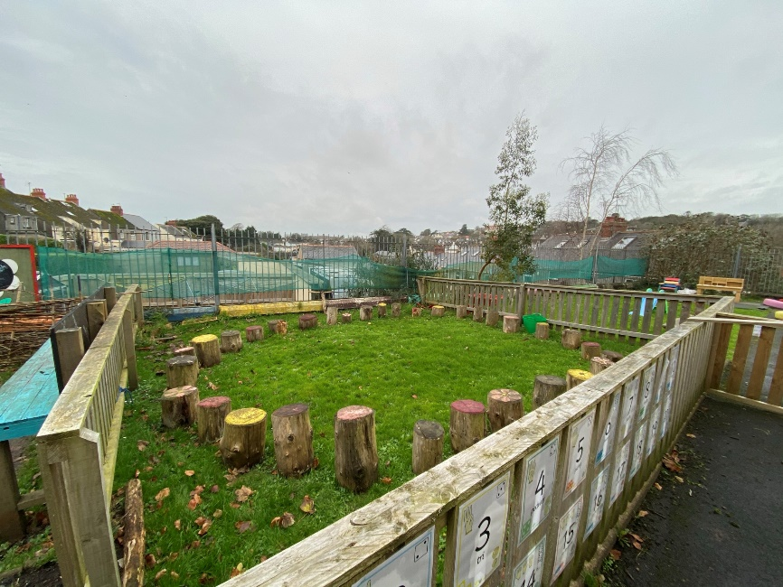
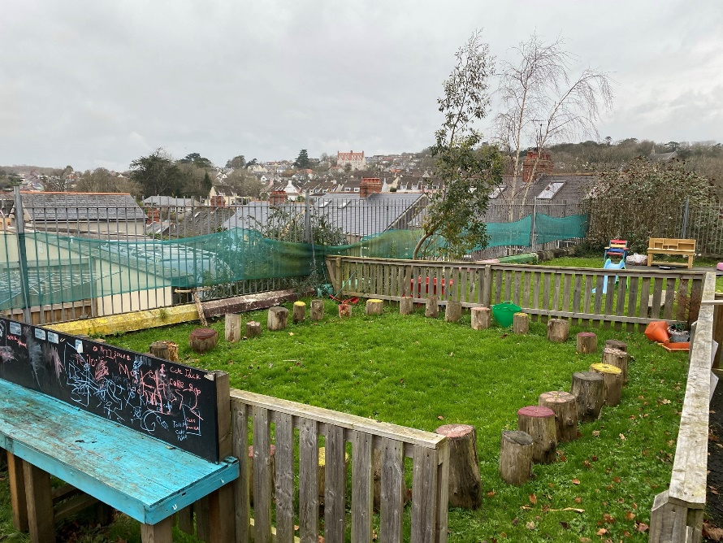
What you’ve got…

Slide 3
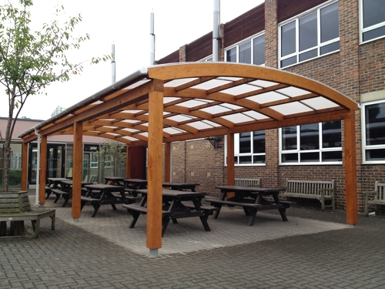
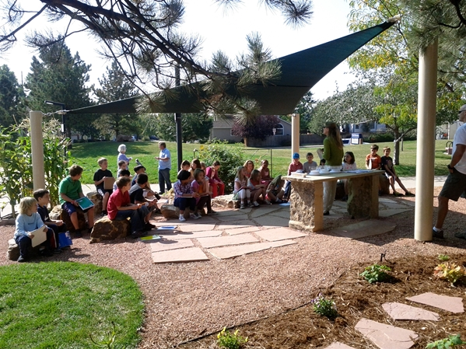
Shelter

Slide 4
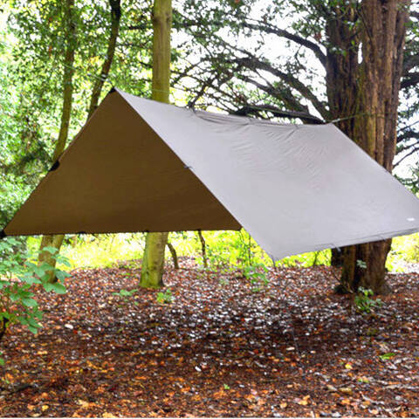
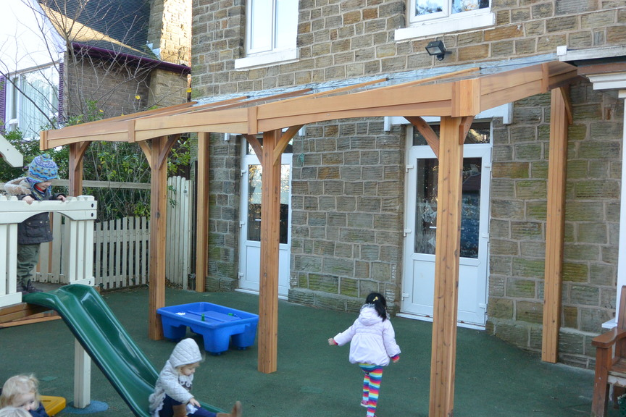
Shelter

Slide 5
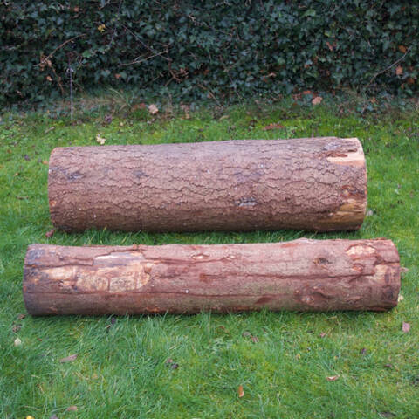
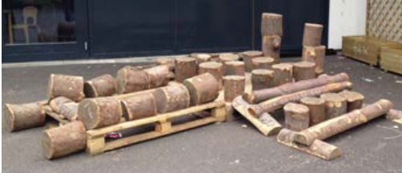
Loose Parts Circle

Slide 6
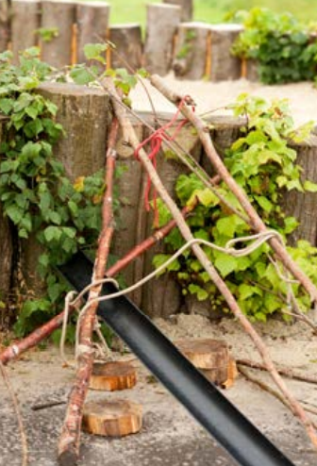
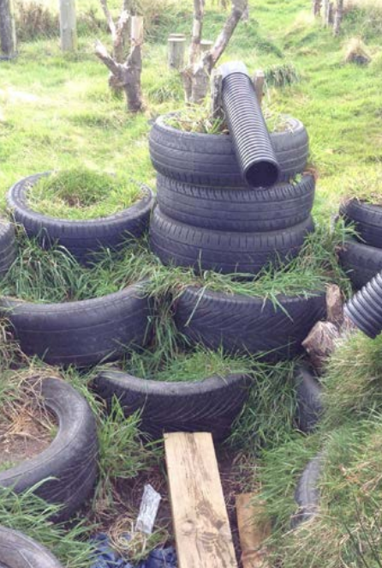
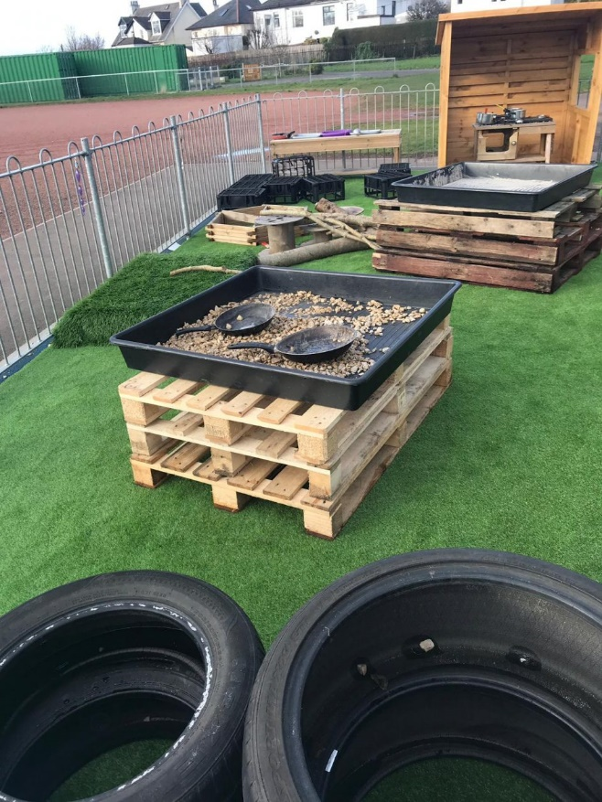
Loose Parts Play

Slide 7
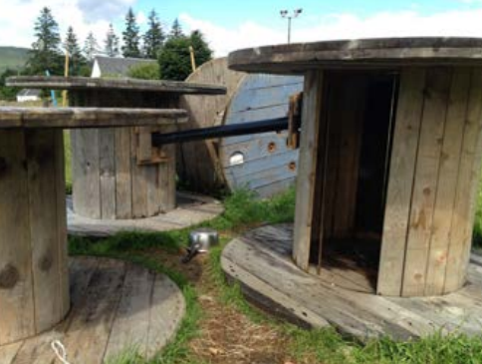
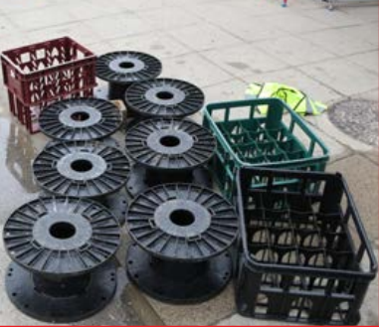
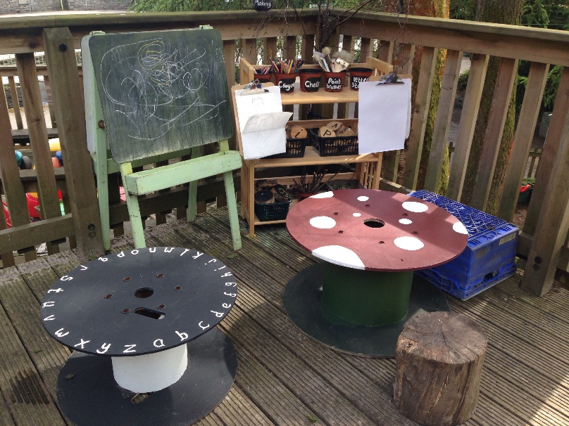
Recycled Materials

Slide 8
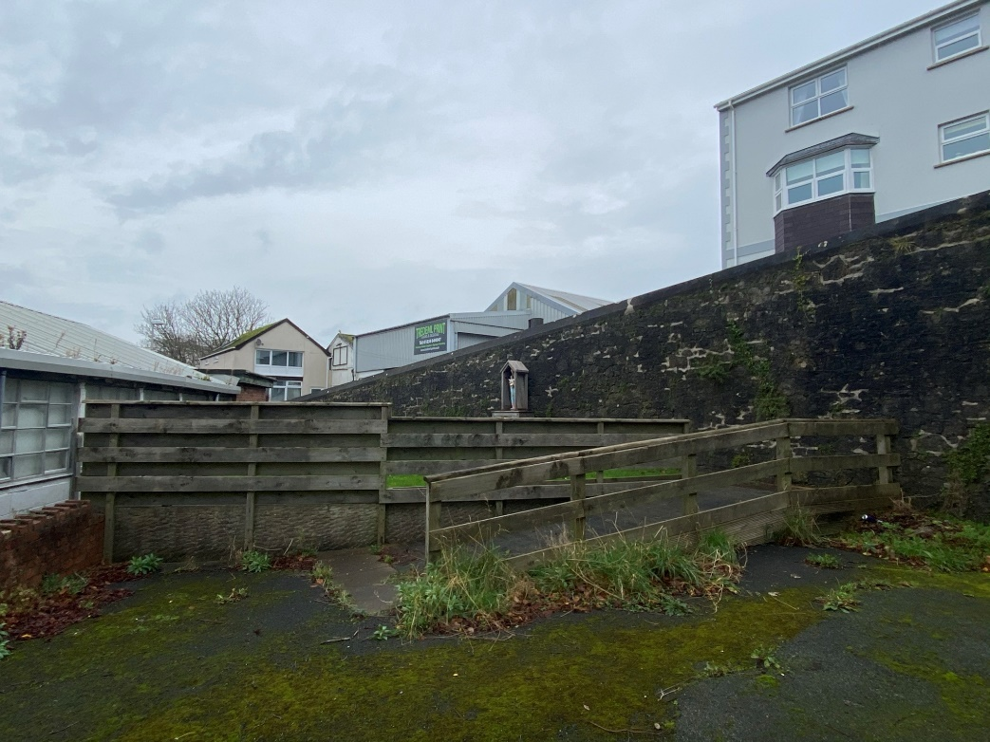
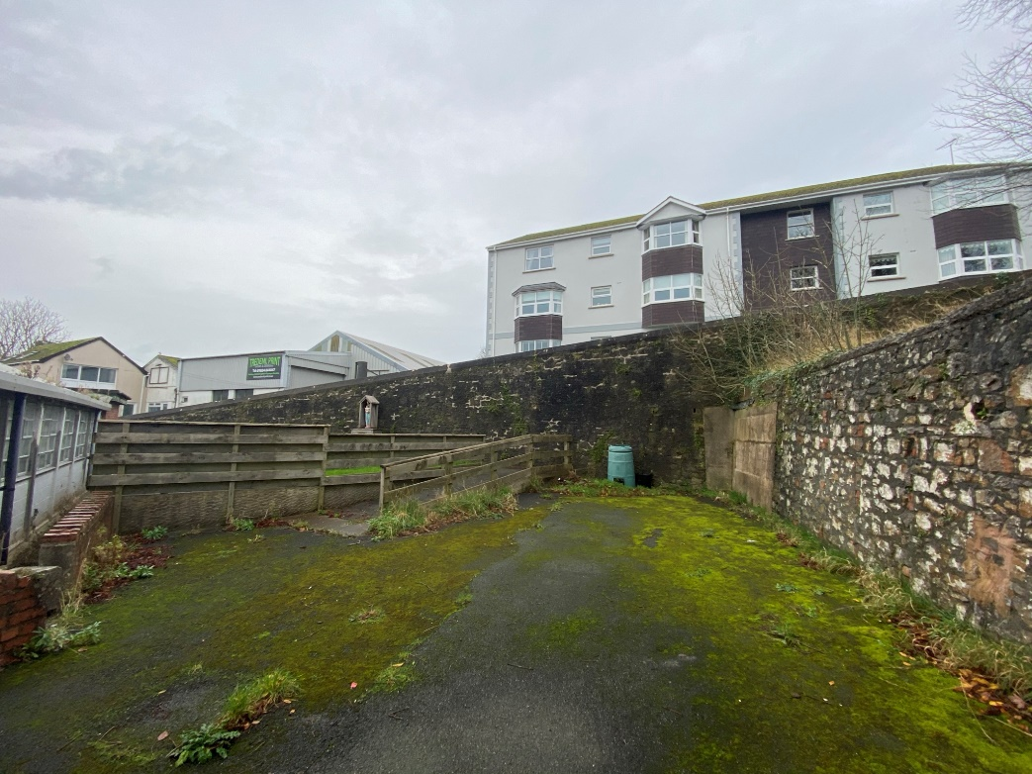
What you’ve got…
An area for a whole class to use – more likely to be KS2 but all classes can use
An additional play time area or somewhere to eat lunch

Slide 9
Ideas
Outdoor Stage (remove fence sides)
Paint wall/mural or add panels
Change flooring from tarmac (in time)
Beach Theme
Mural – art project collaborate with local artist
Loose parts log circle
Potentially a fire pit?
Different learning areas for group work
Plants – wall climbers, palms, bamboo….

Slide 10
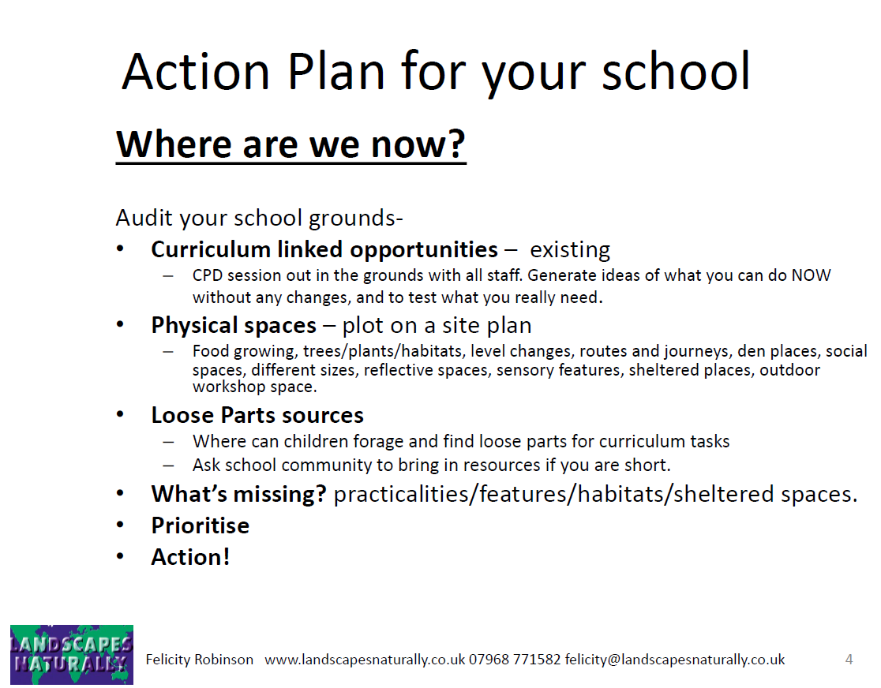
Teacher Audit

Slide 11
Students are key!
An amazing space can be created but doesn’t mean students will interact with that space!
Develop a space together that you all want to learn and play in.

Slide 12
Auditing Activities for Students
Activities that involve every child in a primary or secondary school, with an aim to create on-going dialogue about the school grounds.
Problems and Solutions! This tends to work more effectively than asking children and adults what they want in the school grounds. This puts the focus what needs sorted and improved. It’s also very powerful in that the children are really part of the solution and can be actively involved in making the changes.
Have a slideshow! Show students images of a well developed outside space can look like.
Student Surveyors! All children contribute to mapping their thoughts and feelings about their school grounds.
Take lots of photos! Ask student to take lots of images from every angle so that you can get plenty of good before and after comparative photos.
Plus, minus, interesting! This is a good task to display and record children and others people’s thoughts.
Rate the Grounds! This activity is works well for Information Handling. Every child rates different areas 1-10 then work out the mean, median and mode of the results and compare students results to teachers/adults.

Slide 13
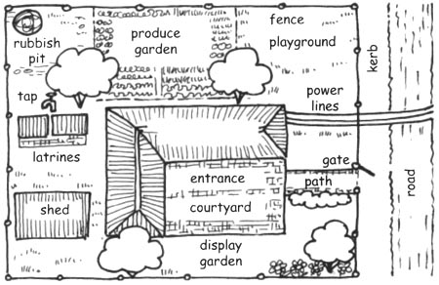
Auditing for Students
Every person must mark on the map:
Where you play most often NAVY BLUE
Where you go to be alone BLACK
The place with the best view LIGHT BLUE
The place to find lots of wildlife and nature GREEN
Best place for being physically active PURPLE
The quietest space BROWN
A good place to relax ORANGE
A dangerous place RED
A safe place PINK

Slide 14
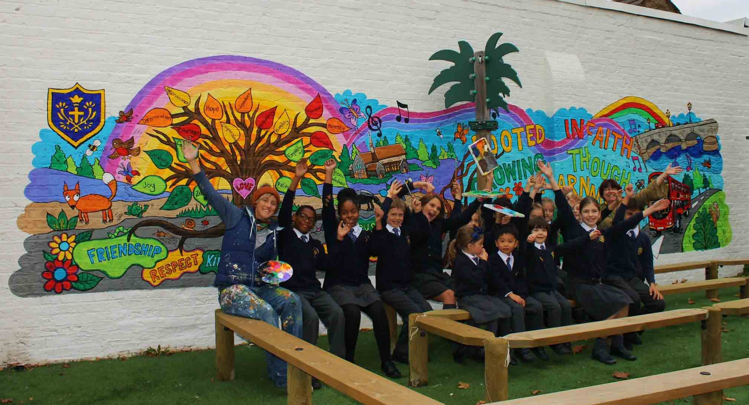
Unique to St Teilo’s…

Slide 15
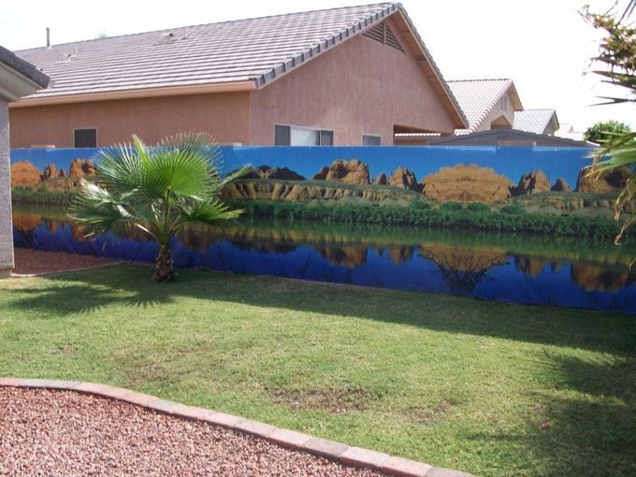
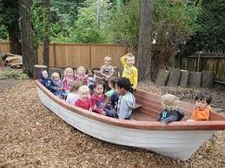
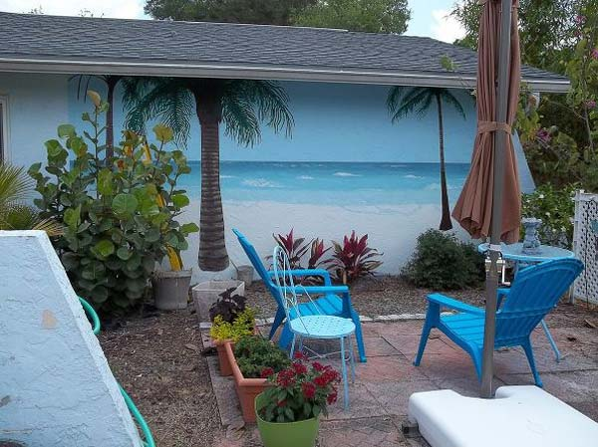
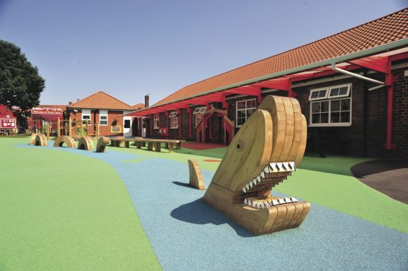
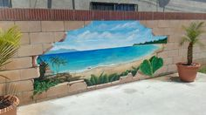
Beach Theme

Slide 16
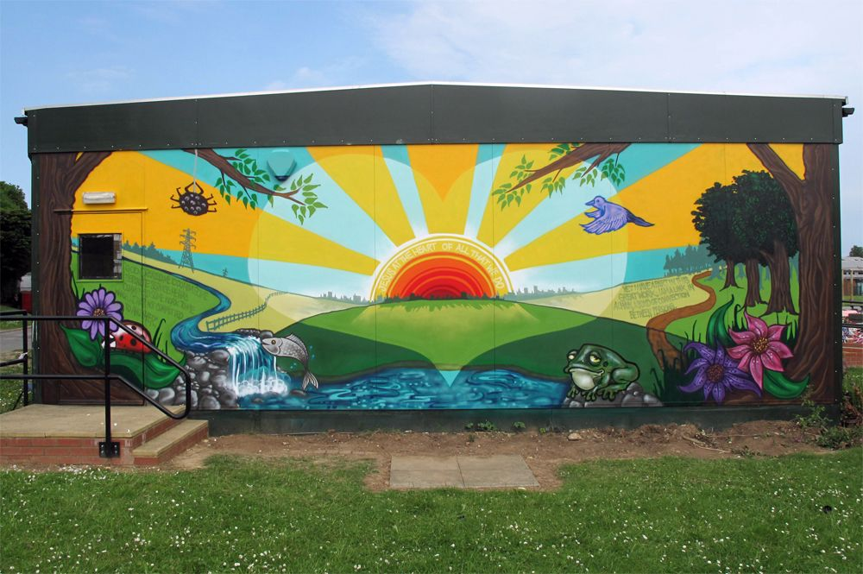
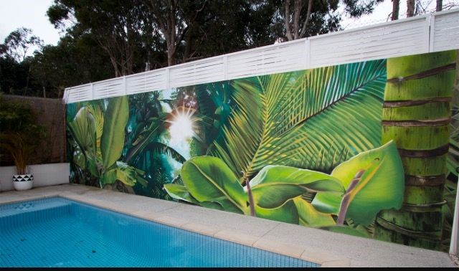
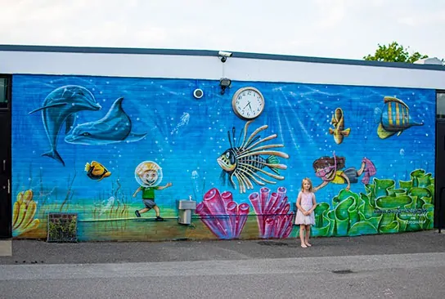
Mural

Slide 17
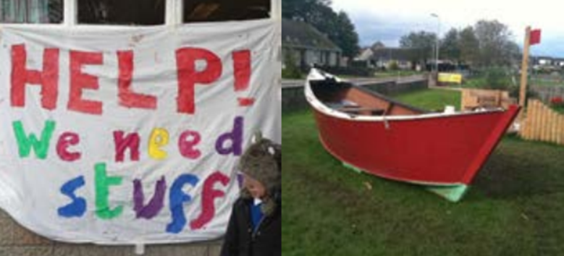
Community Support
Who?
Governors
Parents
Teacher contacts
Local businesses
PODS
How?
Ask the Q’s
Fundraise
Plan
Ground Force Day (parents, teachers, community all in school grounds to create the space!)

