Slide 1






Led by: Ross Williams, teacher at Johnston School
Case Study by Bryony Rees, Pembrokeshire Outdoor Schools (PODS) Co-ordinator
Funded by: Pembrokeshire Coast Charitable Trust, People’s Postcode Lottery and South Hook LNG Roots/Gwreiddiau Project.
Johnston CP School
Pembrokeshire Outdoor Schools (PODS)
Case Study 2020

Slide 2
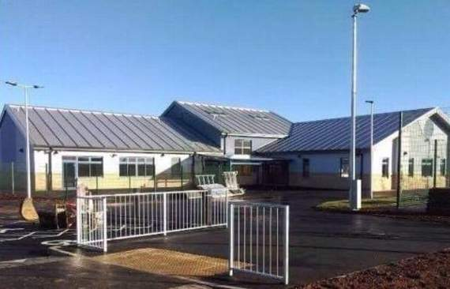
Johnston Community Primary School
Background Info:
Johnston Community Primary School is in Johnston between Haverfordwest and Milford Haven in Pembrokeshire.
The school has 243 pupils aged between 3-11 years, including 40 pupils who attend the nursery part-time.
The school has three mixed-age classes and seven single-age classes.
The school moved to a new building in January 2017 and includes a specialist teaching facility for 12 pupils with autistic spectrum condition from the wider area.
The school have been given access to a farmers field beyond the school grounds.

Slide 3
Outdoor Learning at Johnston School
School given access to the field beyond the grounds.
Aims: Engage students, offer a diverse range of learning opportunities, build an outdoor curriculum.
Over the last year Ross Williams has led planning developments of ‘The field’ and an orchard was planted, an area for growing was prepared.
Pembrokeshire Outdoor Schools and Pembrokeshire Coast National Park Authority supported the developments by building a chicken run, clearing a forest school area and paths and fencing the field.
Local community and farmers have supported by giving advice, topping the field and supplying chickens.

Slide 4
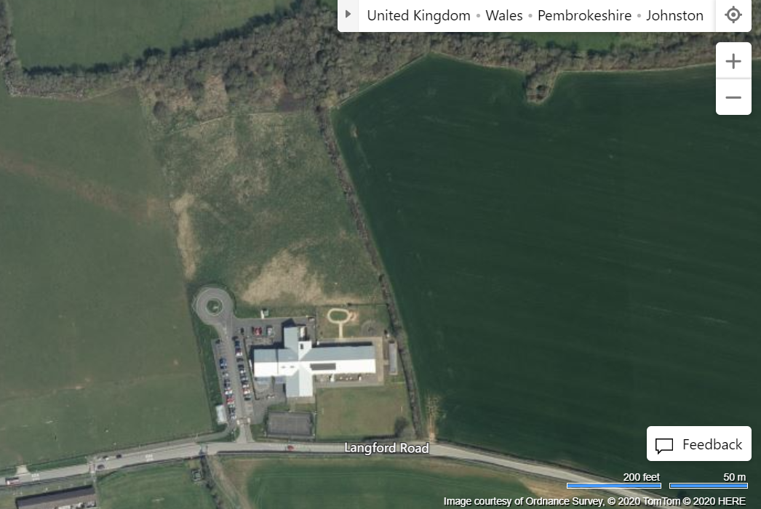
Development of ‘The Field’

Slide 5
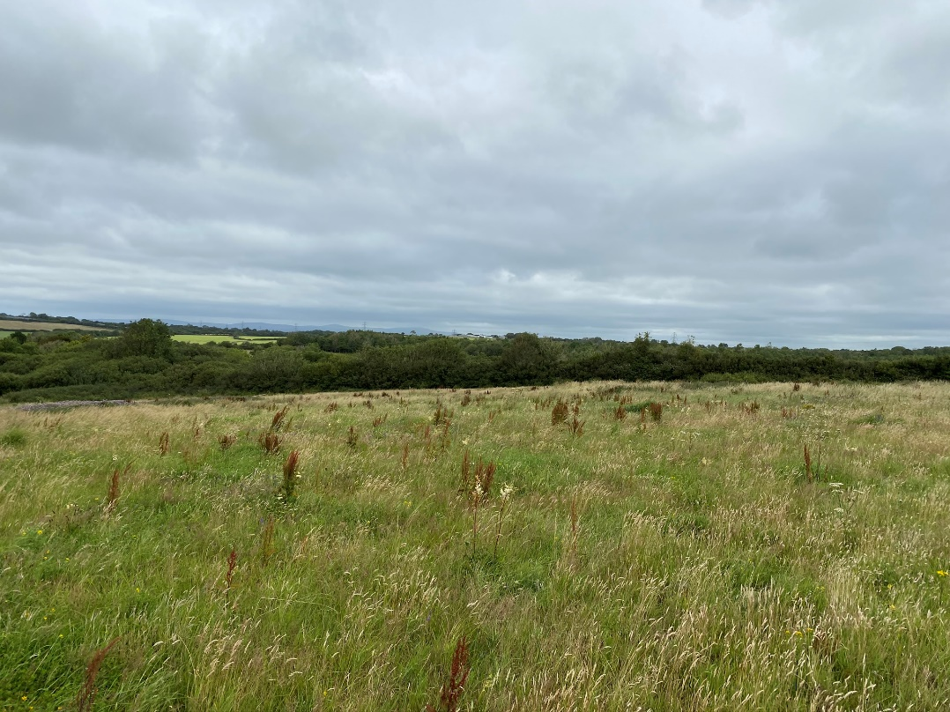
The Field

Slide 6
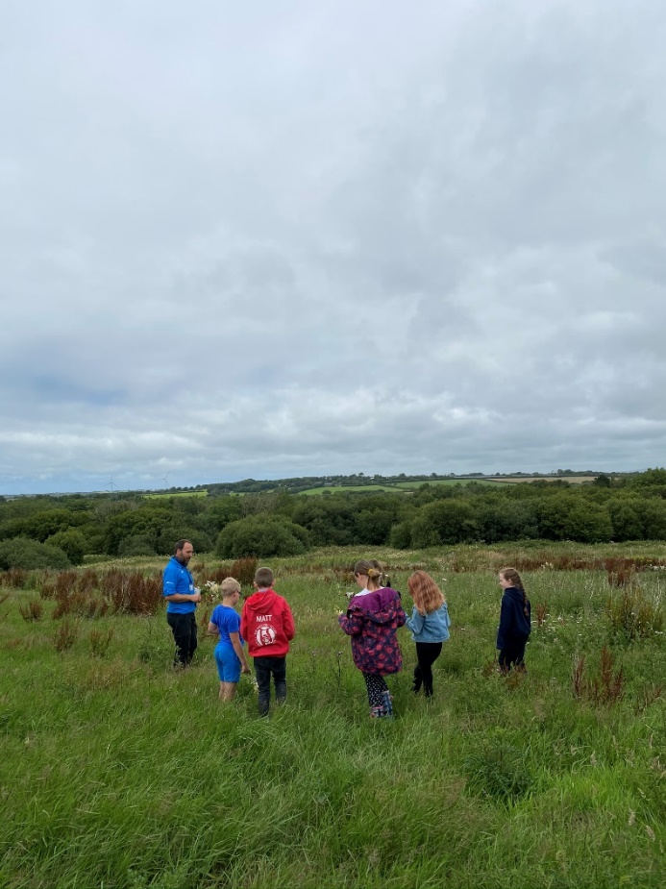

Support from Pembrokeshire Coast National Park Authority (PCNPA)
Tom Bean – Education Officer at PCNPA
Funded by South Hook LNG to deliver the Roots/Gwreiddiau Project in the Milford Haven Cluster of Schools.

Slide 7
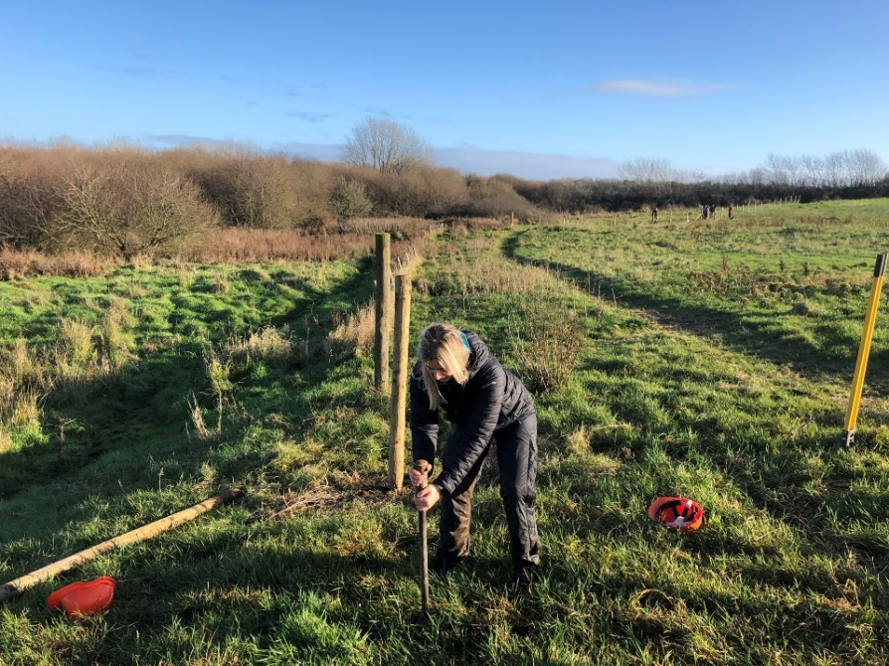
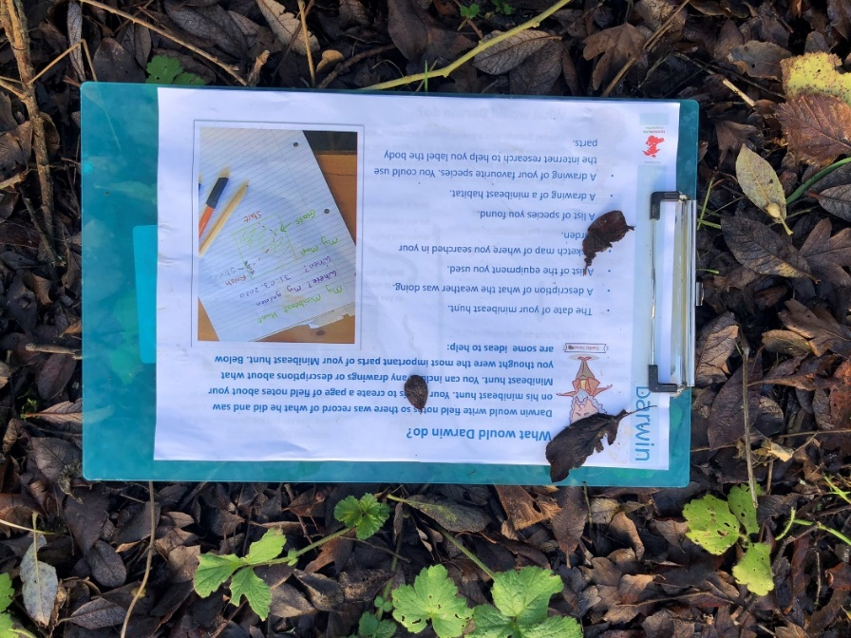
Support from Pembrokeshire Outdoor Schools (PODS) Partnership
Bryony Rees, Pembrokeshire Outdoor (PODS) Co-Ordinator
Resources from PODS partner Darwin Centre

Slide 8
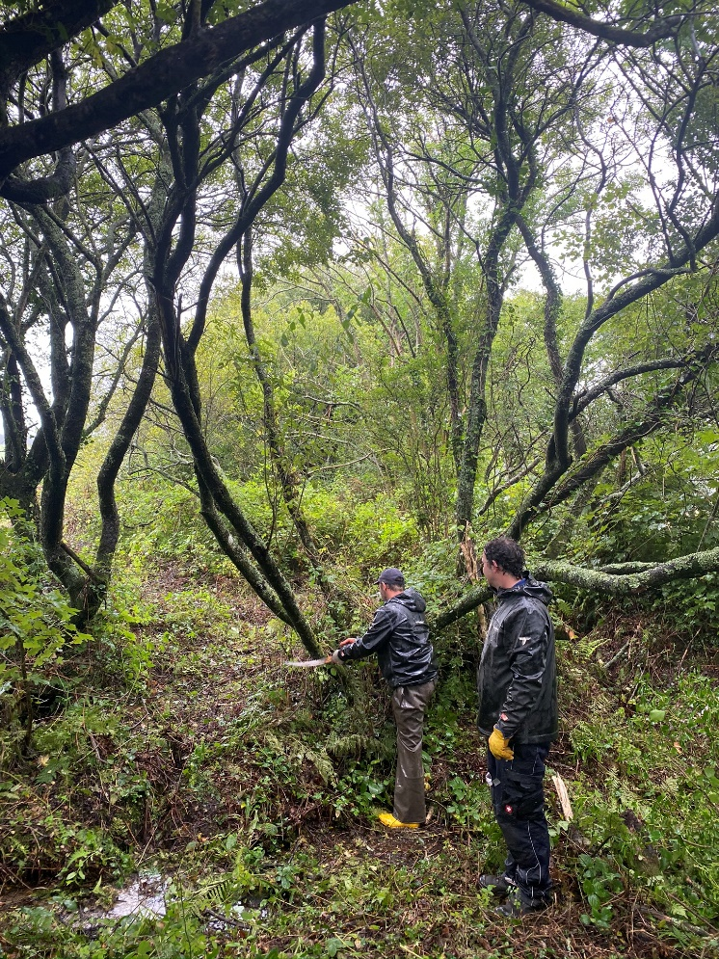
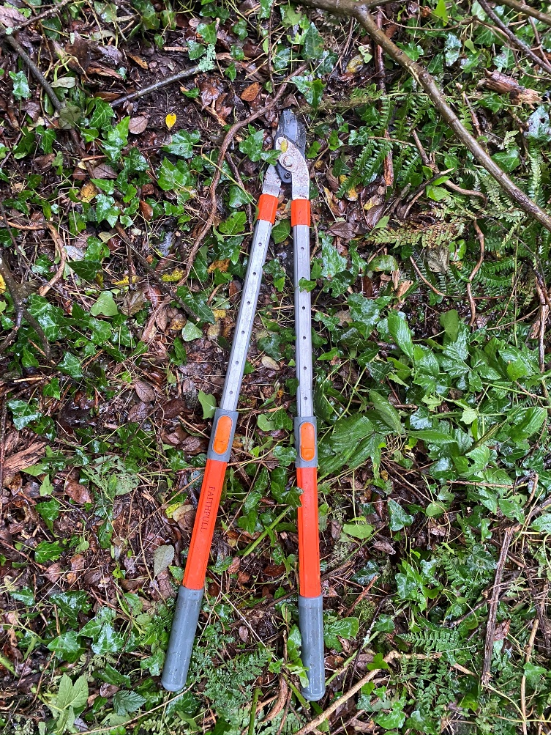
Support from Pembrokeshire Coast National Park Authority (PCNPA)

Slide 9
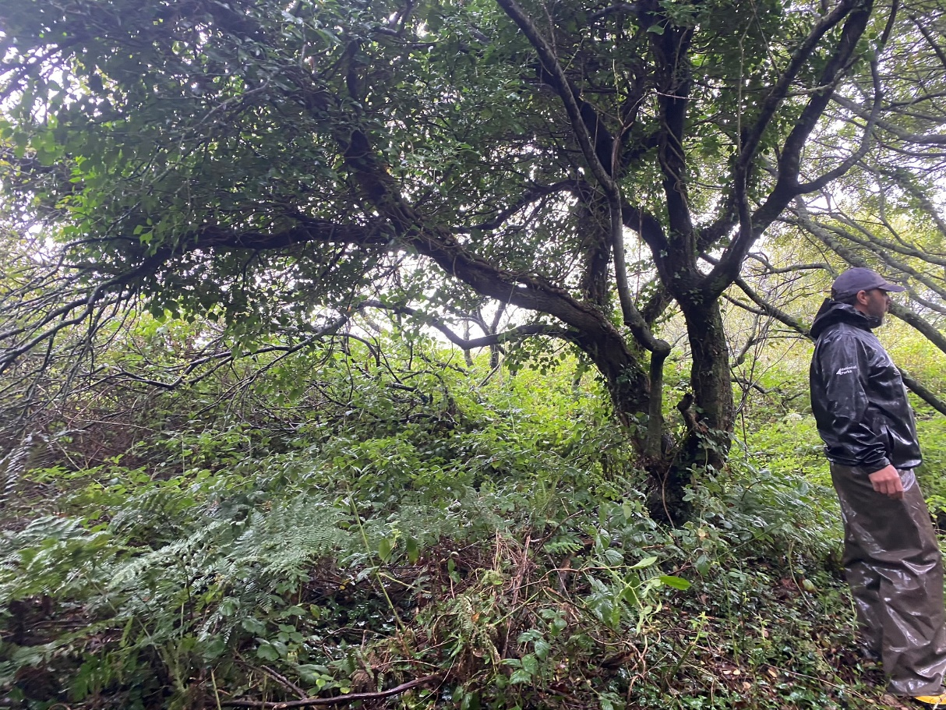
The Woodland Area

Slide 10
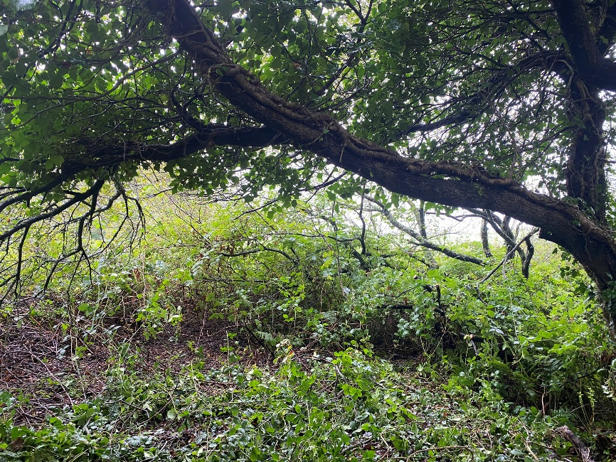
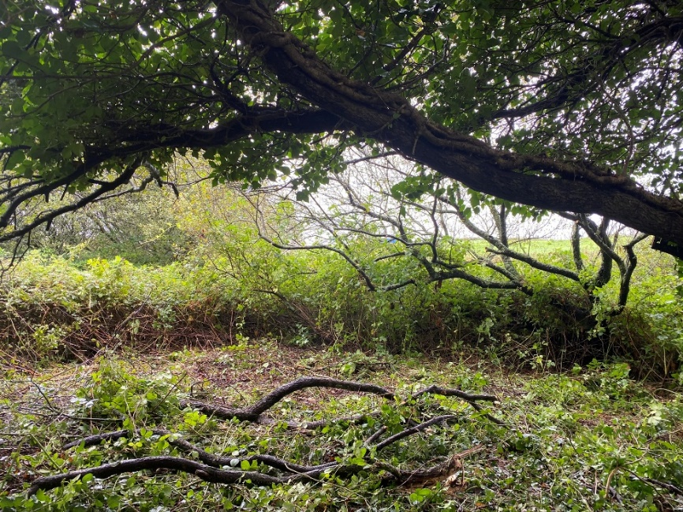
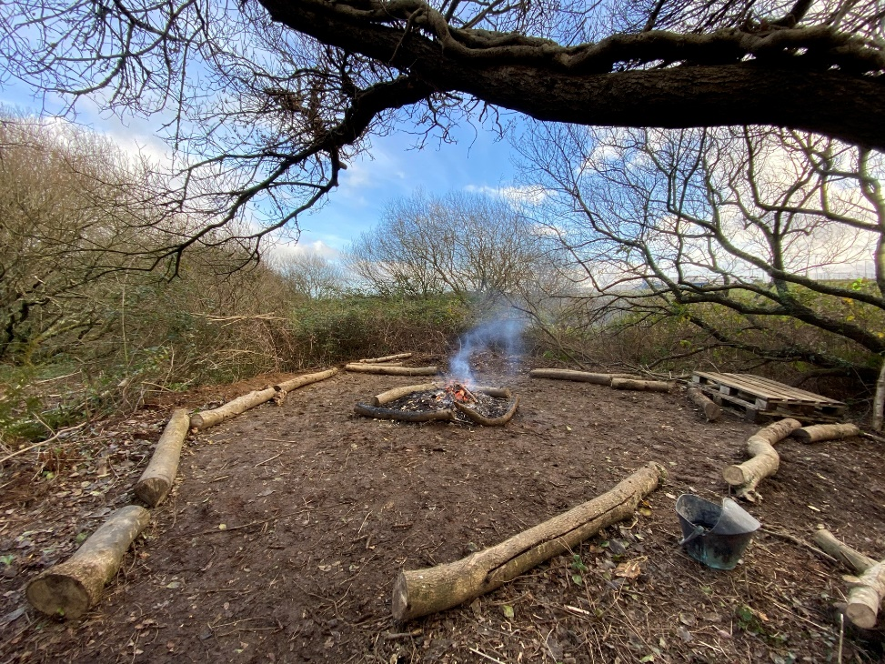
Creating a Woodland Clasroom
Cleared by Bryony Rees, Tom Bean and Tom Iggleden.

Slide 11
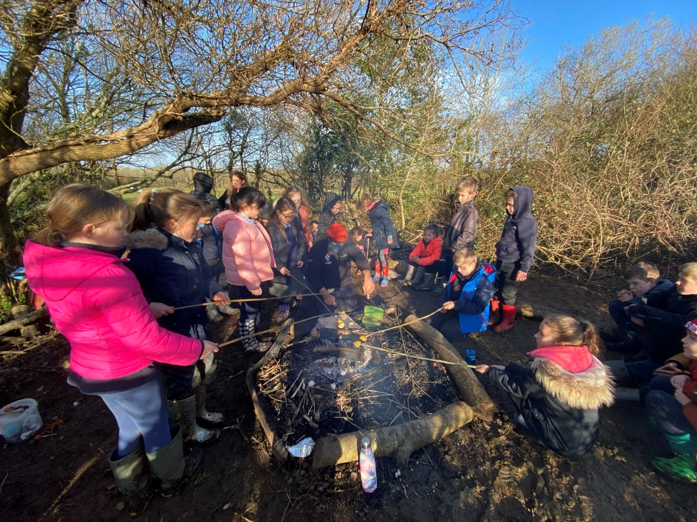
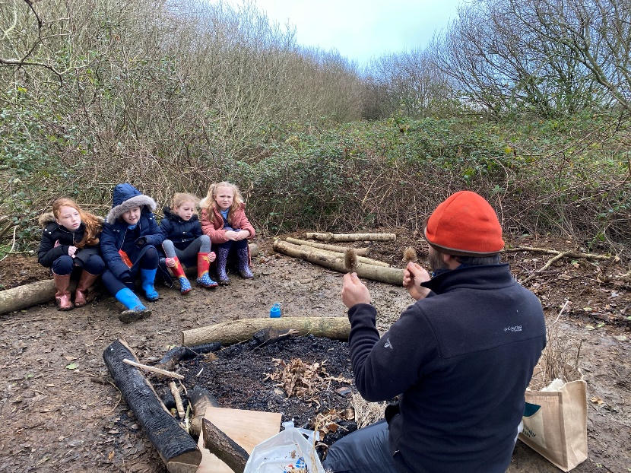
Support from National Park Education Team Tom Bean and the Rangers
Bushcraft support from Tom Bean, and ranger Richard Vaughan.

Slide 12
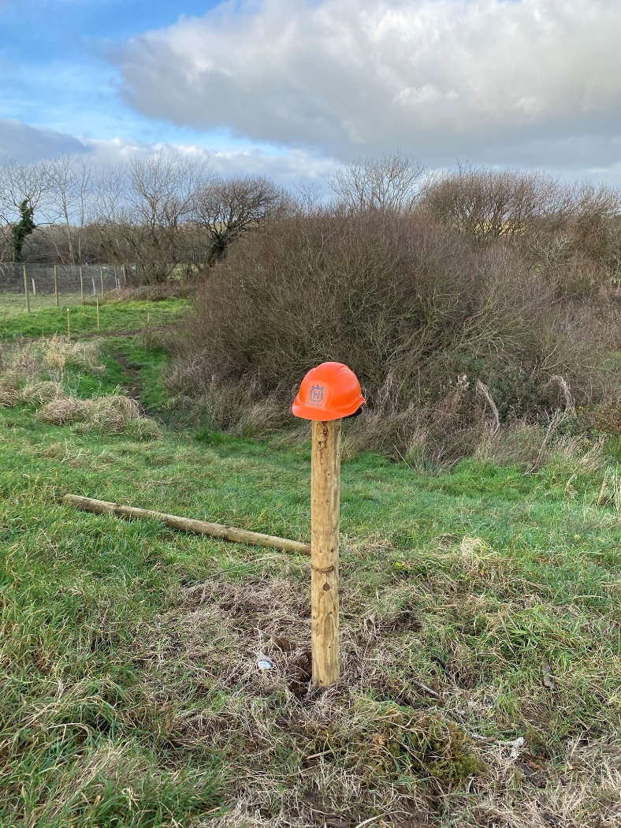
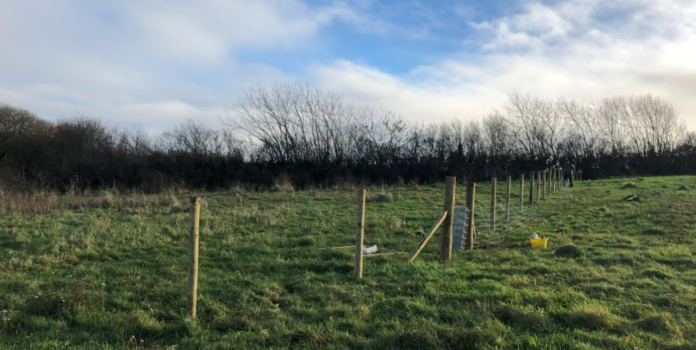
Support from Pembrokeshire Coast National Park Authority (PCNPA) Pathway Volunteers
Fencing built by Pathway Team leader Tom Iggleden, Ranger Ian Meopham and the team of Pathway volunteers

Slide 13
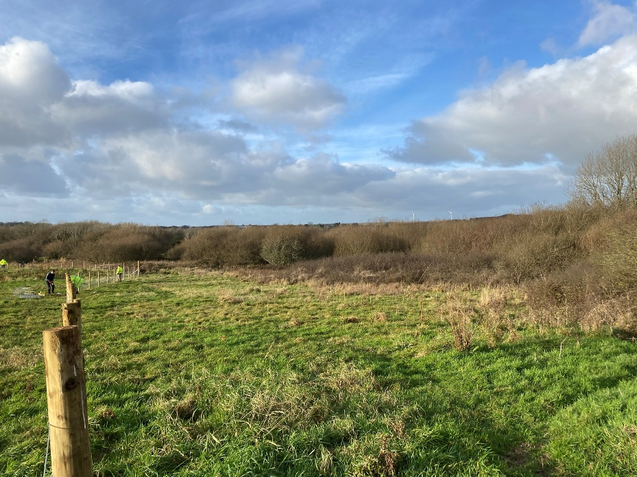
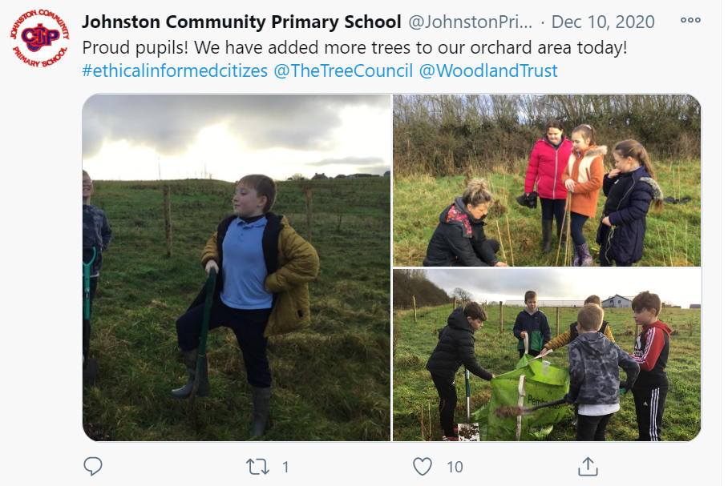
The Orchard
Trees from The Tree Council and The Woodland Trust planted by Education Team at PCNPA and students of Johnston School.

Slide 14
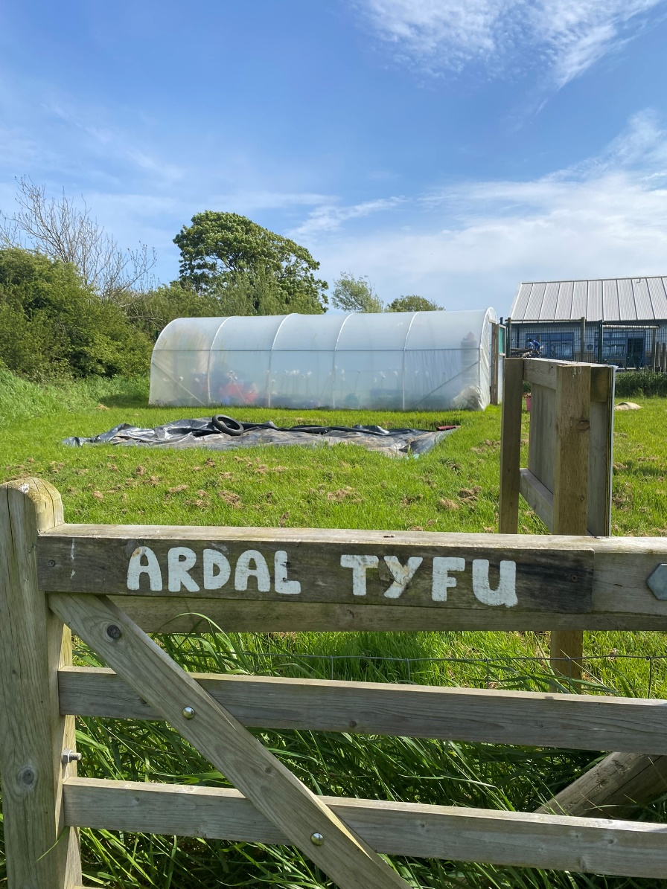
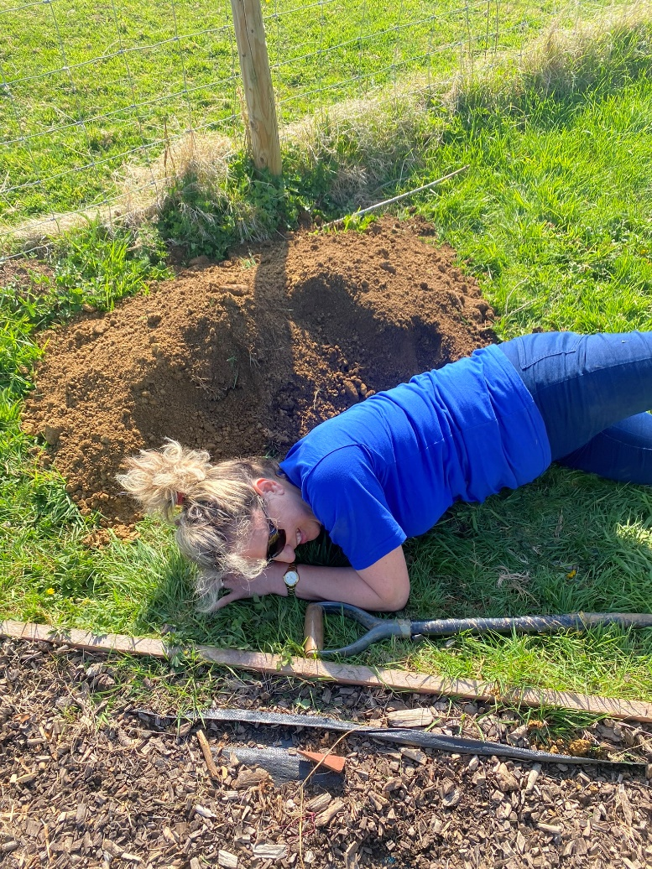
Building the Polytunnel
Polytunnel build by Tom Bean, Ross Williams and Wendy Tamilia

Slide 15
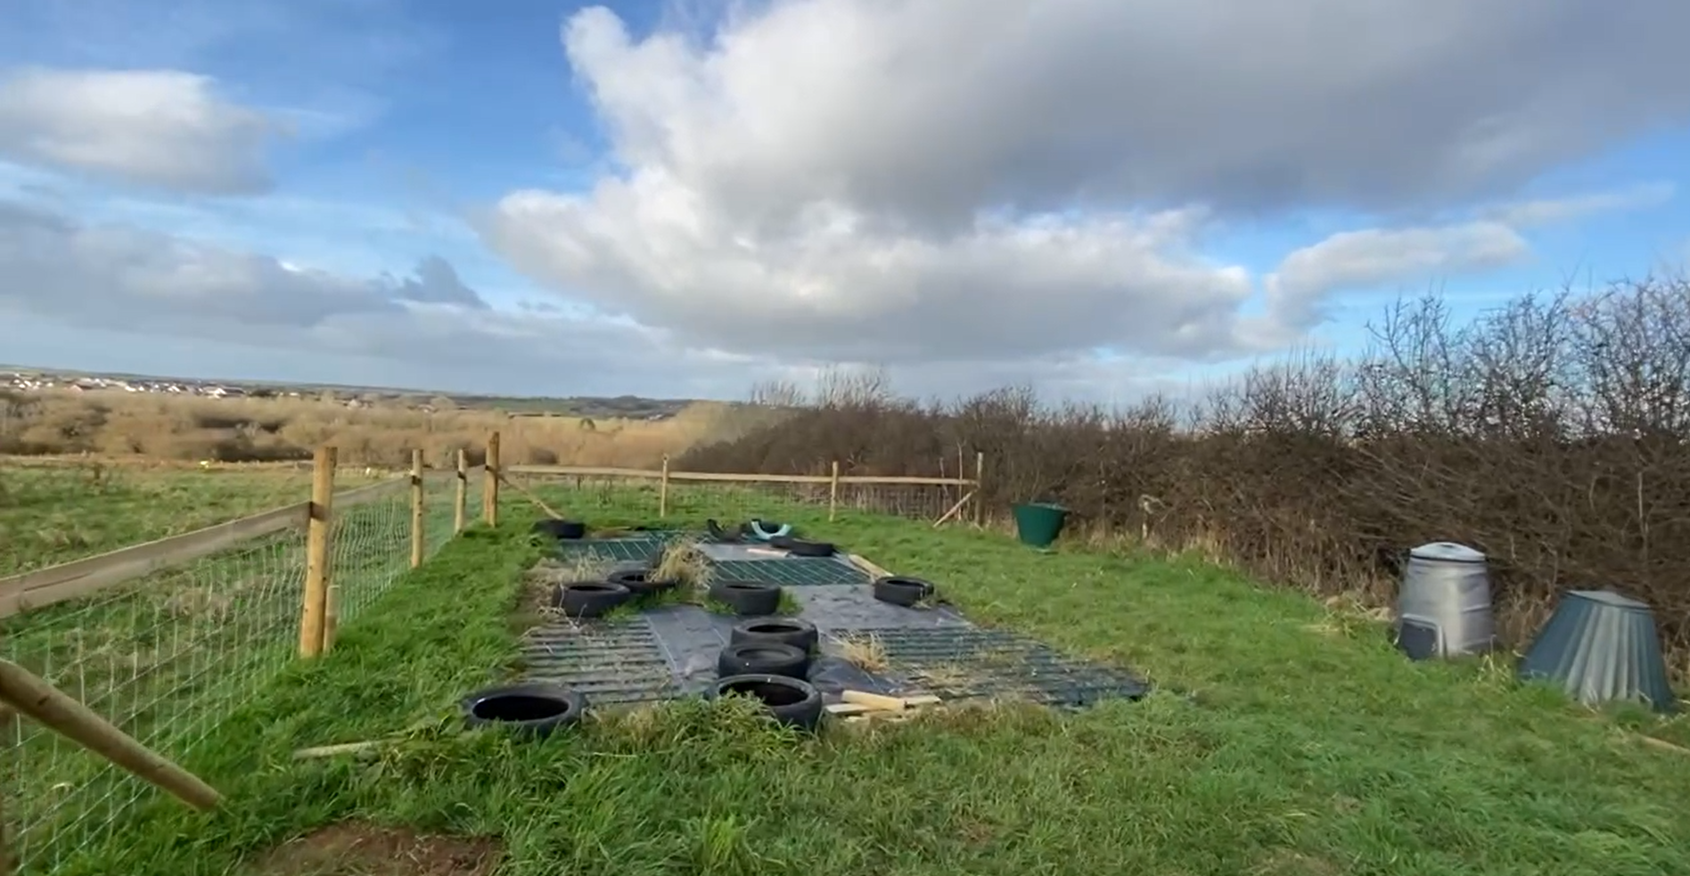
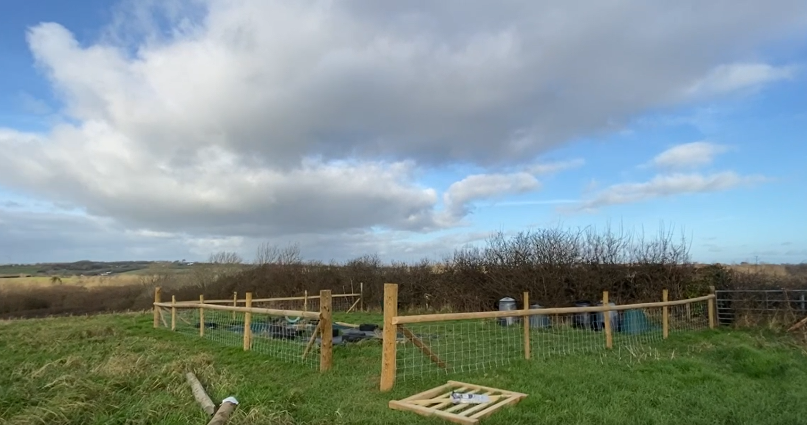
Creating a Growing Area

Slide 16
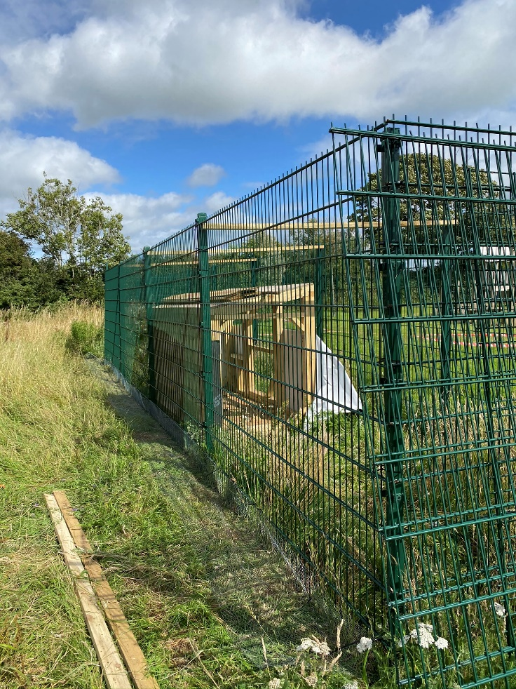
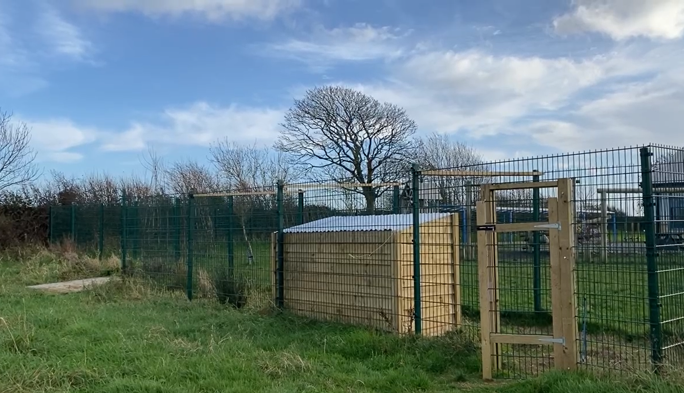
The Chicken Pen

Slide 17
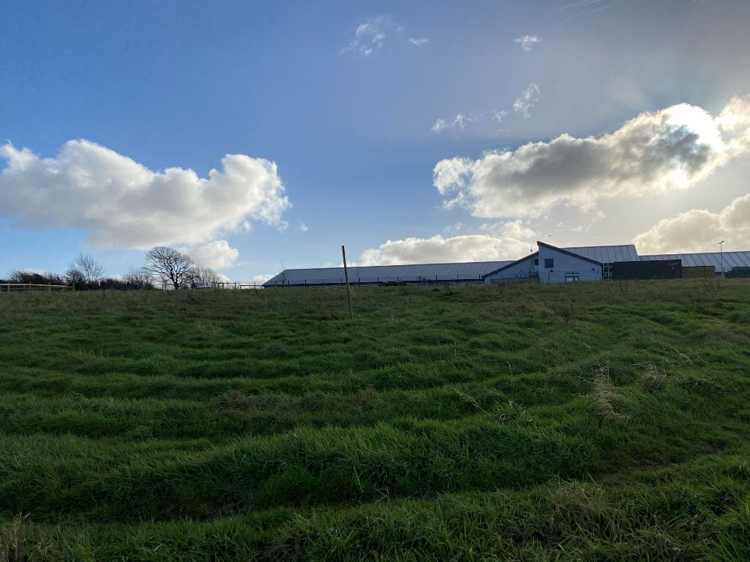
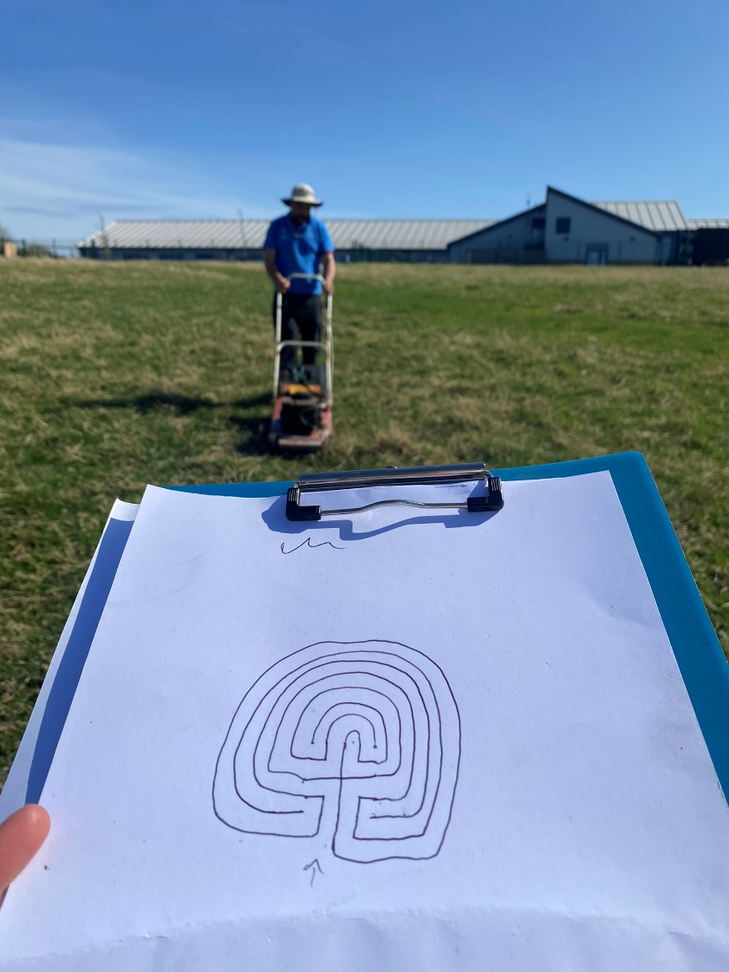
Paths, paths and labrinths!

Slide 18
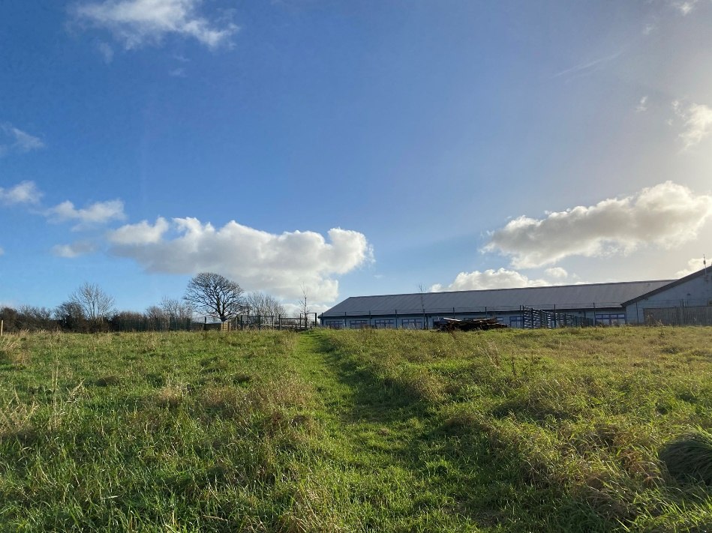
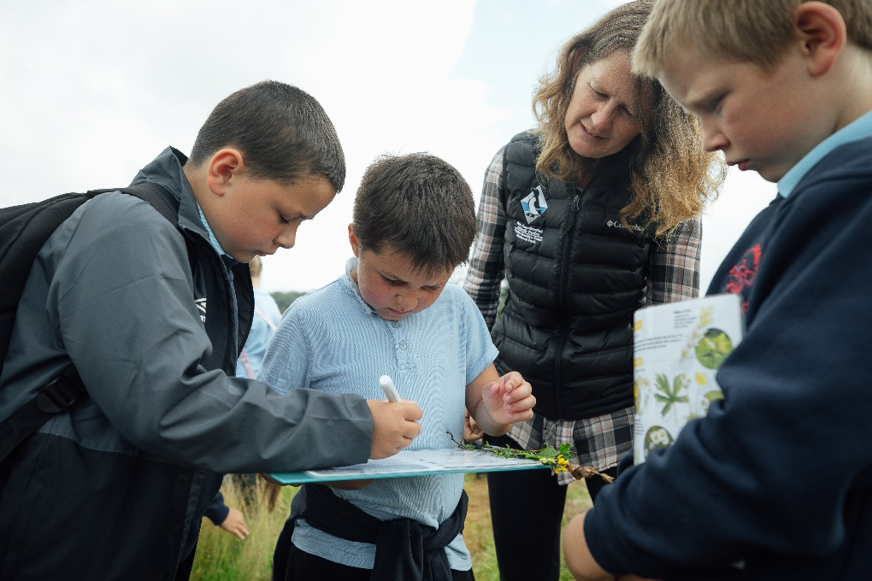
Planting a Meadow
Supported by Julie Garlick, Conservation Officer at Pembrokeshire Coast National Park.

Slide 19
Diolch yn fawr iawn i’r holl staff a myfyrwyr or ysgolion a gymerodd ran!
Thank you very much to all the staff and students of the schools involved!

Slide 20
bryonyr@Pembrokeshirecoast.org.uk
07870 488014
Pembrokeshire Outdoor Schools (PODS) Contact: Bryony Rees

