Slide 1

Developing A Vision
Bryony Rees
Pembrokeshire Outdoor Schools Co-Ordinator

Slide 2

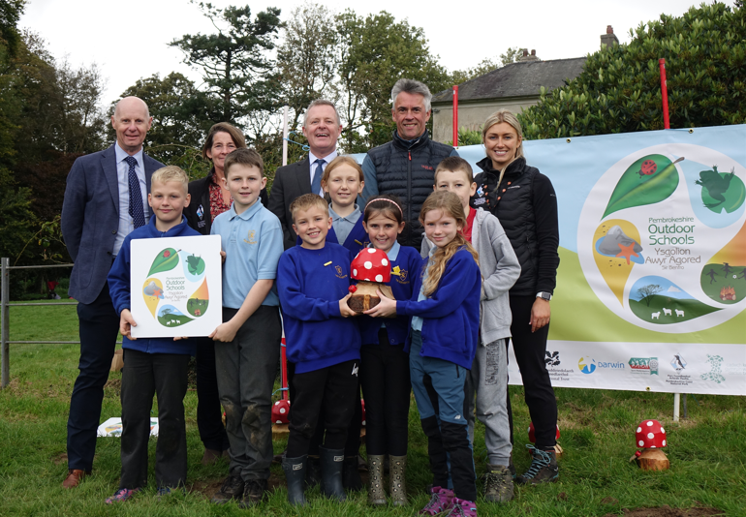

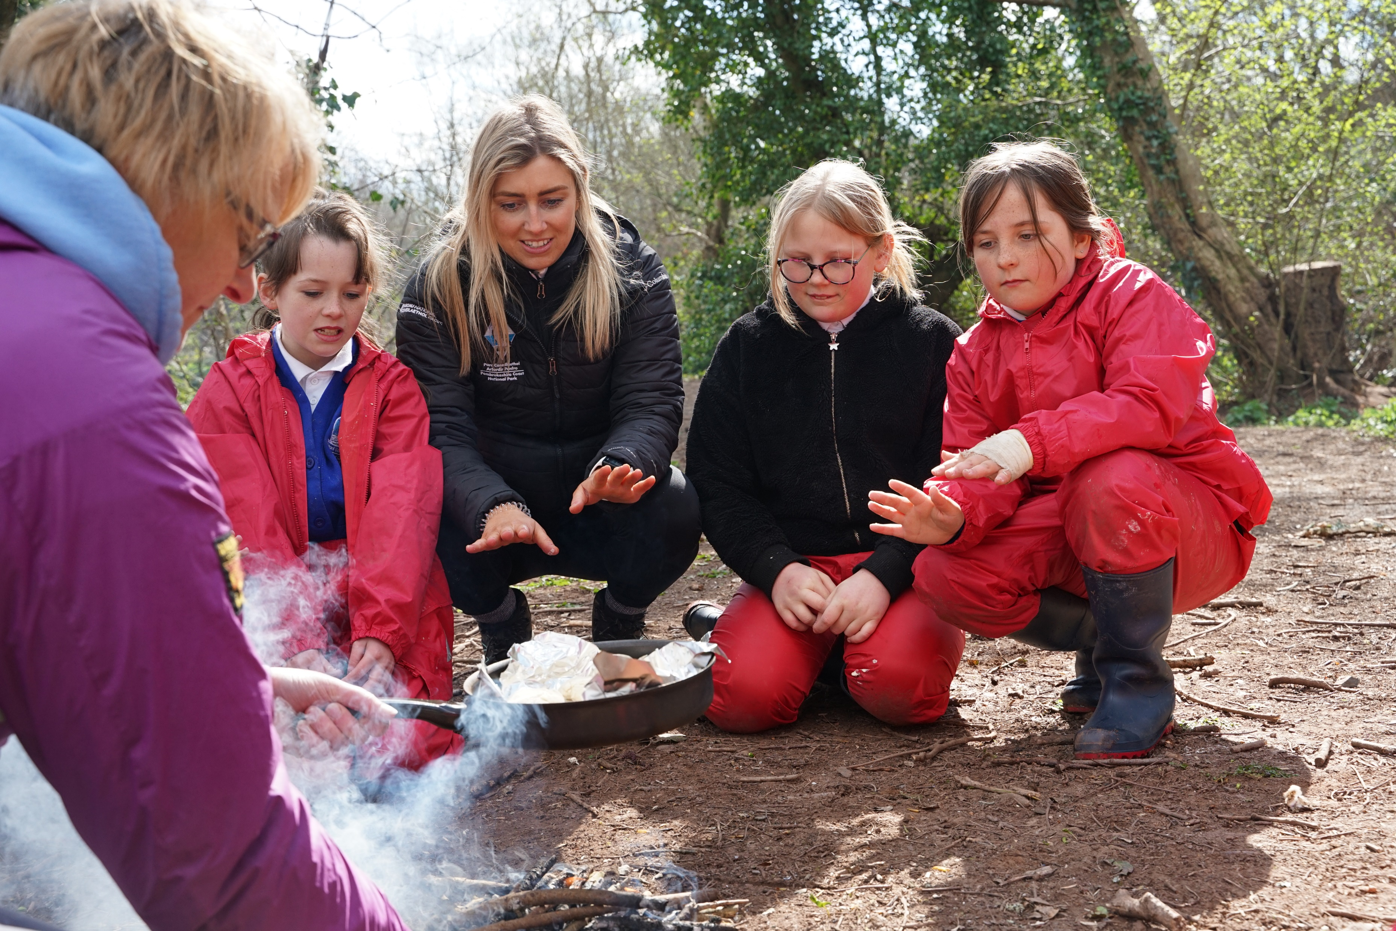
Pembrokeshire Outdoor Schools (PODS) is a co-production model. A partnership of organisations, education partners, advisors, headteachers and teachers.
Education Officer: Tom Bean
Co-ordinator: Bryony Rees

Slide 3
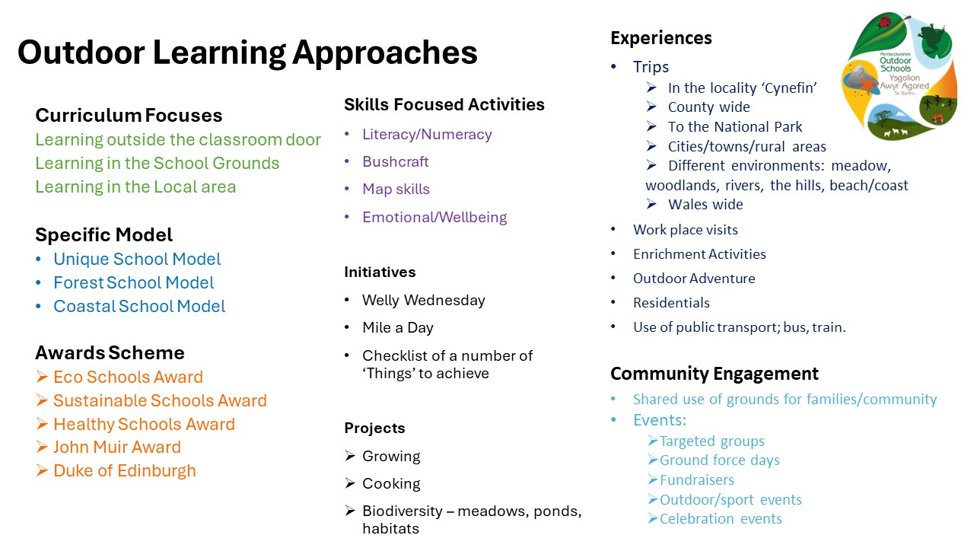
Believe, Achieve, Inspire….. Through the outdoors

Slide 4
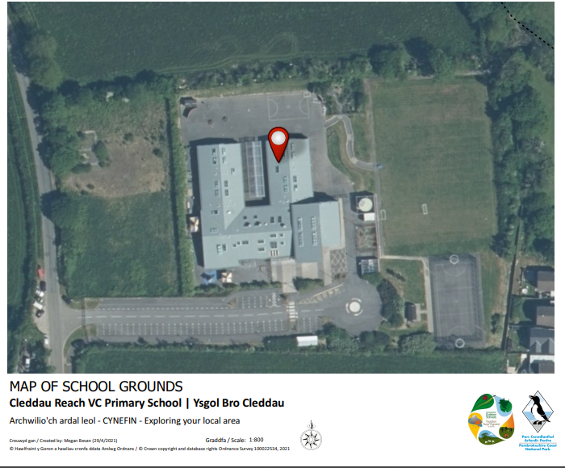
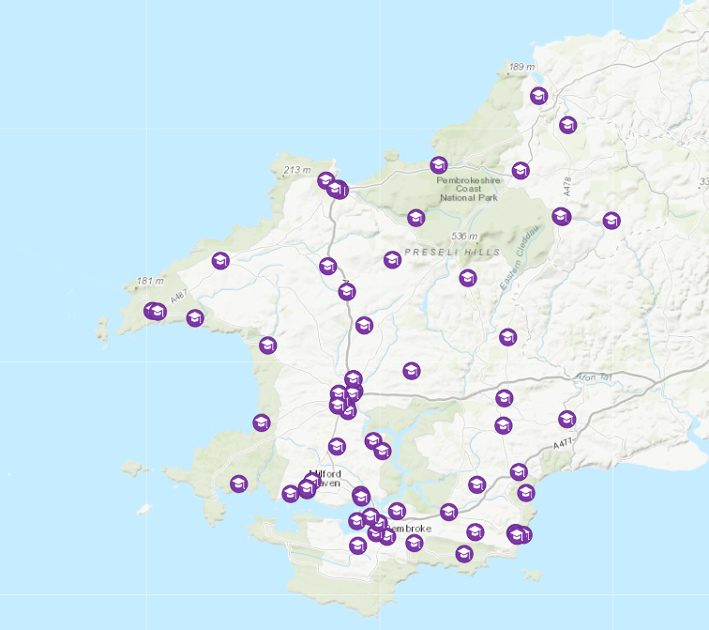
Look at your School Grounds
Maps available on the Pembrokeshire Outdoor Schools Website.

Slide 5
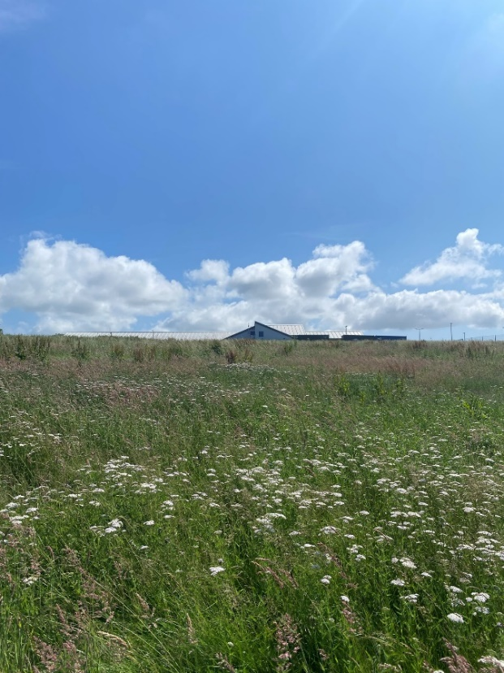
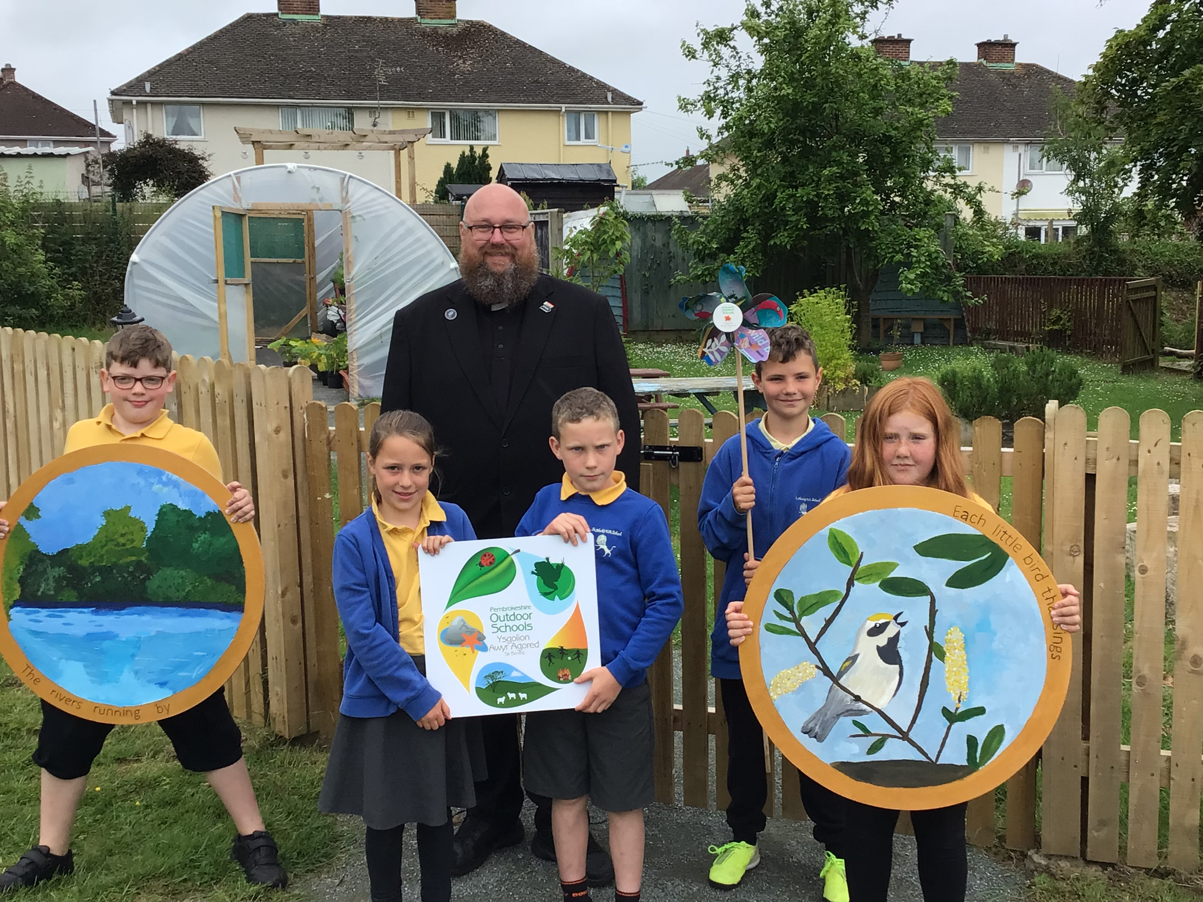
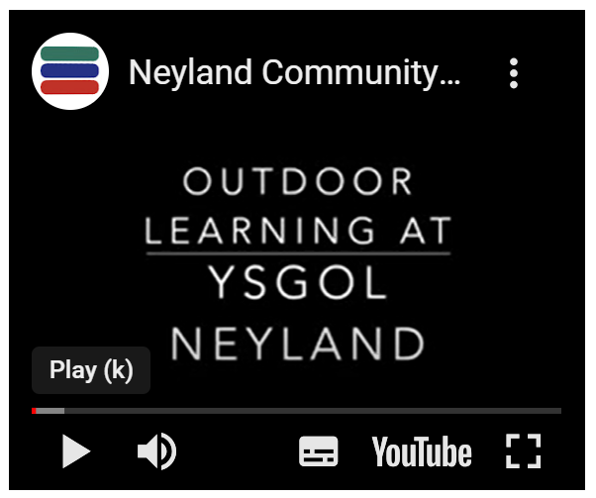
Sector Leading Schools in Pembrokeshire
Ysgolion sy'n Arwain y Sector yn Sir Benfro
Neyland School
Outdoor Learning Curriculum – every Friday students have a whole day of outdoor learning
Improved attainment and attendance
Development of Grounds
‘Mug and Rug’ night time outdoor learning evening
School camp out
St Marks School
Extensive Development of Grounds through a collaborative approach
Links to local businesses
Improved health and wellbeing of students
Johnston CP School
Field Development
Sensory area
Forest Area
Growing Area
Meadow
Orchard

Slide 6
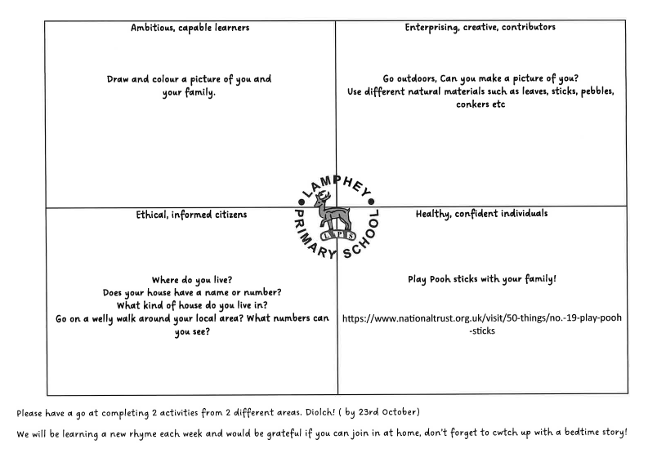
Building an Outdoor Learning Community
Nursery Homework
Example Lamphey School
Good example to engage parents

Slide 7
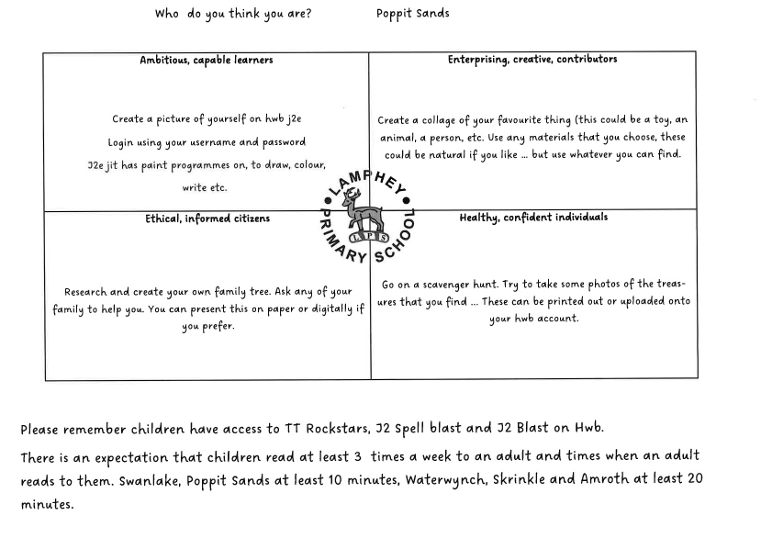
Year 1 and 2 Homework
Lamphey School

Slide 8
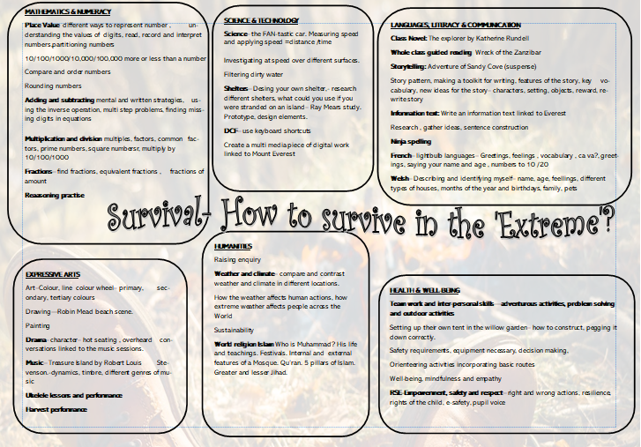
Year 4 and 5
Parent Planning

Slide 9
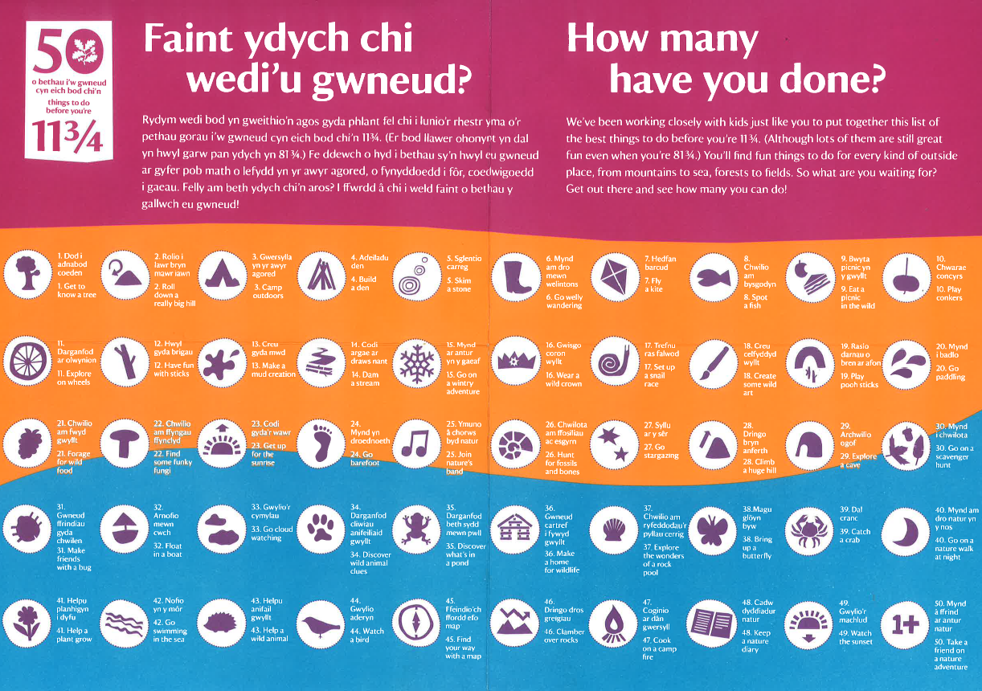
National Trust Resource
A number of ‘Things’ Experiences, skills to accomplish
Build Excitement
Positive Experiences
Beginning of a vision

Slide 10
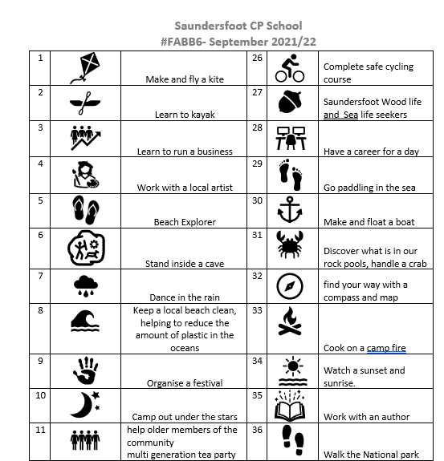

Saundersfoot CP School
#FABB6
Golden Grove School, Pembroke

Slide 11
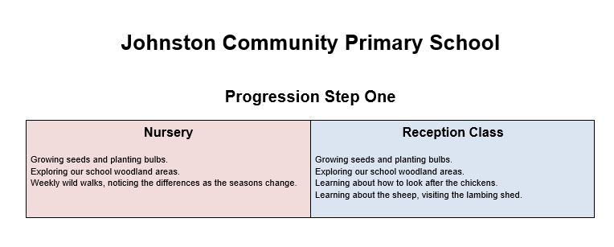
Johnston School
Outdoor Learning
Progression Steps
Map out current opportunities

Slide 12
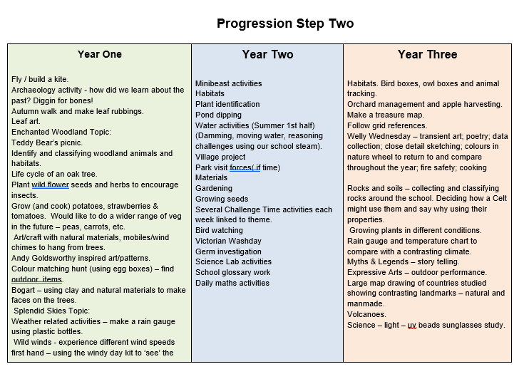

Slide 13
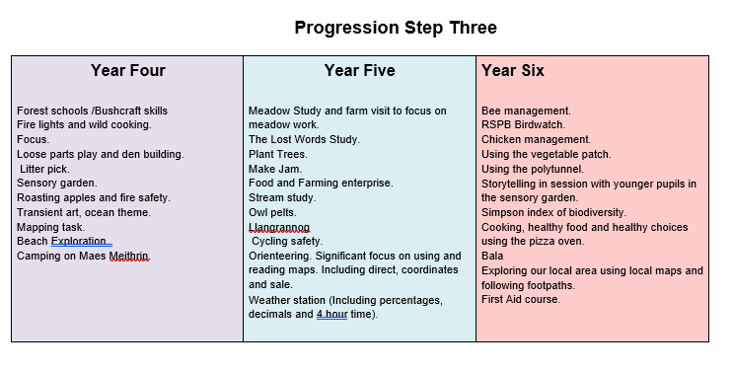

Slide 14
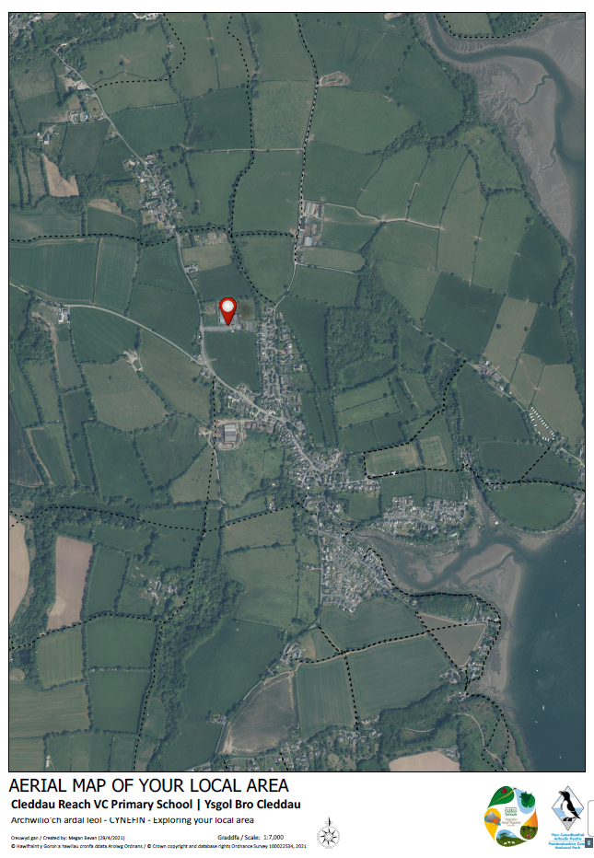
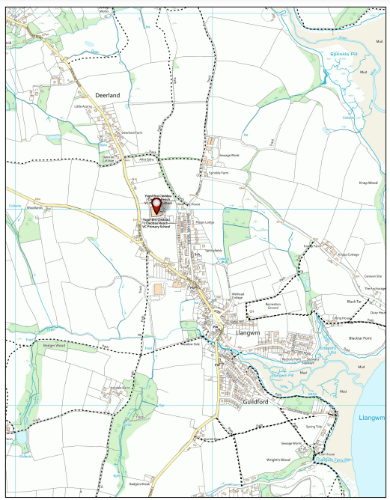
Your Local Area
Maps available on the Pembrokeshire Outdoor Schools Website.

Slide 15

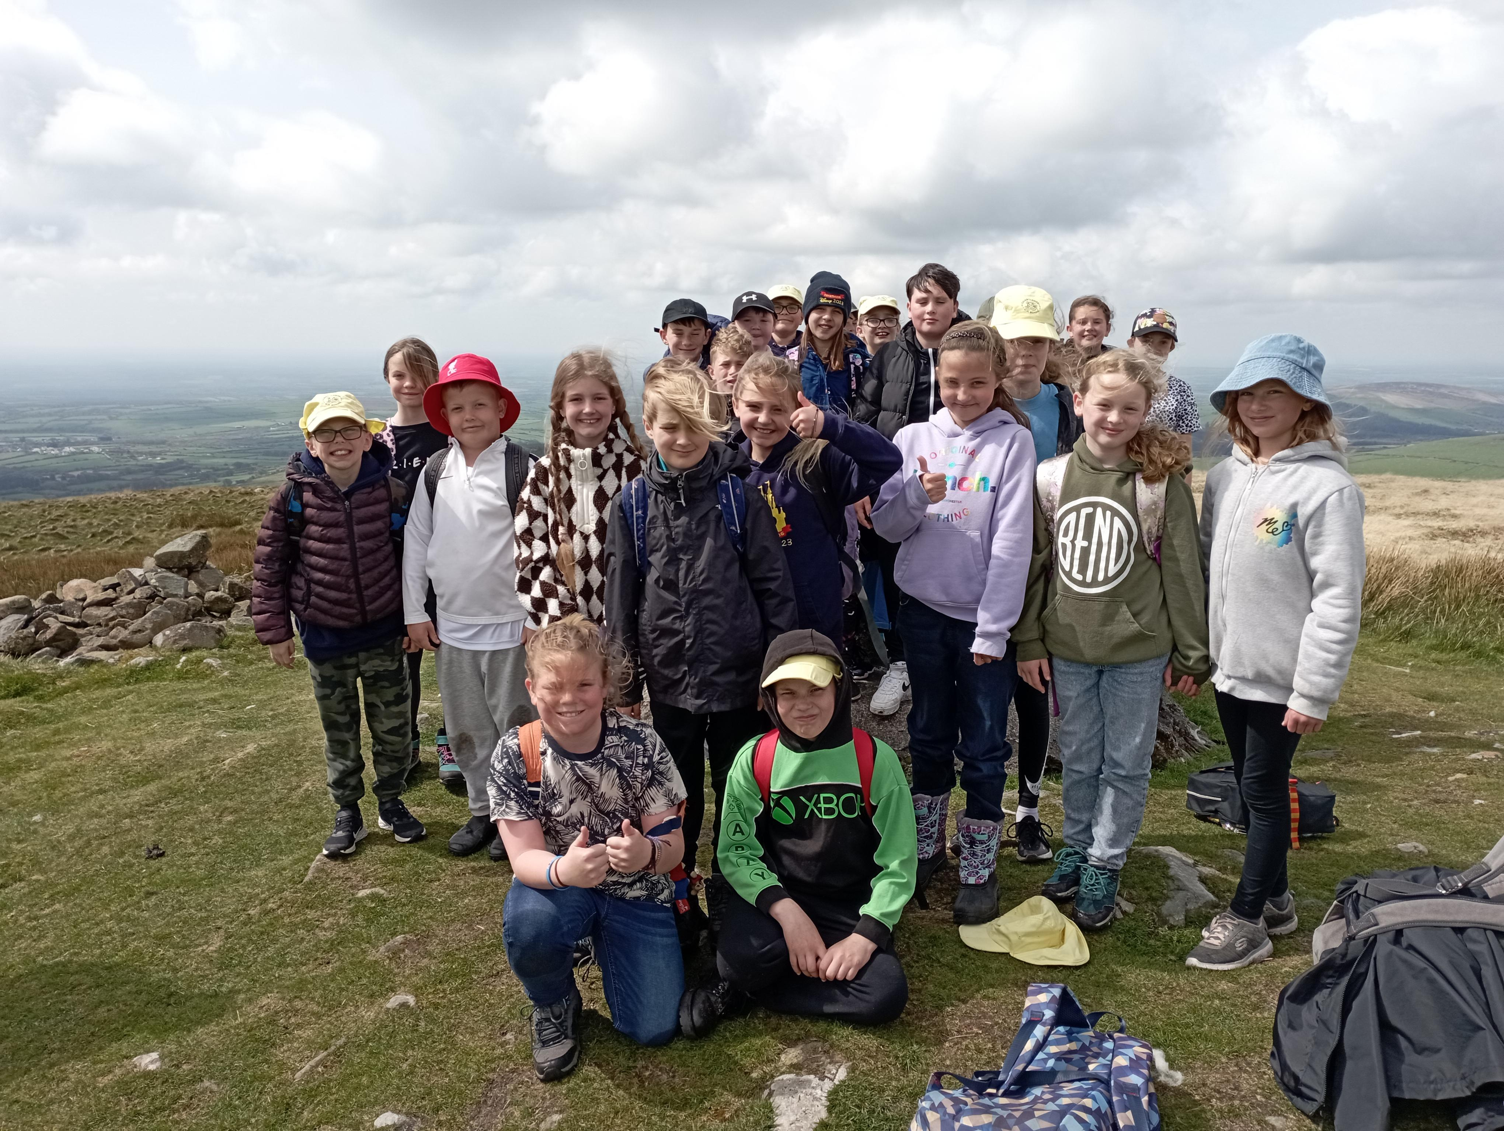
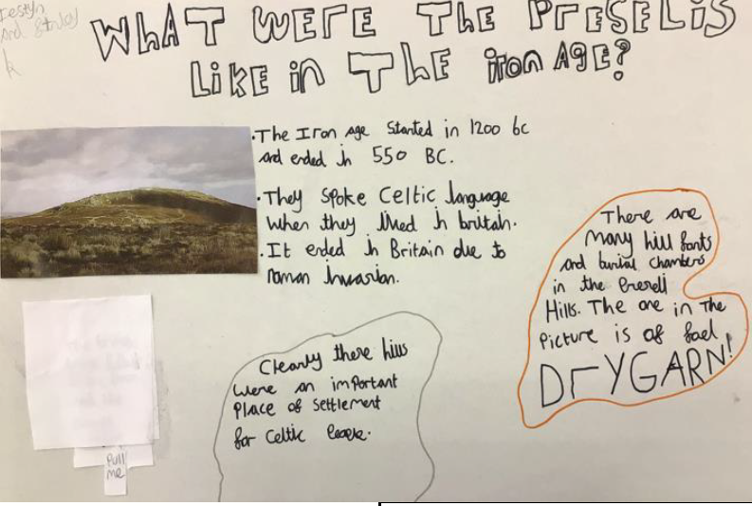

Local to Global

Slide 16

Enrichment Ideas taken from
Gelliswick School John Muir Award
Sessions
Session 1: Walk of the Local Area
Session 2: Big spring Low Spring Tide: Beach Exploration
Session 3: Visit from RNLI
Session 4: Senses Scavenger Hunt
Session 5: Den Building
Session 6: Woodland Session
Session 7: Beach Art and Sculptures
Session 8:Fire lighting and cooking on a Fire
Session 9: Beach Olympics
Session 10:Visit to St Brides Orchard
Session 11: Preparation for Nature Trail - Collecting natural items from beach and woodland
Session 12: Sensory Nature trail for whole School

Slide 17
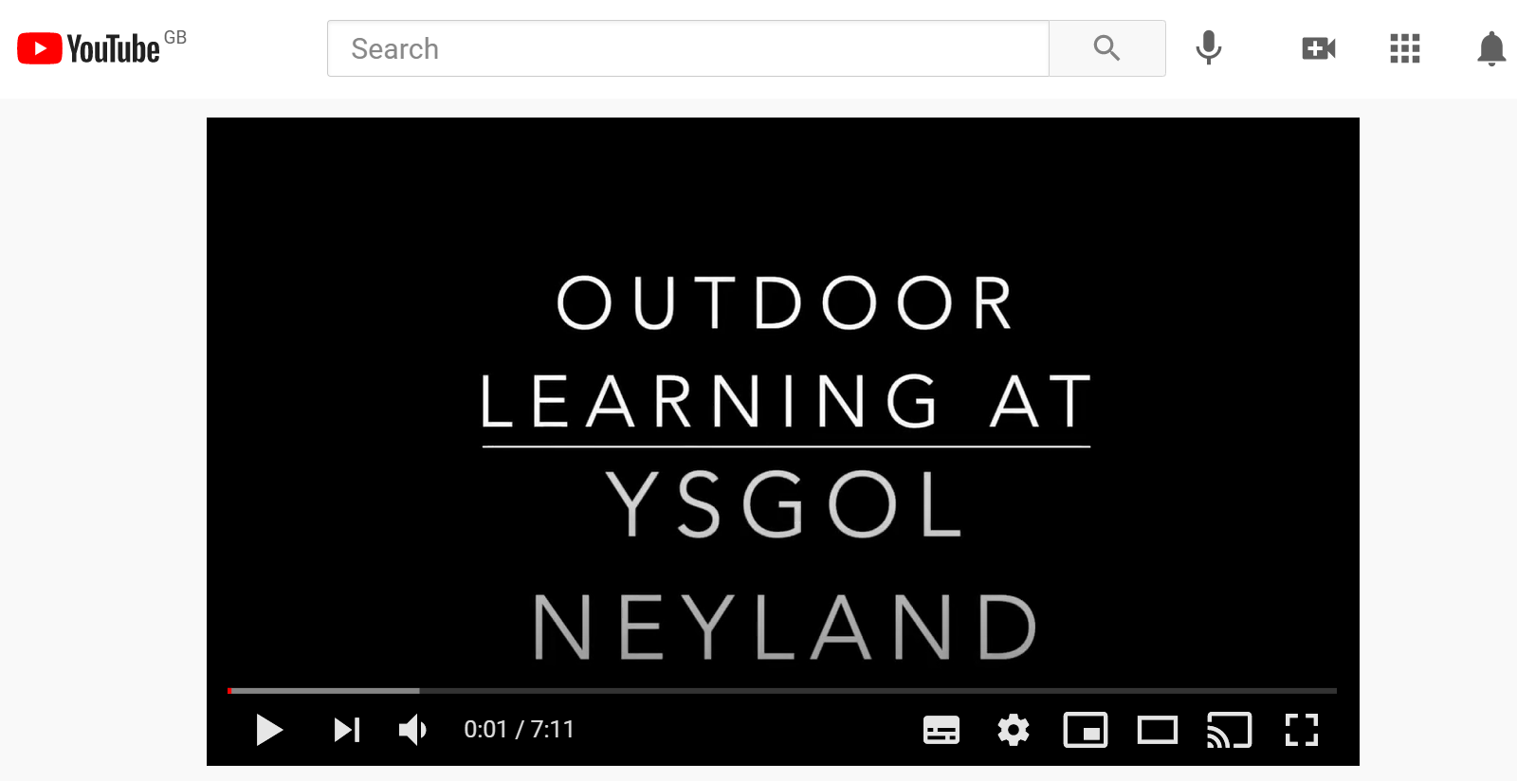




Video

Slide 18
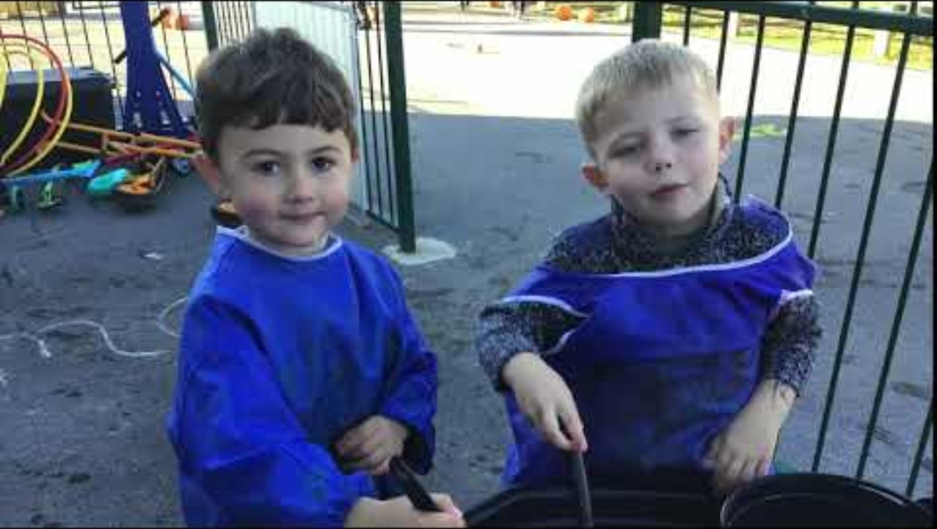
Neyland School
Enrichment Ideas for Friday Outdoors Video
Case Study on the PODS Website
‘Mug and Rug’ after school ‘Dark Sky event’ – signing around the campfire, astronomer, lanterns.

Slide 19
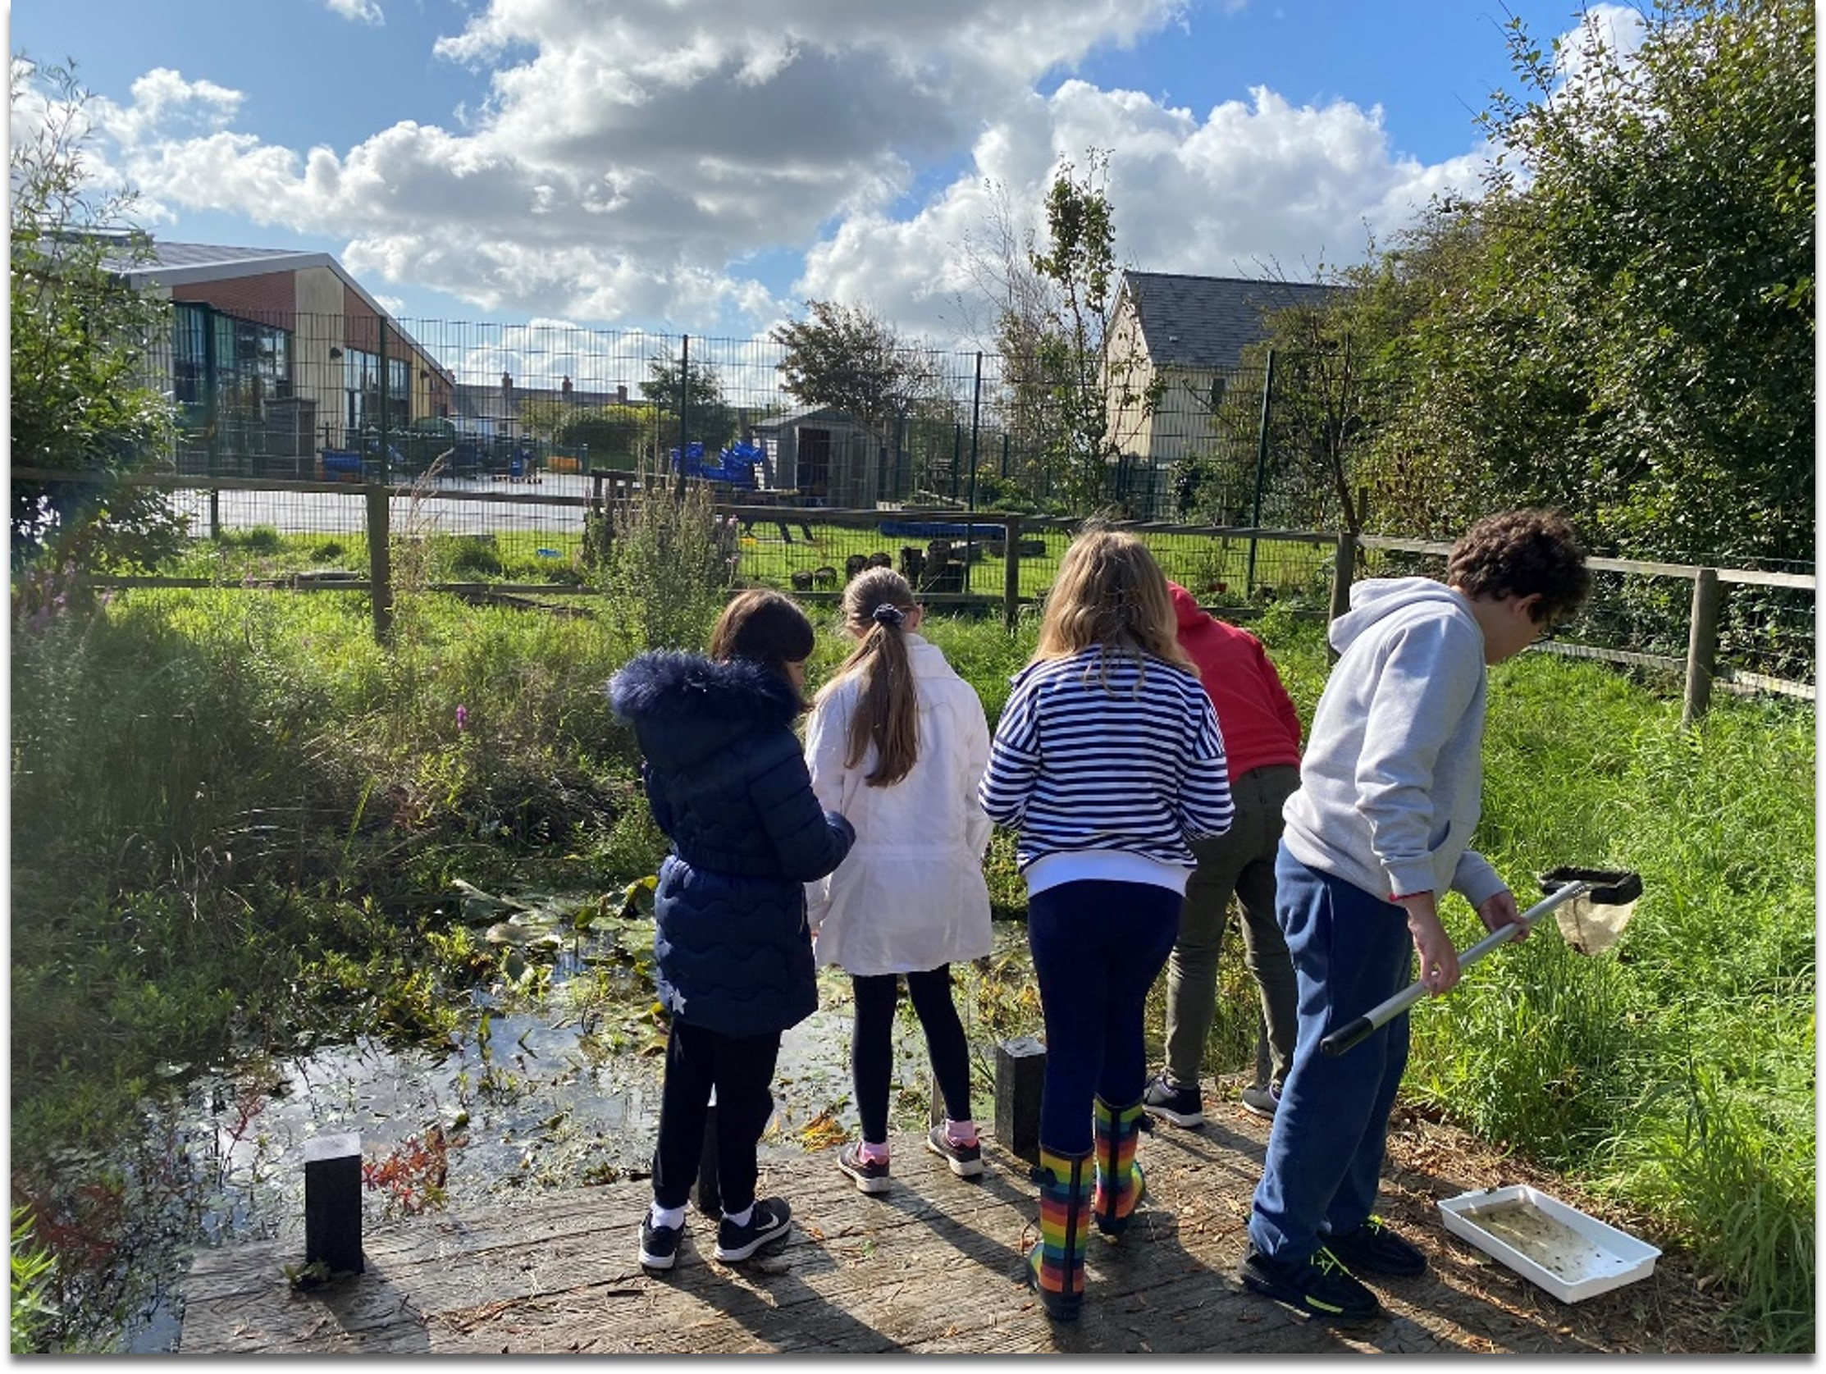
Creating a plan…..
For what you already have:
  Green space
  Pond
  Growing Area
  Orchard
  Local Area
  What would the students, teachers and parents like to….
    Learn about in the outdoors
    Enrichment activities
    Skills
    Staff and student wellbeing
    In terms of play

Slide 20

Resources are available on the Pembrokeshire Outdoor Schools website: https://pembrokeshireoutdoorschools.co.uk/
For questions, queries or details on the partners of Pembrokeshire Outdoor Schools, please contact:
Bryony Rees - Pembrokeshire Outdoor Schools Co-Ordinator
t:(01646) 624872 m: 07870 488014
e: bryonyr@pembrokeshirecoast.org.uk

